Slide 1

Type-Driven Automated Learning with Lale
Guillaume Baudart, Martin Hirzel, Kiran Kate, Pari Ram, and Avi Shinnar
Thursday 9 April 2020
https://github.com/ibm/lale

Slide 2
Manual Machine Learning
Data Scientist
Trainable pipeline (all choices of operators and hyperparameters are bound)
edit
train
Trained pipeline (learnable coefficients are bound)
evaluate
Metrics

Slide 3
Iterated Manual Machine Learning
display
Data Scientist
Trainable pipeline (all choices of operators and hyperparameters are bound)
edit
train
loop
Trained pipeline (learnable coefficients are bound)
evaluate
Metrics

Slide 4
AutoML: Automated Machine Learning
Planned pipeline (some choices of operators and hyperparameters are still free)
generate
Search space (optimizers: GridSearchCV, Hyperopt, SMAC, …)
edit
acquire
Data Scientist
Trainable pipeline (all choices of operators and hyperparameters are bound)
decode
Point in search space
train
loop
Trained pipeline (learnable coefficients are bound)
evaluate
Metrics

Slide 5
Iterated AutoML
Planned pipeline (some choices of operators and hyperparameters are still free)
generate
Search space (optimizers: GridSearchCV, Hyperopt, SMAC, …)
edit
outer loop
acquire
Data Scientist
Trainable pipeline (all choices of operators and hyperparameters are bound)
decode
Point in search space
display
train
inner loop
Trained pipeline (learnable coefficients are bound)
evaluate
Metrics

Slide 6
Problem Statement
Library for semi-automated data science
Easy-to-use automation
Consistency of manual vs. automated experience
Consistency across AutoML optimizers
Display and iterative refinement
Expert-level control

Slide 7
Open-Source AutoML Technologies
Jupyter notebooks
Lale
operator schemas
search space generators
scikit-learn
other operators: XGBoost, AIF360, …
other optimizers: hyperopt, SMAC, …
GridSearchCV
metrics
operators
pipelines
pandas
Dataframe
numpy
ndarray
dtype
OpenML datasets

Slide 8
Operators, Pipelines, and Lifecycle
PlannedIndividualOp
schemas
() →TrainableIndividualOp
PlannedOperator
PlannedPipeline
steps edges
() → TrainablePipeline
1..n
TrainableOperator
fit(X,y?) →TrainedOperator
TrainableIndividualOp
hyperparams
fit(X,y?) →TrainedIndividualOp
TrainablePipeline
fit(X,y?) → TrainedPipeline
1..n
TrainedOperator
one of: - predict(X) → y - transform(X_{in}) → X_{out}
TrainedIndividualOp
learned coefficients
TrainedPipeline
1..n
Legend:
subtype (“is a”)
attribute (“has a”)

Slide 9
Example
Dataset
Manual machine learning
Hyperparameter tuning
Inspecting AutoML results
Algorithm selection

Slide 10
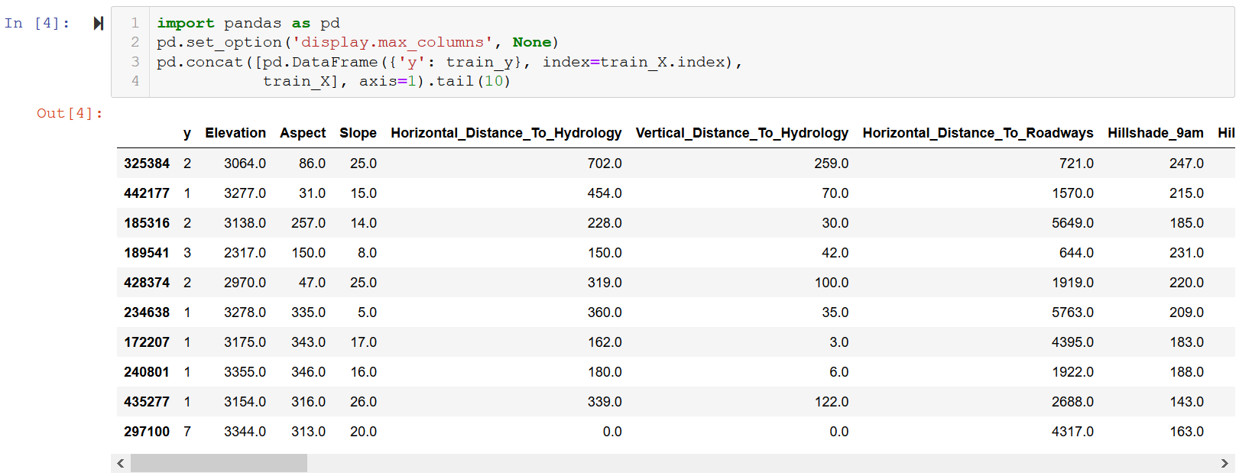
Example: Covertype Dataset
https://nbviewer.jupyter.org/github/IBM/lale/blob/master/examples/talk_2020-0327-lale.ipynb

Slide 11
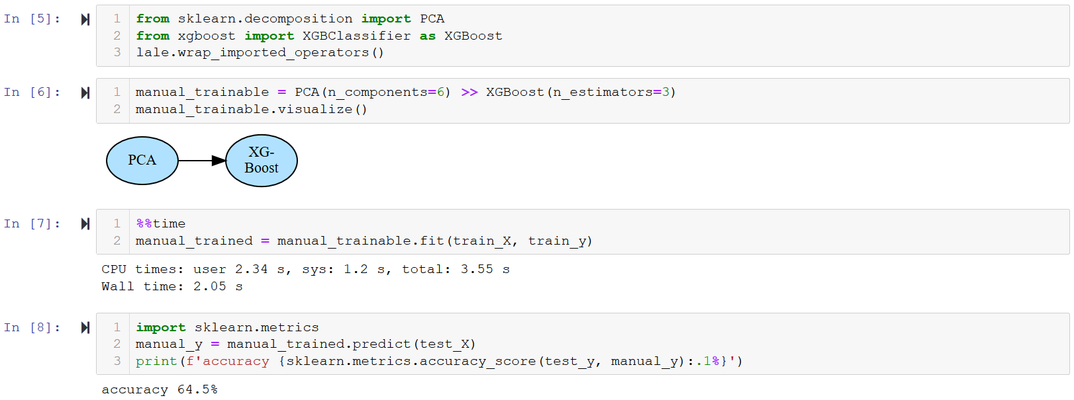
Example: Manual Machine Learning
https://nbviewer.jupyter.org/github/IBM/lale/blob/master/examples/talk_2020-0327-lale.ipynb

Slide 12
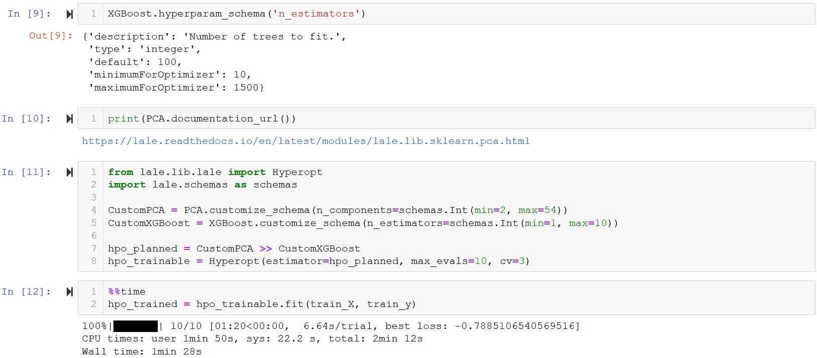
Example: Hyperparameter Tuning
https://nbviewer.jupyter.org/github/IBM/lale/blob/master/examples/talk_2020-0327-lale.ipynb

Slide 13

Types as Search Spaces
Planned pipeline (some choices of operators and hyperparameters are still free)
generate
Search space (optimizers: GridSearchCV, Hyperopt, SMAC, …)
edit
acquire
Data Scientist
Trainable pipeline (all choices of operators and hyperparameters are bound)
decode
Point in search space
train
loop
Trained pipeline (learnable coefficients are bound)
evaluate
Metrics

Slide 14
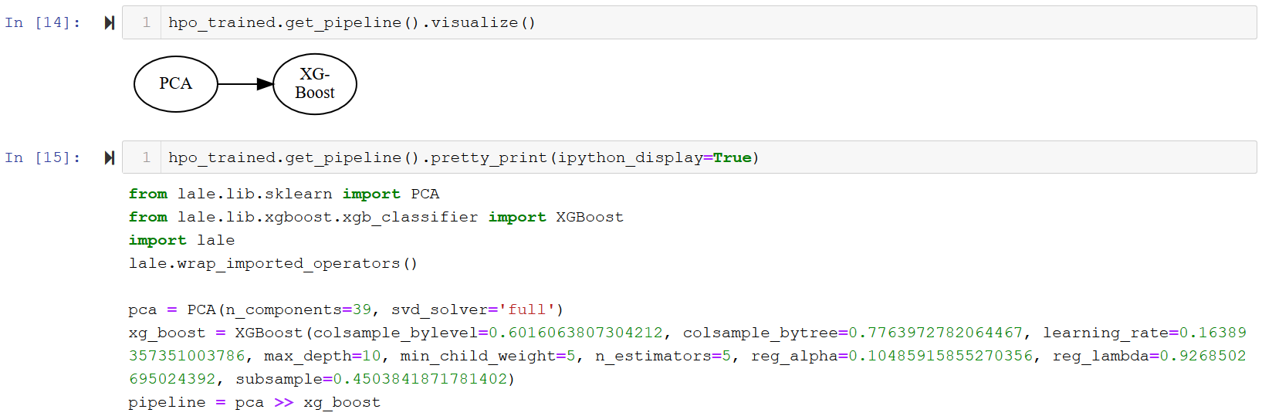
Example: Inspecting AutoML Results
https://nbviewer.jupyter.org/github/IBM/lale/blob/master/examples/talk_2020-0327-lale.ipynb

Slide 15
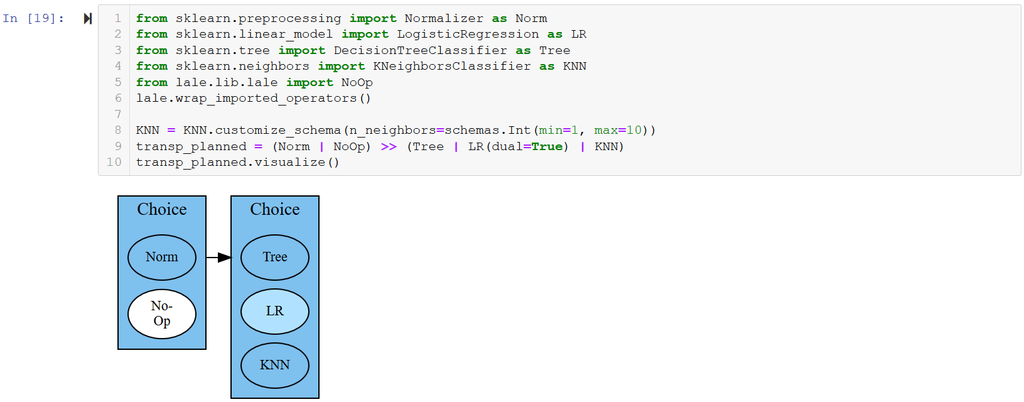
Example: Algorithm Selection
https://nbviewer.jupyter.org/github/IBM/lale/blob/master/examples/talk_2020-0327-lale.ipynb

Slide 16
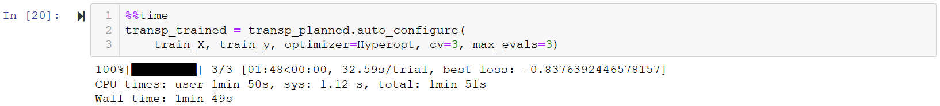
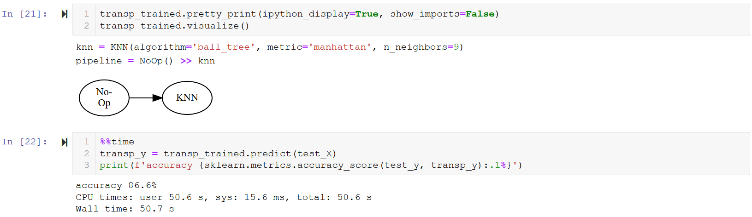
Example: Combined Algorithm Selection and Hyperparameter Tuning
https://nbviewer.jupyter.org/github/IBM/lale/blob/master/examples/talk_2020-0327-lale.ipynb

Slide 17
Expert-Level Control
Custom metrics
Non-linear pipelines
Higher-order operators
Adding new operators

Slide 18
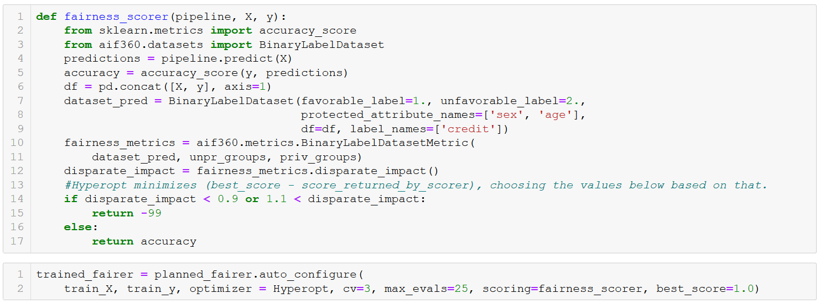
Custom Metrics
https://nbviewer.jupyter.org/github/IBM/lale/blob/master/examples/demo_aif360.ipynb

Slide 19
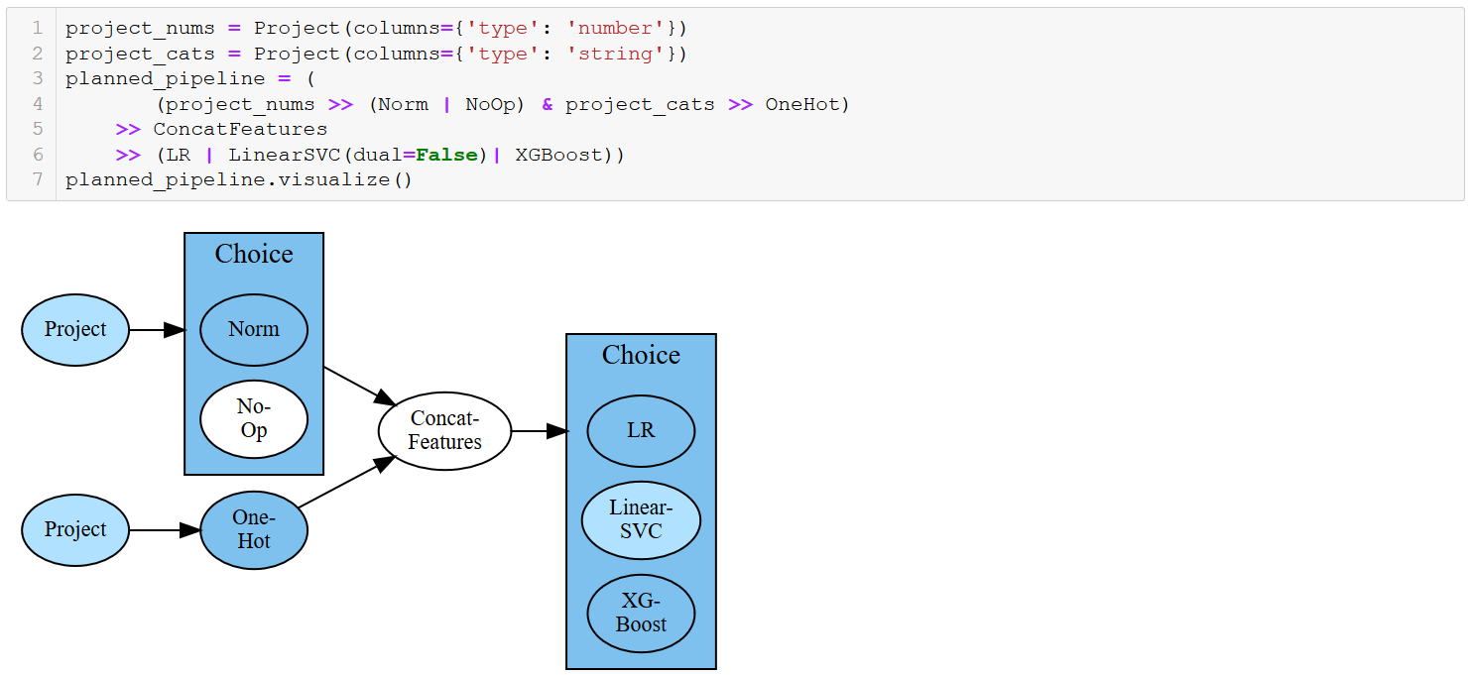
Non-Linear Pipelines
https://nbviewer.jupyter.org/github/IBM/lale/blob/master/examples/talk_2020-0302-lale.ipynb

Slide 20
Pipeline Combinators
Lale features | Name | Description | Scikit-learn features
>> or make_pipeline | pipe | feed to next | make_pipeline
& or make_union | and | run both | make_union or ColumnTransformer
| or make_choice | or | choose one | N/A (specific to given Auto-ML tool)

Slide 21
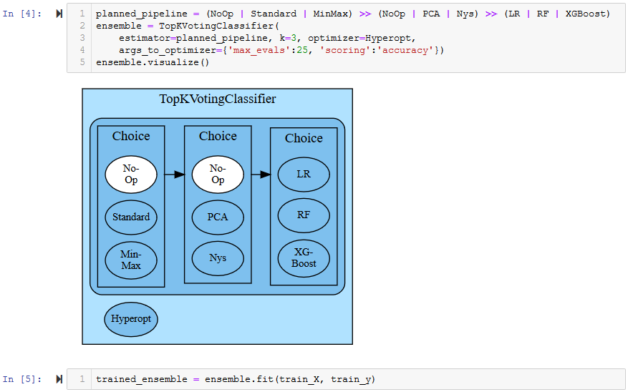
Higher-Order Operators (1/2)
https://nbviewer.jupyter.org/github/IBM/lale/blob/master/examples/demo_top_k_voting_classifier.ipynb

Slide 22
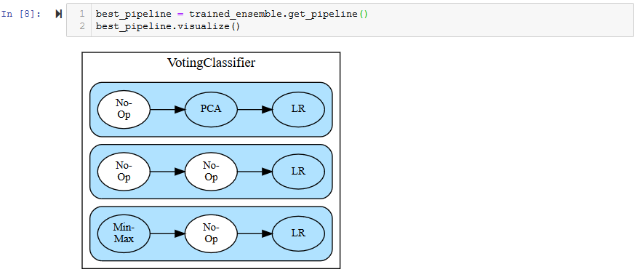
Higher-Order Operators (2/2)
https://nbviewer.jupyter.org/github/IBM/lale/blob/master/examples/demo_top_k_voting_classifier.ipynb

Slide 23
Type-Driven Automated Learning
Types as search spaces
E.g., continuous hyperparameter range
E.g., categorical hyperparameter enum
Types as documentation
E.g., lale.readthedocs.io/en/latest/modules/lale.lib.sklearn.pca.html
Types for feature engineering
E.g., Project(columns={'type': 'string’})
Types for error checking
E.g., datasets, hyperparameters, constraints

Slide 24
Conclusion
Library for semi-automated data science
https://github.com/ibm/lale
Suggested actions:
Try it out and send us feedback
Contribute new individual operators: https://nbviewer.jupyter.org/github/IBM/lale/blob/master/examples/docs_new_operators.ipynb
Do original research (AutoML optimizers, AI fairness, fast AutoML, …)

