Slide 1

Type-Driven Automated Learning with Lale
Martin Hirzel, Kiran Kate, Avi Shinnar, Subhrajit Roy, Pari Ram, and Guillaume Baudart
Monday, December 9th 2019
IBM PL Day 2019

Slide 2
Value Proposition
Augment, but don’t replace, the data scientist.
Automation
Easy search and tuning of pipelines
Usability
Like scikit learn plus types
Portability
Python building blocks & beyond

Slide 3
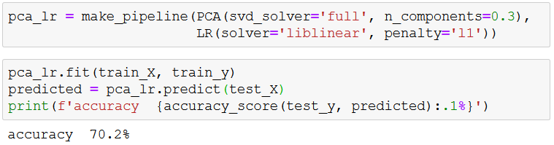
Manual ML with Sklearn
Prior work: scikit learn, popular machine learning package
1
2
3
4
5
6

Slide 4
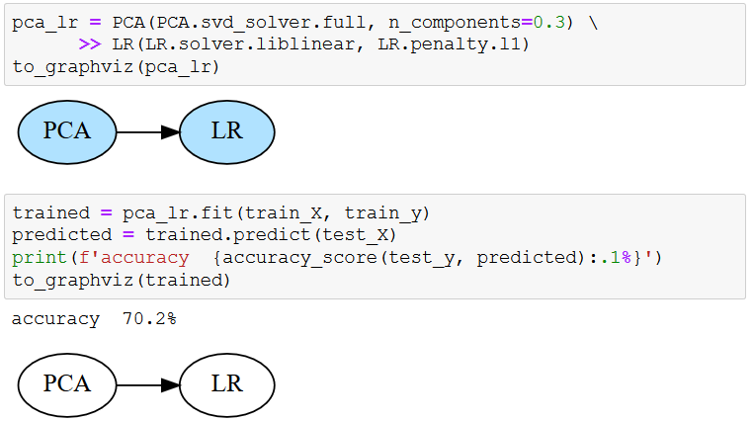
Manual ML with Lale
Our work: Language for Automated Learning Exploration
1
2
3
4
5
6
7
8
9
10

Slide 5
LALE Pipelines
Pipeline Combinators:
Example:
Lale features | Name | Description | Scikit-learn features
>> make_pipeline | pipe | feed to next | make_pipeline
& make_union | and | run both | make_union or ColumnTransformer
| make_choice | or | choose one | N/A (specific to given AI automation tool)
((PCA & MinMaxScaler)
>> Concat
>> (KNN | DecisionTree))

Slide 6
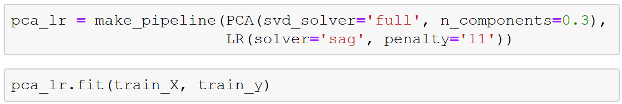
Constraints in Manual ML
Conditional hyperparameters
1
2
3
28
---------------------------------------------------------------------------
ValueError Traceback (most recent call last)
<ipython-input-7-de82d92d1962> in <module>
----> 1 pca_lr.fit(train_X, train_y)
~/python3.7venv/lib/python3.7/site-packages/sklearn/pipeline.py in fit(self, X, y, **fit_params)
265 Xt, fit_params = self._fit(X, y, **fit_params)
266 if self._final_estimator is not None:
--> 267 self._final_estimator.fit(Xt, y, **fit_params)
268 return self
269
~/python3.7venv/lib/python3.7/site-packages/sklearn/linear_model/logistic.py in fit(self, X, y, sample_weight)
1275 "positive; got (tol=%r)" % self.tol)
1276
-> 1277 solver = _check_solver(self.solver, self.penalty, self.dual)
1278
1279 if solver in ['newton-cg']:
~/python3.7venv/lib/python3.7/site-packages/sklearn/linear_model/logistic.py in _check_solver(solver, penalty, dual)
445 if solver not in ['liblinear', 'saga'] and penalty != 'l2':
446 raise ValueError("Solver %s supports only l2 penalties, "
--> 447 "got %s penalty." % (solver, penalty))
448 if solver != 'liblinear' and dual:
449 raise ValueError("Solver %s supports only "

Slide 7
(JSON) Schemas for ML Algorithms
Use of JSON schema for defining hyper-parameter types and search spaces, input and output types.
Example hyper-parameter schema for LogisticRegression:
Most users do not need to write these schemas. Usually, the operator writer adds these once and uses them multiple times for multiple purposes.
1
2
3
4
5
6
7
8
9
10
11
LR: { allOf: [
{ type: object,
properties: {
S: { description: "Optimization problem solver",
enum: [linear, sag, lbfgs], default: linear},
P: { description: "Penalization norm",
enum: [l1, l2], default: l2}}},
{ description: "Solvers sag and lbfgs support only l2.",
anyOf: [
{ not: { type: object, properties: {S: {enum: [sag, lbfgs]}}}},
{ type: object, properties: {P: {enum: [l2]}}}]}]}

Slide 8
Automated Schema Extractor
Python file
DocString
CNL parser
Raw schema
Implementation
Dynamic analysis
Observations
Heuristics
Schema refiner
Overrides
Refined schema
https://github.com/IBM/lale/tree/master/lale/lib/autogen

Slide 9
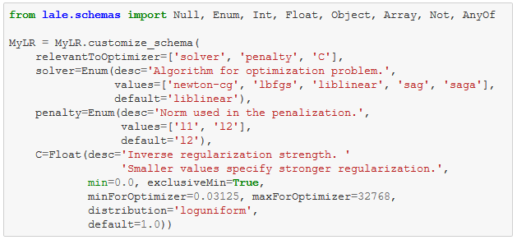
Customizing Schemas by Hand
https://nbviewer.jupyter.org/github/IBM/lale/blob/master/examples/docs_new_operators_schemas_api.ipynb

Slide 10
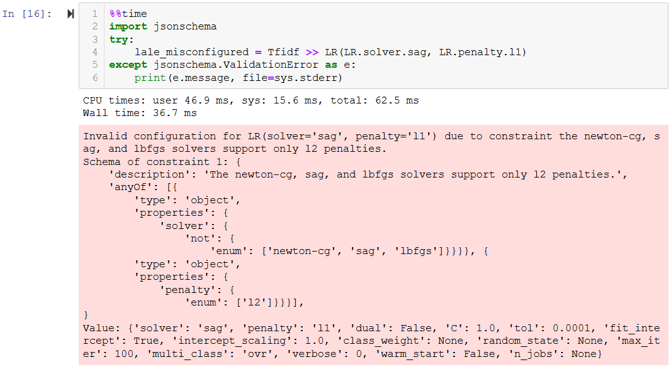
Constraints in Lale

Slide 11
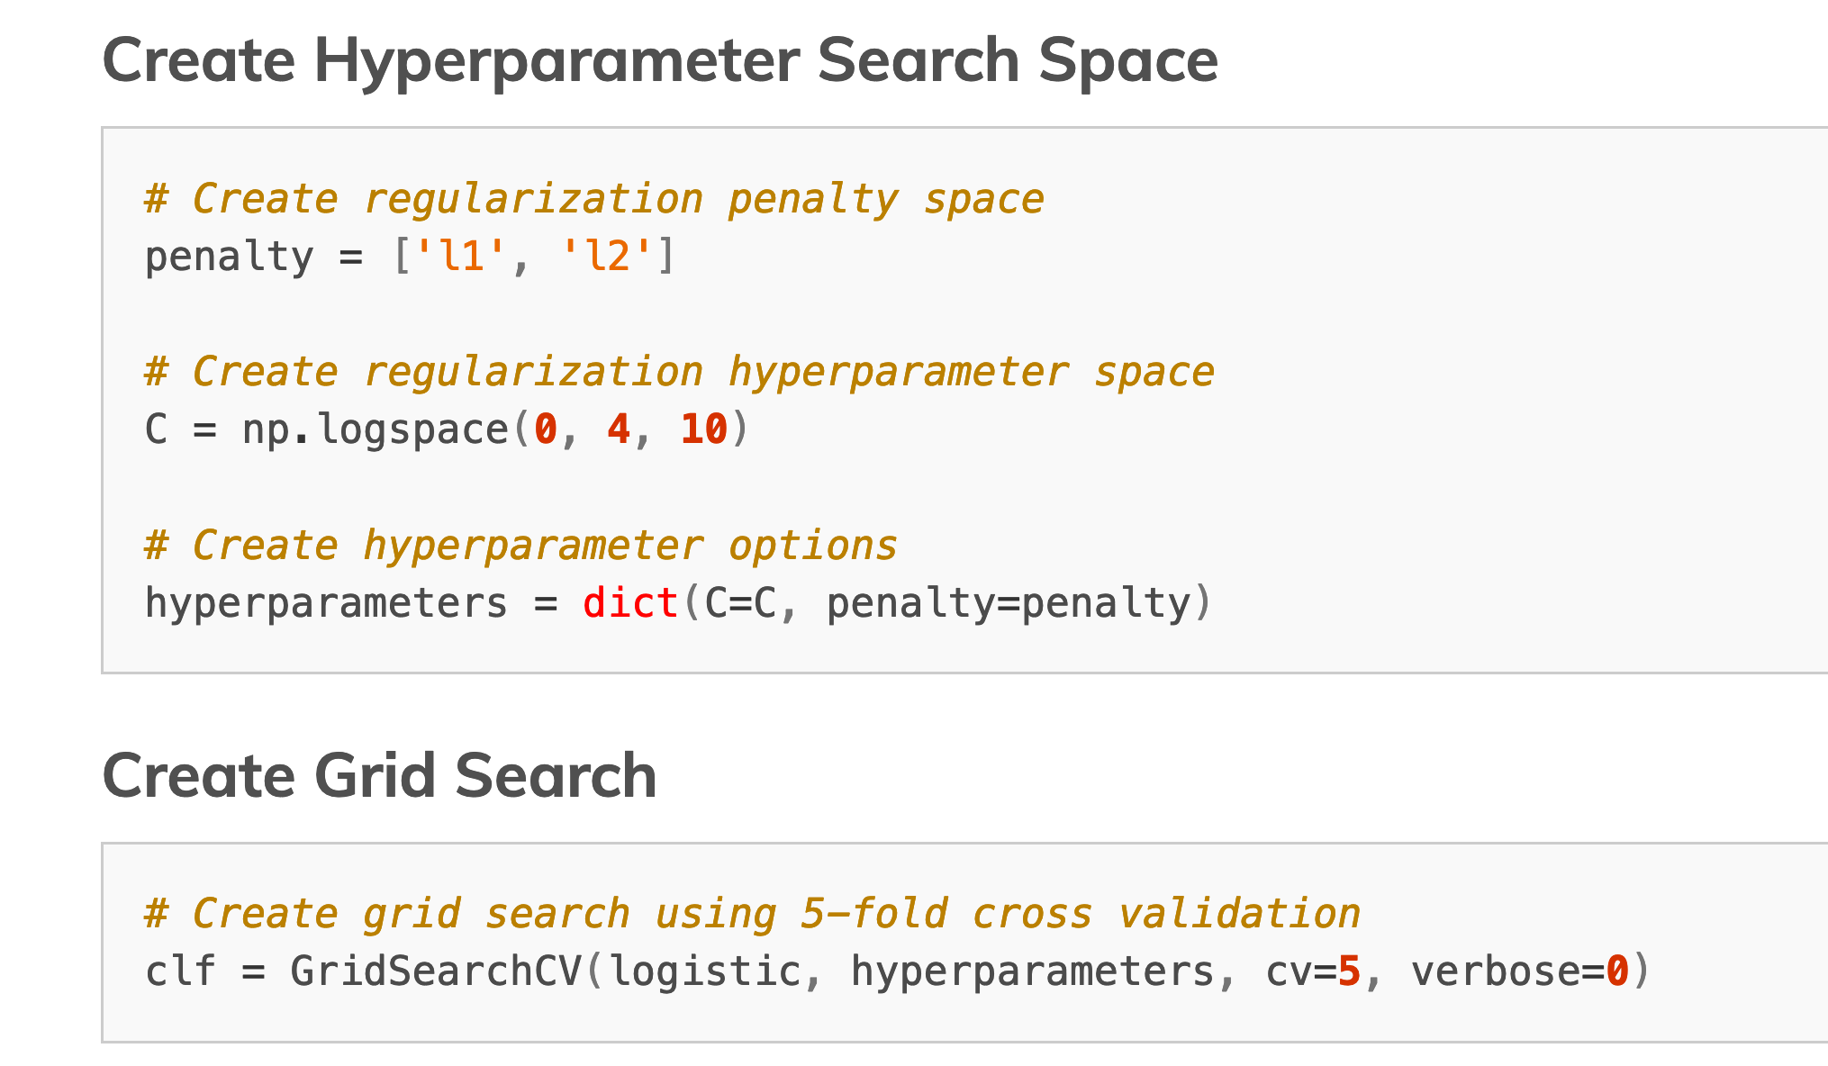
AutoML (GridSearchCV)

Slide 12
Constraints in AutoML
Problem: Some automated iterations raise exceptions
Solution 1: Unconstrained search space
{S:[linear,sag,lbfgs], P: [l1,l2]}
Catch exception
Return made-up loss np.float.max
Solution 2: Constrained search space
{S:[linear,sag,lbfgs], P: [l1,l2]} and (if S: [sag,lbfgs] then P: [l2])
No exceptions
No made-up loss

Slide 13
Algorithm Selection
PCA
J48 | LR

Slide 14
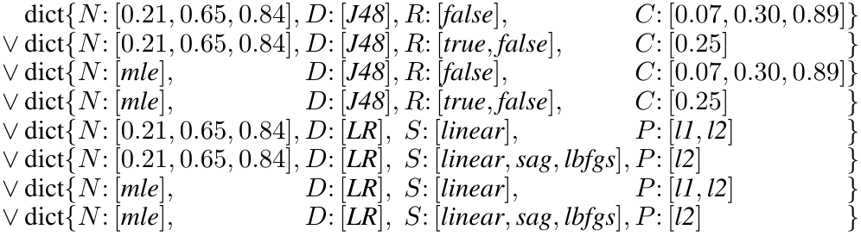
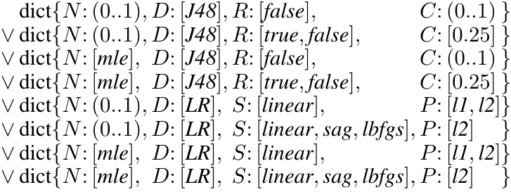
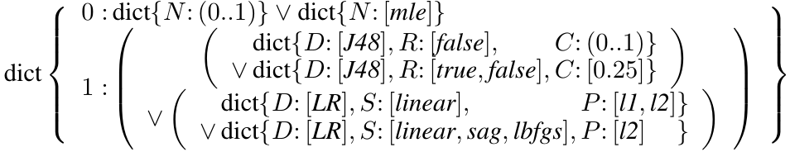
Types as Search Spaces
Lale auto-generates search spaces for AutoML tools
Planned pipeline
Operator schemas
PCA: … J48: … LR: …
PCA
J48 | LR
Compiler
GridSearchCV
SMAC
hyperopt

Slide 15
GridSearchCV Search Space
AutoML included with Sklearn
PCA
J48 | LR

Slide 16
SMAC Search Space
Sequential Model-based Algorithm Configuration
PCA
J48 | LR

Slide 17
Hyperopt Search Space
Supports parallel search
PCA
J48 | LR

Slide 18
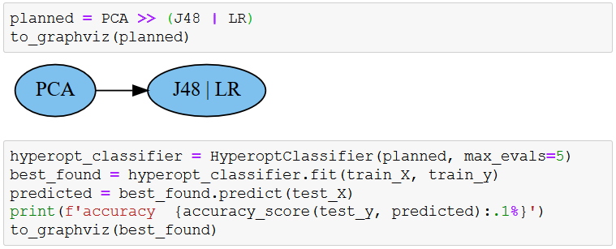
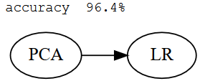
Automated ML with Lale
Combined algorithm selection and hyperparameter tuning
1
2
3
4
5
6
7
8
9
10

Slide 19
Summary
Github URL: https://github.com/IBM/lale
We welcome contributions!
Automation
Usability
Interop
Types as search spaces
Bindings as lifecycle
Scikit-learn compatible interop

Slide 20
Portability
Modality | Dataset | Pipeline (bold: best found choice)
Text | Movie reviews (sentiment analysis) | (BERT | TFIDF) >> (LR | MLP | KNN | SVC | PAC)
Table | Car (structured with categorical features) | J48 | ArulesCBA | LR | KNN
Images | CIFAR-10 (image classification) | ResNet50
Time-series | Epilepsy (seizure classification) | WindowTransformer >> (KNN | XGBoost | LR) >> Voting

Slide 21
Bindings as Lifecycle
 | Individual operator | Pipeline
Meta-model | schemas, priors | steps, grammar
Planned |  | graph topology
Trainable | hyperparameters | operator choices
Trained | learned coefficients
arrange
init
fit
compose (>>, &, |)

Slide 22
Summary
Github URL: https://github.com/IBM/lale
We welcome contributions!
Automation
Usability
Interop
Types as search spaces
Bindings as lifecycle
Scikit-learn compatible interop

Slide 23
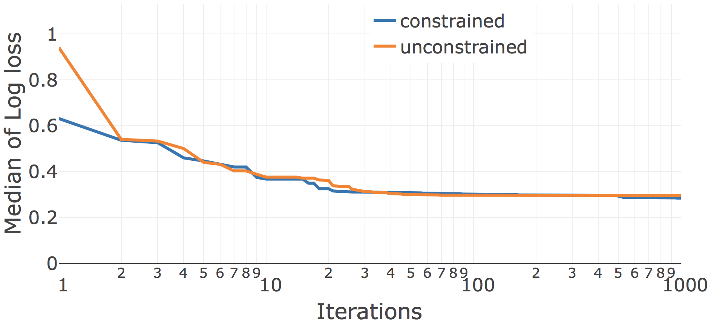
Search Convergence (1/3)
LR | KNN
Car dataset
hyperopt

Slide 24
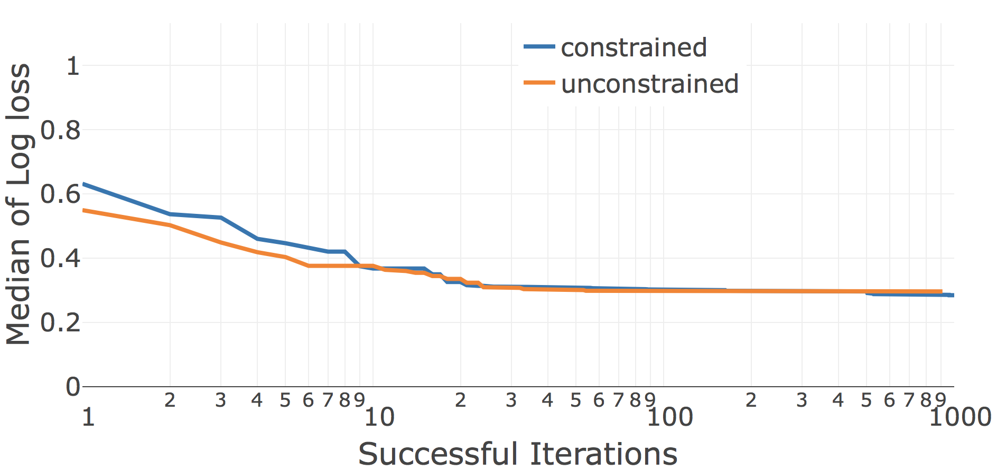
Search Convergence (2/3)
LR | KNN
Car dataset
hyperopt

Slide 25
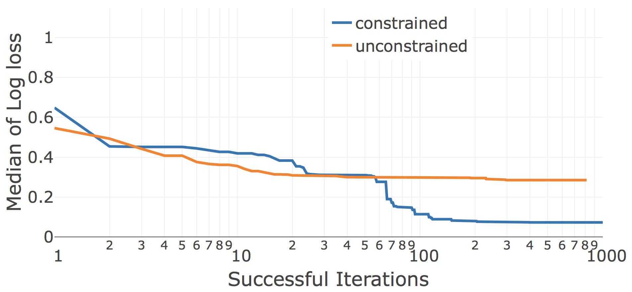
Search Convergence (3/3)
J48 | LR | KNN
Car dataset
hyperopt

