Slide 2
Hands on Workshop:
Getting Started with Presto
Yi-hong Wang
Open Source Developer, IBM
Kiersten Stokes
Open Source Developer, IBM

Slide 3
Over the next 90 minutes you will:
Explore and understand how to deploy a Presto cluster using Docker and query 2 data sources – MySQL and MongoDB

Slide 4
Agenda
Understand the Technology (20 min)
Overview of Presto
Get hands-on (60 min)
Set up a Presto cluster using Docker
Add 2 data sources: MySQL, MongoDB
Query your data sources
Summary and Next Steps (10 min)

Slide 5

Introduction
Watson AI and Data Open Technologies Group in IBM
Work on Presto, Kubeflow, Node.js open-source projects
Yi-Hong Wang
Software Developer at IBM

Slide 6

Introduction
Watson AI and Data Open Technologies Group in IBM
Work on Jupyter Enterprise Gateway, PyTorch, and Presto open-source projects
Kiersten Stokes
Software Developer at IBM

Slide 7
Understanding the Technology

Slide 8
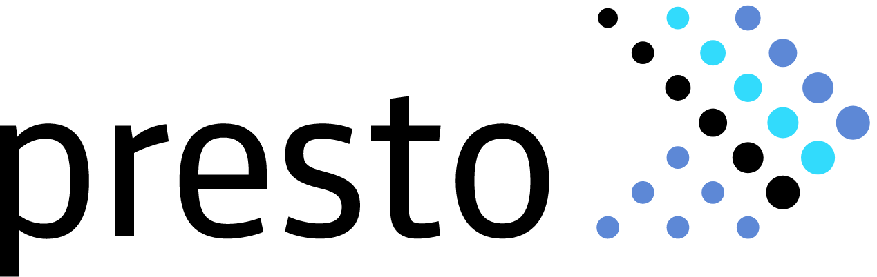
Presto Overview
Presto is an open-source SQL query engine that’s fast, reliable, and efficient at scale
Federate queries and query data where it lives - data lakes, lakehouses, and more
Blazing fast analytics
Standardize your SQL with one engine
Open source

Slide 9
Key Features
High performance and low latency
Interactivity
Robust batch support
Highly scalable
Reliable

Slide 10
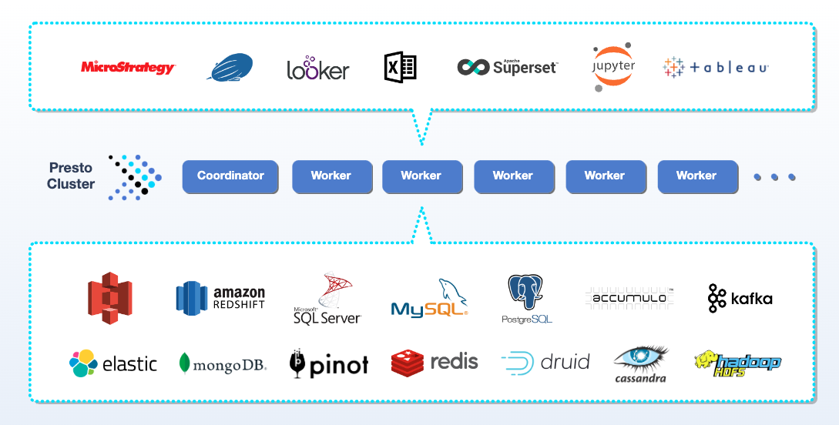
High Level Presto Architecture

Slide 11
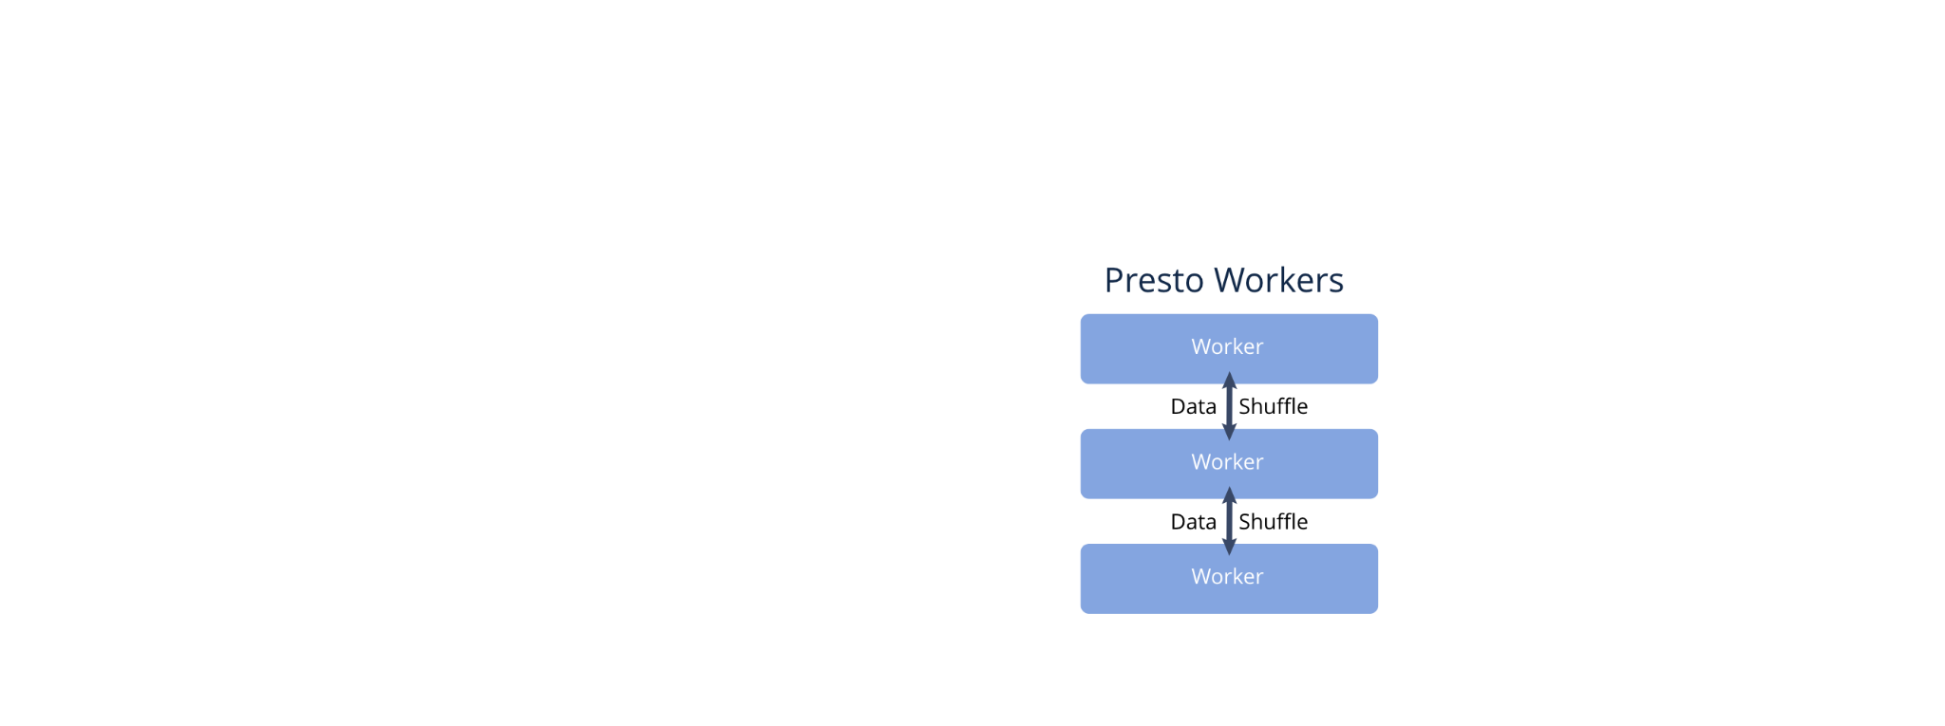
Diving into the Presto Architecture
Streaming Shuffle
Operator Codegen
Multiple Coordinators
MPP Architecture
Sophisticated Caching
Notes:
Let’s talk about the architecture of Presto and how it’s built for high-performance and scalability.
Presto for interactive is best thought of as an MPP. True to MPP design, Presto is by default highly optimized for interactive usage.
Presto is designed to minimize end-to-end latency while maximizing resource utilization. Presto uses in-memory buffered shuffles over HTTP to exchange intermediate results. Workers request intermediate results from other workers using HTTP long-polling to minimizes response time. Presto also actively monitors buffer utilization as well as the backpressure to adjust the concurrent tasks on each worker.
Presto uses a pull based architecture. In a nutshell, clients pull for results, which trigger work to be done on downstream stages, which themselves may pull from downstream stages. This means Presto only has to keep in memory enough to return data to the client, which means less opportunities for out of memory and quicker results for exploratory queries.
Presto uses just in time compilation of key operators to improve performance. What this means is that operators may be custom generated for your specific query, which ensures that the code is optimized for your data.
Presto also allows for scaling out to multiple coordinators. In this mode, multiple coordinators work cooperatively over the same worker fleet, bringing high availability and horizontal scalability for the control plane.
Presto separates coordinators from workers to get better performance out of the worker pool. Presto's architecture also allows for multiple coordinators. These coordinators distribute the workload and manage resources, increasing the system’s resilience and scalability. To top it off, Presto utilizes a Massively Parallel Processing (MPP) design. This design allows Presto to distribute and process data in parallel across many servers, ensuring high performance even for large data sets.
Finally, Presto has sophisticated caching of everything from metadata, ORC footers, to the actual data itself and result fragments. This makes Presto ideal even for low latency dashboards.

Slide 12
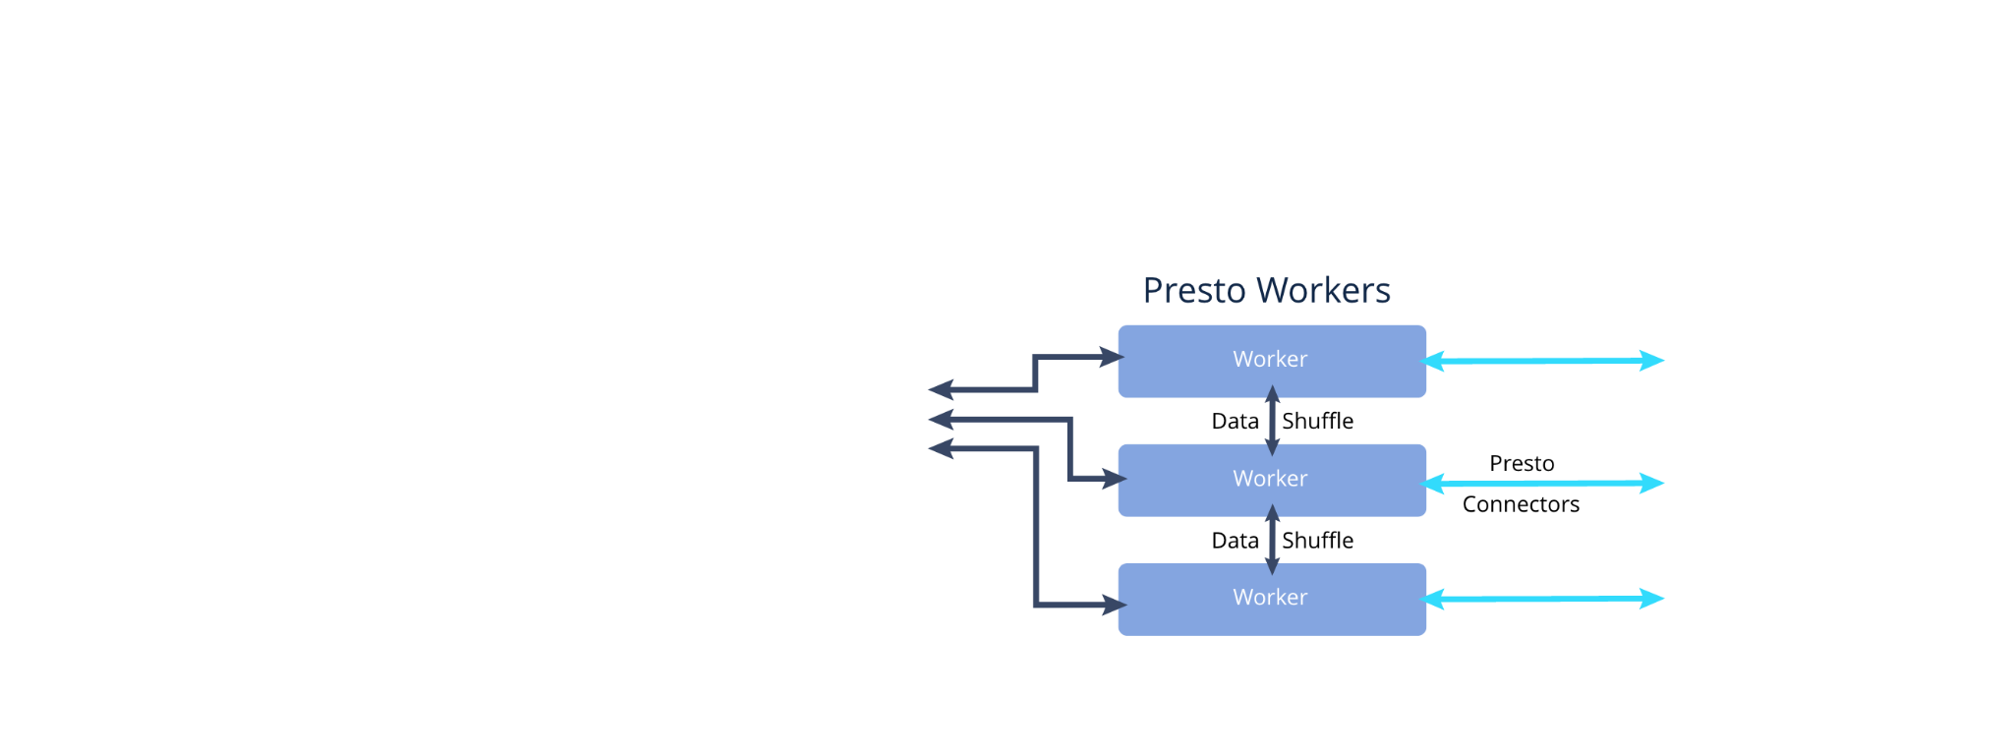
Presto Architecture
Streaming Shuffle
Operator Codegen
Multiple Coordinators
MPP Architecture
Sophisticated Caching
Notes:
Let’s talk about the architecture of Presto and how it’s built for high-performance and scalability.
Presto for interactive is best thought of as an MPP. True to MPP design, Presto is by default highly optimized for interactive usage.
Presto is designed to minimize end-to-end latency while maximizing resource utilization. Presto uses in-memory buffered shuffles over HTTP to exchange intermediate results. Workers request intermediate results from other workers using HTTP long-polling to minimizes response time. Presto also actively monitors buffer utilization as well as the backpressure to adjust the concurrent tasks on each worker.
Presto uses a pull based architecture. In a nutshell, clients pull for results, which trigger work to be done on downstream stages, which themselves may pull from downstream stages. This means Presto only has to keep in memory enough to return data to the client, which means less opportunities for out of memory and quicker results for exploratory queries.
Presto uses just in time compilation of key operators to improve performance. What this means is that operators may be custom generated for your specific query, which ensures that the code is optimized for your data.
Presto also allows for scaling out to multiple coordinators. In this mode, multiple coordinators work cooperatively over the same worker fleet, bringing high availability and horizontal scalability for the control plane.
Presto separates coordinators from workers to get better performance out of the worker pool. Presto's architecture also allows for multiple coordinators. These coordinators distribute the workload and manage resources, increasing the system’s resilience and scalability. To top it off, Presto utilizes a Massively Parallel Processing (MPP) design. This design allows Presto to distribute and process data in parallel across many servers, ensuring high performance even for large data sets.
Finally, Presto has sophisticated caching of everything from metadata, ORC footers, to the actual data itself and result fragments. This makes Presto ideal even for low latency dashboards.

Slide 13
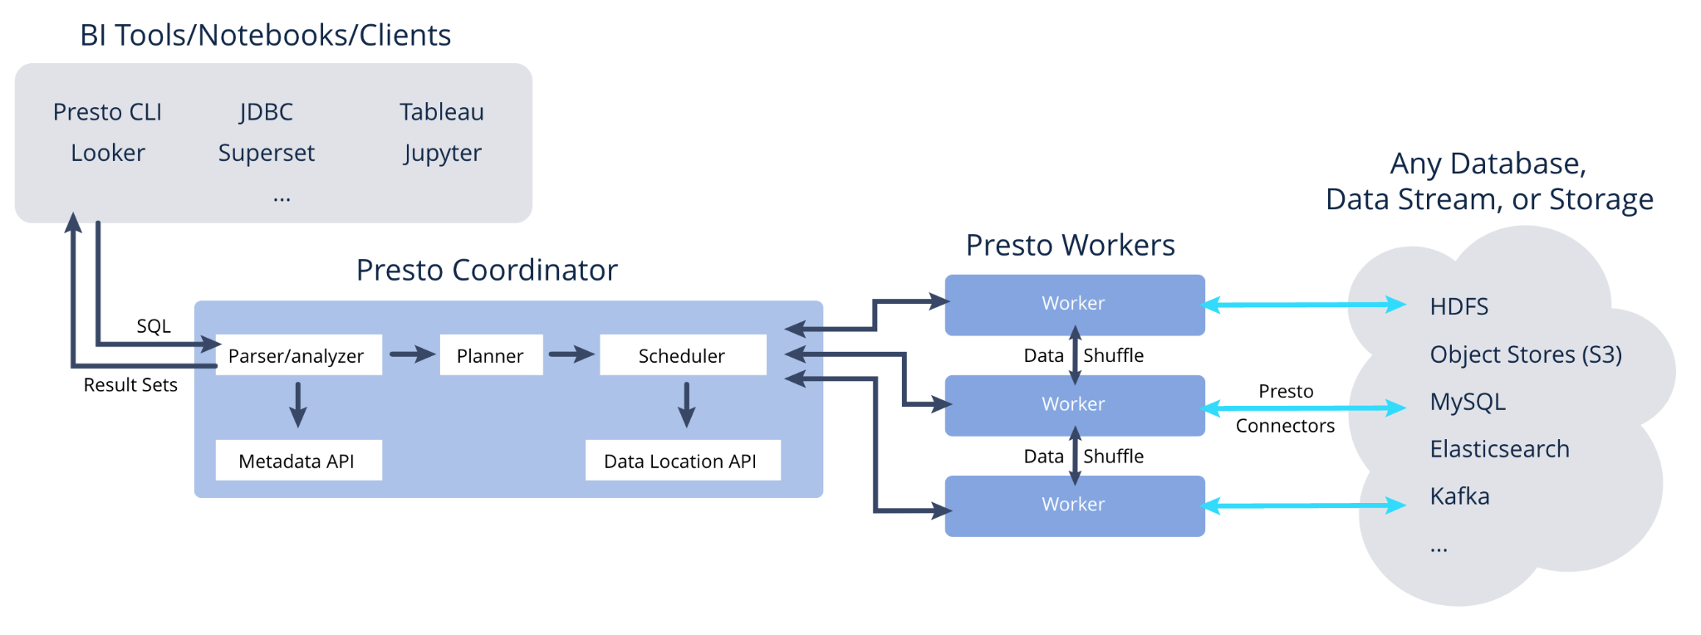
Presto Architecture
Streaming Shuffle
Operator Codegen
Multiple Coordinators
MPP Architecture
Sophisticated Caching
Notes:
Let’s talk about the architecture of Presto and how it’s built for high-performance and scalability.
Presto for interactive is best thought of as an MPP. True to MPP design, Presto is by default highly optimized for interactive usage.
Presto is designed to minimize end-to-end latency while maximizing resource utilization. Presto uses in-memory buffered shuffles over HTTP to exchange intermediate results. Workers request intermediate results from other workers using HTTP long-polling to minimizes response time. Presto also actively monitors buffer utilization as well as the backpressure to adjust the concurrent tasks on each worker.
Presto uses a pull based architecture. In a nutshell, clients pull for results, which trigger work to be done on downstream stages, which themselves may pull from downstream stages. This means Presto only has to keep in memory enough to return data to the client, which means less opportunities for out of memory and quicker results for exploratory queries.
Presto uses just in time compilation of key operators to improve performance. What this means is that operators may be custom generated for your specific query, which ensures that the code is optimized for your data.
Presto also allows for scaling out to multiple coordinators. In this mode, multiple coordinators work cooperatively over the same worker fleet, bringing high availability and horizontal scalability for the control plane.
Presto separates coordinators from workers to get better performance out of the worker pool. Presto's architecture also allows for multiple coordinators. These coordinators distribute the workload and manage resources, increasing the system’s resilience and scalability. To top it off, Presto utilizes a Massively Parallel Processing (MPP) design. This design allows Presto to distribute and process data in parallel across many servers, ensuring high performance even for large data sets.
Finally, Presto has sophisticated caching of everything from metadata, ORC footers, to the actual data itself and result fragments. This makes Presto ideal even for low latency dashboards.

Slide 14



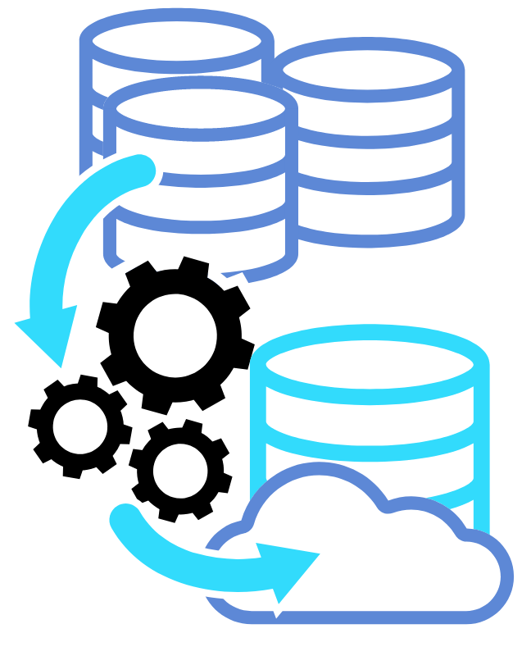

Presto Use Cases
Dashboarding
Business intelligence
Interactive exploration
Batch processing
Data driven apps
Notes:
With Presto, organizations can build lakehouses that combine the features of data warehouses and data lakes. In the area of Dashboarding, Presto proves to be a powerful tool, providing real-time insights and analytics. This capability is incredibly useful for instant decision-making. In the realm of business intelligence, Presto enables businesses to perform complex data analyses and generate reports, which in turn helps organizations to gain deeper insights into their operations. For data scientists, Presto offers an interactive experience, allowing them to query and explore large datasets interactively. Finally, when it comes to batch processing, Presto stands strong, supporting efficient processing of large data volumes. This makes Presto an ideal choice for businesses requiring fast and efficient batch processing operations.
Alt: Dashboarding: Dashboards typically require real-time or near-real-time data for effective visualization and reporting. PrestoDB’s low-latency query processing capability makes it ideal for dashboarding. Its ability to query data in place, across multiple data sources and formats, provides users with the freshest data directly from the source. This eliminates the need for ETL (Extract, Transform, Load) pipelines, which can introduce delays and complexity.
Business Intelligence (BI): PrestoDB enables complex analytical queries across a multitude of data sources, making it a powerful tool for BI operations. Its distributed SQL query engine allows for interactive ad-hoc analysis at scale, a critical requirement for BI. As PrestoDB can connect to various data sources, it allows users to join data across these sources, facilitating comprehensive cross-functional analysis.
Interactive Exploration of Data: PrestoDB is designed for interactive data exploration. Its high-speed query execution, combined with the ability to pull data directly from distributed storage, enables users to perform rapid "what if" analysis, explore data anomalies, and test hypotheses on large datasets in an interactive manner. Moreover, the capability to query across multiple data sources and formats provides users with a holistic view of their data landscape.
Batch Processing: With its integration with Apache Spark, PrestoDB provides robust support for batch processing tasks. Presto on Spark leverages the scalability and resource management capabilities of Spark, along with the SQL capabilities of PrestoDB, to run batch processing tasks more efficiently, particularly for large scale computations. Presto's distributed processing engine can run queries over large volumes of data in an efficient and scalable manner, making it suitable for heavy batch processing workloads.
Data-Driven Applications: PrestoDB's high-speed data retrieval and real-time querying capabilities make it a perfect choice for data-driven applications. Its ability to query large datasets residing in distributed storage allows applications to access the most recent data directly from the source. This ensures that data-driven applications can provide accurate, up-to-date insights to end users. Additionally, PrestoDB's support for various data formats and sources enables these applications to access a wide array of data, enhancing the depth and breadth of data-driven insights.

Slide 15







Powered by
Ride-hailing, micromobility rentals, and food delivery in Europe and Africa. Up to 100k daily queries (over 1.5M queries per month) with over 2000 active internal users on 2 PB data lake.
Social media. 30K queries per day with 1000 daily active users on a 300 PB data lake.
Digital advertising platform. Over 2000 daily reports and 100s of pipelines on a 7 PB data lake with over 400 billion records.
Ride-hailing, food delivery. Over 100M queries per day with 7000 weekly active users on a 50 PB data lake.
Internet technology.
Over 2M queries per day for business intelligence and ad hoc use cases.
Communications API technology. Over 2700 active internal users running 1M queries scanning 40 PB of data per month.

Slide 16
Let’s get hands-on!

Slide 17
What we will do today
Run a 4-node Presto cluster in Docker
Connect Presto to two data sources – MySQL and MongoDB
Run federated queries across both sources

Slide 18
Basic Concepts – Data Sources
Connector
An Implementation of Presto SPI which allows Presto to interact with a data source
Catalog
A group of schemas to a data source from a connector
Schema
A way to organize tables
Table

Slide 19

Pre-Workshop Steps
Install Docker and Docker Desktop
Have a terminal ready
We’ll use this repo to do the lab: https://ibm.github.io/presto-101-lab/

Slide 20
Summary

Slide 21
What did we do today?
Deployed a 4-node cluster using Docker
Connected the Presto cluster to 2 data sources – MySQL and MongoDB
Ran federated queries on both sources, in-place

Slide 22

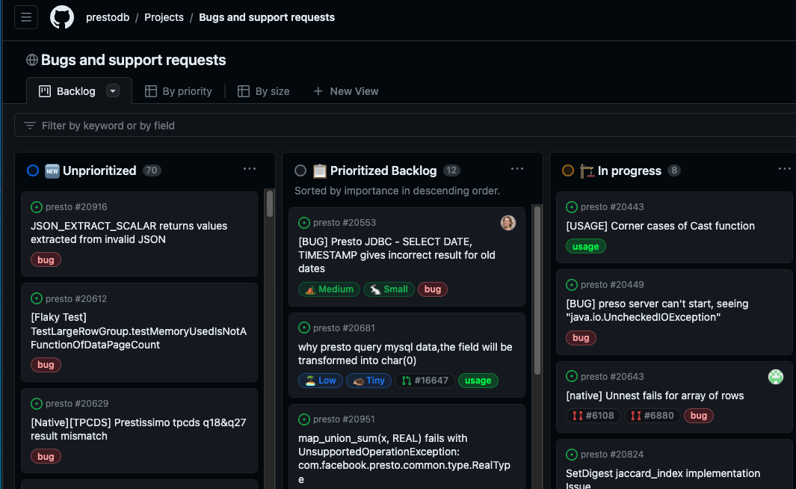
Next Steps
Join the Presto community Slack prestodb.slack.com
Want to start contributing?
Check out the Presto Github project board: Bugs & Support Requests - https://github.com/orgs/prestodb/projects

Slide 23
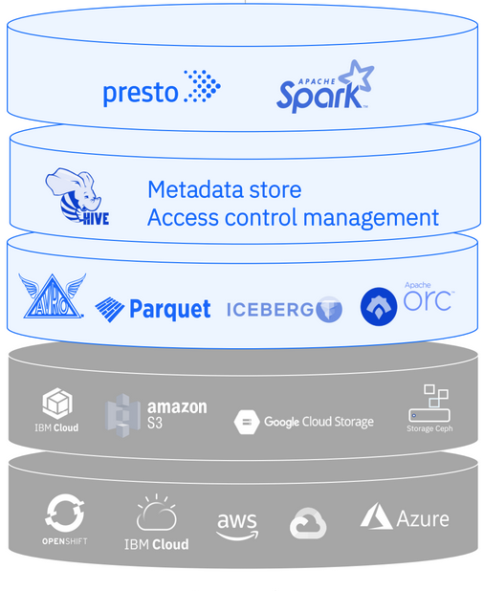

Explore watsonx.data
https://ibm.biz/dev-watsonx-data

