Slide 1
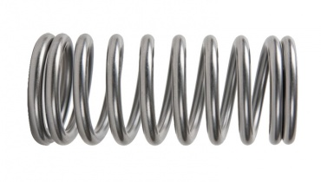
0
1
2
3
4
CX
0
1
2
CX
U
CX
U
g
2g

Slide 2
Simultaneous Randomized Benchmarking
0
1
2
3
C1
C2
C3
C1`
C2`
C3`
0
1
2
3
C1
C2
C3
C1`
C2`
C3`
0
1
2
3
g
g
C1
C2
C3
g
g
g
C1`
g
g
g
C2`
C3`
g
g
g
g

Slide 3
0
1
2
3
g
g
C1
C2
C3
g
g
g
C1`
g
g
g
C2`
C3`
g
g
g
g
0
1
2
3
g
g
g
g
g
g
g
g
g
g
g
g
0
1
2
3
G
G
G
G
G
G
G
G
G
G
G
G
G
G
G
G
G
G
G
G
G
G
G
G
G
G
G
G
G
G
G
G
G
G

Slide 4
Infinitestretch (i.e. don’t care)
Infinitestretch (i.e. don’t care)
-----------------------
Cx qr[0], qr[1];
Cx %0, %1
Declare stretch x
Qreg qr0, qr1,
%0, %1, %2, %3, %4
Stretch %1; //C1
Boxto stretch { // C2
stretch %0;
U 0;
stretch;
}
Cx 0, 1;
Stretch 0; // C3
Boxto stretch { // C4
stretch 0;
U 0;
stretch;
}
Gatecal CX %0, %1 {
play(gaussian, drive(%0))
}
0
1
-----------------------
stretchas x 0;
U 0;
Stretchas x 0;
Stretchas z 1;
Cx 0, 1;
x
x
z
U
CX
y
y
z
V

Slide 5
Ponged CX – example of stretchy gate
0
1
2
CX
R+
R-
R+
stretch
2*stretch
stretch
Centered DD
0
1
2
3
start_stretch
middle_stretch
middle_stretch
middle_stretch
end_stretch
X
Y
X
Y
CX
CX
U

Slide 6
RZ(pi/2)
Delay [50dt]
RZ(pi/2)
RY(pi/2)
RY(pi/2)

