Slide 1
cICD Hub
May 2019 (Copyright Accanto 2019)

Slide 2
ALM 2.0 CICD Hub Overview
DevOps framework and tools that automate the VNF and Network Service lifecycle
Onboarding, Design & Test
CICD Hub
Change Mgmt
Quickly onboard VNF components into an automated CICD lifecycle
LM NFVO
Upgrade, change or move components of network service automatically
LM VNFM
3rd Party VNFM
VIM
Infrastructure

Slide 3



functional architecture
Pipeline Automation
ALM CICD Hub
VNF Lifecycle Scripts
VNF Descriptors
Behaviour Test Scenarios
Network Service Descriptors
ALM Design Tools
ALM Build Slaves
Design Tools
ALM Build Slaves
Descriptor Catalog
Test Store
Environment Orchestration
Behaviour Testing
Test Results Store
Environment Orchestration
Behaviour Testing
Package Builder
Native VNF Packages
Foreign VNF Packages
Test Packages
Network Service Packages
VIM Images
Dev Environment
Pre-Prod Environment
Dev Environment
Pre-Prod Environment
Production Environment
Dev Environment

Slide 4








Onboarding VNFs and network services
(Auto) Trigger snapshot build and behaviour test runs
VNF/NS Project
Pipeline Automation
ALM Behaviour Testing
Lifecycle Playbooks
Fix
Load behaviour tests
Infrastructure Descriptor
Dev Environment
Master
NFVO
New Feature
ALM Environment Orchestration
Behaviour Tests
VNFM
Successful test runs result in release candidate with build version
Create/clean environment and load VNF under test and test packages
VIM
SDN Controller
Network Engineering collect all package artefacts and create initial package snapshot
Image
Package Snapshot-1
Package RC-12448
Developer Machine

Slide 5

Auto testing network services in pre-production
Jenkins kicks off a sequence of formal tests in pre-production environment
Functional Test
Pipeline Automation
Behaviour Test scenarios and packages are owned by service engineering and pre-defined across VNF vendors
Functional Tests
Load
VNF
Probe VNF
Network Engineering trigger a pre-production build of VNF release candidate
Pre-Prod Environment
Performance Test
Performance Tests
Load
VNF
Probe VNF
Pre-production environments are automatically cleaned and setup with test dependencies
Pre-Prod Environment
RC-12448
Stress Test
Stress Tests
Load
VNF
Probe VNF
On success the VNF release candidate is certified ready for production in nexus
Pre-Prod Environment

Slide 6

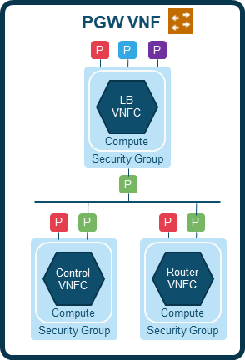

Sample Automated change Pattern
Intent:
Upgrade VNF
Install VNF V2
Activate VNF V2
Run Service Test
Uninstall VNF V1
Controller
Controller
Controller
Controller
Fire Controller Relationship
Fire Controller Relationship
V1
V1
V2
V1
V2
V2

Slide 7
Development Environment
Pipeline Automation
ALM Behaviour Testing
Develop Project Lifecycle Artefacts
Test Environment
Add Behaviour Tests
Create New Local Project
Upload Images
Image
Package Snapshot-1
Create Project CI Pipeline
Create Project CD Pipeline

