Slide 1
TRIRIGA DTO

Slide 2
ESB
Middleware
APC
External System
TRIRIGA
OSLC
DTO
Workflows
TRIRIGA Tables
(Optional)

Slide 3
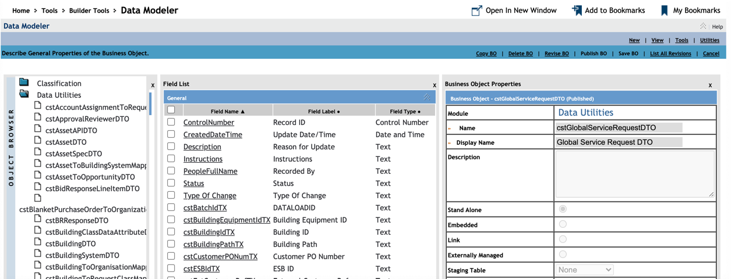

Slide 4
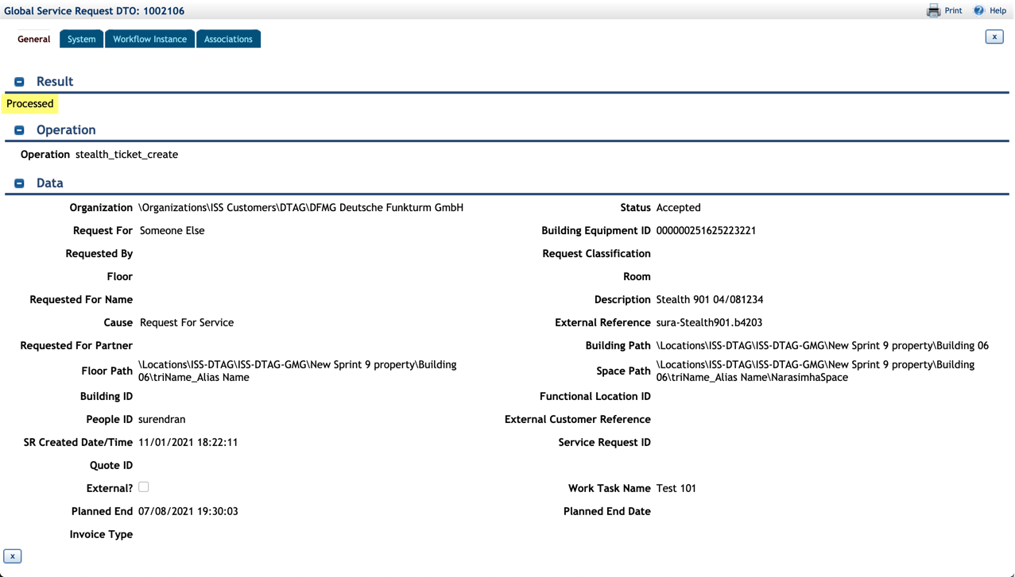

Slide 5
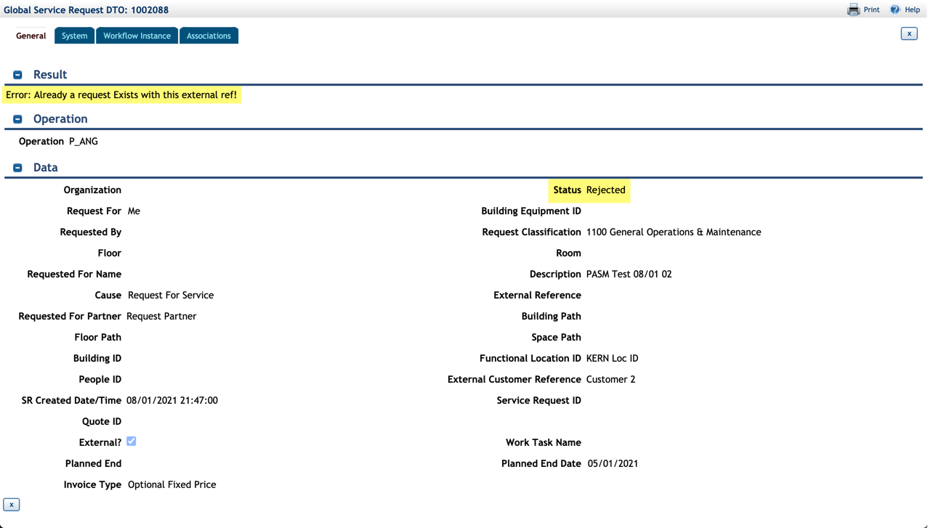

Slide 6
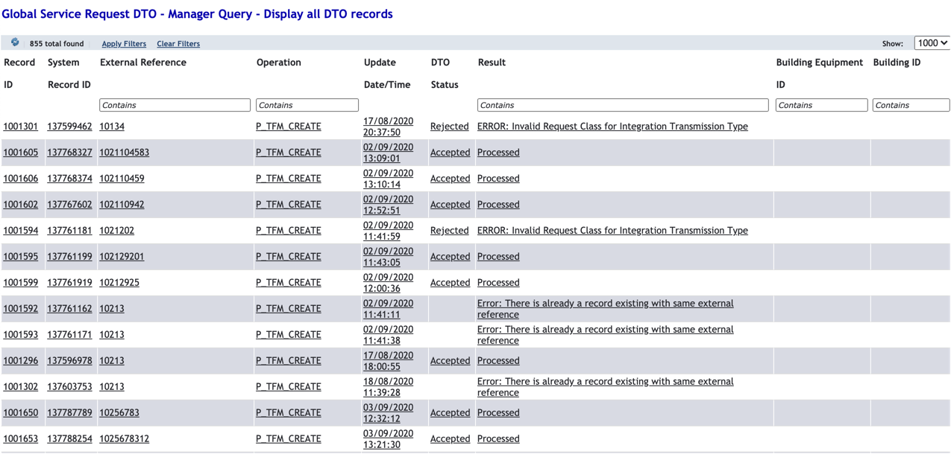

Slide 7
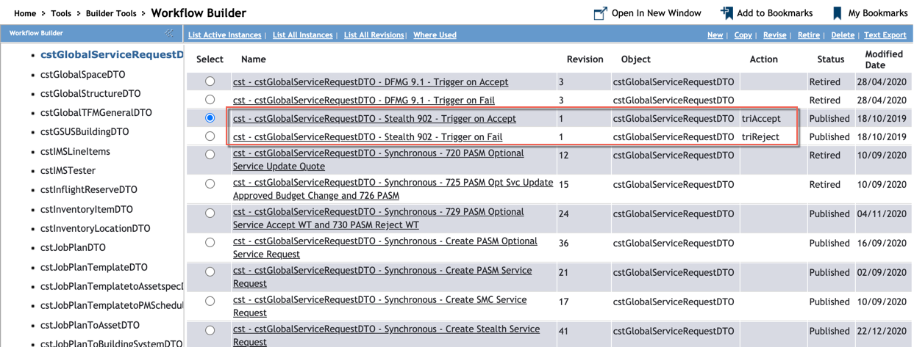

Slide 8
