Slide 1
IBM Software Accelerated Value Program -
WebSphere Application Server Configuration Comparison Tool
Tool Author: Dennis Riddlemoser

Slide 2
Agenda
Acknowledgements
Configuration Comparison Tool (CCT) – A Brief History
What is CCT?
How does it Work?
Reading CCT Reports
Sample Correction Scripts
File System Comparison
Known Limitations
Future enhancements
IBM Software Accelerated Value Program

Slide 3
Acknowledgements
Ricky Marley - Original presentation author
Scott Kurz - Efforts in open sourcing WCCT
Thomas Hikade – Contributions in new reports and bug fixes.
IBM Software Accelerated Value Program

Slide 4
CCT – A Brief History
Visual Configuration Explorer
  Difficult to use
  CPU Intensive
  No Further Enhancements/Updatesbullet level
Multiple WebSphere Clients Requested Cluster Comparison Utility
Additional Requirements Identified
  Cross Cell Comparisons
  Configuration Creep
  Resource Comparisons
  Cross Version (Migration) Comparisons
IBM Software Accelerated Value Program

Slide 5
What is CCT?
Lightweight means of comparing WAS configurations
  Global Security
    Trust Association both global and domain
  Server configurations
    Application Servers
    Node Agents
  Application configurations
  Resource configurations
Lightweight file system comparison facility
Generation of sample wsadmin scripts
CCT is “as is.”
  Please do not open a case for any issues.
  Best effort support at: https://github.com/IBM/websphere-cct/issues
IBM Software Accelerated Value Program

Slide 6
How Does It Work?
CCT report and script generation is a two part process.
ConfigDump.py
  Creates a configuration dump of target environment(s)
  Can be run local or remote to targets
ConfigReport.py
  Generates reports
    Report configuration controlled by property file(s) and properties passed on command line
    Utilizes Perl regular expressions
    Must be run on native Python (only tested on v2.7)
    Reports generated in HTML format
  Generates sample wsadmin correction scripts
    Optional function
    Correction scripts based on reports run
    Provides sample jython code to correct configuration differences
IBM Software Accelerated Value Program

Slide 7
How does it Work? - Contents of CCT tar file
ConfigReport.py: Script for creating reports for Traditional profile WebSphere
ConfigDump.py: wsadmin script for dumping configuration
ConfigUtils.py: Utilities script
WAuJ.py: Utilities script
WAuJ_utilities.py: Utilities script
ConfigReport.properties: Sample properties file for defining reports for Traditional profile WebSphere
ConfigReportAttributes.properties: Defines attributes reported in Traditional profile WebSphere reports. It is not recommended to edit this.
IBM Software Accelerated Value Program

Slide 8
How does it Work? - Contents of CCT tar file
CollectFileData.sh: Collects file data from the specified file system
ConfigReportFiles.py: Generates file system comparison reports
WASConfigurationComparisonTool.pdf: Tool documentation
IBM Software Accelerated Value Program

Slide 9
How does it Work? - Installing CCT
Download the latest CCT files
  URL: https://www-01.ibm.com/support/docview.wss?uid=swg22010928
  Filename: cct-YYYYMMDD.tar.gz
Place all files in the same directory.
If file system comparison reports are needed, set read and execute attributes on the following file.
  CollectFileData.sh
Minimal install also available.
IBM Software Accelerated Value Program

Slide 10
How does it Work? Installing CCT (Minimal Install)
Minimum install for dumping a configuration, place the following files in the same directory.
  ConfigDump.py
  ConfigUtils.py
  WAuJ.py
  WAuJ_utilities.py
Minimum install for running reports and generating scripts, place the following files in the same directory.
  ConfigReport.py
  ConfigUtils.py
  WAuJ.py
  WAuJ_utilities.py
  ConfigReportAttributes.properties
IBM Software Accelerated Value Program

Slide 11
How does it Work? Installing CCT (Minimal Install)
Minimum install for collecting file system data, place the following file on a directory and set read and execute attributes on it.
  CollectFileData.sh
Minimum install for running file system reports, place the following files in the same directory.
  ConfigReportFiles.py
  ConfigUtils.py
  WAuJ.py
  WAuJ_utilities.py
IBM Software Accelerated Value Program

Slide 12
How Does It Work? – Configuration Dump
Acquires configuration dump (ConfigDump.py)
Uses AdminConfig object and wsadmin
Interacts with DMGR on an ND env, no potential for application server impact
Generates ${CELL_NAME}.cfg output file by default
May also generate .pyc and .class files (ignore these)
Supports local and remote modes via wsadmin
  Local mode (connType NONE) requires read access to file system containing WAS profile
  Local mode is preferred due to performance reasons
  Remote mode requires Administrator, Configurator, Operator or Monitor
Two optional parameter formats
  Basic can only specify output file name and cell suffix
  Advanced can additionally specify configuration filtering
No required parameters, simple invocation
Do not make configuration changes to while ConfigDump.py is running.
IBM Software Accelerated Value Program

Slide 13
How Does It Work? – Configuration Dump
Basic syntax parameters
  output_file is optional, this overrides the default output file name.
  cell_suffix is optional
    Overrides the default cell suffix
    A cell suffix must be unique in report generation
    output_file must be specified
Local syntax:
  wsadmin.(sh|bat) -conntype NONE -f ConfigDump.py [output_file] [cell_suffix]
Remote syntax:
  wsadmin.(sh|bat) -port SOAP_CONNECTOR_ADRESS -host HOSTNAME
  -f ConfigDump.py [output_file] [cell_suffix]
  Optionally -user USER –password PASSWORD may be specified before -f
IBM Software Accelerated Value Program

Slide 14
How Does It Work? – Configuration Dump
Advanced syntax
  “parm=value” format with no spaces before or after “=“
  The following should only be specified once
    file=output_file specifies the output file name
    suffix=cell-suffix specifies the cell suffix
  Any number of the following may be specified. Unless a configuration element matches one of the specifications, it will be excluded from the dump. Not advised for users who are not familiar with the configuration repository structure, reports may fail.
    node=node_name specifies a node scope
    server=server_name specifies a server scope
    cluster=cluster_name specifies a cluster scope
    application=application_ear file specifies an application scope
  Only one of the following should be specified. It is a comma delimited list of configuration types. Use these to disable direct collection of the specified. Note, indirect collection may still occur.
    excludeType=Type1,Type1,Type3,…
IBM Software Accelerated Value Program

Slide 15
How Does It Work? – Configuration Dump
Advanced syntax samples
Local syntax:
  wsadmin.(sh|bat) -conntype NONE -f ConfigDump.py [file=output_file] [suffix=cell_suffix] [node=node_name] [cluster=cluster_name] [application=application_ear_file]
Remote syntax:
  wsadmin.(sh|bat) -port SOAP_CONNECTOR_ADRESS -host HOSTNAME
  -f ConfigDump.py file=output_file] [suffix=cell_suffix] [node=node_name] …
  Optionally -user USER –password PASSWORD may be specified before -f
IBM Software Accelerated Value Program

Slide 16
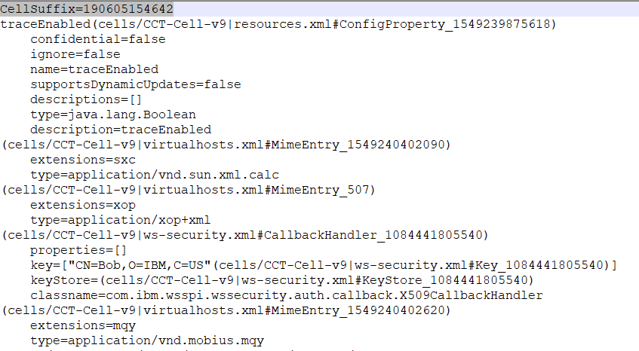
How Does It Work? – Configuration Dump Output
IBM Software Accelerated Value Program

Slide 17
Known Limitations for ConfigDump.py
On Windows platforms, ConfigDump.py must be run from the directory it is installed in if a Unix style “sh” command is not in the path. This is due to a Jython limitation. The following error is seen.
ERROR, cannot continue. Failed to load support scripts. Run wsadmin -f ConfigDump.py from the same directory it exists in.
The following message is seen when ConfigDump.py finishes. This is due to wsadmin expecting a AdminConfig.save() to be called. Since ConfigDump.py makes no changes, no save() is called and this message is expected.
WASX7309W: No "save" was performed before the script "ConfigDump.py" exited; configuration changes will not be saved.
IBM Software Accelerated Value Program

Slide 18
How Does It Work? – Report Generation
Prerequisites to generating reports
Overview of report generation properties
Discussion of Perl regular expressions
Properties processing considerations
IBM Software Accelerated Value Program

Slide 19
How Does It Work? – Report Generation, Prerequisites and Syntax
Report generation requires Python 2.7
Requires one or more .cfg files generated by ConfigDump.py
Syntax:
python ConfigReport.py arg1 arg2 arg3 arg4...
Where arg is either a properties file name or a property in the form of PropertyName=PropertyValue
IBM Software Accelerated Value Program

Slide 20
How Does It Work? – Report Generation, Properties
Java like properties define report generation
  Properties file(s) and/or properties are specified on command line
  Defines reports, input files and output directory
General properties
  ReportList (optional) is a comma delimited list of reports to generate.
    “All” (default) runs all user defined reports as well as built in reports.
  ConfigurationDumpFiles (optional)is a comma delimited set of configuration dumps. Defaults to *.cfg
  ConfigurationReportOutputPath (optional) defines where reports will be generated. Defaults to the present working directory.
  DisableReportKey (optional) The report key documenting the match column and cell background colors as well as replacement values is not added.
IBM Software Accelerated Value Program

Slide 21
How Does It Work? – Report Generation, Match Properties
  ReportOnlyMismatched (optional) do not include items that match.
    “All” will also report items that match because of string replacements.
    “True” will only report items that mistmatch even with string replacements.
  DoNotMatchNames (optional) set to true (default value) to disable replacing cell, node and server names with .* for matching purposes
  ReplaceForMatch:ID (optional) Replaces all instances of the value with .*
    ID is an arbitrary value that must be unique for all ReplaceForMatch instances
    Changes value matching from equality to regular expression matching
    Use with caution as this could have unintended results.
  ReplaceWith:ID (optional) value is used instead of .* for ReplaceForMatch:ID
    ID must match a ReplaceForMatch instance ID.
IBM Software Accelerated Value Program

Slide 22
How Does It Work? – Report Generation, Built In Reports
  Reports listed below only need to be specified in ReportList. They do not need additional attributes.
  Summary – A special report giving server and resource names
  Resources - Compares all like resources by exact name match
  NodeAgent - Compares all node agent configurations
  Applications – Compares all deployed applications by exact name of archive
  Clusters - Finds all clusters (using an exact name match) and creates one server report per cluster comparing all cluster members
  TrustAssociation – Compares Global and domain trust association configuration as well as interceptor properties
IBM Software Accelerated Value Program

Slide 23
How Does It Work? – Report Generation, Report Properties
#Example configuration report properties
ReportList=All
ConfigurationDumpFiles=*.cfg (Note GLOB regular expressions used, not Perl)
ConfigurationReportOutputPath=c:\temp
#Example configuration report properties
DoNotMatchNames=true
ReplaceForMatch:1=SOME_VALUE
ReplaceForMatch:2=OTHER_VALUE
ReplaceWith:2=VALUE_OF_CHOICE
IBM Software Accelerated Value Program

Slide 24
How Does It Work? – Report Generation, Report Properties
Report definitions are specially formatted property names.
The format is NAME:ATTRIBUTE:ID
  NAME an arbitrary label used to associate all attributes with a given report
  ATTRIBUTE is information defining the report
  ID is an arbitrary unique identifier for attributes that may be defined more than once in a report
Some attributes common to all reports.
  ReportType defines what is being compared
    Valid values are a subset of valid WAS configuration types
  Title is the title of the HTML report
  FileName is the name of the HTML report on the file system
  ReportOnlyMismatched (optional) overrides global property value of the same name. Same values as global property.
IBM Software Accelerated Value Program

Slide 25
How Does It Work? – Report Generation, ReportType Values
Server - Application server configuration
ApplicationDeployment - Application deployment configuration
DataSource - Data source configuration
J2CResourceAdapter - J2C resource adapter configuration
JDBCProvider - JDBC driver configuration
ObjectCacheInstance - Object cache configuration
ServletCacheInstance - Servlet cache configuration
SIBus - Service Integration Bus configuration
ResourceEnvironmentProvider - Resource environment provider configuration
ResourceEnvEntry - Resource environment entry configuration
SSLConfig - SSL configuration
IBM Software Accelerated Value Program

Slide 26
How Does It Work? – Report Generation, ReportType Values
JMSProvider – JMS Provider
GenericJMSConnectionFactory – Connection, Topic Connection and Queue Connection Factories
GenericJMSDestination – Topics and Queues
J2CActivationSpec - J2C Activation Specifications.
JAASAuthData – JAAS/J2C Authentication Data
URLProvider – Resources / URL Providers
URL – Resources / URLs
J2CConnectionFactory – J2C Connection Factories
J2CAdminObject – Embedded Mess. Queues & Topics
MQConnectionFactory, – WMQ Connection Factories
MQQueueConnectionFactory, – WMQ Queue Connection Factories
IBM Software Accelerated Value Program

Slide 27
How Does It Work? – Report Generation, ReportType Values
MQTopicConnectionFactory, – WMQ Topic Connection Factories
MQQueue, MQTopic – WMQ Queues & Topics
IBM Software Accelerated Value Program

Slide 28
How Does It Work? – Report Generation, Report Properties
Server reports have two additional attributes
  Clusters selects all servers in matching clusters for comparison
    Clusters key format is NAME:Clusters:ID
    Clusters value format is CellRegex::CellRegex
  Servers selects all matching servers for comparison
    Servers key format is NAME:Clusters:ID
    There are two server value formats.
    CellRegex::ServerRegex
    CellRegex::NodeRegex::ServerRegex
“Regex” refers to a Perl regular expression
  CellRegex matches cell names
  ClusterRegex matches cluster names
  ServerRegex matches server names
  NodeRegex matches node names
IBM Software Accelerated Value Program

Slide 29
How Does It Work? – Report Generation, Report Properties
Sample server reports
The following report will compare all servers in the Cluster1 cluster
Cluster1:ReportType=Server
Cluster1:Title=Cluster1 Servers
Cluster1:Clusters:1=.*::Cluster1
Cluster1:Servers:1=
Cluster1:ReportList=All
Cluster1:FileName=Cluster1
The following report will compare all servers by the name of DCASrv or DCBSrv
DCServers:ReportType=Server
DCServers:Title=DC Servers
DCServers:Clusters:1=
DCServers:Servers:1=.*::DCASrv
DCServers:Servers:2=.*::DCBSrv
DCServers:ReportList=All
DCServers:FileName=DC_Servers
DCServers:ReportOnlyMismatched=All
IBM Software Accelerated Value Program

Slide 30
How Does It Work? – Report Generation, Report Properties
Application reports have one additional attribute
  Archive selects all applications by deployed archive name
    Archive key format is NAME:Archive:ID
    Archive value format is a regular expression
Sample Application report
App:ReportType=ApplicationDeployment
App:Title=Enterprise Application
App:Archive:1=app1\.ear
App:Archive:2a=app2\.ear
App:Archive:All=.*
App:FileName=AppReport
IBM Software Accelerated Value Program

Slide 31
How Does It Work? – Report Generation, Report Properties
Resource reports have two additional attributes
  Scope defines the level of the resource to be matched
    Scope key format is NAME:Scope:ID
    Scope valid values are Cell, Cluster, Server or Node
  Resources selects the resources by name for comparison
    Resources key format is NAME:Resources:ID
    Resources value format is ResRegex
Scope and Resources attributes must be in pairs with matching ID
ResRegex is a regular expression used to match resource names
IBM Software Accelerated Value Program

Slide 32
How Does It Work? – Report Generation, Report Properties
Sample Resource reports
The following report will compare all cluster level Data Sources
DS:ReportType=DataSource
DS:Title=Data Sources
DS:Scope:1=Cluster
DS:Resources:1=.*
DS:FileName=DS
The following report will compare all node level resource adapters with “MQ” in their name or cluster level with “JMS” in their name
J2C:ReportType=J2CResourceAdapter
J2C:Title=Resource Adapters
J2C:Scope:1=Node
J2C:Resources:1=.*MQ.*
J2C:Scope:2=Cluster
J2C:Resources:2=.*JMS.*
J2C:FileName=J2C
IBM Software Accelerated Value Program

Slide 33
How Does It Work? – Report Generation, Regular Expressions
Perl Regular Expressions used for matching
Common matching syntax
  . = match any single character
  * = match previous character 0 or more times
  + = match previous character one or more times
  | = logical or operator (normally used with parenthesis)
Perl Regular Expression documentation available on Internet
Matching cell names requires special handling
  Reason is “CellSuffix” is appended on cell name
    Allows comparisons of cells with same name
    Allows comparisons of same cell to detect “configuration creep”
  CellSuffix is found at the beginning of .cfg file
  CellSuffix has a hard coded delimiter “-” when displayed
IBM Software Accelerated Value Program

Slide 34
How Does It Work? – Report Generation, Properties processing considerations
There is a single properties name space
  No conflict checking for properties
  Last property read takes precedence if a name collision occurs
Defining properties prior to June 2018
  There was a single properties file passed in on the command line.
  All properties were defined in this file
Defining properties June 2018 to present
  ConfigReport.py parameters are processed in order
  ConfigReportAttributes.properties was introduced
    This file contains lists of which configuration attributes are reported
    Prior, these properties were part of the single properties file
    This file loads implicitly and last
    The file must be in the same directory as ConfigReport.py
    This will be compatible with report properties files prior to June 2018 if the configuration attribute list properties were not modified
IBM Software Accelerated Value Program

Slide 35
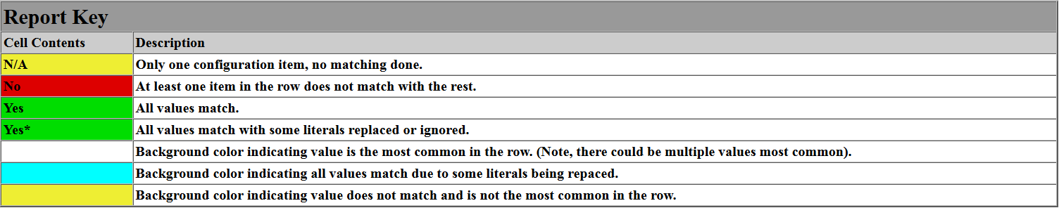
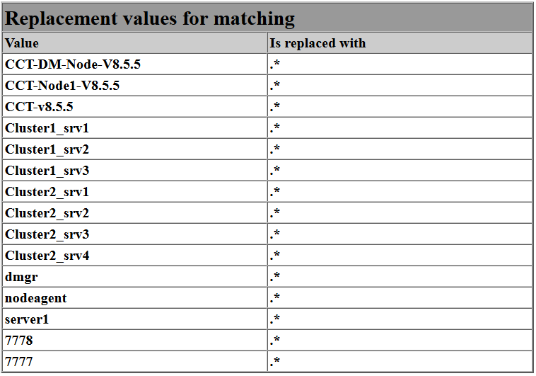
Reading CCT Configuration Reports
A key is generated at the top of each report
  Documents color coding conventions and match column values
  Lists match substitutions
IBM Software Accelerated Value Program

Slide 36
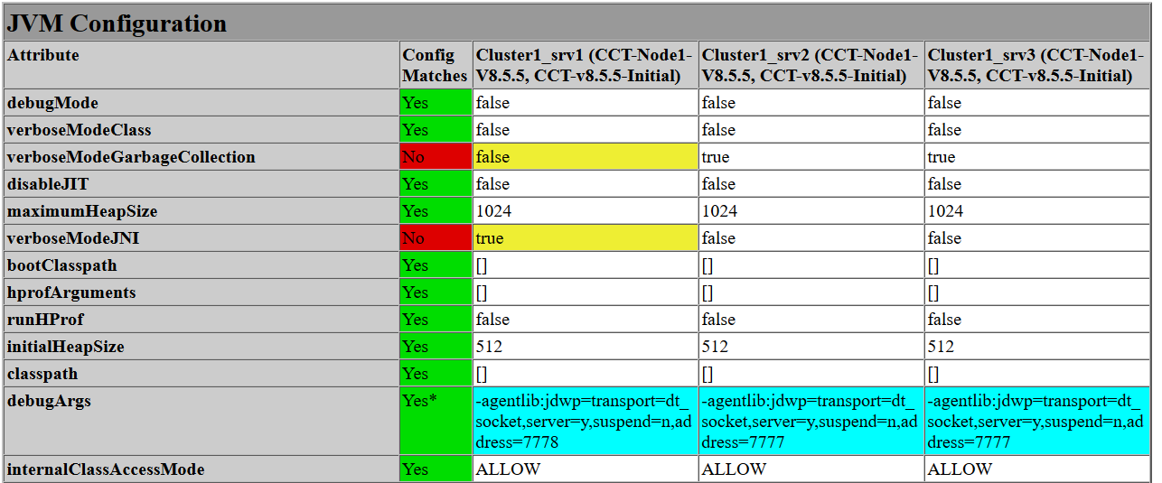
Reading CCT Configuration Reports
There is a title for each sub report
Column headers are names of selected servers or resources
Row headers are configuration XML attribute values (same as used in scripting configuration updates).
IBM Software Accelerated Value Program

Slide 37
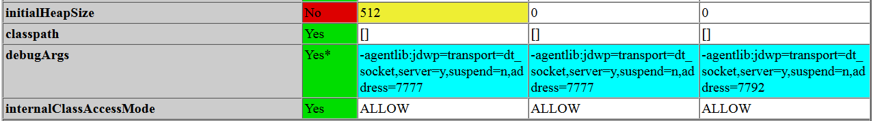
Reading CCT Configuration Reports
Match column
  Green means all config values match for that attribute
    “Yes” means literal values match
    “Yes*” means values match with some replaced strings
  Red means the given attribute does not match on all servers
    Depends on attribute as to if this is really an issue
        For most attributes, it is an issue
        Some attributes may contain server specific information which is expected to be different.
  Yellow (N/A) means only one server or resource was selected so therefore a comparison is not possible.
Values occurring the least are highlighted in yellow as the probable values in error
Values that match due to replacement strings are displayed in blue
IBM Software Accelerated Value Program

Slide 38
Sample Correction Scripts
OutputScripts (optional property)
  “True” value will generate a sample wsadmin Jython script per report
  Sample script will synchronize values based on comparison report
  May be enabled and disabled per report
Sample script features
  Commented with “REVIEW” tags to assist in identifying key areas
    REVIEW tags must be carefully inspected
  Creates a Repository Checkpoint
  Creates a section per table with differences in reports
    Sections labeled with table name
    Differences are “No” values from the Match Column
  Defaults to setting most common value from cells in a given row
Known limitations for generated scripts
  Variables correction samples not provided due to scope and inheritance issues
  Samples of creating and deleting properties not provided
  Using “wsadmin –conntype NONE” highly discouraged
IBM Software Accelerated Value Program

Slide 39
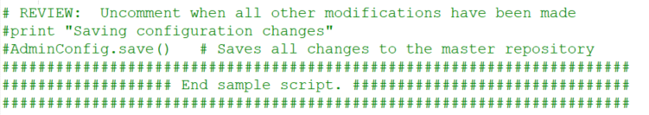
Sample Correction Scripts
Scripts begin with a repository checkpoint
Scripts end with AdminConfig.save() commented out
IBM Software Accelerated Value Program

Slide 40
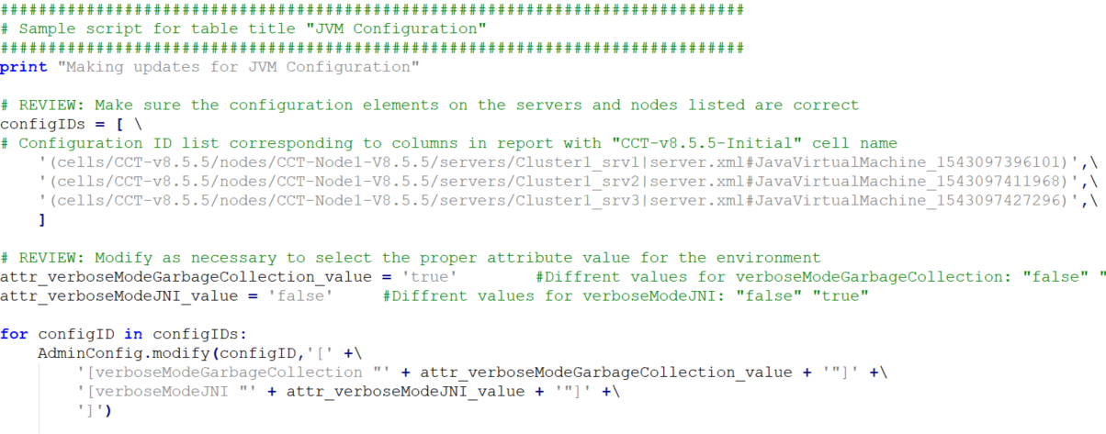
Sample Correction Scripts
Sample Jython to update attributes (sample truncated on right margin)
IBM Software Accelerated Value Program

Slide 41
File System Comparison – Collecting Data
Must be run on locally mounted file system
  Collect from the same path (relative or fully qualified) on each system
  Relative paths recommended as fully qualified paths often change from system to system
File data gathered
  Path to file
  Last modified date/time
  Checksum
All commands are run via “nice –n10” to ensure CPU is not seriously impacted
Tested on Linux, Windows and AIX
  Windows requires GNU utilities in the path (grep, cut, cksum and stat)
  AIX requires bash in the path
Output file name defaults to file-list.YYYYMMDD.HHMMSS.txt
  OutputFileName optionally specified to override default file name
  Recommended to include date/time stamp in file name, as seen above
Syntax:
CollectFileData.sh FileSystemPath OutputFileName
IBM Software Accelerated Value Program

Slide 42
File System Comparison – Generating Reports
File system report generation does not require a properties file
ReportFileName is a file name prefix for the output file
  Date and time of report generation appended to name
Any number of outputs from CollectFileData.sh may be specified
  Each file specified will be a column in the report
Syntax:
python ConfigReportFiles.py ReportFileName FileData1 FileData2 FileData3…
ReportFileName is the name of output report (fully qualified or relative)
FileList parameters are lists of files generated by CollectFileData.sh
IBM Software Accelerated Value Program

Slide 43
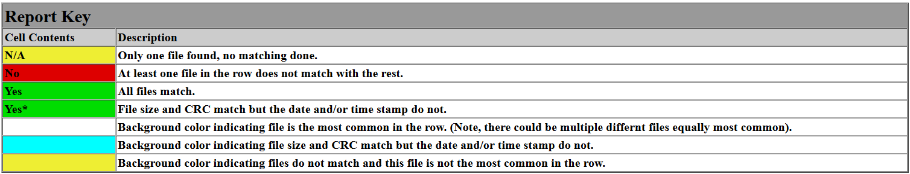
Reading CCT File System Reports
A key is generated at the top of each report
  Documents color coding conventions and match column values
  Same look as configuration reports.
IBM Software Accelerated Value Program

Slide 44
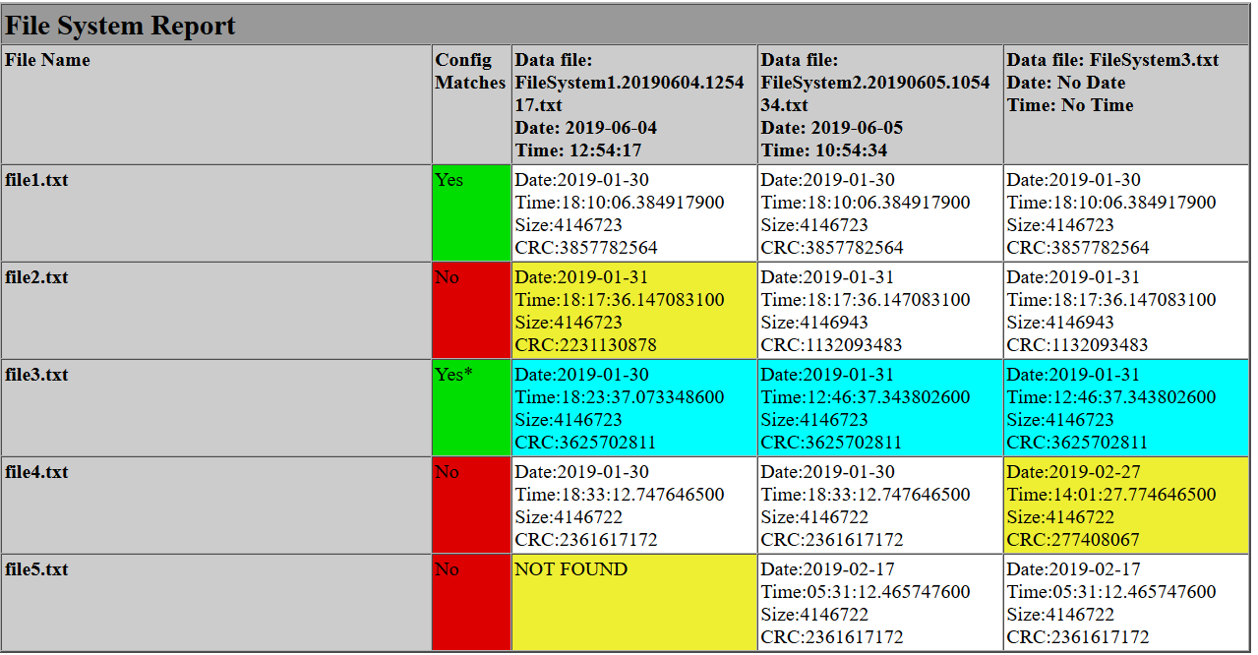
Reading CCT Configuration Reports
Column headers are names input files
Row headers are names of compared files.
Match column
  Green means file exists in all file systems
    “Yes*” means CRC and Size match but date and time differ
  Red means the file is missing or different (CRC and/or size)
IBM Software Accelerated Value Program

Slide 45
Future Enhancements
Liberty profile support (not Tradition Profile to Liberty)
Additional server reports
  Deployment Manager
  Admin Agent
  Web Server Definition
  ODR
  WebSphere Proxy (HTTP & SIP)
Security Domains
Client requested enhancements, what are your needs?
Submit new enhancement requests here:
https://github.com/IBM/websphere-cct/issues
IBM Software Accelerated Value Program

Slide 46
Copyright and License
Copyright International Business Machines Corp. 2014, 2020.
See the NOTICE file distributed with this work for additional information
regarding copyright ownership. Licensed under the Apache License,
Version 2.0 (the "License"); you may not use this file except in compliance
with the License. You may obtain a copy of the License at
http://www.apache.org/licenses/LICENSE-2.0
Unless required by applicable law or agreed to in writing, software
distributed under the License is distributed on an "AS IS" BASIS,
WITHOUT WARRANTIES OR CONDITIONS OF ANY KIND, either express or implied.
See the License for the specific language governing permissions and
limitations under the License.
IBM Software Accelerated Value Program

