Slide 1
Intro to Docker Containers
John Zaccone
john.zaccone@ibm.com

Slide 2
What are containers? (and how are they different then Docker?)

Slide 3
Introducing containers and Docker
Containers – not a new idea
chroot ('80s) process spawned in isolated file space
FreeBSD jails
OS-level virtualization (user-mode-linux, virtuozzo)
Solaris Containers
LinuX Containers (LXC)
Cloud Foundry (Warden, Garden)
More efficient than VMs but less mindshare...
Docker – ecosystem approach transformed perception
Building application-centric containers
Mechanism for sharing images (Docker Registry)
Open-source enabled
Isolation
Isolation
process 1
process 2
OS / kernel
hardware
Notes:
The concept behind Docker containers and the widespread industry interest is not a new idea. The ability to isolate a process from other processes and their use of resources on a common kernel and hardware has been evolving since choot provided a way to implement file space isolation with unix in the '80s.
This evolved to bring more features over time, in early 2000's there were FreeBSD jails, and also user-space virtualization solutions, open source and proprietary products
Solaris Containers and LXC were quite feature-rich, providing just about everything needed for an os-virtualization solution.
Because container systems did not require multiple operating system installations and hypervisors, they have had an edge in efficiency over vms. But VM's which also matured over the same period grabbed major mindshare and use as IT developed consolidation models and grew into Cloud
Docker containers have risen in popularity and use with developers because of the ecosystem approach in combination with platform support for development workstations... Can get Docker engine for MacOSX, Windows, Linux platforms and it runs across server platforms even Linux on IBM 390/system Z

Slide 4
What are Containers?
Similar to VMs but managed at the process level
"VM-like” isolated achieved by set of "namespaces" (isolated view)
PID –isolated view of process IDs
USER- user and group IDs
UTS - hostname and domain name
NS - mount points
NET - Network devices, stacks, ports
IPC - inter-process communications, message queues
cgroups - controls limits and monitoring of resources
The key statement: A container is a process(es) running in isolation
Notes:
VMs isolate at the Operating System level. Multiple independent OS, vs one OS with multiple independent processes.
VM running in isolation - full-blown operating system
Container - run just the processes that you need to get your business function done
- example: tomcat processes -
Container uses namespaces - provides its own view of the world in terms of….
- elaborate on PID namespace as an example. PIDS don’t match host or other containers. Mapped to host.
- namespaces includes all key aspects of a VM
- root file system for each container, means containers get its own view of a file system
CGroups
- limit number of resources so that one container doesn’t take over the machine
Namespaces and protecting
- Access to host? can do anything
- container security is about preventing from hackers from “Escaping the containers”
- users do not have access to the host

Slide 5
VM vs Container
Virtual Machine
Container
Virtual Machine
Container
Virtual Machine
Container
App
App
App
bins / libs
bins / libs
Operating System +procs
VS
OS-specific files
<-Emulates a full OS
Hypervisor
Base OS/Kernel
<- Actual OS
VM ?
Hardware
Hardware
Each VM has its own OS
Containers share the same base Kernel

Slide 6
What is Docker?
Containers is the technology, Docker is the tooling around containers
Without Docker, containers would be unusable (for most people)
Docker simplified container technology to enable it for the masses
Added value: Lifecycle support, setup file system, etc
For extra confusion: Docker is also a company, which is different then Docker the technology…

Slide 7
Follow Along….
https://labs.play-with-docker.com

Slide 8
Our First Container
$ docker run ubuntu echo Hello World
Hello World
What happened?
Docker created a directory with a "ubuntu" filesystem (image)
Docker created a new set of namespaces
Ran a new process: echo Hello World
Using those namespaces to isolate it from other processes
Using that new directory as the "root" of the filesystem (chroot)
That's it!
Notice as a user I never installed "ubuntu"
Run it again - notice how quickly it ran
Notes:
Fast to run containers, but a little bit of work ahead of time
once and image is downloaded, it will be very fast to run subsequent containers

Slide 9
ssh-ing into a container - fake it...
$ docker run -ti ubuntu bash
root@62deec4411da:/# pwd
/
root@62deec4411da:/# exit
$
Now the process is "bash" instead of "echo"
But its still just a process
Look around, mess around, its totally isolated
rm /etc/passwd – no worries!
MAKE SURE YOU'RE IN A CONTAINER!
Notes:
how to debug a container…
but don’t start an ssh daemon (security hole)
-it tty and stdin stdout to connect to terminal
-i by default doesn’t connect stdin
-t psudeo-tty - connect terminal emulator - need this to have things like bash to work
here we assume that the “bash” program is included inside the container image we are attempting to run
containers are given a set of privileges - cannot run sys calls to shutdown machine
can delegate what sys calls each container has access to
comes with default profile that limited

Slide 10
A look under the covers
$ docker run ubuntu ps -ef
UID PID PPID C STIME TTY TIME CMD
root 1 0 0 14:33 ? 00:00:00 ps -ef
Things to notice with these examples
Each container only sees its own process(es)
Each container only sees its own filesystem
Running as "root"
Running as PID 1
Notes:
can only see process IDs on the host
running as root by default
process is running as PID 1

Slide 11
Docker Images
Tar file containing a container's filesystem + metadata
For sharing and redistribution
Global/public registry for sharing: DockerHub
Docker Host
Containers
Containers
Images
Ubuntu
Liberty
Docker Engine
Base OS/Kernel

Slide 12
Docker Registry
The central place to share images with friends! (or coworkers)
DockerHub - http://hub.docker.com
Public registry of Docker Images
Also useful to find prebuilt images for web servers, databases, etc
Enterprises will want to find a private registry to use (such as one built into ICP)
Docker Host
Containers
Containers
Registry
Images
Ubuntu
Liberty
Ubuntu
Liberty
nginx
mysql
Docker Engine
Base OS/Kernel

Slide 13
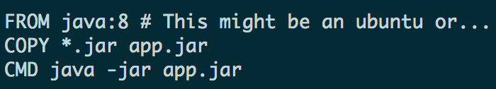
Build your own image with a Dockerfile!
Step 1) Create Dockerfile to script how you want the image to be built
Step 2) docker build to build an image
Step 3) docker push to push to registry
Step 4) From another location, docker pull to download an image
Notes:
Docker. Not a new technology
Containers have been around for a while (IBM helped invent it)
Docker created a tool for the masses
- tool on top of containers
- containers does not mean docker (other providers out there)
- docker implemented tooling very well

Slide 14
Docker special sauce: Layers
But first, let's compare VMs and Containers one more time...

Slide 15
VM vs Container: Notice the layers!
Virtual Machine
Container
Virtual Machine
Container
Virtual Machine
Container
App
App
App
<- Layer
bins / libs
bins / libs
<- Layer
Operating System +procs
VS
OS-specific files
<- Layer
Hypervisor
Base OS/Kernel
VM ?
Hardware
Hardware
Each VM has its own OS
Containers share the same base Kernel

Slide 16
Shared / Layered / Union Filesystems
Docker re-uses common layers between containers and images
A single writeable layer is added on the top every time a new layer is created
Layers are “smushed” with union file system (think transparencies on a projector)
Files are copied up when writes need to be made (copy-on-write)
Bottom Line
More containers per host
Faster downloads and uploads
Faster container startups
CNTR1
CNTR2
CNTR3
CNTR4
Layer
app1
app2
app3
app4
Layer
tomcat
liberty
tomcat
Layer
Fedora
Ubuntu
Base OS / Kernel
Filesystem

Slide 17
Summary
Docker is just a tool to manage containers
Key concepts: Containers, Engine, Images, Registry
Docker value-add:
An excellent User Experience
Image Layers
Easily shared images - DockerHub
Why? When compared to VMs:
Better resource utilization - CPU, Memory, Disk
Faster start-up times
Easier tooling/scripting
Discussion / Questions?

Slide 18
Quiz!
What's the difference between a container and an image?
Answer:
An image is a tar of a filesystem
A container is a filesystem + a set of processing running in isolation

Slide 19
In a Traditional Deployment…
Are you testing these on ever commit?
Code (packages archive)
App server
Runtime versions
System libraries and versions
Notes:
Windows Containers available in Windows Server 2016 Tech Previews, and on Windows 10 Insider Track
“multi-architecture image” docker hub will pull the correct version
people have to go out of their way to build these images
pull x86 image, will it run on Power or Z? probably not
which images are for Power or Z? can’t tell on docker hub
create namespace to identify different architecture support

Slide 20
Container = Code + Dependencies
Code (packages archive)
App server
Runtime versions
System libraries and versions

Slide 21
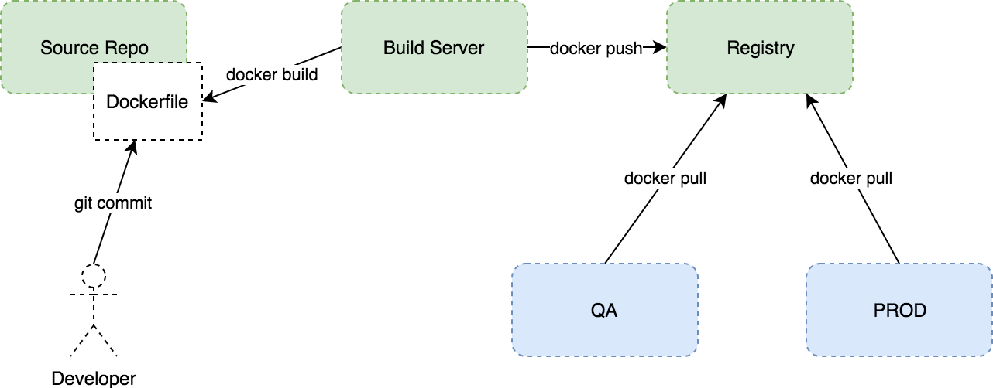
Notes:
this seems like a restriction, but if you think about the benefits of stateless applications its actually going to fit in perfectly with our best practices (12 factor)
stateless applications allow you to
scale.
any application instance can serve any request
graceful shutdown and quick startup times because of shared layers

Slide 22
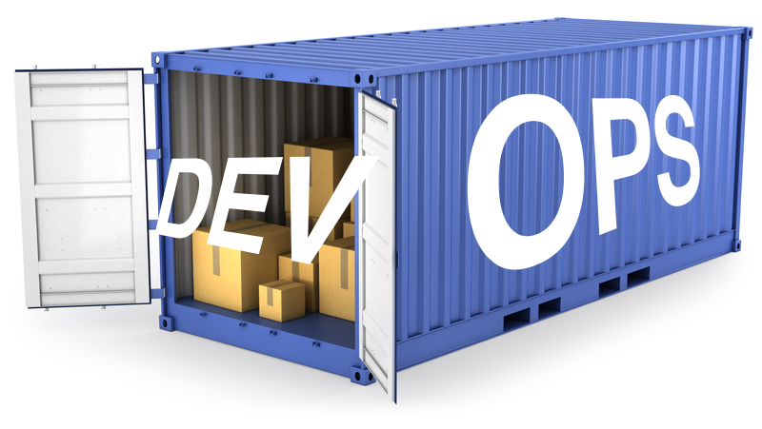
Docker for Operations
Notes:
standard interface for operations will come in handy when trying to solve problems like providing external configuration, and generic operations concerns such as scheduling applications, scaling etc.
it also a measure of portability. applications are self-contained. no dependencies on underlying infrastructure. run on any platform, on-prem cloud, doesn’t matter. Only requirement is linux or windows, and the docker engine installed

Slide 23
Lab– build your own image
ibm.biz/BdjJXT

Slide 24
Questions?
John Zaccone
john.zaccone@ibm.com

