Slide 1

IBM Code London
Monday Meetup
IOT - Part 1
Index Drinks Party #IndexConf

Slide 2
https://www.postscapes.com/internet-of-things-protocols/
https://www.oasis-open.org/committees/download.php/49205/MQTT-OASIS-Webinar.pdf
https://mqtt.org
https://nodered.org
https://coap.technology
https://quickstart.internetofthings.ibmcloud.com
https://developer.ibm.com/code/

Slide 3



Your hosts for the evening
Ross
@rcruicks
Yamini
@yaminigrao
Sean
@seanmtracey

Slide 4
Welcome to #1!
Thanks
  #INDEXCONF – The Beers
  developerWorks – IBM Coder program
Quick overview of the program(s)
  Meetup.com/IBM-Code-London
IOT 101
  Background
  Demos
  Hands on
The Beers
(feedback)

Slide 5


Slide 6
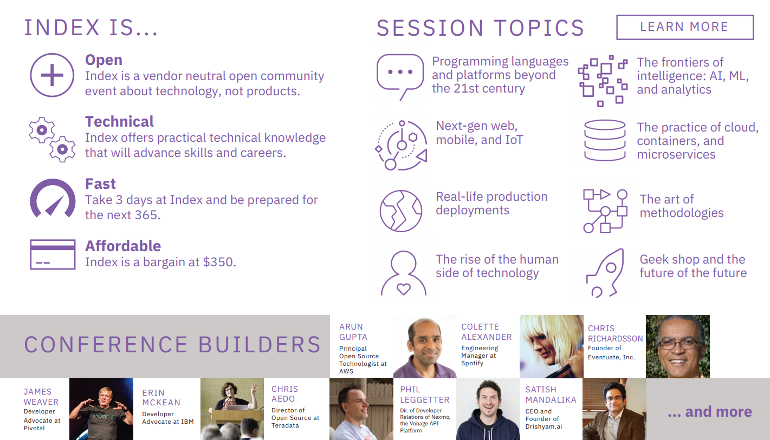

Slide 7
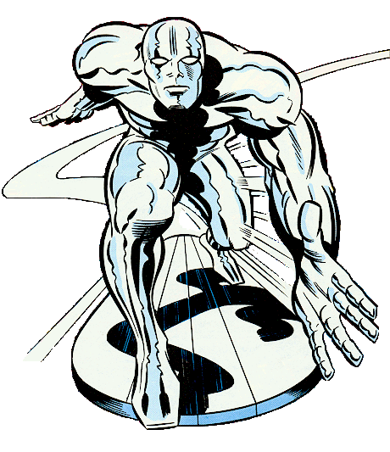
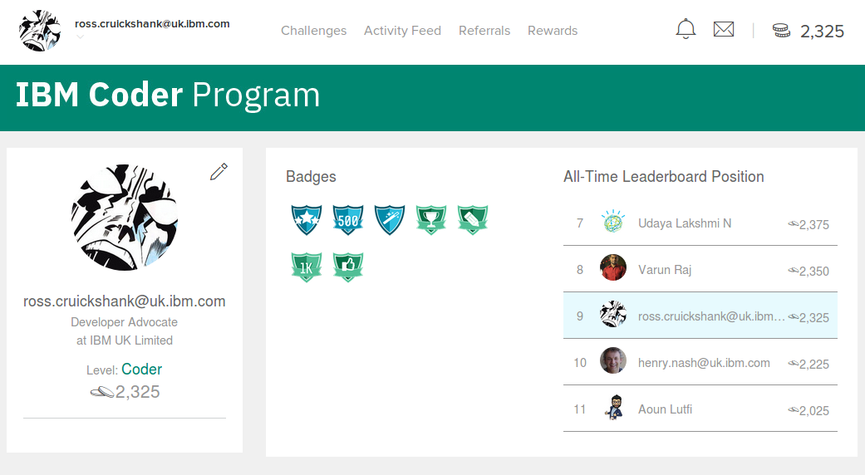
IBM Coder Program

Slide 8
IBM-Code-London
Cloud Native Development and Containers
Internet of Things
Artificial Intelligence and Machine Learning
Data Science
Blockchain

Slide 9
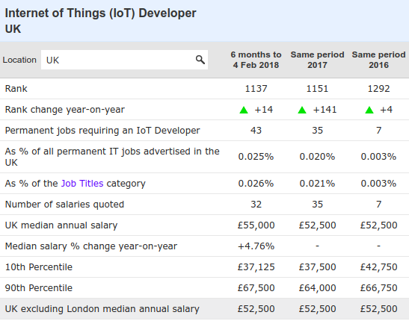
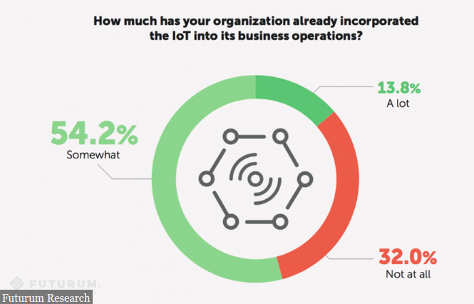
Why IoT?
www.itjobswatch.co.uk

Slide 10
Linked material
https://www.ibm.com/developerworks/library/iot-lp101-quick-start-guide-iot-developers/index.html
  Key Concepts and Skills
  Choosing hardware – prototype and production
  Selecting appropriate networking technologies
  Managing traffic – IOT Platforms
  Getting started
https://www.coursera.org/learn/developer-iot

Slide 11
Skills
Hardware
Networking
Application design
Application development
Security
Business intelligence and data analytics
Machine learning and artificial intelligence (AI)

Slide 12
Hardware selection
Security requirements
Ease of development
Data acquisition, processing and storage requirements
Connectivity requirements
Power requirements
Physical device design
Cost requirements

Slide 13
Network selection
PAN (Personal Area Network)
  PAN is short-range, where distances can be measured in meters, such as a wearable fitness tracker device that communicates with an app on a cell phone over BLE.
LAN (Local Area Network)
  LAN is short- to medium-range, where distances can be up to hundreds of meters, such as home automation or sensors that are installed within a factory production line that communicate over wifi with a gateway device that is installed within the same building.
MAN (Metropolitan Area Network)
  MAN is long-range (city wide), where distances are measured up to a few kilometers, such as smart parking sensors installed throughout a city that are connected in a mesh network topology.
WAN (Wide Area Network)
  WAN is long-range, where distances can be measured in kilometers, such as agricultural sensors that are installed across a large farm or ranch that are used to monitor micro-climate environmental conditions across the property.

Slide 14
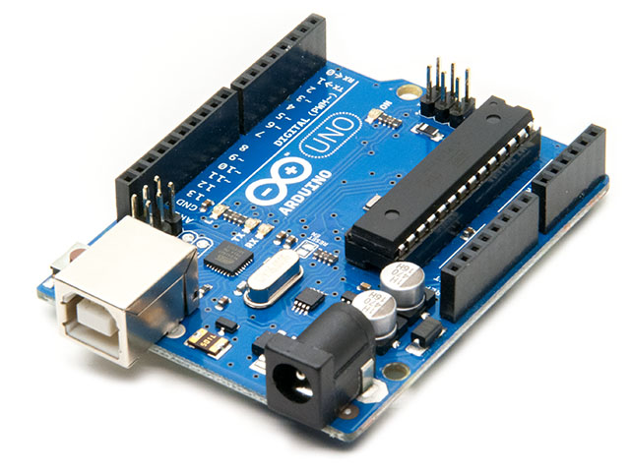
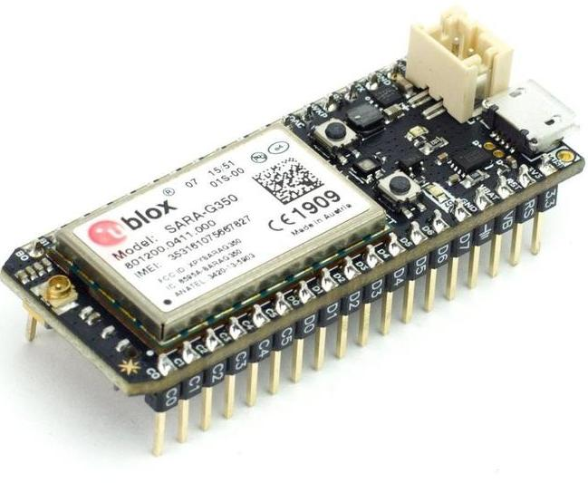
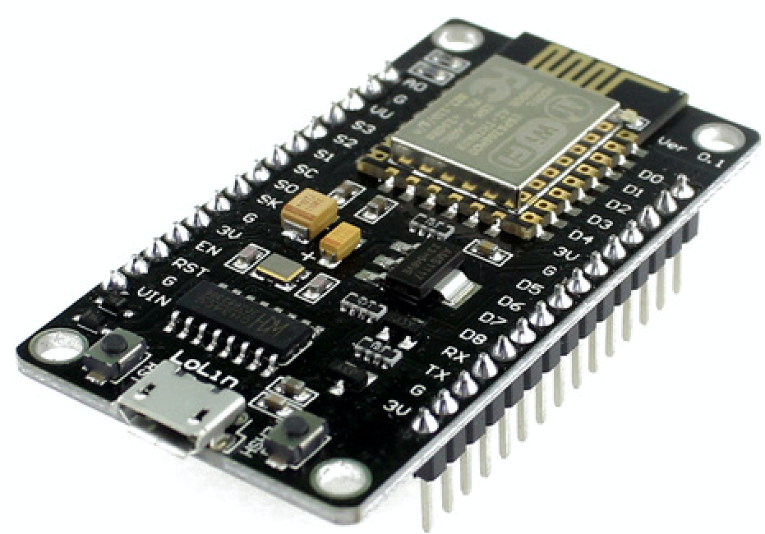
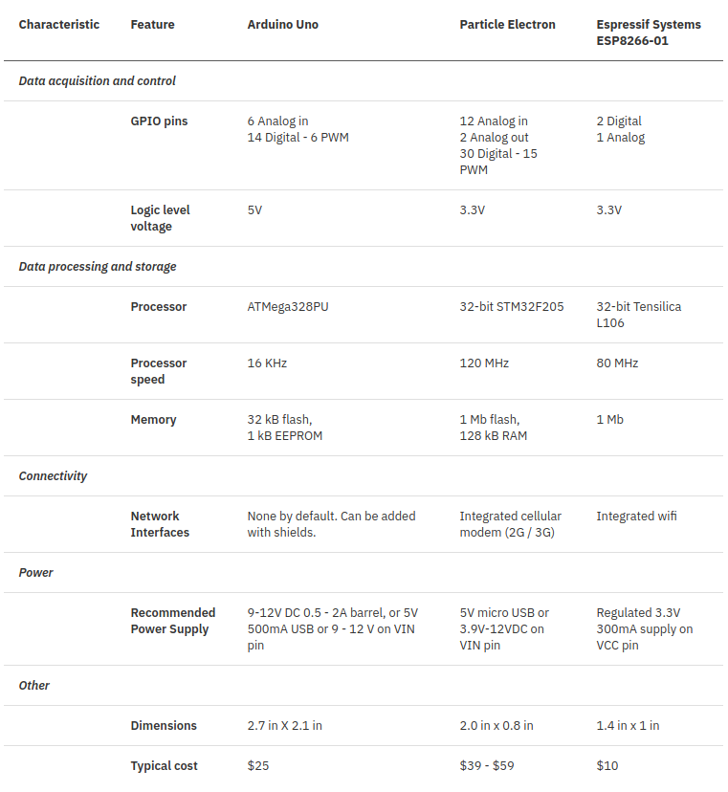
Microcontroller boards

Slide 15
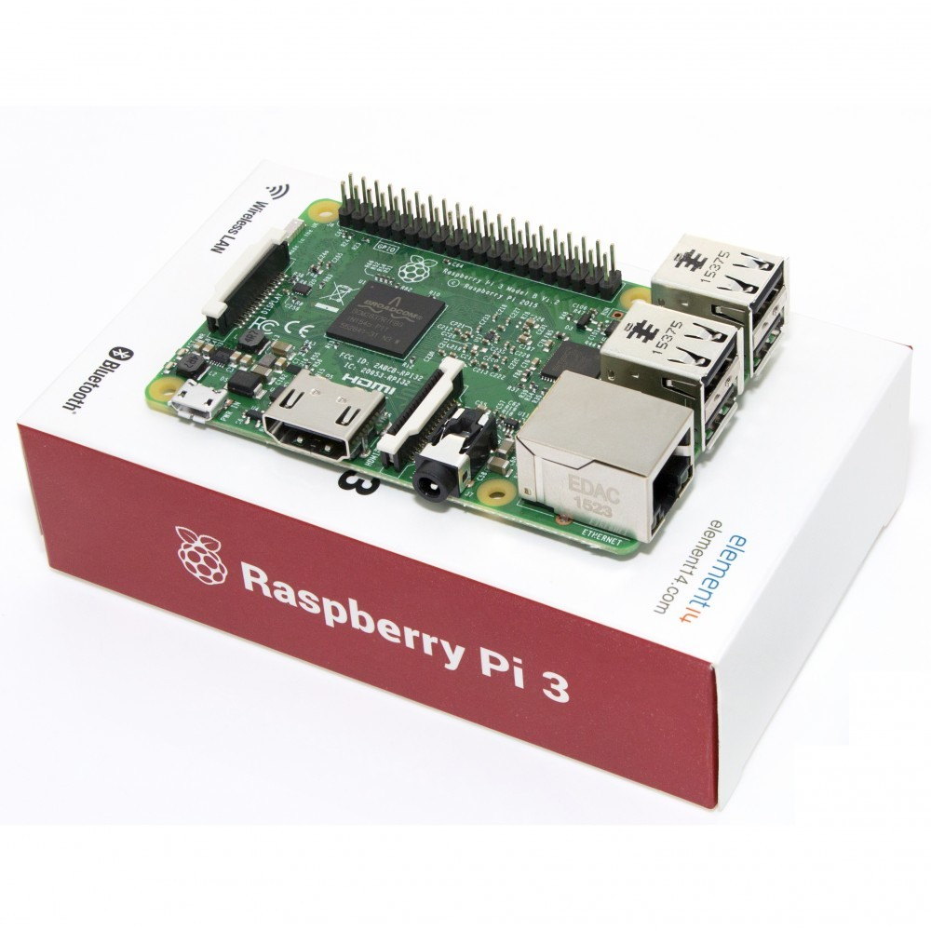
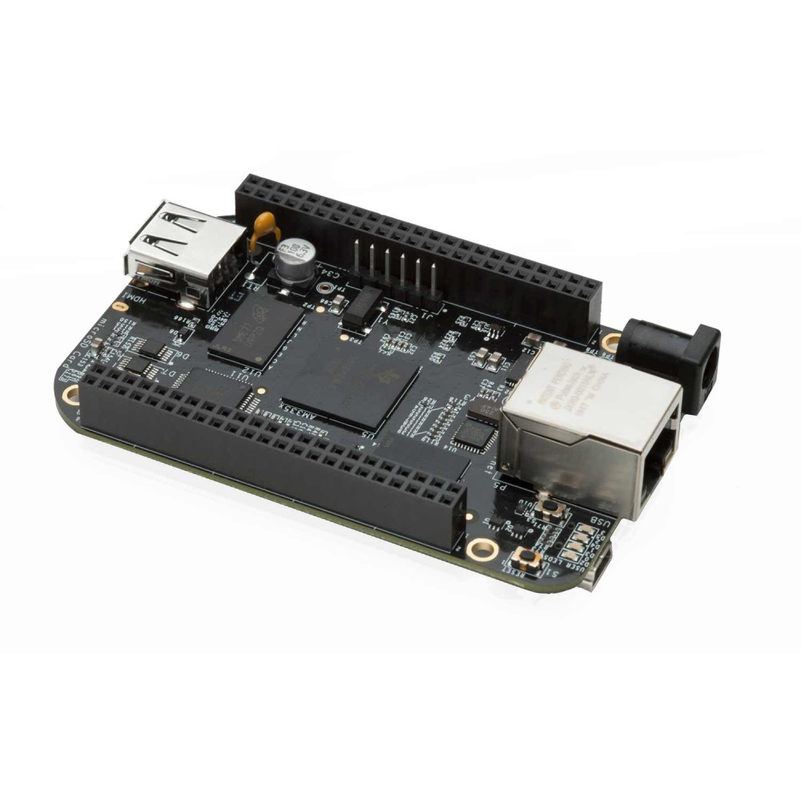
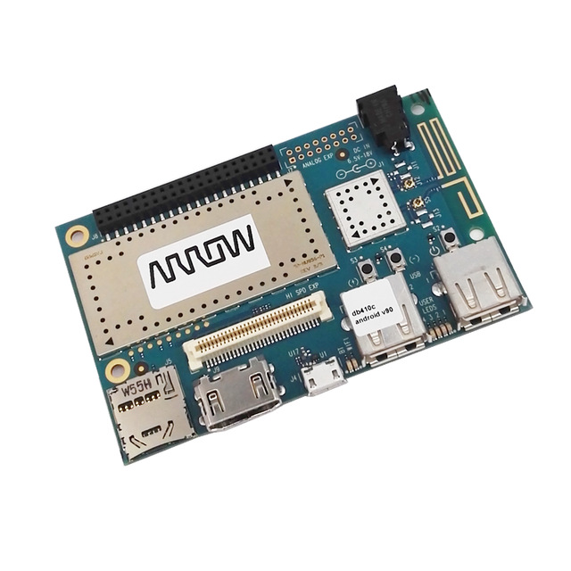
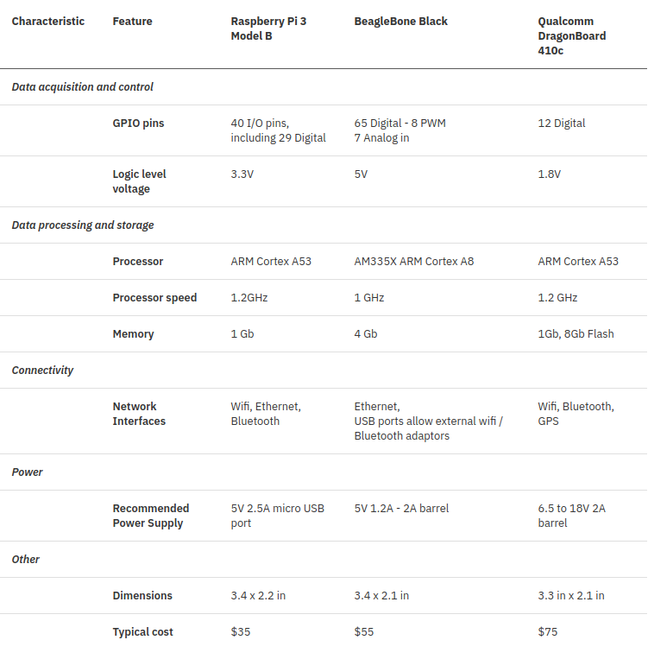
Single board computers

Slide 16
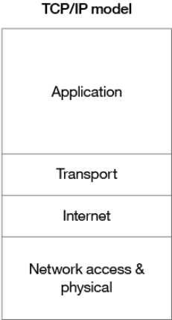
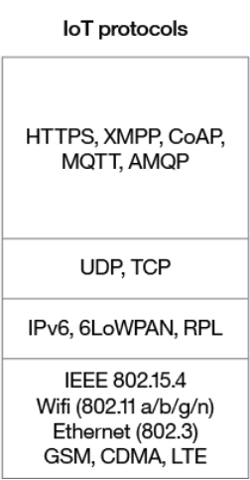
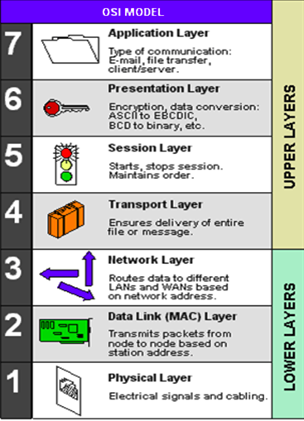
What’s going on in Comms?
OSI 7-layer model

Slide 17
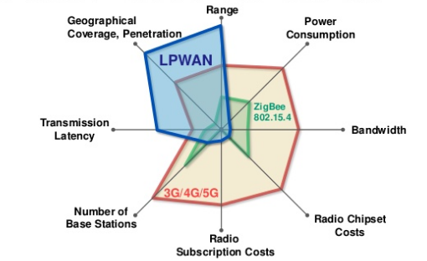
Network trade-offs
Peter R Egli 2015

Slide 18
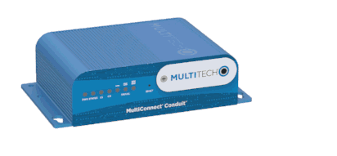
LoRaWAN gateway

Slide 19
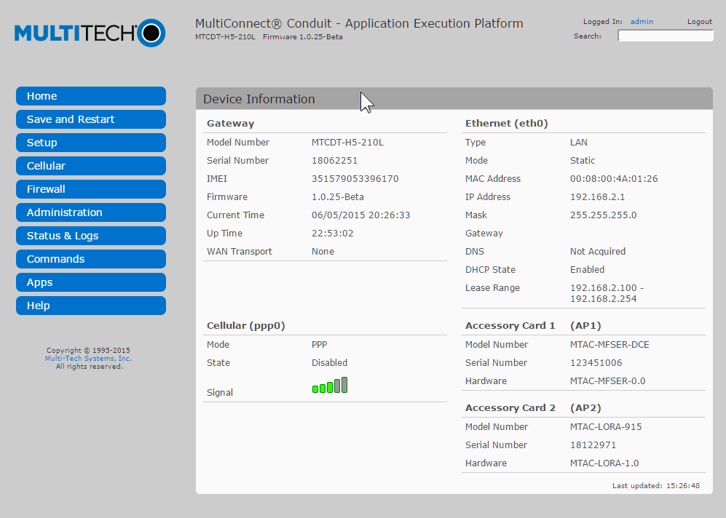

Slide 20
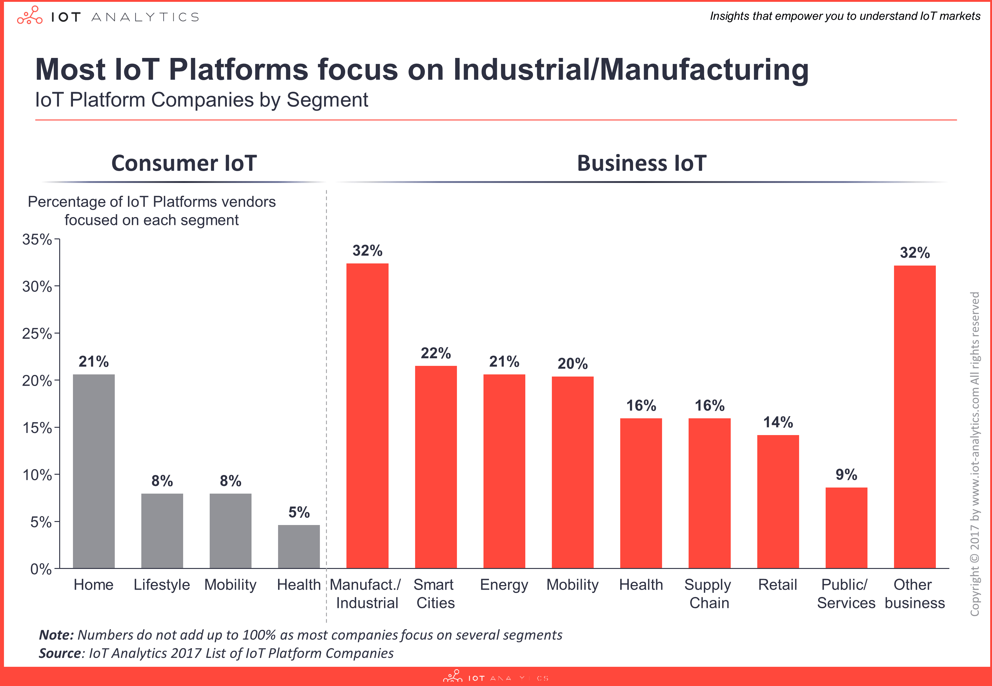
IoT Platform providers

Slide 21
Selecting an IOT platform
Comprehensive Device Management
Support for a Wide Range of Protocols and Standards
Scalable Message Broker
Separate Endpoints for Data Ingestion and Device Connectivity
Support for a Robust, Declarative Rules Engine
Security at Every Layer of the Stack
Integration with the Edge Devices
Clean Separation of Real-time and Batch Processing of Data
Extensible Data Processing Pipeline
Integration with Existing Line-of-Business Applications
Janakiram MSV
https://www.forbes.com/sites/janakirammsv/2016/04/11/the-cio-checklist-for-choosing-the-right-enterprise-iot-platform/#77ba87161d56

Slide 22
√
 | Protocols | Visualisation | Pub/Sub | Rules | Predictive analytics | Device Shadows
AWS IOT | WS, MQTT, HTTP |  | √ | √ |  | √
IBM Watson IOT | MQTT, HTTP | √ | √ | √
Microsoft Azure IOT Suite | MQTT, HTTP, AMQP | √ | √ | √ | √ | √
PTC ThingWorx | WS, MQTT, HTTP, AMQP, CoAP | √ | √ |  | √
Kaa

Slide 23
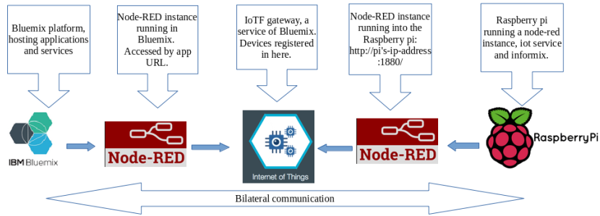
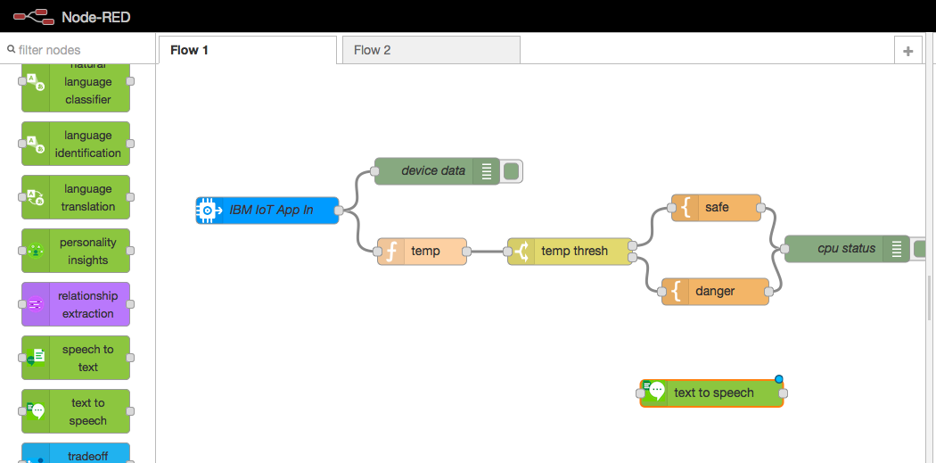

Slide 24

… to be continued

Slide 25

#INDEXCONF

