Slide 1
Watson Services for building a banking conversational agent

Slide 2
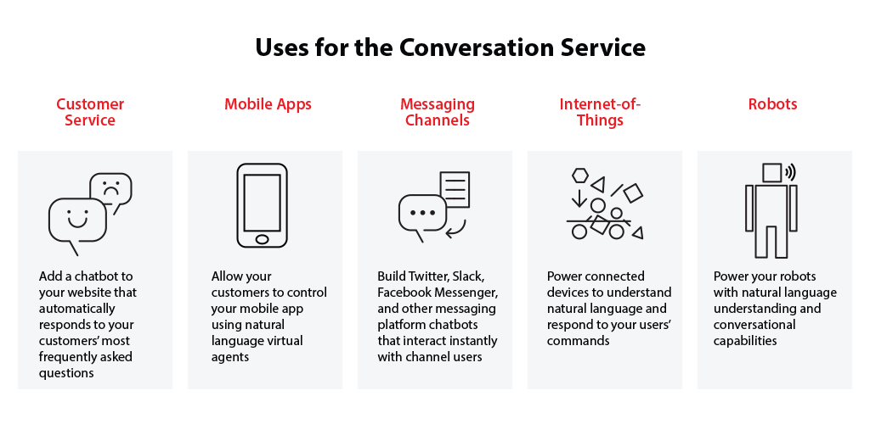
Watson Conversations Service
With the IBM Watson™ Conversation service you can create virtual agents and bots that combine machine learning, natural language understanding, and integrated dialog tools to provide automated customer engagements.

Slide 3

Features
Intents – Identifies the high level features that the chat bot will provide.
Entities – Identifies “parameters” that can provide additional detail on the intent.
Dialog – Uses Intents and Entities to define a conversation and personalize the conversation’s responses for a specific user.
Benefits
Simplicity: The Conversation service has a simple graphical interface that lets you get started quickly,
Self Service: Enables customers to self serve on their terms
Cost Reduction: Reduces costs through deflection of calls to Contact Centers

Slide 4
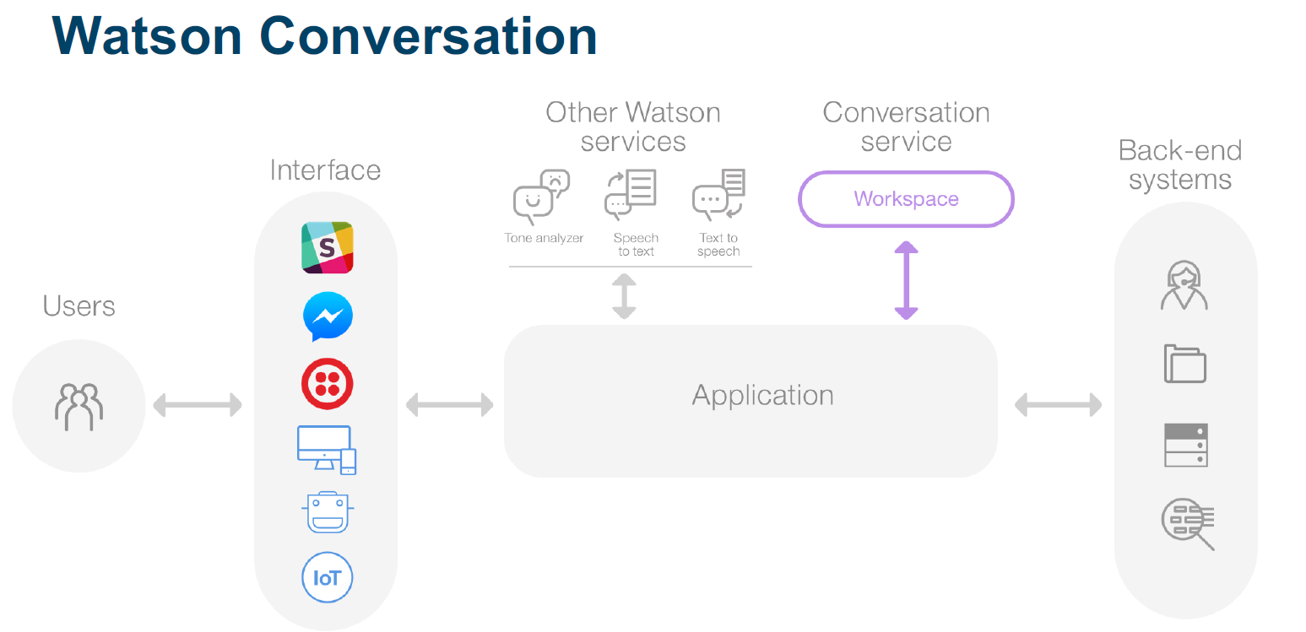

Slide 5
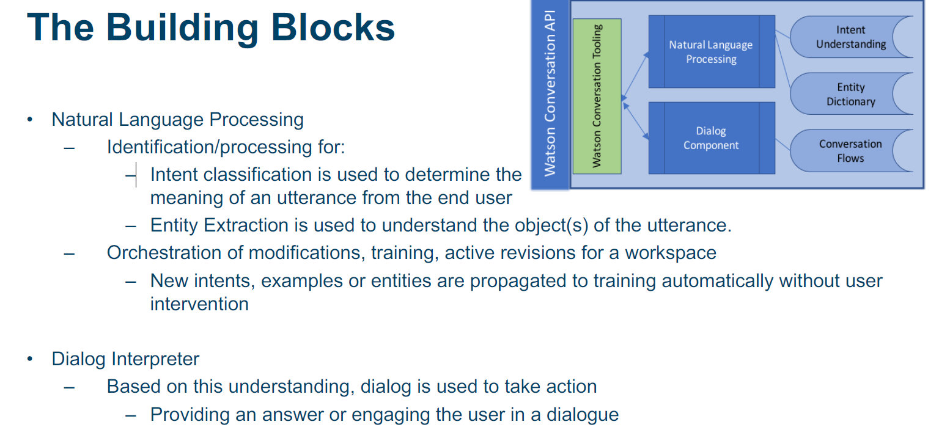

Slide 6
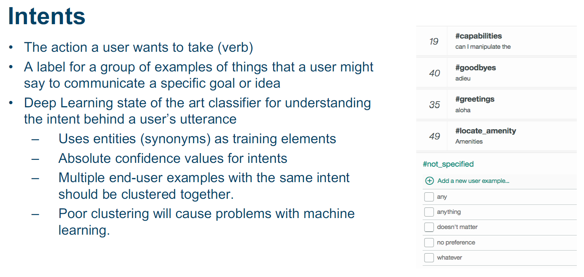
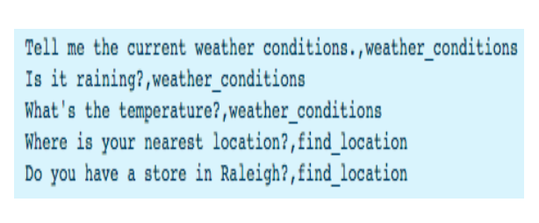

Slide 7
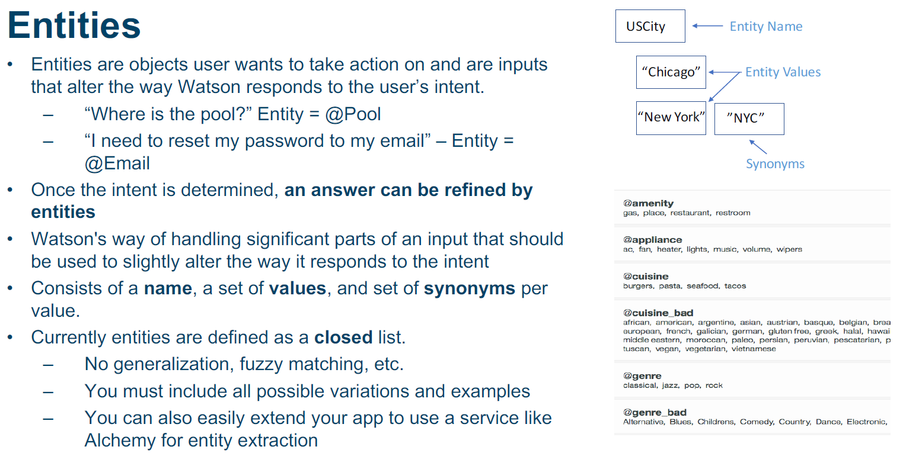

Slide 8
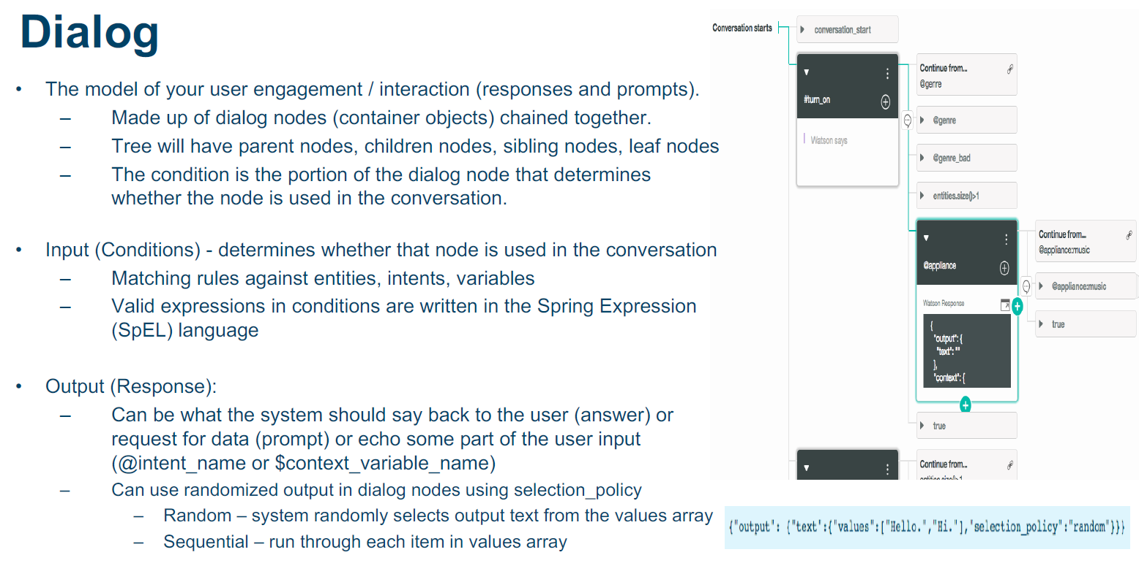

Slide 9
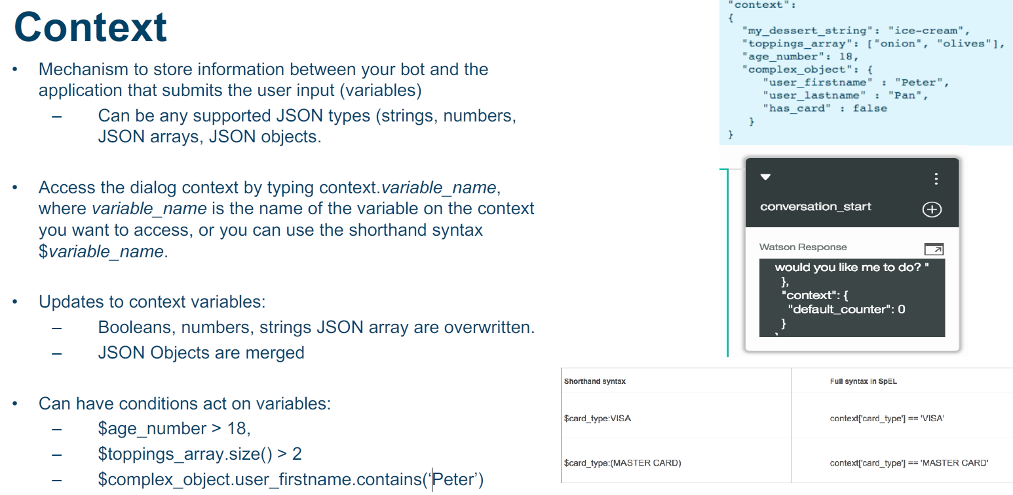

Slide 10
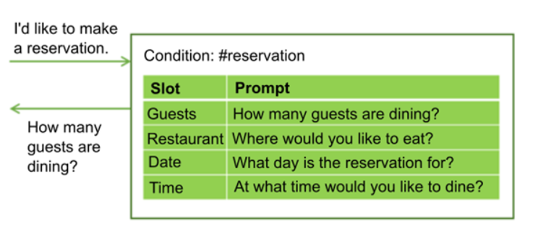
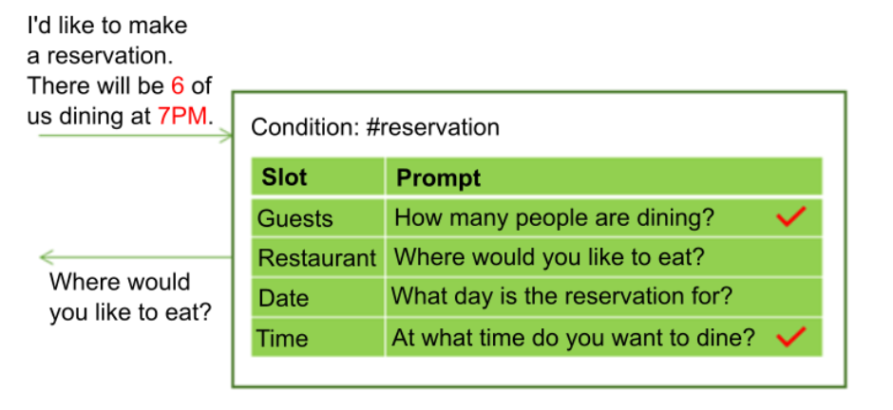
Slots
Add slots to a dialog node to gather multiple pieces of information from a user within that node.
Details the user provides upfront are saved, and the service asks only for the details they do not.
Why add slots?
Use slots to get the information you need before youthats can respond accurately to the user.
For example, if users ask about operating hours, but the hours differ by store location, you could ask a follow-up question about which store location they plan to visit before you answer.
You can then add response conditions that take the provided location information into account.

Slide 11
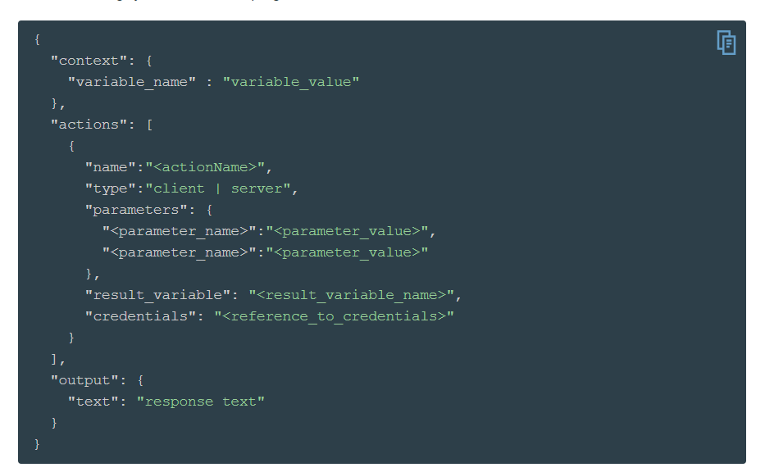
Actions
Define actions that can make programmatic calls to external applications or services and get back a result as part of the processing that occurs within a dialog turn.
Why use Actions?
You can use an external service to validate information that you collected from the user, or perform calculations or string manipulations on the input which are too complex to be handled by using supported SpEL expressions and methods
You can interact with an external web service to get information, such as an air traffic service to check on a flight's expected arrival time or a weather service to get a forecast.

Slide 12
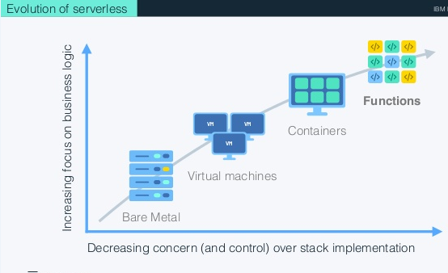
IBM Cloud Functions
Based on Apache OpenWhisk, IBM Cloud Functions is a polyglot functions-as-a-service (FaaS) programming platform for developing lightweight code that scalably executes on demand.
Features:
An open-ended ecosystem
Speed and simplify development
Leverage the benefits of cognitive services
Pay for what you actually use

Slide 13
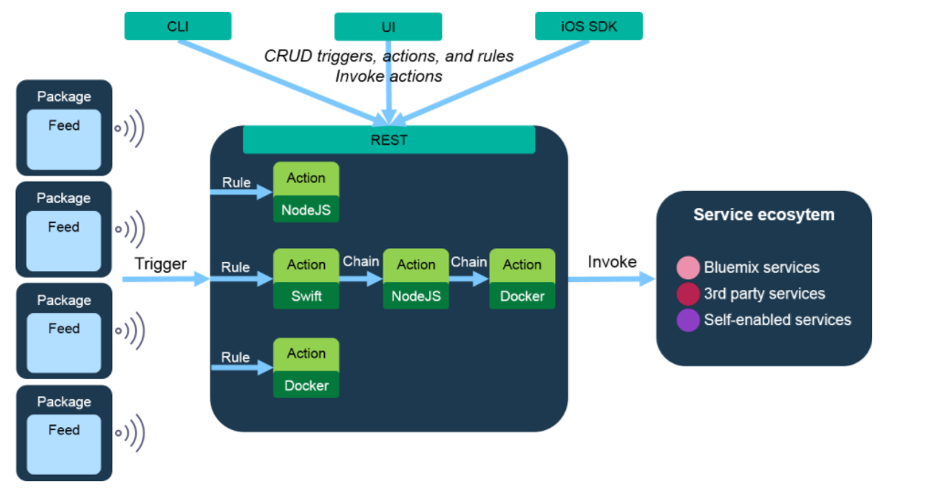
Action: A stateless, relatively short-running function invoked as an event handler
Sequence: A sequence is a chain of actions, invoked in order, where the output of one becomes the input to the next.
Triggers: Triggers represent the events (and their data) themselves without any concept of how they were generated.
Rules: A mapping from a Trigger to an Action which may contain simple conditional logic.

Slide 14






Watson Discovery Service
With Watson Discovery, go from data to insights rapidly and with less effort
- Automated data ingestion via your own data set, publicly available data sets, crawlers. - It can take in various document formats such as JSON, pdf, word, html etc & convert to standard format.
- Auto-applies enrichments, like concepts, relationships, sentiment and tone, then immediately view how your data will look. - Provides a simplified natural language interface for querying, in addition with filters & aggregation to discover patterns.
Documents/Data
Questions
“What are the top terms mentioned by customers in support interactions”
??
“How do I setup a new connection for a customer with a locked accounts”
“How many times was my campaign mentioned over the last 30 days”

Slide 15

Combine Watson Discovery with Watson Conversation for question distribution
Watson
Conversation
Here Watson uses reasoning strategies that focus on the language and context of the question.
Turn on my headlights.
My exhaust is making a rattling sound, how do I troubleshoot the problem?
Frequency of Questions
Watson
Discovery Service
Here Watson uses reasoning strategies that focus on identifying the most appropriate answer.
Short Tail
Long Tail
100s
100,000+
Unique Intents
Notes:
Use Watson Discovery Service as a ‘long-tail solution’ with Watson Conversation when you don’t need – or can’t -- model intents.
As a long-tail solution with Conversation, Discovery helps find intelligent answers to question that don’t have a trained response, returning a list of search results, allowing you to build offerings and apps that combine the power of Q&A with the power of unlocking hidden insights in your data.

Slide 16



https://developer.ibm.com/code/
Signup for IBM Cloud
https://bluemix.net
https://www.ibm.com/watson/products-services/

Slide 17






Stay Connected and continue coding !
Code & instructions
https://github.com/IBMDevConnect
https://github.com/IBM
https://github.com/IBM-Cloud
https://ibm-cloud.github.io/#!/
http://ibm.github.io
https://github.com/watson-developer-cloud
https://github.com/ibm-bluemix-mobile-services
Data Science Experience
https://datascience.ibm.com
Apply for IBM Global Entrepreneur Program
https://developer.ibm.com/startups
developerWorks
https://developer.ibm.com/in/
https://developer.ibm.com/tv/
Join our Meetup groups
Bangalore : https://www.meetup.com/IBMDevConnect-Bangalore
Delhi / Gurugram / Noida : https://www.meetup.com/ibmcloudecosystem/
Mumbai / Pune : https://www.meetup.com/Cloud-Mumbai-Meetup/
Hyderabad / Vishakapatnam: https://www.meetup.com/Hyderabad-Cognitive-with-Cloud
Join our Slack team and stay in touch with the experts
https://ibmdevconnect.slack.com
Send in your request http://ibm.biz/slackrequest

Slide 18


Feedback
https://ibm.biz/codedayfeedback

