Slide 1
IBM WATSON
Watson Developer Cloud

Slide 2
Agenda
IBM Watson – What it is?
IBM Watson Services
API Explorer Walkthrough
Consume an IBM Watson Service

Slide 3
IBM Watson – What it is?
An IBM supercomputer that combines artificial intelligence (AI) and sophisticated analytical software for optimal performance as a “question answering” machine.
“A cognitive technology that can think like an human”
System + Artificial Intelligence + Software
Question answering machine
Visual Recognition
Speech Recognition
Decision Making
Language Translation

Slide 4
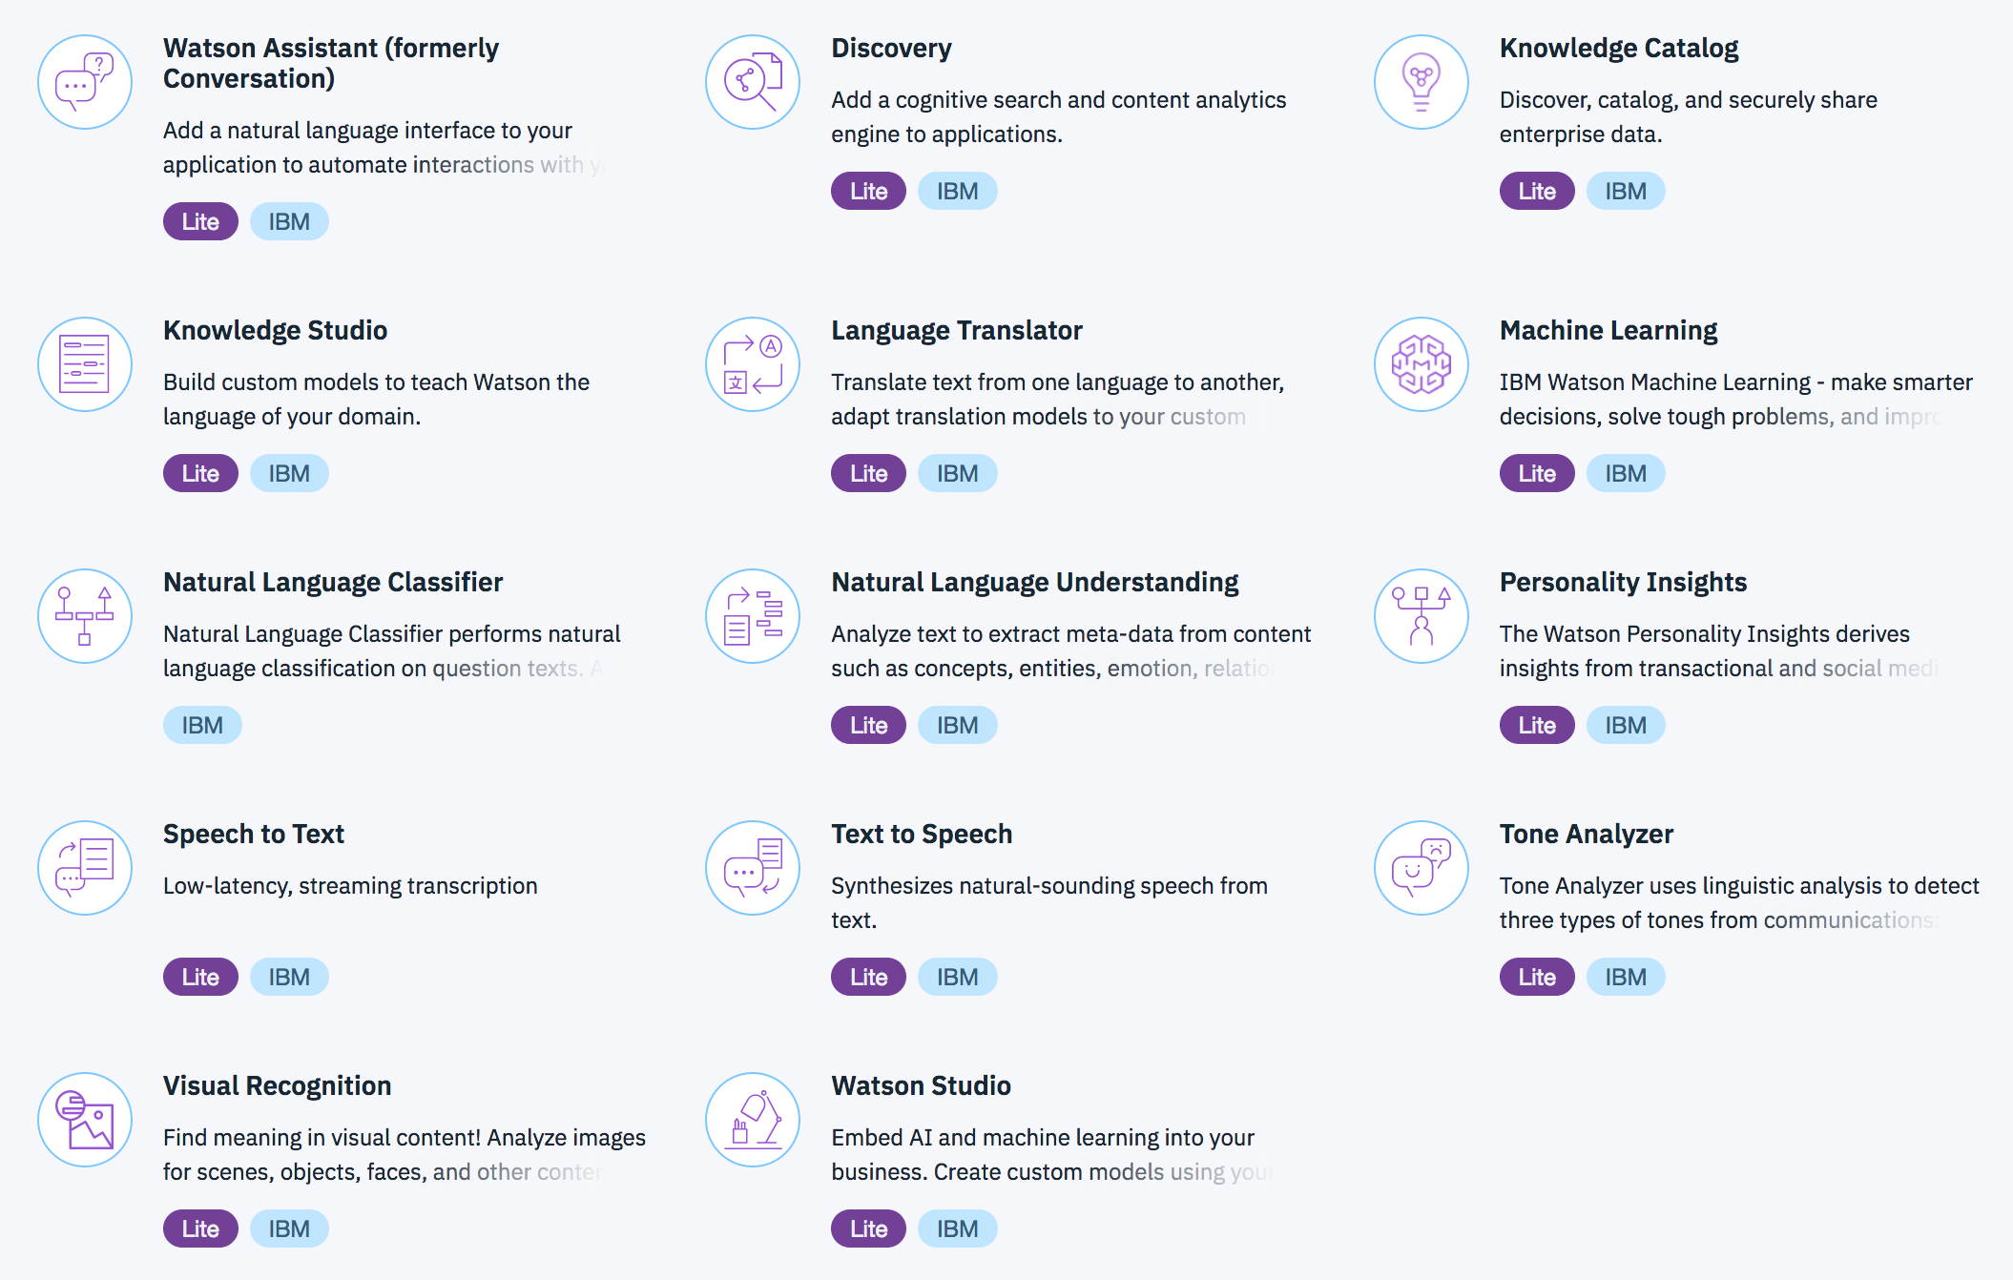
Watson Services

Slide 5
Consume aN IBM Watson service
Sign up/Login into IBM Bluemix
From the catalog, create an Watson service (say Visual Recognition Service )
Once created, you will be provided with an API key to access the Visual recognition API from your application.
Create a custom classifier, to train our visual recognition service to classify images that suits our application.
Try out the various classifier API calls.
Classify an image against our custom classifier.

Slide 6
Getting started
Install Watson
npm install watson-developer-cloud
Get a IBM Bluemix Account!
https://console.ng.bluemix.net/registration
Build a workspace
This is where you will create the input – output logic for your app
Connect to you app
Use the credentials

Slide 7
THANk YOU

