Slide 1
Serverless: What it is & What it is not
Avinash Chandra
Software Developer avinash.chandra@in.ibm.com

Slide 2
Why is it named as Serverless? Is there really no Server involved, then how the code get rendered to Web?

Slide 3

faas IBM Cloud Functions

Slide 4
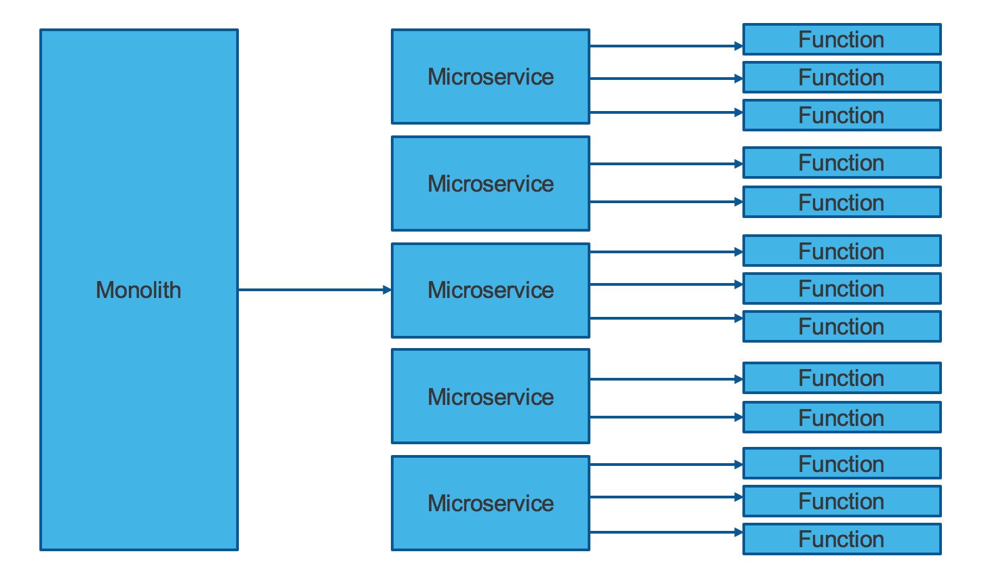

Slide 5
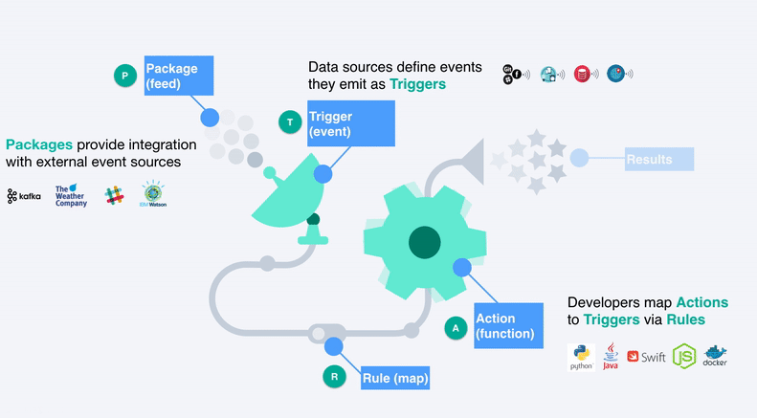
In a Nut-shell

Slide 6

When to use Serverless

Slide 7
Cost:
Pay as you go. It provides the flexibility to pay for the time, server is used. Your server will be only used when an action is triggered. So, you are paying for how much time and memory your application is using the server.
Operation:
Developers need not to spend extra time in provisioning or installing the Web application Server like Apache Tomcat or Websphere.

Slide 8
Scalability:
Since there is no dedicated server and it consumes memory as per the number of request, no extra skill/time is required for fine tuning, scaling the server.
Productivity:
With Function as a service, the units of code exposed are simple functions. Developers need not to worry about multithreading or directly handling HTTP requests in their code. It helps developers on fast and easy back-end software development.

Slide 9

When Serverless doesn't fit

Slide 10
Performance:
Methods shouldn't be written using serverless code if this method will not be used frequently.
This is because many cloud provider typically "spins down" the serverless code completely when it is not in use, it takes extra time to cache your data for first use, after long time.
Problem due to third party API System
Switching vendors in serverless architecture can be little tricky. While switching you would need
to update your tools, code, and design. Security needs to be handled in code due to absence of designated Web Server like IBM Websphere.

Slide 11
Architectural Complexity
It is needed to draw the architecture at unit level, which get more complex as we move granular into the solution. If you ignore granular level architecture diagram you are going away to serverless and near to monolith .
Implementation is a cumbersome task
SIT is tough task on serverless arch because it has a lot of unit level methods, integrating smaller units and testing is always tougher. Versioning, packaging of each individual unit is not easy. goes.

Slide 12

Let's try it out

Slide 13
Download and Install IBM Cloud CLI - https://console.bluemix.net/docs/cli/reference/bluemix_cli/download_cli.html Install IBM Cloud Functions plugin after installing IBM Cloud / Bluemix CLI - https://console.bluemix.net/openwhisk/learn/cli
Install Node.js - https://nodejs.org/en/download/
Install Angular CLI - https://cli.angular.io/
Install a Git command line or GUI client - https://git-scm.com/downloads/
Install Docker - https://docs.docker.com/install/
Install kubectl - https://kubernetes.io/docs/tasks/tools/install-kubectl/
*Install Java, SpringBoot, maven( if you want to modify code locally else you can take docker pull)
Prerequisite

Slide 14
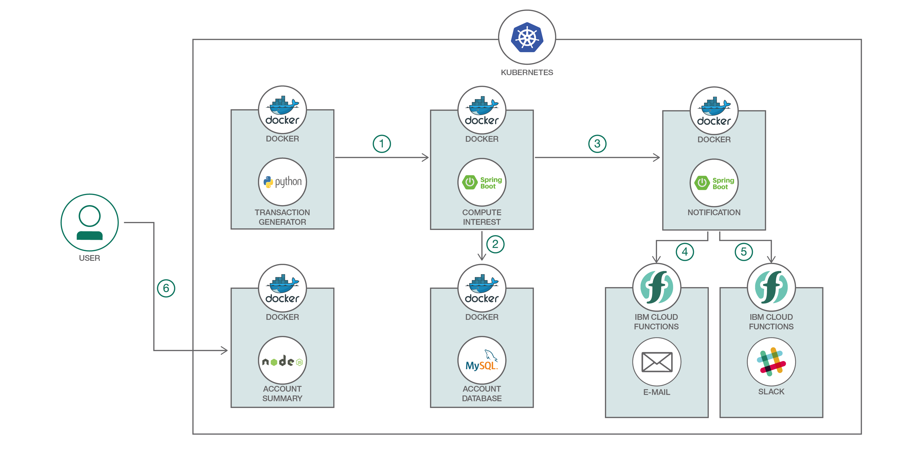
Workshop # Flow
https://developer.ibm.com/code/patterns/deploy-spring-boot-microservices-on-kubernetes

Slide 15


ibm.com
twitter.com/softwarecoder
github.com/softwarecoder
developer.ibm.com/code

Slide 16
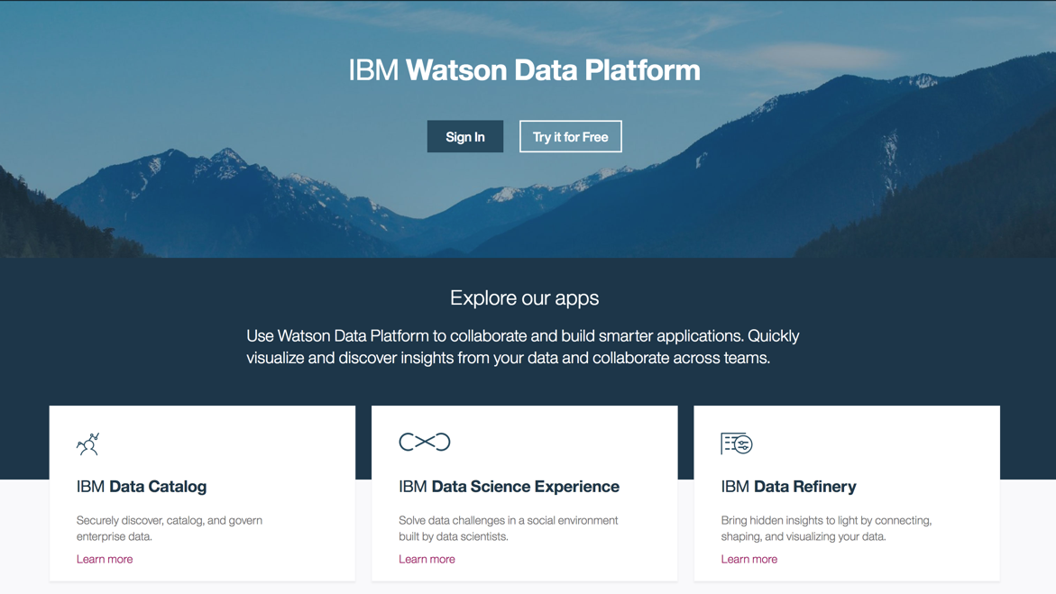

Slide 17



https://developer.ibm.com/code/
Signup for IBM Cloud
https://bluemix.net
https://www.ibm.com/watson/products-services/

Slide 18






Stay Connected and continue coding !
Code & instructions
https://github.com/IBMDevConnect
https://github.com/IBM
https://github.com/IBM-Cloud
https://ibm-cloud.github.io/#!/
http://ibm.github.io
https://github.com/watson-developer-cloud
https://github.com/ibm-bluemix-mobile-services
Apply for IBM Global Entrepreneur Program
https://developer.ibm.com/startups
Join our Meetup groups
Bangalore : https://www.meetup.com/IBMDevConnect-Bangalore
Delhi / Gurugram / Noida : https://www.meetup.com/ibmcloudecosystem/
Mumbai / Pune : https://www.meetup.com/Cloud-Mumbai-Meetup/
Hyderabad / Vishakapatnam: https://www.meetup.com/Hyderabad-Cognitive-with-Cloud
developerWorks
https://developer.ibm.com/in/
https://developer.ibm.com/tv/
Recipes
https://developer.ibm.com/recipes/
Join our Slack team and stay in touch with the experts
https://ibmdevconnect.slack.com
Send in your request http://ibm.biz/slackrequest

Slide 19
Thank you

