Slide 1
IBM Bluemix Runtime
Sudharshan Govindan
IBM Developer Advocate

Slide 2
What is Bluemix ?
IBM's innovative open-standards, cloud computing platform that combines PaaS with IaaS
Bluemix enables you to:
Deploy high performance compute and storage infrastructure
Test and adopt a broad range of cloud services and capabilities
Connect to all of your legacy systems and apps
Spin up and turn down resources in real time
Options to run your apps:
Boilerplates
Runtime
Container Service
Open Whisk

Slide 3
What is Runtime?
Runtimes are based on Bluemix Cloud Foundry—of which IBM is both a founding and platinum member
Runtimes get innovative ideas to market fast with reduced development costs
Runtimes support stateless processes and promote application fault tolerance and scalability
Runtimes link Bluemix services to applications as endpoints

Slide 4
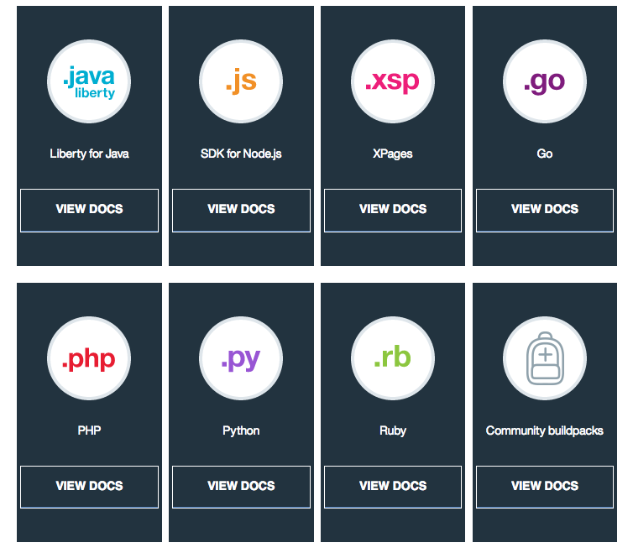
Runtime

Slide 5
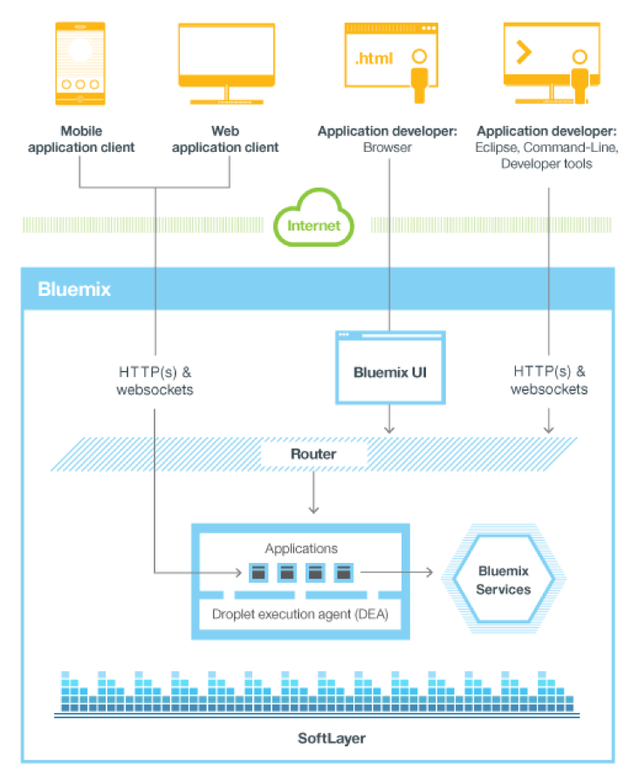
Cloud Foundry Architecture

Slide 6
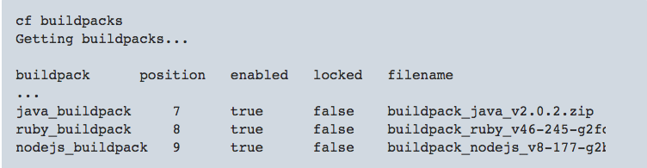
Buildpacks – Liberty for Java
Detection
WAR, EAR, Liberty server directory
Liberty packaged server, Java main, Distzip
Memory limits
Starter application
Community buildpacks
cf buildpacks

Slide 7
Buildpack defaults – Liberty for Java
Version
Stable release
Monthly release
Features
Set the JBP_CONFIG_LIBERTY environment variable explicitly
Deploy your application as a server directory or a packaged server
Java version

Slide 8
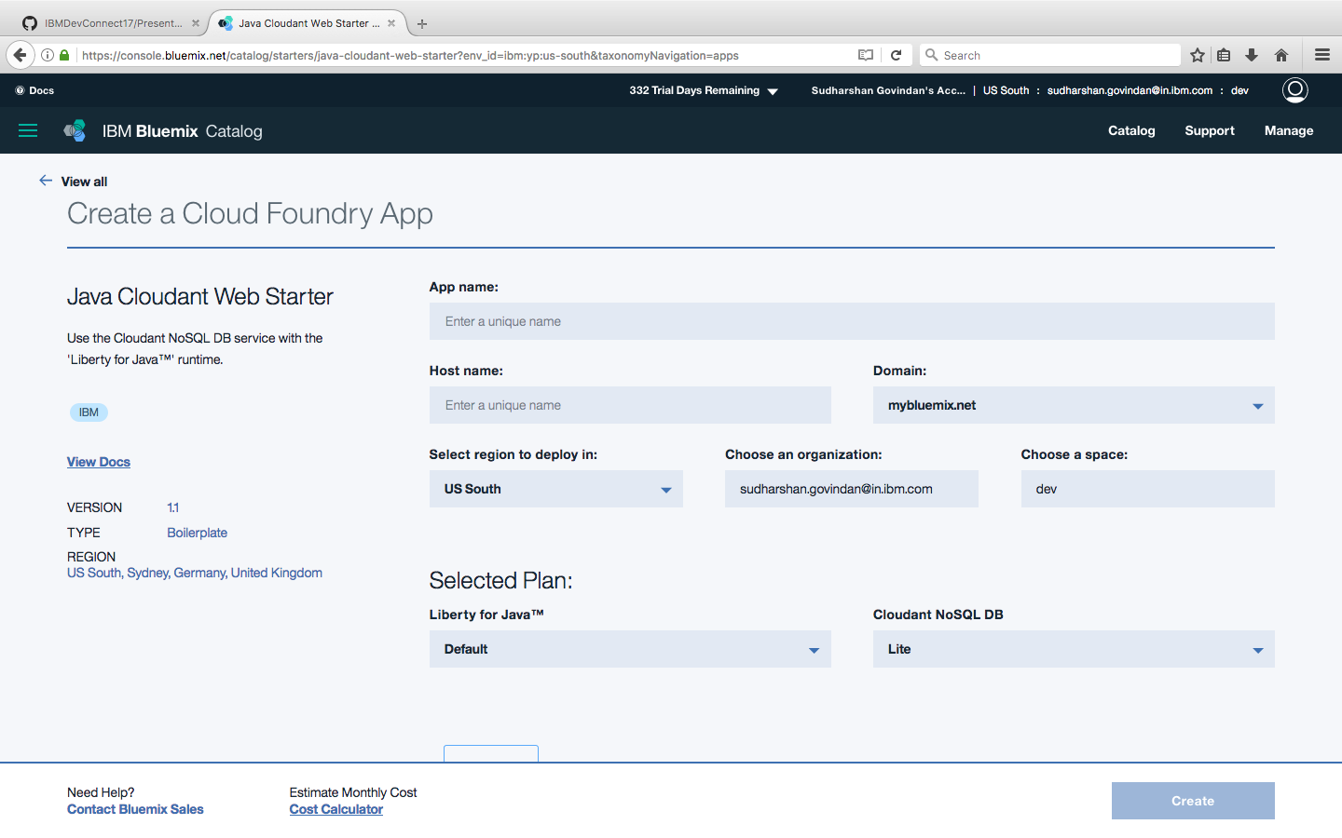
Demo

Slide 9
Troubleshooting for Runtime
Obsolete buildpack used when an app is pushed
How to fix it
Cloud Foundry Java buildpack
Cloud Foundry Node.js buildpack
Enable Node.js buildpack to download node modules from the internet every time
set NODE_MODULES_CACHE=false
NOTICE messages from the PHP buildpack
2015-01-26T15:00:59.70+0100 [App/0] ERR [26-Jan-2015 14:00:59] NOTICE: [pool www] 'user' directive is ignored when FPM is not running as root
How to fix it
Change stderr notice to stderr error in nginx-defaults.conf

Slide 10
Troubleshooting for Runtime
Can't import a third-party Python library into Bluemix
How to fix it
Requirements.txt
web.py==0.37
wsgiref==0.1.2
Procfile
web: python <yourappname>.py $PORT
Credentials are required to open a trace or dump window
Error occurs when trace or dump operations are running
Disk quota exceeded

Slide 11


Please give us your valuable feedback
http://ibm.biz/devconnect17

Slide 12


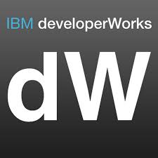

Stay Connected and continue coding !
Code & instructions
https://github.com/IBM/
https://github.com/IBM-Bluemix/
https://ibm-bluemix.github.io/#!/
https://developer.ibm.com/bluemix/
developerWorks India - https://developer.ibm.com/in/
Developer Journeys - https://developer.ibm.com/code/
Join our Slack team and stay in touch with the experts - https://ibmdevconnect.slack.com
Send in your request to - http://ibm.biz/slackrequest

Slide 13
THANK YOU

