Slide 1
WATSON DISCOVERY SERVICE
Actionable Insights for a better decision making
RIYA MARY ROY
DEVELOPER ADVOCATE
IBM

Slide 2
Do you…
Have large volumes of unstructured data with valuable insights locked away?
Need instant access to pre-enriched data sources?
Need a solution that matches your cloud based business strategy?
Need cognitive insights like sentiment analysis integrated to your company’s applications?
Want to free up your data analysts from tedious curation work?
Want to add deep insight answers to your chatbots?
…....Watson Discovery Service can help!

Slide 3
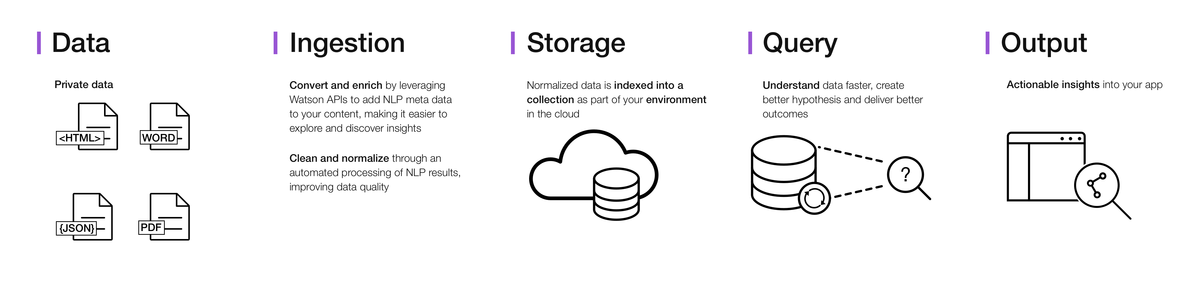
What is Discovery Service?
Discovery service makes it possible to rapidly build cognitive, cloud-based exploration applications that unlock actionable insights hidden in unstructured data.
This is the architecture of a complete Discovery service solution:

Slide 4
Value of Watson Discovery Service
Explore and discover insightful information hidden in unstructured data.
Data can come from public, third party or your own proprietary sources.
WDS is a cloud service available on IBM Bluemix.
Leverage Watson SDKs, web-based tooling and the WDS APIs to bring cognitive insights to your custom applications.
Let WDS crawl, convert, enrich and normalize data- spend your time exploring.
Can be used to address many different use cases from customer insights to question and answer scenarios.

Slide 5
Potential uses
Help customer service team decrease support times, find hidden insights on customer pain points, behavior and needs, and improve agent productivity
Enable research teams to extract the latest studies and insights from journals, newsletters, press release and blogs to provide consolidated industry and domain specific insights
Empower field service teams to locate hard to find answers in manuals, FAQ docs, collaborate sites and more.
Augment a chat bot or other application created with Watson Conversation service to provide possible responses to complex questions without modelling intents.

Slide 6
Terminologies
Environment — The environment defines the amount of storage space that you have for content in the Discovery service. A maximum of one environment can be created for each instance of the Discovery service.
Collection — A collection is a grouping of your content within the environment. You must create at least one collection to be able to upload your content.
The default configuration
The Discovery service includes a standard configuration file that will convert, enrich and normalize your data without requiring you to manually configure these options. It contains enrichments, plus standard document conversions based on font styles and sizes.
Custom Configuration:
Getting the right information out of your content and returning it to your users is the goal of the Discovery service.

Slide 7
Data
Data can be in many standard formats
HTML
Word DOC and DOCX
JSON
PDF
Data can come from different sources
Your private data
Internet sources
3rd party sources

Slide 8
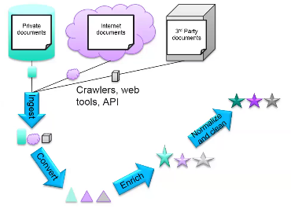
Ingestion, Conversion, Enrichment
Documents can come from your private storage, the internet, or obtained from 3rd party sources.
Crawlers
API
Tooling
Ingested documents are converted and enriched to add NLP meta data, making it easier to explore and discover insights.
NLP results are cleaned and normalized through automated processing to improve data quality.

Slide 9
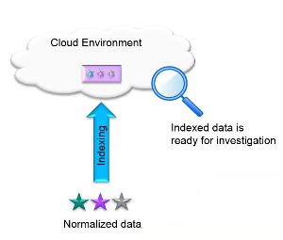
Storage
Normalized data is indexed into a collection as part of your environment in the cloud.
Once the indices are built, the data is ready to be queried and explored using either Discovery Query Language or Natural Language queries.

Slide 10
Add enrichments
By default, the text field of ingested documents is enriched with semantic information
You can add enrichments to other fields through a custom configuration
There are six types of default enrichment. Emotion Analysis is not default
KEYWORD EXTRACTION
CONCEPT TAGGING
ENTITY EXTRACTION
TAXONOMY CLASSIFICATION
SENTIMENT ANALYSIS
RELATION EXTRACTION
EMOTION ANALYSIS

Slide 11
Entity extraction- Returns items such as persons, places, and organizations that are present in the input text.
Keyword extraction- Important topics in your content that are typically used when indexing data, generating tag clouds, or when searching.
Taxonomy classification- Categorizes input text, HTML or web-based content into a hierarchical taxonomy up to five levels deep.
Concept tagging- Identifies concepts with which the input text is associated, based on other concepts and entities that are present in that text. Concept tagging understands how concepts relate, and can identify concepts that are not directly referenced in the text.
Relation extraction- Identifies subject, action, and object relations within sentences in the input content.
Sentiment analysis- Identifies attitude, opinions, or feelings in the content that is being analyzed.
Emotion analysis- Detects anger, disgust, fear, joy, and sadness implied in English text.

Slide 12
Passage Retrieval
Passages are short, relevant excerpts extracted from the full documents returned by your query.
These targeted passages are extracted from the text fields of the documents in your collection.
A maximum of three passages of no more than 2,000 characters each will be returned per relevant document, and no more than 10 passages total will be returned (the number of passages returned cannot be changed).
The passages parameter is only available for private collections; it is not available in the Watson Discovery News collection.

Slide 13
DEMO

Slide 14


Please give us your valuable feedback
http://ibm.biz/devconnect17

Slide 15




Stay Connected and continue coding !
Code & instructions available here https://github.com/IBMDevConnect17/
Join our Meetup groups
Mumbai : https://www.meetup.com/Cloud-Mumbai-Meetup/
Hyderabad: https://www.meetup.com/Hyderabad-Cognitive-with-Cloud
Bangalore : https://www.meetup.com/IBMDevConnect-Bangalore
Join developerWorks India Community
https://developer.ibm.com/in/
Check out the cool developer journeys
https://developer.ibm.com/code/
Join our Slack team and stay in touch with the experts
https://ibmdevconnect.slack.com
Send in your request to - http://ibm.biz/slackrequest

Slide 16
THANK YOU

