Slide 1
A Shallow Dive into Deep Learning –
No Maths , No Formulae !!
Himanshu Shivhare
Artificial Intelligence/Machine Learning Expert
IBM India

Slide 2
Traditional Programming
Machine Learning
Data
Computer
Output
Program
Data
Computer
Program
Output

Slide 3
ML in a Nutshell
Tens of thousands of machine learning algorithms
Hundreds new every year
Every machine learning algorithm has three components:
Representation
Evaluation
Optimization

Slide 4
Representation
Decision trees
Sets of rules / Logic programs
Instances
Graphical models (Bayes/Markov nets)
Neural networks
Support vector machines
Model ensembles
Etc.

Slide 5
Evaluation
Accuracy
Precision and recall
Squared error
Likelihood
Posterior probability
Cost / Utility
Margin
Entropy
K-L divergence
Etc.

Slide 6
Optimization
Combinatorial optimization
E.g.: Greedy search
Convex optimization
E.g.: Gradient descent
Constrained optimization
E.g.: Linear programming

Slide 7
Types of Learning
Supervised (inductive) learning
Training data includes desired outputs
Unsupervised learning
Training data does not include desired outputs
Semi-supervised learning
Training data includes a few desired outputs
Reinforcement learning
Rewards from sequence of actions

Slide 8
Supervised Machine Learning
Parameters
(things we're learning)
w
Input feature vector
x
Sigmoid or other nonlinearity
σ
ŷ
Predicted
value

Slide 9
Supervised Machine Learning
w
x
Update parameters
σ
How wrong were we?
cost( , )
ŷ
y
Actual
value

Slide 10
A Simplified Diagram
x
w
σ
y

Slide 11
What Is the Feature Vector x?
Features are the important aspects of input data, represented as numbers that can be used to train a mathematical function
In image processing, features can be pixel values
In NLP, typically a vector representation of a single character or word
Often reflects the context in which that word is found
Notes:
Strictly speaking, learning word embeddings isn’t necessarily deep learning
But deep learning for NLP uses these … as do many non-deep techniques (e.g., HW3)

Slide 12
An example of one-layer feed-forward neural network
b
x₁
w₁
w₂
x₂
y
Activation function
‘+’ or ‘-’
w₃
w_{n}
Bias ‘b’ or ‘bias’ is an external parameter that can be modeled by adding an extra input
x_{n}

Slide 13
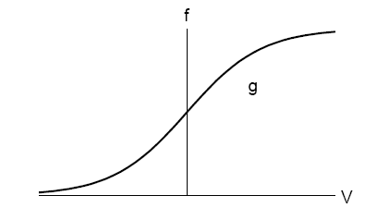
Activation function
Linear-Threshold function:
f
V
Sigmoid function:
g
Sigmoid function

Slide 14
An example of 3-layer feed-forward network
x₁
x₂
y₁
y₂
y_{m}
x_{n}
Input Layer
Hidden layers
Output Layer

Slide 15
What is Deep Learning
Deep learning is a class of machine learning algorithms that^{[1]}:
Use a cascade of many layers of nonlinear processing.
Are part of the broader machine learning field of learning representations of data facilitating end-to-end optimization
Learn multiple levels of representations that correspond to hierarchies of concept abstraction
Simply: it’s a MLP with many hidden layers

Slide 16
Why deep learning?
Deep learning is kind of hard. Why bother with it?
Amazing results… in speech, NLP, vision/multimodal work
Does its own feature selection!
The big players (Google, Facebook, Baidu, Microsoft, IBM…) are doing a lot of this
The hot new thing?
Actually, many of the architectures that we’ll talk about were invented in the 1980s and 1990s
What’s new is hardware that can use these architectures at scale.
Notes:
Jordan, M.I. (1986). Serial order: A parallel distributed processing approach.
LSTM (1997)
Predecessor to CNNs first introduced in 1980, developed in 1988, improved in 1998.

Slide 17

Recurrent Neural Networks (RNNs)
$h_{t}=$ $σ(W_{h}h_{t−1}+W_{x}x_{t})$
h₀
w_{h}
h₁
σ
w_{x}
x₁
Notes:
X is an input, h is our hidden layer, Ws are our weights, sigma is a nonlinearity – typically a sigmoid or tanh function.

Slide 18

RNN
y₁
$h_{t}=$ $σ\left(W_{h}h_{t−1}+W_{x}x_{t}\right)$
$$y_{t}=softmax(W_{y}h_{t})$$
softmax
w_{y}
h₀
w_{h}
h₁
σ
w_{x}
x₁
Notes:
As much as we love hidden layers, we probably want some actual output, so we can apply another set of weights and a softmax to h_t to give us our predicted probabilities for y_t

Slide 19
RNN
y₃
softmax
w_{y}
h₀
w_{h}
h₁
w_{h}
h₂
w_{h}
h₃
σ
σ
σ
w_{x}
w_{x}
w_{x}
x₁
x₂
x₃
The
cat
sat
Notes:
Reason to use RNNs is you have a sequence, such as a sentence.

Slide 20
Updating Parameters of an RNN
y₃
Cost
softmax
w_{y}
h₀
w_{h}
h₁
w_{h}
h₂
w_{h}
h₃
σ
σ
σ
w_{x}
w_{x}
w_{x}
x₁
x₂
x₃
The
cat
sat
Notes:
RNNs are supervised, so once you have your predictions y, you compare them to your correct label for the sequence. For a classification problem, you use something like categorical cross entropy, and you get a cost. You then take the gradient of the cost w.r.t. the parameters to figure out how to update your parameters.

Slide 21
Application Examples
Machine Translation (Sequence-to-sequence learning (Sutskever, Vinyals, and Le, 2014)
RNN for slot filling task
Character-level RNNs for text generation
Semantic Role Labeling http://www.aclweb.org/anthology/P15-1109
Dependency parsing: http://www.aclweb.org/anthology/K/K15/K15-1015.pdf (“producing state-of-art dependency parsing results while requiring minimal feature engineering”)

Slide 22
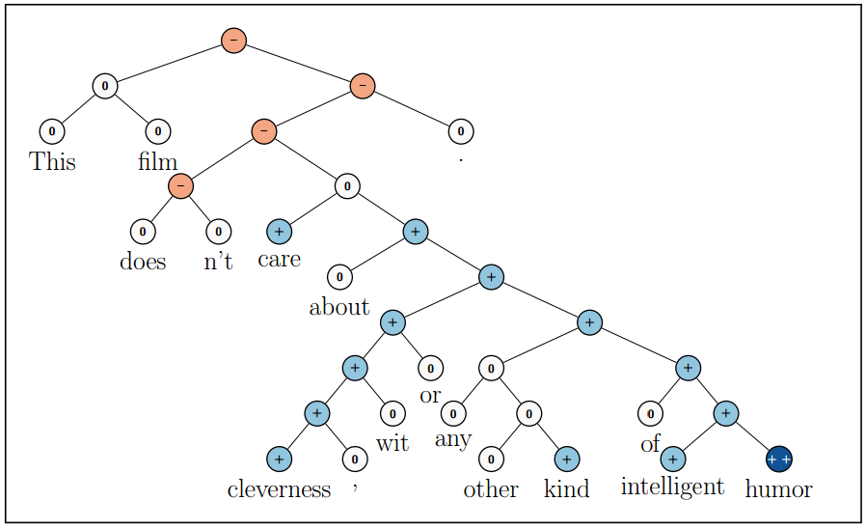
Recursive Neural Networks Example: Sentiment Analysis
Socher et al. (2013)
Recursive Deep Models for Semantic Compositionality Over a Sentiment Treebank

Slide 23
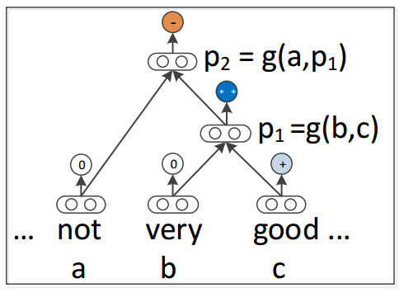
Recursive Neural Networks
Socher et al. (2013)
Recursive Deep Models for Semantic Compositionality Over a Sentiment Treebank

Slide 24
LSTM Motivation
Remember how we update an RNN?
y₃
Cost
softmax
w_{y}
h₀
w_{h}
h₁
w_{h}
h₂
w_{h}
h₃
σ
σ
σ
w_{x}
w_{x}
w_{x}
x₁
x₂
x₃
The
cat
sat
Notes:
RNNs are supervised, so once you have your predictions y, you compare them to your correct label for the sequence. For a classification problem, you use something like categorical cross entropy, and you get a cost. You then take the gradient of the cost w.r.t. the parameters to figure out how to update your parameters.

Slide 25
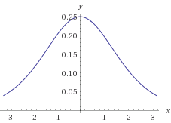
The Vanishing Gradient Problem
Deep neural networks use backpropagation.
Back propagation uses the chain rule.
The chain rule multiplies derivatives.
Often these derivatives between 0 and 1.
As the chain gets longer, products get smaller
until they disappear.
Wolfram|Alpha
Derivative of sigmoid function

Slide 26
Or do they explode?
With gradients larger than 1,
you encounter the opposite problem
with products becoming larger and larger
as the chain becomes longer and longer,
causing overlarge updates to parameters.
This is the exploding gradient problem.

Slide 27

Vanishing/Exploding Gradients Are Bad.
If we cannot backpropagate very far through the network, the network cannot learn long-term dependencies.
My dog [chase/chases] squirrels.
vs.
My dog, whom I adopted in 2009, [chase/chases] squirrels.

Slide 28
LSTM Solution
Use memory cell to store information at each time step.
Use “gates” to control the flow of information through the network.
Input gate: protect the current step from irrelevant inputs
Output gate: prevent the current step from passing irrelevant outputs to later steps
Forget gate: limit information passed from one cell to the next

Slide 29
Transforming RNN to LSTM
c₀
c₁
f₁
$$h_{t}=o_{t}⊙\tanh{c_{t}}$$
+
tanh
h₀
w_{h}
u₁
h₁
σ
i₁
o₁
w_{x}
x₁
Notes:
Finally, we apply a non-linearity to our memory cell, c1, and pass that through the output gate to give us h1

Slide 30
LSTM for Sequences
c₀
c₁
c₂
f₂
c₂
f₁
+
f₂
+
+
tanh
tanh
tanh
h₀
w_{h}
u₁
h₁
w_{h}
u₂
h₂
w_{h}
u₂
h₂
σ
i₁
o₁
σ
i₂
o₂
σ
i₂
o₂
w_{x}
w_{x}
w_{x}
x₁
x₂
x₂
The
cat
sat
Notes:
Now, we can line these up like we did with the regular RNN and start processing sequences

Slide 31

LSTM Applications
http://www.cs.toronto.edu/~graves/handwriting.html
Language identification (Gonzalez-Dominguez et al., 2014)
Paraphrase detection (Cheng & Kartsaklis, 2015)
Speech recognition (Graves, Abdel-Rahman, & Hinton, 2013)
Handwriting recognition (Graves & Schmidhuber, 2009)
Music composition (Eck & Schmidhuber, 2002) and lyric generation (Potash, Romanov, & Rumshisky, 2015)
Robot control (Mayer et al., 2008)
Natural language generation (Wen et al. 2015) (best paper at EMNLP)
Named entity recognition (Hammerton, 2003)
… and many more

Slide 32
Basic Idea of CNNs
Hidden layer
Input
Notes:
Suppose we have a picture coming into the cat’s

Slide 33
Basic Idea of CNNs
Hidden layer
Input

Slide 34
Basic Idea of CNNs
Hidden layer
Input

Slide 35
Basic Idea of CNNs
Hidden layer
Input
Notes:
And of course, we like deep networks, so let’s add another layer where we pool this hidden layer into one neuron.
The set of weights that’s learned for the window becomes a filter. A filter looks for the same feature in each sub-region of the input. So, for example, if diagonal lines turn out to be an important feature, your hidden layer will become a map of where the diagonal lines were in the input.

Slide 36
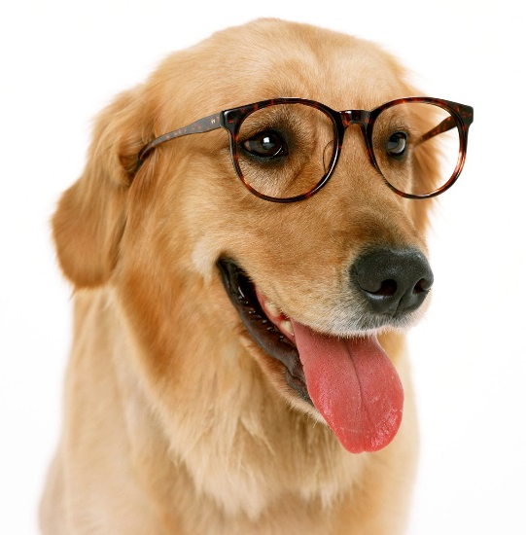
CNN for Image Classification
Convolutional Layer

Slide 37
CNN for Image Classification
Convolutional Layer
Notes:
You slide the window over the image, and you apply the same weights at each spot, and you come up with a feature map that shows you where the feature these weights are good at detecting shows up in the image. But probably you want more than one feature.

Slide 38
CNN for Image Classification
Convolutional Layer
Notes:
So you slide another set of weights, and the idea is that those will learn a filter for another feature. So right now we’re just learning low level features, and maybe blue learned to recognize diagonal lines, and orange learns horizontal.

Slide 39
CNN for Image Classification
Convolutional Layer
Notes:
And you keep doing that until you get feature maps for a bunch of features. Now you want to do something to combine them,

Slide 40
CNN for Image Classification
Convolutional Layer
Notes:
And you keep doing that until you get feature maps for a bunch of features. Now you want to do something to combine them,

Slide 42
CNN for Image Classification
Max Pooling
Notes:
Now you have this pile of matrices, each of which is a feature map. The next step is called max pooling. You look at some number of adjacent squares in your matrix, keep the one with the highest value, and throw away the rest.
This has a few benefits. One is that it makes the model more robust to minor shifts in the image. Another is that it can allow us to deal with inputs of varying sizes. And another is that we’ve got a lot of squares that don’t really tell us anything important.

Slide 43
CNN for Image Classification
Max Pooling
Notes:
Max pooling pools several squares and takes their max to represent the whole pool.

Slide 44
CNN for Image Classification
Max Pooling

Slide 45
CNN for Image Classification
Max Pooling
Notes:
We apply max pooling to all the layers, and now we have a smaller matrix with the most important information from each matrix in the convolutional step.

Slide 46
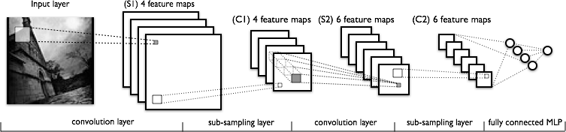
CNN for Image Classification
http://deeplearning.net/tutorial/lenet.html
Notes:
If you alternate those layers -- the convolution layer and a max pooling layer – you can build a LeNet, the type of CNN designed by Yann LeCunn.
MLP = Multi-layer perceptron: fully connected input layer, hidden layer, and output.

Slide 47
CNN for Image Classification
How good are CNNs?
“We also entered a variant of this model in the ILSVRC-2012 competition and achieved a winning top-5 test error rate of 15.3%, compared to 26.2% achieved by the second-best entry.”
Krizhevsky et al., 2012: ImageNet Classification with Deep Convolutional Neural Networks
Competition to classify photos from ImageNet, http://www.image-net.org/

Slide 48
Tools for Deep Learning
Theano (Python): http://deeplearning.net/software/theano/
Lasagne: Built on top of Theano, has pre-designed networks: https://github.com/Lasagne/Lasagne
Torch (Lua): http://torch.ch/
TensorFlow (Python and C++): https://www.tensorflow.org/

Slide 49
Is everything else we’ve learned moot?
Given how magical deep learning is, why do anything else?
Deep learning requires a lot of data… seriously, a lot. Sometimes we don’t have enough data.
Deep learning requires a lot of computing power.
Benefits of combining power of deep learning with linguistic knowledge
Notes:
To quantify “a lot,” it’s not uncommon to see a paper pretrain on 100,000 or 300,000 sentences before they train for the real task. The exact amount of data is going to vary by architecture and by the quality of the data for the task.
Similarly, how much computing power we need will vary by application. I ran an experiment a week ago to test a tree LSTM. Because I was just testing it out, I only had it run 5 epochs. It used 24 core server and ran for 24 hours. You can get better speed using expensive hardware.

Slide 50
IBM Watson Platform
Brings the power of the best deep learning techniques to the users, hiding away deep complexities of the underlying algorithm
Provides simple, straightforward and easy to use interface for every application
Allows the user to concentrate on data generation and collection
Provides easy setup and multiple infrastructure options to get the user up and running as quickly as possible

Slide 51
Some Questions??
Cocktail party problem: Identifying speech from background noise at a cock tail party.
Identifying objects in an image
Identifying whether two text fragments have the same meaning or not.
Automatic script generation

Slide 52
Reading Materials
“Neural Networks and Deep Learning”
written by Michael Nielsen
http://neuralnetworksanddeeplearning.com/
“Deep Learning” (not finished yet)
Written by Yoshua Bengio, Ian J. Goodfellow and Aaron Courville
http://www.iro.umontreal.ca/~bengioy/dlbook/

Slide 53

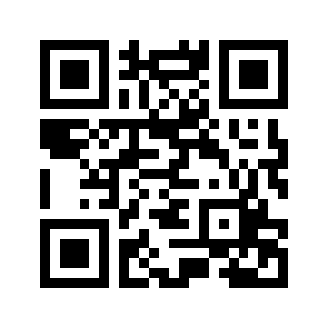
Please give us your valuable feedback
http://ibm.biz/devconnect17

Slide 54




Stay Connected and continue coding !
Code & instructions available here https://github.com/IBMDevConnect17/
Join our Meetup groups
Mumbai : https://www.meetup.com/Cloud-Mumbai-Meetup/
Hyderabad: https://www.meetup.com/Hyderabad-Cognitive-with-Cloud
Bangalore : https://www.meetup.com/IBMDevConnect-Bangalore
Join developerWorks India Community
https://developer.ibm.com/in/
Check out the cool developer journeys
https://developer.ibm.com/code/
Join our Slack team and stay in touch with the experts
https://ibmdevconnect.slack.com
Send in your request to - http://ibm.biz/slackrequest

