Slide 1
Hands on Session
Using IBM DSX
Krishna Chaitanya B
Watson and Cloud Developer
Digital Business Group, IBM

Slide 2
Takeaways
Quick tour of IBM DSX
Introduction to Classification And Regression
Classification using IRIS Dataset
Hand Written Number recognition using MNIST Data
Accessing File storage in DSX
Predicting Real estate prices / TV Viewership using Regression
Peek at an Amazing Alpha feature

Slide 3
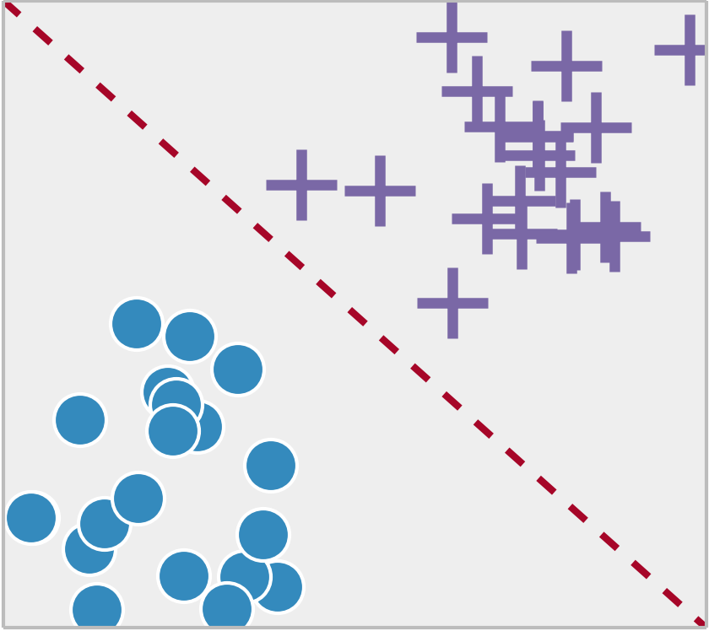
Classification: Given a known relationship, identify the class that the data belongs.

Slide 4
Applications of Classification
Spam Filtering
Detecting Cancer
OCR (Optical Character Recognition)
Email Sorting
Recommender Systems

Slide 5
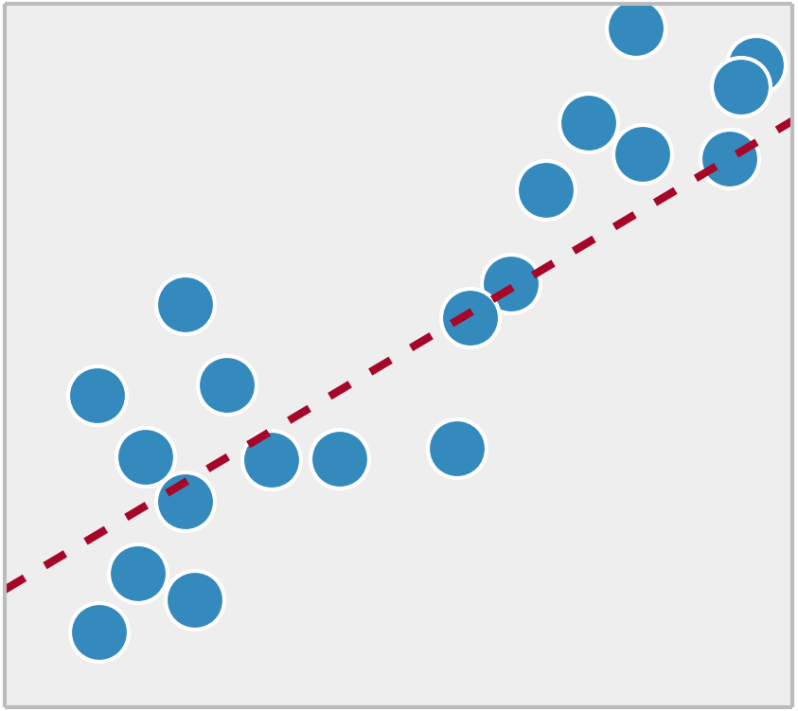
Regression: Given a set of data, find the best relationship that represent the set of data.

Slide 6
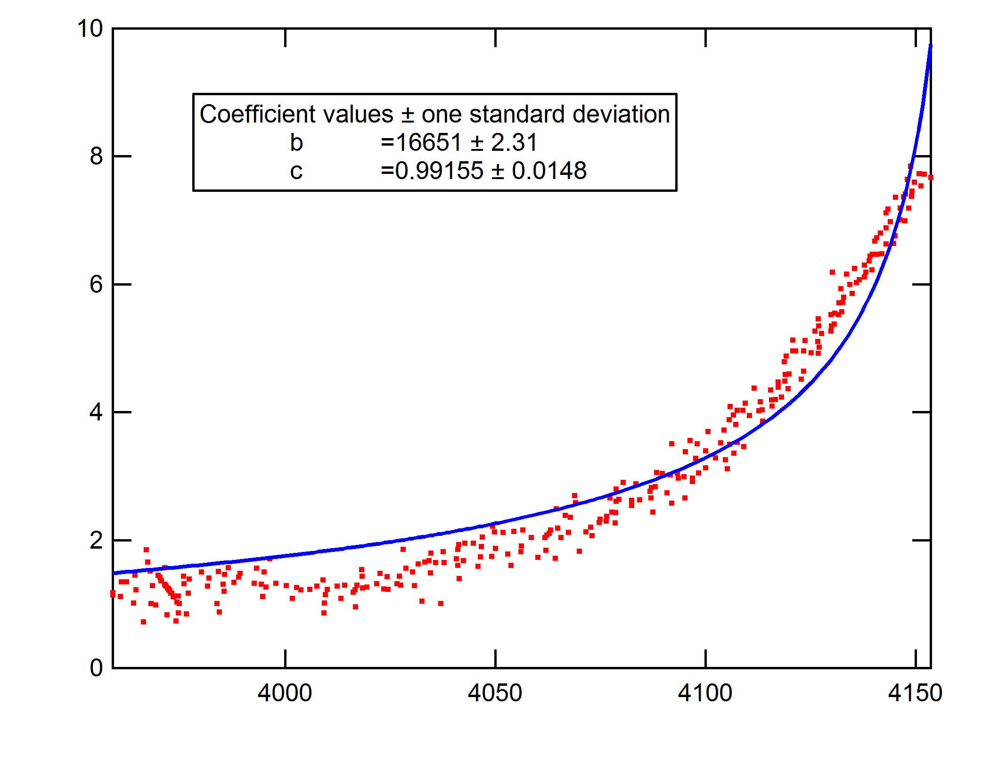
Curve Fitting

Slide 7
Applications of Regression
Predicting Stock Prices
Estimating Real Estate price boom
Optimizing machine running times in factories
Predicting Weather
User Preference learning

Slide 8
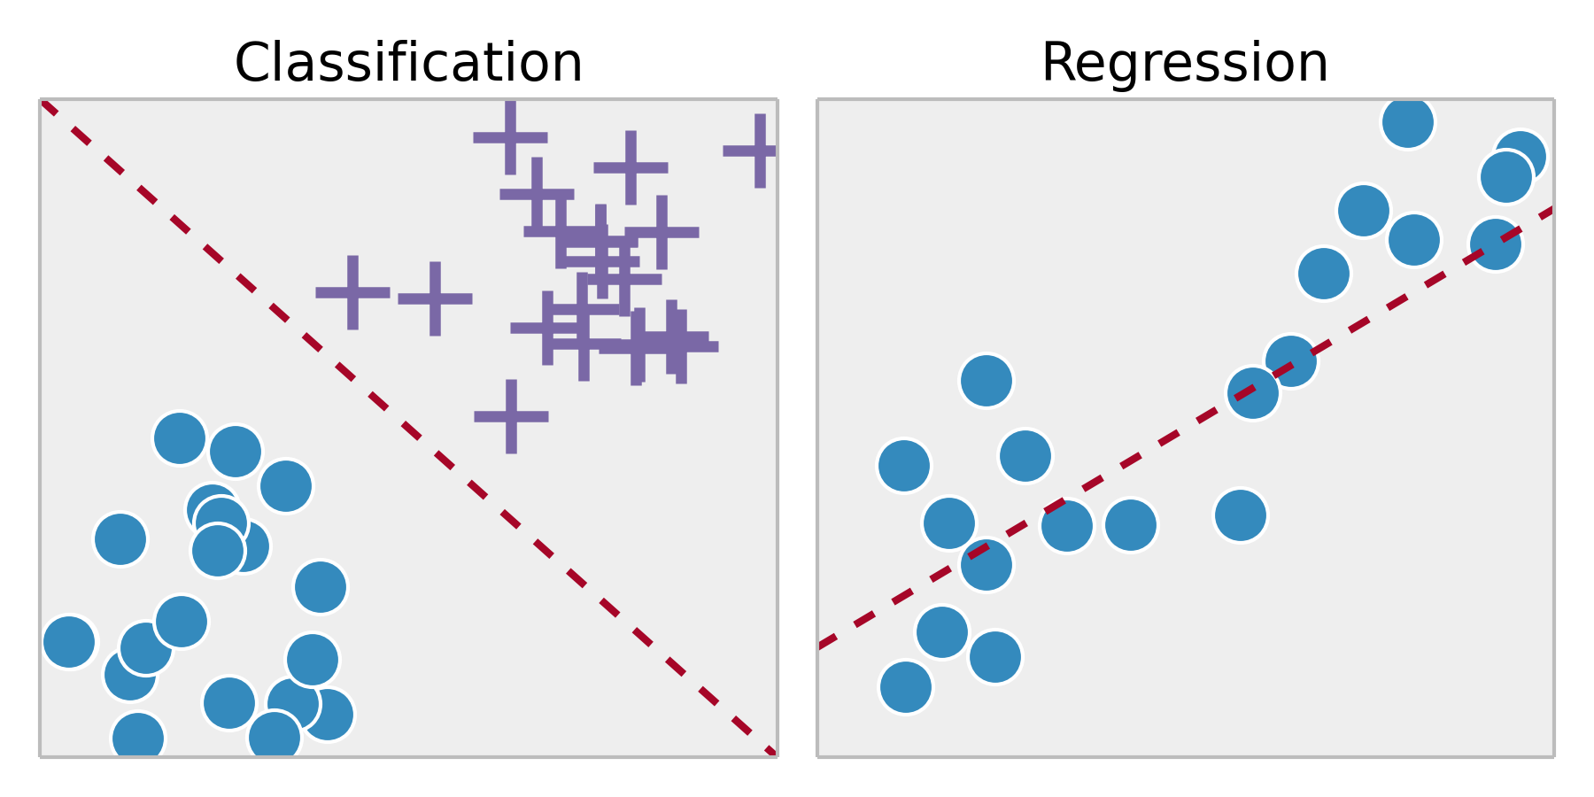
Classification: The output variable takes class labels. Regression: The output variable takes continuous values.
In summary

Slide 9
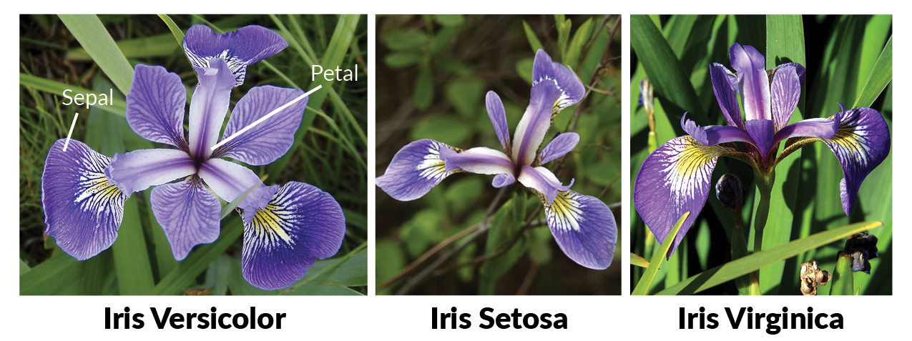
IRIS Classifier

Slide 10
IRIS Dataset
This data sets consists of 3 different types of irises’ ( Setosa, Versicolour and Virginica ) petal and sepal length, stored in a 150x4 Table
The rows being the samples and the columns being: Sepal Length, Sepal Width, Petal Length and Petal Width

Slide 11
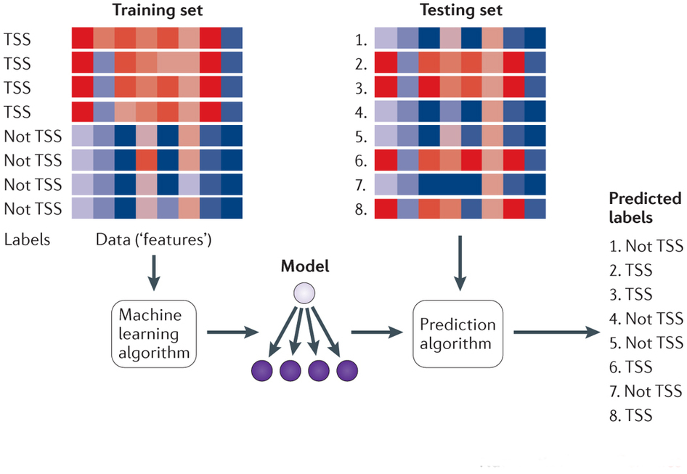
Dataset segregation

Slide 12
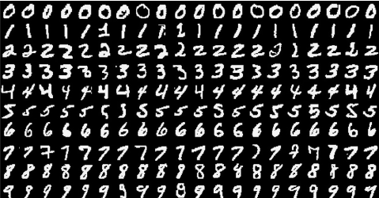
MNIST
MNIST (Modified National Institute of Standards and Technology) database contains handwritten digits sorted into a training set of 60,000 examples, and a test set of 10,000 examples

Slide 13
Regression Hands On

Slide 14
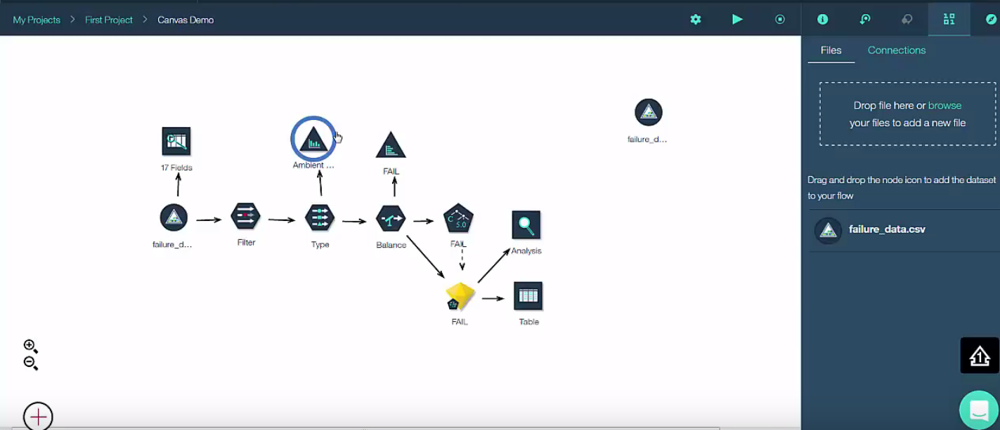
Visual Flows

Slide 15
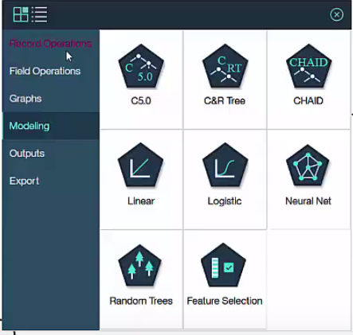
Visual Flows

Slide 16
Thank You!
Krishna Chaitanya B
Watson and Cloud Developer
Digital Business Group, IBM

