Slide 1
Delving Deeper into Data with Machine Learning
Data Science Track
Gaurav Goswami
Data Scientist
IBM

Slide 2
Different Modes of Machine Learning
Supervised:
Ground truth is available for each data point
Map input (features) to output (labels)
Examples: find the sentiment of a new tweet given a database of labeled tweets
Unsupervised:
No ground truth is available
Map data points to groups (or clusters) in the data
Examples: categorize people into different spending capability groups based on financial data
Reinforcement:
Behavior inspired: Action and consequence (reward)
No “correct” input-output pairs
Focus is on the overall ‘reward’
Examples: robot control

Slide 3
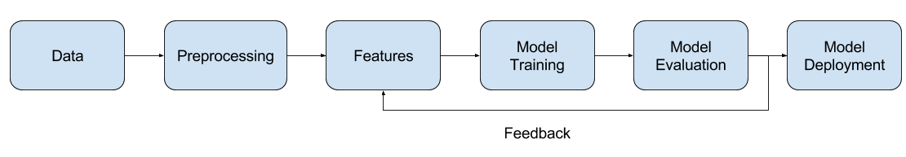
Machine Learning Pipeline

Slide 4
Preprocessing
Adapt and coalesce the data to a compatible format
Cleaning the data
Splitting the data into training/validation/testing sets

Slide 5
Features
Extract representations that capture the “essence” of data
For classification: Maximize the intra-class similarity and inter-class distance
For regression: Maximize the explanation power
Multiple methods
No clear “right” or “wrong” answers
Question: What are the potential “features” for:
Grouping students based on academic performance
Determining the sentiment of a tweet
Object Recognition in Images

Slide 6
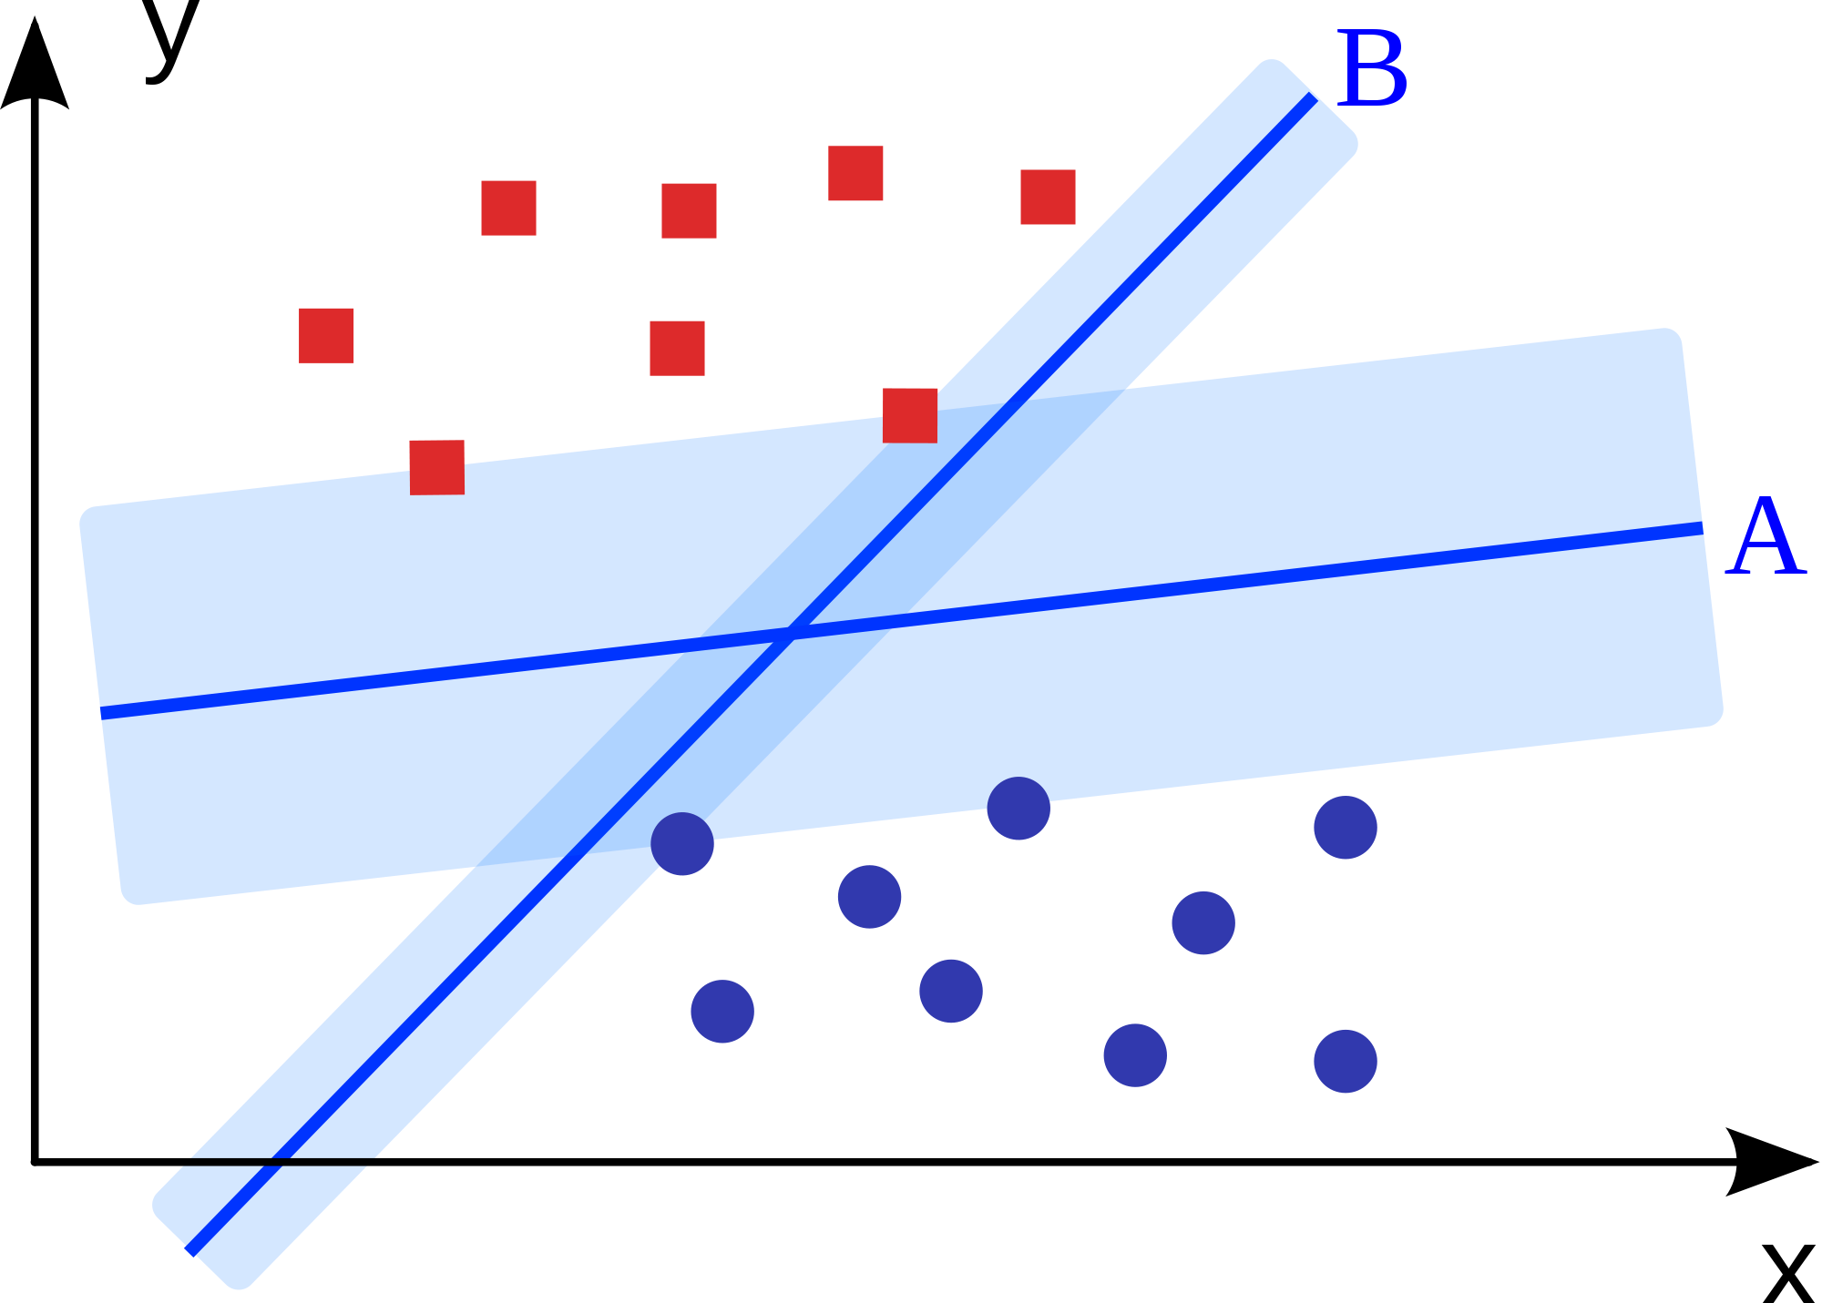
Model Training
Learn the mapping from features to output
Ideal: 100% accuracy in differentiating features of different classes
Practical: Maximize accuracy while maintaining “generalizability”
Quality dependent on training data quality/quantity
Choosing an ML algorithm for the task
Choosing the labels

Slide 7

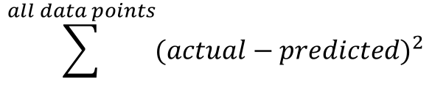
Model Evaluation
Success Criterion:
Classification: accuracy
Regression: residual error
Preliminary evaluation: Validation
Validation: “validate” the trained model on a set of unseen data
Final evaluation: Testing
Testing: “test” the estimated real-world performance of the model
$$\frac{No. of correctly classified data points}{Total no. of data points}$$
$$\sum^{all data points}{{(actual−predicted)}^{2}}$$

Slide 8
Feedback and Model Deployment
Machine Learning is an iterative process
The model is re-trained many times till validation performance is satisfactory
What changes in future iterations?
Preprocessing
Features
Choice of algorithm
Choice of parameters
Training data
Testing performance indicates estimated real-world performance of the model
The testing performance is the final reported value

Slide 9
What’s next?
Features:
Dimensionality reduction
Feature selection
Feature ensembles
Algorithm:
Choice of algorithm
Parameter optimization
More training data
Different regularization function

Slide 10
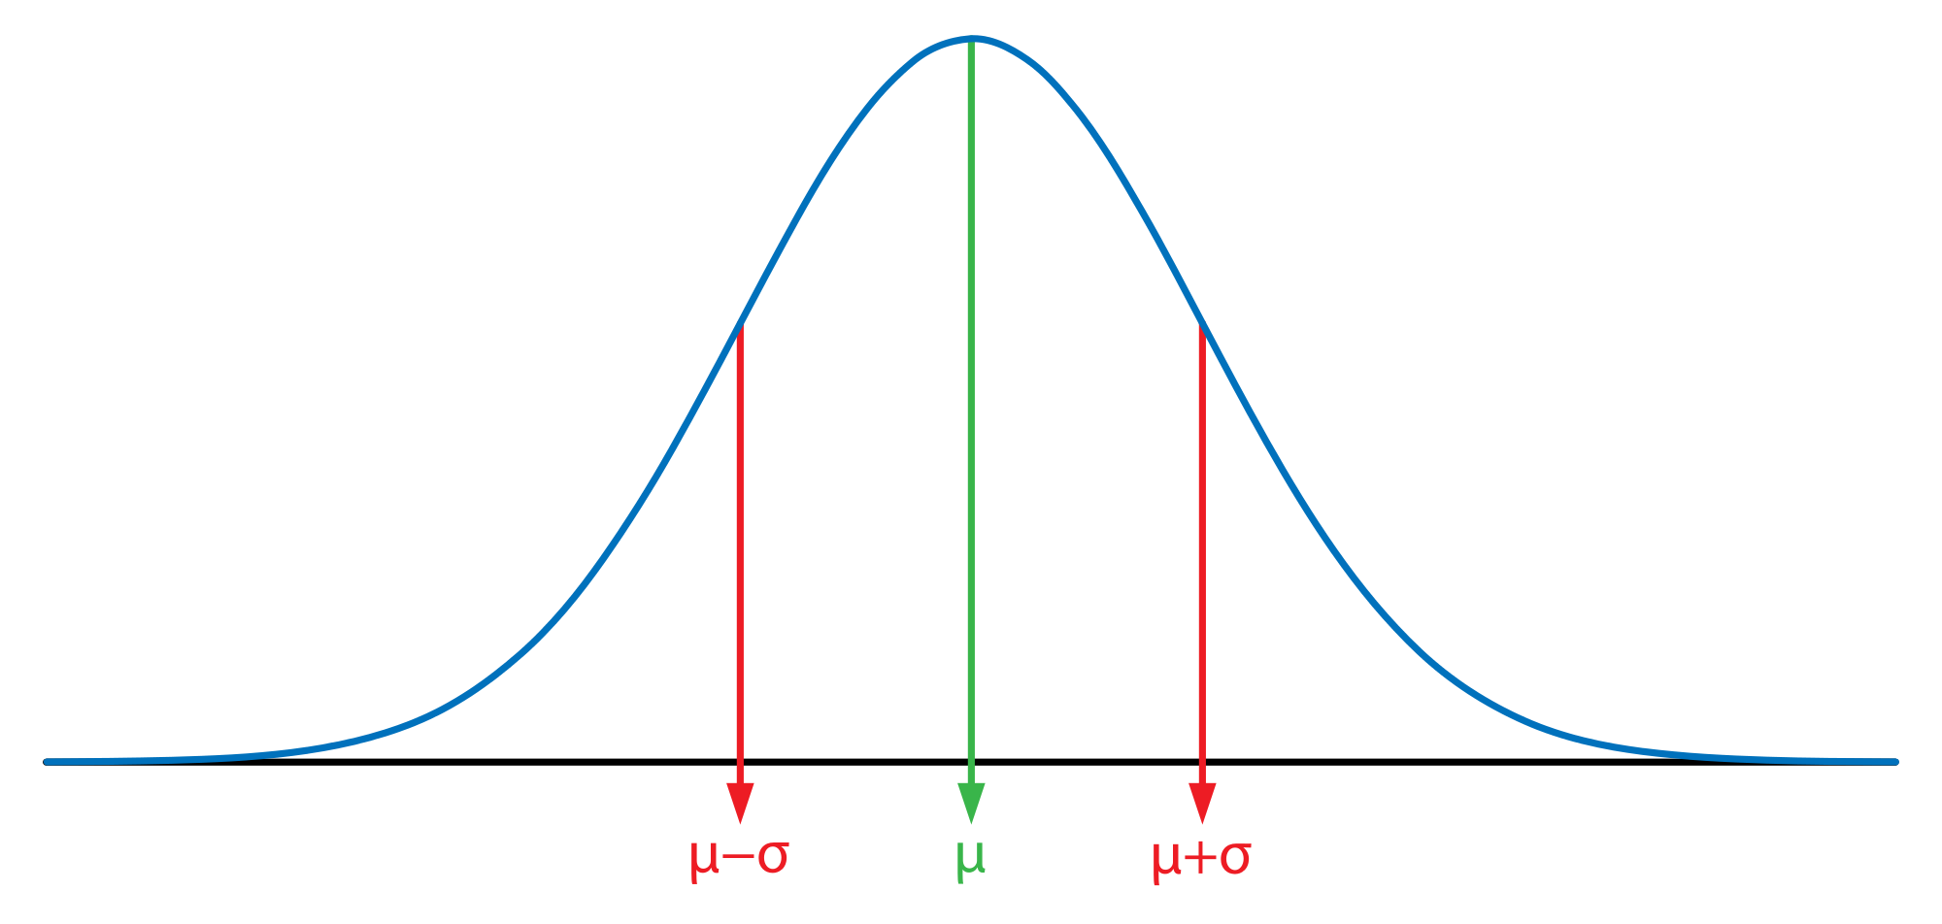
Example Assumption: Gaussian/Normal Distribution (Bell Curve)

Slide 11
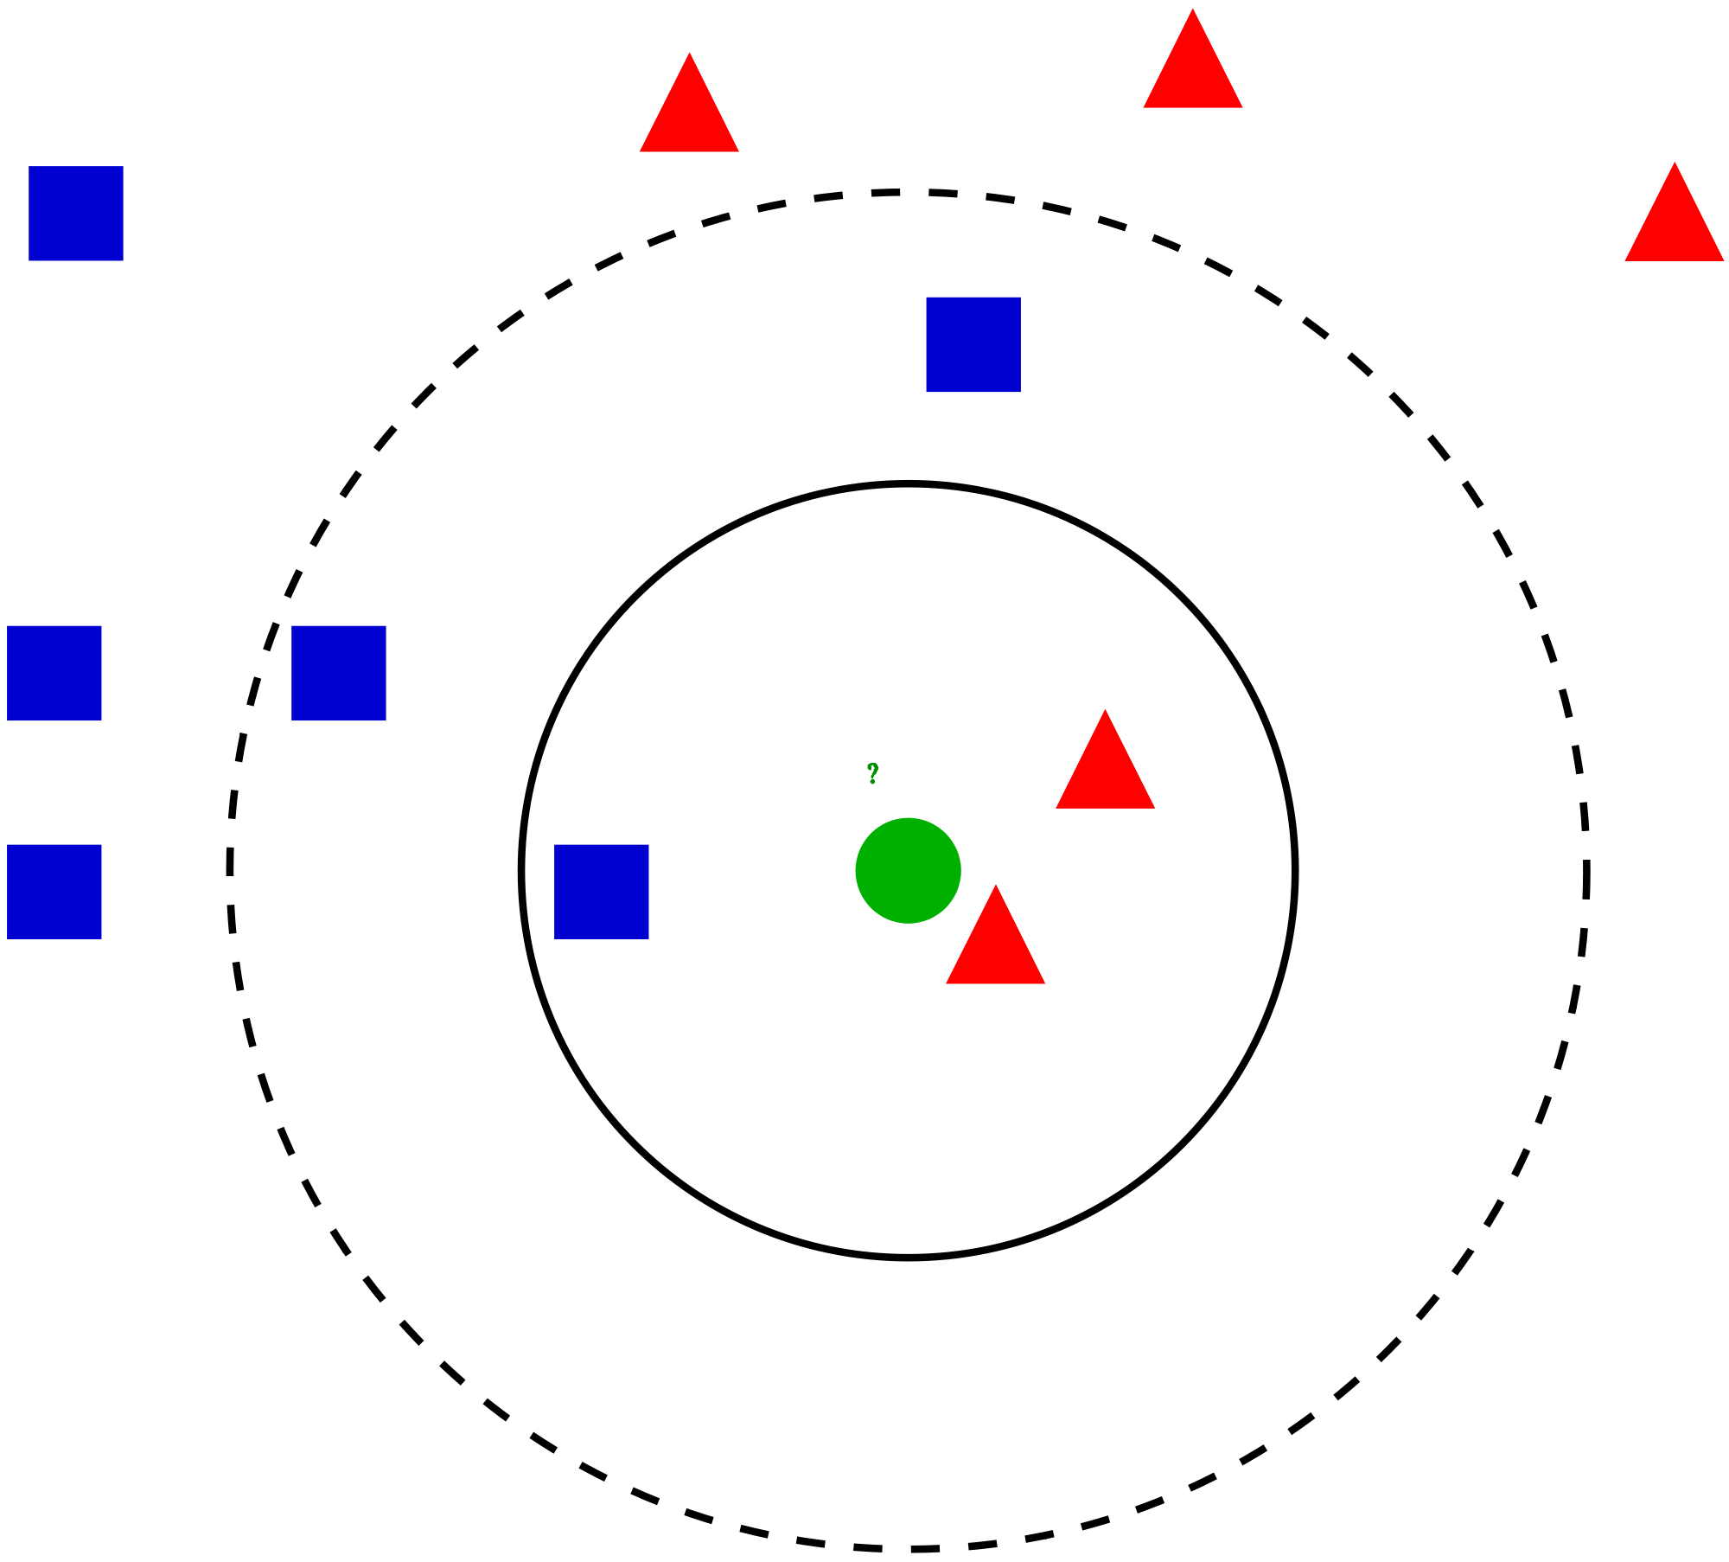
KNN: K-Nearest Neighbors
Classification:
Assign the class label by majority voting among the labels of the k nearest neighbors
Regression:
Assign the average value of the k nearest neighbors

Slide 12
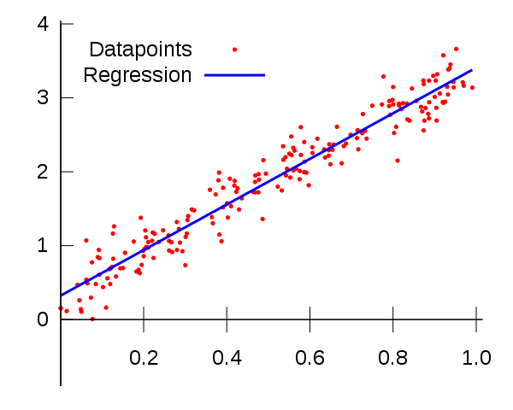
Linear Regression
Fit a model to compute the value of a dependent scalar variable based on one or more predictors
Single predictor: Simple linear regression
y = Ax + b + e
A line in 2 dimensions, where x is the predictor and y is the dependent variable, b is called the bias/intercept/constant, e is the error/noise that captures everything other than x that influences the value of y
Multiple predictors: Multiple linear regression
Vector dependent variable: Multivariate linear regression

Slide 13
Cross Validation
Divide the training data into equal partitions
K-fold: K partitions (5-fold, 10-fold)
Leave one out:
Train on K-1 folds
Validate on Kth fold
Repeat K times
Random subsampling:
Randomly assign data points to train and validation sets
Train and validate
Repeat N times
Report mean and standard deviation
Ideal: high mean and low standard deviation

Slide 14
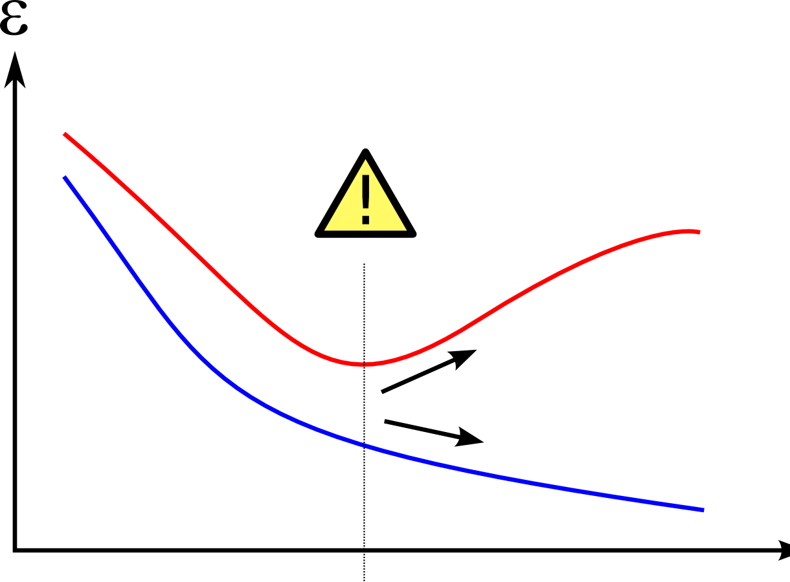
Underfitting and Overfitting

Slide 15
Underfitting and Overfitting
Underfitting:
High bias
High training/validation/test error
Low model complexity
Increase features
Choose a more expressive model
Overfitting:
High variance
Low training error, high validation/test error
High model complexity, low generalizability
Increase training data, lower feature dimension
Regularization (making the model simpler)

Slide 16
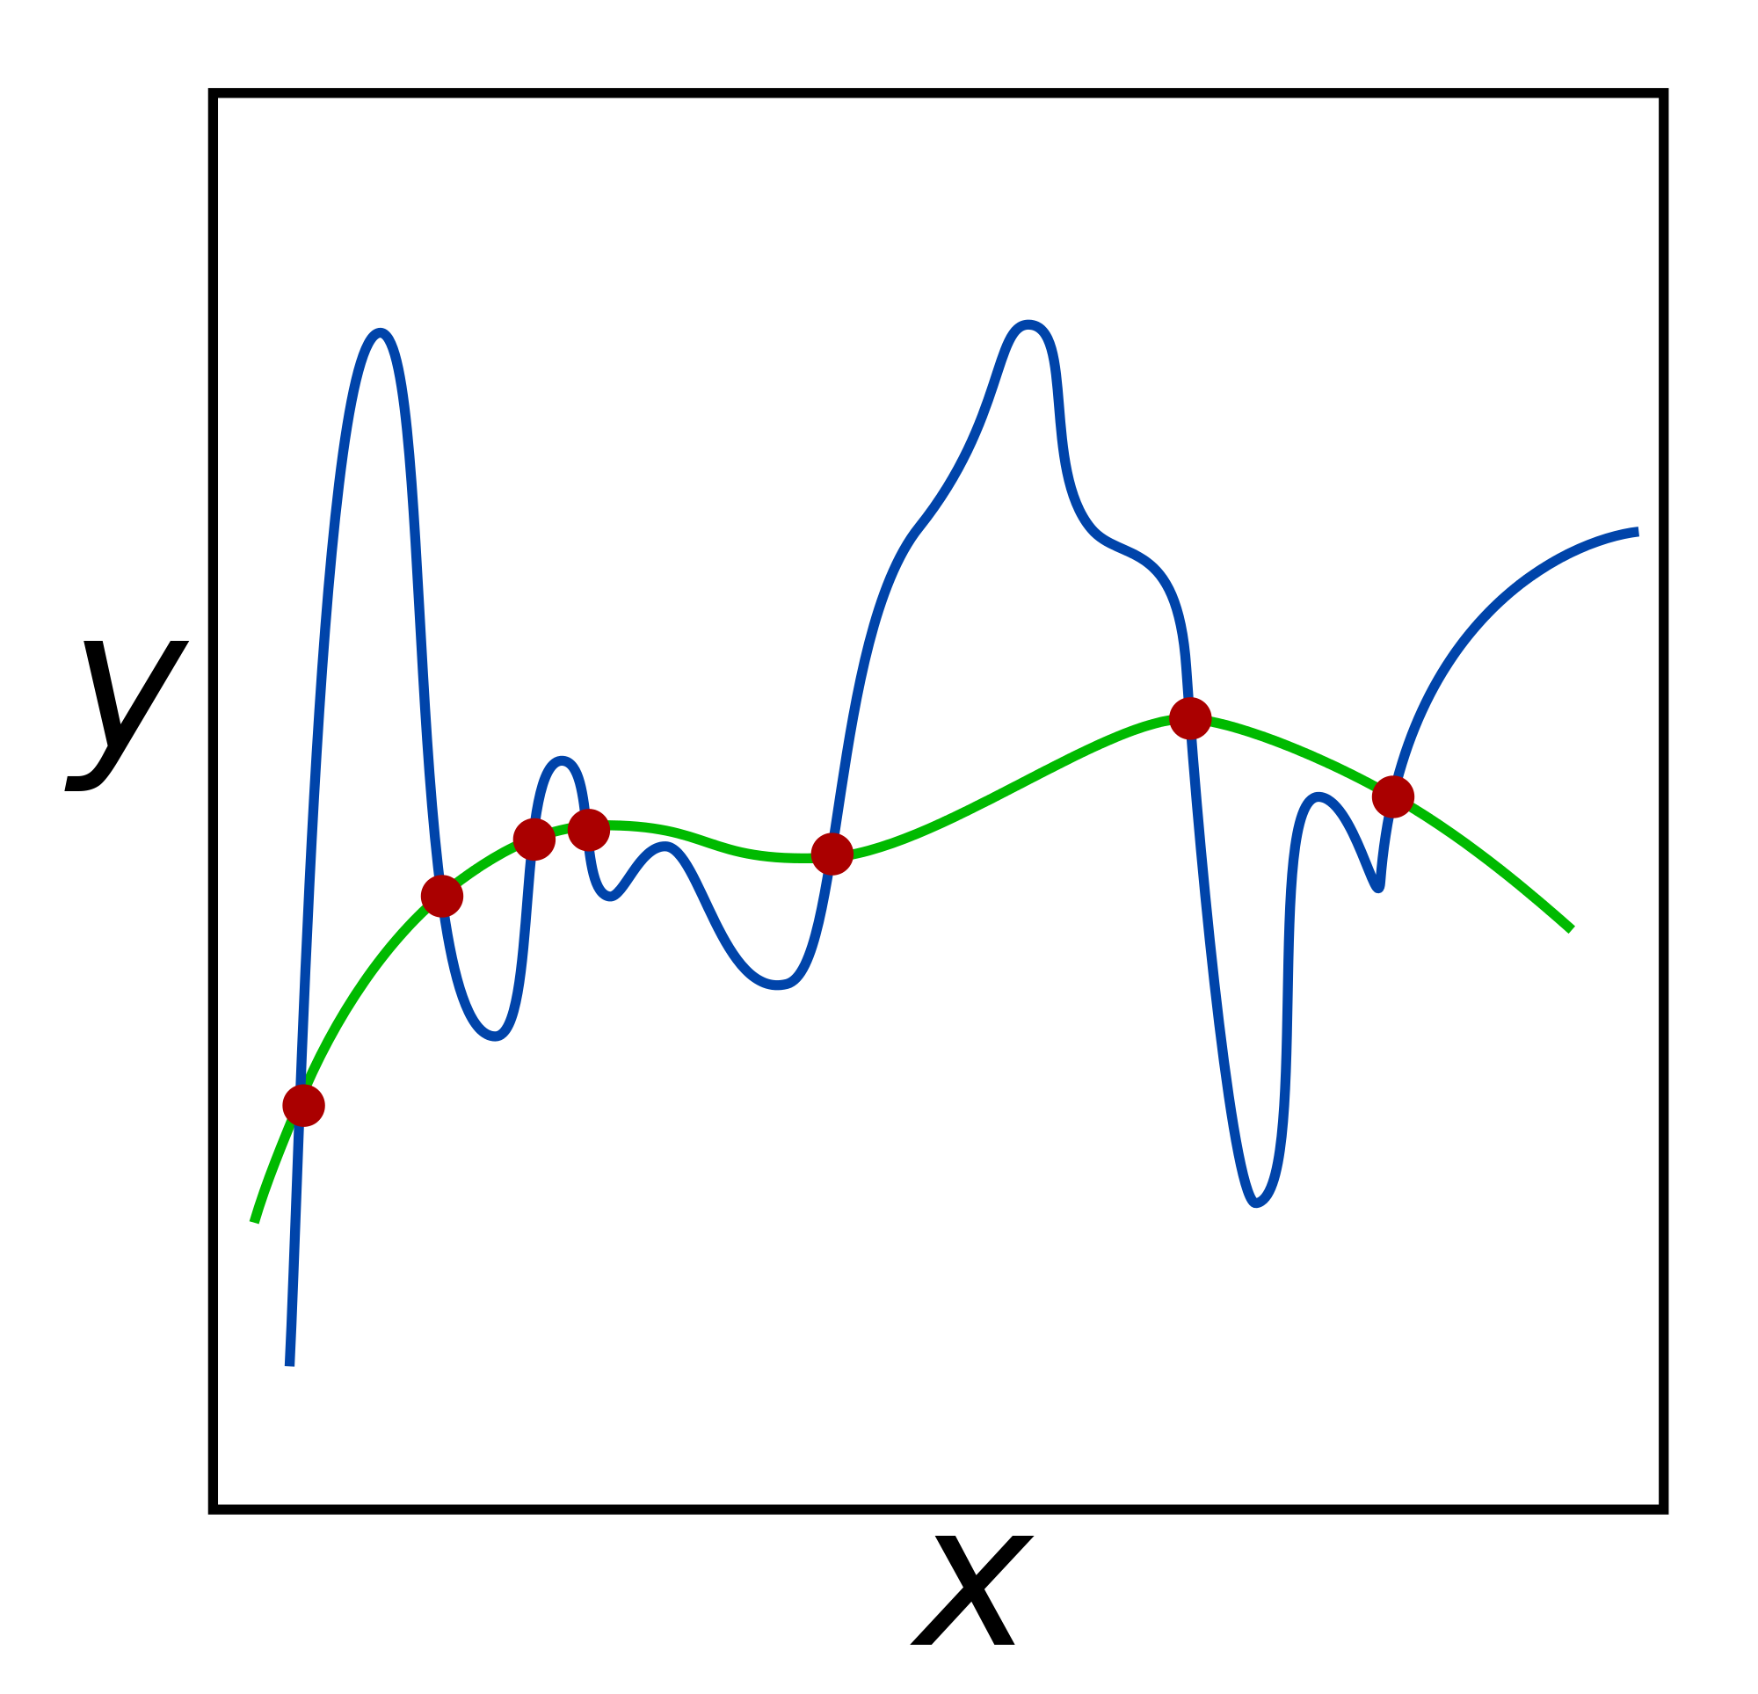
Regularization
Reduce the decision boundary complexity
Reduce overfitting on training data
Increase real world performance
Existing regularization methods: L-1, L-2, Elastic Net, dropout, dropconnect (deep learning)

Slide 17
Regularization: Example
Overfit decision rule:
If X <= 3.7, class = 1
Regularized decision rule:
If X <=3 class = 1
Sacrifice training performance to obtain a more generalizable decision rule that can potentially scale better to unseen data
Trade-off
Class Label | Feature (X)
1 | 2.7
2 | 3.8
1 | 2.8
2 | 5.5
1 | 3.7
1 | 3.0
1 | 2.9
2 | 3.9

Slide 18
Machine Learning in the Real World
Problem: You are the data scientist for a hospital. The management wants you to create a system to automatically assign a patient to the correct medical expert based on described symptoms.
Questions:
Is this a machine learning problem?
What kind of a model would you use?
What kind of preprocessing might be required?
What kind of features would be useful?
What will be one data point?
Will you use labels? If yes, what would be your labels?

Slide 19
Machine Learning in the Real World
Problem: You are working as a data scientist in a company that manufactures cricket bats. You are asked to create a system that can automatically classify each bat made by type of defect. The company does not have an exhaustive list of potential defects.
Questions:
Is this a machine learning problem?
What kind of a model would you use?
What kind of preprocessing might be required?
What kind of features would be useful?
What will be one data point?
Will you use labels? If yes, what would be your labels?

Slide 20
Machine Learning in the Real World
Problem: You are working as a data scientist for an e-commerce website (Amazon, Flipkart). The company wants you to analyze their data and determine how many customers have spent more than 20,000 INR on their products in the last month. They also want you to categorize their spending habits based on the top 3 departments (clothing, electronics, etc.) where they have spent the most money.
Questions:
Is this a machine learning problem?
What kind of a model would you use?
What kind of preprocessing might be required?
What kind of features would be useful?
What will be one data point?
Will you use labels? If yes, what would be your labels?

Slide 21
Machine Learning in the Real World
Problem: You are developing your own software for an automatically driven car. You want the car to be able to use an inbuilt camera to navigate an obstacle challenge course. The challenge course is not static and might change at any time.
Questions:
Is this a machine learning problem?
What kind of a model would you use?
What kind of preprocessing might be required?
What kind of features would be useful?
What will be one data point?
Will you use labels? If yes, what would be your labels?

Slide 22
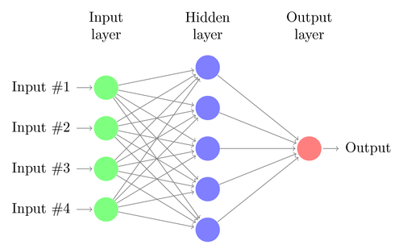
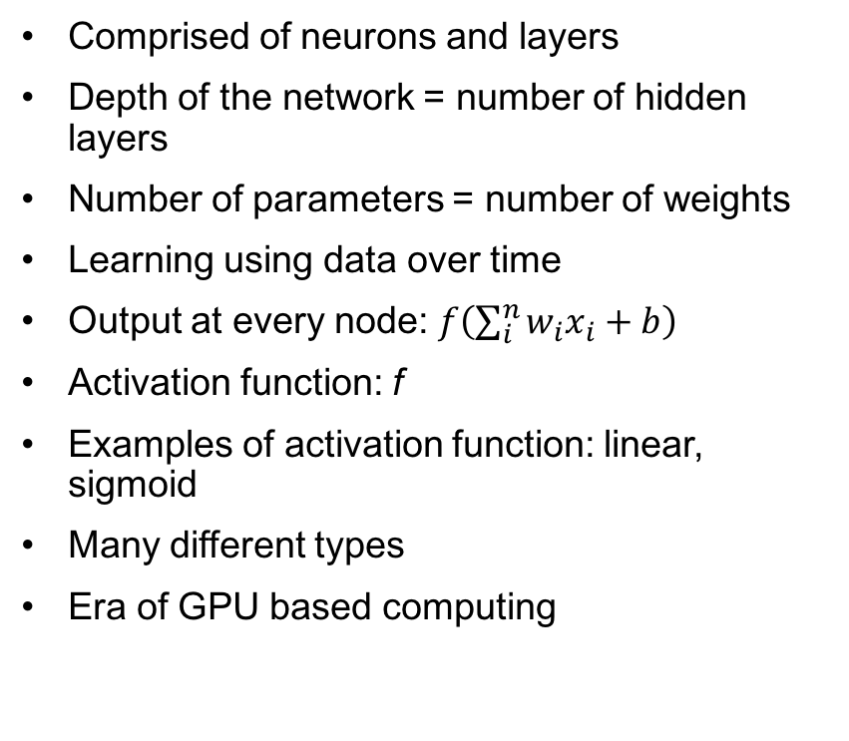
Introduction to Deep Learning
Comprised of neurons and layers
Depth of the network = number of hidden layers
Number of parameters = number of weights
Learning using data over time
Output at every node: $f\left(\sum_{i}^{n}{w_{i}x_{i}+b}\right)$
Activation function: f
Examples of activation function: linear, sigmoid
Many different types
Era of GPU based computing

Slide 23
Types of Deep Architectures
Feed-forward: for simple classification tasks
Convolutional Neural Networks: face recognition networks such as Deepface (Facebook), DeepID3 (Baidu)
Autoencoders: denoising data, dimensionality reduction
Recurrent Neural Networks: Google’s spell correction

Slide 24
Deep Learning: Tools and Frameworks
Keras: https://keras.io/
Tensorflow: https://github.com/tensorflow/tensorflow
Theano: https://github.com/Theano/Theano
Caffe: http://caffe.berkeleyvision.org/

Slide 25
Get in touch
Please leave your valuable feedback here – http://ibm.biz/devconnect17/
Get connected with your fellow developers @ https://developer.ibm.com/in/
Join our Slack team @ https://ibmdevconnect.slack.com .
Send in your request to - http://ibm.biz/slackrequest
You can also join our Meetup group
Mumbai : https://www.meetup.com/Cloud-Mumbai-Meetup/
Hyderabad: https://www.meetup.com/Hyderabad-Cognitive-with-Cloud
Bangalore : https://www.meetup.com/IBMDevConnect-Bangalore

