Slide 1
IBM Bluemix Runtime
Sudharshan Govindan
Developer Advocate, IBM
@sudhargovindan

Slide 2
What is Bluemix ?
IBM's innovative open-standards, cloud computing platform that combines PaaS with IaaS
Bluemix enables you to:
Deploy high performance compute and storage infrastructure
Test and adopt a broad range of cloud services and capabilities
Connect to all of your legacy systems and apps
Spin up and turn down resources in real time
Options to run your apps:
Boilerplates
Runtime
Container Service
Open Whisk

Slide 3
What is a Runtime ?
Runtimes are based on Bluemix Cloud Foundry—of which IBM is both a founding and platinum member
Runtimes get innovative ideas to market fast with reduced development costs
Runtimes support stateless processes and promote application fault tolerance and scalability
Runtimes link Bluemix services to applications as endpoints

Slide 4
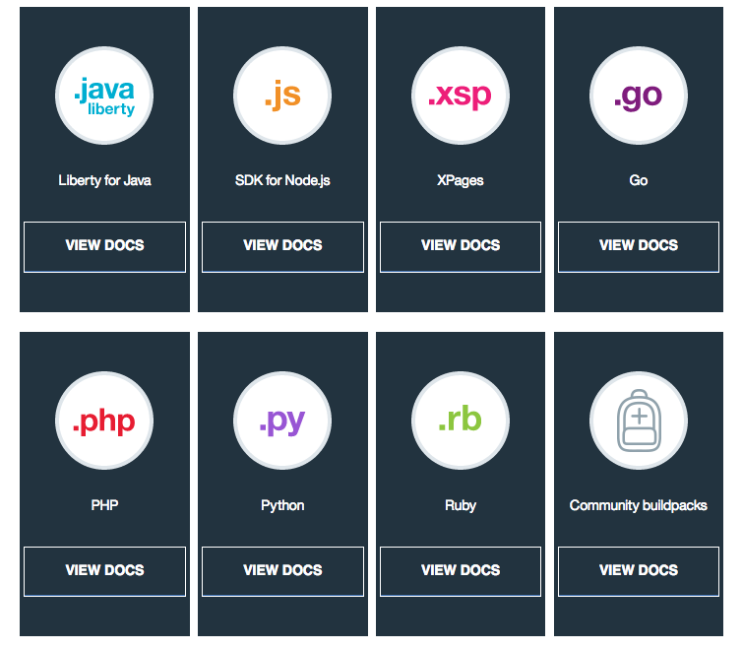
Runtime

Slide 5
Node.js Runtime
In 10 minutes or less, you’ll learn to:
Set up a development environment
Download sample code
Run the application locally
Run the application on Bluemix Cloud Foundry
Add a Bluemix Database service
Connect to the database from your local application

Slide 6
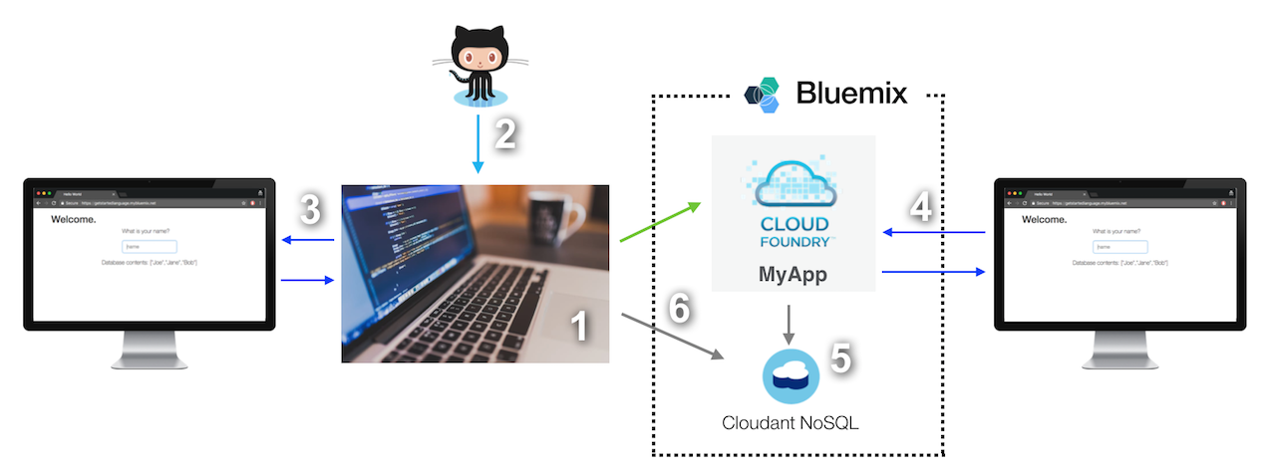
Node.js Runtime

Slide 7
Node.js Runtime

Slide 8
Node.js Demo
A Node.js application that uses express framework to provide a REST API to receive requests from the UI
API uses node-cfenv package to read database credentials and nodejs-cloudant client library to persist the visitor names to a Cloudant database
Pre-requisites:
Bluemix account (http://bluemix.net/)
Cloud Foundry CLI (https://github.com/cloudfoundry/cli#downloads)
Any Git UI tool (https://desktop.github.com/)
Node (https://nodejs.org/)
Notes:
https://console.bluemix.net/docs/runtimes/nodejs/getting-started.html#getting-started-with-node-js-on-bluemix

Slide 9
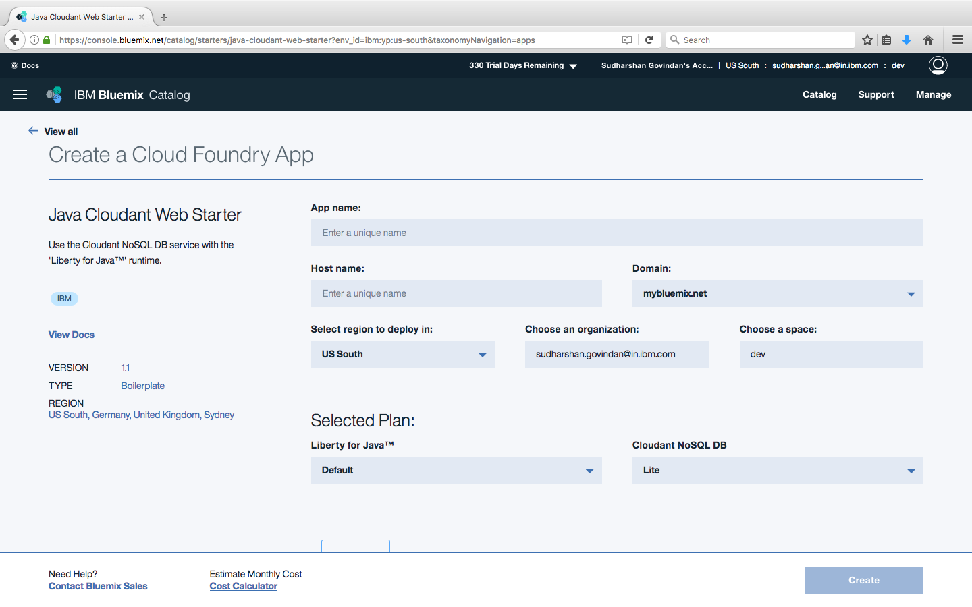
Liberty for Java Runtime

Slide 10
Troubleshooting Runtime
Obsolete buildpack used when an app is pushed
Use Cloud Foundry Java / Node.js buildpacks
Enable Node.js buildpack to download node modules from the internet every time
set NODE_MODULES_CACHE=false
NOTICE messages from PHP buildpack
2015-01-26T15:00:59.70+0100 [App/0] ERR [26-Jan-2015 14:00:59] NOTICE: [pool www] 'user' directive is ignored when FPM is not running as root
Change stderr notice to stderr error in nginx-defaults.conf for error_log parameter
Can't import a third-party Python library into Bluemix
Requirements.txt - web.py==0.37 wsgiref==0.1.2
Procfile - web: python <yourappname>.py $PORT

Slide 11
Troubleshooting Runtime
Credentials are required to open a trace or dump window
Error occurs when trace or dump operations are running
Disk quota exceeded

Slide 12


https://developer.ibm.com/code/
Signup for IBM Bluemix
http://ibm.biz/DevConnNoida

Slide 13



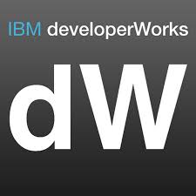


Stay Connected and continue coding !
Code & instructions
https://github.com/IBMDevConnect17/
https://github.com/IBM/
https://github.com/IBM-Bluemix/
https://ibm-bluemix.github.io/#!/
Join Data Science Experience now!
https://datascience.ibm.com/
Apply for the IBM Global Entrepreneur program
https://developer.ibm.com/startups/
Join developerWorks India Community
https://developer.ibm.com/in/
Check out the cool developer journeys
https://developer.ibm.com/code/
Join our Meetup groups
Delhi: https://www.meetup.com/ibmcloudecosystem/
Mumbai:
https://www.meetup.com/Cloud-Mumbai-Meetup/
Hyderabad: https://www.meetup.com/Hyderabad-Cognitive-with-Cloud
Bangalore : https://www.meetup.com/IBMDevConnect-Bangalore
Join our Slack team and stay in touch with the experts
https://ibmdevconnect.slack.com
Send in your request to http://ibm.biz/slackrequest

Slide 14


Please give us your valuable feedback
http://ibm.biz/devconnect17

Slide 15


