Slide 1


Watson API Overview

Slide 2

Agenda
Cognitive Computing
Introduction to Watson
Watson APIs
Demos
Useful links

Slide 3
What is Cognitive Computing?
https://youtu.be/xRamODPdU1U

Slide 4
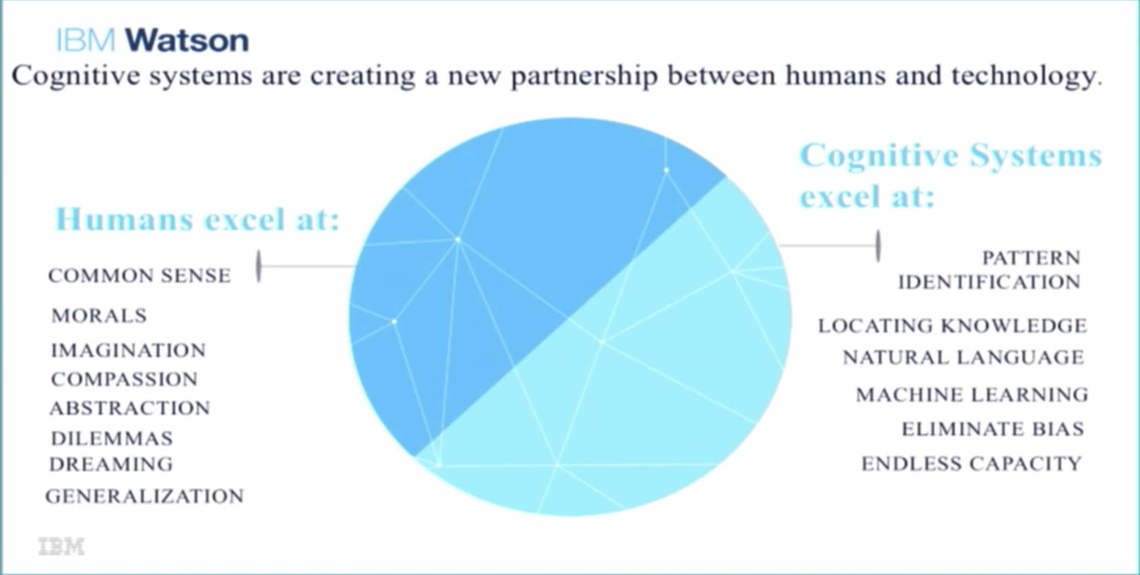

Slide 5
Technology platforms that are based on scientific disciplines of Artificial Intelligence and Signal Processing
Machine Learning, Reasoning, Natural Language Processing, Speech Recognition and Vision, Human–Computer interaction, Dialog and Narrative generation etc
New type of computing with the goal of more accurate models of how the human brain / mind senses, reasons and responds to stimulus
Refers to new hardware / software that mimics the functioning of the human brain
Helps to improve human decision-making
Cognitive systems’ features:
Adaptive
Interactive
Iterative & Stateful
Contextual

Slide 6
Introduction to Watson

Slide 7
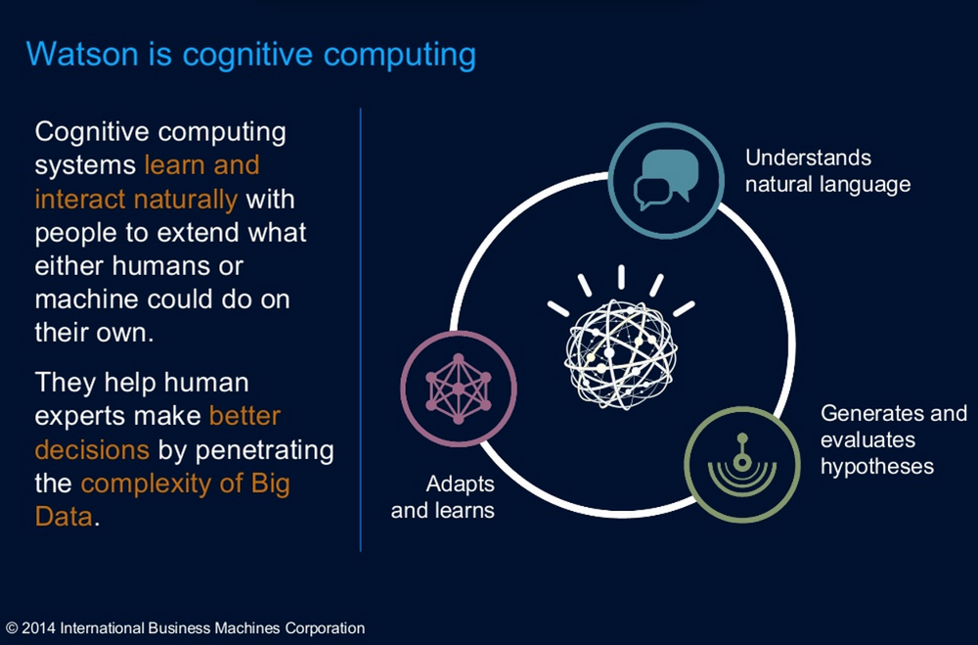

Slide 8
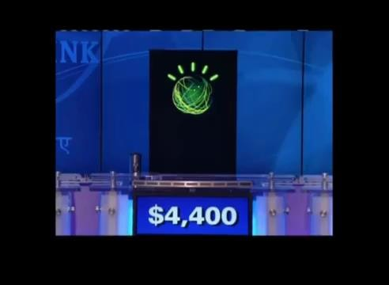
Watson Jeopardy – Where it all started
https://youtu.be/WFR3lOm_xhE

Slide 9

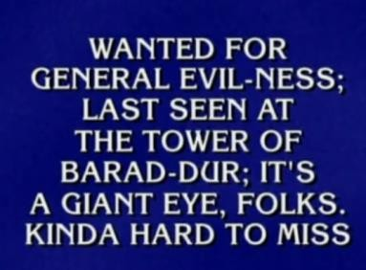





How Watson Jeopardy came up with answers
2. Searched sources for candidate answers
It’s sources were mostly unstructured data (e.g. Wikipedia)
Sources were annotated to enable intelligent searching
3. Analyzed answers and
computed confidence
4. Delivered top responses and
their
confidence
Results used to train Watson further
1. Understood the question
Decomposed it to identify
things like:
Entities
People, places, things
Relationships
e.g. Melville (person) is the author of Moby Dick(novel)
Concepts
e.g. “Late 50’s” refers to the years 1957, 1958, 1959
Intent of the question
E.g. looking for a character in a novel
Used machine learning to
learn by experience

Slide 10
Watson Jeopardy Legacy
Solved a lot of issues that made it hard to develop cognitive apps
Understanding of natural language as input / output mechanism and as a source of knowledge
Analyzing subtle meaning, irony, riddles and other complexities of natural language
Annotating unstructured data and then issuing natural language queries against it
e.g., What were the highlights of Ronald Reagan’s tenure as Governor of California (based on Wikipedia entries)
Speed of accurate responses and confidence scoring of answers
Automatically improving answers over time by learning from mistakes
Spawned APIs that can be used as building blocks for building Cognitive apps
Examples
Understanding the structure and the intent of natural language communication
Annotating data as a source for evidence based natural language queries
Customizing those annotations for specific domains

Slide 11









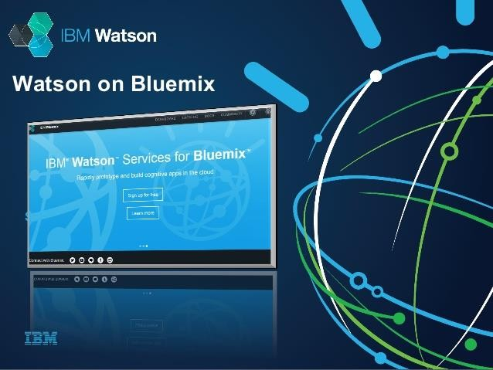
Roots of today’s Watson REST based APIs
Watson Jeopardy components extracted & enhanced
Other IBM Research projects
Other IBM products/ acquisitions

Slide 12
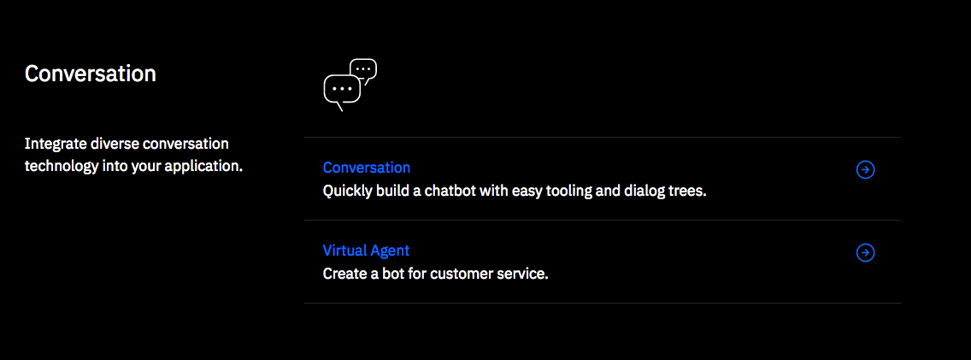
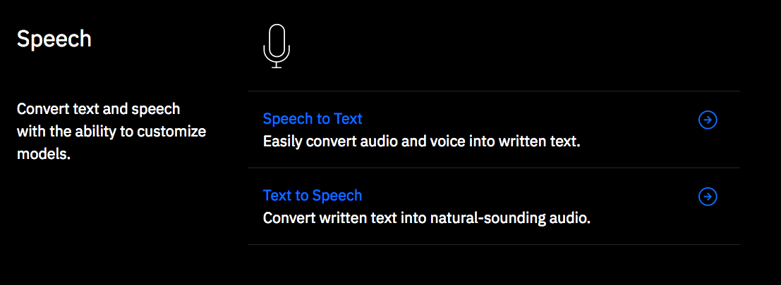
Watson API categories

Slide 13
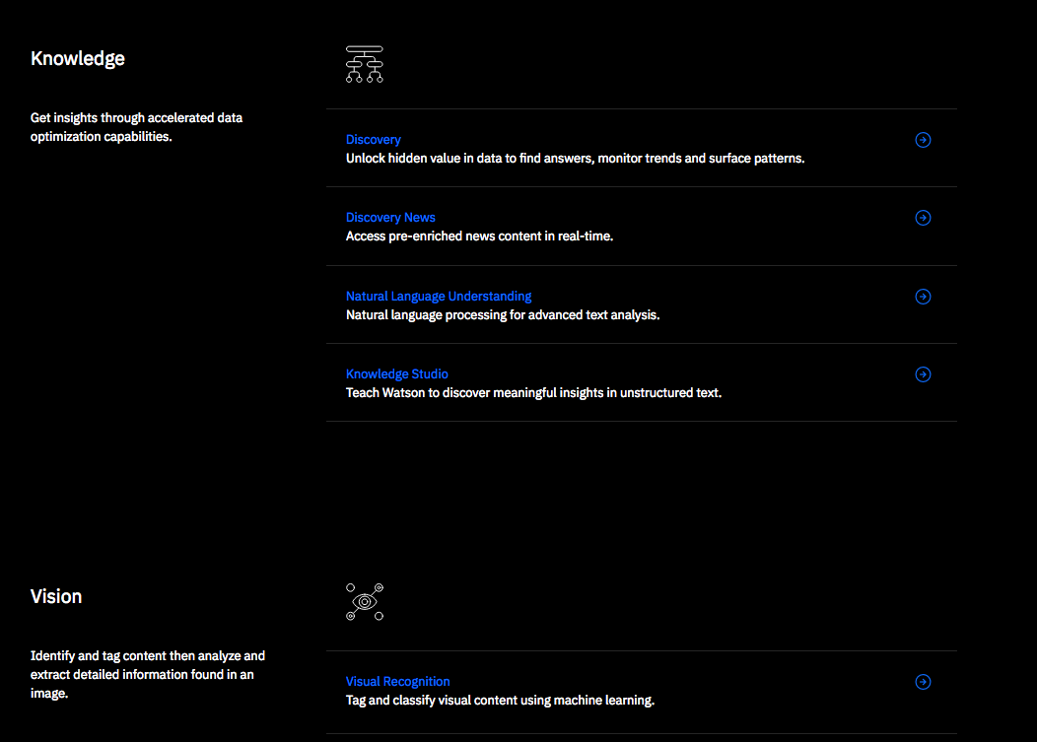
Watson API categories

Slide 14
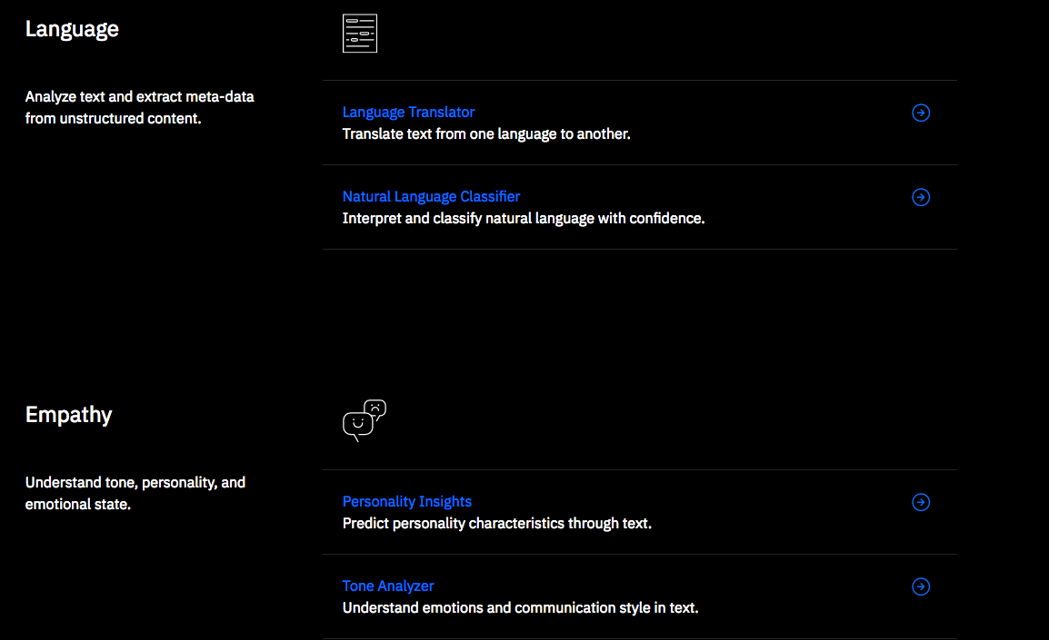
Watson API categories

Slide 15
Positioning
Watson API design goals
Provide the building blocks to build a wide variety of cognitive apps with focus on:
Flexibility
Customization
Productivity
Ease of use
Watson offers key three key differentiators:
provides unparalleled domain expertise
lives and works on a cloud optimized for data and AI workloads
clients maintain ownership of their data, insights and IP

Slide 16
Watson APIs

Slide 17
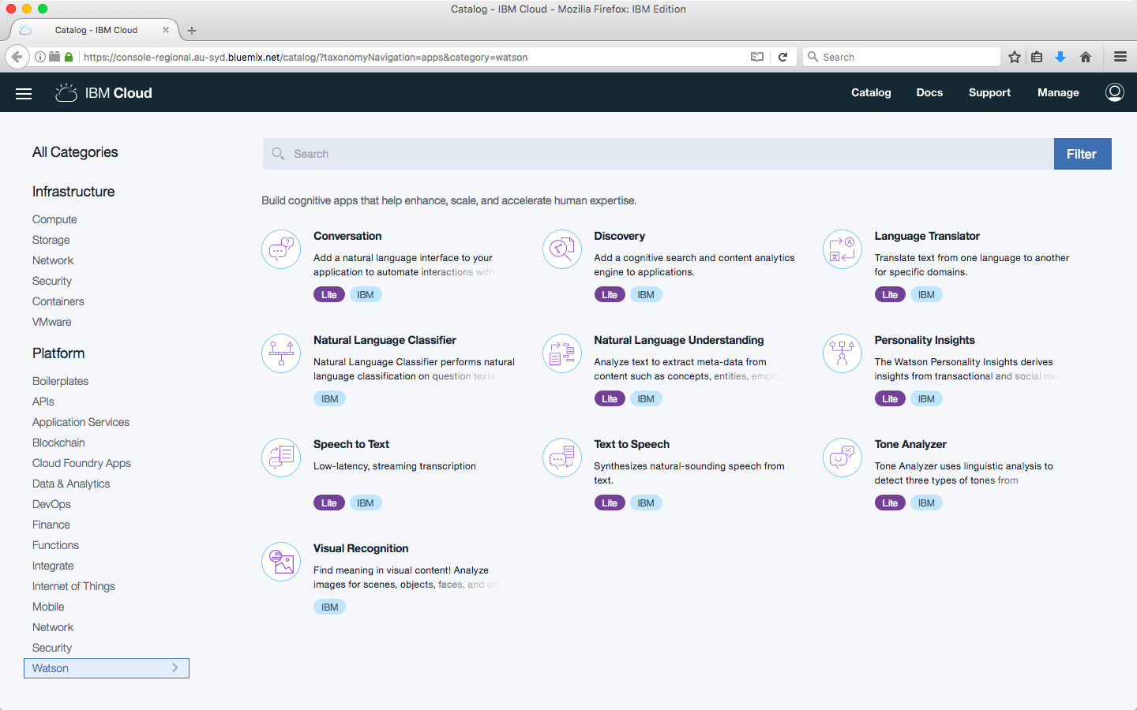
Watson API Summary

Slide 18

The basics
All APIs are REST based with public endpoints
For authentication services, use either
An api key that is a param to each request or
Basic authentication with an HTTPS endpoint
- Username/password in request header
Each service instance is created in IBM Cloud and has it’s own credentials
Credentials are available in the IBM Cloud console
For apps bound to a service instance
Credentials available as JSON in VCAP_SERVICES environment
Each service has a deployed demo app that can be run and then cloned from GitHub

Slide 19
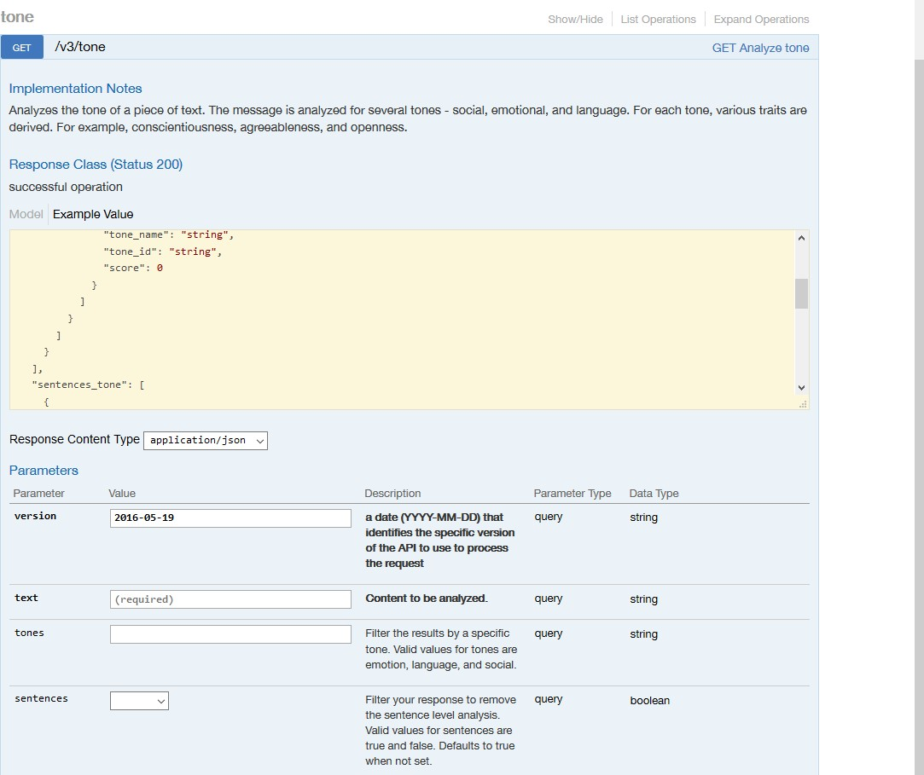
Watson API Explorer
A collection of Swagger documentation for the Watson APIs
Test API calls for various services as long as you have the credentials
https://watson-api-explorer.mybluemix.net/

Slide 20
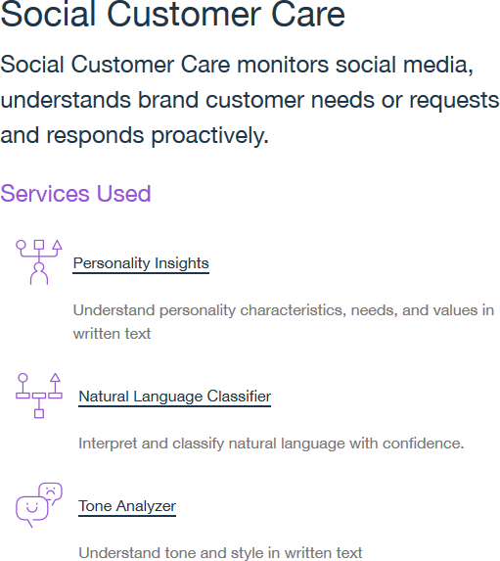
SDKs and starter kits
SDKs are wrappers around the REST API and are available for various programming languages / platforms
Node, Java, Python, iOS, Unity etc
Starter Kits are complete code examples that
combine multiple services for common use cases
https://www.ibm.com/watson/developer-resources/

Slide 21
Demos

Slide 22
Vision: Visual Recognition
Tag and classify visual content using machine learning
Understands the contents of images
Find human faces, approximate age and gender, and find similar images in a collection
Detect a dress type in retail, identify spoiled fruit in inventory and more
Input: JPEG or PNG images to train model or to classify
Output: Set of labels and likelihood scores
Dataset: Large number of classified pictures
https://www.ibm.com/watson/services/visual-recognition/

Slide 23
Knowledge: Natural Language Understanding
Natural language processing for advanced text analysis
Extract meta-data from content such as concepts, entities, keywords, categories, sentiment,
emotion, relations, semantic roles
Develop custom annotation models using Watson Knowledge Studio
Identify industry / domain specific entities and relations
Languages: Arabic, English, French, German, Italian, Japanese, Korean, Portuguese, Russian, Spanish, Swedish
Input: Text or URL to be analyzed
Output: Categories, concepts, emotion, entities, keywords, metadata, relations, semantic roles, and sentiment.
https://www.ibm.com/watson/services/natural-language-understanding/

Slide 24
Speech: Speech to Text
Convert audio and voice into written text
Use to transcribe calls to identify what is being discussed, when to escalate calls, and to understand content from multiple speakers
Create voice-controlled applications
Customizable model to improve accuracy such as product names, sensitive subjects, or names of individuals
Input: streamed or recorded audio
Output: text transcriptions of the recognized words
Dataset: English, Spanish, French, Arabic, Chinese, Japanese, Portuguese
https://www.ibm.com/watson/services/speech-to-text/

Slide 25
Speech: Text to Speech
Convert written text into natural-sounding audio
Converts written text into natural sounding audio in a variety of languages and voices
Customize and control the pronunciation of specific words
Develop interactive toys for children, automate call center interactions, and communicate directions hands-free.
Input: Text to be converted to audio
Output: Synthesized audio based on the input text
Dataset: English, Spanish, French, Italian, Portuguese, German, Japanese, Portugese
https://www.ibm.com/watson/services/text-to-speech/

Slide 26
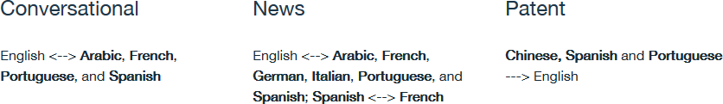
Language: Language Translator
Translate content into multiple languages
Translates from one language to another or identifies the language of the input text
Offers multiple customizable domain-specific models
Languages:
Input: Text to be translated or identified
Output: Translated text or language code
https://www.ibm.com/watson/services/language-translator/

Slide 27
Language: Natural Language Classifier
Interpret and classify natural language with confidence
Understands the intent behind text and returns a classification and confidence score
Answer questions in contact centers, chatbots etc
Categorize written content
Languages: English, Arabic, Brazilian Portuguese, French, German, Japanese, Italian, Spanish
Input: Trained with data mapping phrases to intents. After training, phrases are input.
Output: Intent of input phrase and confidence
https://www.ibm.com/watson/services/natural-language-classifier/

Slide 28
Empathy: Personality Insights
Understand personality characteristics, needs, and values in written text
Extracts personality characteristics based on how a person writes
Match individuals to other individuals, opportunities, and products
Characteristics include the Big 5 Personality Traits, Values, and Needs
Needs at least 1200 words of input text
Input: Text from an individual
Output: Tree of social characteristcs in JSON and visualizations using HTML and SVG
https://www.ibm.com/watson/services/personality-insights/

Slide 29
Empathy: Tone Analyzer
Understand tone and style in written text
Uses linguistic analysis to detect three types of tones in written text: emotions, social tendencies, and writing style
Understand emotional context of conversations and communications
Use this insight to respond in an appropriate manner
Languages: English, French
Input: Text to be analyzed in JSON
Output: Analysis of input text in JSON
https://www.ibm.com/watson/developercloud/tone-analyzer.html

Slide 30
Language: Conversation
Build chatbots that understand natural language and deploy them on messaging
platforms and websites, on any device
Quickly build, test and deploy a bot or virtual agent on Mobile devices, messaging platforms like Slack or even on a physical robot
A visual dialog builder to use without any coding experience required
Languages: Brazilian Portuguese, English, French, Italian, Spanish, German, Traditional Chinese,
Simplified Chinese, Dutch, Arabic
Input: Input phrases for a specific workspace
Output: Workspace defined response based on current state
https://www.ibm.com/watson/services/conversation/

Slide 31
Knowledge: Discovery
Rapidly build a cognitive search and content analytics engine
Convert, normalize and enrich unstructured data
Use a simplified query language to explore that data
Tap into pre-enriched datasets like the Discovery News collection - 300,000 new articles and blogs added daily, sourced from more than 100,000 sources.
Input: Cognitive Query
Output: Query results
https://www.ibm.com/watson/services/discovery/

Slide 32
Useful links

Slide 33
Watson Services in IBM Cloud
https://console.bluemix.net/catalog/?category=watson
Watson API Explorer
https://watson-api-explorer.mybluemix.net/
Watson SDKs and Starter Kits
https://www.ibm.com/watson/developer-resources/
Watson Developer Cloud (API Docs, demo apps and tutorials)
https://www.ibm.com/watson/developer/
Additional Watson API tutorials (IBM developerWorks)
https://www.ibm.com/developerworks/learn/cognitive/

Slide 34
Thank You
Sudharshan Govindan
Developer Advocate
Email: sudharshan.govindan@in.ibm.com
Twitter : @sudhargovindan

