Slide 1
IBM Bluemix Overview & Runtime
Sudharshan Govindan
Developer Advocate, IBM
Twitter : @sudhargovindan

Slide 2
What is Bluemix ?
IBM's innovative open-standards, cloud computing platform that combines PaaS with IaaS
Bluemix enables you to:
Deploy high performance compute and storage infrastructure
Test and adopt a broad range of cloud services and capabilities
Connect to all of your legacy systems and apps
Spin up and turn down resources in real time
Options to run your apps:
Boilerplates
Runtime
Container Service
Open Whisk
Notes:
IBM's innovative open-standards, cloud computing platform that combines platform as a service (PaaS) with infrastructure as a service (IaaS) for building, running, and managing applications
It has a rich catalog of cloud services that can be easily integrated with PaaS and IaaS to build business applications rapidly
Bluemix has cloud deployments that fit your needs whether you are a small business that plans to scale, or a large enterprise that requires additional isolation. You can develop in a cloud without borders, where you can connect your private services to the public Bluemix services available from IBM.
You and your team can access the apps, services, and infrastructure in Bluemix and use existing data, systems, processes, PaaS tools, and IaaS tools. Developers can tap into the rapidly growing ecosystem of available services and runtime frameworks to build applications using polyglot programming approaches.
With Bluemix, you no longer have to make large investments in hardware to test out or run a new app. Instead, we manage it all for you and only charge for what you use. Bluemix provides public, dedicated, and local integrated deployment models.
Bluemix enables you to:
Deploy high performance compute and storage infrastructure in secure IBM Cloud Data Centers around the world
Test and adopt a broad range of cloud services and capabilities from IBM, open source communities, and third-party developers
Connect to all of your legacy systems and apps from a single, scalable, cloud platform through private network and API capabilities
Spin up and turn down resources in real time as your business needs or workload demands change
Options to run your apps:
A boilerplate is a template for an application and its associated runtime environment and predefined services for a specific domain
A runtime is the set of resources that is used to run an app, provided as containers for different types of apps
Use Container Service to run Docker containers in a hosted cloud environment on Bluemix
Use OpenWhisk for distributed, event-driven computing. OpenWhisk runs application logic in response to events or direct invocations from web or mobile apps over HTTP.

Slide 3
Bluemix Console
Dashboard
Account, Region, Organization and Space
Catalog, Support and Billing
Documentation

Slide 4
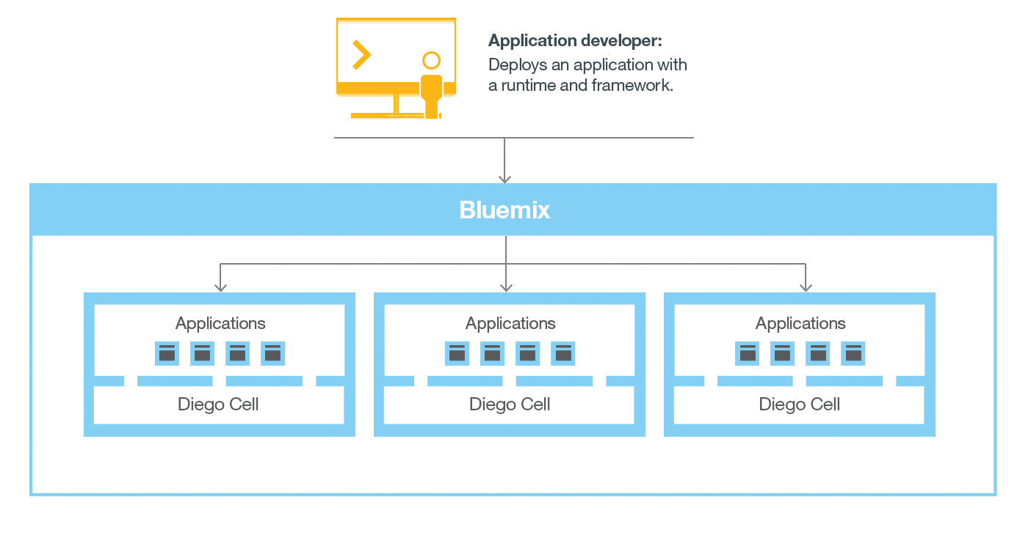
Bluemix Cloud Foundry

Slide 5
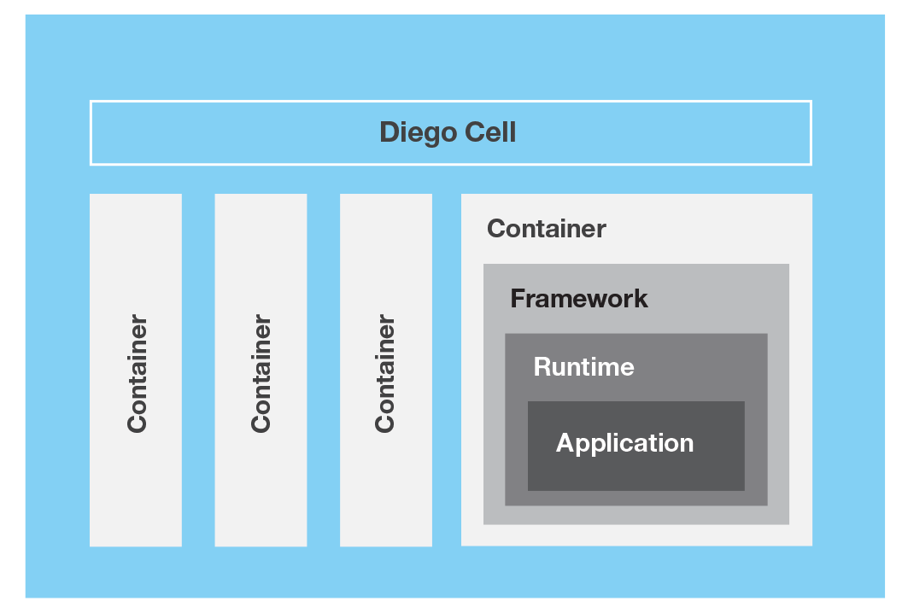
Bluemix Cloud Foundry

Slide 6
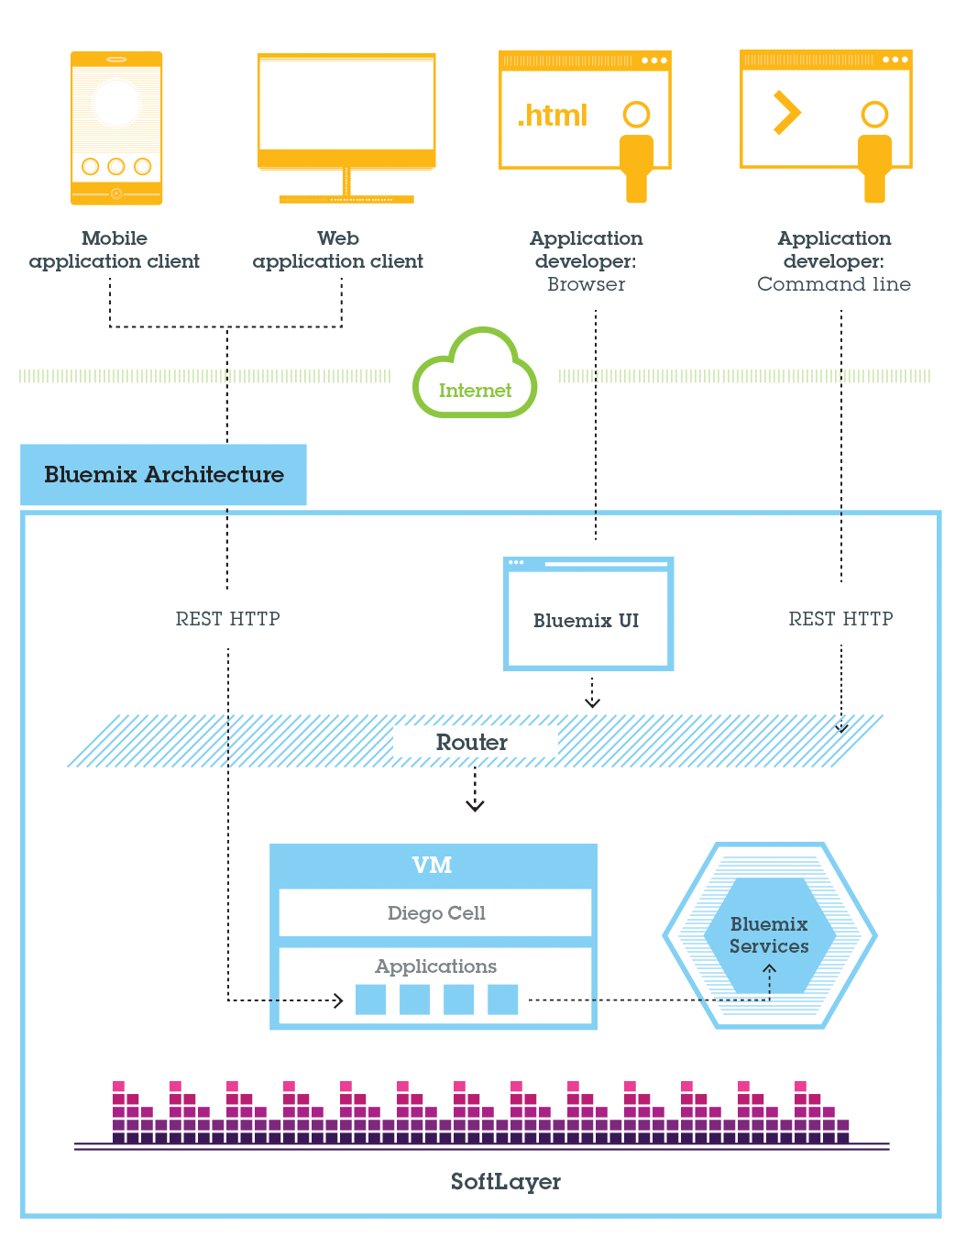
Cloud Foundry Architecture

Slide 7
Bluemix Pre-requisites
Browsers
Chrome
Firefox
Internet Explorer: version 11
Safari
Cloud Foundry
cf command line interface, version 6.5.1 or later

Slide 8
Bluemix Deployment Models
Public
Infrastructure resources are shared by different companies and users
Dedicated
Your own dedicated Bluemix Infrastructure (SoftLayer), which you can connect securely to Bluemix Public cloud and your own network
Local
Sits behind your company firewall, which can protect your most sensitive workloads and can connect securely to both Bluemix Public and Bluemix Dedicated clouds

Slide 9
Bluemix Security
https://console.bluemix.net/docs/api/content/security/images/platform_sec.svg?lang=en
https://console.bluemix.net/docs/api/content/security/images/security_local_platform.svg?lang=en

Slide 10
What is a Runtime ?
Runtimes are based on Bluemix Cloud Foundry—of which IBM is both a founding and platinum member
Runtimes get innovative ideas to market fast with reduced development costs
Runtimes support stateless processes and promote application fault tolerance and scalability
Runtimes link Bluemix services to applications as endpoints

Slide 11
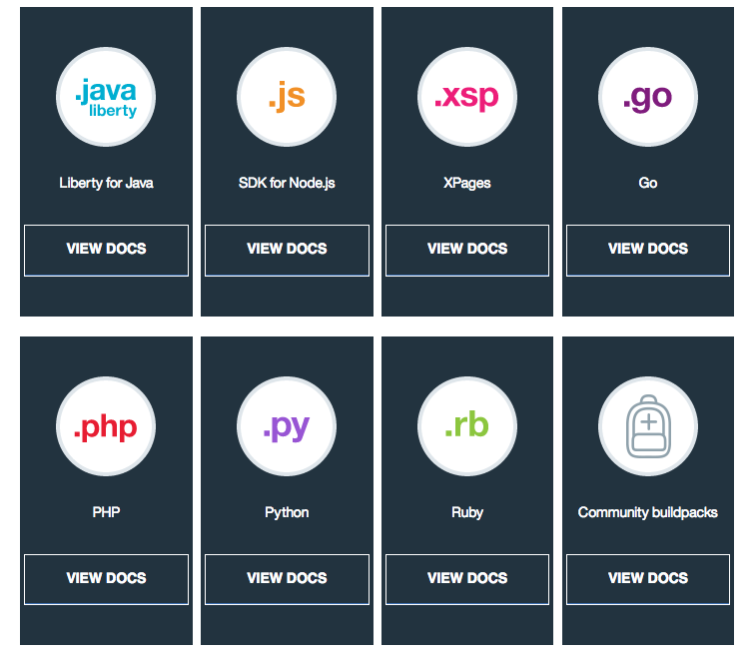
Runtime

Slide 12
Node.js Runtime
In 10 minutes or less, you’ll learn to:
Set up a development environment
Download sample code
Run the application locally
Run the application on Bluemix Cloud Foundry
Add a Bluemix Database service
Connect to the database from your local application

Slide 13
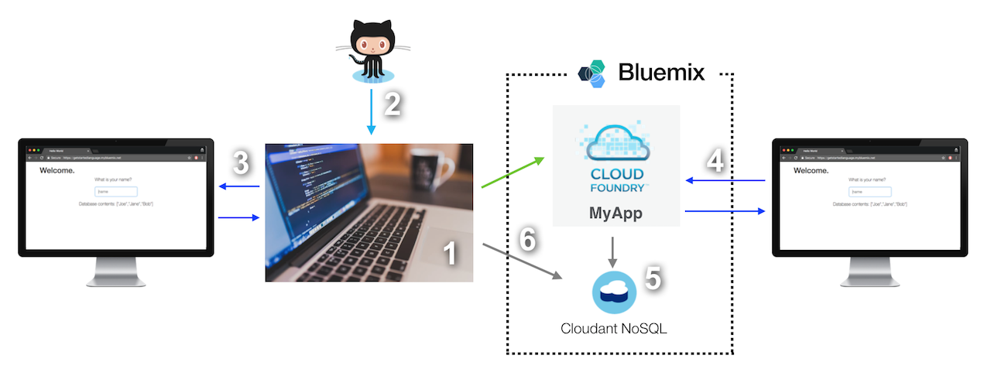
Node.js Runtime

Slide 14
Node.js Runtime

Slide 15
Node.js Demo
A Node.js application that uses express framework to provide a REST API to receive requests from the UI
API uses node-cfenv package to read database credentials and nodejs-cloudant client library to persist the visitor names to a Cloudant database
Pre-requisites:
Bluemix account (http://bluemix.net/)
Cloud Foundry CLI (https://github.com/cloudfoundry/cli#downloads)
Any Git UI tool (https://desktop.github.com/)
Node (https://nodejs.org/)
Notes:
https://console.bluemix.net/docs/runtimes/nodejs/getting-started.html#getting-started-with-node-js-on-bluemix

Slide 16
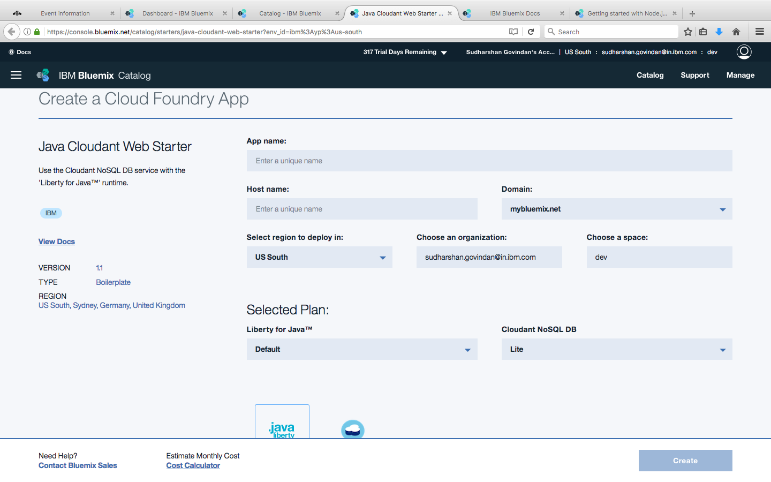
Liberty for Java Runtime
Notes:
https://console.bluemix.net/catalog/starters/java-cloudant-web-starter?env_id=ibm%3Ayp%3Aus-south

Slide 17
Troubleshooting Runtime
Obsolete buildpack used when an app is pushed
Use Cloud Foundry Java / Node.js buildpacks
Enable Node.js buildpack to download node modules from the internet every time
set NODE_MODULES_CACHE=false
NOTICE messages from PHP buildpack
2015-01-26T15:00:59.70+0100 [App/0] ERR [26-Jan-2015 14:00:59] NOTICE: [pool www] 'user' directive is ignored when FPM is not running as root
Change stderr notice to stderr error in nginx-defaults.conf for error_log parameter
Can't import a third-party Python library into Bluemix
Requirements.txt - web.py==0.37 wsgiref==0.1.2
Procfile - web: python <yourappname>.py $PORT

Slide 18
Troubleshooting Runtime
Credentials are required to open a trace or dump window
Error occurs when trace or dump operations are running
Disk quota exceeded

Slide 19


https://developer.ibm.com/code/
Signup for IBM Bluemix
https://bluemix.net

Slide 20



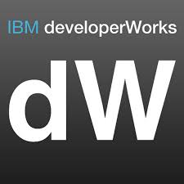


Stay Connected and continue coding !
Code & instructions
https://github.com/IBMDevConnect17/
https://github.com/IBM/
https://github.com/IBM-Bluemix/
https://ibm-bluemix.github.io/#!/
Join Data Science Experience now!
https://datascience.ibm.com/
Apply for the IBM Global Entrepreneur program
https://developer.ibm.com/startups/
Join developerWorks India Community
https://developer.ibm.com/in/
Check out the cool developer journeys
https://developer.ibm.com/code/
Join our Meetup groups
Delhi: https://www.meetup.com/ibmcloudecosystem/
Mumbai:
https://www.meetup.com/Cloud-Mumbai-Meetup/
Hyderabad: https://www.meetup.com/Hyderabad-Cognitive-with-Cloud
Bangalore : https://www.meetup.com/IBMDevConnect-Bangalore
Join our Slack team and stay in touch with the experts
https://ibmdevconnect.slack.com
Send in your request to http://ibm.biz/slackrequest

Slide 21


Please give us your valuable feedback
http://ibm.biz/devconnect17

Slide 22


