Slide 1
Overview of IBM Bluemix & Runtime
Sudharshan Govindan
Developer Advocate, IBM
Twitter : @sudhargovindan

Slide 2
The Future of Retail is Consumer-Connected and Cognitive
58% of retailers agree that businesses focused only on brick-and-mortar stores will not survive past the near future
72% of respondents stated that they believe one or more prominent merchants will disappear in the next 1-3 years
Technology is enabling two tectonic shifts — enabling outsiders to disrupt retail’s traditional business models and drastically changing consumer expectations
The industry will undergo a major transformation in the next 10 years
Retailers need to become more relevant and responsive to stay competitive and increase market share
They’re turning to Cognitive technologies that can analyze massive amounts of unstructured data, enabling them to better understand consumer behaviors and deliver differentiated, individualized shopping experience at any point in time

Slide 3
The Future of Retail is Consumer-Connected and Cognitive (contd)
In an IBM study
91% of retail executives familiar with cognitive computing believe it will play a disruptive role in their organization
94% intend to invest in it
This industry is also realizing the potential of the Internet of Things (IoT), where data harvested from IoT sensors and devices can be used to enhance the customer experience, optimize store operations and improve inventory and supply chain management.
Analysts predict the IoT retail market to grow 20% to $35 billion in five years
The global data supply reached 2.8 ZB in 2012 - or 2.8 trillion GB - but just 0.5% of this is used for analysis, according to IDC
By 2020, data volumes are projected to reach 40 ZB or 5,247 GB per person

Slide 4
The Future of Retail is Consumer-Connected and Cognitive (contd)
Cognitive tools are helping brands manage the in-store experience
Location Analytics can map how customers move through a store
Using IoT enabled sensors, cameras, and devices, Cognitive technologies can track what parts of a store receive the most traffic in general and over different points of the day and week
Staffing can be aligned accordingly so customers get the service they need promptly
IBM Watson is a complete cognitive computing platform
When Watson defeated Jeopardy Champions Brad Rutter and Ken Jennings in 2011, it did one thing—natural language Q&A, based on five technologies
Today, Q&A is only one of many Watson capabilities, from Machine learning to Visual analysis
Many of these capabilities are integrated and made available to developers as APIs

Slide 5
The Future of Retail is Consumer-Connected and Cognitive (contd)
IBM is working with 40 of the top 50 retailers in more than 175countries
Watson is currently engaged with clients in 25 countries and 20 different industries
By combining Watson with our deep industry expertise, IBM can deliver a safe, secure cognitive computing experience for consumers
Presenting intelligent fashion: IBM’s Watson and Vogue unveil the world’s first AI-inspired saree - https://youtu.be/2_7EZIXMt9w
Notes:
IBM Watson used its Personality Insights API and smart IoT integration to create a LED-embedded saree that changes colours based on each WOTY 2017 winner’s dominant personality traits
Watson was tasked with finding dominant patterns and colours from the regions that the winners belonged to, by examining the hashtags of those regions on social networks and crawling through more than 5 million photographs to gather data
Watson’s Visual Recognition API was used to extract specific context around patterns and colors that were most dominant
Data can create magic, and that’s exactly what happened at the WOTY 2017 ceremony. The team analysed each winner’s personality from their Twitter handles and mapped it against seven traits which included:
Effectiveness in organising thoughts
Open-mindedness and originality
Confidence in problem solving
Action orientation
Conscientiousness
Openness to possibilities and alternatives
Social energy

Slide 6
What is Bluemix ?
IBM's innovative open-standards, cloud computing platform that combines PaaS with IaaS
Bluemix enables you to:
Deploy high performance compute and storage infrastructure
Test and adopt a broad range of cloud services and capabilities
Connect to all of your legacy systems and apps
Spin up and turn down resources in real time
Options to run your apps:
Boilerplates
Runtime
Container Service
Open Whisk
Notes:
IBM's innovative open-standards, cloud computing platform that combines platform as a service (PaaS) with infrastructure as a service (IaaS) for building, running, and managing applications
It has a rich catalog of cloud services that can be easily integrated with PaaS and IaaS to build business applications rapidly
Bluemix has cloud deployments that fit your needs whether you are a small business that plans to scale, or a large enterprise that requires additional isolation. You can develop in a cloud without borders, where you can connect your private services to the public Bluemix services available from IBM.
You and your team can access the apps, services, and infrastructure in Bluemix and use existing data, systems, processes, PaaS tools, and IaaS tools. Developers can tap into the rapidly growing ecosystem of available services and runtime frameworks to build applications using polyglot programming approaches.
With Bluemix, you no longer have to make large investments in hardware to test out or run a new app. Instead, we manage it all for you and only charge for what you use. Bluemix provides public, dedicated, and local integrated deployment models.
Bluemix enables you to:
Deploy high performance compute and storage infrastructure in secure IBM Cloud Data Centers around the world
Test and adopt a broad range of cloud services and capabilities from IBM, open source communities, and third-party developers
Connect to all of your legacy systems and apps from a single, scalable, cloud platform through private network and API capabilities
Spin up and turn down resources in real time as your business needs or workload demands change
Options to run your apps:
A boilerplate is a template for an application and its associated runtime environment and predefined services for a specific domain
A runtime is the set of resources that is used to run an app, provided as containers for different types of apps
Use Container Service to run Docker containers in a hosted cloud environment on Bluemix
Use OpenWhisk for distributed, event-driven computing. OpenWhisk runs application logic in response to events or direct invocations from web or mobile apps over HTTP.

Slide 7
Bluemix Console
Dashboard
Account, Region, Organization and Space
Catalog, Support and Billing
Documentation

Slide 8
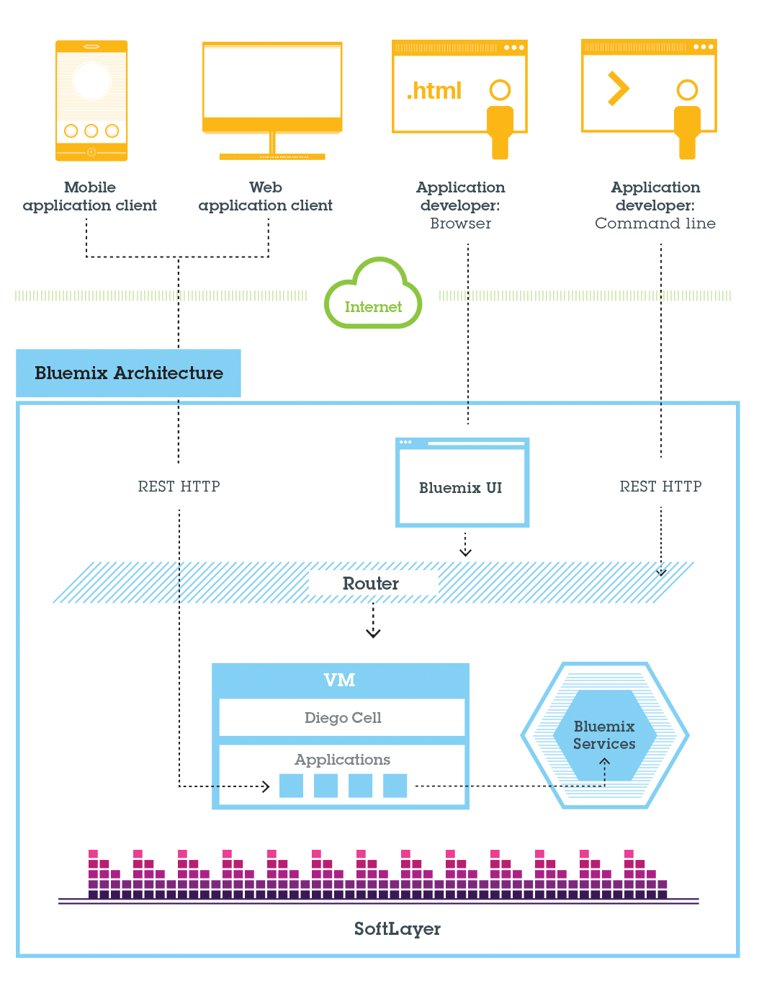
IBM Cloud Platform – Bluemix
Notes:
In general, you don't have to worry about the operating system and infrastructure layers when running apps on Bluemix in Cloud Foundry. Layers such as root filesystems and middleware components are abstracted so that you can focus on your application code.
As a developer, you can interact with the Bluemix infrastructure by using a browser-based user interface. You can also use a Cloud Foundry command line interface, called cf, to deploy web apps.
Clients--which can be mobile apps, apps that run externally, apps that are built on Bluemix, or developers that are using browsers--interact with the Bluemix-hosted apps. Clients use REST or HTTP APIs to route requests through Bluemix to one of the app instances or the composite services.
You can deploy your apps to different Bluemix regions, for latency or security considerations. You can choose to deploy either to one region or across multiple regions.

Slide 9
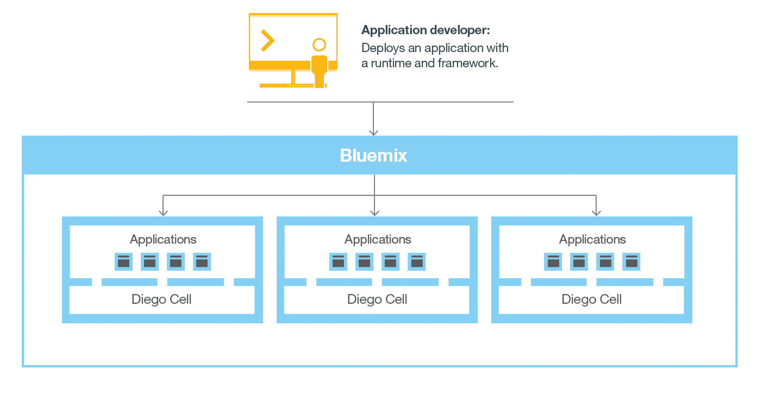
Bluemix Cloud Foundry
Notes:
When you deploy an app to Bluemix Cloud Foundry, you must configure Bluemix with enough information to support the app.
For a mobile app, Bluemix contains an artifact that represents the mobile app's back end, such as the services that the mobile app uses to communicate with a server.
For a web app, you must ensure that information about the runtime and framework is communicated to Bluemix, so that Bluemix can set up the appropriate execution environment to run the app.
Each execution environment, including both mobile and web, is isolated from the execution environment of other apps, even though these apps are on the same physical machine

Slide 10
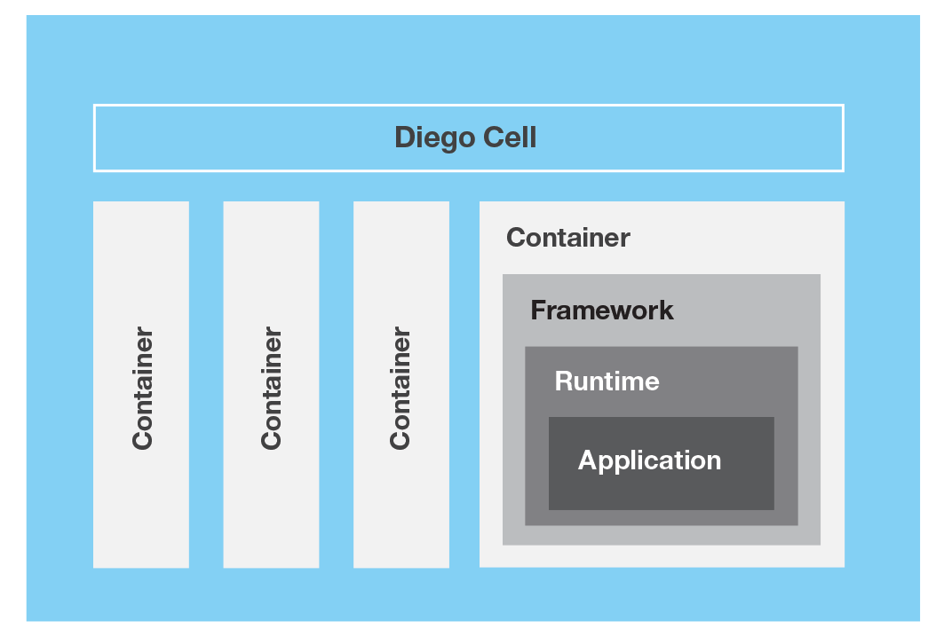
Bluemix Cloud Foundry (contd)
Notes:
When you create an app and deploy it to Bluemix Cloud Foundry, the Bluemix environment determines an appropriate virtual server to send the app, or the artifacts that the app represents, to.
For a mobile app, a mobile back-end projection is created on Bluemix. Any code for the mobile app running in the cloud eventually runs in the Bluemix environment.
For a web app, the code running in the cloud is the app itself that the developer deploys to Bluemix.
The determination of the virtual server is based on several factors, including:
The load already on the machine
Runtimes or frameworks supported by that virtual server
After a virtual server is chosen, an application manager on each virtual server installs the appropriate framework and runtime for the app. Then, the app can be deployed into that framework. When the deployment completes, the application artifacts are started.
The following figure shows the structure of a virtual server, also known as Droplet execution agent (DEA), that has multiple apps deployed to it
Each app can have one or more URLs associated with it, but they must all point to the Bluemix endpoint. When a request comes in, Bluemix examines the request, determines which app it is intended for, then selects an instance of the app to receive the request.

Slide 11
Bluemix Pre-requisites
Browsers
Chrome
Firefox
Internet Explorer: version 11
Safari
Cloud Foundry
cf command line interface, version 6.5.1 or later

Slide 12
Bluemix Deployment Models
Public
Infrastructure resources are shared by different companies and users
Dedicated
Your own dedicated Bluemix Infrastructure (SoftLayer), which you can connect securely to Bluemix Public cloud and your own network
Local
Sits behind your company firewall, which can protect your most sensitive workloads and can connect securely to both Bluemix Public and Bluemix Dedicated clouds

Slide 13
Bluemix Security
https://console.bluemix.net/docs/api/content/security/images/platform_sec.svg?lang=en
https://console.bluemix.net/docs/api/content/security/images/security_local_platform.svg?lang=en

Slide 14
What is a Runtime ?
Runtimes are based on Bluemix Cloud Foundry—of which IBM is both a founding and platinum member
Runtimes get innovative ideas to market fast with reduced development costs
Runtimes support stateless processes and promote application fault tolerance and scalability
Runtimes link Bluemix services to applications as endpoints
Notes:
They ensure that the build and deploy aspects of coding remain carefully coordinated with any attached services, resulting in quick, consistent, and reliable iterating of applications in production
They level the field of opportunity so that any organization can keep up with or set a new pace of market transformation
One can quickly start and stop, replicate if an instance fails, and duplicate if sustained or increased performance requires
Giving any instance of an application embedded knowledge of how to manage relevant calls and data. In fact, runtimes manage all linked resources through SDKs, APIs (whether made available as Bluemix services or exposed from within a traditional enterprise as custom services), and also applications themselves when used as resources by other applications.

Slide 15
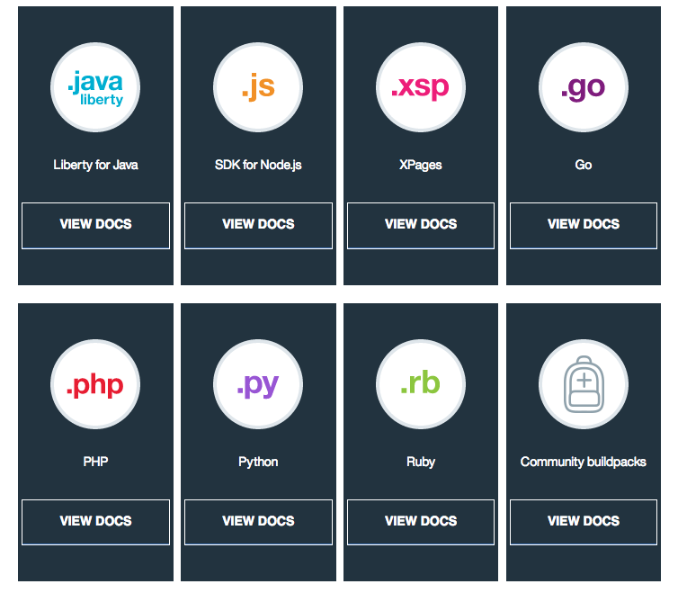
Runtime
Notes:
Bluemix Cloud Foundry includes runtimes for Java, Node.js, PHP, Python, Ruby, Swift, Go, ASP.NET Core and Community build packs
Combined with DevOps services, the application runtimes enable a delivery pipeline that automates much of the iterative development process

Slide 16
Node.js Runtime
In 10 minutes or less, you’ll learn to:
Set up a development environment
Download sample code
Run the application locally
Run the application on Bluemix Cloud Foundry
Add a Bluemix Database service
Connect to the database from your local application

Slide 17
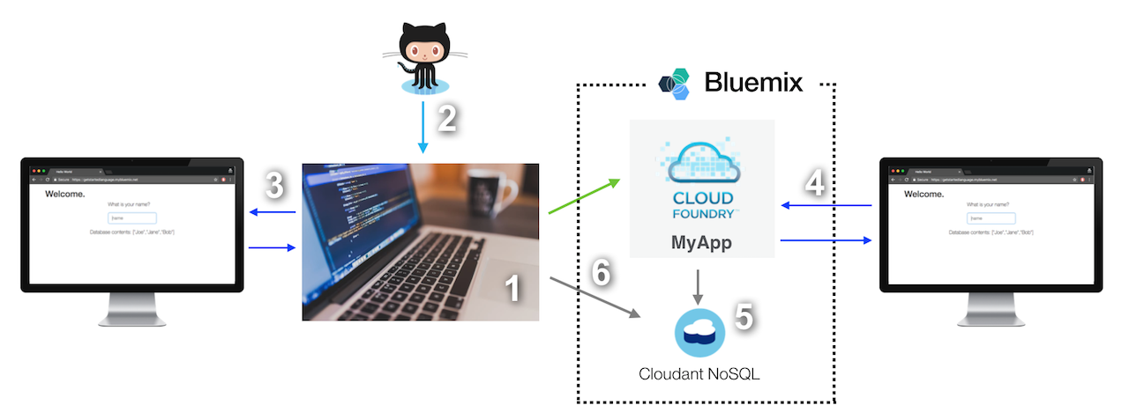
Node.js Runtime

Slide 18
Node.js Runtime

Slide 19
Node.js Demo
A Node.js application that uses express framework to provide a REST API to receive requests from the UI
API uses node-cfenv package to read database credentials and nodejs-cloudant client library to persist the visitor names to a Cloudant database
Pre-requisites:
Bluemix account (http://bluemix.net/)
Cloud Foundry CLI (https://github.com/cloudfoundry/cli#downloads)
Any Git UI tool (https://desktop.github.com/)
Node (https://nodejs.org/)
Notes:
https://console.bluemix.net/docs/runtimes/nodejs/getting-started.html#getting-started-with-node-js-on-bluemix

Slide 20
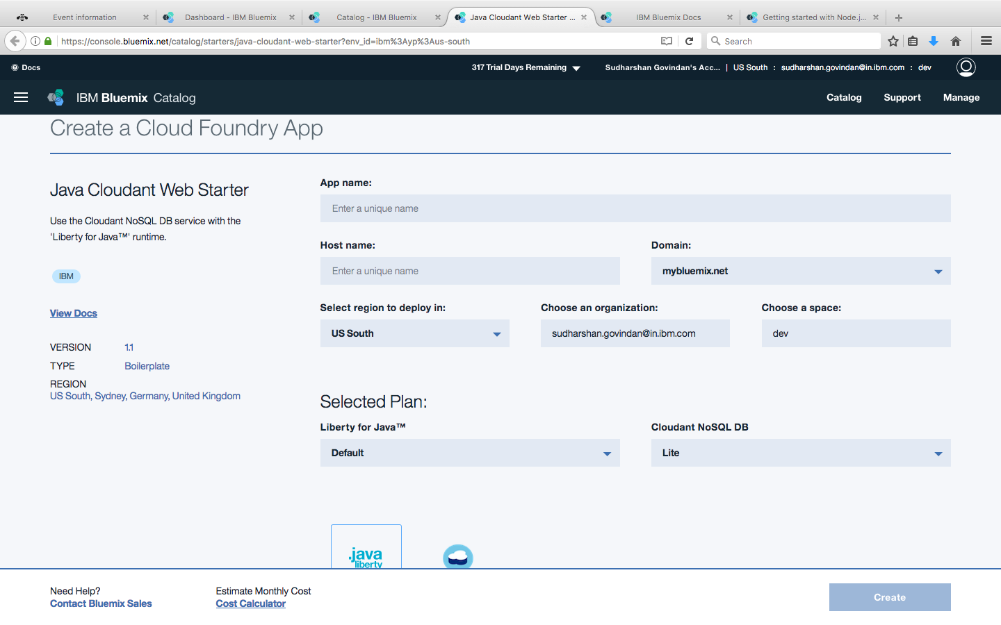
Liberty for Java Runtime
Notes:
https://console.bluemix.net/catalog/starters/java-cloudant-web-starter?env_id=ibm%3Ayp%3Aus-south

Slide 21
Troubleshooting Runtime
Obsolete buildpack used when an app is pushed
Use Cloud Foundry Java / Node.js buildpacks
Enable Node.js buildpack to download node modules from the internet every time
set NODE_MODULES_CACHE=false
NOTICE messages from PHP buildpack
2015-01-26T15:00:59.70+0100 [App/0] ERR [26-Jan-2015 14:00:59] NOTICE: [pool www] 'user' directive is ignored when FPM is not running as root
Change stderr notice to stderr error in nginx-defaults.conf for error_log parameter
Can't import a third-party Python library into Bluemix
Requirements.txt - web.py==0.37 wsgiref==0.1.2
Procfile - web: python <yourappname>.py $PORT
Notes:
You might not be able to use the latest buildpack components when you push an app. You can use buildpacks that have built-in mechanisms to prevent loading obsolete components, or you can delete the contents in your app's cache directory before you push or restage the app.
What's happening
When you push or restage an app after the buildpack is updated, the latest buildpack components aren't loaded automatically. As a result, your app uses the obsolete buildpack components from the cache. Updates that were applied to the buildpack since the last time you pushed the app aren't implemented.
Why it's happening
Some buildpacks aren't configured to automatically download all updated components from the internet to ensure that you always use the latest version.
How to fix it
You can use buildpacks that have built-in mechanisms to avoid loading obsolete components, for example:
Cloud Foundry Java buildpack has a built-in mechanism to ensure that the latest version of the buildpack is used
Cloud Foundry Node.js buildpack provides similar functionality by using environment variables
If the buildpack that you are using doesn't provide a mechanism to load the latest components automatically, you can manually delete the contents in the cache directory and push your app again
You might see messages that contain NOTICE from the logs. You can stop the logging of these messages by changing the logging level.
What's happening
When you push an app to Bluemix by using a PHP buildpack, you might see messages that contain NOTICE
Why it's happening
In the PHP buildpack, the error_log parameter defines the logging level. By default, the value of the error_log parameter is stderr notice
How to fix it
The NOTICE messages are for information and might not indicate a problem. You can stop the logging of these messages by changing the logging level from stderr notice to stderr error in the nginx-defaults.conf file of your buildpack.
You might not be able to import a third-party Python library into Bluemix. To resolve the problem, add configuration files to the root directory of your python app.
What's happening
When you try to import a third-party Python library, such as the web.py library, the cf push command fails
Why it's happening
Configuration information for the Python app is missing
How to fix it
Add a requirements.txt file and a Procfile file to the root directory of your Python app
The requirements.txt file specifies the library packages that are required for your Python app and the version of the packages. The following example shows the content of the requirements.txt file, where web.py==0.37 indicates the version of the web.py library that will be downloaded is 0.37, and wsgiref==0.1.2 indicates the version of the web server gateway interface that is required by the web.py library is 0.1.2.
The Procfile file must contain the start command for your Python app. In the following command, yourappname is the name of your Python app, and PORT is the port number that your Python app must use to receive requests from users of the app. $PORT is optional. If you don't specify PORT in the start command, the port number under the VCAP_APP_PORT environment variable that is inside the app is used.

Slide 22
Troubleshooting Runtime
Credentials are required to open a trace or dump window
Error occurs when trace or dump operations are running
Disk quota exceeded
Notes:
Credentials are required to open a trace or dump window
What's happening
A user name and password are required to open the trace or dump window
Why it's happening
This problem occurs because of the login session timeout
How to fix it
Enter the user name and password again
Error occurs when trace or dump operations are running
What's happening
An error message is displayed while the trace or dump operations are running. The message indicates that a target instance for an app isn't in the running state.
Why it's happening
This problem occurs for the following reasons:
The trace or dump management capabilities are only for app instances that are running. Trace or dump operations can't be used on app instances that are stopped, starting, or crashed.
The status of the app instance is changing when the trace or dump dialog is opened
How to fix it
Close the window, then open it again.
Disk quota exceeded
What's happening
You see the Disk quota exceeded error message in the log of your app.
Why it's happening
This problem occurs for one of the following reasons:
The dump files are generated with the running app instances, and the files use up the allocated disk quota.
The disk quota is limited by the current organization quota.
How to fix it
Use one of the following methods:
Delete dump files after they are downloaded.
Redeploy the app with a bigger disk quota in the deployment manifest

Slide 23


https://developer.ibm.com/code/
Signup for IBM Bluemix
https://bluemix.net

Slide 24


Code & Assets
https://github.com/IBM
https://github.com/IBM-Bluemix
https://ibm-bluemix.github.io/#!
https://github.com/watson-developer-cloud
https://github.com/ibm-bluemix-mobile-services
Join our Slack team and stay in touch with experts
https://ibmdevconnect.slack.com
Send in your request to http://ibm.biz/slackrequest

Slide 25
THANK YOU !
Sudharshan Govindan
Developer Advocate, IBM
Twitter : @sudhargovindan

