Slide 1
Intro to Kubernetes
WW Developer Advocacy Team

Slide 2
But Wait? What About Production?
Automated scheduling and scaling
Zero downtime deployments
High availability and fault tolerance
A/B deployments

Slide 3
What is container orchestration?
Container orchestration
Cluster management
Scheduling
Service discovery
Replication
Health management
Manager
Image Repository
Scheduler
Discovery DB
Replicator
Node
Node
Node
Daemon
Daemon
Daemon
Containers
Containers
Containers
© Copyright IBM Corporation 2017

Slide 4
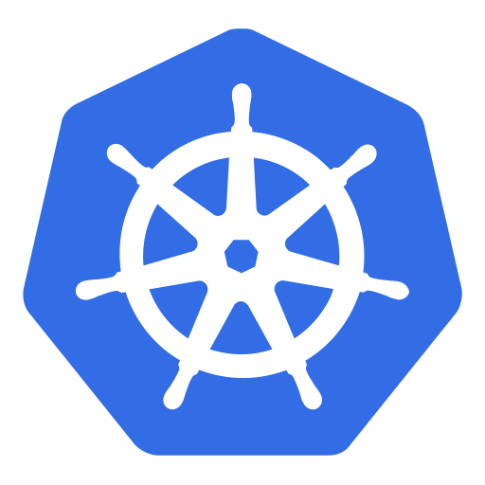
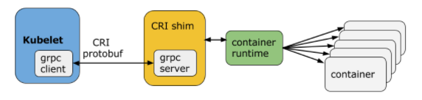
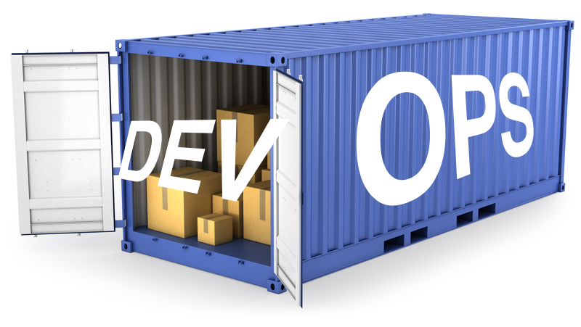
Container Runtime Interface
As at V1.18:
Docker
CRI-O
Containerd
frakti
Notes:
standard interface for operations will come in handy when trying to solve problems like providing external configuration, and generic operations concerns such as scheduling applications, scaling etc.
it also a measure of portability. applications are self-contained. no dependencies on underlying infrastructure. run on any platform, on-prem cloud, doesn’t matter. Only requirement is linux or windows, and the docker engine installed

Slide 5
What is Kubernetes?
Container Orchestrator
Provision, manage, scale applications
Manage infrastructure resources needed by applications
Volumes
Networks
Secrets
And many many many more..
What's in a name?
Kubernetes (K8s/Kube): "Helmsman" in ancient Greek
Declarative model
Provide the "desired state" and Kubernetes will make it happen
Notes:
Now that we know what containers are, let us define what Kubernetes is. Kubernetes is a container orchestrator to provision, manage, and scale applications. In other words Kubernetes allows you to manage the lifecycle of containerised applications within a cluster of Nodes.
Your applications need many other resources to run such as Volumes, Networks, Secrets that will help you to do things such as connect to databases, talk to firewalled backends, and secure keys. Kubernetes helps you add these resources into your application.
Infrastructure resources needed by applications are managed declaratively.
The key paradigm of kubernetes is it’s Declarative model. The user provides the "desired state" and Kubernetes will make it happen. If you need 5 instances, you do not start 5 separate instances on your own but rather tell Kubernetes that you need 5 instances and Kubernetes will reconcile the state automatically. Simply at this point you need to know that you declare the state you want and Kubernetes make that happen, if something goes wrong with one of your instances and it crashes, Kubernetes still knows the desired state and restores the crashed instance on an available node.
Kubernetes goes by many names. Sometimes it is shortened to k8s (losing the internal 8 letters), or kube. The word is rooted in ancient greek and means "Helmsman". A helmsman is the person who steers a ship. We hope you can seen the analogy between directing a ship and the decisions made to orchestrate containers on a cluster.

Slide 6
How was Kubernetes created
Based on Google’s Borg & Omega
Open Governance
Cloud Native Compute Foundation
Adoption by Enterprise
RedHat, Microsoft, IBM and Amazon
Notes:
Kubernetes is built on the experience of Google when running cloud scale applications on their internal product called Borg. Google open sourced the project. A Open source project allows you to download the code, play with it and if you want to make changes, you can do so and contribute back. Kubernetes contributor community grew incredibly fast as many companies realized the value of the project.
Kubernetes also adopted Open Governance under the CNCF which allowed community of contributors to decide on all aspects of the project including design, development and release cycles. Google or any other company will not dictate the direction of the project. The community itself is responsible for the fate of the project.
Google wanted to open source their knowledge of creating and running the internal tools Borg & Omega. It adopted Open Governance by starting the Cloud Native Computing Foundation (CNCF) making it less influenced by Google. Many companies such as RedHat, Microsoft, IBM and Amazon quickly joined the foundation.

Slide 7
Kubernetes Architecture
At its core, Kubernetes is a database (etcd). With "watchers" & "controllers" that react to changes in the DB. The controllers are what make it Kubernetes. This pluggability and extensibility is part of its "secret sauce".
DB represents the user's desired state
Watchers attempt to make reality match the desired state
"API Server" is the HTTP/REST front-end to the DB
More on controllers later...
Client/User
API Server
Watcher Controller
Request
Monitor
DB
Networks
Node
Volumes
Secrets
...
Notes:
At its core, Kubernetes is a data store (etcd). The declarative model is stored in the data store as objects, that means when you say I want 5 instances of a container then that request is stored into the data store. This information change is watched and delegated to Controllers to take action. Controllers then react to the model and attempt to take action to achieve the desired state. The power of Kubernetes is in its simplistic model.
As shown, API server is a simple HTTP server handling create/read/update/delete(CRUD) operations on the data store. Then the controller picks up the change you wanted and makes that happen. Controller are responsible for instantiating the actual resource represented by any Kubernetes resource. These actual resources are what your application needs to allow it to run successfully.

Slide 8
Kubernetes Resource Model
A resource for every purpose
Config Maps
Daemon Sets
Deployments
Events
Endpoints
Ingress
Jobs
Nodes
Namespaces
Pods
Persistent Volumes
Replica Sets
Secrets
Service Accounts
Services
Stateful Sets, and more...
Kubernetes aims to have the building blocks on which you build a cloud native platform.
Therefore, the internal resource model is the same as the end user resource model.
Key Resources
Pod: set of co-located containers
Smallest unit of deployment
Several types of resources to help manage them
Replica Sets, Deployments, Stateful Sets, ...
Services
Define how to expose your app as a DNS entry
Query based selector to choose which pods apply
Notes:
Kubernetes Infrastructure defines a resource for every purpose. Each resource is monitored and processed by a controller. When you define your application, it contains a collection of these resources. This collection will then be read by Controllers to build your applications actual backing instances. Some of resources that you may work with are listed below for your reference, for a full list you must go to https://kubernetes.io/docs/concepts/. In this class we will only use a few of them, like Pod, Deployment, etc.
Config Maps holds configuration data for pods to consume.
Daemon Sets ensure that each node in the cluster runs this Pod
Deployments defines a desired state of a deployment object
Events provides lifecycle events on Pods and other deployment objects
Endpoints allows a inbound connections to reach the cluster services
Ingress is a collection of rules that allow inbound connections to reach the cluster services
Jobs creates one or more pods and as they complete succefully the job is marked as completed.
Node is a worker machine in Kubernetes
Namespaces are multiple virtual clusters backed by the same physical cluster
Pods are the smallest deployable units of computing that can be created and managed in Kubernetes
Persistent Volumes provides an API for users and administrators that abstracts details of how storage is provided from how it is consumed
Replica Sets ensures that a specified number of pod replicas are running at any given time
Secrets are intended to hold sensitive information, such as passwords, OAuth tokens, and ssh keys
Service Accounts provides an identity for processes that run in a Pod
Services is an abstraction which defines a logical set of Pods and a policy by which to access them - sometimes called a micro-service.
Stateful Sets is the workload API object used to manage stateful applications.
and more...
Kubernetes does not have the concept of an application. It has simple building blocks that you are required to compose. Kubernetes is a cloud native platform where the internal resource model is the same as the end user resource model.

Slide 9
Kubernetes Client
CLI tool to interact with Kubernetes cluster
Platform specific binary available to download
https://kubernetes.io/docs/tasks/tools/install-kubectl
The user directly manipulates resources via json/yaml
$ kubectl (create|get|apply|delete) -f myResource.yaml

Slide 10
Kubernetes in Action!
User via "kubectl" deploys a new application
API server receives the request and stores it in the DB (etcd)
Watchers/controllers detect the resource changes and act upon it
ReplicaSet watcher/controller detects the new app and creates new pods to match the desired # of instances
Scheduler assigns new pods to a kubelet
Kubelet detects pods and deploys them via the container runtime (e.g. Docker)
Kubeproxy manages network traffic for the pods – including service discovery and load-balancing
Kub Client
( kubectl )
deployment.yml
1
6
Master
Node
Node
API Server
Storage
(etcd)
Kublet
Kube-Proxy
7
2
Images
Ubuntu
Liberty
3
Pod
Controllers
Replication
Endpoints
...
Pod/Service
Scheduler
4
Docker Engine
C
C
C
5
Base OS/Kernel

Slide 11
Benefits of Container Orchestration
Automated scheduling and scaling
Zero downtime deployments
High availability and fault tolerance
A/B deployments
Manager
Image Repository
Scheduler
Discovery DB
Replicator
Node
Node
Node
Daemon
Daemon
Daemon
Containers
Containers
Containers
© Copyright IBM Corporation 2017

Slide 12
But Wait? What About Production?
Kubernetes by itself is not enterprise-ready
Kubernetes must integrate with underlying platform to provide infrastructure, storage, etc.
Lacking in operational view + controls, pre-built catalogs

Slide 13
Kubernetes @ IBM
Offerings / Plans
IKS - IBM Cloud Kubernetes Service
ICP - IBM Cloud Private
IBM Cloud service teams use Kubernetes to host
Key Development Activities
Service Catalog (co-lead)
Contributor Experience
Networking & Istio (co-lead)
ContainerD integration (co-lead)
Storage
Performance

