Slide 1
Hands on Lab
Deploy an application on IBM Cloud Kubernetes Cluster
Jeya Gandhi Rajan M

Slide 2
Agenda
Objective
Pre Requisite
Cluster Operations
Deploy the application
Access the application
Scale the application
Delete the application

Slide 3
Objective
Deploy hello-world application docker image in the IBM Cloud Kubernetes cluster
Scale the application

Slide 4
Pre Requisite
User should have registered and got the IBM cloud trail account access
The Kubernetes clusters should have been created

Slide 5
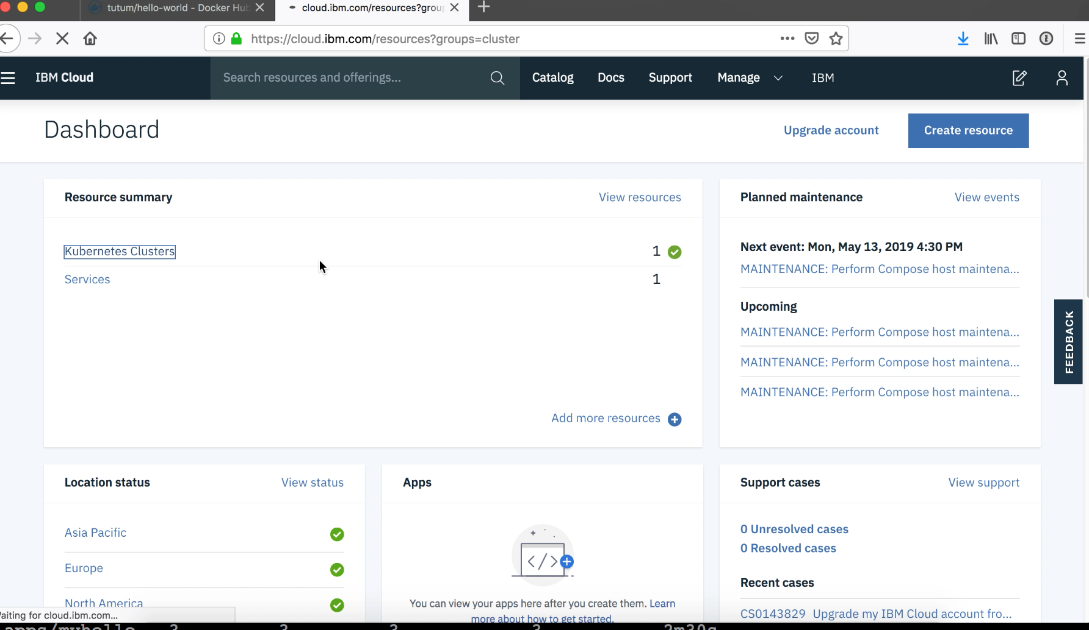
Login to IBM Cloud
Login to the IBM cloud account
https://cloud.ibm.com
Click on Kubernetes Clusters

Slide 6
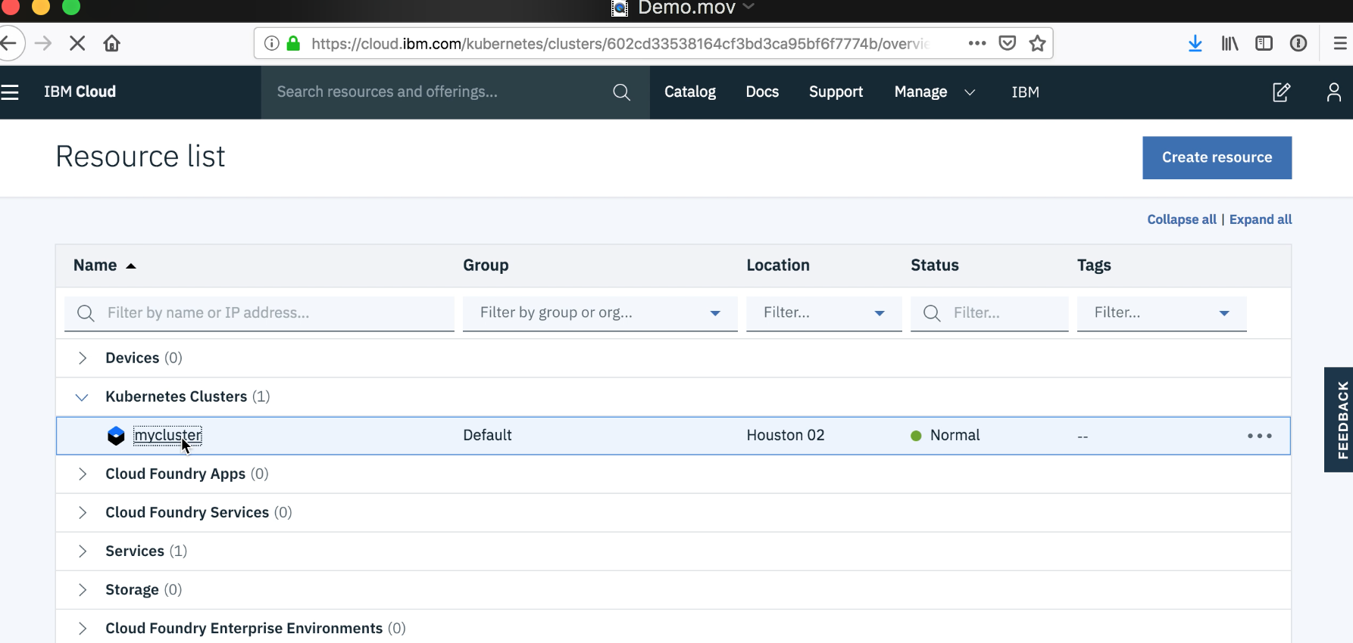
Select Kubernetes cluster
Click on mycluster, which you have already created

Slide 7
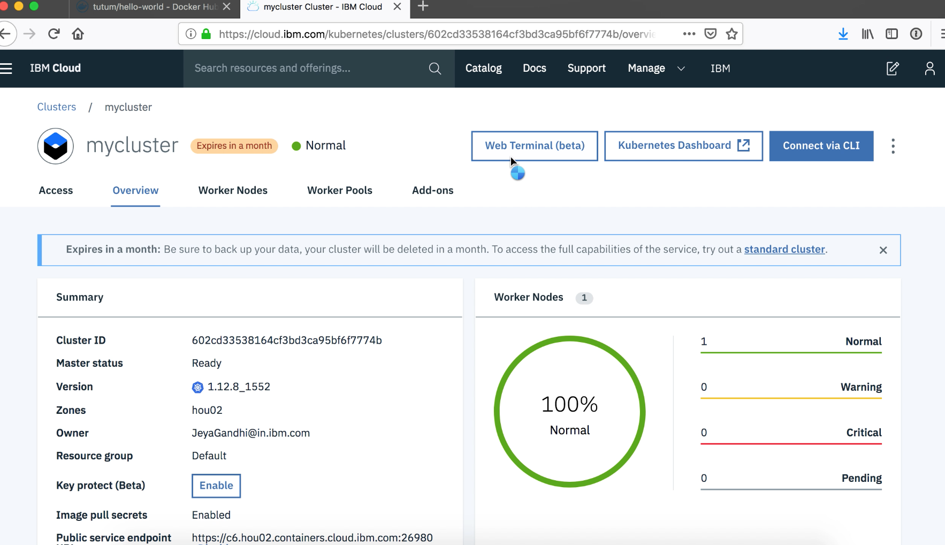
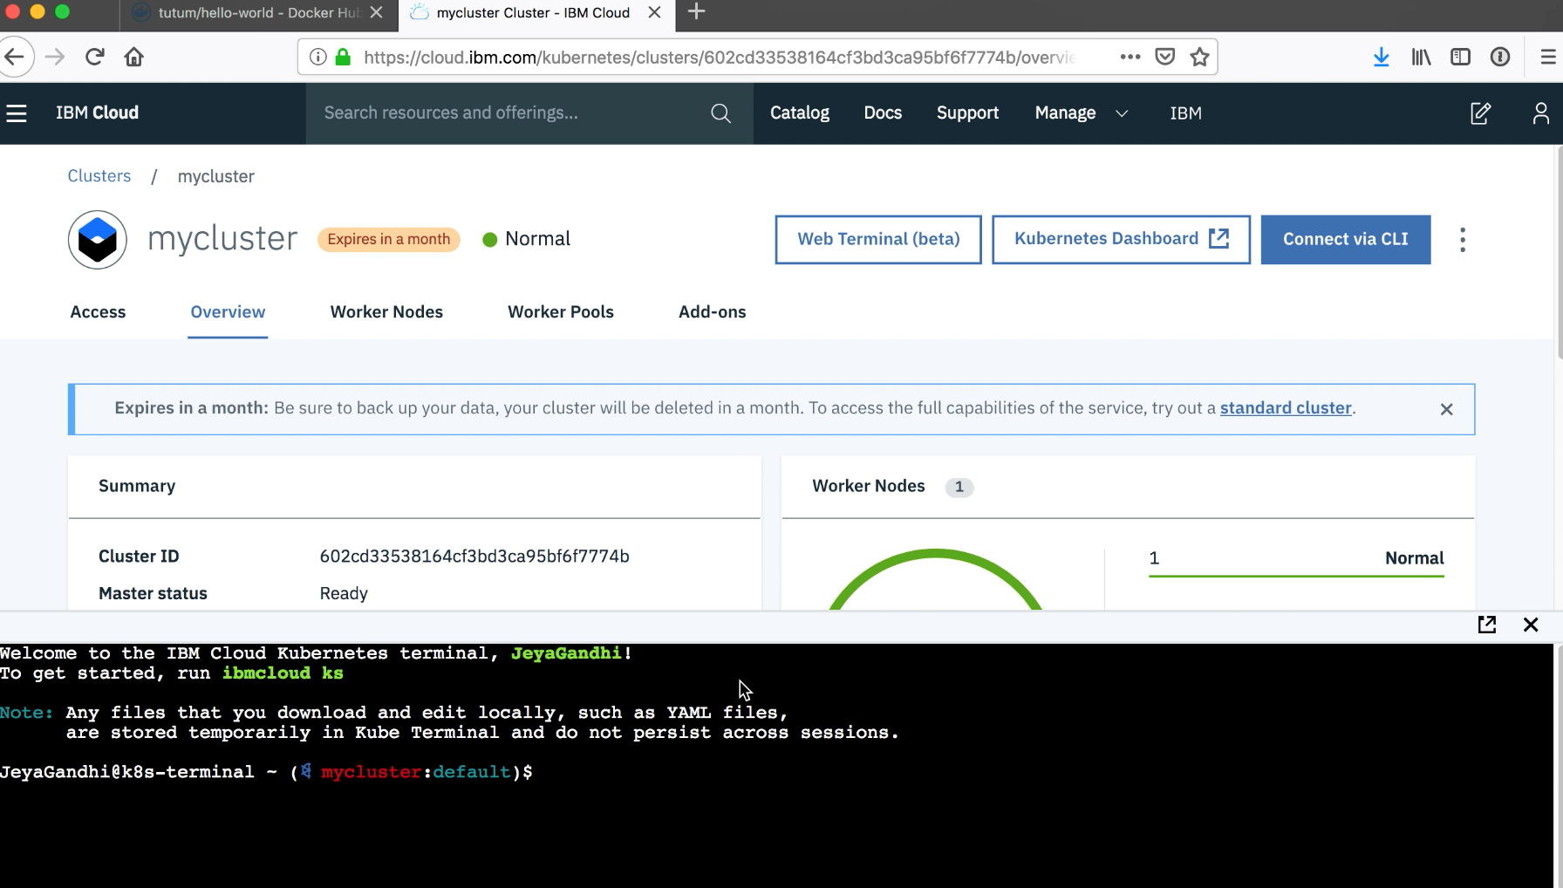
Choose Web Terminal
Click on Web Terminal button
Choose the full screen icon in the web terminal

Slide 8
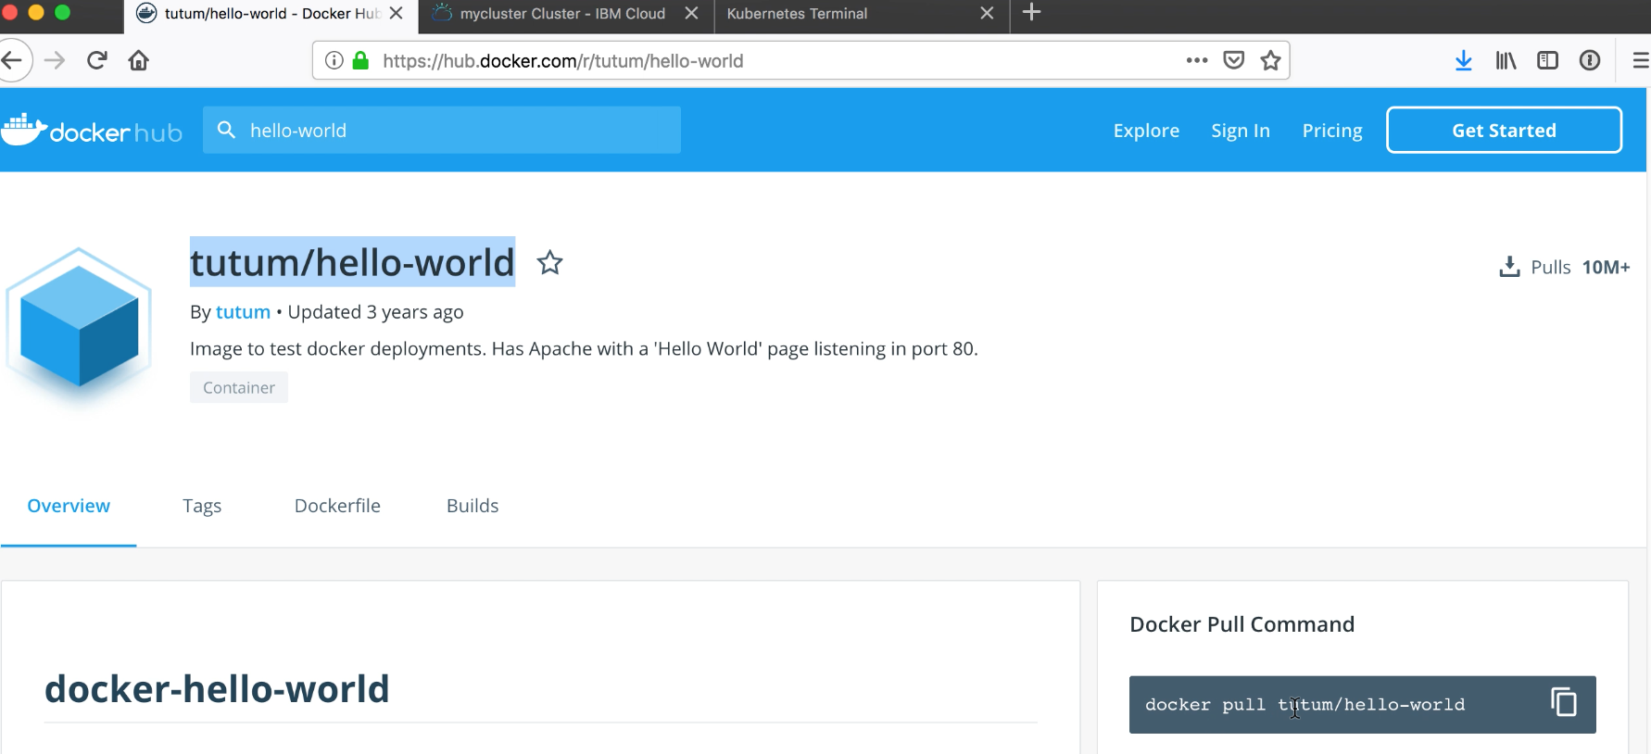
Hello-World image
We are going to deploy this hello-world image from docker hub

Slide 9
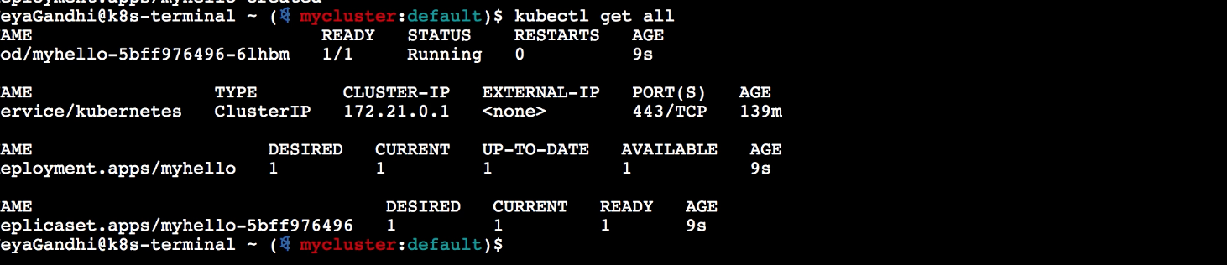
Deploy the application
Use kubectl create to deploy the app
kubectl create deployment myhello --image=tutum/hello-world
Use kubectl get all to display all the resources that we created
kubectl get all

Slide 10
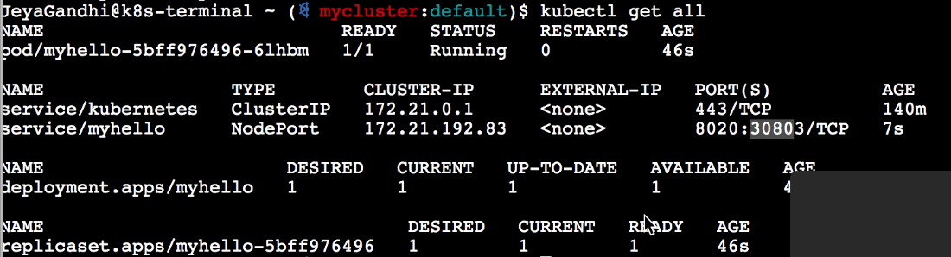
Expose the service outside the cluster
Use kubectl expose to expose the deployed app outside the cluster
kubectl expose deployment myhello --port=8020 --target-port=80 --type=NodePort
See the resources created.
Note that service is exposed in the port 30803
kubectl get all

Slide 11
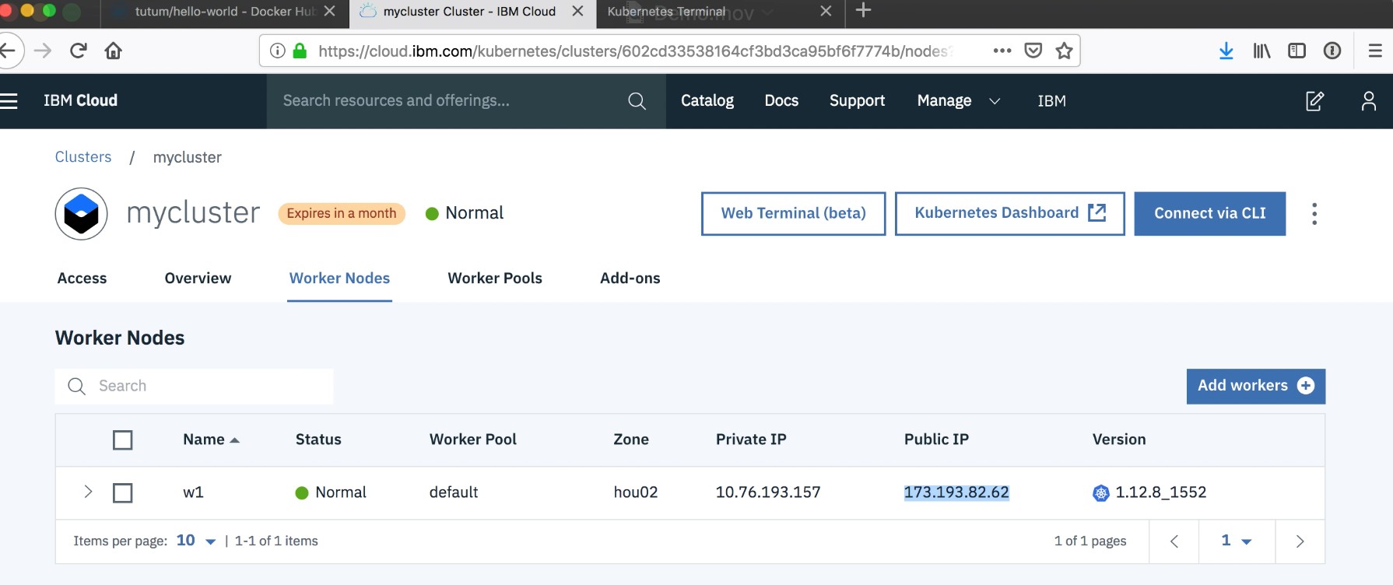
Find the public IP of the cluster
Go to the Worker Nodes tab
Look at the Public IP Column
Note that the public ip is 173.193.82.62

Slide 12
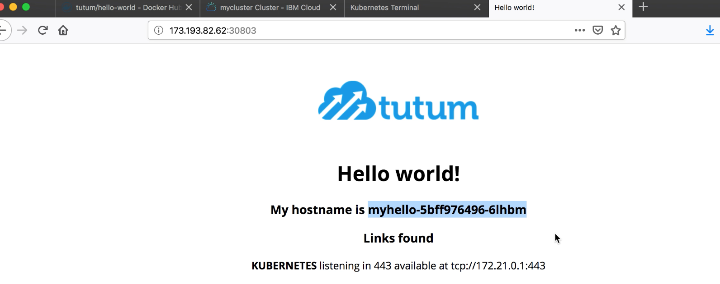
Access the deployed application
Access the application using the IP and Port that we identified in the previous steps
http://173.193.82.62:30803
Note that the host name displayed in the application is same as the pod name

Slide 13
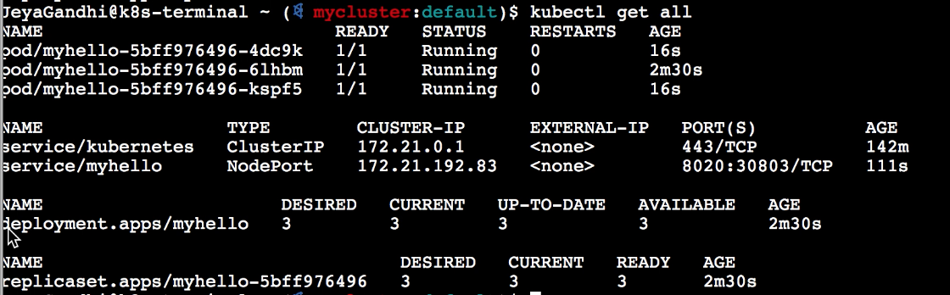
Scaling the application
Use kubectl scale to scale the application. Here we are going to have 3 instances
kubectl scale --replicas=3 deployment.apps/myhello
See the 3 instances got created.

Slide 14
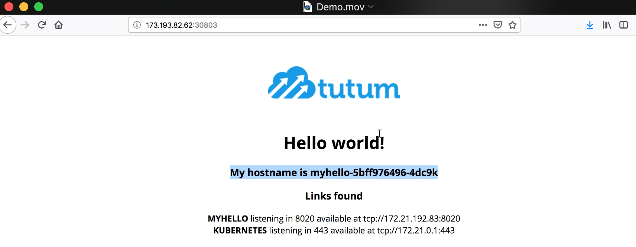
Scaling application
Access the application from another browser and see the host name displayed

Slide 15
Scaling application
Access the application from another browser and see the host name displayed

Slide 16
Deleting the resources
The created resources can be deleted through the following commands
kubectl delete deployment --all
kubectl delete service --all

