Slide 1
Hands on Workshop - Cloud
IBM Cloud and Kubernetes cluster
Jeya Gandhi Rajan M

Slide 2
Agenda
IBM Cloud trial account Registration
Create Kubernetes Cluster in IBM Cloud
Presentation
Dockers
Kubernetes
Hands on lab

Slide 3
IBM Cloud trial account Registration and activation
Create your free account with your mail id
Activate the account by clicking on the link sent to your mail id
Upgrade your account to trail account by using the promo codes
Open the IBM Cloud web console
https://cloud.ibm.com/registration
https://cloud.ibm.com

Slide 4
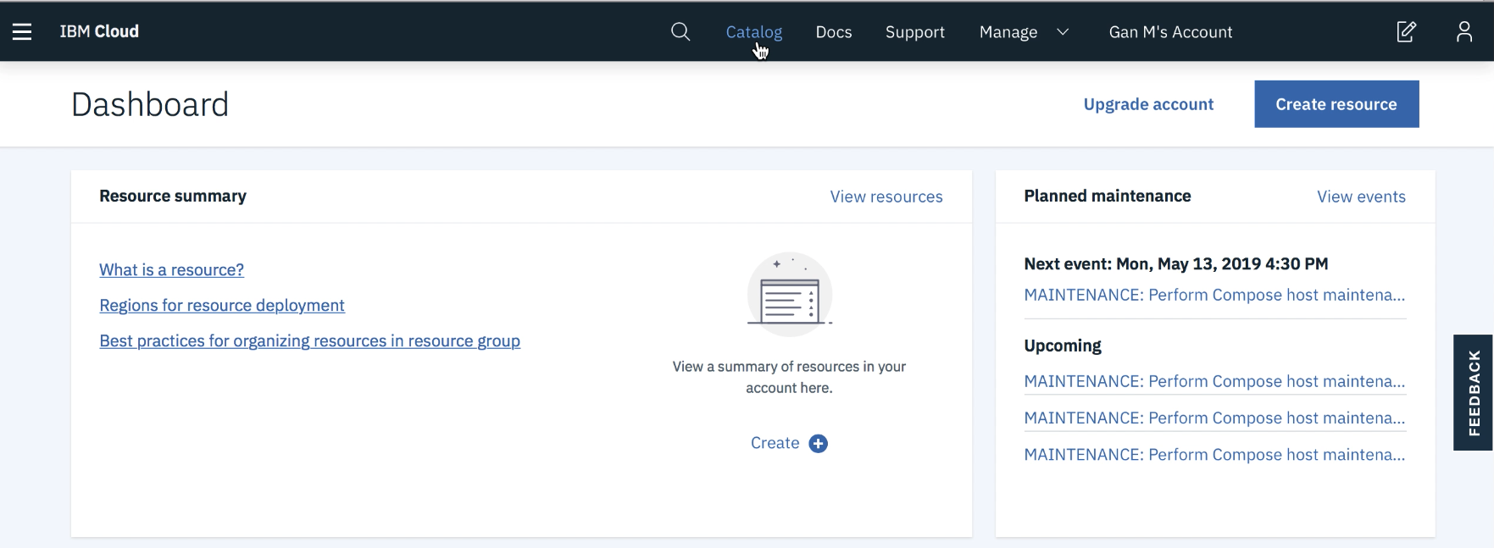
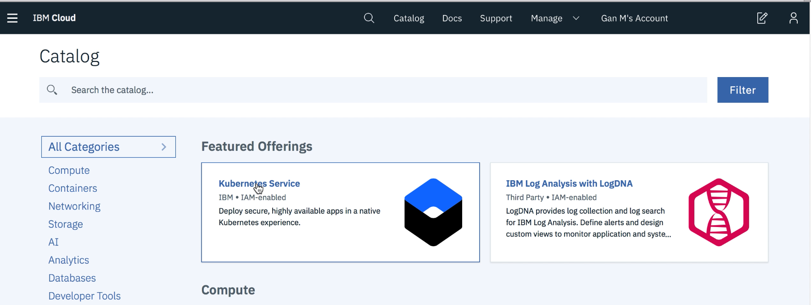
Create Kubernetes Cluster
Login to IBM Cloud with your credentials.
Click on Catalog
Click on Kubernetes Service
https://cloud.ibm.com

Slide 5
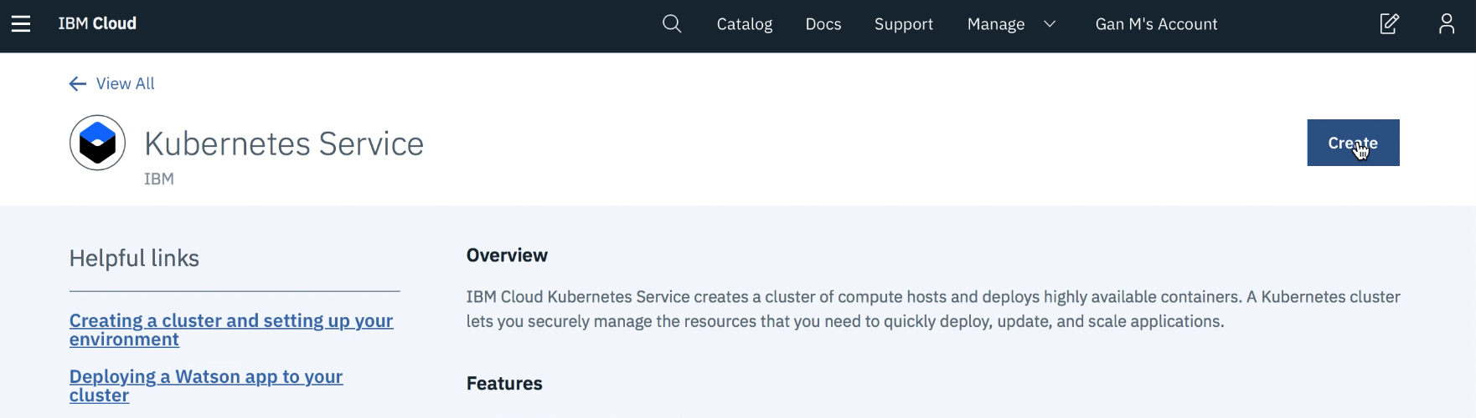
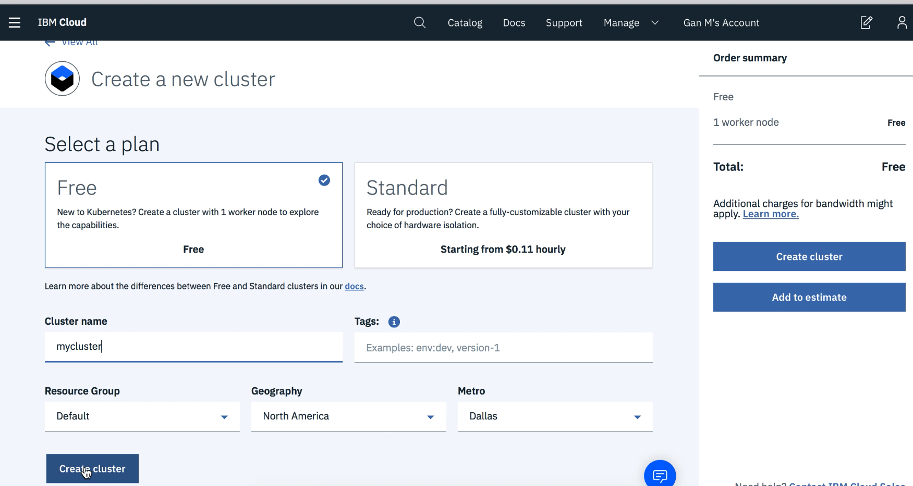
Create Kubernetes Cluster …
Click on Create
Select a Plan - Free
Click on Create Cluster

Slide 6
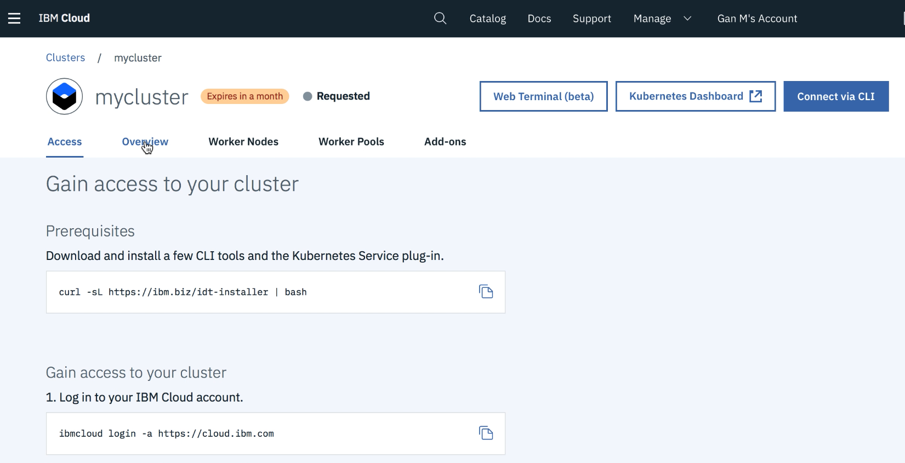
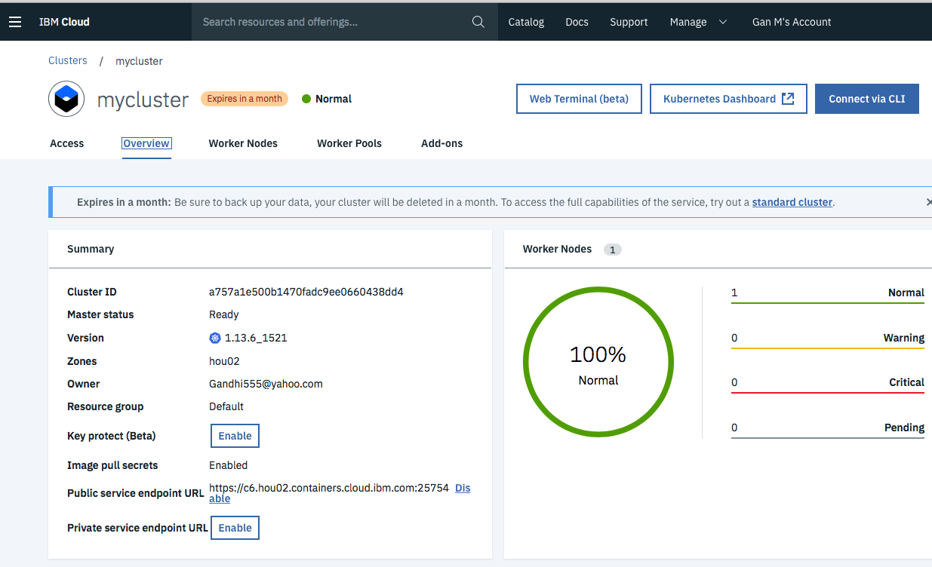
Create Kubernetes Cluster …
You will get a cluster screen with Requested Status
Note: This will take 20 -25 mins to spin up your cluster, which will be used to deploy your application later in the lab below
After the provisioning the cluster you will have the status as Normal

Slide 7
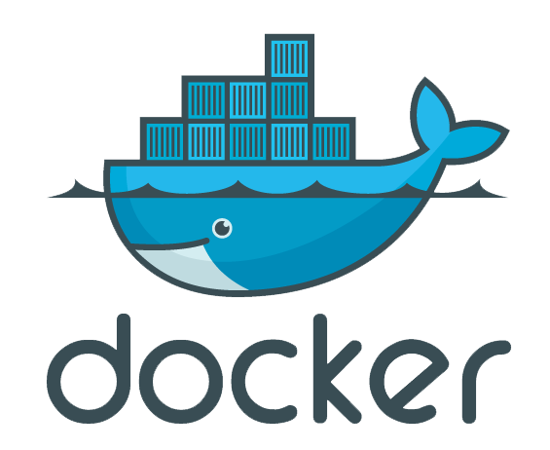
Dockers
Docker
Docker is a platform to develop, deploy, and run applications with containers.
Image
An image is an executable package that bundles everything needed to run an application.
Code
Libraries
Environment variables
Configuration files
Container
A container is a runtime instance of an image

Slide 8
Dockers …
Containers and virtual machines
Containers
Runs natively on Linux
Shares the kernel of the host machine with other containers
Virtual Machine
Runs a full-blown guest operating system
Container
VM
App A
App B
App C
App A
App B
App C
Bins/Libs
Bins/Libs
Bins/Libs
Bins/Libs
Bins/Libs
Bins/Libs
Docker
Guest OS
Guest OS
Guest OS
Host OS
Hypervisor
Infrastructure
Infrastructure

Slide 9
Dockers
Docker Architecture
Docker Client
Docker Host
Docker Registry
docker build
Docker Daemon
Docker hub
docker run
Private Registry
docker push
Containers
Images
docker pull

Slide 10
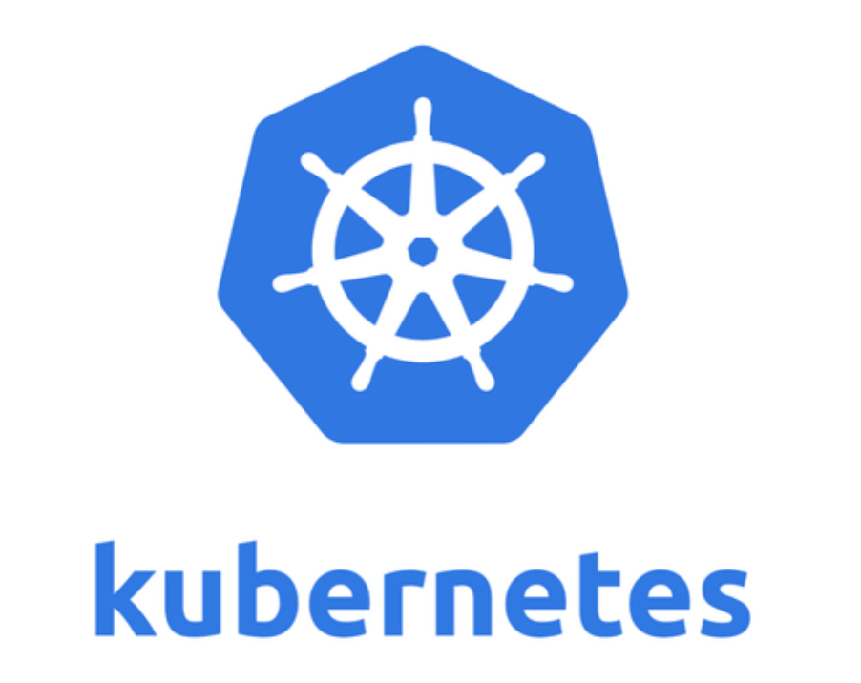
Kubernetes
Container Orchestration System to manage containerized applications across a cluster of nodes
Can scale up and down dynamically.
Self-healing
Seamless upgrading or rollback of applications.

Slide 11
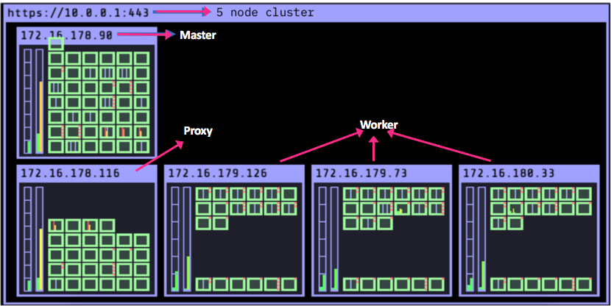
Cluster
Cluster with 5 Nodes
1 Master Node
1 Proxy Node
3 Worker nodes

Slide 12

Kubernetes Cluster
Nodes
MASTER
PODS
API Server
Containers
Containers
Scheduler
Containers
Containers
Admin
Controller
Containers
etcd
Kubelet
Kube-proxy
Container Runtime Engine
Client

Slide 13
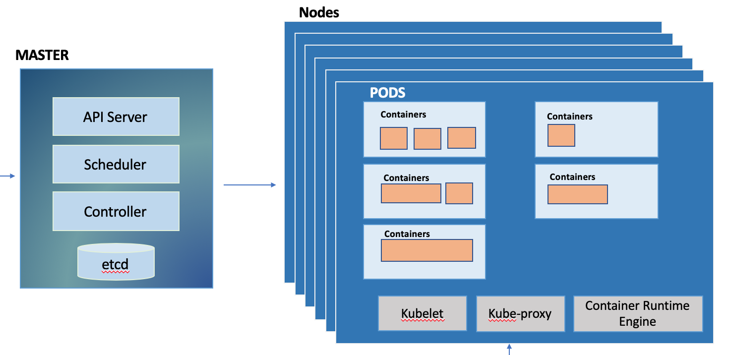
Kubernetes Master components
Etcd
etcd is a cluster datastore
Provides highly available key-value store for persisting cluster state
Stores objects and config information
Scheduler
Allocate the node for the newly created pod
Scheduling decisions are based on hardware/software/policy constraints, data locality and etc

Slide 14
Kubernetes Master components …
Controller
Monitors the cluster state via the apiserver
Maintain the cluster towards the desired state.
Few controllers are
Node Controller
Replication Controller
Endpoints Controller
API Server
Main management point of the entire cluster
When we issued command through kubectl, it communicates with API Server component
Handles authentication and authorization, request validation and etc

Slide 15
Kubernetes Nodes Components
kubelet
An agent that runs on each node in the cluster.
It makes sure that containers are running in a pod as per pod spec.
kube-proxy
Manages the network rules on each node.
Performs connection forwarding or load balancing for Kubernetes cluster services.
Container Runtime Engine
A container runtime is a Container Runtime Interface compatible application that executes and manages containers.
Containerd (docker)
Rkt

Slide 16
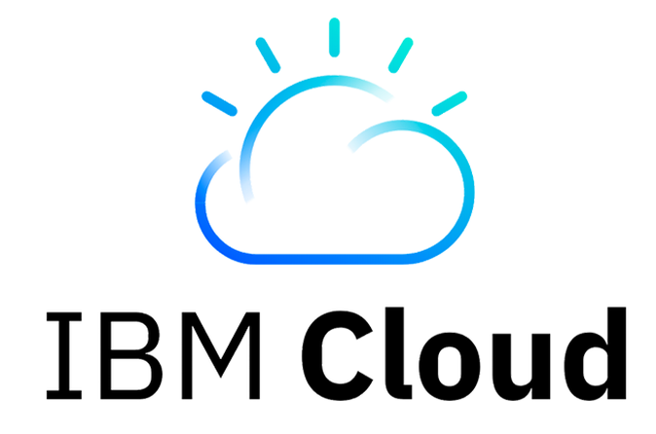

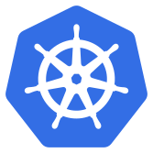
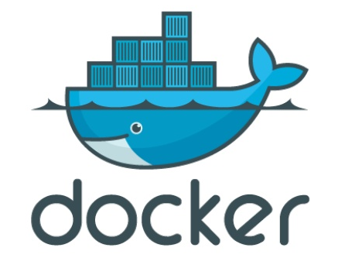


Hands On : Deploy an application on IBM Cloud Kubernetes Cluster
Architectural Flow:
Deploy HelloWorld App
Access App
Scale App
Technology Stack (IBM Cloud):
Docker Container
Kubernetes
HelloWorld App
USER

Slide 17

Hands on lab

Slide 18
Thank You

Slide 19


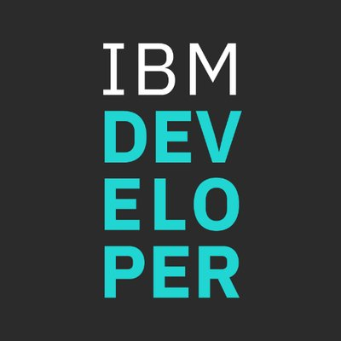

Stay Connected and continue coding !
Instructions available here https://github.com/IBMEvent/HandsOnCloud-201906
Join our Meetup groups
Mumbai : https://www.meetup.com/Cloud-Mumbai-Meetup/
Hyderabad: https://www.meetup.com/Hyderabad-Cognitive-with-Cloud
Bangalore : https://www.meetup.com/IBMDevConnect-Bangalore
Chennai: https://www.meetup.com/Chennai-CodeWeekend-Meetup/
Check out the cool developer journeys
https://developer.ibm.com/patterns/
Join our Slack team and stay in touch with the experts
https://ibmdevconnect.slack.com
Send in your request to - http://ibm.biz/slackrequest

