Slide 1
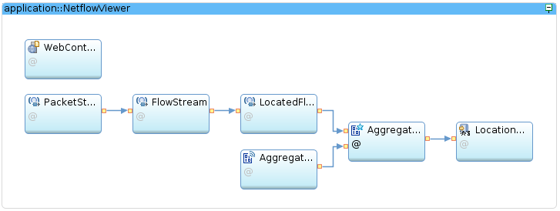

ingest packets
map legend:
IBM Yorktown
IBM offices
parse Netflow messages
v
Internet websites
locate flow endpoints
v
IBM Streams
aggregate flows by city
stream aggregations to browsers
web
files
v
v
location
data
web server
merge
location
data
Internet
router
router
router
IBM internal network
IBM Yorktown
v
MaxMind, Inc.
OpenStreetMap

