Slide 1
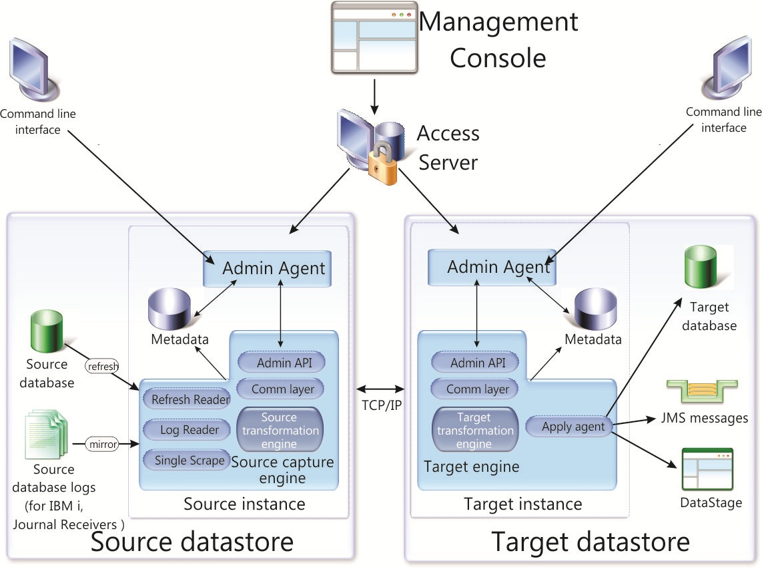

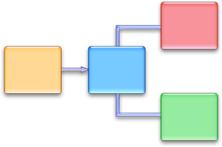


IBM Streams
CDCSource
CDCStreams user exit
CDC Streams
Toolkit

