Slide 1
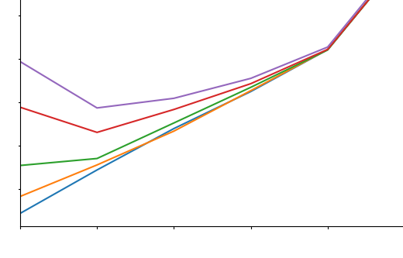
 | Experiments
Genes | 60 | … | 32.5
 | 60 |  | 35
 | … |  | …
 | 20 |  | 37.5
 | Experiments
Genes | 50 | … | 30
 | 70 |  | 40
 | … |  | …
 | 20 |  | 35
(1-x)
 | Experiments
Genes | 60 | … | 32.5
 | 60 |  | 35
 | … |  | …
 | 20 |  | 37.5
Normalized Data Matrix
+
 | Experiments
Genes | 70 | … | 35
 | 50 |  | 30
 | … |  | …
 | 20 |  | 40
 | Experiments
Genes | 60 | … | 32.5
 | NaN |  | 35
 | … |  | …
 | 20 |  | NaN
(x)
Data Matrix with Noise
(1 – x) * Normalized Data Matrix + (x) * Noise
x is the noise ratio
Noise
(Randomly Permutated Data Matrix)
Add noise with different noise ratio (x) to data matrix
Remove some value randomly with different missing value ratio
Expected | Imputed | Error
60 | 55 | -5
37.5 | 40 | 2.5
… | … | …
Noise Ratio | Avg Error (SMAPE)
0 | 0.3
0.2 | 0.5
… | …
1 | 0.7
Expected | Imputed | Error
60 | 55 | -5
37.5 | 40 | 2.5
… | … | …
Noise Ratio | Avg Error (SMAPE)
0 | 0.3
0.2 | 0.5
… | …
1 | 0.7
Expected | Imputed | Error
60 | 55 | -5
37.5 | 40 | 2.5
… | … | …
Average
Noise Ratio | Avg Error (SMAPE)
0 | 30%
0.2 | 50%
… | …
1 | 70%
 | Experiments
Genes | 60 | … | 32.5
 | NaN |  | 35
 | … |  | …
 | 20 |  | NaN
Error table for different noise ratio
Avg Error table
for different missing value ratio
 | Experiments
Genes | 60 | … | 32.5
 | 55 |  | 35
 | … |  | …
 | 20 |  | 40
Avg Error (SMAPE)
Missing value ratio = 0.3
Missing value ratio = 0.5
Missing value ratio = 0.7
Missing value ratio = 0.9
Missing value ratio = 0.99
Noise Ratio
Observe imputation error for different noise ratio and missing value ratio
Impute missing values

