Slide 1
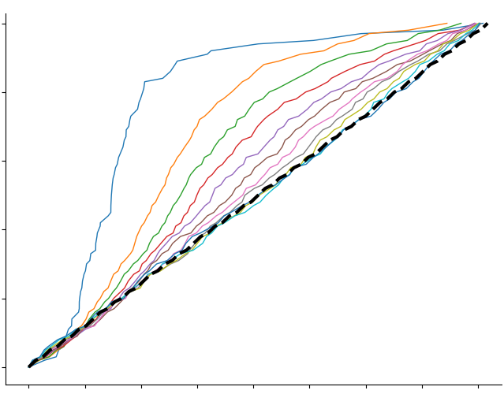
exp_id (Samples) | indicator (Case or Ctrl)
SRX1638996 | 0
SRX1638997 | 0
SRX1638999 | 1
Calculate the rank of absolute log2 fold change
Calculate absolute log2 fold change
gene_list
STM0001
…
STM2054
 | Experiments
Genes | 50 | … | 30
 | 70 |  | 40
 | … |  | …
 | 20 |  | 35
(1-x)
 | Experiments
Genes | 60 | … | 32.5
 | 60 |  | 35
 | … |  | …
 | 20 |  | 37.5
 | Avg Gene Expression |  | Abs Log2(Case/Ctrl) | Rank
Genes | Ctrl | Case | 1.21 | 120
 |  |  | 0.32 | 400
 |  |  | 1.13 | 150
 |  |  | … | …
 |  |  | 0.01 | 3000
 |  |  | 3.01 | 30
Sample List
Gene List
 | Abs Log2(Case/Ctrl) | Rank
Genes | 1.21 | 100
 | 0.32 | 500
 | 1.13 | 120
 | … | …
 | 0.01 | 3024
 | 3.01 | 30
Rank
120
500
…
3024
Rank | Gene Count | Hit Ratio
120 | 1 | 0.1
500 | 2 | 0.2
… | …
3024 | 10 | 1
Rank | Gene Count | Hit Ratio
120 | 1 | 0.1
500 | 2 | 0.2
… | …
3024 | 10 | 1
Rank | Gene Count | Hit Ratio
120 | 1 | 0.1
500 | 2 | 0.2
… | …
3024 | 10 | 1
Normalized Data Matrix
+
Hit Ratio
 | Experiments
Genes | 70 | … | 35
 | 50 |  | 30
 | … |  | …
 | 20 |  | 40
Noise Ratio = 0
Noise Ratio = 0.1
…
(x)
Data Matrix with Noise
(1 – x) * Normalized Data Matrix +
(x) * Noise
x is the noise ratio
(#Gene in gene list = 10)
Rank vs. hit ratio for different noise ratio
Rank
Noise
(Randomly Permutated Data Matrix)
Add noise with different noise ratio (x) to data matrix
Select and group samples, and then take the average of cases and control and then calculate the absolute log fold change (case/ctrl) and corresponded rank
Select the genes in gene list, extract the rank and sort them.
Count the gene from top to the bottom, and then divided by the #genes in gene list to get hit ratio. Plot the rank vs. hit ratio for different noise ratio cases.

