Slide 1
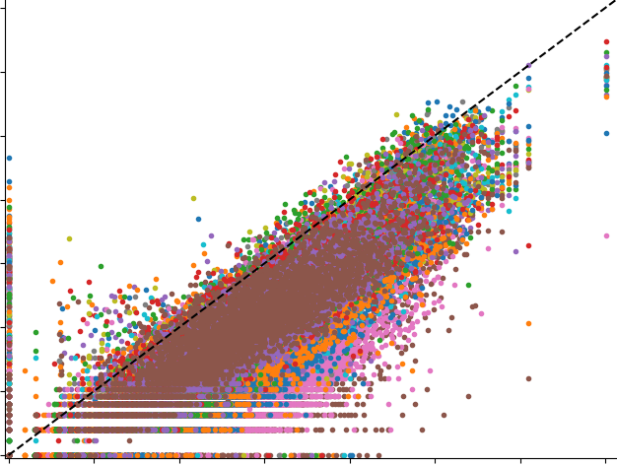
 | Experiments
Genes | 60 | … | 32.5
 | 60 |  | 35
 | … |  | …
 | 20 |  | 37.5
Avg PCC = 0.89±0.03
Avg SCC = 0.91±0.03
Normalized Data Matrix in compendium
Log2 gene expression in published data
 | Experiments
Genes | 55 | … | 37
 | 40 |  | 38
 | … |  | …
 | 30 |  | 40
Log2 gene expression in compendium
Data Matrix from published data

