Slide 1
Mix original data matrix and noise with different ratios
Samples
Random Permutation
Features
…
…
 | Noise Ratio = 0.1 | Noise Ratio = 0.5 | Noise Ratio = 0.9
Noise | 10% | 50% | 90%
Original Data | 90% | 50% | 10%
Original Data Matrix
Noise

Slide 2
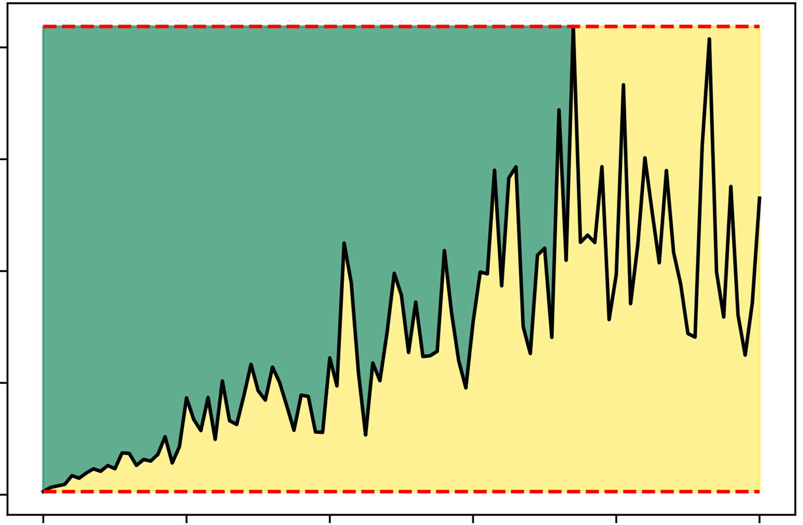
The noise ratio yields min error
(Noise_{minerr})
The noise ratio yields min error
(Noise_{maxerr})
Max Error
(Error_{max})
Avg Imputation Error
Min Error
(Error_{min})
Noise Ratio

Slide 3
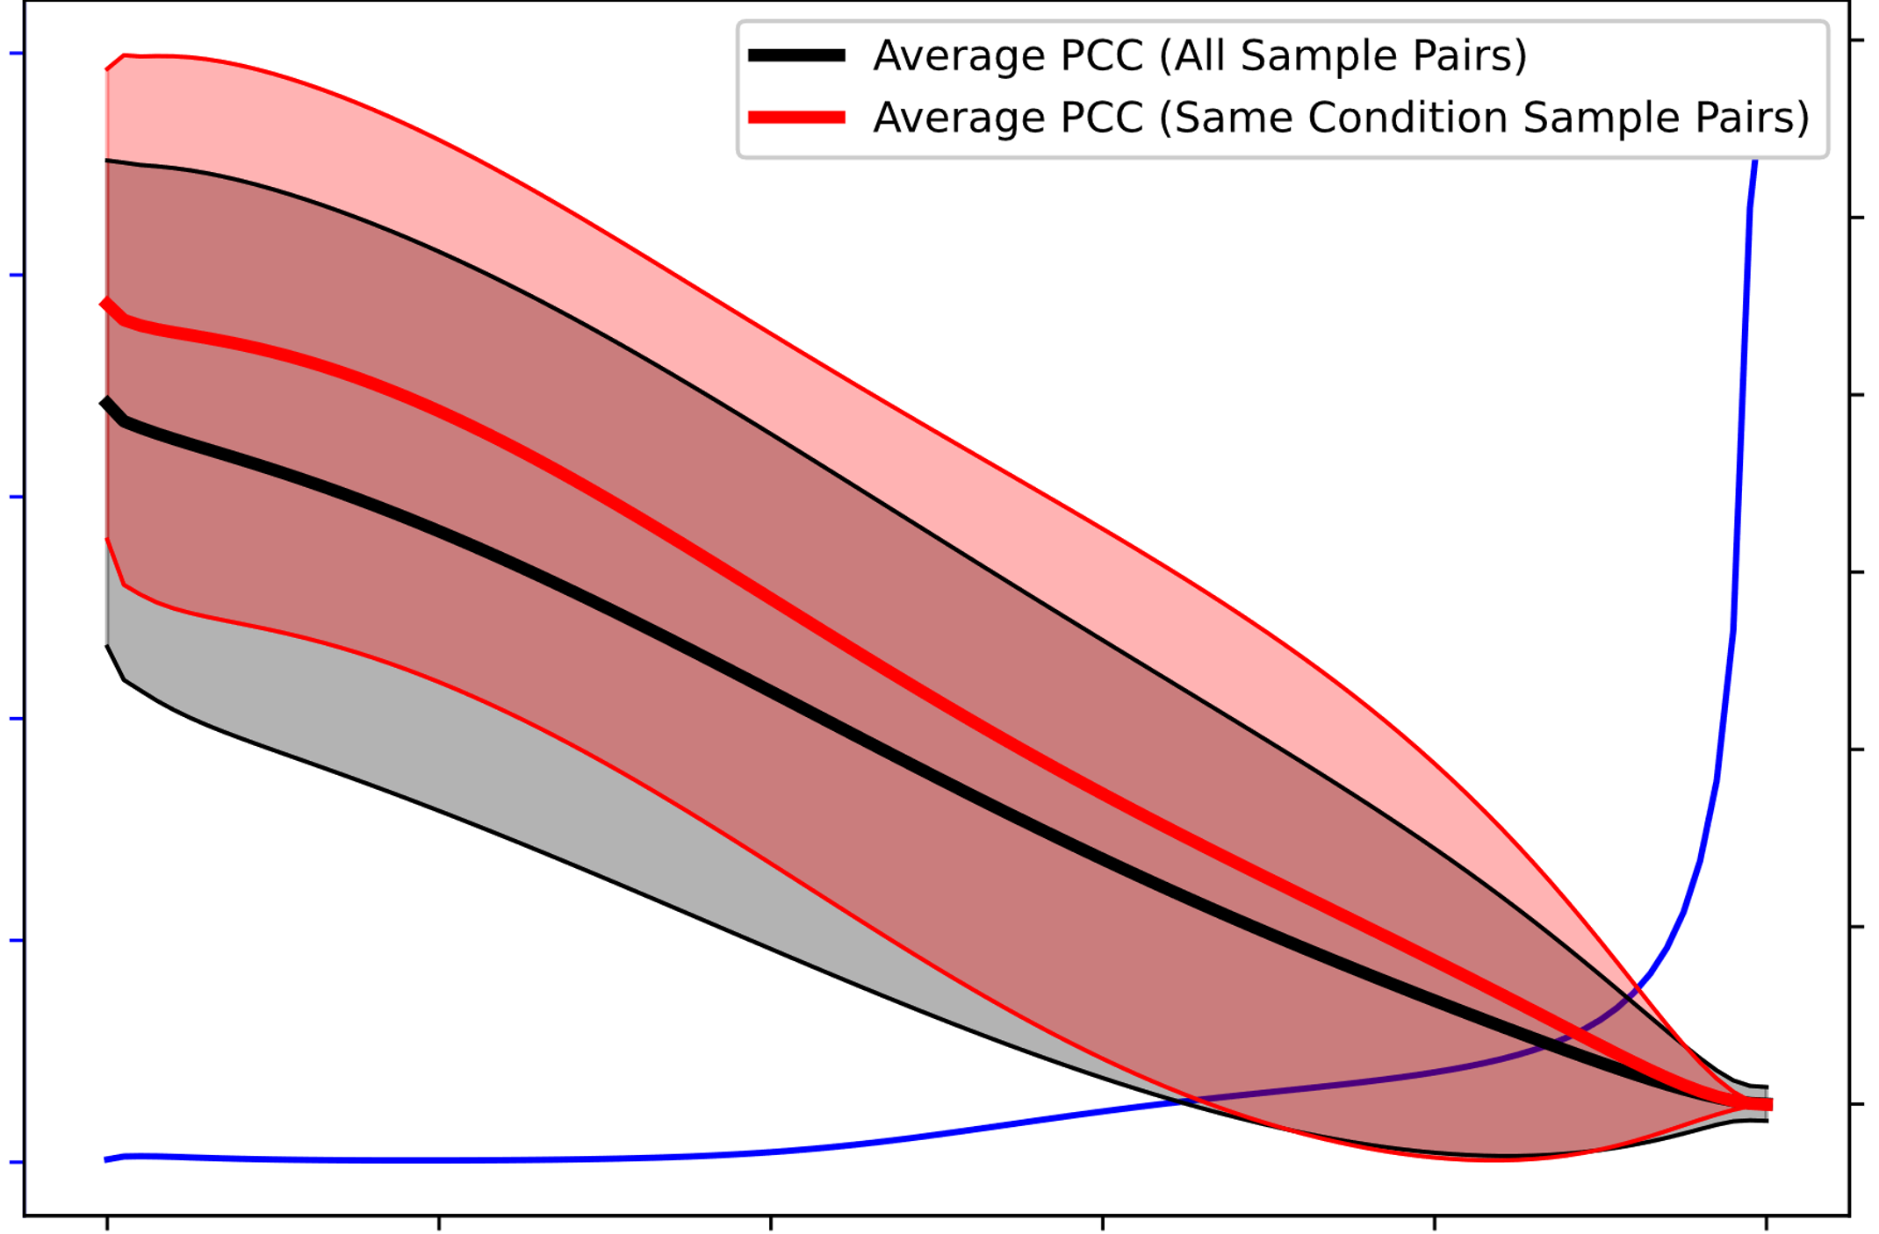
p-value
Average PCC
Pre-specified p-value threshold (0.05 as default)
Score: Max Noise that average PCC among same conditions I samples still significantly higher than average PCC among all samples
Noise Ratio

Slide 4
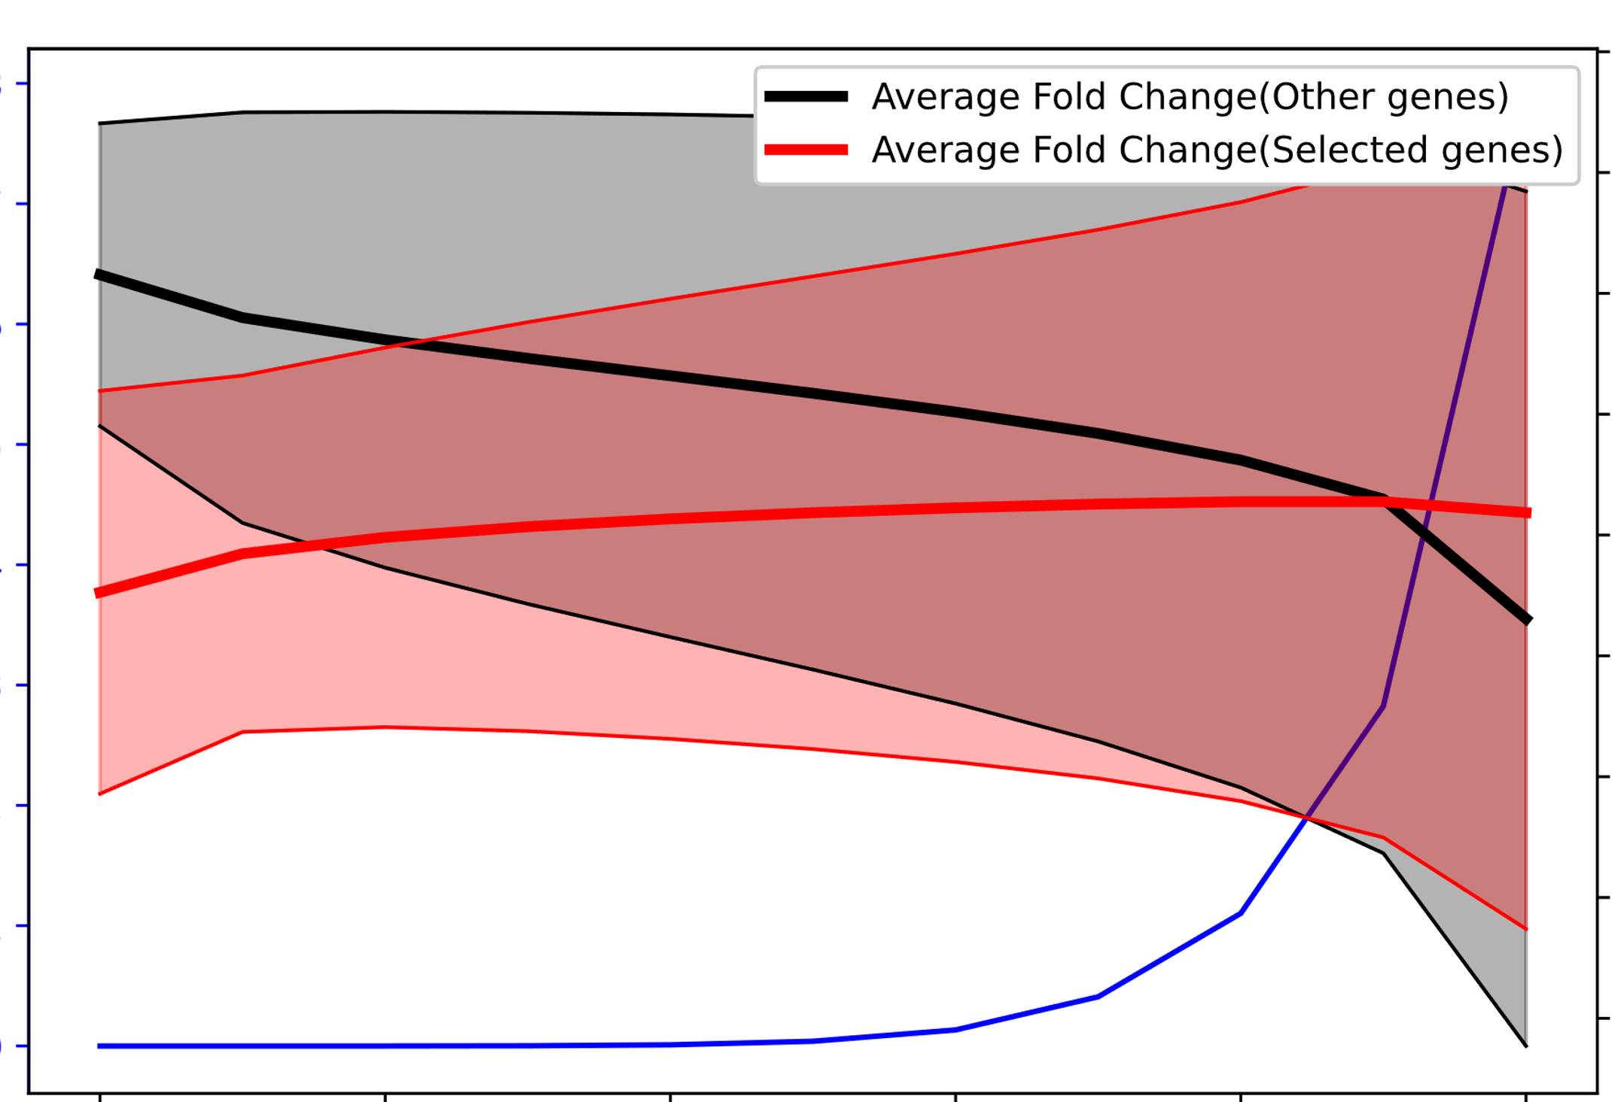
p-value
Average Fold Change
Pre-specified p-value threshold (0.05 as default)
Score: Max Noise that average fold change of selected genes is still significantly lower (or higher) than other genes
Noise Ratio

Slide 5
