Slide 1
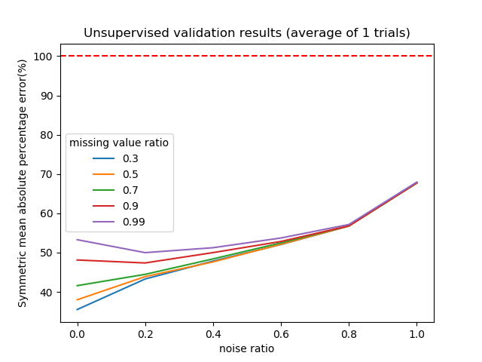
AREA = 49.35%

Slide 2
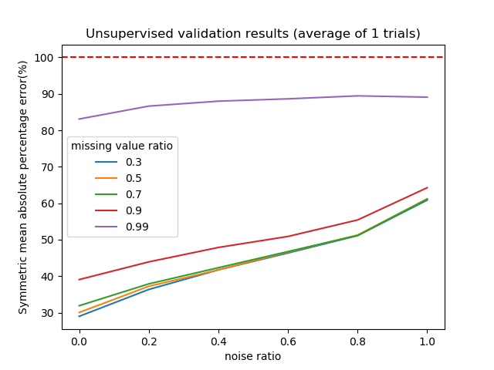
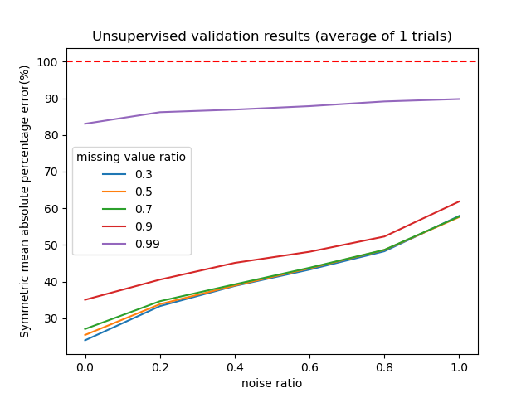
(A)
(B)
(C)
AREA = 49.35%
AREA=55.51%
AREA = 58.7%

