Slide 1

Online Voting System
using TCP in
Python
Team Members:
Modem Upendra- RA2011031010071
Varun Reddy- RA2011031010093
IBRAHIM MUFEEZ – RA2011031010100

Slide 2
Introduction
The Online Voting System has the following features –
Voters can cast their vote online with decent network connectivity.
Cost-effective and secure.
Time saving.
Efficiently handles large database.
Less prone to electoral frauds since, each voter has their own unique ID and password.

Slide 3
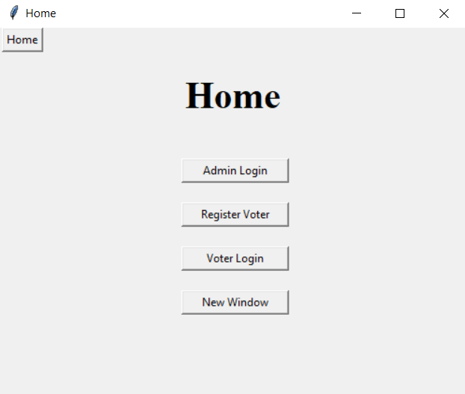
Working of Modules
The program starts displaying the home page with 4 buttons –
Admin Login
Register Voter
Voter Login
New Window

Slide 4
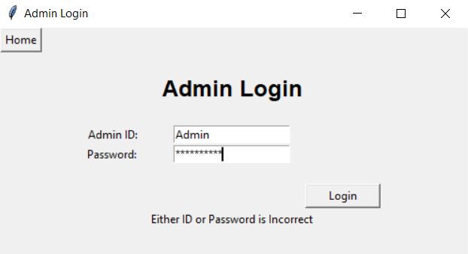
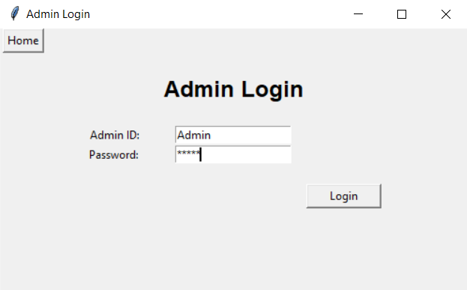
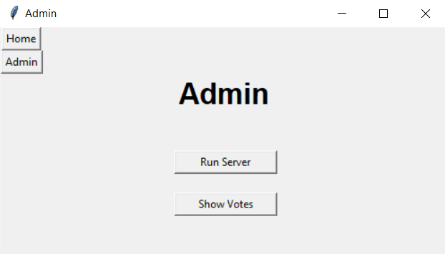
Admin Login
The Admin login page inputs Admin’s ID and password and verifies the login credentials.

Slide 5
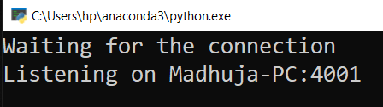
On providing the correct credentials, the program displays Admin page with two buttons –
Run Server
Show Votes
Clicking Run Server, opens the server in a new window and the client establishes a connection with the server, this implies that the TCP protocol is being used. The server allocates a new thread for every new incoming client(voter), using concurrent threading, that is, when the number of connections are made with the server, that time each thread doesn’t interfere with one another hence, synchronizing the threads.

Slide 6
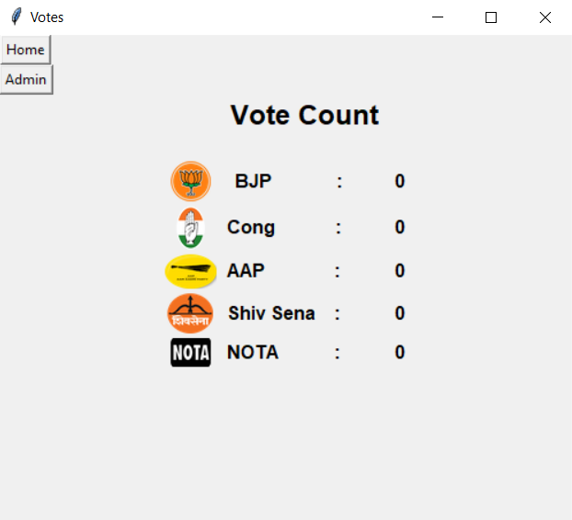
Clicking Show Votes displays the total vote count of all the parties.
Initially, all the vote count are zero.

Slide 7
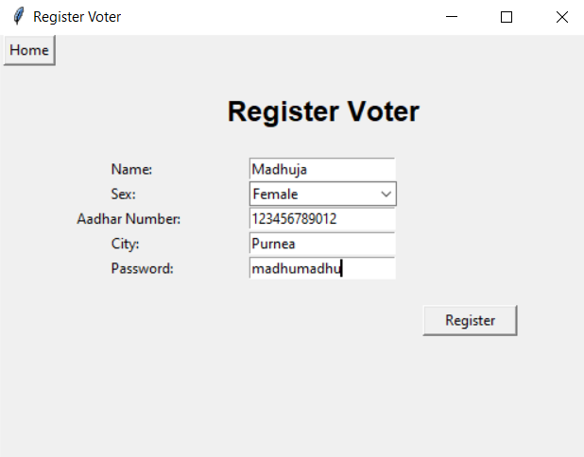
Register Voter
The voters register themselves by entering their details.
The voters provide their Aadhar Number and set their own unique password.

Slide 8
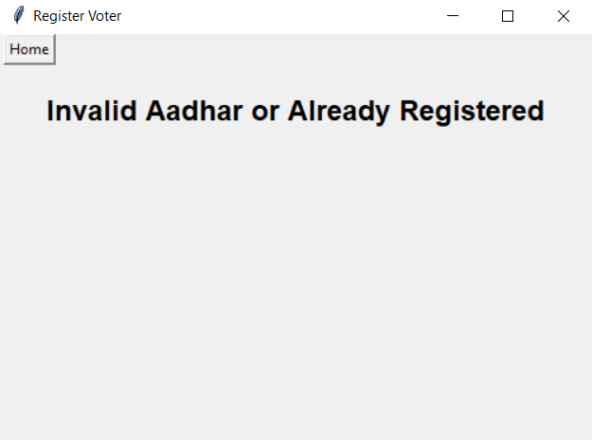
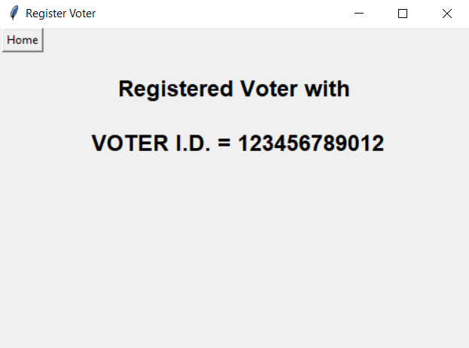
If the Aadhar Number entered by the voter is invalid (not a 12 digit number) or already exists, the program gives an error message.
Else, Voter is successfully registered with Voter ID as their Aadhar Number and voters list (database) is updated.

Slide 9
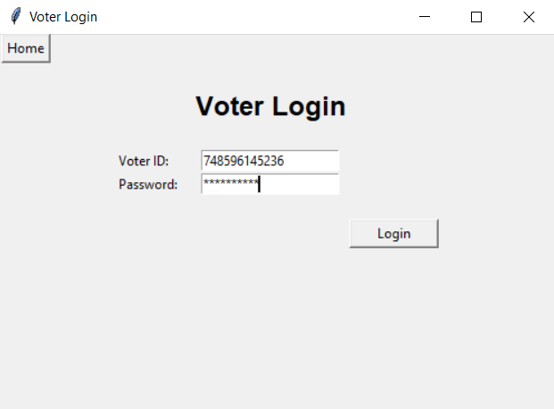
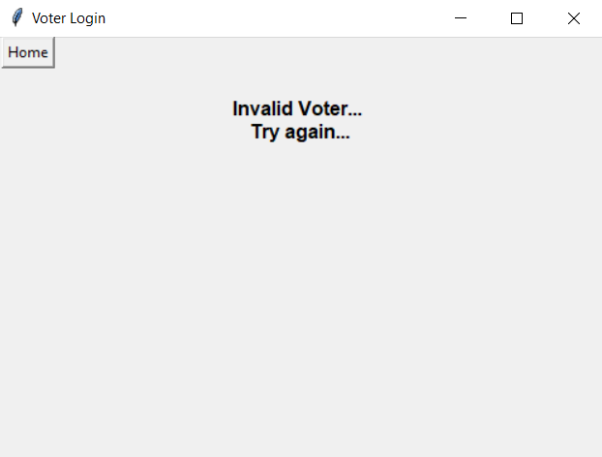
Voter Login
The Voter login page inputs Voter’s ID and password and verifies the login credentials.
If the credentials don’t match, it gives an error message.

Slide 10
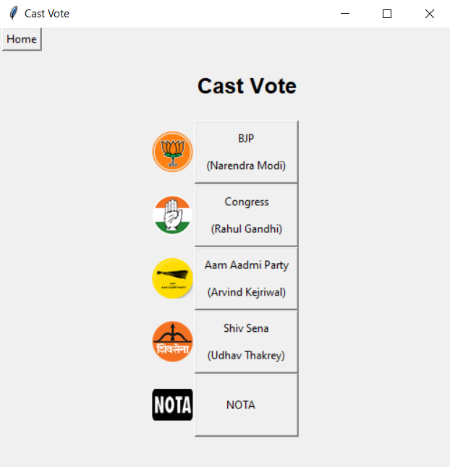
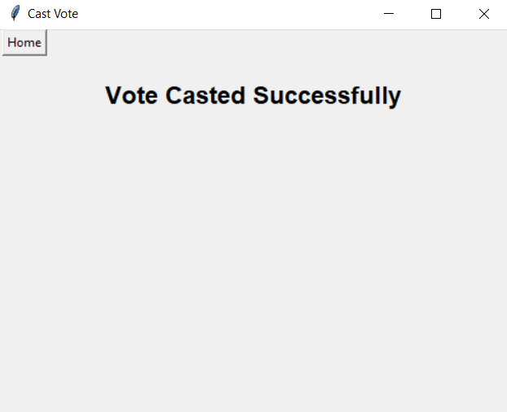
If the credentials match, the cast vote page is displayed and the voter can cast vote of their choice.

Slide 11
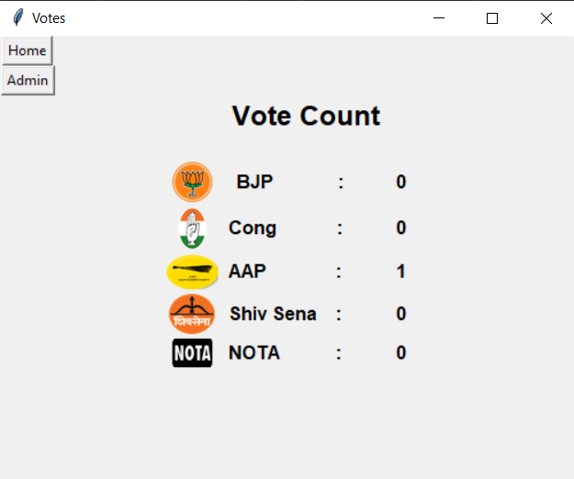
The casted vote is updated in candidate list (database) and displayed in show votes page.

Slide 12
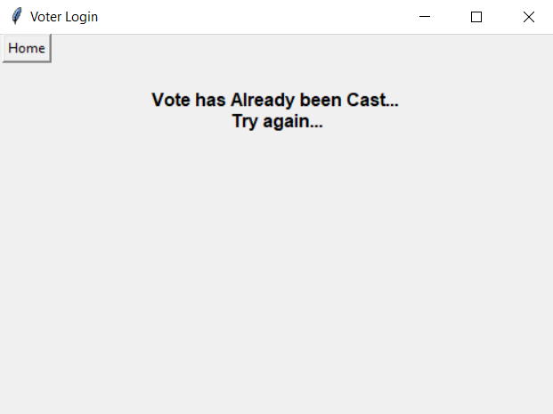
One voter can cast vote only once. If the voter tries to vote again the program displays an error message.

Slide 13
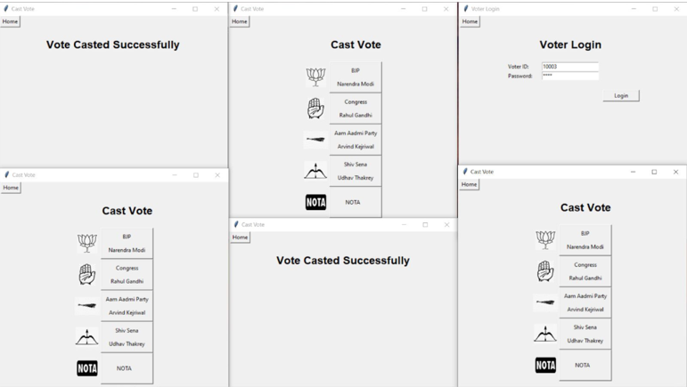
New Window
Clicking new window button opens a new window which allows multiple voters to vote concurrently (should work for 5 different voters at a time).

Slide 14
Thank You !

