Slide 1
Clustering mixed-type data
Louise McMillan

Slide 2
The problem

Slide 3
Clustering mixed-type data
Name | Age | Severity | Exercise Type | Diastolic blood pressure
Wen | 23 | Mild | Cycling | 82
Mirai | 57 | Mild | Running | 98
An | 51 | Severe | Cycling | 112
Max | 43 | Moderate | Rowing | 72
Mixed-type data are gathered in many disciplines and industries

Slide 4
Clustering mixed-type data
Name | Age | Severity | Exercise Level | Diastolic blood pressure
Wen | 23 | Mild | Cycling | 82
Mirai | 57 | Mild | Running | 98
An | 51 | Severe | Cycling | 112
Max | 43 | Moderate | Rowing | 72
?
We want to find groups of individuals that are similar

Slide 5
Handling categorical data
Name | Age | Severity | Exercise Level | Diastolic blood pressure
Wen | 23 | 1 – Mild | Cycling | 82
Mirai | 57 | 1 – Mild | Running | 98
An | 51 | 3 – Severe | Cycling | 112
Max | 43 | 2 – Moderate | Rowing | 72
A common approach is to convert ordinal data to numerical labels…

Slide 6
Handling categorical data
Name | Age | Severity | Exercise Level | Diastolic blood pressure
Wen | 23 | 1 | Cycling | 82
Mirai | 57 | 1 | Running | 98
An | 51 | 3 | Cycling | 112
Max | 43 | 2 | Rowing | 72
… and then treat the numerical labels as numerical data

Slide 7
Handling categorical data
Name | Age | Severity | Exercise Level | Diastolic blood pressure
Wen | 23 | 1 | Cycling | 82
Mirai | 57 | 1 | Running | 98
An | 51 | 3 | Cycling | 112
Max | 43 | 2 | Rowing | 72
?
What can you do with nominal (unordered) categorical data?

Slide 8
The problem with numerical labels
None
Mild
Moderate
Severe
1
2
3
4
1
1.5
3.3
4
They may not be accurate!

Slide 9
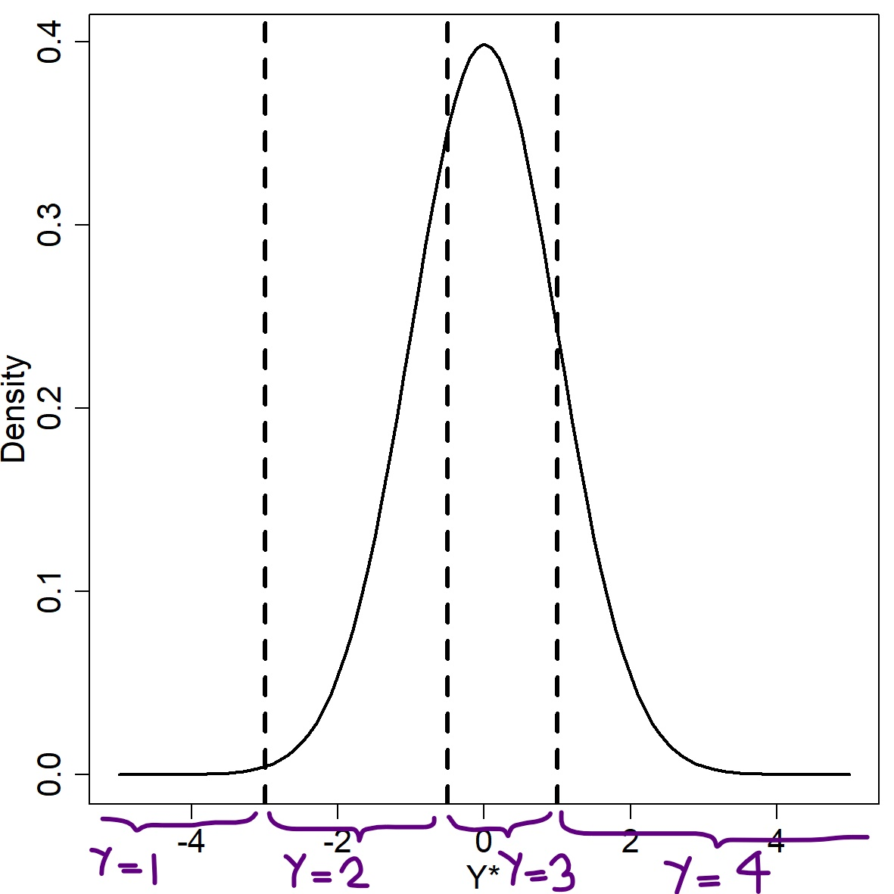
Handling categorical data
Some methods pretend ordinal variable is gaussian variable with cut points

Slide 10
Handling categorical data
Cut points may be fitted based on the data, or may be treated as constant for all variables
Method restricts you to gaussian distribution patterns and gaussian dependency structures between variables

Slide 11
Related Methods

Slide 12
Clustering ordinal data
Name | Q1 | Q2 | Q3 | Q4 | Q5 | Q6
Wen | 3 | 3 | 2 | 3 | 3 | 3
Mirai | 1 | 2 | 3 | 1 | 3 | 2
An | 2 | 2 | 2 | 1 | 3 | 2
Max | 2 | 1 | 1 | 1 | 2 | 1
Can already cluster ordinal variables with a constant number of categories

Slide 13
R package ‘clustord’
github.com/vuw-clustering/clustord
Co-authors Daniel Fernández, Eleni Matechou, Ying Cui, Richard Arnold, Ivy Liu

Slide 14
R package ‘clustord’
github.com/vuw-clustering/clustord
Uses ordinal-specific models
Proportional Odds Model (POM)
Ordered Stereotype Model (OSM)

Slide 15
R package ‘clustord’
github.com/vuw-clustering/clustord
Allows inclusion of covariates along with ordinal response data

Slide 16
Solution A
Co-authors Kien Tran, Alberto de Rosa

Slide 17
Genetic clustering
Several existing methods
Can handle complexities of categorical data

Slide 18
Genetic clustering
ID | L1.a1 | L1.a2 | L2.a1 | L2.a2 | L3.a1 | L3.a2
Kai-3 | 128 | 128 | 112 | 140 | 136 | 138
Kai-4 | 96 | 128 | 140 | 140 | 130 | 136
Kai-6 | 92 | 96 | 140 | 142 | 120 | 120
Nel-1 | 96 | 96 | 112 | 140 | 120 | 138
Nel-3 | 128 | 130 | 112 | 112 | 124 | 138
Nuclear DNA data looks numerical but is ordinal/nominal categorical data

Slide 19
Genetic clustering
ID | L1.a1 | L1.a2 | L2.a1 | L2.a2 | L3.a1 | L3.a2
Kai-3 | 128 | 128 | 112 | 140 | 136 | 138
Kai-4 | 96 | 128 | 140 | 140 | 130 | 136
Kai-6 | 92 | 96 | 140 | 142 | 120 | 120
Nel-1 | 96 | 96 | 112 | 140 | 120 | 138
Nel-3 | 128 | 130 | 112 | 112 | 124 | 138
nDNA also has more than one response per variable

Slide 20
Existing genetic clustering algorithm
Estimate allele frequencies for each population
Estimate probability of individual’s alleles originating from each population
Estimate proportion of individual’s genome originating from each population

Slide 21
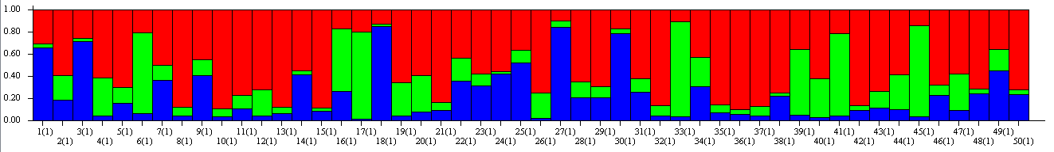
STRUCTURE genetic clustering results

Slide 22
Existing genetic clustering algorithm
Data input segment is modular, separate component per variable
Feasible to add more modules for different data types

Slide 23
Genetic clustering
ID | L1.a1 | L1.a2 | L2.a1 | L2.a2 | L3.a1 | L3.a2 | mtDNA
Kai-3 | 128 | 128 | 112 | 140 | 136 | 138 | P
Kai-4 | 96 | 128 | 140 | 140 | 130 | 136 | L
Kai-6 | 92 | 96 | 140 | 142 | 120 | 120 | A
Nel-1 | 96 | 96 | 112 | 140 | 120 | 138 | P
Nel-3 | 128 | 130 | 112 | 112 | 124 | 138 | O
Biologists also collect mitochondrial DNA haplotypes

Slide 24
Mixed genetic data
Mainland
+
= ?
Offshore Island
Biologists have to analyse nuclear DNA and mitochondrial DNA separately

Slide 25
Isotope data
ID | L1.a1 | L1.a2 | L2.a1 | L2.a2 | L3.a1 | L3.a2 | mtDNA | 15N
Kai-3 | 128 | 128 | 112 | 140 | 136 | 138 | P | 8.3
Kai-4 | 96 | 128 | 140 | 140 | 130 | 136 | L | 7.1
Kai-6 | 92 | 96 | 140 | 142 | 120 | 120 | A | 6.2
Nel-1 | 96 | 96 | 112 | 140 | 120 | 138 | P | 9.2
Nel-3 | 128 | 130 | 112 | 112 | 124 | 138 | O | 9.1
Biologists collect isotope data

Slide 26
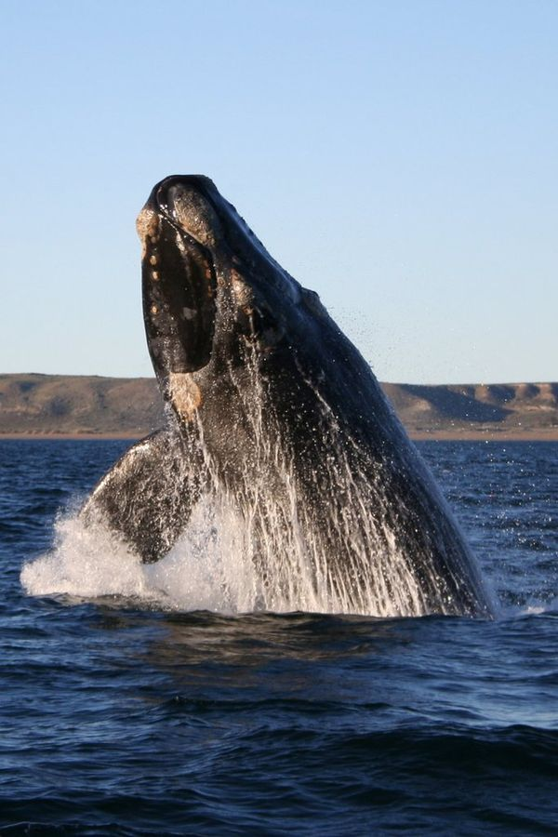
Tohorā
https://tohoravoyages.ac.nz/track-the-2021-tohora/
Image by Michaël CATANZARITI, under the licence Creative Commons Attribution-Share Alike 3.0 Unported

Slide 27
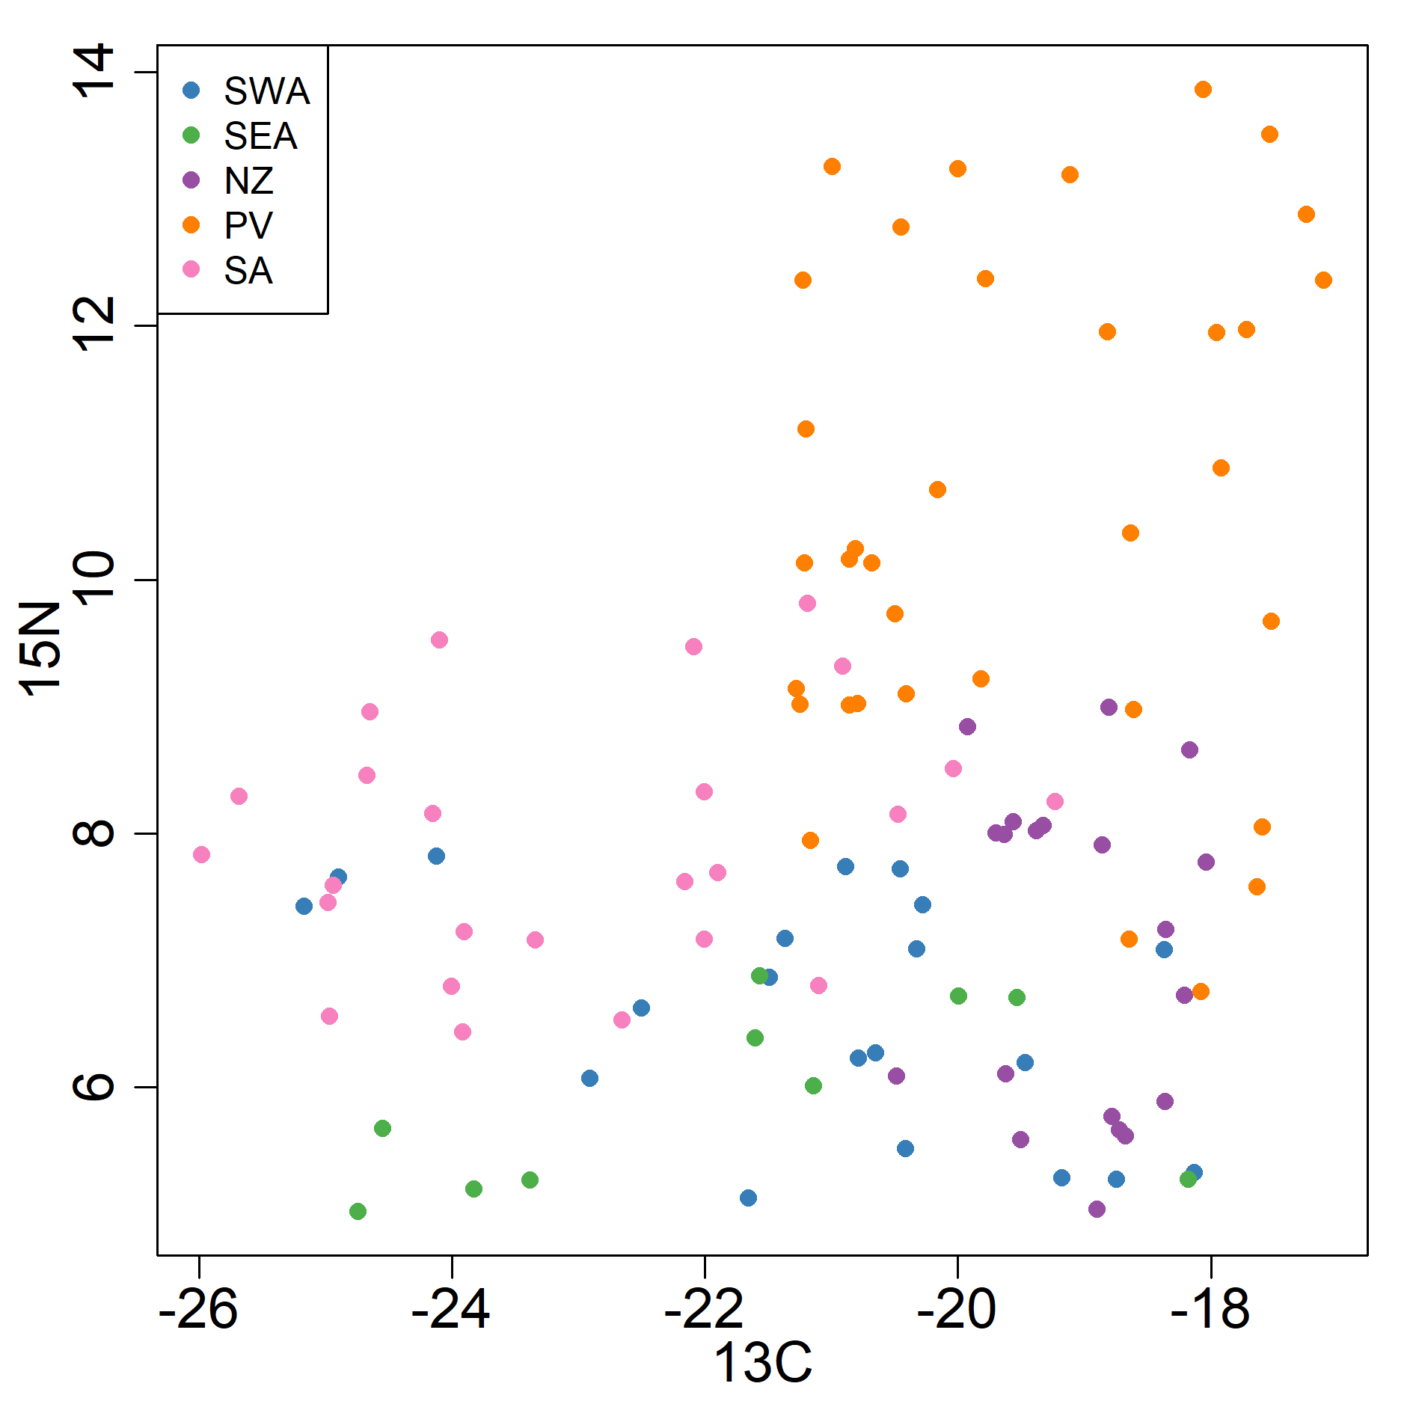
Genetic and isotope data
Mainland
+
Offshore Island
+
=?

Slide 28
Modified clustering algorithm
Estimate [allele/isotope] frequencies for each population
Estimate probability of individual’s [alleles/isotopes] originating from each population
Estimate proportion of individual’s [data] originating from each population
nDNA
mtDNA
isotopes

Slide 29
General mixed-type clustering?
ID | L1.a1 | L1.a2 | L2.a1 | L2.a2 | L3.a1 | L3.a2
Kai-3 | 128 | 128 | 112 | 140 | 136 | 138
Kai-4 | 96 | 128 | 140 | 140 | 130 | 136
Kai-6 | 92 | 96 | 140 | 142 | 120 | 120
Nel-1 | 96 | 96 | 112 | 140 | 120 | 138
Nel-3 | 128 | 130 | 112 | 112 | 124 | 138
Genetic clustering method already handles varying number of categories…

Slide 30
General mixed-type clustering?
Estimate [variable] frequencies for each population
Estimate probability of individual’s [variable values] originating from each population
Estimate proportion of individual’s [data] originating from each population
binary
categorical
numerical

Slide 31
Solution B

Slide 32
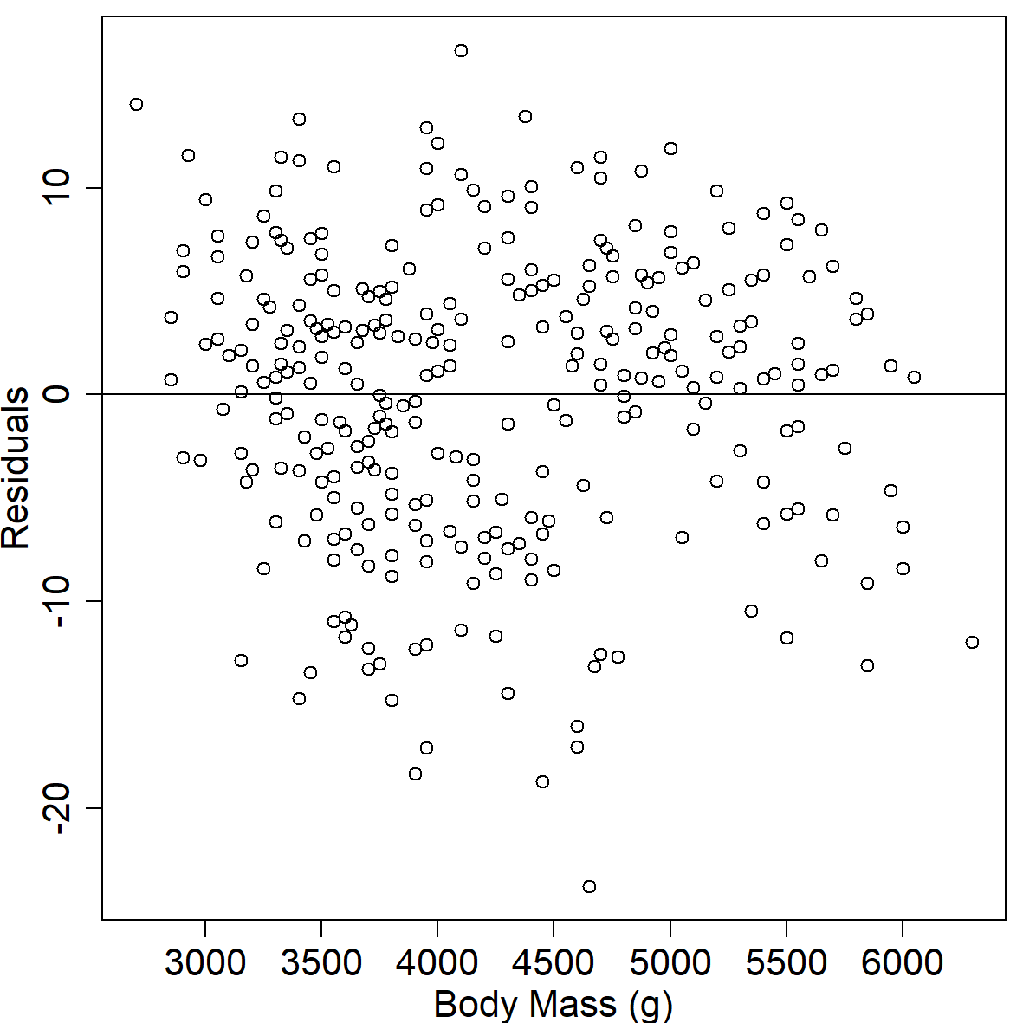
Residuals for linear regression
We’re accustomed to using residuals for linear regression

Slide 33
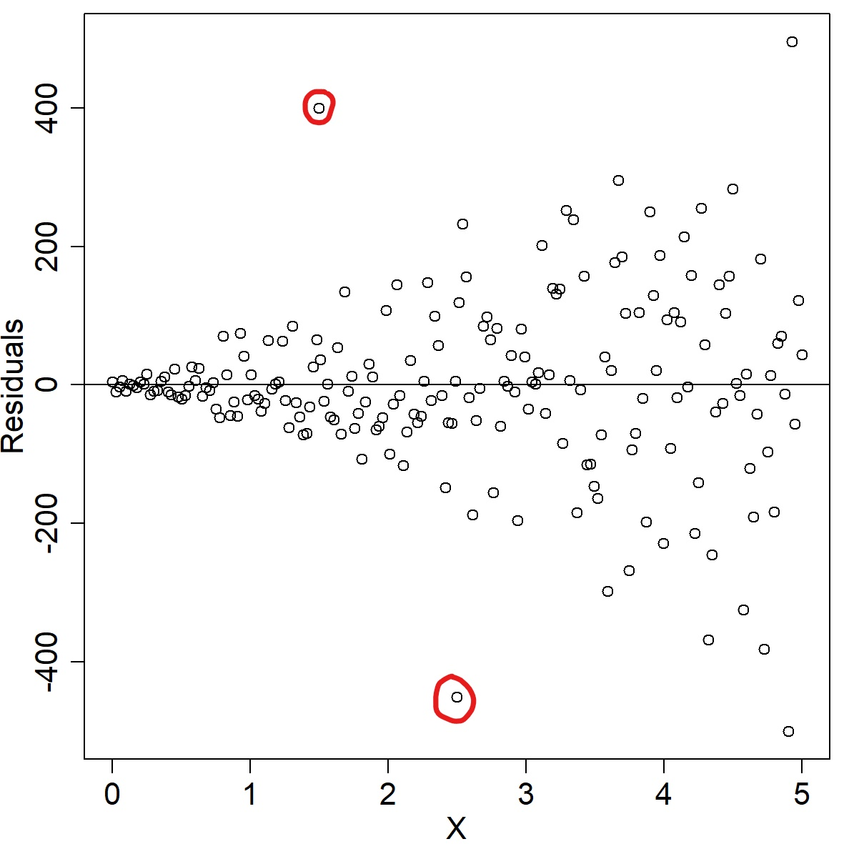
Residuals for linear regression
We can identify funnelling and outliers

Slide 34
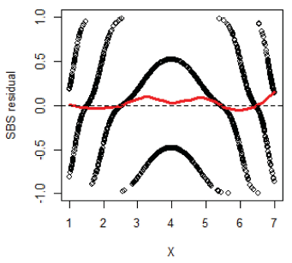
Residuals for ordinal regression
What do you make of this?
Li & Shepherd (2012) “A New Residual for Ordinal Outcomes,” Biometrika, 99, 473–480. [845]

Slide 35
Residuals for ordinal regression
These are sign-based statistic (SBS) residuals, for a model that is correctly specified!
Li & Shepherd (2012) “A New Residual for Ordinal Outcomes,” Biometrika, 99, 473–480. [845]

Slide 36
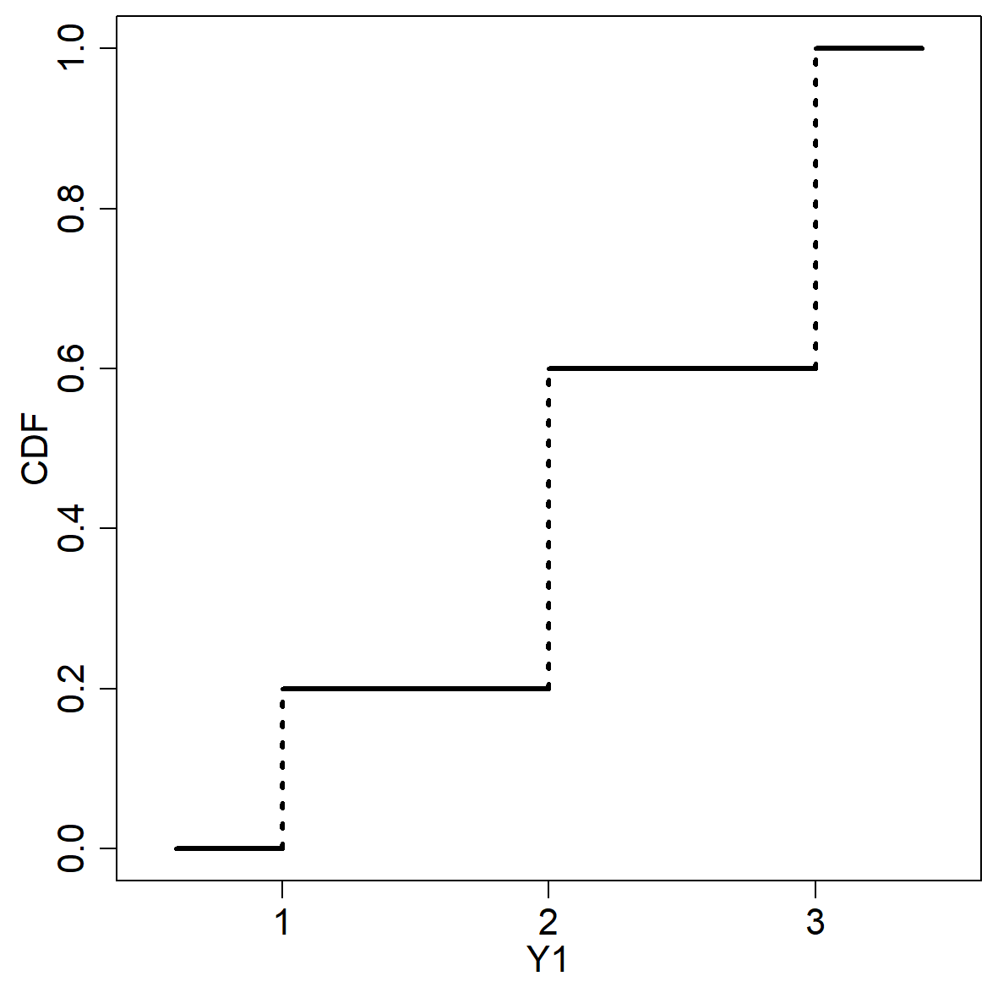
Ordinal residuals?
Every CDF is distributed in (0,1)

Slide 37
Ordinal residuals?
Useful for simulating continuous random variables from discrete data

Slide 38
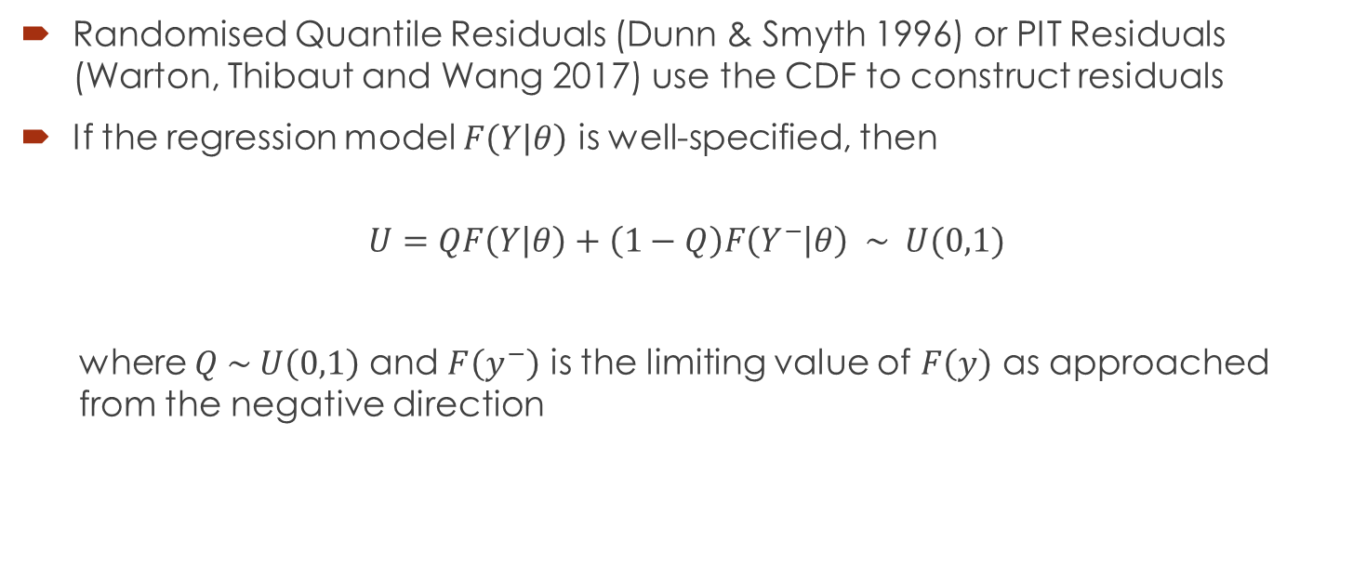
Randomised Quantile Residuals/ PIT Residuals
Randomised Quantile Residuals (Dunn & Smyth 1996) or PIT Residuals (Warton, Thibaut and Wang 2017) use the CDF to construct residuals
If the regression model $F\left(Y | θ\right)$ is well-specified, then
$$U=QF\left(Y | θ\right)+\left(1−Q\right)F\left(Y^{−} | θ\right) \sim U(0,1)$$
where $Q \sim U\left(0,1\right)$ and $F\left(y^{−}\right)$ is the limiting value of $F\left(y\right)$ as approached from the negative direction

Slide 39
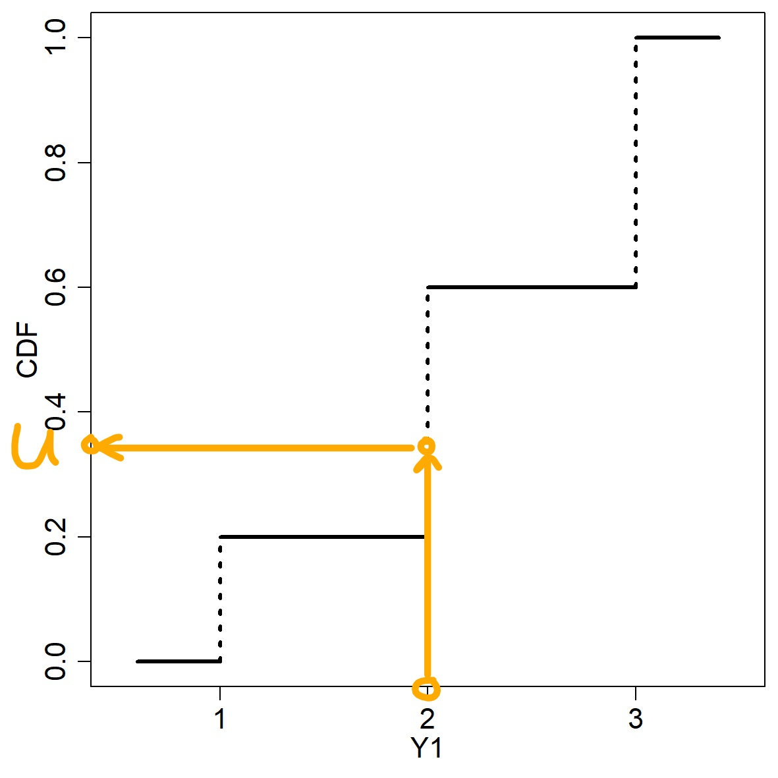
Randomised Quantile Residuals/ PIT Residuals
Randomised Quantile Residuals (Dunn & Smyth 1996) or PIT Residuals (Warton, Thibaut and Wang 2017)

Slide 40

Randomised Quantile Residuals/ PIT Residuals
Optionally, can apply inverse-normal CDF to produce normally-distributed residuals
Even without that, $u_{i}$ are residuals ranging from 0 to 1 with central value 0.5

Slide 41
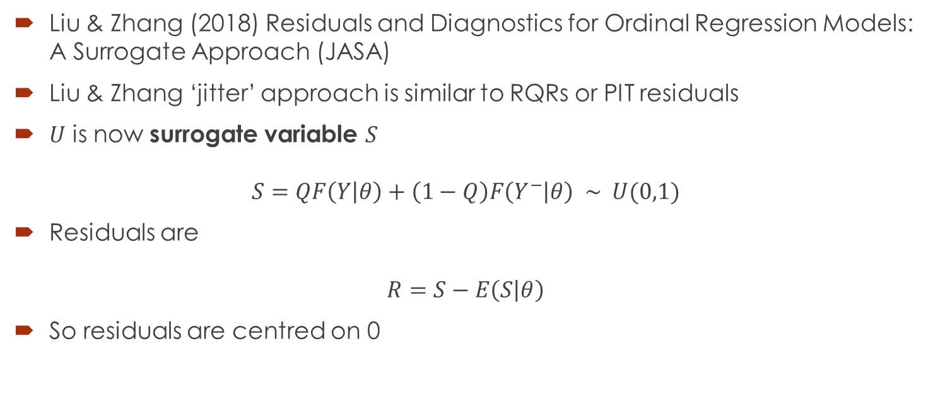
Surrogate Residuals
Liu & Zhang (2018) Residuals and Diagnostics for Ordinal Regression Models: A Surrogate Approach (JASA)
Liu & Zhang ‘jitter’ approach is similar to RQRs or PIT residuals
$U$ is now surrogate variable $S$
$$S=QF\left(Y | θ\right)+\left(1−Q\right)F\left(Y^{−} | θ\right) \sim U(0,1)$$
Residuals are
$$R=S−E\left(S | θ\right)$$
So residuals are centred on 0

Slide 42
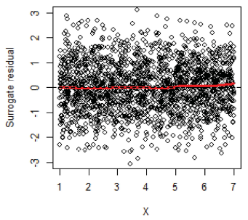
Surrogate Residuals
Correctly specified model

Slide 43
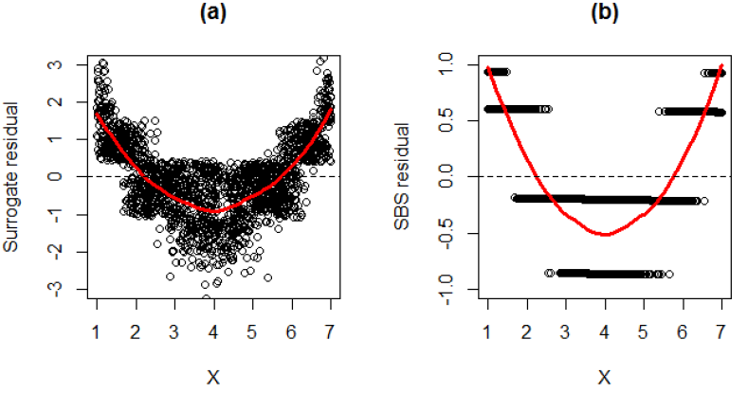
Surrogate Residuals
Incorrectly specified model

Slide 44
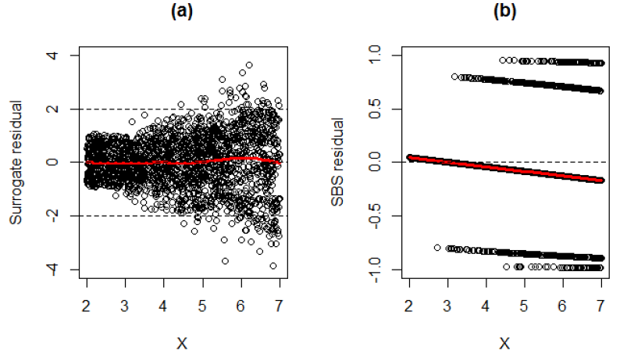
Surrogate Residuals
Incorrectly specified model

Slide 45
Surrogate residuals used for clustering
Calculate estimated CDFs of ordinal variables based on frequency tables
Convert ordinal data to continuous values by inverting CDF with randomisation
Look for correlations using e.g. Pearson’s correlation

Slide 46
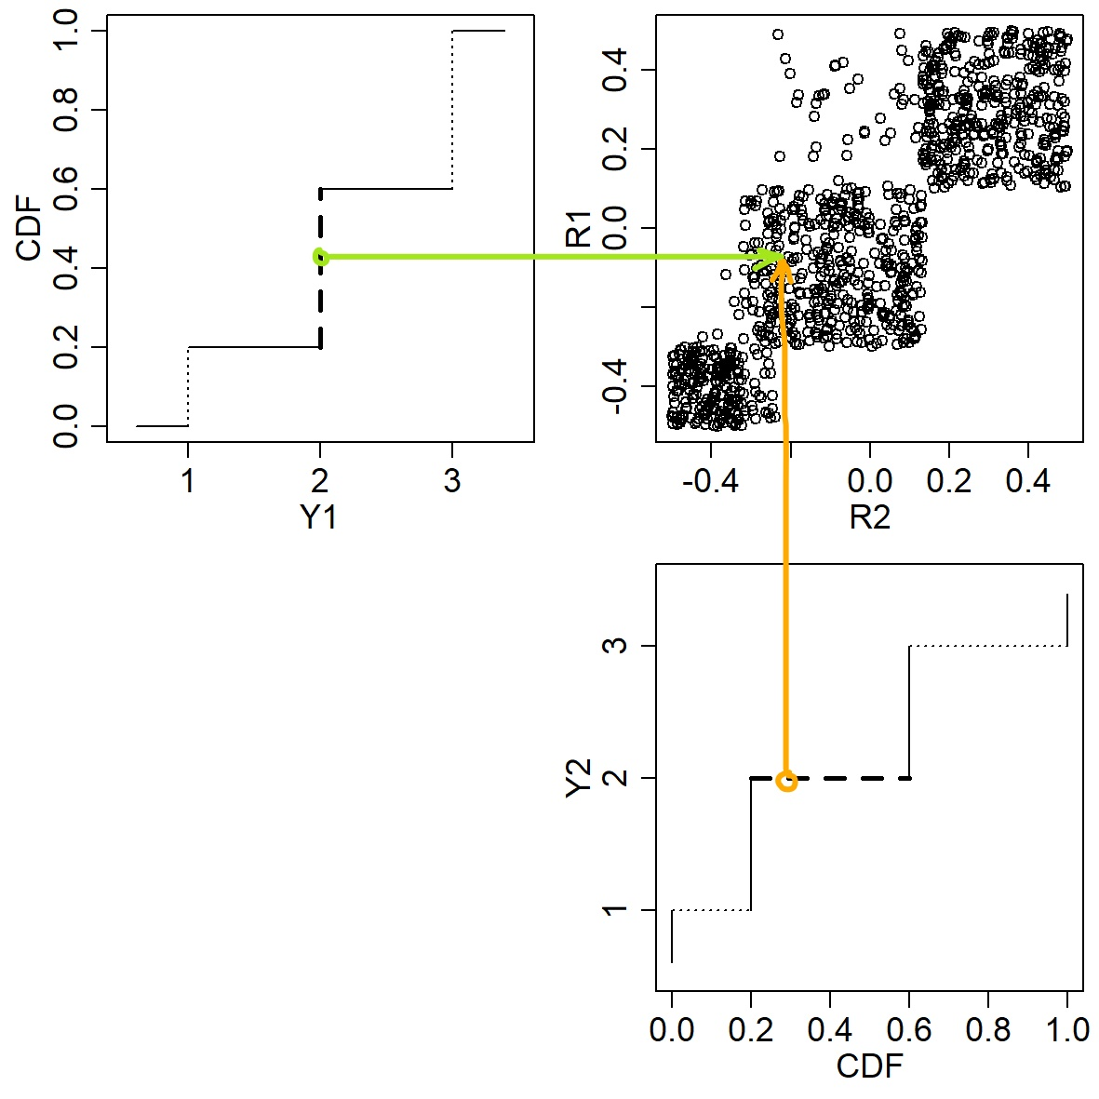
Surrogate residuals used for clustering

Slide 47
Surrogate residuals used for clustering
Useful for genetic data
Residuals can be calculated after accounting for strong dependencies between variables
Approach already demonstrated for correlation between response variables in regression by Liu et al. (2021)
Liu et al. (2021) Assessing partial association between ordinal variables: quantification, visualization, and hypothesis testing (JASA)

Slide 48
PhD student wanted!
Fully funded PhD including $35K annual stipend and paid tuition fees
Please contact louise.mcmillan@vuw.ac.nz

Slide 49
References
Dunn, P. K., & Smyth, G. K. (1996) Randomized quantile residuals, Journal of Computational and Graphical Statistics, 5(3), 236-244
Warton D. I., Thibaut L., & Wang Y. A. (2017) The PIT-trap – A “model-free” bootstrap procedure for inference about regression models with discrete, multivariate responses, PLoS ONE, 12(7): e0181790. https://doi.org/10.1371/journal.pone.0181790
Liu, D., & Zhang, H. (2018) Residuals and Diagnostics for Ordinal Regression Models: A Surrogate Approach, Journal of the American Statistical Association, 113:522, 845-854, DOI: 10.1080/01621459.2017.1292915
Liu, D., Li, S., Yu, Y., & Moustaki, I. (2021) Assessing partial association between ordinal variables: quantification, visualization, and hypothesis testing, Journal of the American Statistical Association, 116:534, 955-968, DOI:10.1080/01621459.2020.1796394

Slide 50

Stats game
Island survival game for testing students on first-year statistics material
Email me at louise.mcmillan@vuw.ac.nz for more information
Game graphics by Paperdog Ltd.

