Slide 1
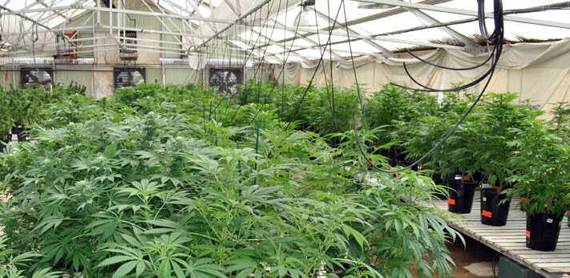
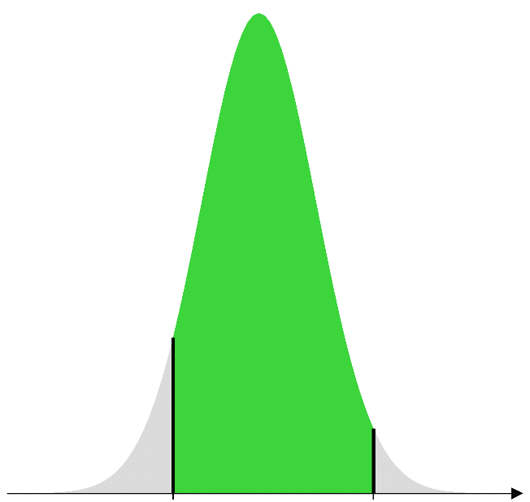
Analysis of Censored Cannabidiol Data
Vanessa Cave Roger Payne David Baird

Slide 2
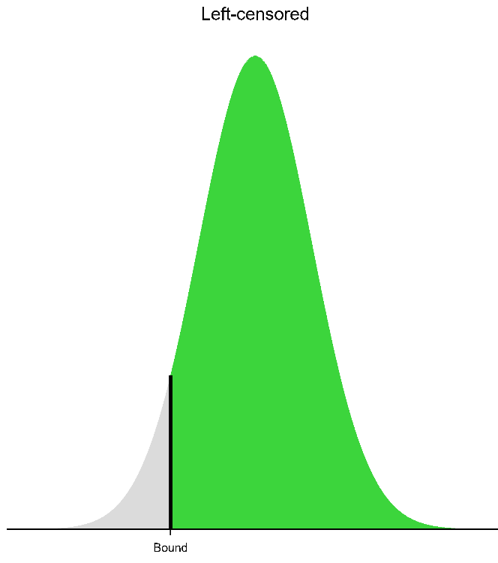
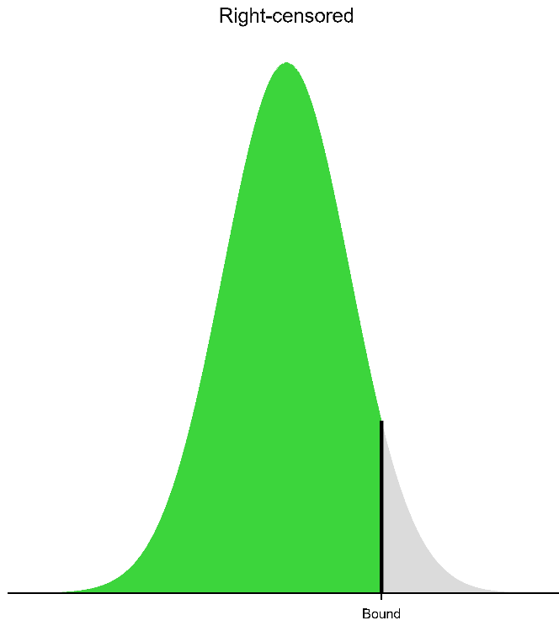
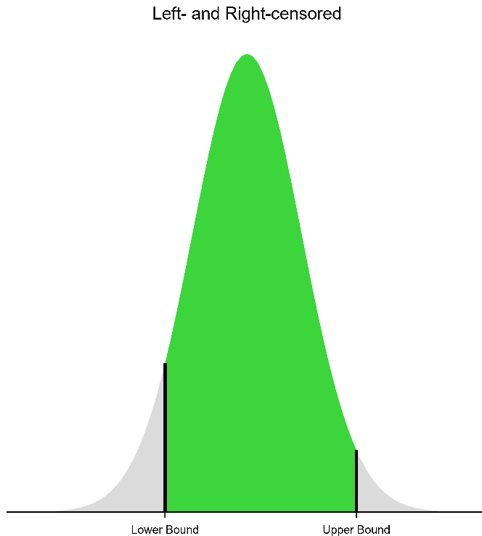
Censored Data
Left Right Left and Right
Bound Bound Lower Bound Upper Bound
Notes:
Censoring occurs during data collection when measurements are not, or cannot, be taken above or below a certain bound.
For example, chemical concentrations may be left-censored if they fall below a minimum level of detection.
An example of when right-censoring may occur is if an experiment generates some very large counts, and its only practical to count up to certain number. Observations exceeding this number will therefore be right-censored
In some circumstances, data may even be subjected to both left- and right- censoring, where the quantification method has both lower and upper limits of detection. And indeed this is the case with the cannabidiol dataset I’m going to discuss today.

Slide 3

Cannabidiol (CBD) Example
Medicinal cannabis production is a burgeoning industry in NZ
Research is needed to improve plant-lines and cultivation practices
Experiment: Comparing CBD potency between different nutrient feeds
CBD has: ✓ potential therapeutic effects
✓ little-to-no psychoactive effects
Prescribed for anxiety, pain, chemotherapy-induced nausea etc.
Notes:
In NZ, medicinal cannabis production is an emerging industry.
Most growers in NZ have been adopting cultivation practices, and using plant-lines, developed by large and established overseas enterprises, such as those in the USA.
However, these may not be optimal for NZ conditions and/or the markets growers in NZ are targeting.
Therefore, there is a need for research so growers in NZ can enhance their plant-lines and improve their cultivation practices.
The example I’m sharing today is from a medicinal cannabis producer in NZ exploring ways to optimize the cannabidiol potency of their raw product by improving the nutrient feed they use.
Cannabidiol, or CBD, is one of the active compounds in cannabis plants. For medicinal purpose, CBD is important as it is believed to have therapeutic effects. However, unlike THC, another active compound in cannabis plants, CBD has little-to-no psycho-active effects. That is, ingesting CBD doesn’t make you high.
CBD is prescribed predominately for anxiety, pain and chemotherapy-induced nausea, but it is also used to treat may other ailments and health conditions.

Slide 4



Trial Design
3 cultivars
2 nutrient feeds (new and standard)
12 replicates
Split-plot
Notes:
The data in this talk was from a small experiment, involving just 3 cultivars and 2 different nutrient feeds: the company’s standard one and a new one.
The 3 cultivars were targeted specifically as their performance wasn’t a good as expected.
Due to commercial sensitives, unfortunately I’m not able to describe the two nutrient feeds in detail or to name the cultivars. Which is a shame, because the cultivars have very imaginative names. However, I can say that the new nutrient feed is actually a programme of feeds that provides a different concoction of nutrients according to the various growth stages of the cannabis plant. Conversely, with the standard feed, the same recipe of nutrients is provided regardless of growth stage.
The experiment comprised of 12 replicates layout as shown here.
And the design was “split-plot”, with nutrient feeds applied at the row level, and the three cultivars randomised within rows.

Slide 5

Design Limitations
Constrained where the dripper lines supplying the nutrient feeds could go
systematic layout of the nutrient feeds
Single source for each of the nutrient feeds
no independent replication
Notes:
For practical reasons, the design did suffer from several important limitations.
Firstly, because we were constrained where the dripper lines supplying the different nutrient feeds could go, we were unable to properly randomise the two nutrient feeds to the rows within the replicates
After some feasibility testing, the best we could do was this serpentine type of arrangement, where the two dripper lines supplying the nutrient feeds zig-zagged down the rows of plants. And even this was very fiddly and difficult to implement.
Another important limitation was that each nutrient feed was supplied to the plants down a single pipeline, all from the same batch. Therefore, we don’t really have any independent replication of the individual nutrient feeds. For example, different batches of the same nutrient feed will vary, but this variation isn’t captured in this trial. Consequently, we have to be careful that we don’t over interpret and over generalise the results from this experiment.

Slide 6
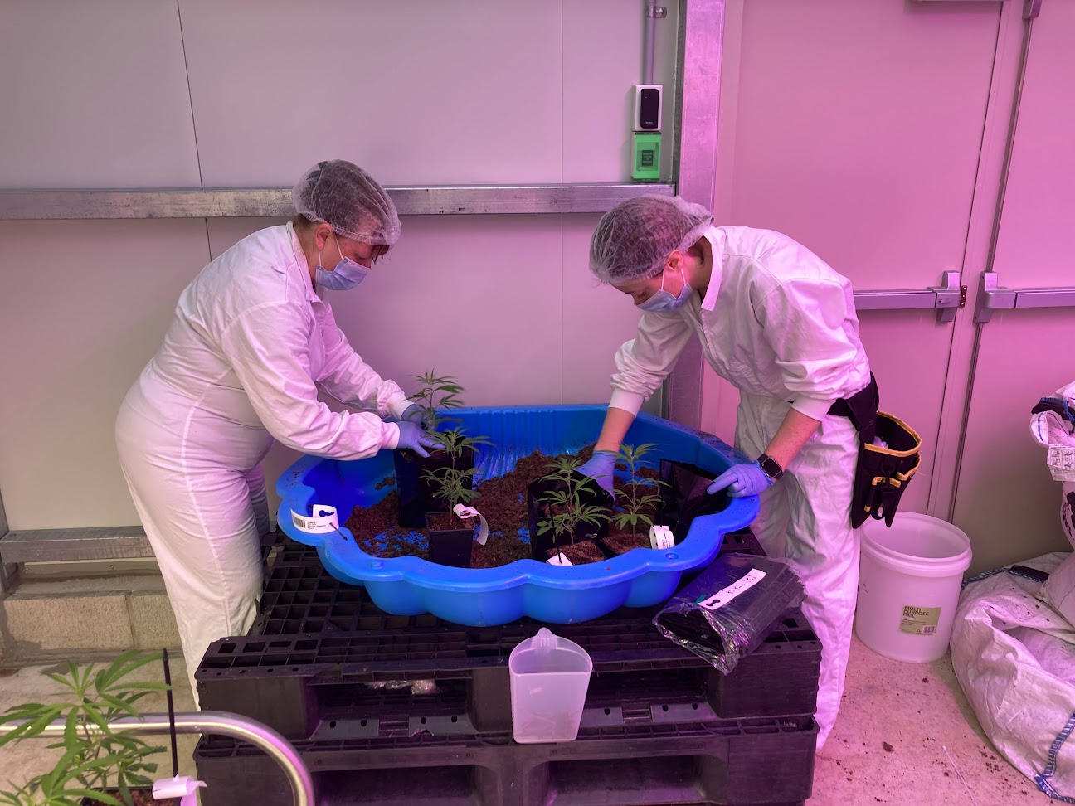
Notes:
Here’s a couple of photo of the trial being set-up. In this photo the plants are being re-potted into suitably sized bags in which they can grow over the duration of the trial, which was approximately 3 months
Prior to potting, the plants had been randomised and arranged into their replicate groups.

Slide 7
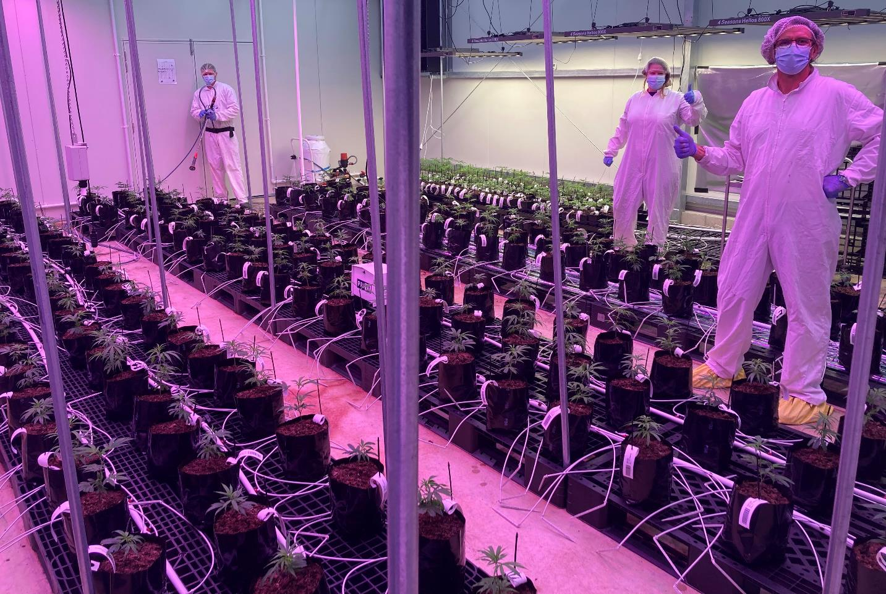
Notes:
After potting, the plants were laid-out in their appropriate positions within the grow shed according the experimental design.
The experiment I’m talking about now is in the middle row. In the other rows, plants are being grown for different purposes and reasons. For example, in the back row, the run-off from the plants fed the new nutrient feed is being collected and analysed to better understand what plants are taking up and what they are not.
The white piping you can see running down the pallets is what supplies the nutrient feeds, and the wee hoses hanging off the pipes are the drippers, 2 of which had to go into each pot.
Even with our simplified design, it was a painstaking job ensuring the right drippers were feeding each pot.
And in case you are wondering about the groovy purple light, this has important implications for cannabis plant growth. It is actually a mixture of red and blue wavelengths of light. Cannabis is very light-sensitive, and blue light is very important for its vegetative growth and red light is very important its flowering.
Now, I’d like to quickly mention here that this is the first experiment this company has ever embarked upon. So, it was a bit of a learning curve for all of us. It is also why we kept the trial small and the design relatively simple.

Slide 8
CBD Potency
Measured on-site using a commercially available device
Units: % CBD relative to plant material (wet weight)
Detection limits: 2% to 15%
Both left- and right- censored observations
Nutrient Feed | Cultivar | Left-censored | Right-censored | Uncensored
New | A | 1 |  | 11
 | B |  | 1 | 11
 | C |  | 5 | 7
Standard | A | 4 |  | 8
 | B | 2 |  | 10
 | C |  |  | 12
Notes:
The plants grew happily for approximately 3 months, and at harvest the response of interest, CBD potency, was measured on-site using a commercially available device.
The units of measurement were % CBD relative to the plant material wet weight.
However, the quantification method used by the device had both a lower and upper limit of detection, 2 and 15% respectfully.
And unfortunately, in the resulting dataset, we ended up with censored observations: some observations were left-censored and others were right- censored. Fortunately, however, we weren’t in the situation where all data for a particular treatment combination was censored.
Not a lot of the data was censored, only approximately 20% - but this is enough to be problematical, particularly as one of our key analysis goals was to estimate the treatment means.

Slide 9
Tobit Model: Normal Data
Censored data can be analysed using the Tobit model
Replaces censored observations with their expected values
Left-censored: E(y | y < bound, m, s) = m - s × ϕ(z)/ɸ(z)
where z = (bound - m) / s
Right-censored: E(y | y > bound, m, s) = s × ϕ(z)/ɸ(z)- m
where z = (m - bound) / s
E(y) depends on m and s
E-M algorithm
ϕ - standard Normal PDF
ɸ - standard Normal CDF
Notes:
However, fortunately, censored data such as this can be analysed using a Tobit model, enabling us to obtain well-behaved and reliable estimates of the treatment means.
Now, what the Tobit model does is replace the censored observations with their expected values.
Here, I’ll illustrate the Tobit model in terms of Normally distributed data, but it can be applied to data from other distributions, such Poisson count data.
Under the Tobit method, the probabilities for the uncensored observations are just the usual Normal probabilities.
Whereas the probabilities for the left-censored observations are the cumulative lower Normal probabilities for values less than or equal to the lower bound
Similarly, for right-censored observations, the probabilities are cumulative upper Normal probabilities for values greater than or equal to the upper bound.
This leads to these two expressions for the expected values of the censored observations, where
Lowercase phi z represents the probability density function of the standard normal distribution
And uppercase Phi z represents the cumulative distribution function of the standard normal distribution
However, the expression for the expected value of a censored observation depends on both its mean m and its standard deviation s. Thus, the Tobit method employs the EM algorithm to optimize the model.

Slide 10
E-M algorithm
Tobit model uses the E-M algorithm
E-M algorithm
1. Initialize the unknown model parameters
2. E-step: Estimate the unobserved data given the parameter estimates
3. M-step: Maximize the likelihood, using the estimated unobserved data as if observed, to obtain new model parameter estimates
4. Iterate 2 & 3 until convergence
Notes:
In brief, the E-M algorithm is an iterative two step algorithm.
It begins by initializing the unknown parameters.
Then at the E-step, the unobserved data, which in our case are the censored observations, are estimated as their expected values given the parameter estimates.
These estimates are then treated as observed data in the M-step, in which the likelihood is maximised to yield new estimates of the model parameters.
We then return to the E-step and iterate over the E and M steps until convergence.
Convergence is determined when changes in the model’s parameters are less than some chosen tolerance.

Slide 11
Tobit Method: LMM
Provide initial estimates for the censored observations (e.g., bound)
Fit the LMM using REML
Save the means (fitted values) and variances
Replace censored observations with their expected tail values
Iterate 2-4
Notes:
So, for example, when fitting a linear mixed model to data with censoring we start by providing initial values for the censored observations. For example, we could initialize them at their bounds
We then fit our linear mixed model to the data using REML as per usual, treating the estimates of the censored observations as if they were fully observed.
This yields means, i.e., fitted values, and variances that we then use to re-estimate the censored values. And we repeat until convergence.

Slide 12
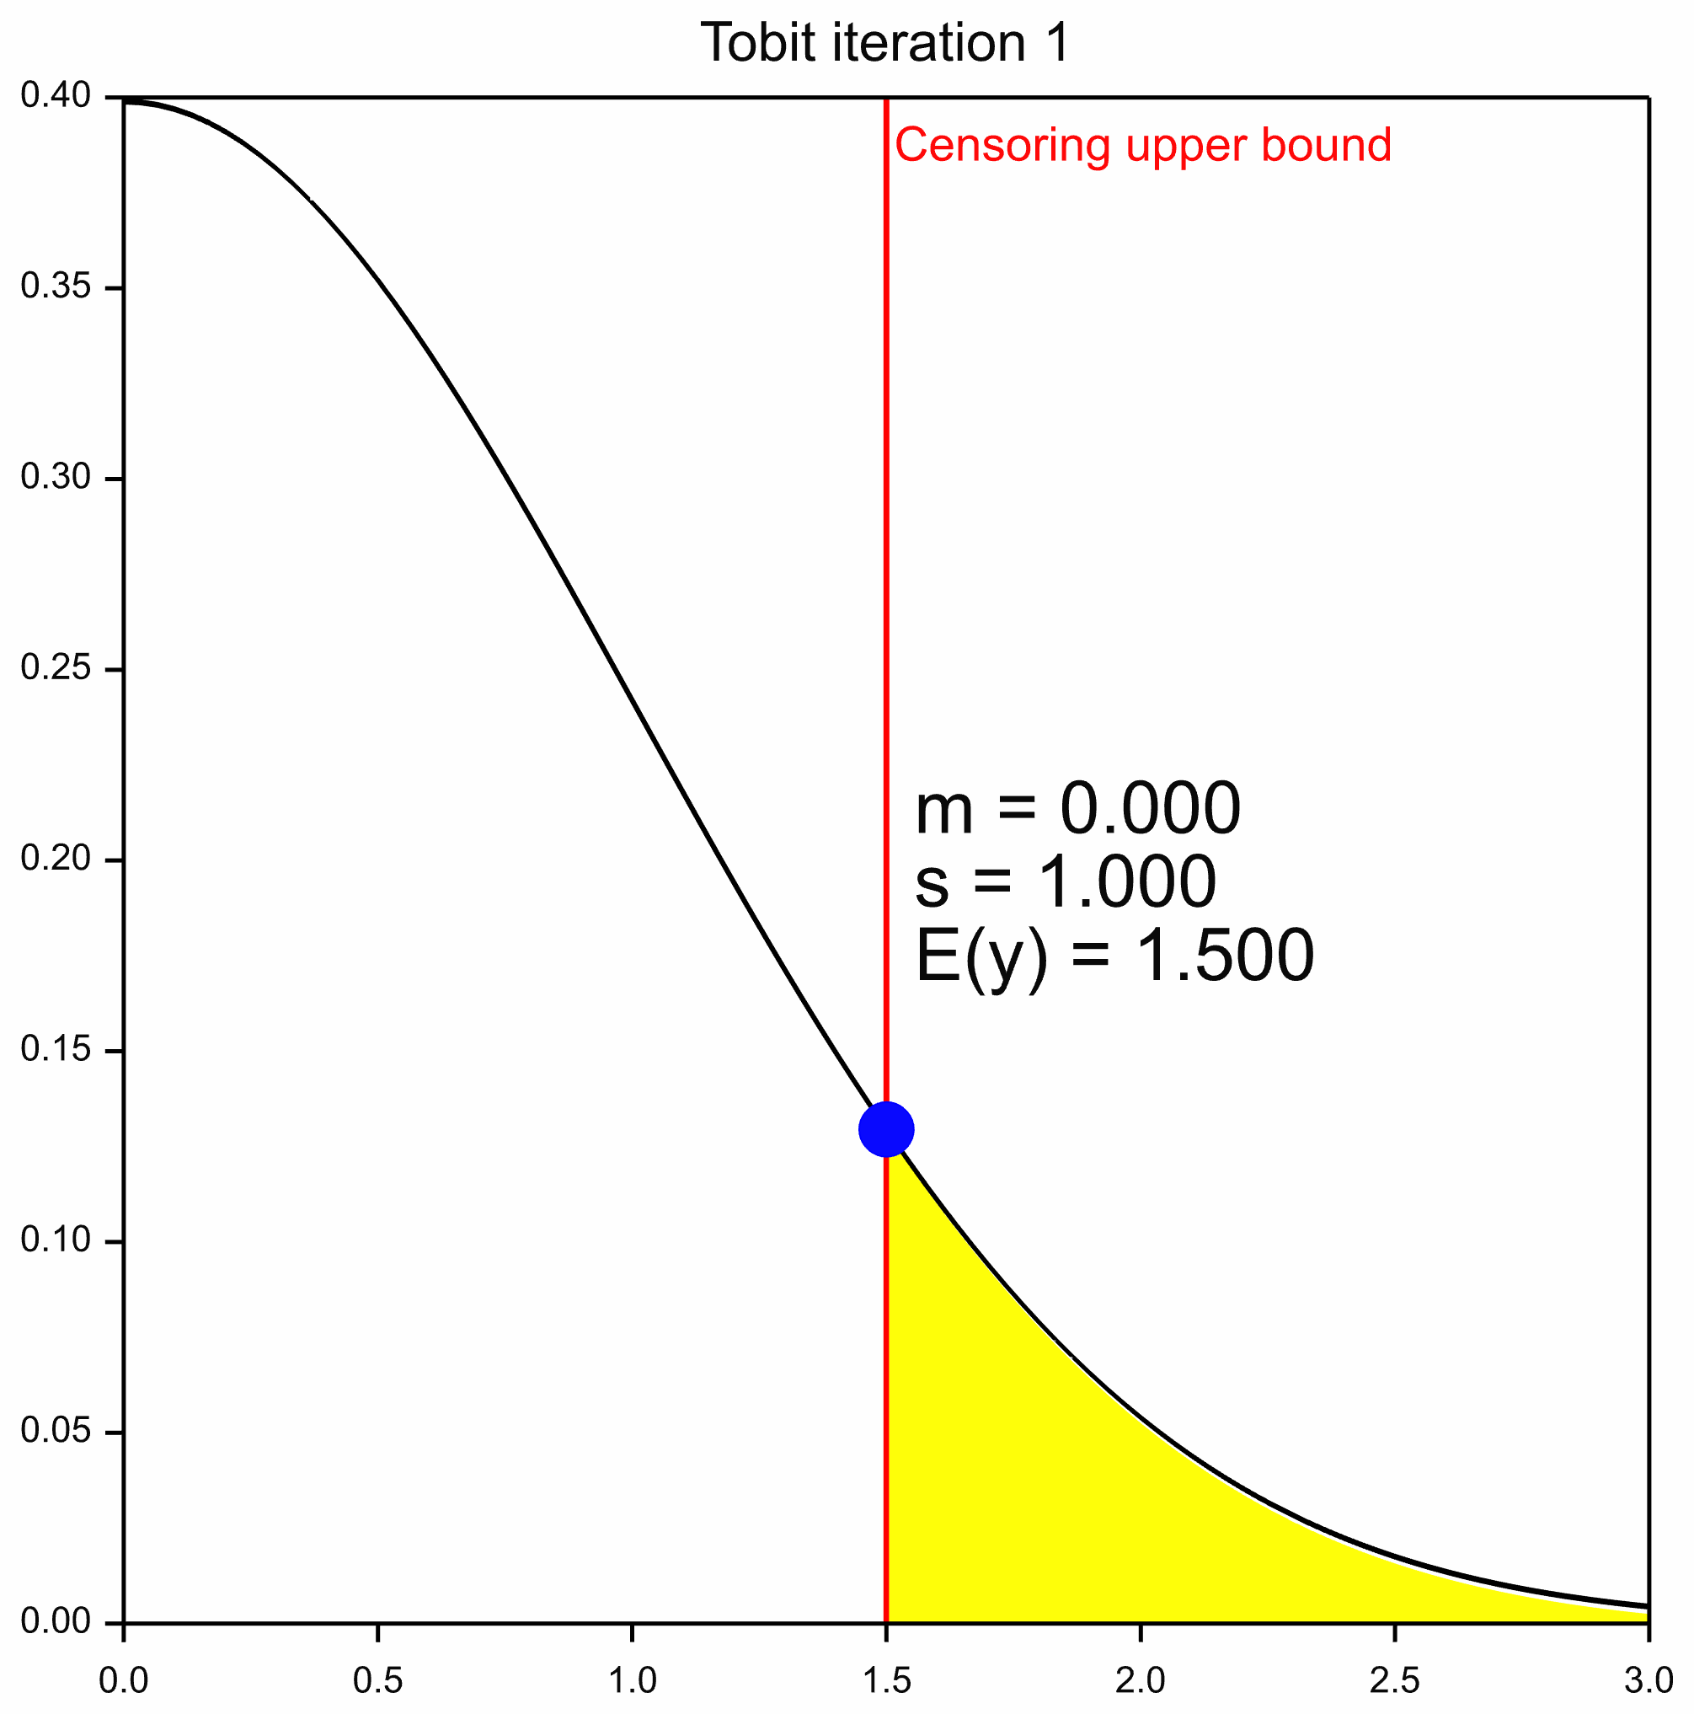
Iteration 1
Notes:
Here’s a wee demonstration of the Tobit model.
At the first iteration, the initial E-step uses a starting value for our estimated censored observation. Here, the bound at which the observation is right-censored is used: 1.5.
We then obtain an estimated mean and variance for the distribution of the censored observation.

Slide 13
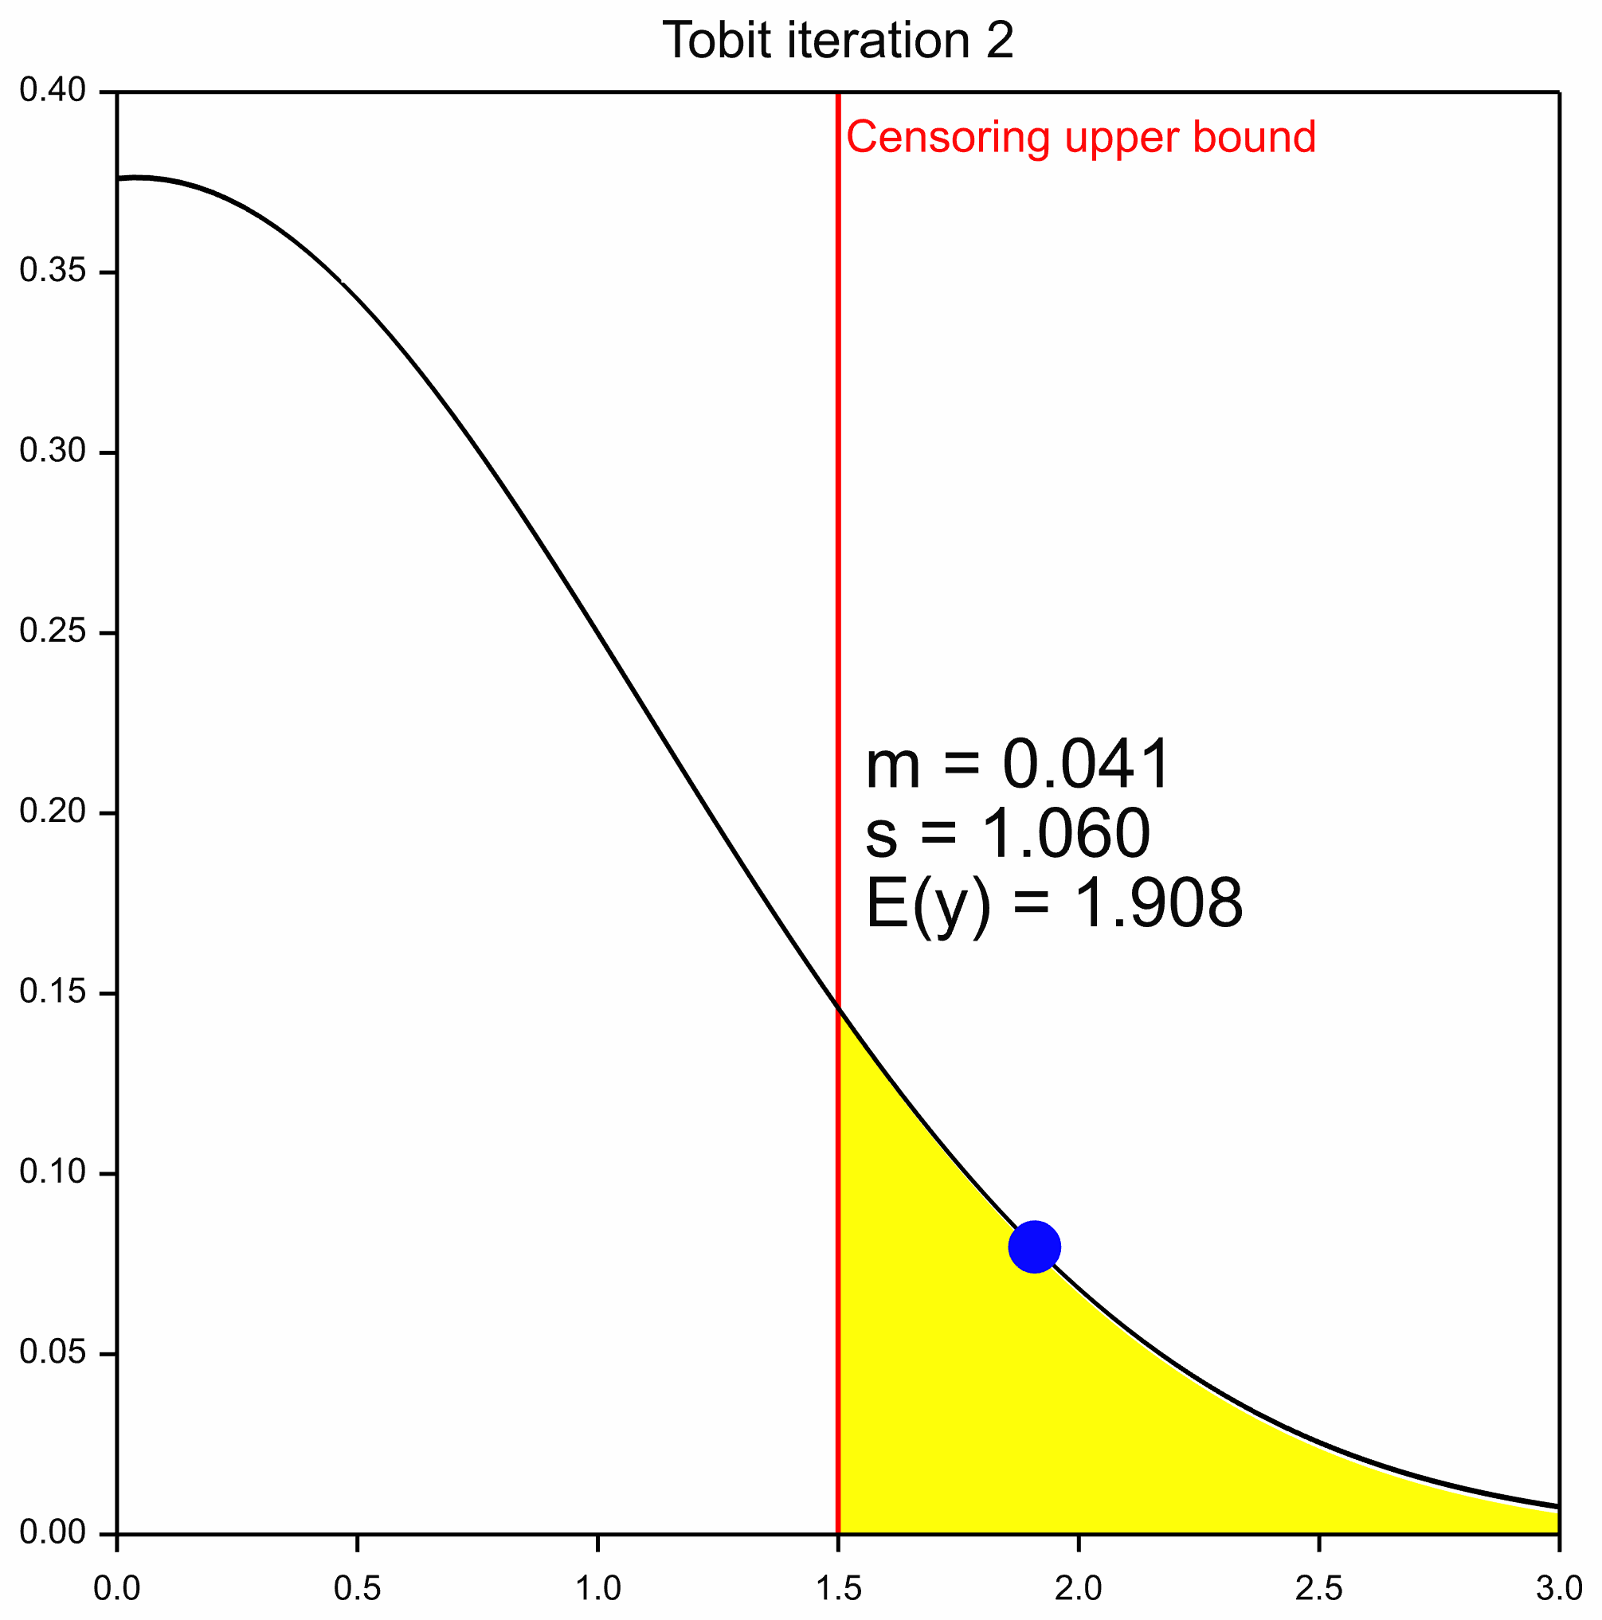
Iteration 2
E(y | y > bound=1.5, m=0.041, s=1.060)
Notes:
Then, at iteration 2, we use this mean and variance to re-estimate the censored observation.
In this example, as the observation is right-censored, this updated estimate is given by the expected value of the upper tail of the Normal distribution.

Slide 14
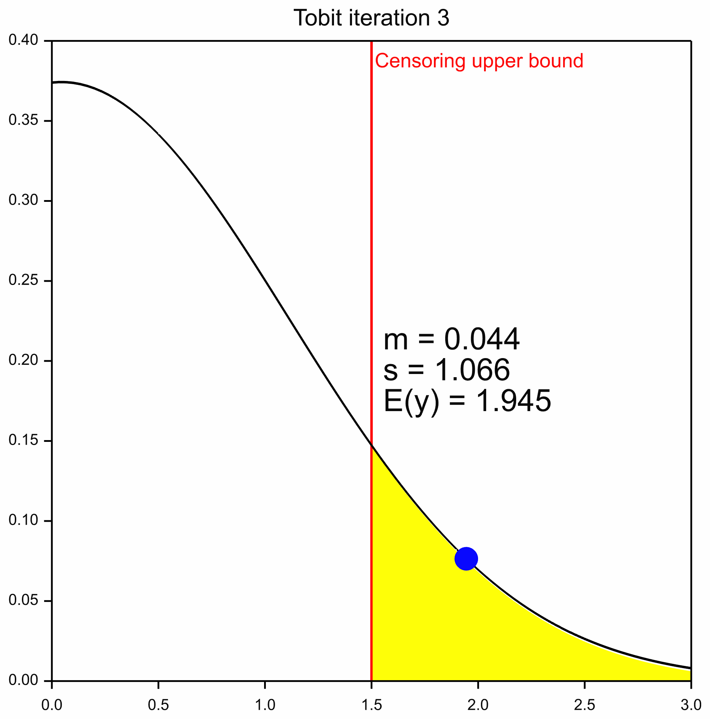
Iteration 3
Notes:
This re-estimation of the mean and variance, and then the censored observation, is repeat this until we have convergence.

Slide 15

Iteration 4
Notes:
At the 4th iteration, there is a small change in the expected value.

Slide 16

Iteration 5
Notes:
But by iteration 5, the EM algorithm has converged.

Slide 17
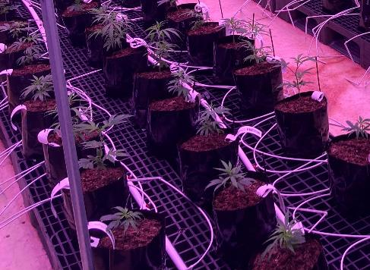
CBD example
3 cultivars
2 nutrient feeds (new and standard)
Split-plot
Response: CBD potency
Detection limits: 2 to 15
~20% censoring
Notes:
Let’s return to our CBD example.
If you recall, the treatments are 3 cultivars by 2 nutrient feeds. A split-plot design was used with nutrient feeds applied to the rows, and cultivars within rows.
Of interest is estimating the mean CBD potency for the different treatment combinations.
However, a modest number of CBD values are censored, with some observations falling below the lower bound of 2, and others exceeding the upper bound of 15.

Slide 18
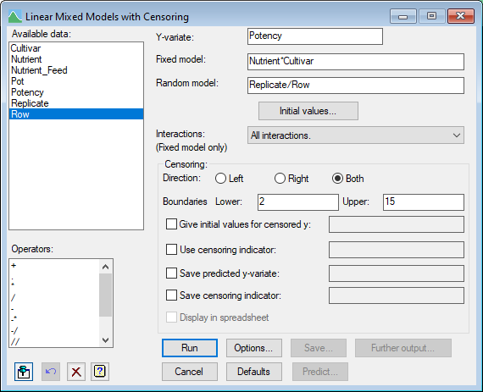

Data Analysis
Tobit linear mixed model analysis
Response: CBD potency
Fixed model: Nutrient Feed + Cultivar + Nutrient Feed . Cultivar
Random model: Replicate / Row
Notes:
So, to analyse this censored data set, I used a Tobit linear mixed model.
The fixed model comprised the main effects of nutrient feed and cultivar + their interaction
And the random model reflected the split-plot design of replicates and rows within replicates.
This model is super easy fit Genstat 24 – which is due for release early next year, either via the menus or using code.
Tobit linear mixed models for censored data are available in the current version, Genstat 23, however censoring is assumed to be in just one direction: either left or right.

Slide 19
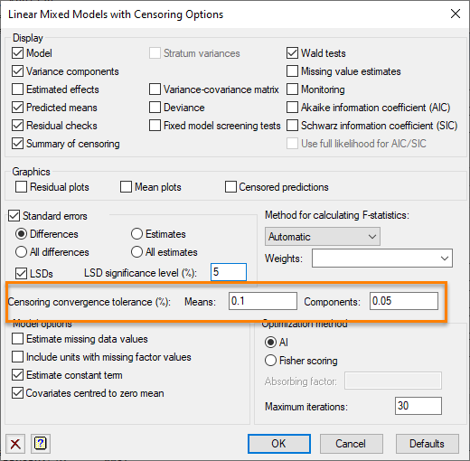

Data Analysis
The E-M algorithm was deemed to have converged when:
the percentage change in each estimated treatment mean was < 0.1%
and
the percentage change in each estimated variance component was < 0.05%
E-M algorithm converged after 8 iterations
Notes:
Underpinning the Tobit model is an EM algorithm. I deemed it to have converged when the percentage change in each estimated treatment mean was less than 0.1%, and the percentage change in each estimated variance component was less than 0.05%.
E-M algorithm converged very quickly, after just 8 iterations
As the main goal was to estimate and compare the cultivar by nutrient feed treatment means, let’s look at a plot of the predicted means.

Slide 20
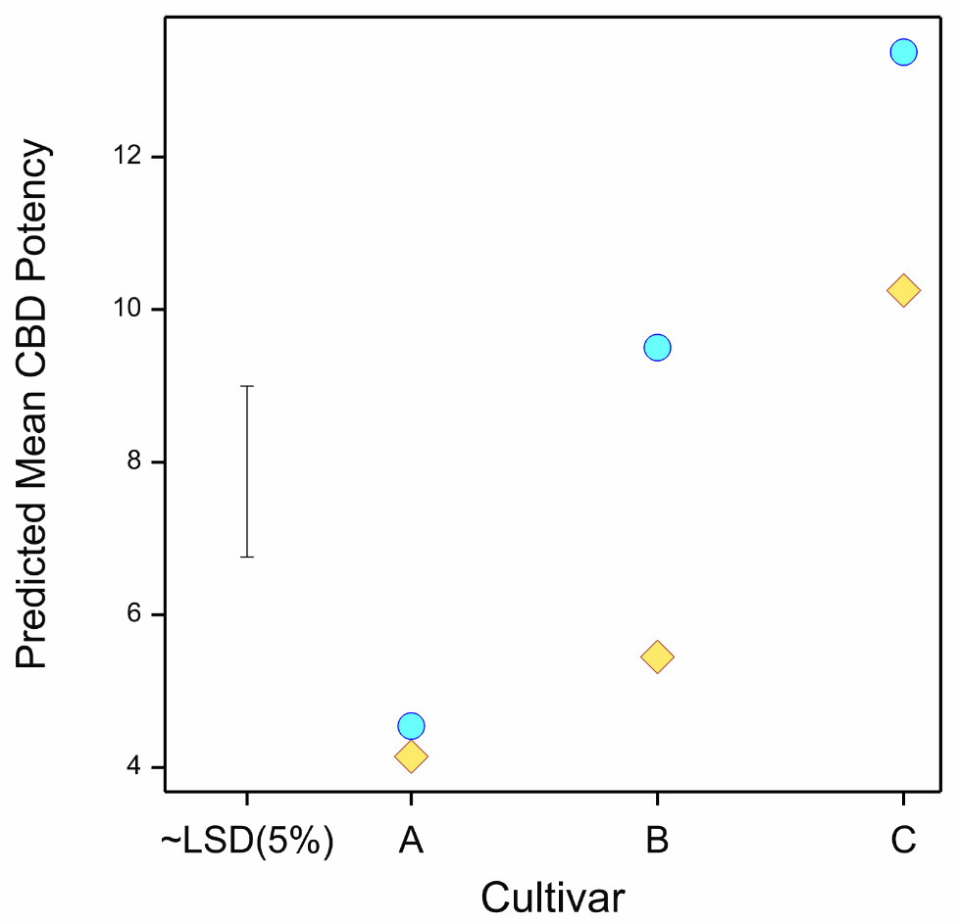
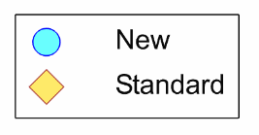
Results: Means
Notes:
The predicted treatment means are shown here. Across the x-axis we have the three cultivars : excitingly named A, B, C, ordered fortuitously from lowest to highest CBD potency.
The means for the new nutrient feed are plotted with blue circles, and the standard feed with yellow diamonds.
From this plot, we can see that the new nutrient feed has given an advantage, in particular for cultivars B and C
However, for cultivar A, which has a low overall CBD potency, there’s little difference between the new and standard feeds.
Note, the LSD is only approximate because Genstat takes the smallest of the available d.d.f. the contrasts amongst the Cultivar by Nutrient means

Slide 21
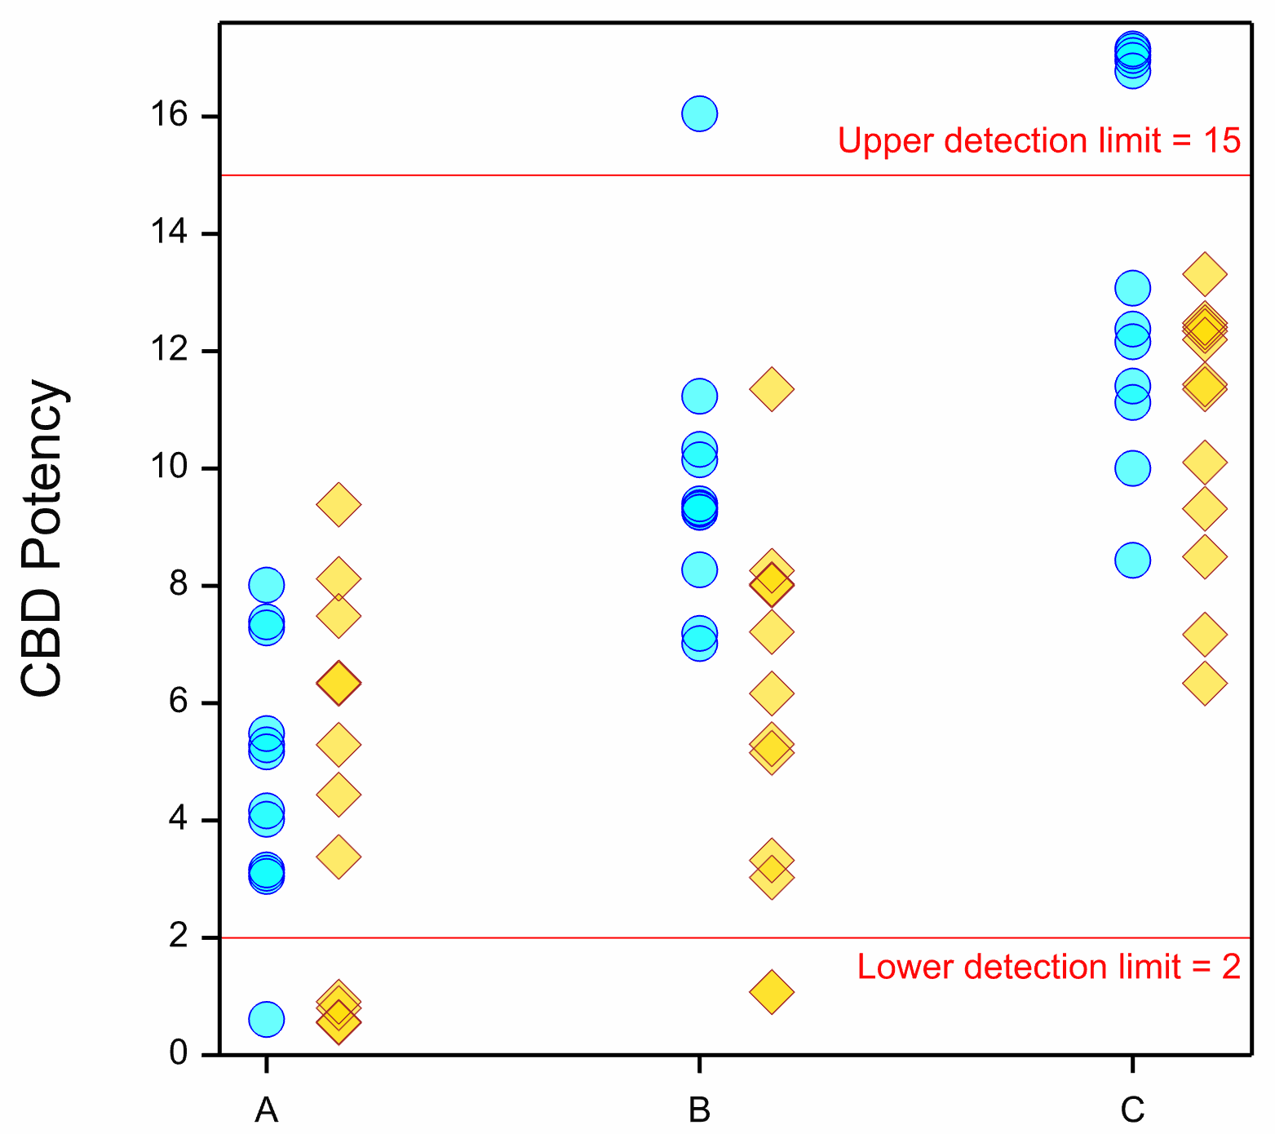
Results: Estimated Values
Notes:
From the Tobit algorithm we also get estimated values for the censored observations. And these can be seen in this plot.
Uncensored data is that plotted between the lower and upper limits.
The estimates of the left-censored observations can be seen plotted below the lower limit of detection, and the estimates of the right-censored observations can be seen plotted above the upper limit of detection.
There wasn’t a lot of variability between the replicates or rows – the variance components were very small. And that’s why we don’t see a lot of difference in the estimated values within a treatment combination.

Slide 22
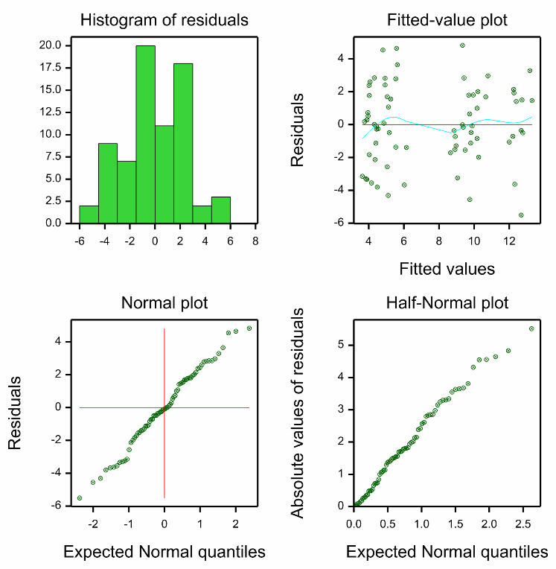
The Response is a %...
CBD potency quantified as % CBD relative to plant wet weight
Residuals look good
Minimum estimate of a left-censored value: 0.43 > 0
Notes:
Some of you are no doubt justifiably concerned that I analysed the response, which is a percentage, using a linear model.
In my defence, the residuals look surprisingly good. The histogram of the residuals and the Normal plot are fairly consistent with what we’d expect from Normal data, and the scatter plot of residuals against the fitted values doesn’t raise any alarms regarding non-constant variance.
It is also reassuring that all of the left-censored observations have been estimated to be greater than 0. However, of course there is no guarantee that this would be case.
Arguably, perhaps I should have logit transformed the data, or used a different model, for example a beta regression.

Slide 23
Recent Genstat Developments
Censored data analysis menus for:
Genstat 22
LMM
Genstat 23
log-Poisson GLM, GLMM, HGLM
Genstat 24
ANOVA
Gamma and Negative Binomial GLMs
Extensions to allow for…
both left- and right- censoring
censoring at different points
Notes:
And as alluded to earlier, the Tobit method isn’t restricted to Normal data. And indeed, Roger, David and I have been implementing a suite of Tobit models in Genstat, including for the analysis of censored Poisson data.
And in the 24th Edition, which is beta-erring at the moment, menus have also been added for Tobit ANOVA, Tobit Gamma GLM, and Tobit Negative Binomial GLM.
We’ve also extended the functionality to allow for data with both left and right censoring, as well as censoring at different points.

Slide 24

Thank you!
Any questions or comments?
Notes:
Well, that’s all from me. I hope you have all enjoyed the conference and the beautiful Bay of Islands. Any questions or comments.

