Slide 1


Slide 2
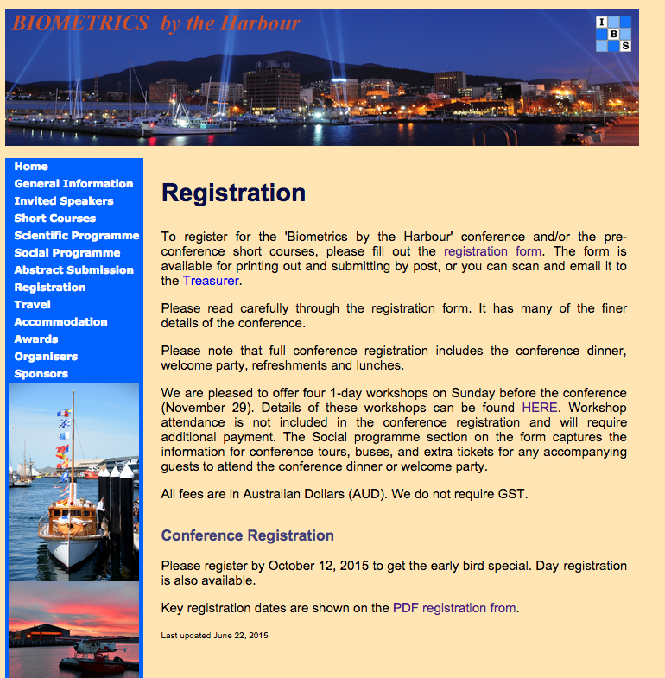

Slide 3
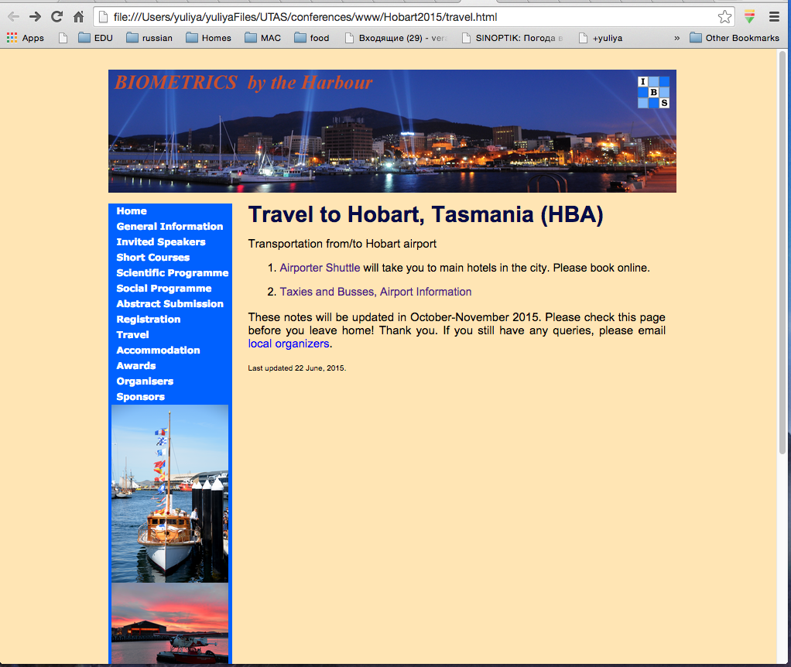

Slide 4
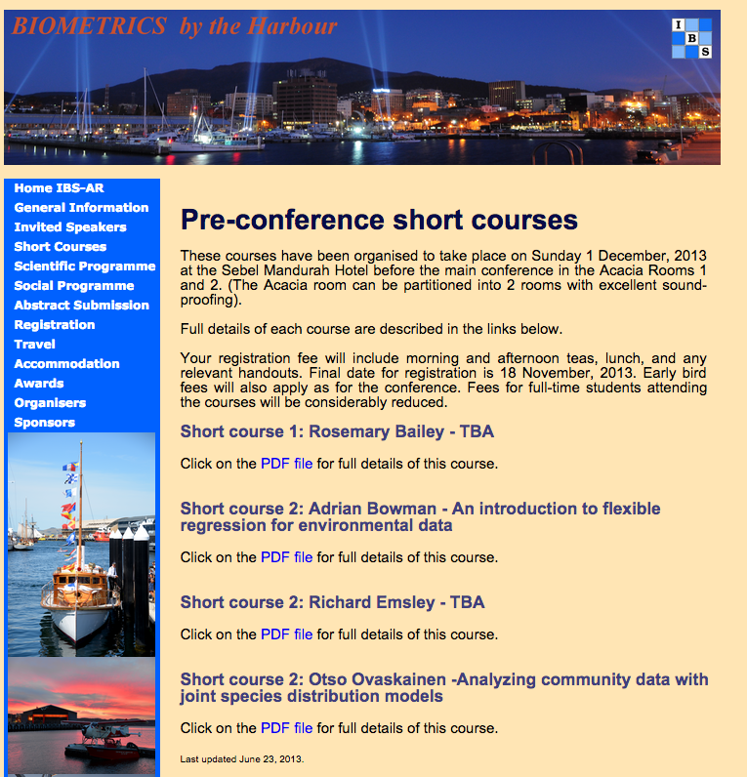

Slide 5
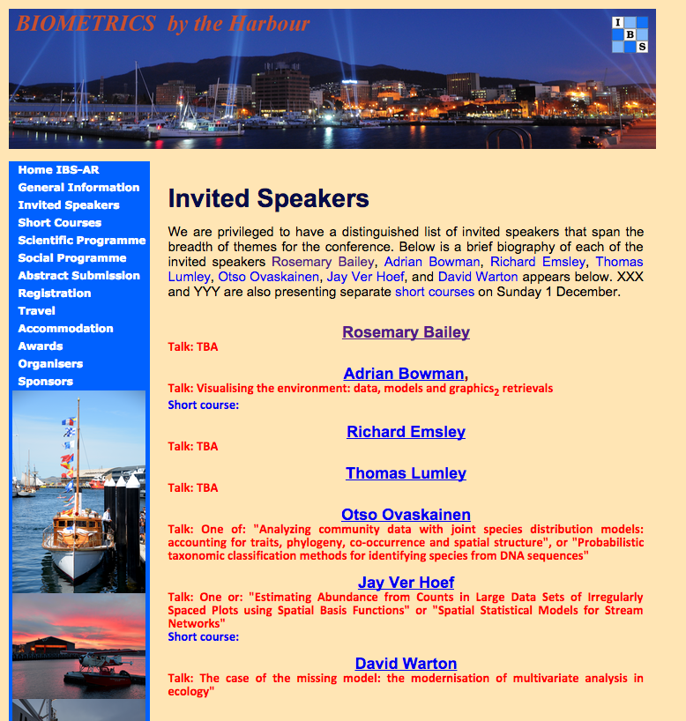
Not edited since May

Slide 6
Pages edited:
Home
Invited Speakers (need some edits)
Short courses( need some info)
Registration
Travel
Pages that need editing:
General Info
Scientific Program
Social Program
Abstract Submission
Accommodation
Organizers
Sponsors

