Slide 1

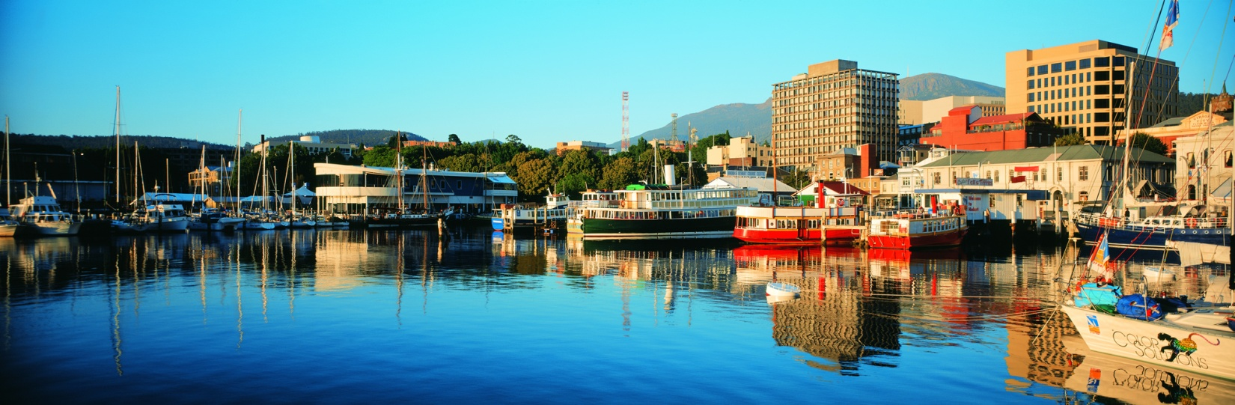
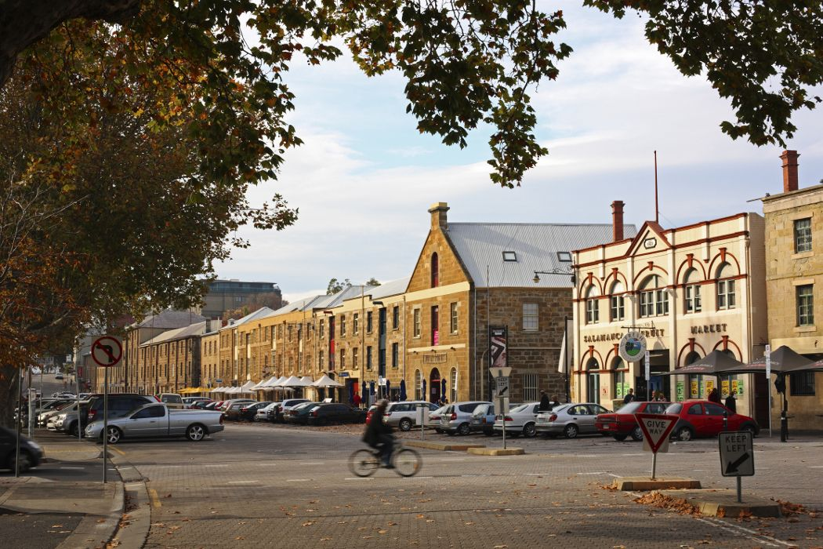
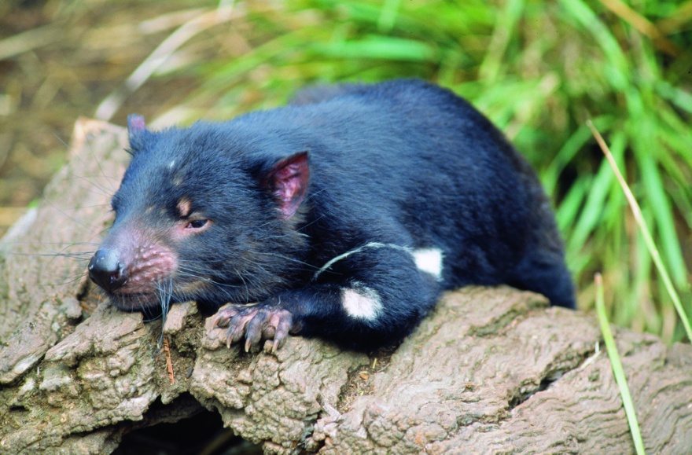
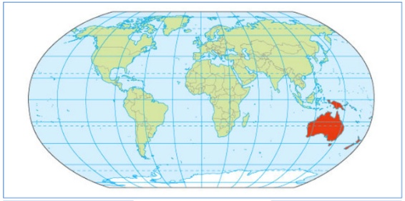

The International Biometric Society Australasian Region Conference
Biometrics by the Harbour
Hobart, Tasmania, 29th November – 3rd December, 2015
On behalf of the Australasian Region of the International Biometric Society, we invite you to join us for our biennial conference. Share your work with colleagues working with statistical tools on problems in the biosciences, including ecology, agriculture, biomedical science, public health, environmental science and forestry.
The conference will be held at one of Hobart’s oldest hotels – Hadley’s Hotel - located in the heart of Hobart. Hobart itself is well known for its history, its natural beauty, its food and culture, and as a gateway to pristine wilderness.
Come and enjoy a world-class conference in a stimulating environment.
Conference themes, invited speakers, workshops and the social program will be announced shortly, so stay tuned!
Details will be posted at:
http://www.biometricsociety.org.au/
Kiama 2011
Taupo 2009
Albany 2013

Slide 2
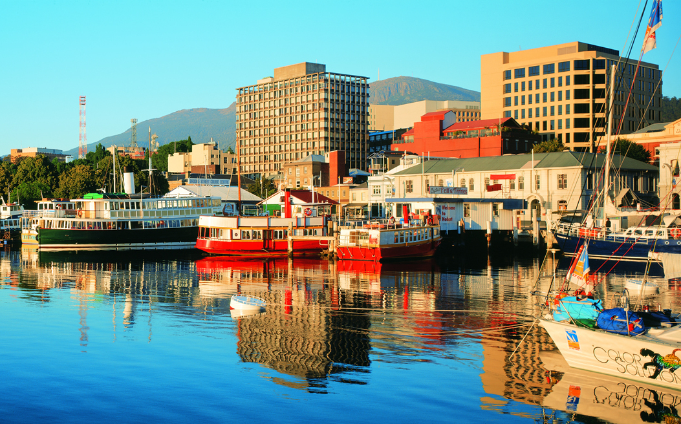
Biometrics by the Harbour
Hobart, Tasmania, 2015
29th November – 3rd December

