Slide 1
Limitations of Hierarchical and Mixture Model Comparisons
By
M. A. C. S. Sampath Fernando
Department of Statistics – University of Auckland
And
James M. Curran
Renate Meyer
Jo-Anne Bright
John S. Buckleton

Slide 2
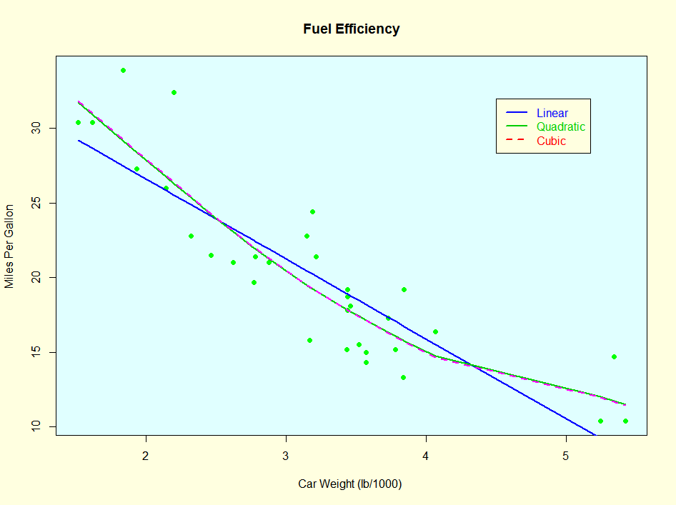
Introduction
What is modelling?
A statistical model is a probabilistic system
A probability distribution
A finite/infinite mixture of probability distributions
Good models
All models are approximations
π = 3.14159 ? π ≈ 3.14159 π ≈ 3.14 π ≈ 3

Slide 3
Modelling the behaviour of data
If we wish to perform statistical inference, or use our model to probabilistically evaluate the behavior of new observations, then we need three steps
Assume that the data are generated from some statistical distribution
Write down equations for the parameters of the assumed distribution, e.g. the mean and the standard deviation
Use standard techniques to estimate the unknown parameters in 2.
Steps 1–3 should be repeated as often as possible to get the “best” model.
Most model building consists of steps 2 and 3.
Classical and Bayesian approaches
Distributional assumptions on data
Model parameters
Prior distributions (believes) on model parameters
Parameters estimate

Slide 4
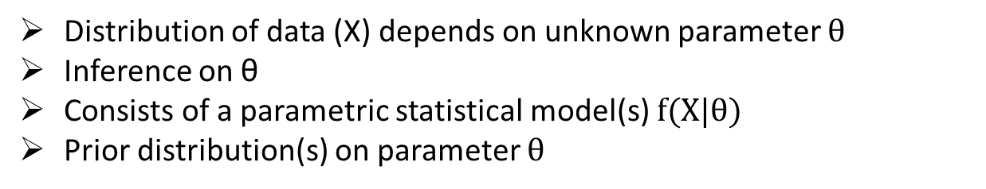
Bayesian Statistical Models
Distribution of data (X) depends on unknown parameter $θ$
Inference on θ
Consists of a parametric statistical model(s) $f(X|θ)$
Prior distribution(s) on parameter $θ$
Simple models
Model parameter(s)
Prior distribution(s) – distribution(s) model parameter(s)
Hyperparameter(s) – parameter(s) of prior distribution(s)
Hierarchical models
Hyperprior(s) - prior distribution(s) on hyperparameter(s)
Hyperhyperparameter(s) – parameter(s) of hyperprior distribution(s)
Mixture models
Assumes heterogeneous two or more unknown sources of data
Each data source is called a cluster
Clusters are modelled using parametric models (simple or hierarchical)
Represents as a weighted average of cluster models

Slide 5
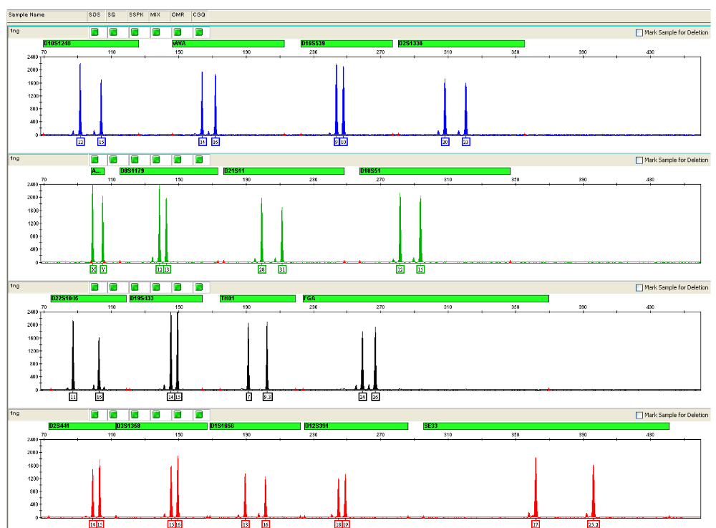
Electropherogram (EPG)

Slide 6
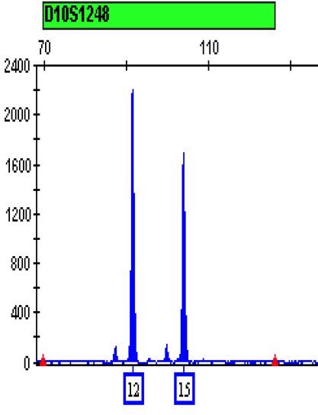
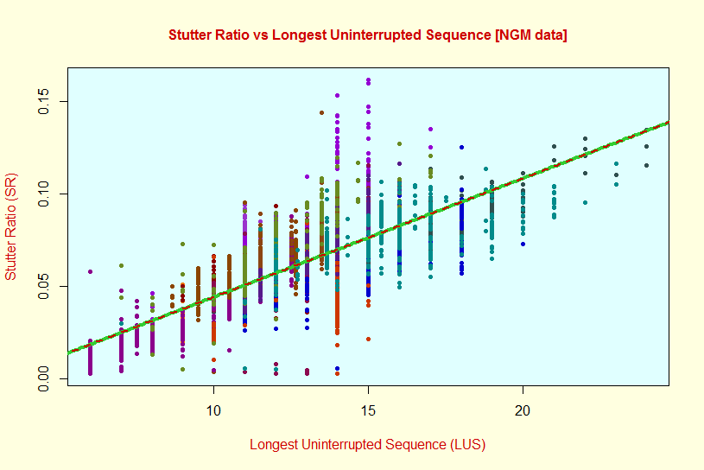
Models for stutter
Stutters
We are interested in modelling the stutter ratio (SR) $SR= \frac{O_{a−1}}{O_{a}}$
The smallest value of SR is zero, we expect most SR values to be small, with a long tail out to the right
Mean SR behavior is affected by the longest uninterrupted sequence of the allele, LUS
We expect the values of SR to be more variable for smaller values of O_{a}

Slide 7
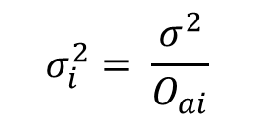
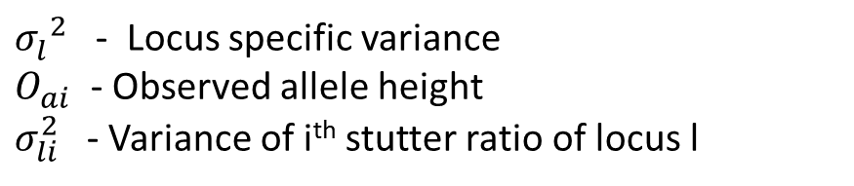
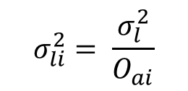
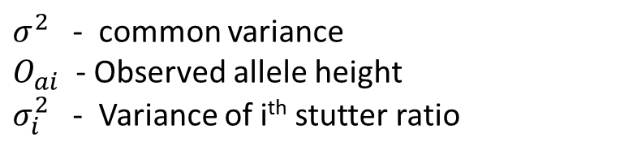
Mean and Variance in Stutter Ratio
Mean Stutter Ratio
$μ_{li}=E[{SR}_{li}]=β_{l0}+ β_{l1} {LUS}_{li}$
Variance in Stutter ratio is inversely proportional allele height
A common variance for all the loci - models with profilewide variances
$$σ_{i}^{2}= \frac{σ^{2}}{O_{ai}}$$
$σ^{2}$ - common variance
$O_{ai}$ - Observed allele height
$σ_{i}^{2}$ - Variance of i^{th} stutter ratio
Locus specific variance
$$σ_{li}^{2}= \frac{σ_{l}^{2}}{O_{ai}}$$
${σ_{l}^{}}^{2}$ - Locus specific variance
$O_{ai}$ - Observed allele height
$σ_{li}^{2}$ - Variance of i^{th} stutter ratio of locus l

Slide 8
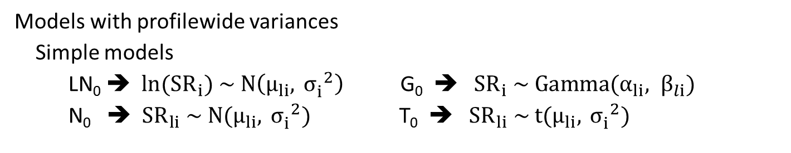
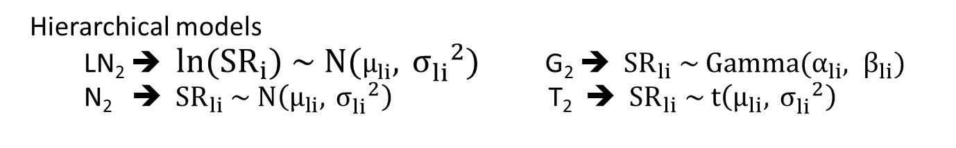
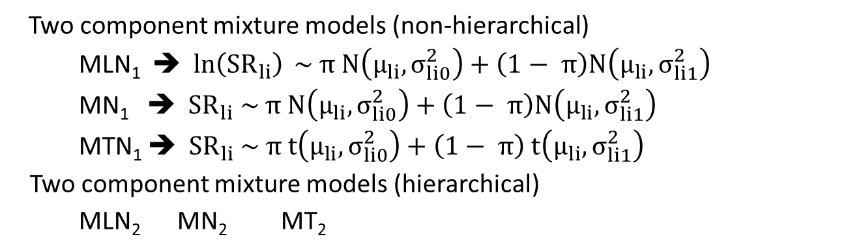
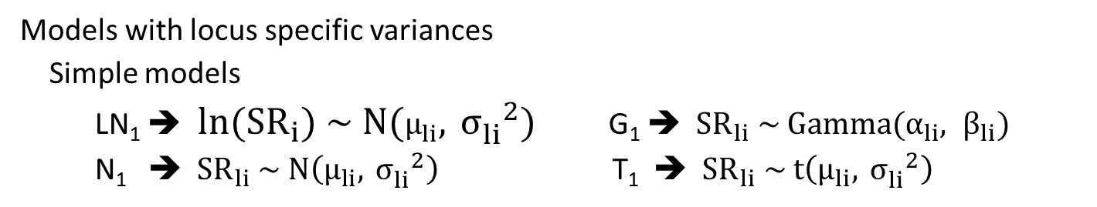
Different models for SR
Models with profilewide variances
Simple models
LN₀ ➔${ ln⁡(SR}_{i}) \sim N\left(μ_{li}, {{ σ}_{i}^{}}^{2}\right)$ G₀ ➔${ SR}_{i} \sim Gamma(α_{li}, β_{li})$
N₀ ➔${ SR}_{li} \sim N(μ_{li}, {{ σ}_{i}^{}}^{2})$ T₀ ➔${ SR}_{li} \sim t(μ_{li}, {{ σ}_{i}^{}}^{2})$
Models with locus specific variances
Simple models
LN₁ ➔ ${ ln⁡(SR}_{i}) \sim N(μ_{li}, {{ σ}_{li}^{}}^{2})$ G₁ ➔${ SR}_{li} \sim Gamma(α_{li}, β_{li})$
N₁ ➔ ${ SR}_{li} \sim N\left(μ_{li}, {{ σ}_{li}^{}}^{2}\right)$ T₁ ➔ ${ SR}_{li} \sim t\left(μ_{li}, {{ σ}_{li}^{}}^{2}\right)$
Hierarchical models
LN₂ ➔ ${ ln⁡(SR}_{i}) \sim N(μ_{li}, {{ σ}_{li}^{}}^{2})$ G₂ ➔${ SR}_{li} \sim Gamma(α_{li}, β_{li})$
N₂ ➔ ${ SR}_{li} \sim N\left(μ_{li}, {{ σ}_{li}^{}}^{2}\right)$ T₂ ➔ ${ SR}_{li} \sim t\left(μ_{li}, {{ σ}_{li}^{}}^{2}\right)$
Two component mixture models (non-hierarchical)
$$\text{ML}\text{N}\text{1} \text{➔} ln\left({SR}_{li}\right) \sim π N\left(μ_{li}, σ_{li0}^{2}\right)+\left(1− π\right)N\left(μ_{li}, σ_{li1}^{2}\right)$$
MN₁ ➔${ SR}_{li} \sim π N\left(μ_{li}, σ_{li0}^{2}\right)+\left(1− π\right)N\left(μ_{li}, σ_{li1}^{2}\right)$
MTN₁ ➔${ SR}_{li} \sim π t\left(μ_{li}, σ_{li0}^{2}\right)+\left(1− π\right) t\left(μ_{li}, σ_{li1}^{2}\right)$
Two component mixture models (hierarchical)
$\text{ML}\text{N}\text{2}$ $\text{M}\text{N}\text{2}$ $\text{M}\text{T}\text{2}$

Slide 9
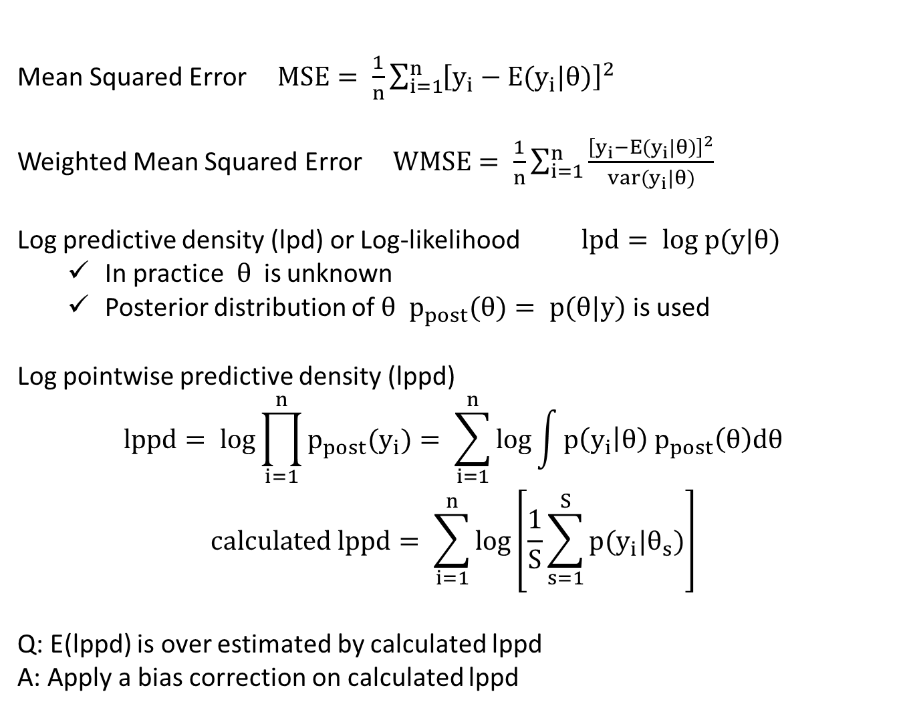
Measures of Predictive Accuracy
Mean Squared Error $MSE= \frac{1}{n}\sum_{i=1}^{n}{{\left[y_{i}−E(y_{i}|θ)\right]}^{2}}$
Weighted Mean Squared Error $WMSE= \frac{1}{n}\sum_{i=1}^{n}{\frac{{\left[y_{i}−E(y_{i}|θ)\right]}^{2}}{var(y_{i}|θ)}}$
Log predictive density (lpd) or Log-likelihood$lpd= log p(y|θ)$
In practice$θ$ is unknown
Posterior distribution of $θ$ $p_{post}(θ)= p(θ|y)$ is used
Log pointwise predictive density (lppd)
$$lppd= log\prod_{i=1}^{n}{p_{post}(y_{i})}= \sum_{i=1}^{n}{\log{\int{p\left(y_{i} | θ\right) p_{post}\left(θ\right)dθ}}}$$
$$calculated lppd= \sum_{i=1}^{n}{\log\left[\frac{1}{S}\sum_{s=1}^{S}{p(y_{i}|θ_{s})}\right]}$$
Q: E(lppd) is over estimated by calculated lppd
A: Apply a bias correction on calculated lppd

Slide 10
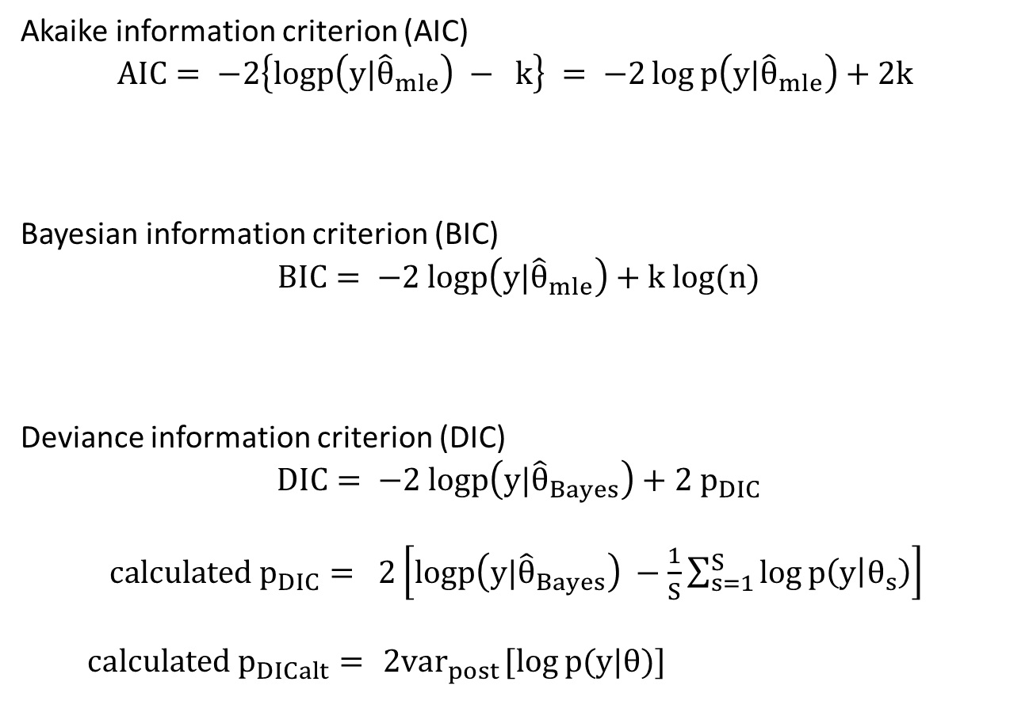
Information Criterion
Akaike information criterion (AIC)
$$AIC= −2\left\{logp\left(y|{\hat{θ}}_{mle}\right) − k\right\} = −2\log{p\left(y|{\hat{θ}}_{mle}\right)}+2k$$
Bayesian information criterion (BIC)
$$BIC= −2 logp\left(y|{\hat{θ}}_{mle}\right)+k log(n)$$
Deviance information criterion (DIC)
$$DIC= −2 logp\left(y|{\hat{θ}}_{Bayes}\right)+2 p_{DIC}$$
$calculated p_{DIC}= 2\left[logp\left(y|{\hat{θ}}_{Bayes}\right) −\frac{1}{S}\sum_{s=1}^{S}{\log{p\left(y | θ_{s}\right)}}\right]$
$calculated p_{DICalt}= { 2var}_{post}[\log{p(y|θ)]}$

Slide 11
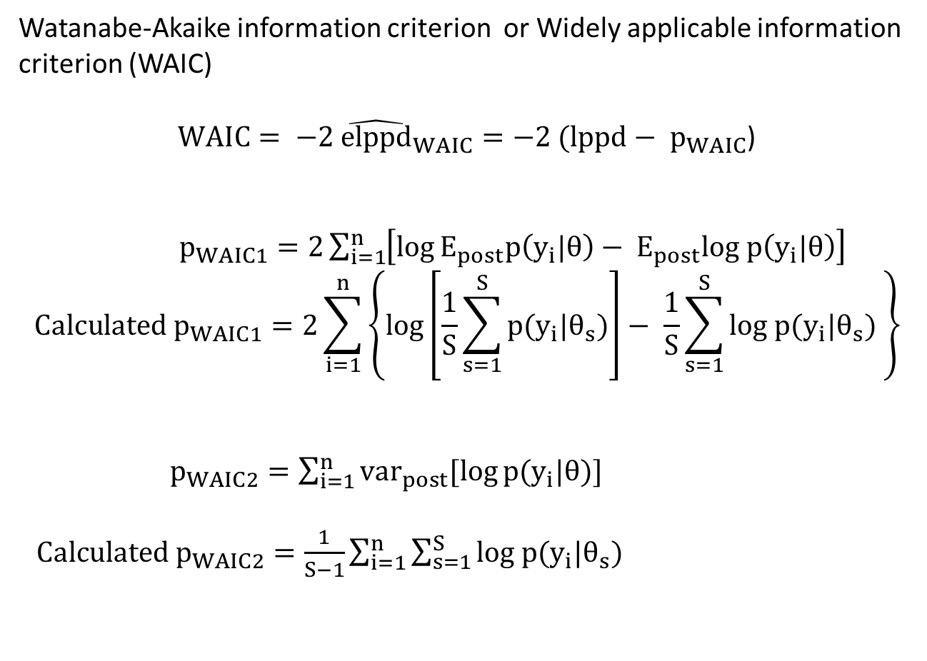
Information Criterion
Watanabe-Akaike information criterion or Widely applicable information criterion (WAIC)
$WAIC= −2 {\hat{elppd}}_{WAIC}=−2 (lppd− p_{WAIC}$)
$p_{WAIC1}=2\sum_{i=1}^{n}{\left[\log{E_{post}p\left(y_{i}|θ\right)}− E_{post}log p\left(y_{i}|θ\right)\right]}$
$${Calculated p}_{WAIC1}=2\sum_{i=1}^{n}{\left\{\log\left[\frac{1}{S}\sum_{s=1}^{S}{p(y_{i}|θ_{s})}\right]− \frac{1}{S}\sum_{s=1}^{S}{log p(y_{i}|θ_{s})} \right\}}$$
$p_{WAIC2}=\sum_{i=1}^{n}{{var}_{post}[\log{p(y_{i}|θ)]}}$
${Calculated p}_{WAIC2}=\frac{1}{S−1}\sum_{i=1}^{n}{\sum_{s=1}^{S}{log p(y_{i}|θ_{s})}}$

Slide 12
Results
Model | Log lik | -2 log lik | k | 2k | Log(n) k | penalty
LN0 | 13350.6 | -26701.2 | 33 | 66 | 278.6 | 41.1
G0 | 14212 | -28424.1 | 33 | 66 | 278.6 | 33.7
LN2 | 14463.1 | -28926.2 | 48+ |  |  | 40.2
LN1 | 14463.9 | -28927.8 | 48 | 96 | 405.3 | 48.4
G2 | 14776.8 | -29553.5 | 48+ |  |  | 46.1
G1 | 14777.7 | -29555.3 | 48 | 96 | 405.3 | 33.9
N0 | 14877.3 | -29754.6 | 33 | 66 | 278.6 | 44.9
N2 | 15233.1 | -30466.1 | 48+ |  |  | 32.8
N1 | 15233.7 | -30467.4 | 48 | 96 | 405.3 | 53.6
MLN2 | 15276 | -30551.9 | 65+
MLN1 | 15276 | -30552 | 65 | 130 | 548.8
T0 | 15328.8 | -30657.6 | 49 | 98 | 413.7 | 38.7
T2 | 15348.3 | -30696.7 | 64+ |  |  | 87.8
T1 | 15352.1 | -30704.2 | 64 | 128 | 540.4 | 104.7
MN2 | 15471.9 | -30943.8 | 65+
MN1 | 15473.3 | -30946.6 | 65 | 130 | 548.8
MT1 | 15749.2 | -31498.4 | 81 | 162 | 683.9
MT2 | 15833.9 | -31667.7 | 81+
Model | WAIC1 | Model | WAIC2
LN0 | -25141 | LN0 | -22973
G0 | -26947 | G0 | -25070
LN2 | -27350 | LN2 | -25188
LN1 | -27353 | LN1 | -25193
G2 | -28084 | T2 | -25764
G1 | -28091 | G1 | -26237
N0 | -28294 | G2 | -26244
T2 | -28906 | N0 | -26501
N2 | -28977 | T0 | -26525
N1 | -29000 | MN2 | -26539
MLN1 | -29021 | T1 | -26568
MLN2 | -29141 | MT2 | -26569
T0 | -29343 | MN1 | -26589
MN2 | -29348 | MT1 | -26604
MT2 | -29362 | MLN2 | -27047
MN1 | -29366 | MLN1 | -27088
T1 | -29367 | N2 | -27172
MT1 | -29378 | N1 | -27213

Slide 13

Summary
Posterior predictive checks are very useful in model comparisons (even with completely different models)
Information criteria are useful under some circumstances
WAIC is fully Bayesian method and performs better than AIC, BIC and DIC in many aspects
Model | AIC | BIC | DIC | WAIC
Simple
Hierarchical
Non-hierarchical Mixture
Hierarchical Mixture

Slide 14
Thank you!

