Slide 1

Diagnostic methods for checking multiple imputation models
Cattram Nguyen, Katherine Lee, John Carlin
Biometrics by the Harbour, 30 Nov, 2015

Slide 2

Motivating example: Longitudinal Study of Australian Children (LSAC)
5107 infants (0-1 year) recruited in 2004
Data collection has occurred every 2 years

Slide 3
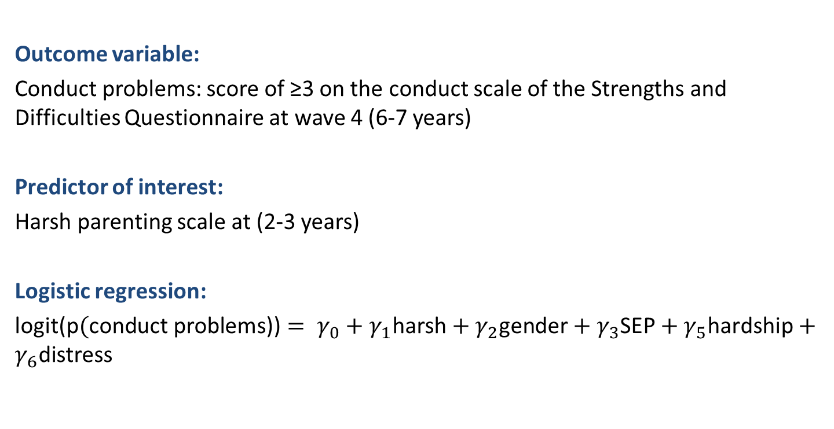
Relationship between harsh parental discipline and behavioural problems
Outcome variable:
Conduct problems: score of ≥3 on the conduct scale of the Strengths and Difficulties Questionnaire at wave 4 (6-7 years)
Predictor of interest:
Harsh parenting scale at (2-3 years)
Logistic regression:
logit($\text{p}(\text{conduc}\text{t} \text{problems}\text{)}\text{)}= γ_{0}+γ_{1}\text{harsh}+γ_{2}\text{gender}+γ_{3}\text{SEP}+γ_{5}\text{hardship}+γ_{6}\text{distress}$
Bayer et al. (2011) Pediatrics. 128(4):e865-79.
Notes:
For this case study, I focus on the conduct subscale score, which assesses the frequency of behaviours such as fighting, stealing and lying (see Table 2). The conduct subscale scores are calculated by summing the scores from five individual items, giving a minimum score of 0 and a maximum score of 10. The SDQ conduct scores can be used as continuous variables; however, cutpoints are often used to screen for cases. The cutpoints for classification as “normal”, “borderline” and “abnormal” are 0-2, 3, and 4-10 respectively. This classification was designed so that approximately 80% of children were in the “normal” category, 10% were borderline and the remaining 10% had abnormally high scores
The predictor of primary interest is harsh discipline at wave 2 as measured by the hostile parenting scale. The hostile parenting items were adapted from questions used in the Early Childhood Longitudinal Study (birth cohort) [23] and the National Longitudinal Survey of Children and Youth [24]. This scale was included in a questionnaire that was left behind by the interviewer for the parent to complete. The hostile parenting scale consisted of three items assessing the frequency of hostile behaviour towards the child, such as being angry or raising one’s voice (see Table 2 for details). Each item was scored on a 10-point Likert scale, where 1= not at all and 10= all the time. The harsh discipline score is the average of the three hostile parenting items. Scores ranged between 1 and 10, where higher scores represented harsher discipline. Figure 1 (b) is a histogram of the wave 2 harsh discipline scores in the LSAC dataset. Scores ranged between 0-10, with a median of 3.

Slide 4
Missing data in LSAC
There was completely observed data for 3163 (62%) participants
Variable | Number missing | Percentage
Conduct problems | 896 | 18%
Harsh parenting | 1601 | 31%
Gender | 0 | 0%
Socieconomic position | 505 | 10%
Financial hardship | 533 | 10%
Psychological distress | 688 | 13%

Slide 5
Proposed imputation model
Multivariate imputation by chained equations (MICE)
Variables in the imputation model:
Analysis model variables
Auxiliary variables (22 variables)
No transformation of skewed variables
Outcome variable included as continuous variable (not dichotomised)
Created 40 imputed datasets

Slide 6
Proposed imputation diagnostics
Graphical comparisons of the observed and imputed data
Numerical comparisons of the observed and imputed data
Standard regression diagnostics
Cross-validation
Posterior predictive checking

Slide 7
Graphical comparisons of the observed and imputed data
Notes:
-The most commonly recommended approach for checking the plausibility of the imputed values
Most commonly available in statistical software
Useful for examining the distribution – examine the plausibilty of the imputed values relative to subject matter knowledge
Also examine the plausibilty with respect to the observed data

Slide 8
Graphical comparisons of the observed and imputed data

Slide 9
Summary: graphical comparisons of observed and imputed data
Exploring the imputed data
Challenge when working with large numbers of imputed variables
Difficulty interpreting differences when data are not MCAR.

Slide 10
Proposed imputation diagnostics
Graphical comparisons of the observed and imputed data
Numerical comparisons of the observed and imputed data
Standard regression diagnostics
Cross-validation
Posterior predictive checking

Slide 11
Numerical comparisons of the observed and imputed data
Formally test for differences between the observed and imputed data
Highlight variables that may be of concern. Overcome the challenge of checking all imputed variables
Proposed numerical methods:
Compare means (difference in means greater than 2)
Compare variances (ratio of variances less than 0.5)
Kolmogorov-Smirnov test (p-value <0.05)
Abayomi, K. et al. (2008). Journal of the Royal Statistical Society Series
Stuart, E. et a. (2009) American Journal of Epidemiology

Slide 12
Simulation evaluation of the Kolmogorov-Smirnov test
Simulated incomplete datasets
Deliberately misspecified imputation models
Results
Not useful under MAR
Kolmogorov-Smirnov p-values did not correspond to bias/RMSE.
KS test p-values depend on sample size and amount of missing data
Nguyen C, Carlin J, Lee K (2013). BMC Medical Research Methodology 13:144

Slide 13
Proposed imputation diagnostics
Graphical comparisons of the observed and imputed data
Numerical comparisons of the observed and imputed data
Standard regression diagnostics
Cross-validation
Posterior predictive checking

Slide 14
Regression diagnostics
Possible to check the goodness of fit of imputation models using established regression diagnostic tools
Residuals, outliers, influential values
White et al. 2011. Statistics in Medicine.
Notes:
There are some proposed graphical diagnostics that are used to check the assumptions of the imputation model.
In this case, I have used a linear regression model to impute the harsh discipline score.
So I can check the assumptions of the regression imputation model using standard regression diagnostics.

Slide 15
Proposed imputation diagnostics
Graphical comparisons of the observed and imputed data
Numerical comparisons of the observed and imputed data
Standard regression diagnostics
Cross-validation
Posterior predictive checking

Slide 16
Cross-validation
Assess the predictive performance of the imputation model
Delete each observed value in turn and use the imputation model to impute the withheld values
Gelman et al. (2005) Biometrics
Honaker et a. (2011) Journal of Statistical Software

Slide 17
Cross-validation
Plot of imputed/predicted vs observed

Slide 18
Summary: cross-validation
Advantage
can be used to assess imputations produced by any method
Disadvantages
Can only assess adequacy of the imputation model within range of observed values
Focuses on predictive ability of the imputation model (does not investigate relationships between variables)

Slide 19
Proposed imputation diagnostics
Graphical comparisons of the observed and imputed data
Numerical comparisons of the observed and imputed data
Standard regression diagnostics
Cross-validation
Posterior predictive checking

Slide 20
Posterior predictive checking
Assesses model adequacy with respect to target parameters
“Replicated” datasets are simulated from the imputation model
Analyses of interest are applied to replicated datasets

Slide 21






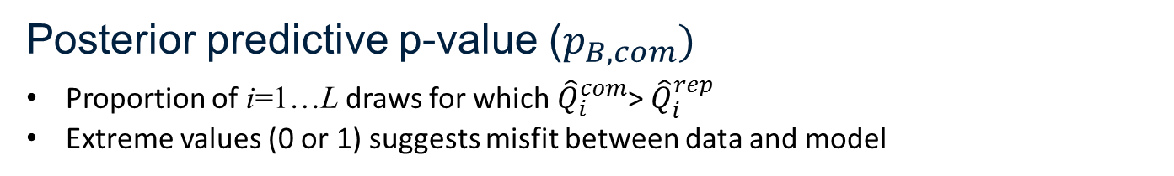
DUPLICATE
AND
CONCATENATE
Based on He and Zaslavsky (2011)
1st completed
2nd completed
…
Lth completed
$${\hat{Q}}_{1}^{com}$$
$${\hat{Q}}_{2}^{com}$$
$${\hat{Q}}_{L}^{com}$$
IMPUTATION
MODEL
$${\hat{Q}}_{1}^{rep}$$
$${\hat{Q}}_{2}^{rep}$$
$${\hat{Q}}_{L}^{rep}$$
1st replicated
2nd replicated
…
Lth replicated
Posterior predictive p-value ($p_{B,com})$
Proportion of i=1…L draws for which ${\hat{Q}}_{i}^{com}$> ${\hat{Q}}_{i}^{rep}$
Extreme values (0 or 1) suggests misfit between data and model
Notes:
Make arrows smaller so that it is not so squished
Explain that I am replicating the variables that have missing data
Include something about if the imputation model is correct, we would expect the p-value to be at 0.5
Then talk about extreme.
Also fix up notation so that theta i=1…M

Slide 22
Simulation evaluation of posterior predictive checking
Simulated incomplete datasets under MAR
Deliberately misspecified imputation models
1=de-skewing, 2=no de-skewing, 3=no auxiliary variables, 4=no outcome variables

Slide 23
Posterior predictive checking: summary
Advantages
versatile: can be used to check any imputation model
focuses on the effect of the imputation model on target quantities of interest
Disadvantages
Computationally intensive
Usefulness diminishes with increased amounts of missing data
Nguyen, C. D., Lee, K. J. and Carlin, J. B. (2015), Posterior predictive checking of multiple imputation models. Biometrical Journal

Slide 24
Posterior predictive checking
 | Logistic regression coefficients
 | Completed | Replicated | pbcom
Harsh parenting | 0.30 | 0.34 | 0.86
Gender | 0.38 | 0.38 | 0.53
Socioeconomic position | -0.31 | -0.30 | 0.61
Financial hardship | 0.10 | 0.13 | 0.69
Psychological distress | 0.04 | 0.04 | 0.64

Slide 25
Summary
Graphical diagnostics useful for exploring imputed data
Numerical comparisons (e.g. KS test) not recommended
PPC was useful for assessing the model with respect to target parameters
All methods have strengths and limitations.

Slide 26
References
Abayomi, K., Gelman, A., & Levy, M. (2008). Diagnostics for multivariate imputations. Journal of the Royal Statistical Society Series C-Applied Statistics, 57, 273-291.
Bayer, J. K., Ukoumunne, O. C., Lucas, N., Wake, M., Scalzo, K., & Nicholson, J. M. (2011). Risk Factors for Childhood Mental Health Symptoms: National Longitudinal Study of Australian Children. Pediatrics, 128, e865-879. doi: 10.1542/peds.2011-0491
Gelman, A., Van Mechelen, I., Verbeke, G., Heitjan, D. F., & Meulders, M. (2005). Multiple imputation for model checking: Completed-data plots with missing and latent data. Biometrics, 61(1), 74-85.
He, Y., & Zaslavsky, A. M. (2011). Diagnosing imputation models by applying target analyses to posterior replicates of completed data. Statistics in Medicine, 31(1), 1-18. doi: 10.1002/sim.4413
Nguyen, C., Carlin, J., & Lee, K. (2013). Diagnosing problems with imputation models using the Kolmogorov-Smirnov test: a simulation study. BMC Medical Research Methodology, 13(1), 1-9. doi: 10.1186/1471-2288-13-144
Nguyen, C. D., Lee, K. J. and Carlin, J. B. (2015), Posterior predictive checking of multiple imputation models. Biometrical Journal
Stuart, E. A., Azur, M., Frangakis, C., & Leaf, P. (2009). Multiple Imputation With Large Data Sets: A Case Study of the Children's Mental Health Initiative. American Journal of Epidemiology, 169(9), 1133-1139. doi: 10.1093/aje/kwp026

Slide 27
Acknowledgements
Missing data group
John Carlin
Katherine Lee
Julie Simpson
Jemisha Apajee
Alysha Madhu De Livera
Anurika De Silva
Panteha Hayati Rezvan
Emily Karahalios
Margarita Moreno Betancur
Laura Rodwell
Helena Romaniuk
Thomas Sullivan
Funding
ViCBiostat

