Slide 1
Computing Standard Error for Half-life of Rotenone
Maheswaran Rohan^{1*}, Alastair Fairweather², Natasha Grainger²
¹Department of Biostatistics and Epidemiology,
Auckland University of Technology, Auckland.
²Science and Capability, Department of Conservation, Hamilton, New Zealand

Slide 2
Outline of Presentation
Introduction of Rotenone
Usage of rotenone
Reason for monitoring
Estimation of half-life of Rotenone
Brief note of Delta method
Computation of standard error of half-life estimate
Results from the model
Conclusion.

Slide 3
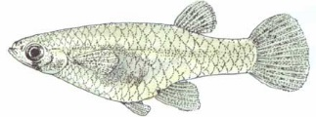
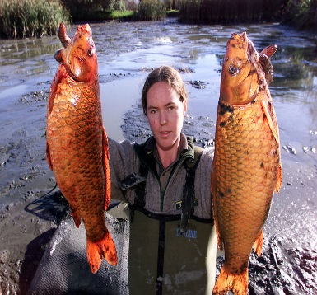
Rotenone
Natural toxin
Derived from the roots and stems of several tropical and sub-tropical plants
Usage required approval from New Zealand Environmental Protection Agency
Used to eradicate invasive pest fish species in New Zealand.
Target species
Gambusia (Gambusia affinis)
Koi carp (Cyprinus carpio)
It is common practise world wide.

Slide 4
Why Monitoring
It is important to monitor rotenone concentration in water body.
Why?
Address Science Issues
Determine when water taken for drinking and recreational activities can resume.
Determine when fish can be restocked
To ensure a complete kill of the target fish
Avoid Public Concerns
Ensuring public confidence in the use of rotenone is maintained
To show that rotenone is not persisting in the environment.

Slide 5
Interest of Study
Life time of rotenone in the water-body
Particularly
Determine time when rotenone becomes half initial concentration.
Known as DT₅₀ (Dissipation value)
Determine time when rotenone is undetectable in the water body
(Not discussed in this talk)
Life time of rotenone varied depends on temperature, pH, water hardness, and sunlight

Slide 6
Computation of Half-Life of Rotenone (DT₅₀)
Dynamic model is often used to estimate the half-life
Rohan, et.al (2015) introduced the stochastic model to compute half-life rotenone
Show the benefit of the stochastic model compare with dynamic model
Able to estimate the half-life by adjusting covariates
Able to account for random variation among ponds
Rohan, M., Fairweather, A., Grainger, N., (2015), Using gamma distribution to determine half-life of rotenone, applied in fresh water, Science of the Total Environment, 527-528:246-251.

Slide 7
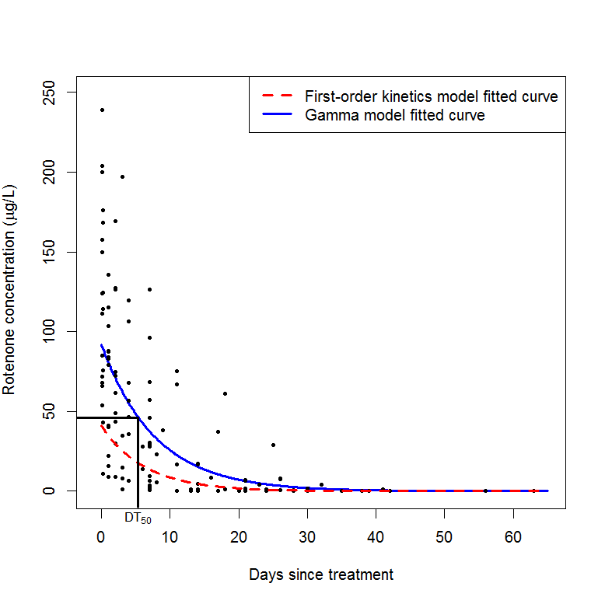

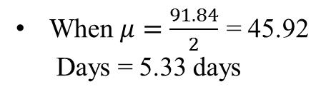

Results from Our Study
$log μ=4.52 −0.13 Days$
$μ=91.84 ∗ {0.88}^{Days}$
When $μ=\frac{91.84}{2}$ = 45.92
Days = 5.33 days
It is known as half-life of rotenone DT₅₀

Slide 8
Improving the Model
To determine rate of change in the rotenone concentration at various temperature levels.
It is considered as pilot study
Only six ponds water temperatures were recorded.
Temperature has two levels
Cool temperature (≤17°C)
Warm temperature (>17°C)

Slide 9
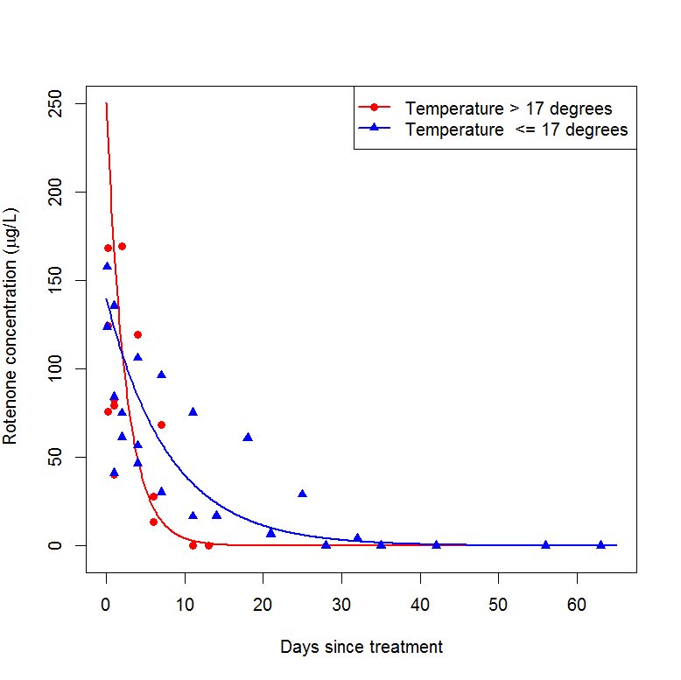
Results from Improved Model
DT₅₀ in warm temperatures is 1.7 days
DT₅₀ in cool temperatures is
5.53 days

Slide 10
Management Interest
Wanted to have range of DT₅₀ rather than single value
Make sure to safety of re-using the water
Required to compute the standard error of DT₅₀.
Computation of standard error is complicated
Delta method is used.

Slide 11
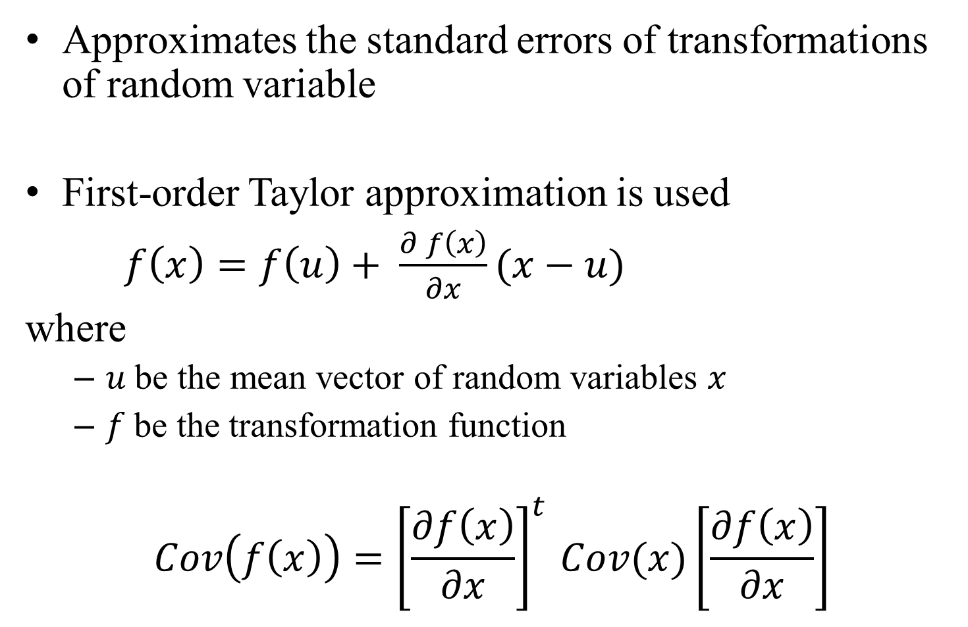
Delta Method
Approximates the standard errors of transformations of random variable
First-order Taylor approximation is used
$f\left(x\right)=f\left(u\right)+ \frac{∂ f\left(x\right)}{∂x}(x−u)$
where
$u$ be the mean vector of random variables $x$
$f$be the transformation function
$$Cov\left(f\left(x\right)\right)={\left[\frac{∂f\left(x\right)}{∂x}\right]}^{t }Cov(x)\left[\frac{∂f\left(x\right)}{∂x}\right]$$

Slide 12
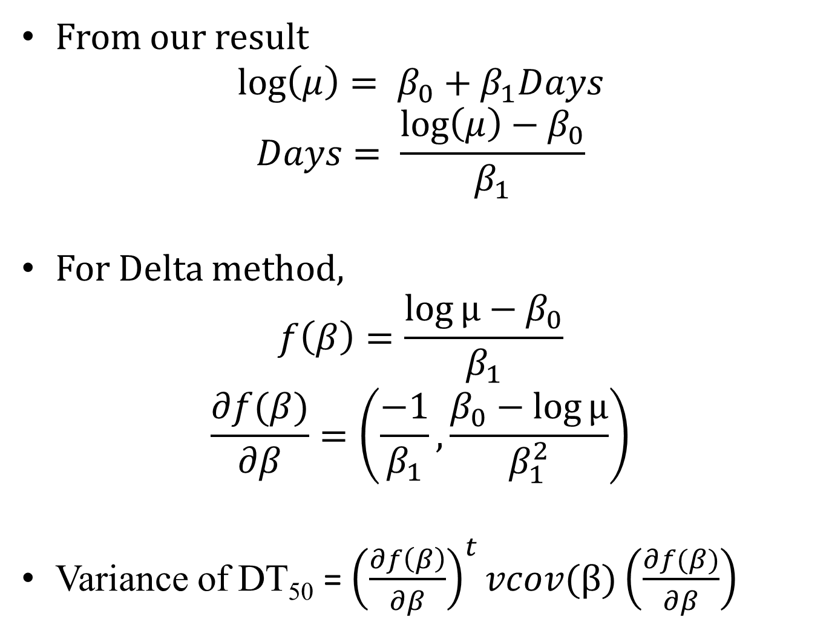
Computation of Variance of DT₅₀
From our result
$$\log\left(μ\right)= β_{0}+β_{1}Days$$
$$Days= \frac{\log\left(μ\right)−β_{0}}{β_{1}}$$
For Delta method,
$$f\left(β\right)=\frac{\log{μ}−β_{0}}{β_{1}}$$
$$\frac{∂f(β)}{∂β}=\left(\frac{−1}{β_{1}},\frac{β_{0}−log{μ}}{β_{1}^{2}}\right)$$
Variance of DT₅₀ = ${\left(\frac{∂f\left(β\right)}{∂β}\right)}^{t}vcov(β)\left(\frac{∂f(β)}{∂β}\right)$

Slide 13
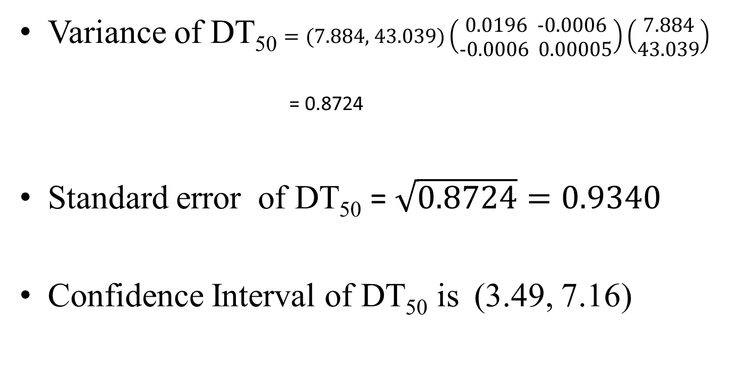
Standard error of DT₅₀
Variance of DT₅₀ $=(\text{7.884, 43.039})\left(\begin{aligned}\text{0.0196 } \text{−0.0006} \\ \text{−0.0006 0.0000}5\end{aligned}\right)\left(\begin{aligned}7.884 \\ 43.039\end{aligned}\right)$
= 0.8724
Standard error of DT₅₀ = $\sqrt{0.8724}=0.9340$
Confidence Interval of DT₅₀ is (3.49, 7.16)

Slide 14
Conclusion
The Gamma model fitted the rotenone data well.
The model is more flexible than the dynamic model, by allowing us to use covariates.
Computation of standard error of half-life of rotenone is possible.
Able to predict a confidence interval for the half-life of rotenone.
The break down of rotenone over time was dependant on water temperature.
faster in warmer than in cooler water.

