Slide 1


Testing random effects
Permutation tests for assessing significance of random terms in linear mixed models
Vanessa Cave
Statistician
Corinne Watts
Invertebrate Ecologist
Notes:
(15 mins + 5 mins questions)
In this presentation, I’ll describe the use of permutation tests for assessing the significance of random effects in linear mixed models.
I’ll attempt to illustrate the methodology using an interesting dataset provided by Corinne Watts, an Invertebrate Ecologist at Landcare Research New Zealand.

Slide 2
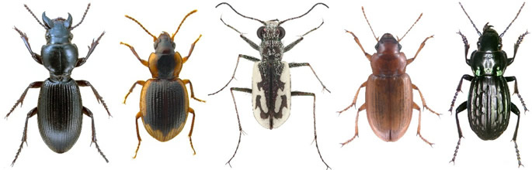
Talk Outline
Provide a motivating example
Modelling changes in beetle communities following pest control
Describe a pair of permutation tests
Examine results from a simple simulation study
Apply permutation tests to example data
Notes:
The presentation comprises 4 parts:
Firstly, to motivate the use of permutation tests for random effects, I’ll introduce an example dataset that was collected to model changes in beetle communities following pest control.
Then, I’ll describe a pair of permutation tests, and briefly examine their size and power using a simple simulation study.
Finally, I’ll apply the permutation tests to guide the selection of the best model for the beetle data.

Slide 3


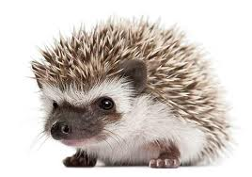
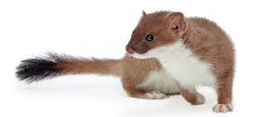
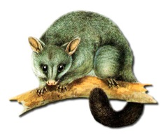

Motivating Example
Introduced mammals
devastating impact on NZ’s native flora and fauna
Case study investigated …
How species richness of ground-dwelling beetles responded to pest control
Two study sites different pest control regimes
Notes:
Small introduced mammals, such as the Australian brush-tailed opossum, have had a devastating impact on NZ’s native flora and fauna, including our native invertebrates.
Meet Corinne – Corinne is interested how beetle communities respond to mammalian pest control.
In a 10 year case study, Corinne collected data on beetles at two Wellington native bush sites. Both sites have very similar vegetation and climates, but they employ different pest control regimes.

Slide 4

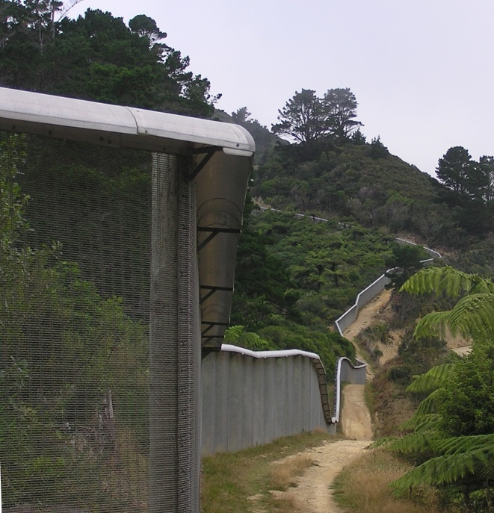
Zealandia: Ecological island
225 ha native-bush sanctuary
surrounded by predator-proof fence
Since 2000, all mammals eradicated (except mice)
Notes:
The first study site was Zealandia – an 225 ha ecological island. This is an area of land completely surrounded by a predator-proof fence.
By 2000, all mammals, except for mice, had been eradicated from Zealandia. Mice are controlled, but they have proved difficult to eradicate as the sneaky wee things re-invade through any minor weakness in the fence.
Both these photos have been taken from the outside of the fence, looking into Zealandia. And there’s Wellington CBD.

Slide 5
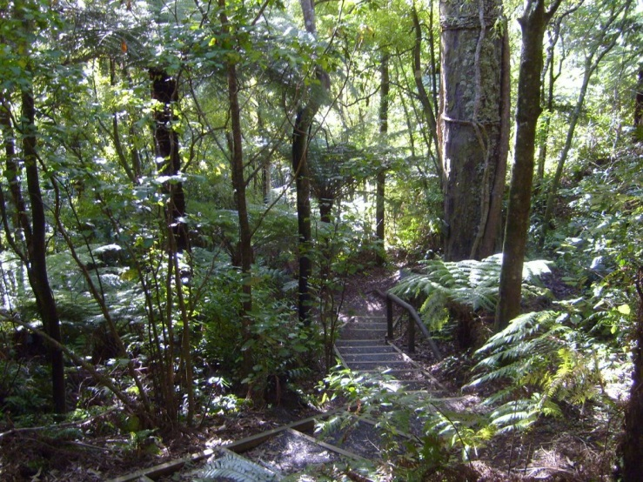
Otari-Wilton’s Bush
96 ha native-bush reserve
periodic intensive mammal control
Few but diverse mammals
2.4 km from Zealandia, similar vegetation and climate
“Control” site
Notes:
The second study site was Otari-Wilton’s Bush. This is a 96 ha native-bush reserve only 2.4km from Zealandia.
This site is unfenced, but undergoes sustained mammal control through trapping, poisoning and hunting.
There are few, but diverse mammals present in Otari bush.
This site is viewed as the “control” for Zealandia.

Slide 6
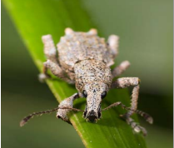
The Data
Beetles collected using pitfall traps
1-3 fixed seasonal visits per year
Zealandia: 1998-99, 2002-09 1998-99 pre-eradication
Otari: 2002-09 no data pre-eradication at Zealandia
Sampling effort at a given seasonal visit …
within site: standardized
between sites: differed
14,413 beetles from 282 species caught
Notes:
Using pitfall traps, Corinne collected beetles at 1-3 seasonal visits per year.
Data from Zealandia was collected for 2 years prior to mammal eradication, 1998 and 1999, and then for 7 years post eradication, from 2002-2009.
Unfortunately data collection at Otari only began in 2002. So we have no data from Otari corresponding to pre mammal eradication at Zealandia.
In terms of study design, within a site, sampling effort for a particular seasonal visit was standardised between years. However, sampling effort did differ between sites.
During the study, over 14,000 beetles were captured from 282 species.

Slide 7


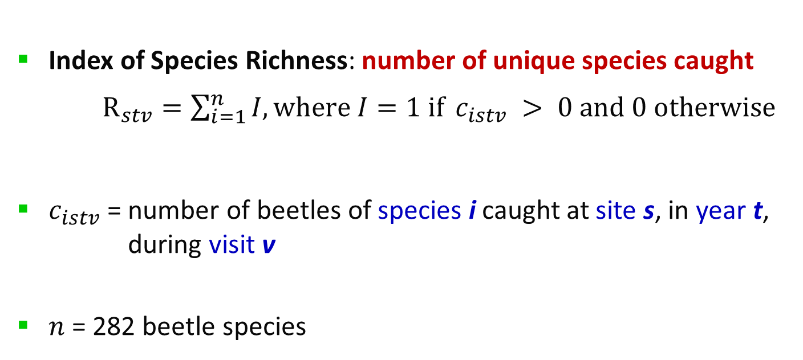
Beetle Species Richness
Index of Species Richness: number of unique species caught
$R_{stv}=\sum_{i=1}^{n}{I, where I=1 if} c_{istv} > 0 and 0 otherwise$
$c_{istv}$ = number of beetles of species i caught at site s, in year t, during visit v
$n$ = 282 beetle species
Notes:
In this talk, I’ll focus on the use of the data to describe changes in species richness over time at the two sites.
Here, an index of richness is given by the number of unique beetle species caught at site s in year t during visit v.

Slide 8
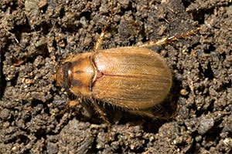

The Model
Cubic smoothing spline
Term | Type | Model Component
Constant | Fixed | Underlying fixed linear regression on year with a site-specific intercept and slope.
Site | Fixed (factor)
Year | Fixed (continuous)
Site.Year | Fixed
Spline (Year) | Random | Site specific, non-linear, smooth, deviations from the underlying fixed linear regression model.
Site.Spline(Year) | Random
Visit | Random (factor) | Site-specific, short-term, non-smooth deviations at the mean, i.e. 'seasonal' fluctuations.
Site.Visit | Random
Notes:
As the index of beetle richness is expected to be site dependent, to exhibit consistent seasonal effects, and to vary smoothly with time, cubic smoothing splines formulated as linear mixed effects models were used to model the data.
In this table, the fully site-dependent model is described.
The fixed terms of Site, Year and Site by Year model an underlying site-specific linear regression on year.
The 2 random spline terms allow for site specific, non-linear, smooth, deviations from the underlying fixed linear regression model.
Finally, the random terms involving Visit accommodate site-specific ‘seasonal' fluctuations.

Slide 9
The Model
Does the annual trend in richness differ between sites?
Inference focuses on the inclusion of the random
Site.Spline(Year) effect
Cubic smoothing spline
Term | Type | Model Component
Constant | Fixed | Underlying fixed linear regression on year with a site-specific intercept and slope.
Site | Fixed (factor)
Year | Fixed (continuous)
Site.Year | Fixed
Spline (Year) | Random | Site specific, non-linear, smooth, deviations from the underlying fixed linear regression model.
Site.Spline(Year) | Random
Visit | Random (factor) | Site-specific, short-term, non-smooth deviations at the mean, i.e. 'seasonal' fluctuations.
Site.Visit | Random
Notes:
Now the important biological question of interest is “does the annual trend in richness differ between sites?”
Therefore, inference focuses upon the need for the inclusion of the random site-specific spline term in the model. That is, we want to assess the significance of a random effect.

Slide 10
Testing Random Effects
Simple case: two nested random models
Unconstrained, uncorrelated variance parameters
Likelihood ratio statistic → asymptotically chi-squared
If variance parameters are constrained or correlated …
Complex
Area of ongoing research
Lee and Braun (2012) proposed a pair of permutation tests:
1) rLR-based testing ≥ 1random term(s)
2) BLUP-based testing 1 random term
Lee, O.E. and Braun, T.M. (2012). Permutation Tests for Random Effects in Linear Mixed Models. Biometrics, 68, 486-493.
Notes:
In the simple case of unconstrained and uncorrelated variance parameters, two nested random models (with the same fixed terms) can be compared using the difference between their deviances. Under the null hypothesis, the change in deviance is asymptotically chi-squared with degrees of freedom equal to the number of variance parameters being dropped.
However, the situation is more complex if variance parameters are constrained or correlated, and this is an area of ongoing research.
In their 2012 Biometrics paper, Lee and Braun proposed a pair of permutation tests for testing significance of random terms.
One, based on the restricted likelihood ratio test statistic (rLR-based), can simultaneously test for the presence of multiple random effects.
The other, based on the best linear unbiased predictors (or BLUPs), can be used for inference about a single random effect.

Slide 11
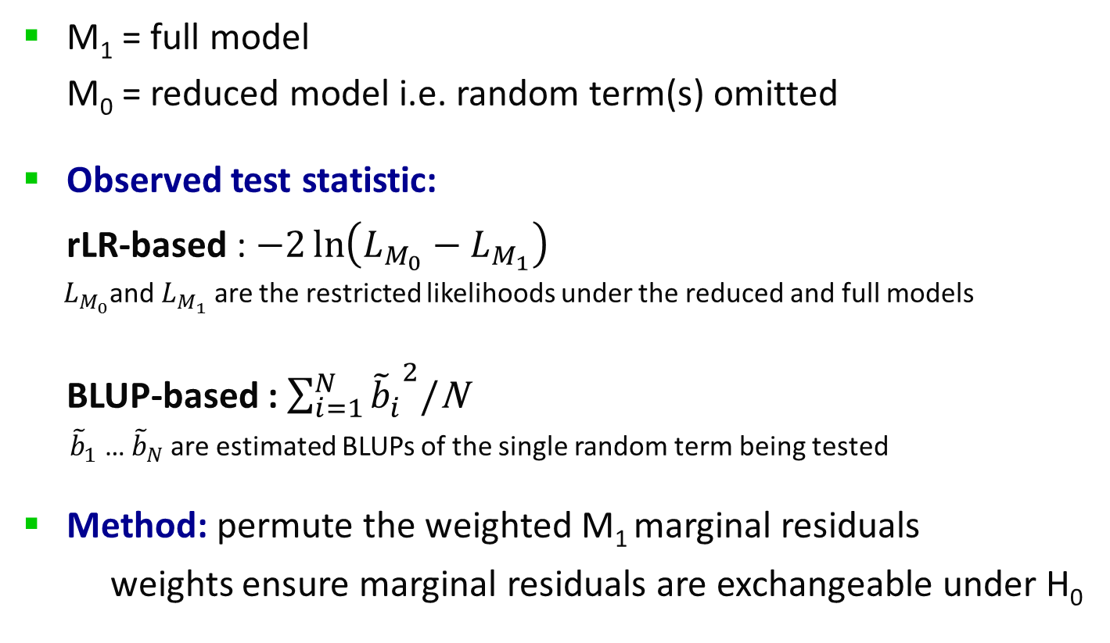
Permutation Tests
M₁ = full model
M₀ = reduced model i.e. random term(s) omitted
Observed test statistic:
rLR-based : $−2\ln\left(L_{M_{0}}−L_{M_{1}}\right)$
$L_{M_{0}}$and $L_{M_{1}}$ are the restricted likelihoods under the reduced and full models
BLUP-based : $\sum_{i=1}^{N}{{{\tilde{b}}_{i}^{}}_{}^{2}}$/N
${\tilde{b}}_{1}$ … ${\tilde{b}}_{N}$are estimated BLUPs of the single random term being tested
Method: permute the weighted M₁ marginal residuals
weights ensure marginal residuals are exchangeable under H₀
Notes:
In the coming slide, I’ll use M1 to denote the full model, and M0 the reduced model, where random terms have been omitted.
The test statistic for the restricted likelihood ratio based test is the change in deviance.
For the BLUP based test, as under Ho the variance of the random effect is 0, the test statistic used is the sample variance of the BLUPs.
Both tests then involve permuting the weighted marginal residuals. Appropriate weights are used to ensure the marginal residuals are exchangeable under the null hypothesis.

Slide 12
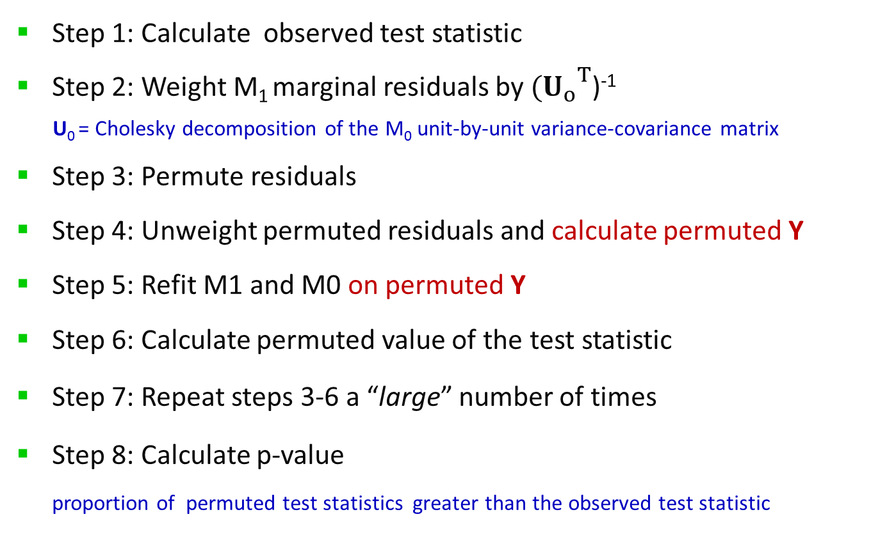
Algorithm
Step 1: Calculate observed test statistic
Step 2: Weight M₁ marginal residuals by ${{(U}_{o}^{}}_{}^{T}$)⁻¹
U₀ = Cholesky decomposition of the M₀ unit-by-unit variance-covariance matrix
Step 3: Permute residuals
Step 4: Unweight permuted residuals and calculate permuted Y
Step 5: Refit M1 and M0 on permuted Y
Step 6: Calculate permuted value of the test statistic
Step 7: Repeat steps 3-6 a “large” number of times
Step 8: Calculate p-value
proportion of permuted test statistics greater than the observed test statistic
Notes:
The algorithm proceeds as follows.
First the observed test statistic is calculated.
Then the marginal M1 residuals are weighted by the Cholesky decomposition of the unit-by-unit variance-covariance matrix
The residuals are then permuted.
The permuted residuals are then unweighted, and a permuted Y variate is obtained.
The full and reduced models are refitted with the permuted Y variate, and a permuted value of the test statistic is calculated.
Steps 3-6 are repeated a large, say 1000, number of times to generate a distribution of permuted test statistics.
Finally a p-value is obtained by calculating the proportion of permuted test statistics greater than the observed test statistic.
I’ve highlighted in red permuted Y, as this is where I have deviated slightly from the method of Lee and Braun. They refit the full and reduced models to the unweighted permuted residuals.

Slide 13
Simple Simulation
Testing random slope given an independent random intercept
Y_{ij} = β₀ + β₁x_{ij} + b_{0i} + b_{1i} x_{ij} + e_{ij}
where: i = 1 … S subjects and j = 1 … T times
β₀ = 3, β₁ = 2.75, b_{0i} ~ N(0, 0.5), b_{1i} ~ N(0,σ_{b1}²), e_{ij} ~ N(0,1)
and x_{ij} was randomly drawn from N(0,1)
500 datasets generated for each of σ_{b1}² = 0, 0.1, 0.25, 0.5, or 1
Permutation test (with 1000 permutes) on each dataset
Determined power/size: proportion of p-values ≤ 0.05
Repeated with and without positivity constraints
Notes:
To help examine the performance of the permutation tests, we can conduct a comprehensive simulation study.
However here I’m just going to present results from a very simple study: testing for a random slope given an independent random intercept.
The variance parameter for the random slope was set at either 0, 0.1, 0.25, 0.5 or 1, and for each of these settings 500 datasets were generated
The power, or in the case of 0 variance, the size of the permutation test was determined by calculating the proportion of p-values LE 0.05.
Furthermore, the permutation tests were repeated with and without positivity constraints on the variance parameters.

Slide 14
Simulation Study Results
Size
 |  |  |  |  |  |  | σ_{b1}²
Test | Constraints |  |  |  |  |  | 0 | 0.1 | 0.25 | 0.5 | 1
 |  |  |  |  | S = 10 subjects, T = 10 times
rLR-based |  |  |  | positive |  |  | 0.050 | 0.390 | 0.762 | 0.938 | 0.996
BLUP-based |  |  |  | positive |  |  | 0.054 | 0.372 | 0.756 | 0.946 | 0.996
rLR-based |  |  |  | none |  |  | 0.041 | 0.355 | 0.715 | 0.934 | 0.994
BLUP-based |  |  |  | none |  |  | 0.048 | 0.238 | 0.627 | 0.882 | 0.988
 |  |  |  |  |  | S = 50 subjects, T = 10 times
rLR-based |  |  |  | positive |  |  | 0.044 | 0.918 | 1.000 | 1.000 | 1.000
BLUP-based |  |  |  | positive |  |  | 0.044 | 0.904 | 1.000 | 1.000 | 1.000
rLR-based |  |  |  | none |  |  | 0.032 | 0.846 | 1.000 | 1.000 | 1.000
BLUP-based |  |  |  | none |  |  | 0.024 | 0.820 | 1.000 | 1.000 | 1.000
Notes:
The results from the simulation study are summarized in this table.
In the top half, a smallish dataset with 10 subjects measured at 10 time points is considered. In the second half, a much larger dataset is considered, involving 50 subjects.
In terms of size, both tests perform well with and without positively constraints, and regardless of the size of the dataset.
In terms of power, with a large dataset, both tests perform well. However, not unexpectedly, with a more limited dataset, the tests only perform well if there is a big departure from the null.
Now that we have described permutation tests, and examined their size and power, let’s return to the beetle example.

Slide 15
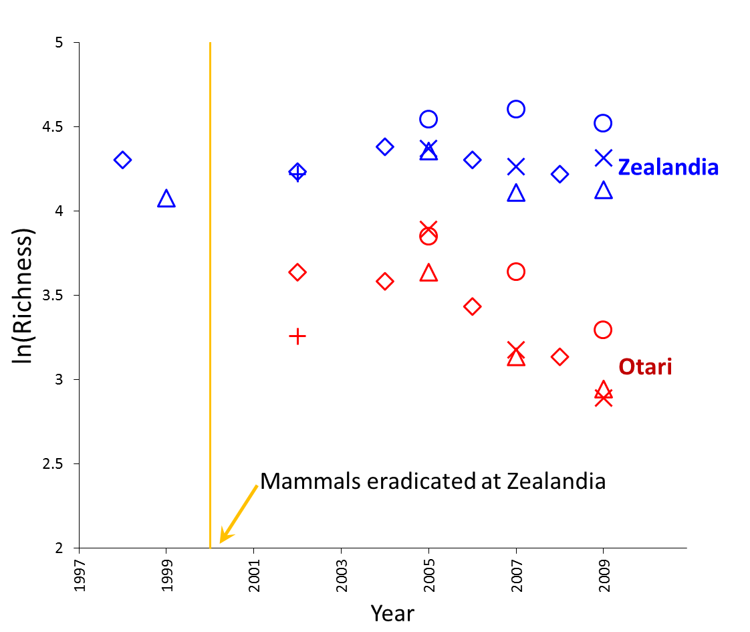
Application to Beetle Richness
Does the annual trend in richness differ between sites?
Symbols denote different seasonal visits
Notes:
Recall, we have species richness measured at 1-3 seasonal visits per year, and we are interested in assessing whether the annual trend in richness differs between sites.
In this graph the raw data is plotted : blue from Zealandia and red for Otari. Different symbols are used to denote the different seasonal visits.
Mammals were eradicated from Zealandia in 2000, as indicated by the yellow line.

Slide 16
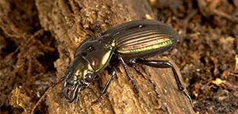
Application to Beetle Richness
Test of site-specific spline term, Site.Spline(Year)
Random Model | Deviance | DF
Visit+Site.Visit+Spline(Year)+Site.Spline(Year) | -57.26 | 21
Visit+Site.Visit+Spline(Year) | -53.38 | 22
Fixed model: Site + Year + Site.Year
Notes:
We are interested in testing the need for the inclusion of the random site-specific spline term in the model.
The two random models we are interested in comparing are shown in this table. Both models have the same fixed effects.
The model allowing for site-specific splines has a smaller deviance, by approximately 4 units for the cost of 1 df.

Slide 17
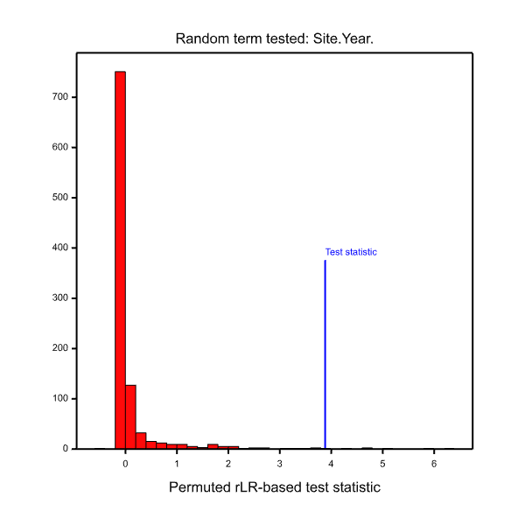
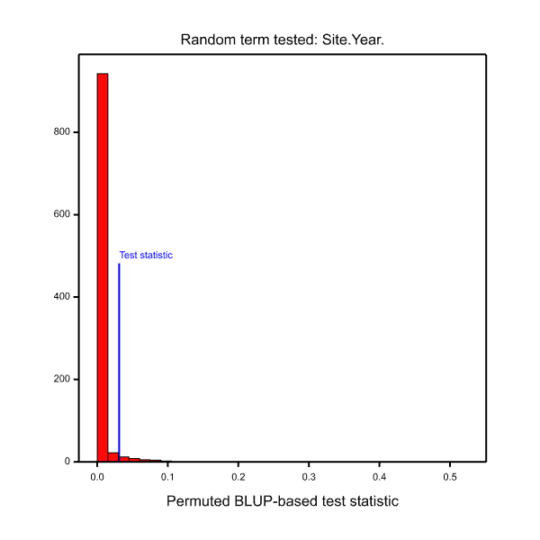
Permutation test of Site.Spline(Year)
rLR-based
BLUP-based
P-value = 0.007
P-value = 0.036
Notes:
In this slide, histograms of the permuted test statistics under the restricted likelihood ratio and BLUP based approaches are given. As you can see, the observed test-statistic, indicated by the blue line, is far greater than the majority of permuted test statistics.
So, both methods provide fairly convincing evidence for the need to include site-specific splines in the model.

Slide 18
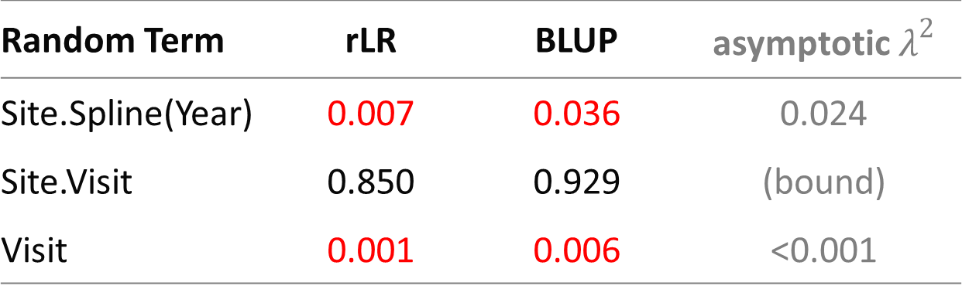
Model for Beetle Richness
Random Term | rLR | BLUP | asymptotic $λ^{2}$
Site.Spline(Year) | 0.007 | 0.036 | 0.024
Site.Visit | 0.850 | 0.929 | (bound)
Visit | 0.001 | 0.006 | <0.001
Final random model: Visit + Spline(Year) + Site.Spline(Year)
Evidence of differing annual trends between Zealandia and Otari-Wilton’s Bush
Notes:
To complete our selection of the best model for the beetle richness data, we can also test whether there is evidence of visit effects, or in other words seasonal fluctuations.
Neither permutation tests provides any evidence of site-specific ‘seasonal' fluctuations, however there is evidence of an overall visit effect.
Therefore, our final random model comprises a common visit effect and separate annual spline models for each site.
That is, there is evidence of differing annual trends in species richness between Zealandia and Otari.

Slide 19
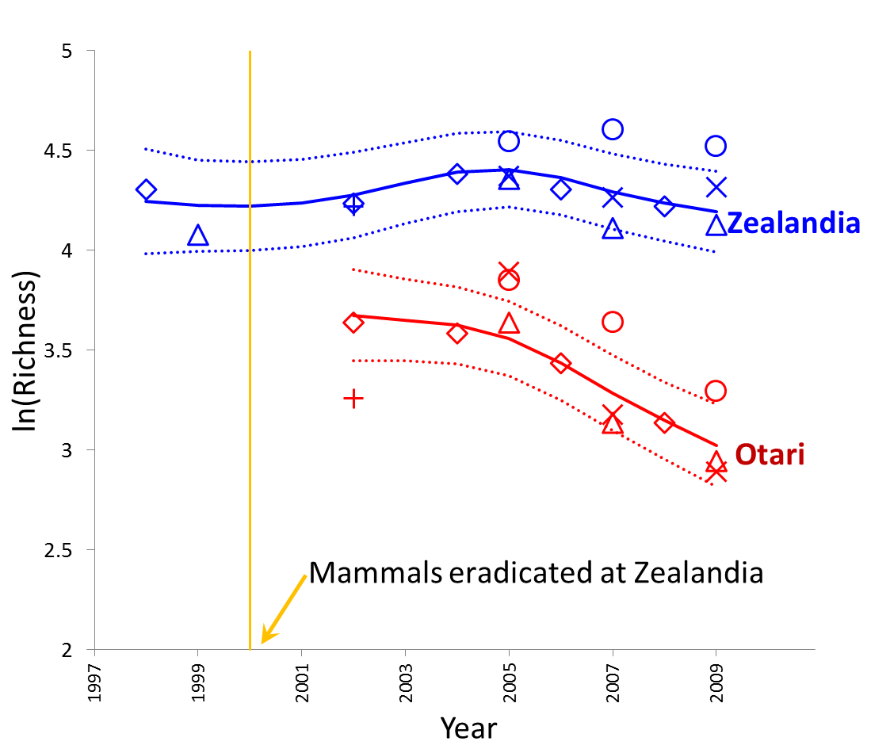
Notes:
This slide give a plot of the predicted annual trend in species richness, with 95% confidence intervals, for both sites.
Richness at Zealandia has remained fairly constant over time, but at Otari, richness has declined in the later years.

Slide 20
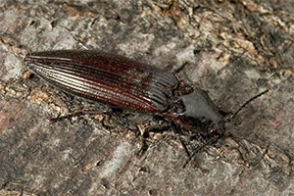
Interpretation Caveat
No replication
No "before" data from Otari-Wilton’s Bush
Analysis is descriptive
Can't conclude differences in pest control is the cause of the different trend in richness between Zealandia and Otari
Notes:
Finally, I just want to highlight an important caveat to the interpretation of the results.
As there is no replication and no "before" data at the “control” site, the analysis is entirely descriptive.
We can't conclude that the differences in pest control regimes are causing the different trend in species richness between Zealandia and Otari. We believe it is likely is a major contributor but we have no objective way of assessing this.

Slide 21
Summary
Permutation tests provide a useful and simple method for testing the significance of random terms in linear mixed models
QUESTIONS?
Notes:
In conclusion – permutation tests provide a useful and simple method for testing the significance of random terms in linear mixed models.

