Slide 1
Modelling EVOLUTION
Teresa Neeman
Statistical Consulting unit
ANU

Slide 2
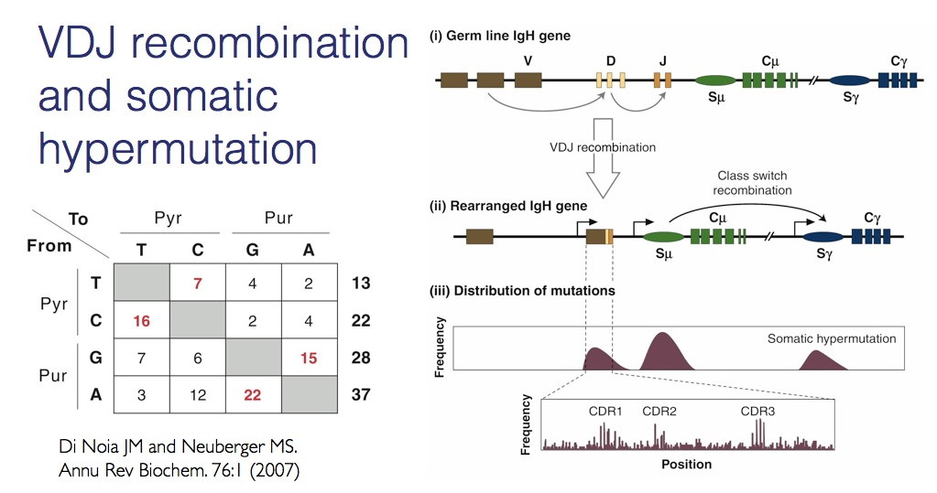
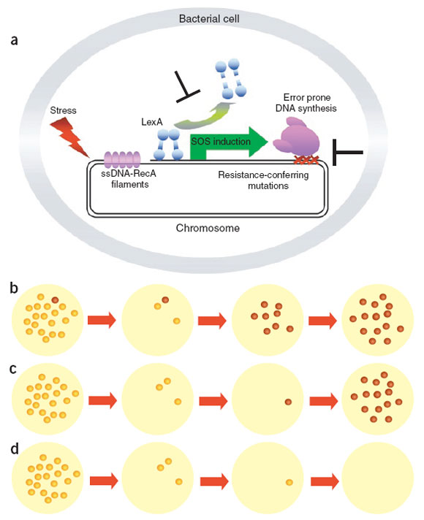
Drivers of evolution: random process + selection/ADAPTATION
Bacteria undergo hypermutation in response to stress
Adaptive immune system undergoes somatic hypermutation to mount a specific immune response
Notes:
According to the currently widely accepted theory of evolution, the main drivers of evolution are mutation (stochastic process) and selection/adaptation which reflects an organism’s ability to survive and reproduce in the environment. These processes are certainly integrated, as we have observed that bacteria undergo hypermutation in response to stress. In a complementary way, T-cells and B-cells in our immune system undergo somatic hypermutation in order to mount a specific immune response.
But today I’m going to focus on modelling the underlying stochastic process, the substrate of the evolutionary process.

Slide 3
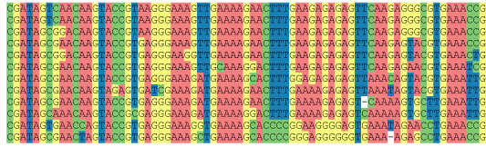
Deriving stochastic models of molecular evolution
COMPARE HOMOLOGOUS GENES ACROSS SPECIES USING SEQUENCE ALIGNMENTS
Notes:
Given the huge amounts of molecular data (e.g. DNA sequences), we can model the process of point mutations by comparing homologous genes across species. Basically, we align sequences, and compare the columns. Base differences are informative for both mutation rate and species relatedness.

Slide 4
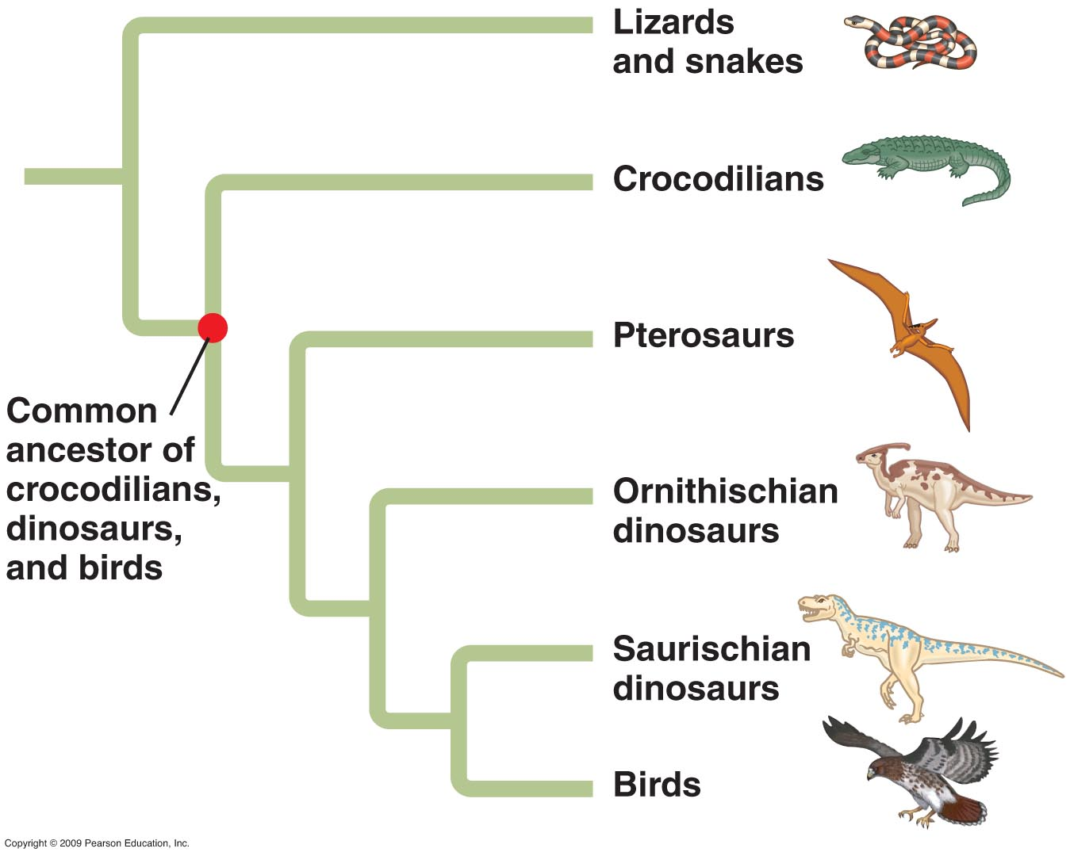
Phylogenetics: tool for modelling evolution
What is the evolutionary relationship between a set of taxa? (identify the tree)
Given a tree, what is the evolutionary distance along the branches?
Notes:
We borrow the tools of the phylogeneticists: given a set of taxa, what is evolutionary relationship? And what are the evolutionary distances. The order of modelling is (1) fit the tree, and (2) fit the branch lengths given the tree, but the process can also be iterative.
Stick to easy examples of 3 taxa, where there is only 1 (unrooted tree)
With so much sequence data available, we can fit a separate model for many homologous sequences. Focus on the questions of developing models that fit the data well.

Slide 5
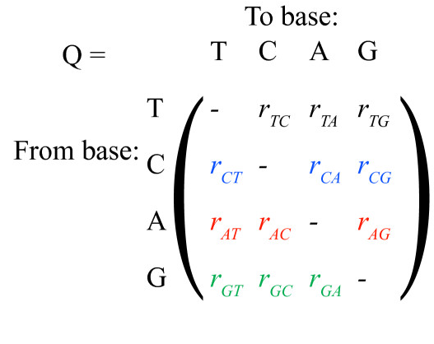
Continuous time markov processes to model molecular evolution
Underlying substitution rate matrix Q
Initial nucleotide distribution, e.g. π = (.25, .25, .25, .25)
Up to 12 free parameters

Slide 6
A brief history of continuous time markov processes for modelling evolution
Model Substitution Rate #Parameters
Jukes-Cantor(1969) all equal 1
Kimura (1980) transitions > transversions 2
Felsenstein (1981) estimate initial state 3
Gen. Time-reversible (1986) exchangeable 9

Slide 7

Properties of all of these models
Stationarity: the distribution of bases (A,C,G,T) unchanged over evolutionary time
Time-reversibility: the process looks the same whether run forwards or backwards
$${π }_{i}P_{ij}={π }_{j}P_{ji}$$

Slide 8
Nested models in common models of evolution
2 df
Kimura(1980)
1 df
5 df
9 df
Jukes-Cantor(1969)
HKY(1984)
GTR(1986)
?
Felsenstein(1981)
(4^k -1) df
DATA
(sufficient statistic)
3 df
Notes:
Is there something in between

Slide 9
ASSESSING AN EVOLUTIONARY model
Choice of model should reflect evident patterns in data
Stationary models: A/C/G/T content should be similar across taxa
Note: time reversible models are stationary
Models should “fit” the data
Likelihood ratio tests against the “saturated model”
GOLDMAN, N. 1993. Statistical tests of models of DNA substitution. J Mol Evol, 36, 182-98

Slide 10
FULLy generalised continuous time markov model
12 free parameters for each edge
Initial nucleotide distribution, to be estimated by the data
Up to 12 free parameters

Slide 11
COMPARING NESTED MODELS in 3-taxa (unrooted) tree 4000 SEQUENCE ALIGNMENTS (NUCLEUS)
HUMAN
MOUSE
QH
QM
TIME-REVERSIBLE Q (GTR) 9 df
Q
Q
GENERAL MODEL QH, QM, QO 39 df
QO
Q
“FULLY SATURATED” MODEL (MULTINOMIAL) 63 df
OPOSSUM
KAEHLER, B. et al 2015. Genetic distance for a general non-stationary markov substitution process. Syst Biol, 64, 281-93

Slide 12
HOW OFTEN ARE THE MARKOV MODELS “ADEQUATE” RELATIVE TO THE SATURATED MODEL?
“ADEQUATE” = LIKELIHOOD RATIO TEST (p >0.05)
GENERAL MODEL – 94%
TIME-REVERSIBLE MODEL - 18%
The saturated model can be approximated using a Markov model!

Slide 13
Model fit vs model complexity
MARKOV MODELS WITH N TAXA:
GTR model: 9 free parameters
General model: (2N-3)*12 + 3 free parameters
Can we reduce the model complexity without sacrificing model fit?

Slide 14
DATA: substitution rate estimates for 4000 nuclear sequence alignments: 12000 X 12
Gene | edge | T.A | T.G | C.T | C.A | etc.
1 | MOUSE | 0.37 | 0.06 | 0.04 | 0.10
2 | MOUSE | 0.24 | 0.14 | 0.04 | 0.58
1 | HUMAN | 0.10 | 0.01 | 0.01 | 0.00
2 | HUMAN | 0.17 | 0.03 | 0.06 | 2.06
1 | OPOSSUM | 0.02 | 0.03 | 0.01 | 0.05
2 | OPOSSUM | 0.33 | 0.11 | 0.05 | 0.37

Slide 15
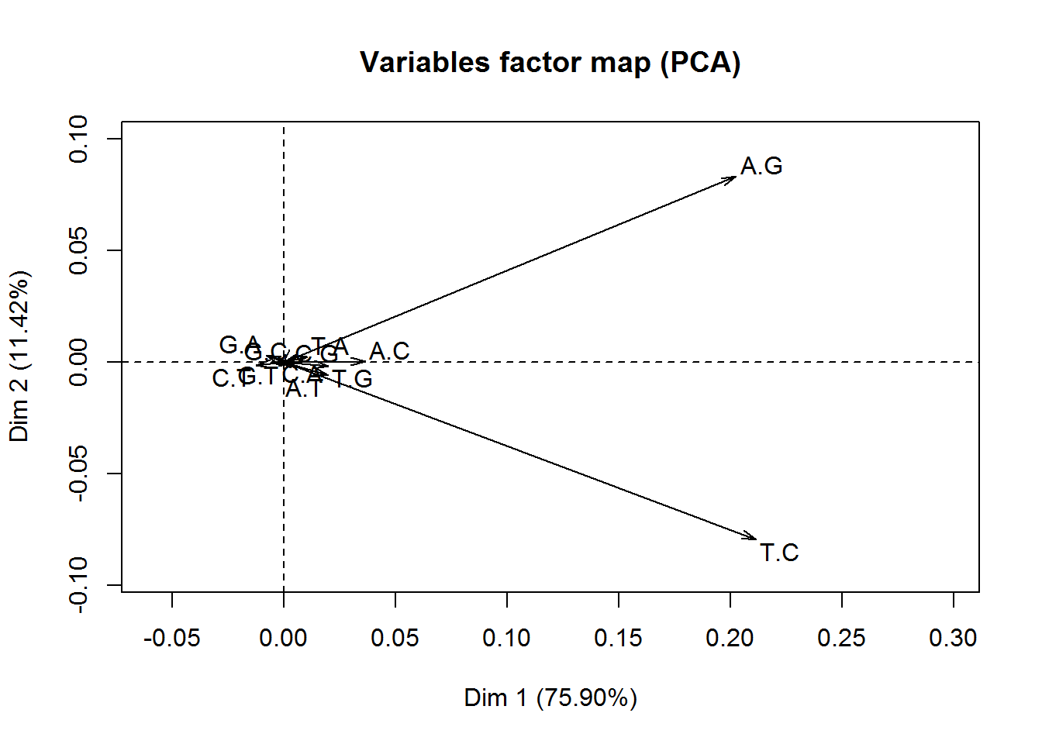
Dimensions of variation (PCA) in substitution rate 4000 rate matrices: human
TWO dimensions explains 87% total variation between rate matrices
Strand symmetry: A>G, T>C are most variable substitutions
Transitions: A>G, T>C, C>T and G>A are most common substitutions

Slide 16
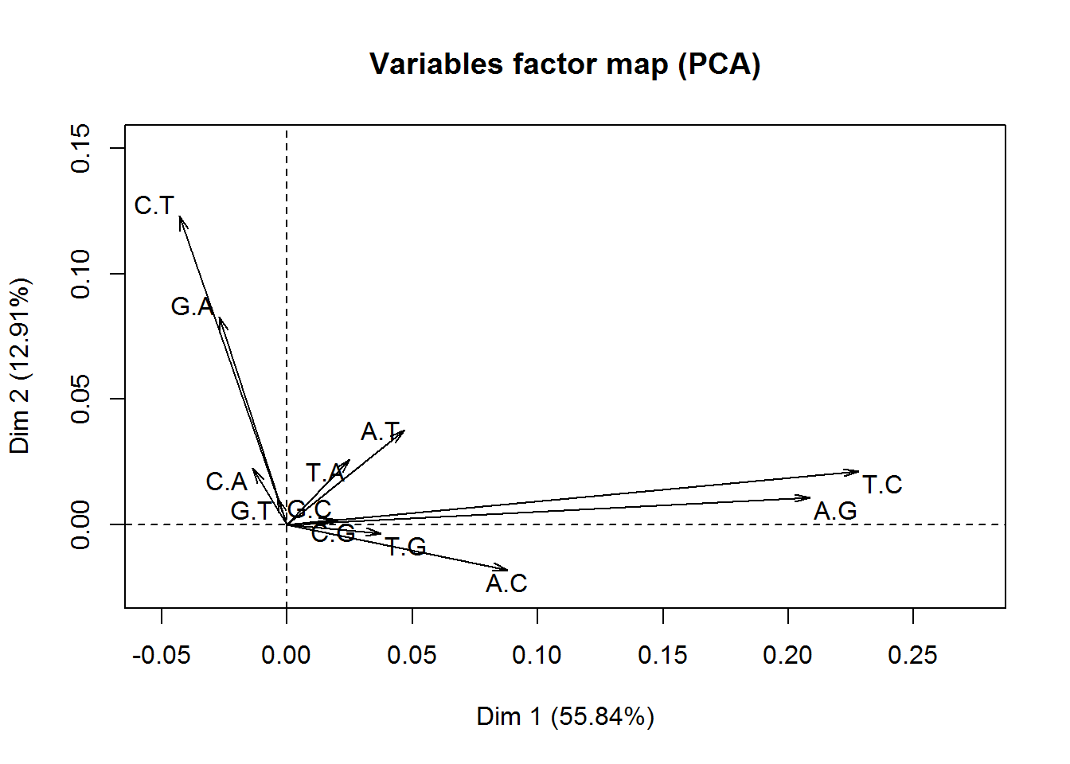
Dimensions of variation in substitution rate 4000 rate matrices: opossum
TWO dimensions explains 69% total variation between rate matrices
Strand symmetry: A>G, T>C are most variable substitutions
Transitions: A>G, T>C, C>T and G>A are most common substitutions
Issue: Opossum is the outgroup, models are not time-reversible.

Slide 17
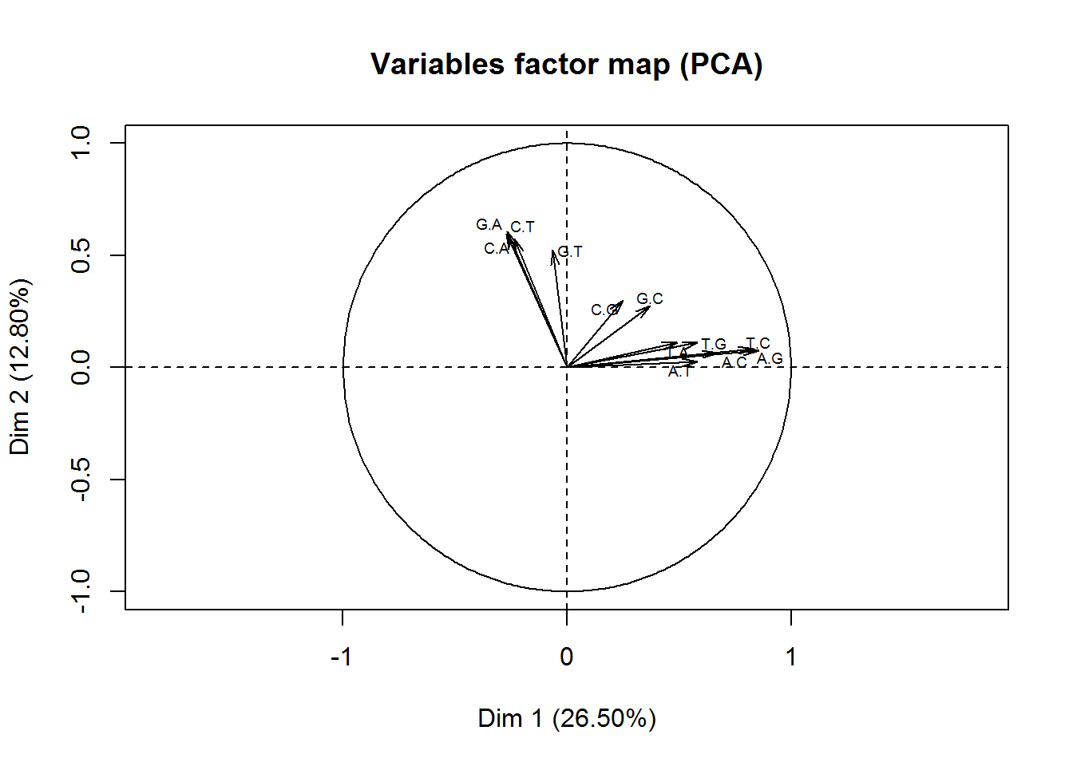
Dimensions of variation in (NORMALISED) substitution rate 4000 rate matrices: human
FOUR dimensions explains 56% total variation between rate matrices
Strand symmetry: for all substitutions
Transitions: A>G, T>C, C>T and G>A are most common substitutions
Could strand-symmetric models be “as good as” general model?

Slide 18
Preliminary conclusions
Continuous time Markov models can be good models of molecular evolution
General Markov models trump traditional evolutionary models
General Markov models can be too parameter-rich
We can fit general models to sequence alignment data and look for lower dimensional alternatives
?
DATA
(sufficient statistic)
GTR(1986)
Fully General Markov

Slide 19
Acknowledgements and references
Gavin Huttley, JCSMR ANU
Ben Kaehler, JCSMR, ANU
KAEHLER, B. et al 2015. Genetic distance for a general non-stationary markov substitution process. Syst Biol, 64, 281-93
GOLDMAN, N. 1993. Statistical tests of models of DNA substitution. J Mol Evol, 36, 182-98

Slide 20
NEXT directions: using python
FOCUS ON FEATURES
For each alignment, fit the general model and reduced model (e.g. strand symmetric models)
Compare models using likelihood ratio tests
FOCUS ON PROJECTIONS
Fit general model to all 4000 alignments: Q_all for each species
Project Q_all matrices to Q0 using singular value decomposition
Compare models using likelihood ratio tests

