Slide 1



Stratified medicine: the essential role of mechanisms evaluation
Dr Richard Emsley
Centre for Biostatistics, Institute of Population Health,
The University of Manchester, Manchester Academic Health Science Centre
North West Hub for Trials Methodology Research
Visiting Lecturer, Institute of Psychiatry, Psychology and Neuroscience, KCL
http://www.population-health.manchester.ac.uk/staff/RichardEmsley/
richard.emsley@manchester.ac.uk
Biometrics by the Harbour, Hobart, Australia
Tuesday 1st December 2015

Slide 2





Manchester, England

Slide 3


Methodology Research: Efficacy and Mechanisms Evaluation
Joint work with Graham Dunn, Andrew Pickles, Sabine Landau, Antonia Marsden, Andrea Jorgensen, Matthias Pierce.
Funded by MRC Methodology Research Programme/Fellowship/HTMR grants:
Estimation of causal effects of complex interventions in longitudinal studies with intermediate variables (2009-2012)
MRC Early Career Centenary Award (2012-13)
Designs and analysis for the evaluation and validation of social and psychological markers in randomised trials of complex interventions in mental health (2010-12)
Developing methods for understanding mechanism in complex interventions (2013-15)
Theme 4, North West Hub for Trials Methodology Research (2013-18)

Slide 4
Rationale: stratified medicine
Motivating question: what is the optimal treatment to give to this patient right now, given their current and previous characteristics?
Moving beyond ‘one side fits all’ approach to medicine
“Right treatment to right person at right time”
Also known as:
Personalised/targeted/precision medicine
Hype or new paradigm?
Interest to health care providers and drug companies

Slide 5
MRC definition of stratified medicine
“Stratified medicine is the identification of key sub-groups of patients with distinct endotypes, these being distinguishable groups with differing mechanisms of disease, or particular responses to treatments.”
Stratification can be used to improve mechanistic understanding of disease processes and enable:
the identification of new targets for treatments;
the development of biomarkers for disease risk, diagnosis, progression and response to treatment;
treatments to be tested and applied in the most appropriate patient groups.

Slide 6
Example: stratified medicine questions
What is the optimal choice of dual therapy (metformin + something) for an individual with diabetes?
What is the optimal first line biologic therapy for an individual with psoriasis?
What is the optimal first line biologic therapy for an individual with rheumatoid arthritis?
Which class of neuroleptics should we prescribe to an individual diagnosed with schizophrenia?
What factors make psychotherapy a suitable treatment option for an individual?

Slide 7
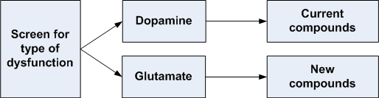
MRC Consortium: STRATA
Schizophrenia: Treatment Resistance And Therapeutic Advances
Most neuroleptic compounds assume a dopamine dysfunction.
A significant subgroup of patients may have a different neurobiological dysfunction based on abberant glutamate
Stratifying by underlying disease mechanism
Notes:
positron emission tomography – 7 scanners in the UK

Slide 8






Example: preventing harm
Steroids
T2 Diabetes
NSAIDs
T2 Diabetes

Slide 9
Defining treatment effects on outcome
Consider a randomised controlled trial with two arms: treatment (T) versus control (C) and a continuous outcome Y
Two potential outcomes for each participant in the trial:
the outcome after receiving treatment, Y(T)
the outcome after receiving the control, Y(C)
For a given individual, the effect of treatment is the difference:
ITE(Y)=Y(T)-Y(C)
As a result of the allocation, however, it is only ever possible to observe one of them
the other is a counterfactual

Slide 10
Rationale: stratified medicine and treatment effect heterogeneity
Nothing in the theory suggests that Y(T)-Y(C) is the same for every person:
Treatment effect heterogeneity
This is the underlying foundation of stratified medicine.
If a treatment is effective, we are interested in knowing who is it (most) effective for, in advance of treatment allocation/decisions to treat.
We need access to pre-treatment characteristics that predict treatment-effect heterogeneity:
Not just predict outcome/response to treatment

Slide 11
Why not predict treatment-outcome?
Given an additive treatment effect, the outcome of treatment is:
Y(T)=Y(C) + ITE(Y)
Now let's introduce a baseline marker, X.
Correlate X with treatment outcome Y(T):
Corr(X,Y(T))=Corr(X,Y(C) + ITE(Y))
A significant correlation can arise from two sources:
Y(C) is correlated with X (prognosis), or
ITE(Y) is correlated with X (prediction)
If X is prognostic then you can get a correlation between Y(T) and X even when the ITE(Y) is ZERO for everyone in the study.

Slide 12
Predicting response
When are we interested in predicting response?
For the individual patient who is responding
But why they are responding?
For non-responders, it doesn’t give enough information to decide on an alternative treatment:
treatment with a different mechanism (IL-6 vs. TNF-α)
more likely to comply with treatment (oral vs. injection)
So this can’t tell us about stratified medicine…
Stratified medicine assists in treatment decision making for next cohort of patients, not for current cohort…

Slide 13
The role of averages: treatment effects in stratified medicine (not personalised?)
Outcome=Y, Randomisation=Z∈ {T,C}, Marker=X∈{0,1}
The overall ITT effect is estimated by:
Ave[Y(T)−Y(C)] = Ave[Y|Z=T] − Ave[Y|Z=C]
The ITT effect in the ‘predictive marker positive’ group:
Ave[Y(T)−Y(C)|X=1] = Ave[Y|Z=T, X=1] − Ave[Y|Z=C, X=1]
The ITT effect in the ‘predictive marker negative’ group:
Ave[Y(T)−Y(C)|X=0] = Ave[Y|Z=T, X=0] − Ave[Y|Z=C, X=0]

Slide 14
What are we estimating?
Interested in various measures of effect
Effectiveness - the benefit of a treatment policy
Efficacy - the benefit of actually receiving treatment
ITT measures effectiveness as implemented in a given trial
What is the effectiveness of offering the intervention?
It tells us whether randomising the treatment works
On average, not for an individual patient!
Regardless of whether you receive the treatment or not!
Should stratified medicine be more interested in efficacy?

Slide 15
Variation in clinical trials
Senn (2004) describes sources of variability in clinical trials:
Between treatments
Between patients
Patient-by-treatment interaction
Within patients
In a parallel group design, only the between treatment variation is identified:
Everything else is in the error term
In a cross-over trial, we can estimate between treatment and between patient variation
In a repeated cross-over trial, we can estimate between treatment variation, between patient variation and the patient by treatment interaction

Slide 16
Markers which are not prognostic or predictive (irrelevant to outcome)
Outcome
Treated
Untreated
Treatment effect
Markers
Notes:
Associated with disease outcome.

Slide 17
Prognostic markers (risk factors)
Outcome
Treated
Untreated
Treatment effect
Prognostic markers
A ‘prognostic biomarker’ is a biological measurement made before treatment to indicate long-term outcome for patients either untreated or receiving standard treatment (Simon 2010).
Notes:
Associated with disease outcome.

Slide 18
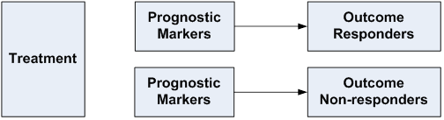
Prognostic markers in a treated cohort
Searching for prognostic markers of response in a treated only cohort is akin to a (nested) case-control study:

Slide 19
Predictive marker
Outcome
Treatment effect
depends on predictive variable
Treated
Untreated
Predictive marker
A ‘predictive biomarker’ is a biological measurement made before treatment to identify which patient is likely or unlikely to benefit from a particular treatment (Simon 2010).
Notes:
Associated with treatment effect.

Slide 20
Predictive marker with qualitative interaction
Outcome
Treated
Treatment effect
depends on predictive variable
Untreated
Predictive marker
Notes:
Associated with treatment effect.

Slide 21
Misclassification error
In statistical terms, what if there is misclassification (measurement) error in the predictive marker?
We need to measure the predictive marker well, or account for the possible error.
Questions:
How do we know treatment won’t work in the “marker negative” group?
How sure are we about our classification?
What level of evidence would you need to deny someone the treatment?

Slide 22
Identifying and validating predictive markers
“In the case of predictive biomarkers, observational data are clearly inadequate and randomized controlled trials are mandatory for predictive biomarker validation.”
Sargent and Mandrekar (Clinical Trials, 2013)
Retrospective versus prospective validation:
Retrospective validation involves searching for marker by treatment interactions in data already collected in previously conducted RCTs.
Prospective designs:
Enrichment designs – select only ‘marker positive’ subgroup
Biomarker stratified design - unselected with upfront stratification
BS-EME design – incorporates mechanisms evaluation

Slide 23
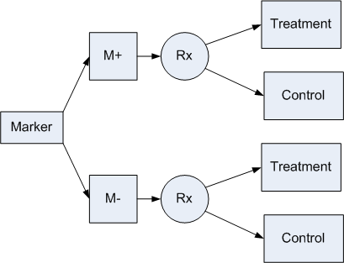
Example: Biomarker stratified design
Compare randomised differences

Slide 24
Efficacy and mechanisms evaluation: estimating valid effects in trials
U – the unmeasured confounders
error
U
Mediator
Random
allocation
Outcomes
error
Covariates

Slide 25
Solutions to unmeasured confounding: instrumental variables
U – the unmeasured confounders
error
U
Randomisation* covariate interactions
Mediator
Random
allocation
Outcomes
error
Covariates
Emsley et al (2010), Emsley & Dunn (2012)

Slide 26
We need more information to make progress
For stratified medicine, this information could be:
Genetic and phenotypic markers
Clinical history
Past environmental exposures, lifestyle, etc.
Advantage of genetic markers is that they are essentially randomised and independent of treatment allocation
Can we use markers as this extra information?
How we do this depends on the assumptions we make about relationships between markers and outcomes

Slide 27
Stratification and mechanisms evaluation
Predictive effect only acts on the mediator
U – unmeasured confounders
U
Mediator
Predictive
biomarker
(moderator)
Random
allocation
Outcomes
Are we correct in assuming that there is no moderating effect on the other pathways?
Dependent on prior knowledge of the biology/biochemistry of the system.

Slide 28
Combining prognostic and predictive markers for mechanisms evaluation
Predictive effect only acts on the mediator
U – unmeasured confounders
U
Mediator
Predictive
biomarker
(moderator)
Random
allocation
Outcomes
Prognostic biomarker (risk factor)
Notes:
Are we correct in assuming that there is no moderating effect on the other pathways?
Dependent on prior knowledge of the biology/biochemistry of the system

Slide 29
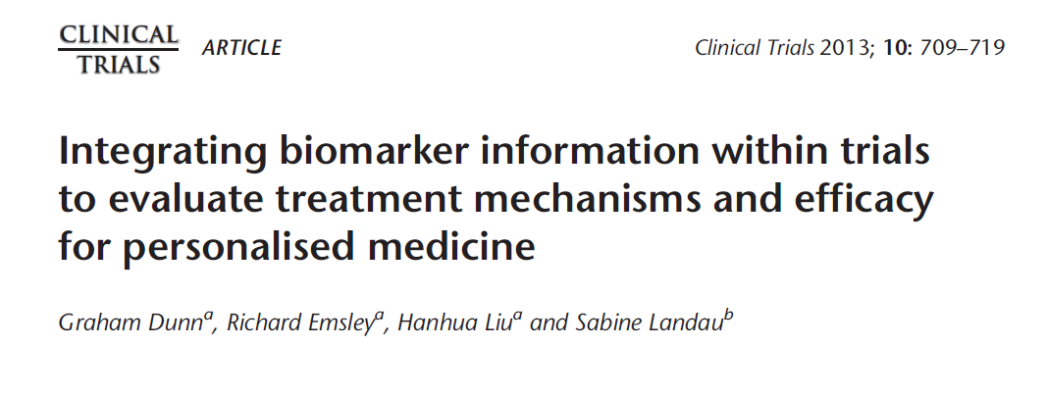
Biomarker Stratified-Efficacy and Mechanisms Evaluation (BS-EME) trial

Slide 30
The Biomarker Stratified-Efficacy and Mechanisms Evaluation (BS-EME) trial
We supplement the baseline information (i.e. predictive marker) by:
measuring all previously-validated prognostic markers
baseline covariates thought to have prognostic value
baseline measurement of the putative mediator
baseline value for the final outcome measurement
The rationale for all of these measurements is
(a) to allow for as much confounding of the effects of the mediator on final outcome as is feasible,
(b) to assess sensitivity of the results to assumptions concerning residual hidden confounding and, perhaps more importantly,
(c) increase the precision of the estimates of the important causal parameters.

Slide 31
Rationale for BS-EME trial design
Personalised (stratified) medicine and treatment-effect mechanisms evaluation are inextricably linked;
Stratification without corresponding mechanisms evaluation lacks credibility;
In the almost certain presence of mediator-outcome confounding, mechanisms evaluation is dependent on stratification for its validity;
Both stratification and treatment-effect mediation can be evaluated using a biomarker stratified trial design (BS-EME trial);
Direct and indirect (mediated) effects should be estimated through the use of instrumental variable methods together with adjustments for all known prognostic biomarkers (confounders).

Slide 32

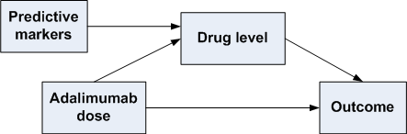
MRC Consortium: PSORT
Psoriasis Stratification to Optimise Relevant Therapy
Current standardised dosing of biologic therapies
Different biologics act through different pathways (IL-6, TNF-α)

Slide 33
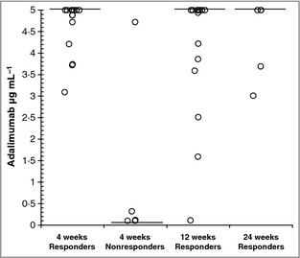
PSORT: preliminary data on mechanisms
Blood levels of adalimumab 4 weeks after start of therapy are predictive of response to therapy at 14 weeks
Mahil et al (2013), BJD.

Slide 34
Future methodology work: exploring the key equation
OUTCOME = TREATMENT * MARKER
Scale of interaction
Combining several markers
Appropriate measures of treatment (exposure)
Incorporating a decision rule
Multivariate outcomes
(Appropriate confounding adjustment)

Slide 35
Scale of interaction
Presence of an interaction is scale dependent.
multiplicative scale: relative treatment effects
additive scale: absolute treatment effects
Interactions on the additive scale are more appropriate when targeting treatments to different subgroups.
Allows for different baseline risks
Additive interaction cannot be directly measured in a multiplicative model:
surrogate measures of additive interaction can be calculated from the model output.
Relative Excess Risk of Interaction (RERI)
Assess significance of the interaction, not the magnitude
Marsden, Emsley et al, submitted, (2015)

Slide 36

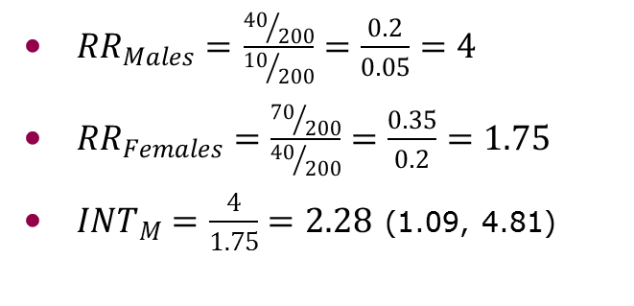
Additive versus multiplicative interaction
 | Males |  |  | Females
 | Headaches | No headaches | Total | Headaches | No headaches | Total
Treated | 40 | 160 | 200 | 70 | 130 | 200
Not treated | 10 | 190 | 200 | 40 | 160 | 200
Total | 50 | 350 | 400 | 110 | 290 | 400
${RR}_{Males}=$ $\frac{{40}/{200}}{{10}/{200}}=\frac{0.2}{0.05}=4$
${RR}_{Females}=\frac{{70}/{200}}{{40}/{200}}=\frac{0.35}{0.2}=1.75$
${INT}_{M}=\frac{4}{1.75}=2.28$ (1.09, 4.81)
${RD}_{Males}=0.2−0.05=0.15$
${RD}_{Females}=0.35−0.2=0.15$
${INT}_{A}$=0
Marsden, Emsley et al, submitted, (2015)

Slide 37
Multiple markers
How likely is it to be a single predictive marker?
Cancer e.g. genotype of tumour
Other disciplines…unlikely?
Kraemer (2013) distinguishes baseline variables into 3 mutually exclusive groups:
those irrelevant to treatment outcome,
those non-specific predictors (prognostic),
and those that are moderators (predictive & prognostic)
Developed a weighted linear composite moderator, which might more strongly moderate the effect of a treatment on outcome than any single moderator
Needs extending for multi-modal markers
E.g. imaging, genotype, clinical

Slide 38
Incorporating compliance or departures from randomised treatment

Slide 39
Incorporating compliance or departures from randomised treatment

Slide 40
Evaluating a decision rule
Optimal choice | Randomisation
 | Treatment | No treatment
Treatment | Lucky | Unlucky
No treatment | Unlucky | Lucky

Slide 41
Comparing outcomes
Ave[Y^{rule}] = average outcome if everyone follows treatment rule
Ave[Y^{opt}] = average outcome if everyone follows optimal treatment
Ave[Y^{rand}] = average outcome if everyone follows randomisation
Ave[Y^{treat}] = average outcome if everyone receives treatment
Ave[Y^{control}] = average outcome if everyone receives control
Treatment rule:
Φ^{rule} = Ave[Y^{rule}] – Ave[Y^{rand}]
Optimal treatment rule:
Φ^{opt} = Ave[Y^{opt}] - Ave[Y^{rand}]
Pierce, Emsley et al, submitted, (2015)

Slide 42



Treatment rationing?
Notes:
Public perception? PPI?

Slide 43
Some thoughts on randomised trials for stratified medicine
There has been lots of work for validating predictive markers, but less about what to do when we identify them.
Do we need new trial designs?
Wider use of cross-over trials?
Is stratified medicine any different from subgroup analysis?
Increased sample size needed?
Limitations of RCTs
Limited inclusion criteria
Consent bias
Estimates effectiveness not efficacy
Incorporate compliance information

Slide 44
Some thoughts on observational studies and stratified medicine
Larger sample sizes – more precise estimates and the ability to study rare outcomes.
Aims to measure efficacy rather than effectiveness:
But needs good quality data on adherence
A control group is essential.
Should include an evaluation of mechanisms underpinning the stratification.
Non-random allocation to treatment is a problem for:
Evaluation of treatment effects
Evaluation of predictive markers

Slide 45
Stratified medicine: How far can it take us?
Stratified medicine and treatment-effect mechanisms evaluation are inextricably linked, but stratification without corresponding mechanisms evaluation lacks credibility.
Why does treatment work in only one subgroup?
Adherence to treatment is clearly a major factor in response, and needs considering in both trials and observational studies.
Needs to be more than predicting response to treatment.
Validation of predictive markers
Is the evidence strong enough to deprive treatment?
We can get better than ‘one size fits all’, but there are lots of technical challenges to be solved first.

Slide 46
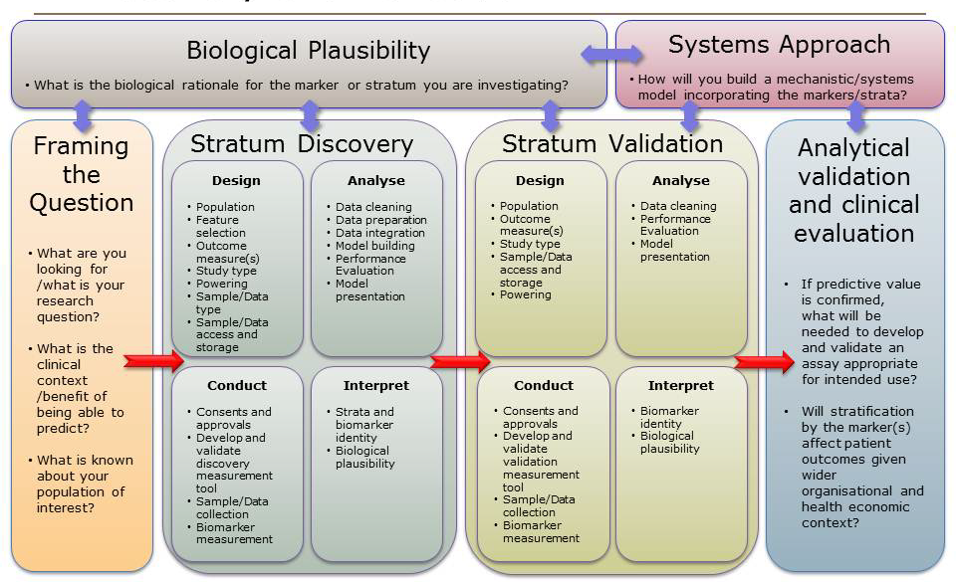
MRC Framework for Development, Design and Analysis of Stratified Medicine Research

Slide 47
MRC Molecular pathology nodes (~£16m)
Glasgow
Edinburgh
Newcastle
Manchester
Nottingham
Leicester

Slide 48
Recent methodology report
Dunn G, Emsley RA, Liu H, Landau S, Green J, White I and Pickles A. (2015). Evaluation and validation of social and psychological markers in randomised trials of complex interventions in mental health. Health Technology Assessment 19(93).
Non-technical introduction and summary of our work on analysing complex interventions:
Introduction
Mediation analysis
Process evaluation
Longitudinal extensions
Stratified medicine
Guidance and tips for trialists

Slide 49
Selected references
Dunn G, Emsley RA, Liu H & Landau S. (2013). Integrating biomarker information within trials to evaluate treatment mechanisms and efficacy for personalised medicine. Clinical Trials, 10(5):709-19.
Emsley RA & Dunn G. (2012) Evaluation of potential mediators in randomized trials of complex interventions (psychotherapies). In: Causal Inference: Statistical perspectives and applications. Eds: Berzuini C, Dawid P & Bernardinelli, L. Wiley.
Emsley RA, Dunn G & White IR. (2010). Modelling mediation and moderation of treatment effects in randomised controlled trials of complex interventions. Statistical Methods in Medical Research, 19(3), 237-270.
Sargent D and Mandrekar S. (2013). Statistical issues in the validation of prognostic, predictive and surrogate biomarkers. Clinical Trials, 10(5), 647-653
Simon R. (2010). Clinical trials for predictive medicine: new challenges and paradigms. Clinical Trials, 7:516-524

Slide 50


THANK YOU!

