Slide 1
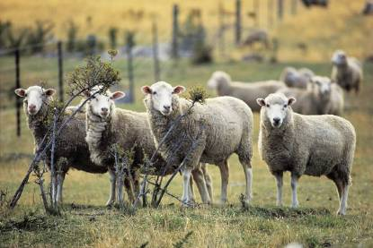
Fitting Quadratic Peaks to Fluorescence Data to Identify Chemical Compounds
Martin Upsdell, AgResearch Keith Millington, CSIRO Roland Sumner, AgResearch
Light Emitted
Excitation wavelength
Emission wavelength

Slide 2
The Yellowing Problem
Develops in the fleece
Most severe in lower regions of the fleece
Increases with moisture, warmth, high pH
Unscourable
The most serious fault in wool processing
Affects the appearance of dyed wool
Chromophores are protein degradation products
Notes:
Yellowing is the most serious fault in wool processing.
Yellow discolorations are unscourable and affect the appearance of dyability wool, particularly light blue
It develops in the fleece while the sheep is grazing.
It is associated with proteins,
It increases wit moisture, heat and pH.

Slide 3
Fluorescent Spectroscopy surfaces
Notes:
Height is the intensity of light emitted when irradiated by
Dotted lines are Rayleigh lines – incident light is reflected back
Region above emission > 2 excitation has harmonics
No light received when emission < excitation
Y component is the green area of the visible spectrum and Z is the blue sector. The difference is the Yellow sector of the spectrum.

Slide 4
Size of Data
Wool Samples | 108
Spectral points | 468
Number of data points | 50,544

Slide 5
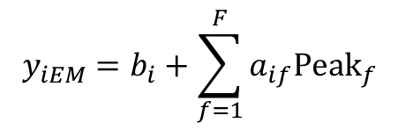
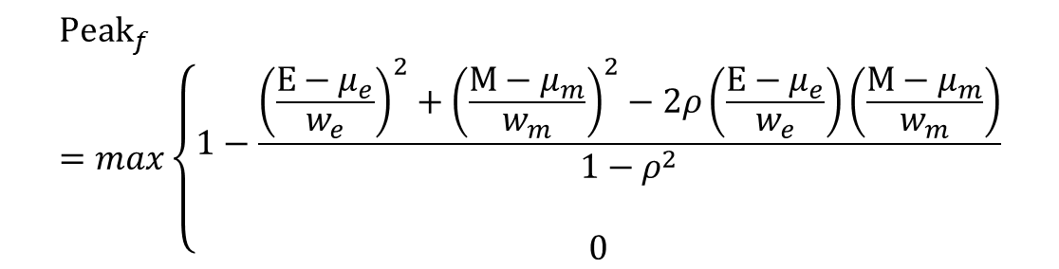
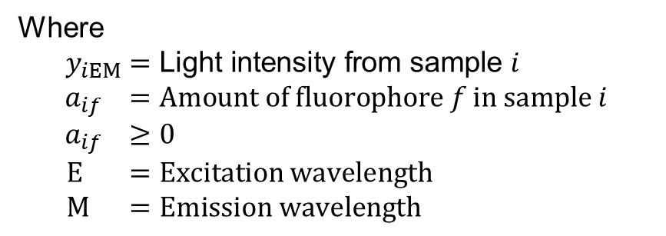
Basic Model
Linear regression for each sample
Where
$$y_{iEM}=\text{Light} \text{intensity} \text{from} \text{sample} i \\ a_{if} =Amount of fluorophore f in sample i \\ a_{if} ≥0 \\ E =Excitation wavelength \\ M =Emission wavelength$$
$$y_{iEM}=b_{i}+\sum_{f=1}^{F}{a_{if}{Peak}_{f}}$$
Non linear part for each peak
${Peak}_{f}$ is quadratic with 5 parameters on an elliptical base
$${Peak}_{f}=max\left\{\begin{matrix}\begin{aligned}1−\frac{{\left(\frac{E−μ_{e}}{w_{e}}\right)}^{2}+{\left(\frac{M−μ_{m}}{w_{m}}\right)}^{2}−2ρ\left(\frac{E−μ_{e}}{w_{e}}\right)\left(\frac{M−μ_{m}}{w_{m}}\right)}{1−ρ^{2}} \\ \end{aligned} \\ 0\end{matrix}\right.$$
Notes:
Method of fitting
Split into linear and non linear parts

Slide 6
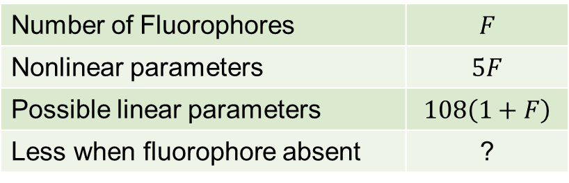
Size of Model
Number of Fluorophores | $$F$$
Nonlinear parameters | $$5F$$
Possible linear parameters | $$108\left(1+F\right)$$
Less when fluorophore absent | ?

Slide 7
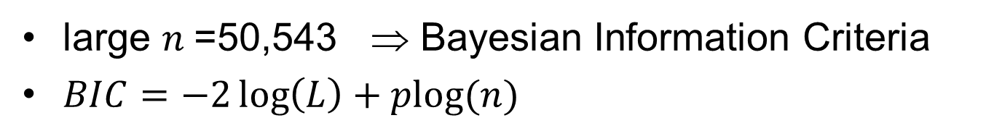
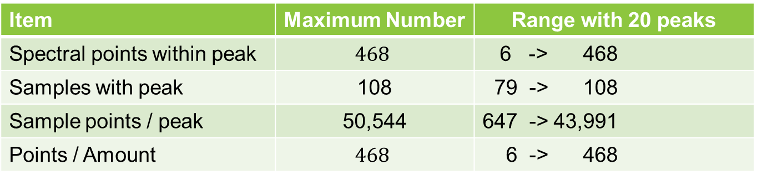
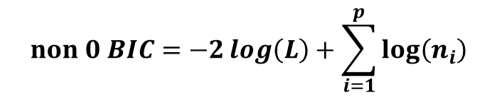

Model Selection: How Many Fluorophores?
large $n$=50,543 ⇒ Bayesian Information Criteria
$BIC=−2\log\left(L\right)+plog(n)$
What is $n$? 50,544?
Quadratic Peak
Item | Maximum Number | Range with 20 peaks
Spectral points within peak | $$468$$ | 6 -> 468
Samples with peak | 108 | 79 -> 108
Sample points / peak | 50,544 | 647 -> 43,991
Points / Amount | $$468$$ | 6 -> 468
$$non 0 BIC=−2\log\left(L\right)+\sum_{i=1}^{p}{log⁡\left(n_{i}\right)}$$

Slide 8
20 Fluorophores!
Parameters: 2368 available; 2271 used; 2171 linear; 100 nonlinear

Slide 9
20 Fluorophores (A to T)
Reader effects? Splitting peaks?
Outliers?

Slide 10
Are the Fluorophores Influential ?
A
B
C
D
E
G
H
I
F
K
L
M
N
O
P
R
S
T
U
V

Slide 11
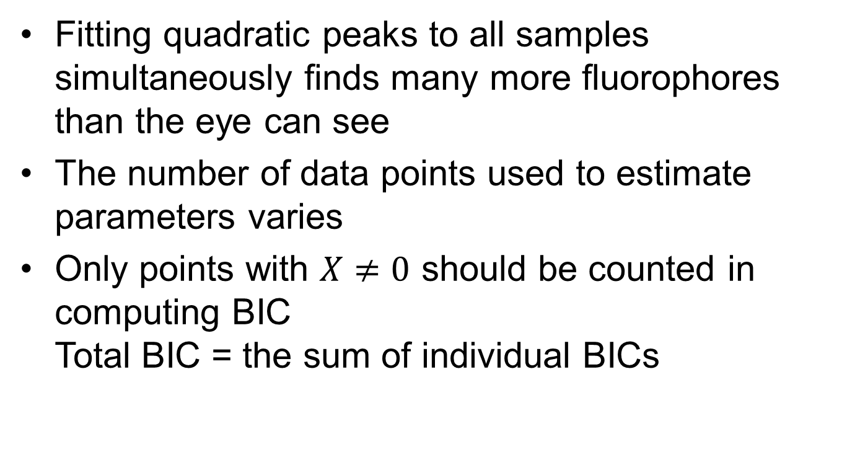
Conclusions
Fitting quadratic peaks to all samples simultaneously finds many more fluorophores than the eye can see
The number of data points used to estimate parameters varies
Only points with $X≠0$ should be counted in computing BIC Total BIC = the sum of individual BICs

Slide 12
Questions?

Slide 13
Hill | N Obs | N Sample | N Points | Excitation | Emission | Excitation Width | Emission Width | Correlation
1 | 21,105 | 105 | 201 | 409 | 496 | 104 | 88 | 0.59
2 | 13,068 | 108 | 121 | 380 | 447 | 74 | 82 | 0.72
3 | 19,503 | 106 | 184 | 147 | 505 | 246 | 151 | -0.75
4 | 647 | 108 | 6 | 168 | 346 | 62 | 104 | 0.77
5 | 2,808 | 108 | 26 | 285 | 292 | 35 | 92 | -0.23
6 | 29,808 | 108 | 276 | 368 | 513 | 80 | 136 | 0.40
7 | 17,064 | 108 | 158 | 491 | 495 | 119 | 206 | -0.11
8 | 9,179 | 108 | 85 | 194 | 476 | 90 | 204 | -0.28
9 | 11,016 | 108 | 102 | 386 | 402 | 83 | 104 | -0.61
10 | 18,792 | 108 | 174 | 272 | 323 | 147 | 216 | 0.92
11 | 15,500 | 100 | 155 | 291 | 395 | 83 | 186 | 0.90
12 | 1,512 | 108 | 14 | 227 | 398 | 18 | 95 | 0.87
13 | 1,512 | 108 | 14 | 295 | 350 | 10 | 51 | 0.05
14 | 9,702 | 98 | 99 | 398 | 435 | 69 | 99 | -0.56
15 | 14,378 | 79 | 182 | 530 | 534 | 236 | 71 | 0.27
16 | 9,984 | 96 | 104 | 362 | 397 | 49 | 140 | -0.46
17 | 43,991 | 94 | 468 | 332 | 545 | 213 | 265 | 0.25
18 | 5,076 | 108 | 47 | 371 | 527 | 28 | 57 | 0.18
19 | 14,112 | 98 | 144 | 418 | 474 | 63 | 112 | -0.09
20 | 3,267 | 99 | 33 | 439 | 441 | 72 | 44 | -0.12

