Slide 1
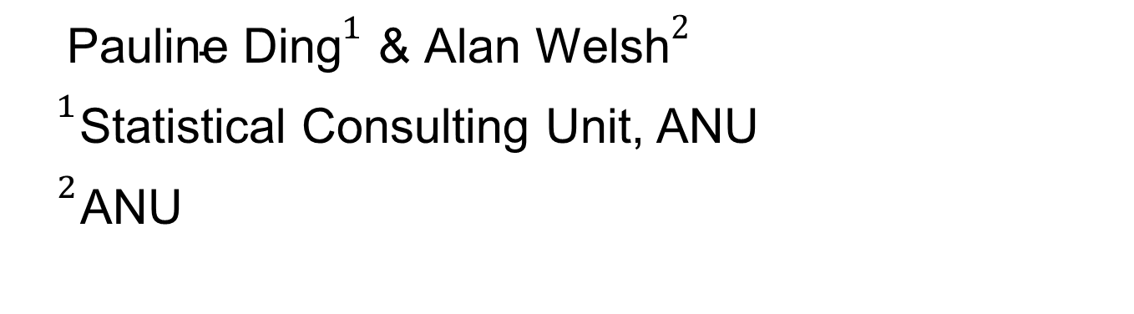
Bootstrap influence on the variance component estimators in the longitudinal data with multiple sources of variation
${\text{Pauline} \text{Ding}}^{1}$ & ${\text{Alan} \text{Welsh}}^{2}$
${}^{1}$Statistical Consulting Unit, ANU
${}^{2}$ANU

Slide 2
Outline
Notation and Estimators
Bootstrap Methods
Asymptotic Properties
Simulation Results
Real Data Application

Slide 3
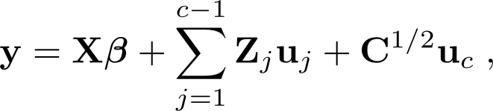
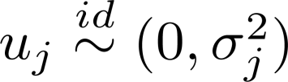
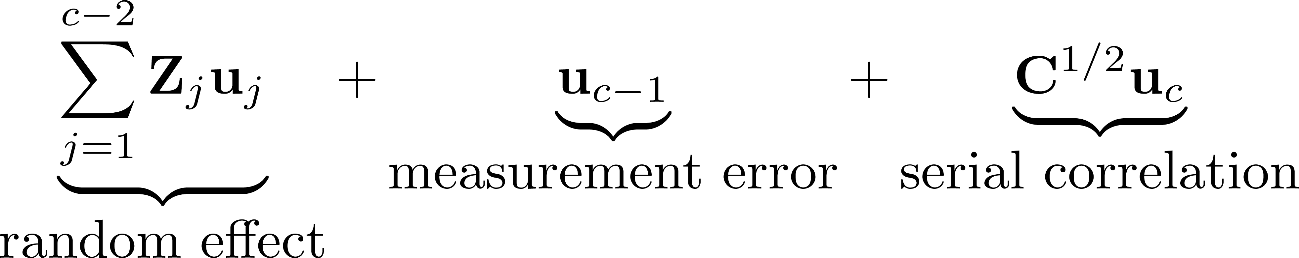
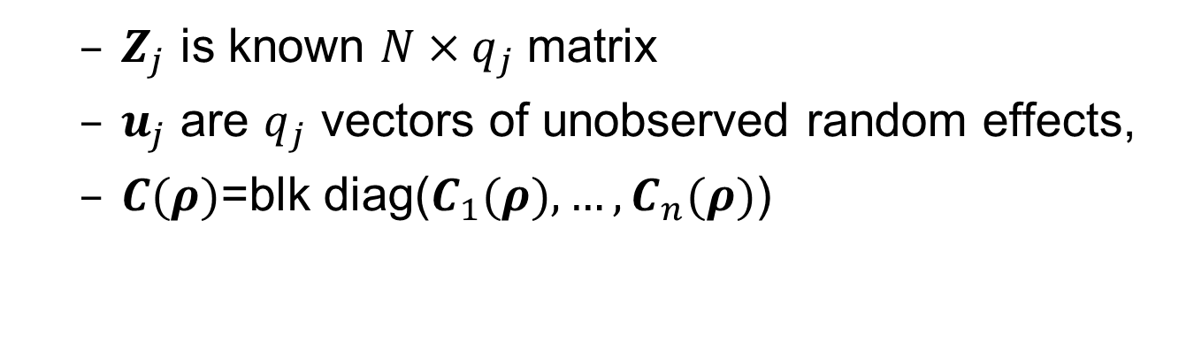
Linear Mixed Models
$Z_{j}$ is known $N×q_{j}$matrix
$u_{j}$ are $q_{j}$ vectors of unobserved random effects,
$C(ρ)$=blk diag($C_{1}(ρ),…,C_{n}(ρ)$)
Random Structure
Parameters of interest
Notes:
To keep generality

Slide 4
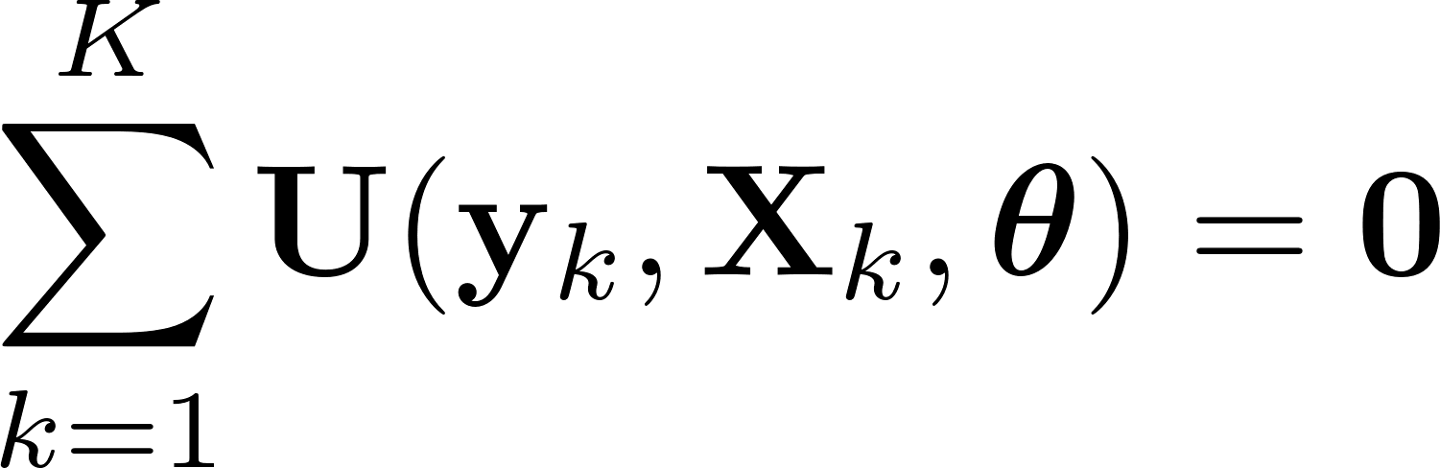
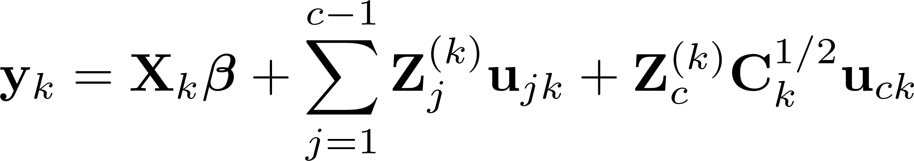
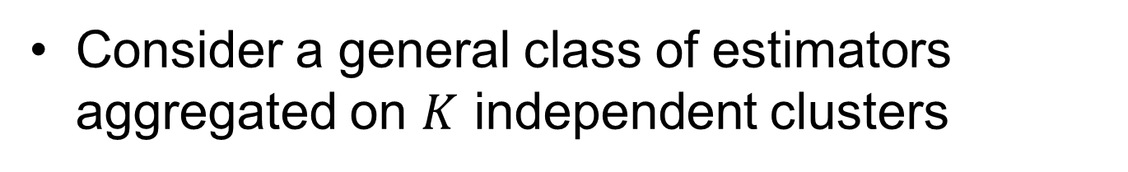
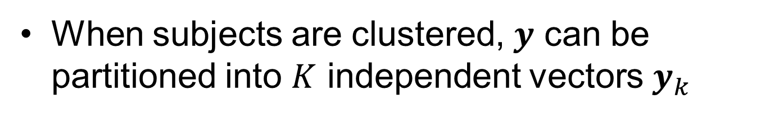
Parameter Estimation
Consider a general class of estimators aggregated on $K$ independent clusters
When subjects are clustered, $y$ can be partitioned into $K$ independent vectors $y_{k}$

Slide 5
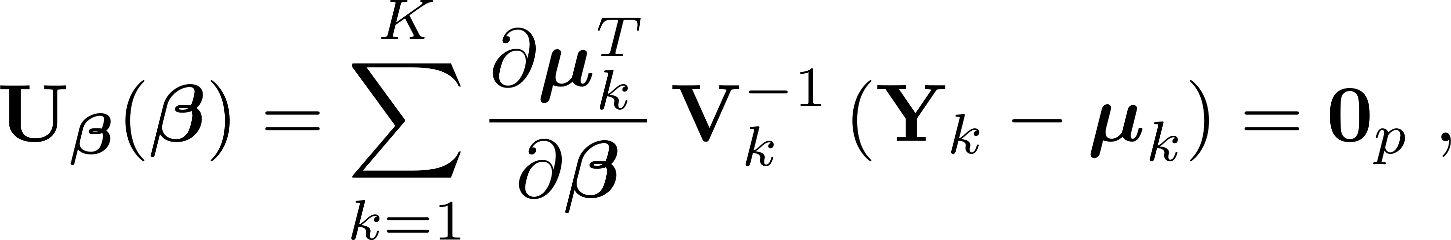
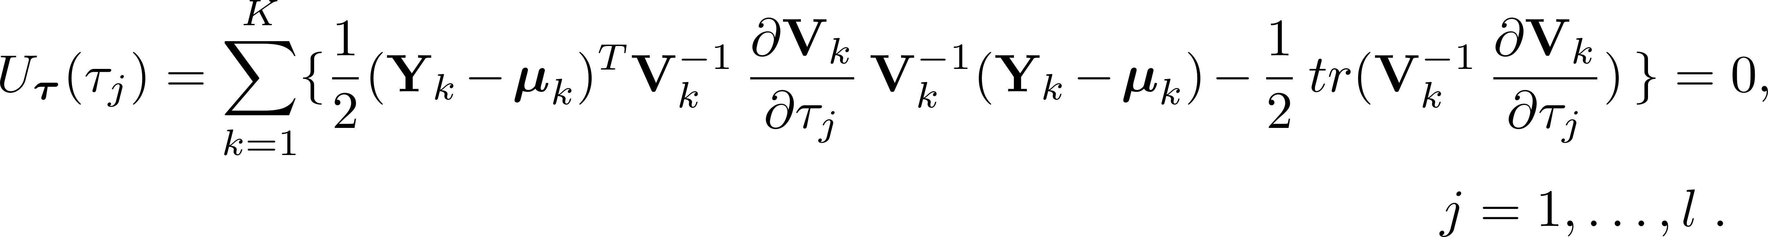
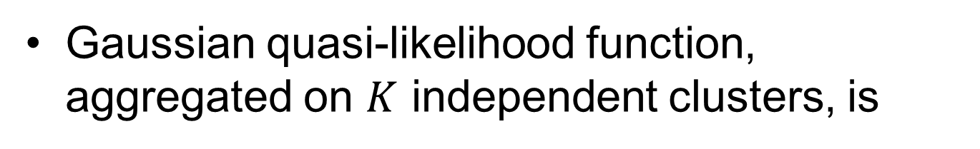
Gaussian quasi-likelihood function, aggregated on $K$ independent clusters, is
Regression parameter $β$ estimator
Covariance estimator ${τ=(σ}^{2},ρ)$
Notes:
Differentiating quasi-likelihood function with respect to different parameters and equating the derivatives to zero

Slide 6
Bootstrap Inference
Semi-parametric bootstraps
Transformation bootstrap
Estimating equation bootstraps
Applying weights to estimating equations

Slide 7

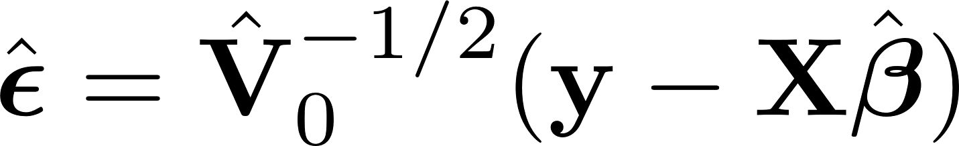
Semiparametric Bootstraps
Transformation Bootstrap
The transformation bootstrap observations
Sample without replacement from

Slide 8
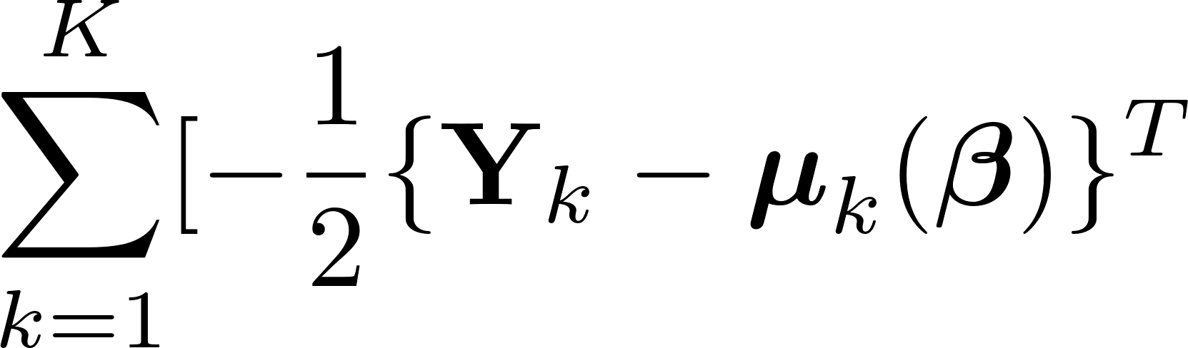
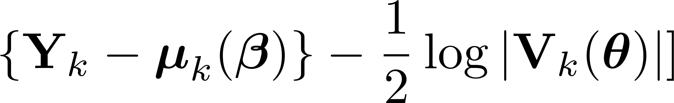
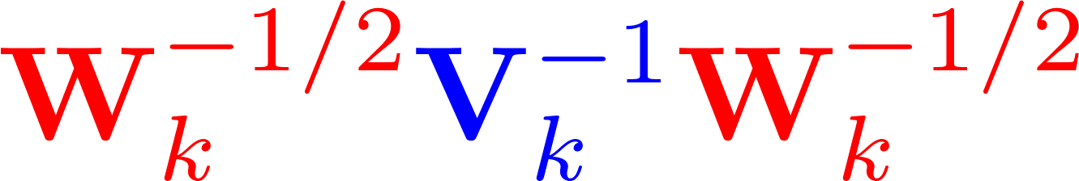
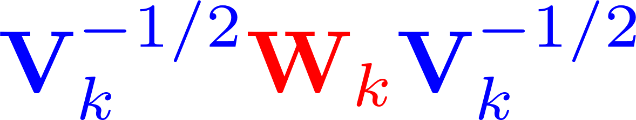

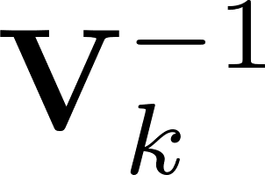
Estimating Equation Bootstraps
Three weight schemes:
Independent weights on independent clusters
Independent weights on subjects
Independent weights on observations
Many places to put weights into the estimating equations, e.g.
Notes:
Estimating equation bootstrap:
Apply bootstrap weights to the estimating equations

Slide 9
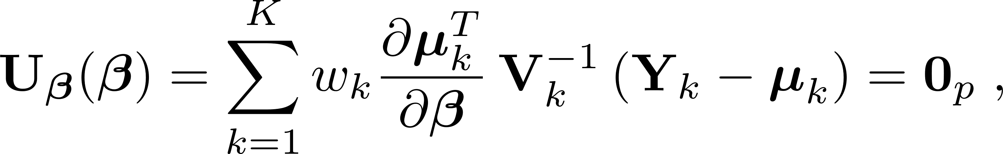
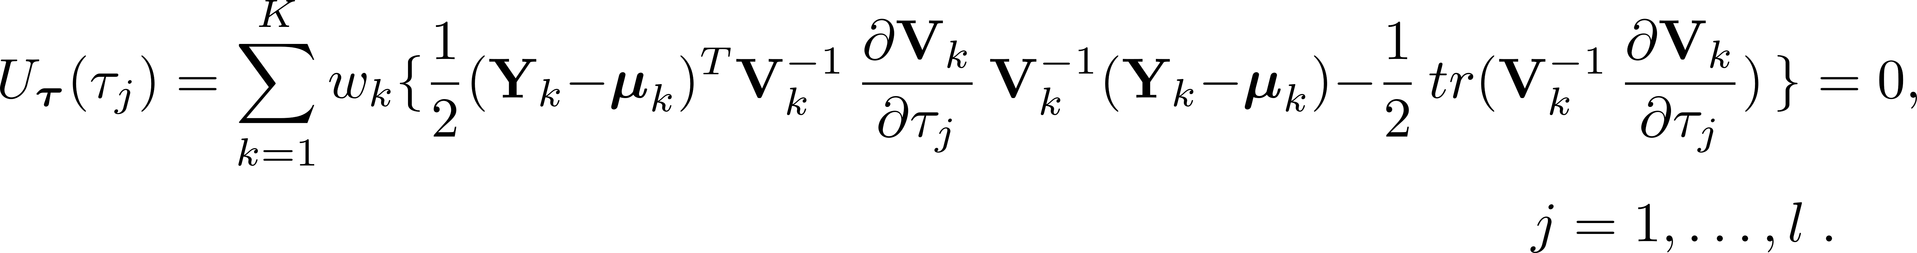
Estimating Equation Bootstraps
Cluster Bootstrap
Independent weights at the cluster level
Regression parameter $β$ estimator
Covariance estimator ${τ=(σ}^{2},ρ)$

Slide 10
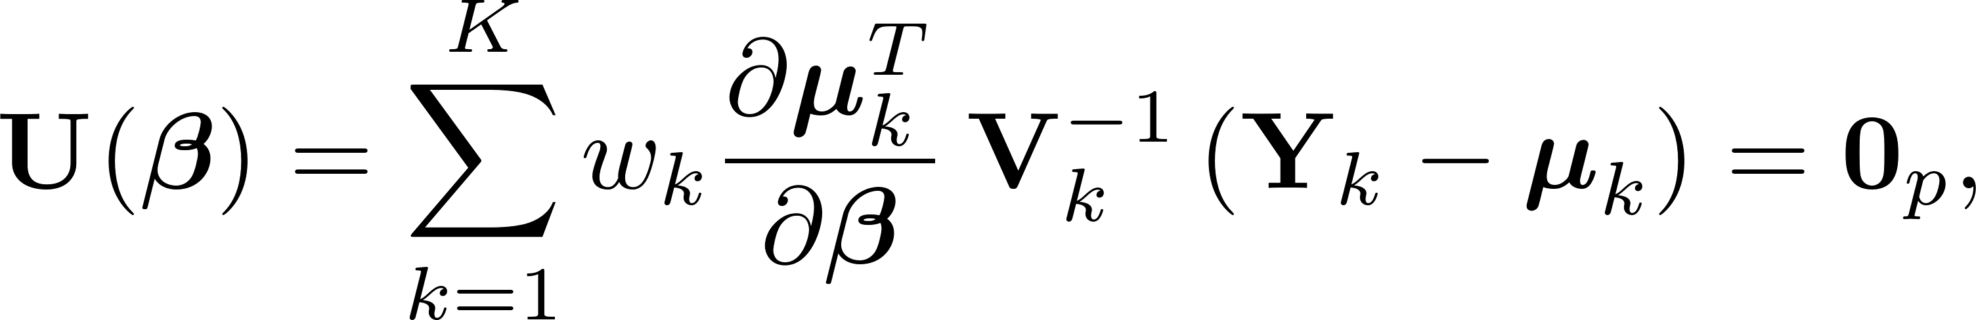
New Estimating Equation Bootstrap: Mixed Cluster Bootstrap
Inspirations: estimators are not bound to a single Quasi-likelihood function
Select different weight schemes for different parameter estimators
Regression parameter $β$ estimator

Slide 11
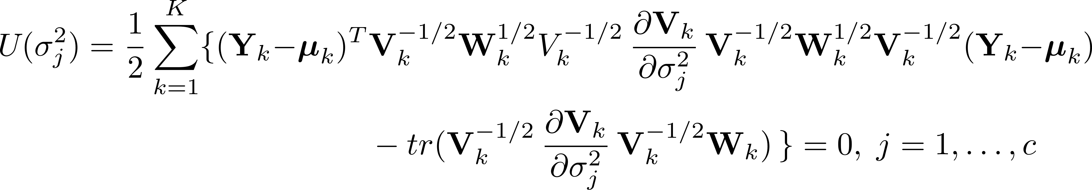
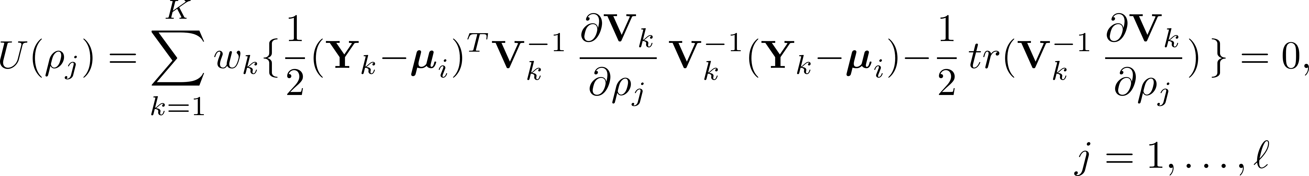
Variance component $σ^{2}$ estimator
Correlation parameter $ρ$estimator

Slide 12
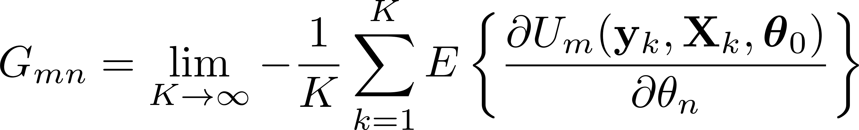
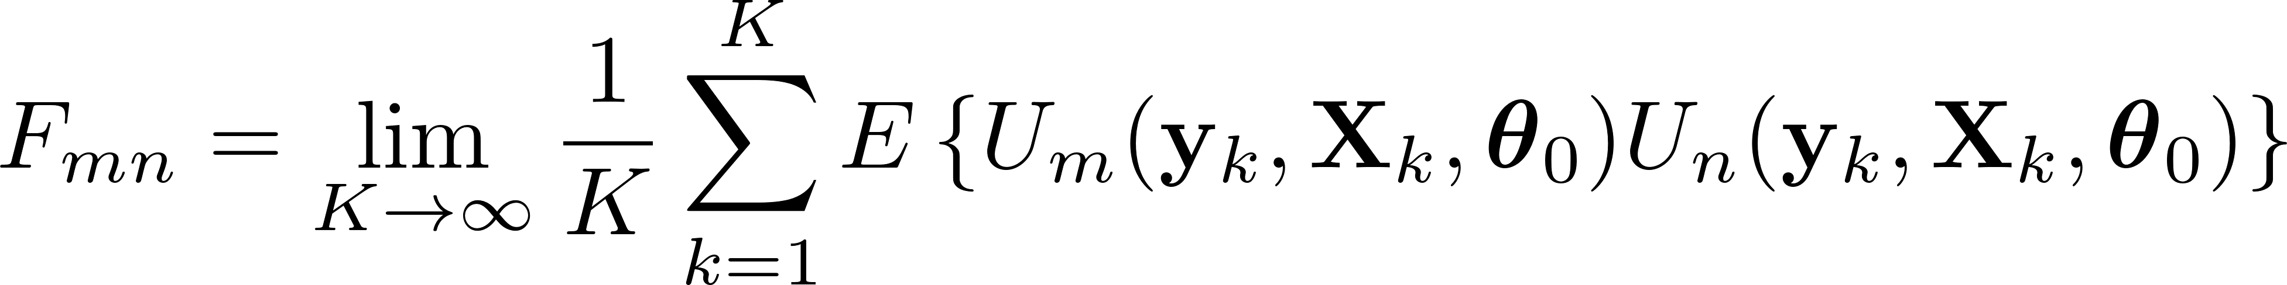
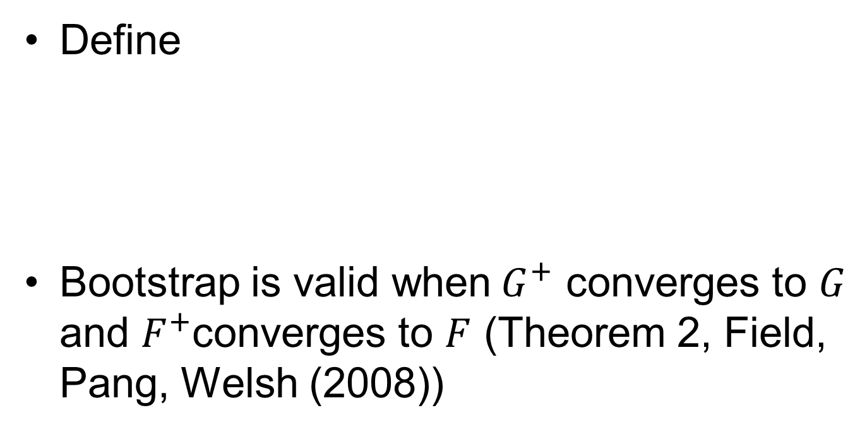
Validating Bootstrap Methods
Define
Bootstrap is valid when$G^{+}$ converges to $G$ and $F^{+}$converges to $F$ (Theorem 2, Field, Pang, Welsh (2008))
Notes:
G: the expected value of the estimator- checking the bias
F: variance/covariance of the estimators

Slide 13
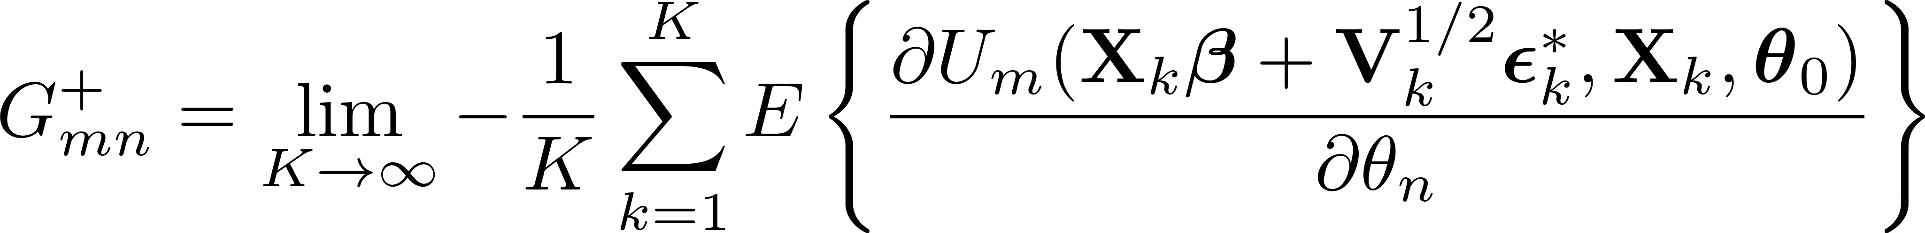
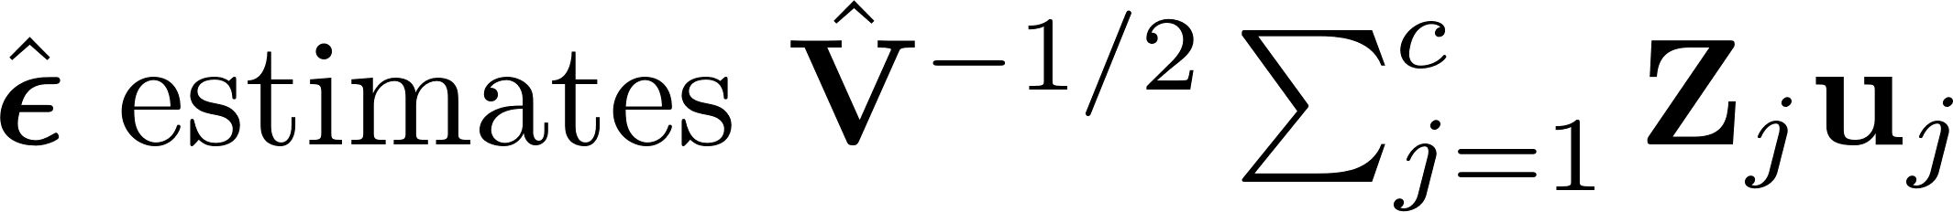
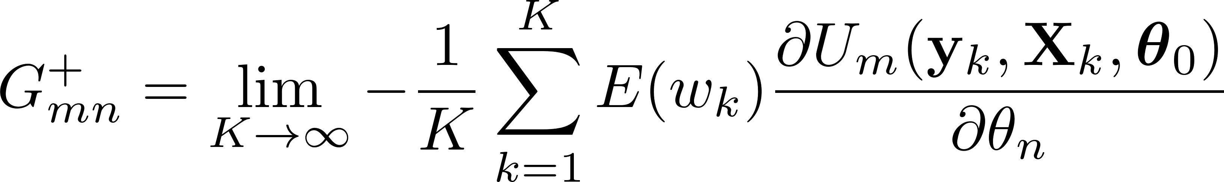
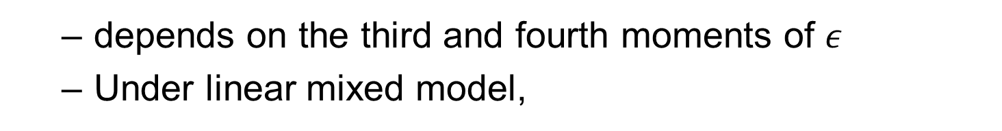
Transformation Bootstrap
depends on the third and fourth moments of $ε$
Under linear mixed model,
Cluster Bootstrap
It requires $E\left(w_{k}\right)=var\left(w_{k}\right)=1$

Slide 14
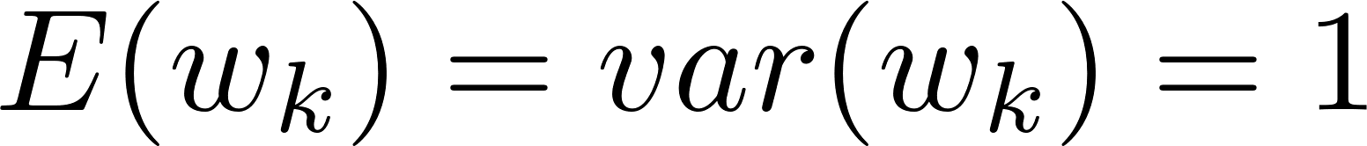
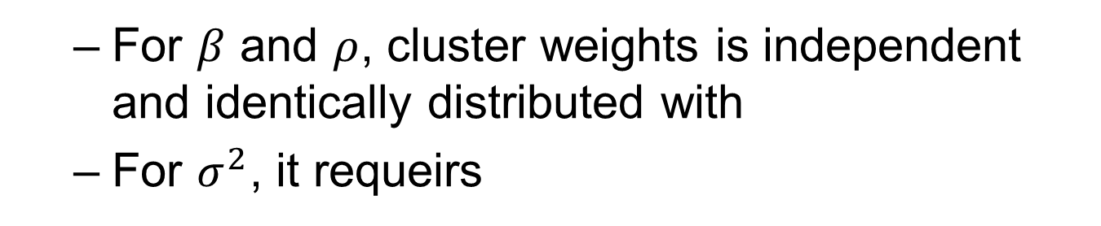
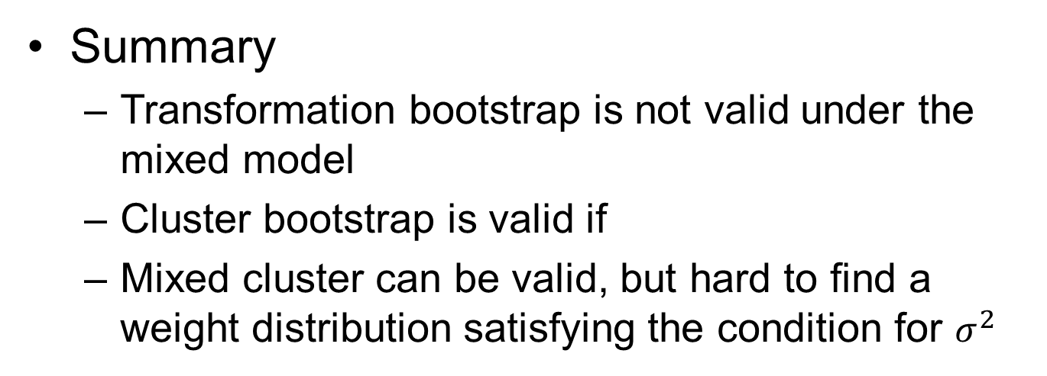
Mixed Cluster Bootstrap
For $β$ and $ρ$, cluster weights is independent and identically distributed with
For $σ^{2}$, it requeirs
Summary
Transformation bootstrap is not valid under the mixed model
Cluster bootstrap is valid if
Mixed cluster can be valid, but hard to find a weight distribution satisfying the condition for $σ^{2}$

Slide 15
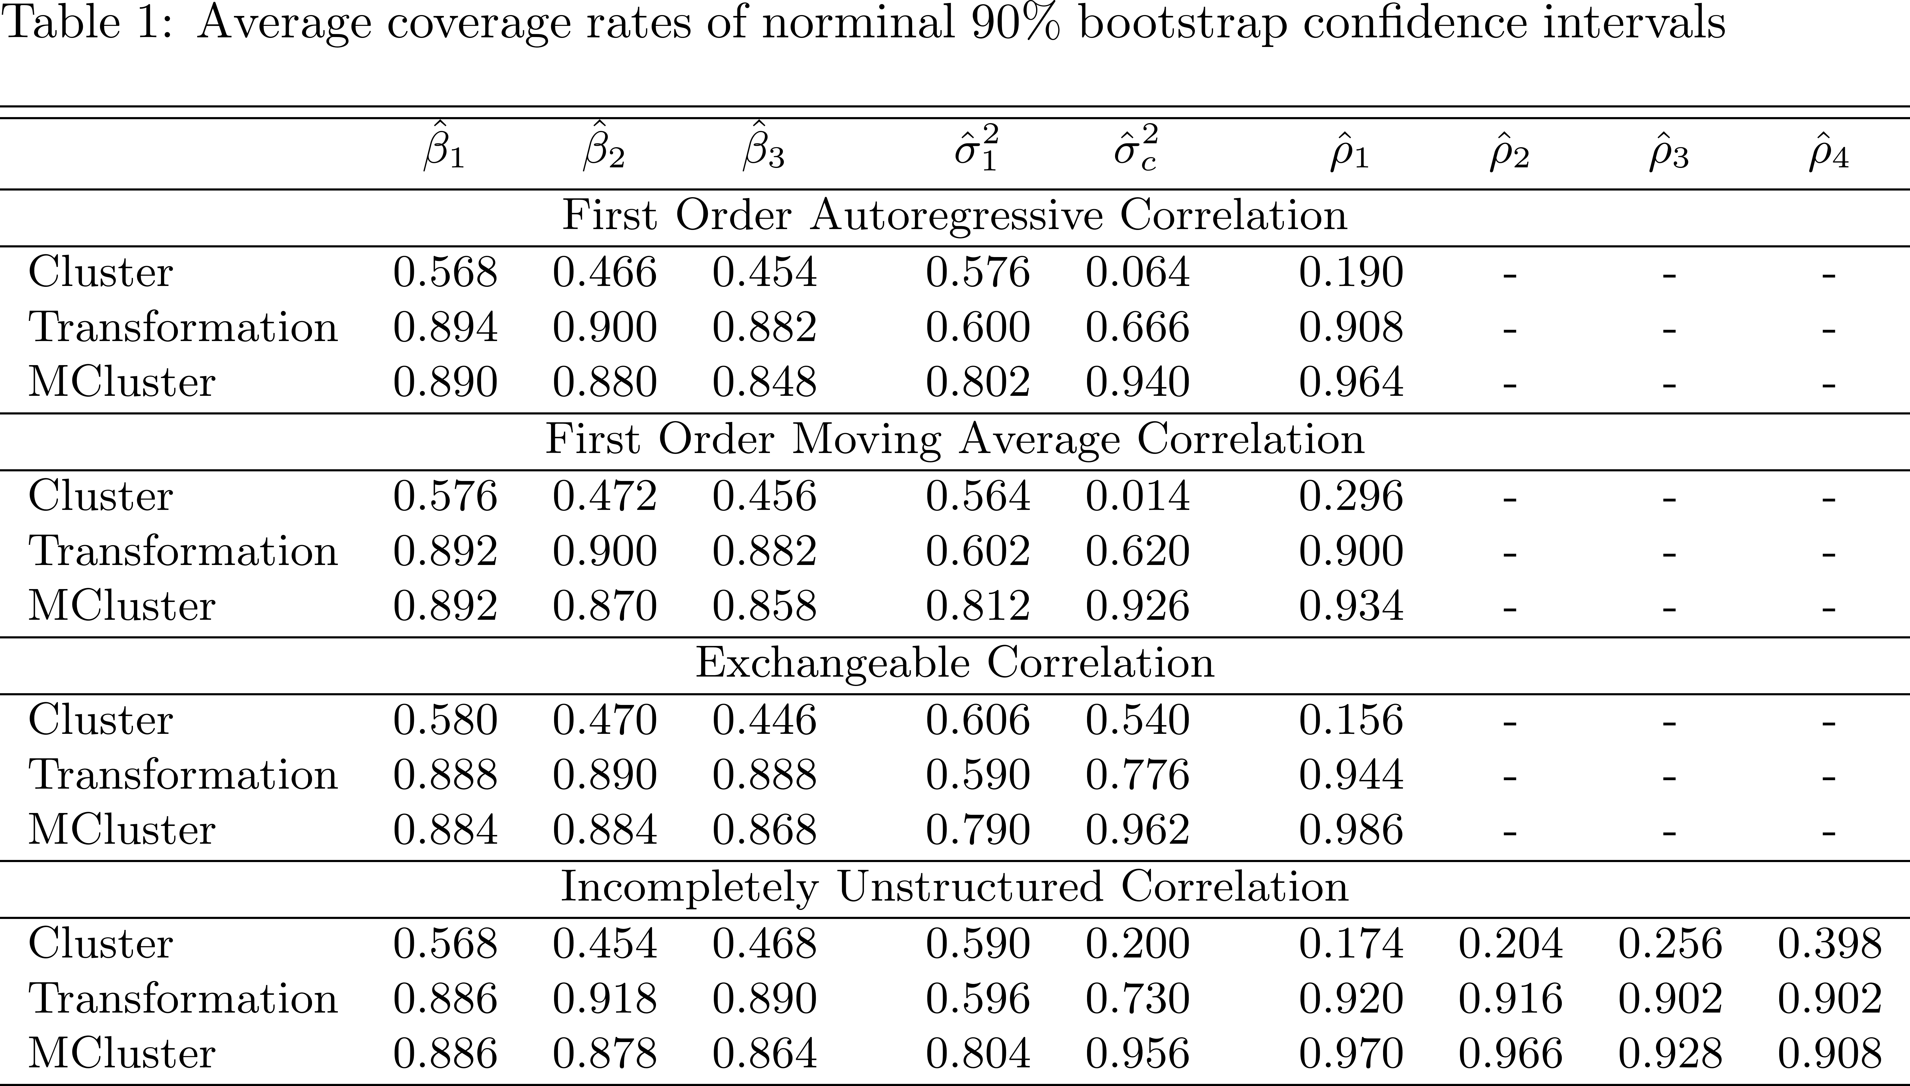
Bootstrap Results: coverage
Two-level nested model
K=40, B=500

Slide 16
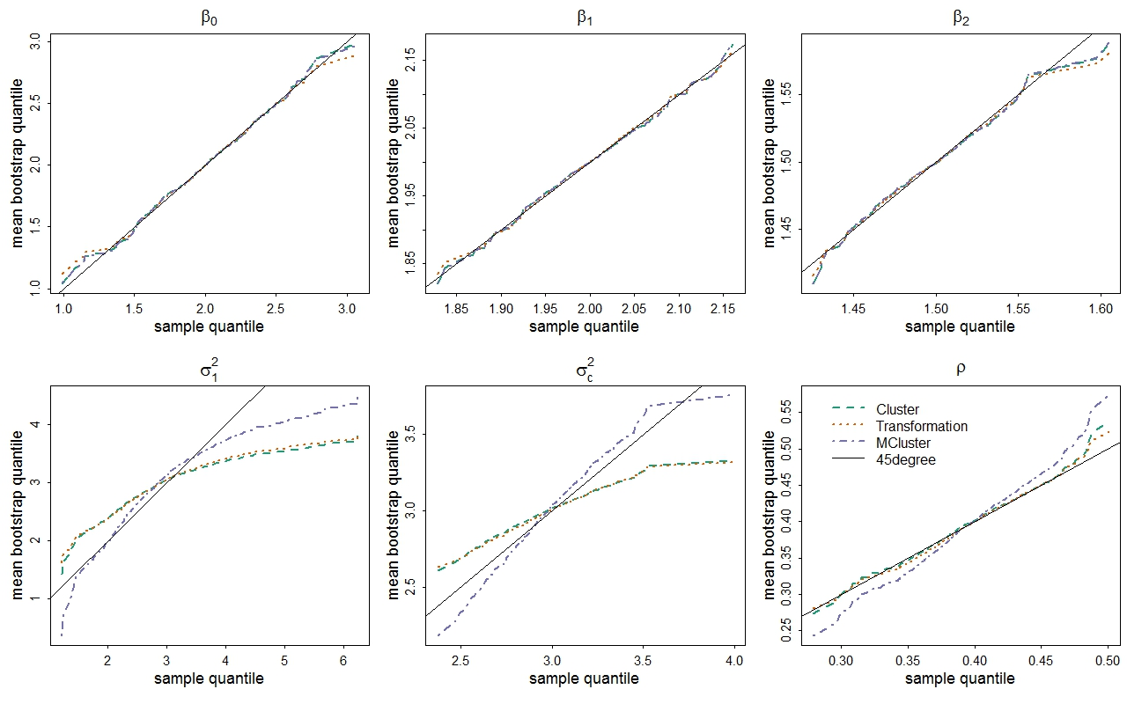
Bootstrap Results: bootstrap estimation
Notes:
Underestimate the variability in the upper tail of the sampling distribution of the estimators=>smaller variance=>optimistic=>CI too narrow=>model overfitting in random model (model mis-specification)
However using of GEE guarantee some level of robustness in term of the regression parameter estimation. The consequence of the mis-specification in the random model from overfitting is worthy of further exploration.

Slide 17


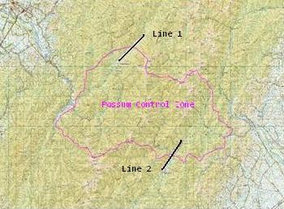
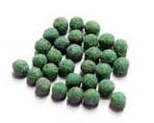
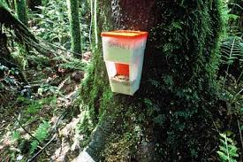
Foliar Nutrient Study
Two 5 km transect lines with 25 equally spaced plots
5 species of NZ native trees
Leaf samples collected 4 times
Outcome variable: Available Nitrogen
Tararua Mountain

Slide 18
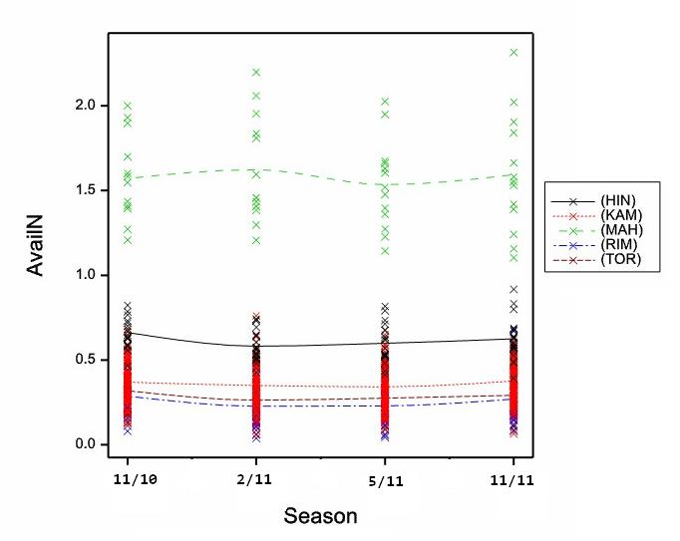

Slide 19

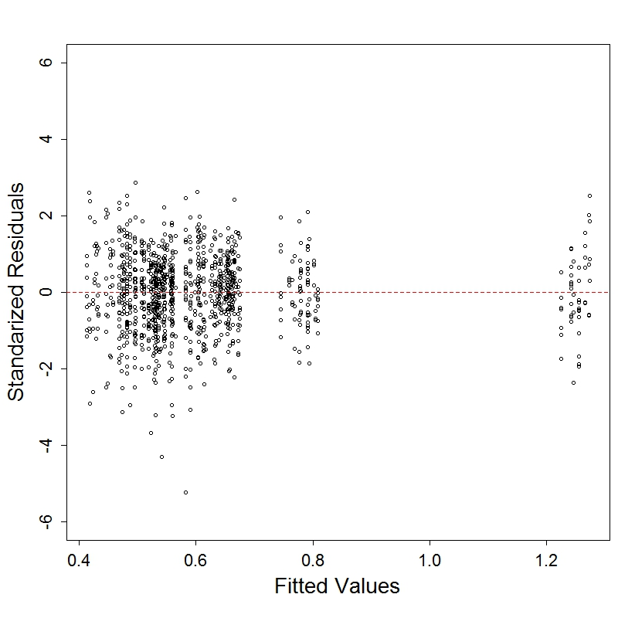
for i th plot, j th tree

Slide 20
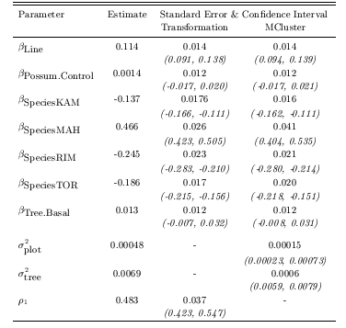
, for i th plot, j th tree

Slide 21
Highlights and Future Directions
Cluster bootstrap is asymptotic valid, but does not perform well in finite sample
Mixed cluster bootstrap improve variance estimation for variance component, but generally is not valid asymptotically
Generalize application to binary or count data
Robustness; missing data
In the future far far away….,spatial component

