Slide 1



A novel methodology for identification of inhomogeneities in climate time series
Andrés Farall¹, Jean-Phillipe Boulanger¹, Liliana Orellana²
¹CLARIS LPB Project - University of Buenos Aires
²Biostatistics Unit - Deakin University
CLARIS LPB. A Europe-South America Network for Climate Change Assessment and Impact Studies in La Plata Basin

Slide 2
Climate time series. Quality control
Climatology relies on observational data to understand the climate
In order to accurately monitor long-term marine or atmospheric climate change the quality of the data is of utmost importance
One key challenge is to discriminate the climatic signal from noise generated by errors or inhomogeneities
Errors and inhomogeneities are due to changes in the conditions data are measured, recorded, transmitted and/or stored

Slide 3
Quality control
Instant change ⇒ Error
Detection of atypical data
Lasting change ⇒ Inhomogeneity
Detection of breakpoints
In this talk
we will focus in the problem of detection of inhomogeneities in temperature series
Most common causes of inhomogeneities
Station relocations
Changes in instruments
Changes in the surroundings or land use (gradual changes)
Changes in the observational and calculation procedures

Slide 4
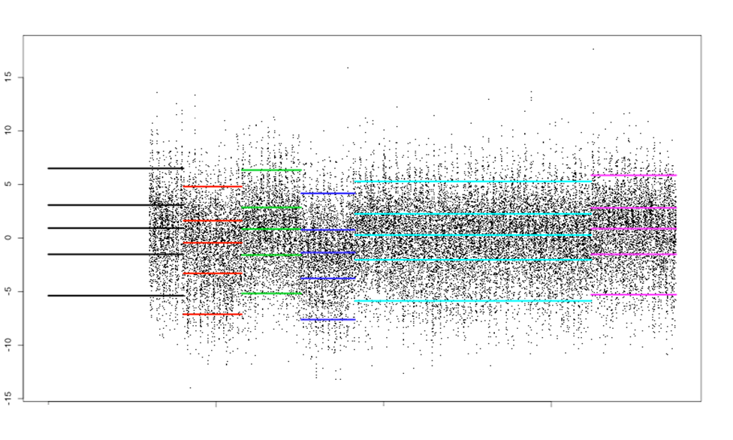
Minimum temperature Salta Aero
p₅
p₂₅
p₅₀
p₇₅
p₉₅
1931
1949
1920
1940
1958
1980
Metadata: Station Relocation in 1931, 1949, 1958
1960
2000
?
?

Slide 5
Traditional approaches
Rely on metadata and/or expertise to identify the breakpoints
(e.g. Craddock et al 1976)
Make strong DGP assumptions
(e.g. Anderson et al.1997, Caussinus and Mestre, 2004)
Use a reference (homogeneous) time series
(e.g. Vincents, 1999; Della-marta and Wanner, 2006)
Some are designed to
detect one type of change in the series (usually a shift)
detect just one breakpoint in the time series
work on univariate time series
Many assume independent observations or group daily data, say monthly, to overcome dependence

Slide 6
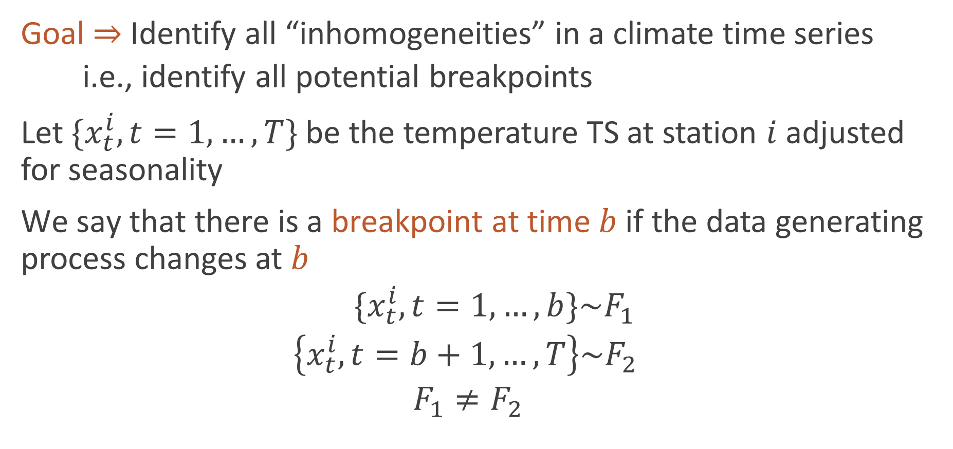
Inhomogeneity definition
Goal ⇒ Identify all “inhomogeneities” in a climate time series
i.e., identify all potential breakpoints
Let $\{x_{t}^{i}, t=1, …,T\}$ be the temperature TS at station $i$ adjusted for seasonality
$\text{We} \text{say} \text{that} \text{there} \text{is} \text{a} \text{breakpoint} \text{at} \text{time} b$if the data generating process changes at $b$
$\{x_{t}^{i}, t=1, …,b\}\sim F_{1}$
$\left\{x_{t}^{i}, t=b+1, …,T\right\}\sim F_{2}$
$$F_{1}≠F_{2}$$

Slide 7
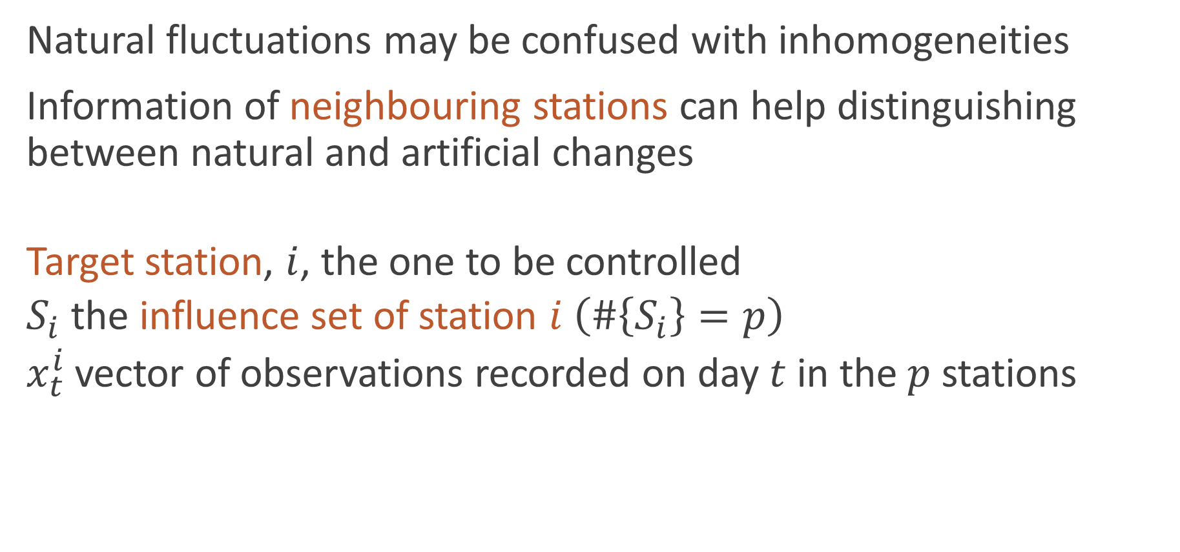
Influence set for a target station
Natural fluctuations may be confused with inhomogeneities
Information of neighbouring stations can help distinguishing between natural and artificial changes
Target station, $i$, the one to be controlled
$S_{i}$ the influence set of station $i$ $\left(\#\left\{S_{i}\right\}=p\right)$
$x_{t}^{i}$vector of observations recorded on day $t$ in the $p$ stations

Slide 8
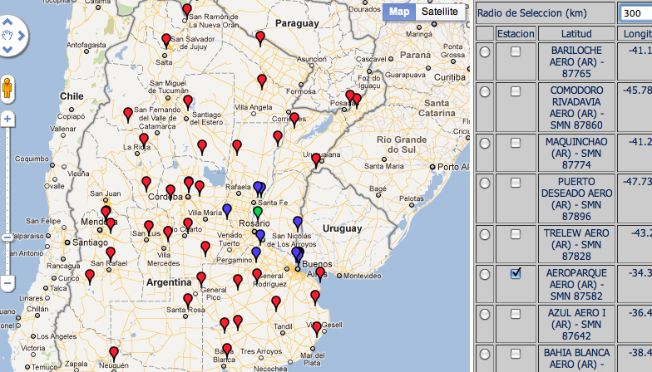
Target station

Slide 9
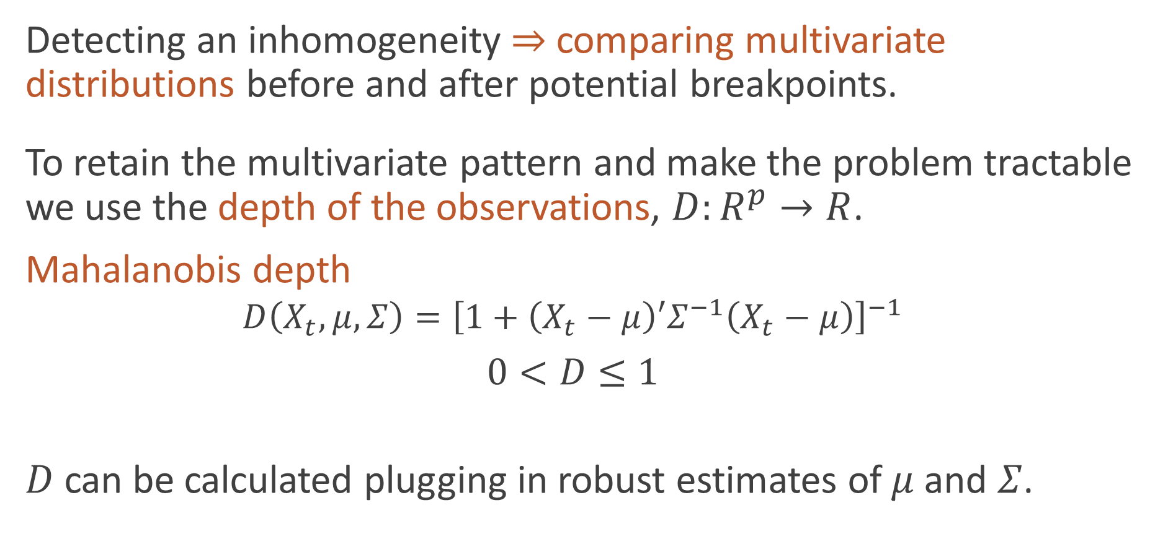
Depth of a multivariate observation
Detecting an inhomogeneity ⇒ comparing multivariate distributions before and after potential breakpoints.
To retain the multivariate pattern and make the problem tractable we use the depth of the observations, $D:R^{p}→R$.
Mahalanobis depth
$$D\left(X_{t},μ, Σ\right)={\left[1+\left(X_{t}−μ\right){′Σ}^{−1}\left(X_{t}−μ\right)\right]}^{−1}$$
$$0<D≤1$$
$D$ can be calculated plugging in robust estimates of $μ$and $Σ$.

Slide 10
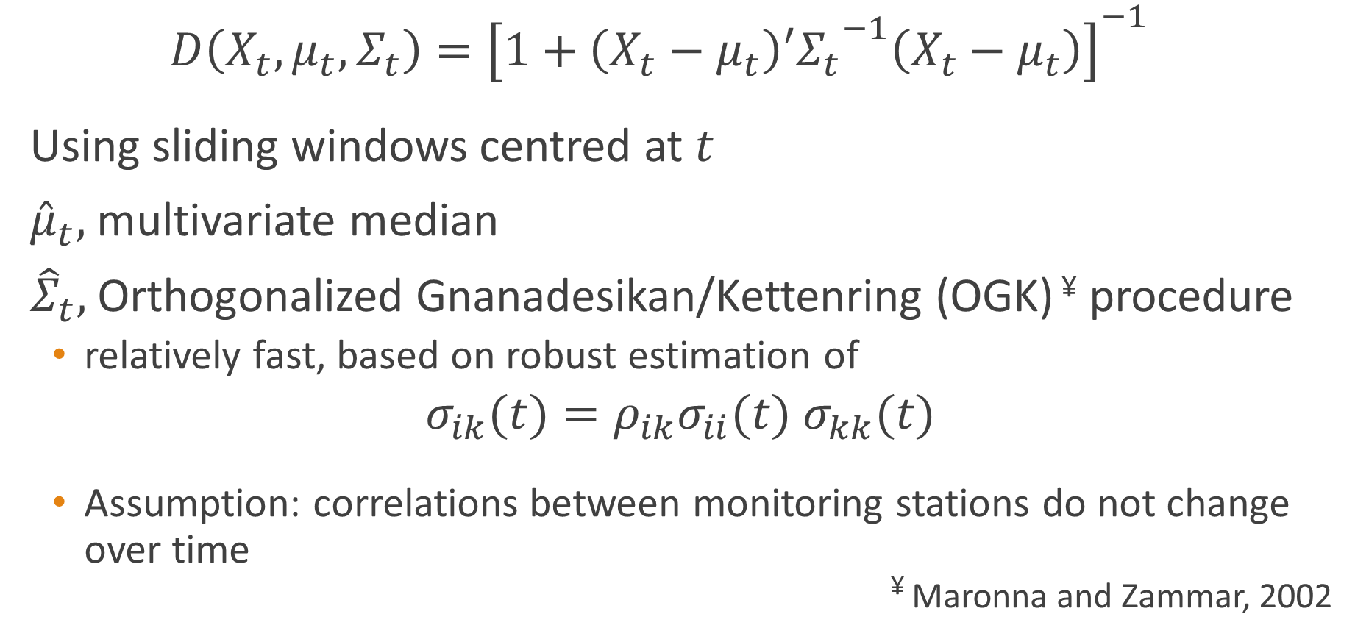

Estimation of $μ_{t}$ and $Σ_{t}$
$$D\left(X_{t}, μ_{t},Σ_{t}\right)={\left[1+\left(X_{t}−μ_{t}\right){′Σ_{t}}^{−1}\left(X_{t}−μ_{t}\right)\right]}^{−1}$$
Using sliding windows centred at $t$
${\hat{μ}}_{t},$ multivariate median
${\hat{Σ}}_{t},$ Orthogonalized Gnanadesikan/Kettenring (OGK) ¥ procedure
relatively fast, based on robust estimation of
$σ_{ik}(t)=ρ_{ik}σ_{ii}(t)$ $σ_{kk}(t)$
Assumption: correlations between monitoring stations do not change over time
¥ Maronna and Zammar, 2002

Slide 11
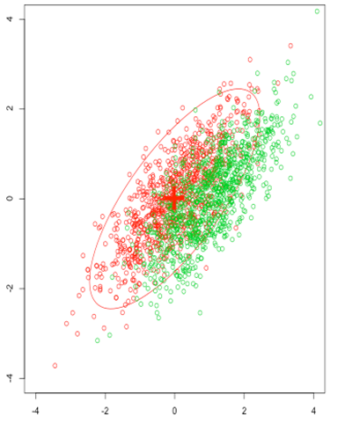
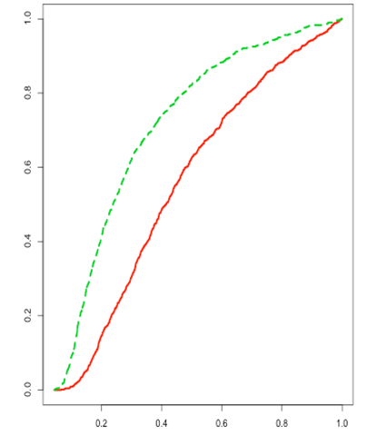




Distribution of depths (shift at $t=n$)
$$\{x_{t}^{i}, t=1, …,n\}$$
$$\{x_{t}^{i}, t=n+1, …,n+m\}$$

Slide 12
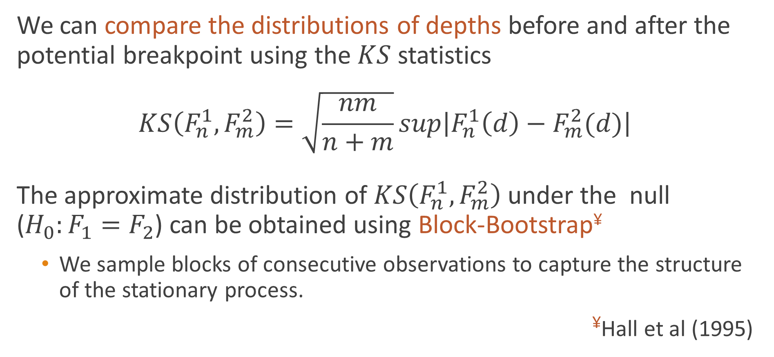
The standardized Kolmogorov-Smirnov statistic
We can compare the distributions of depths before and after the potential breakpoint using the $KS$ statistics
$$KS\left(F_{n}^{1},F_{m}^{2}\right)=\sqrt{\frac{nm}{n+m}}sup\left|F_{n}^{1}\left(d\right)−F_{m}^{2}(d)\right|$$
The approximate distribution of $KS\left(F_{n}^{1},F_{m}^{2}\right)$ under the null ($H_{0}:F_{1}=F_{2}$) can be obtained using Block-Bootstrap¥
We sample blocks of consecutive observations to capture the structure of the stationary process.
¥Hall et al (1995)

Slide 13
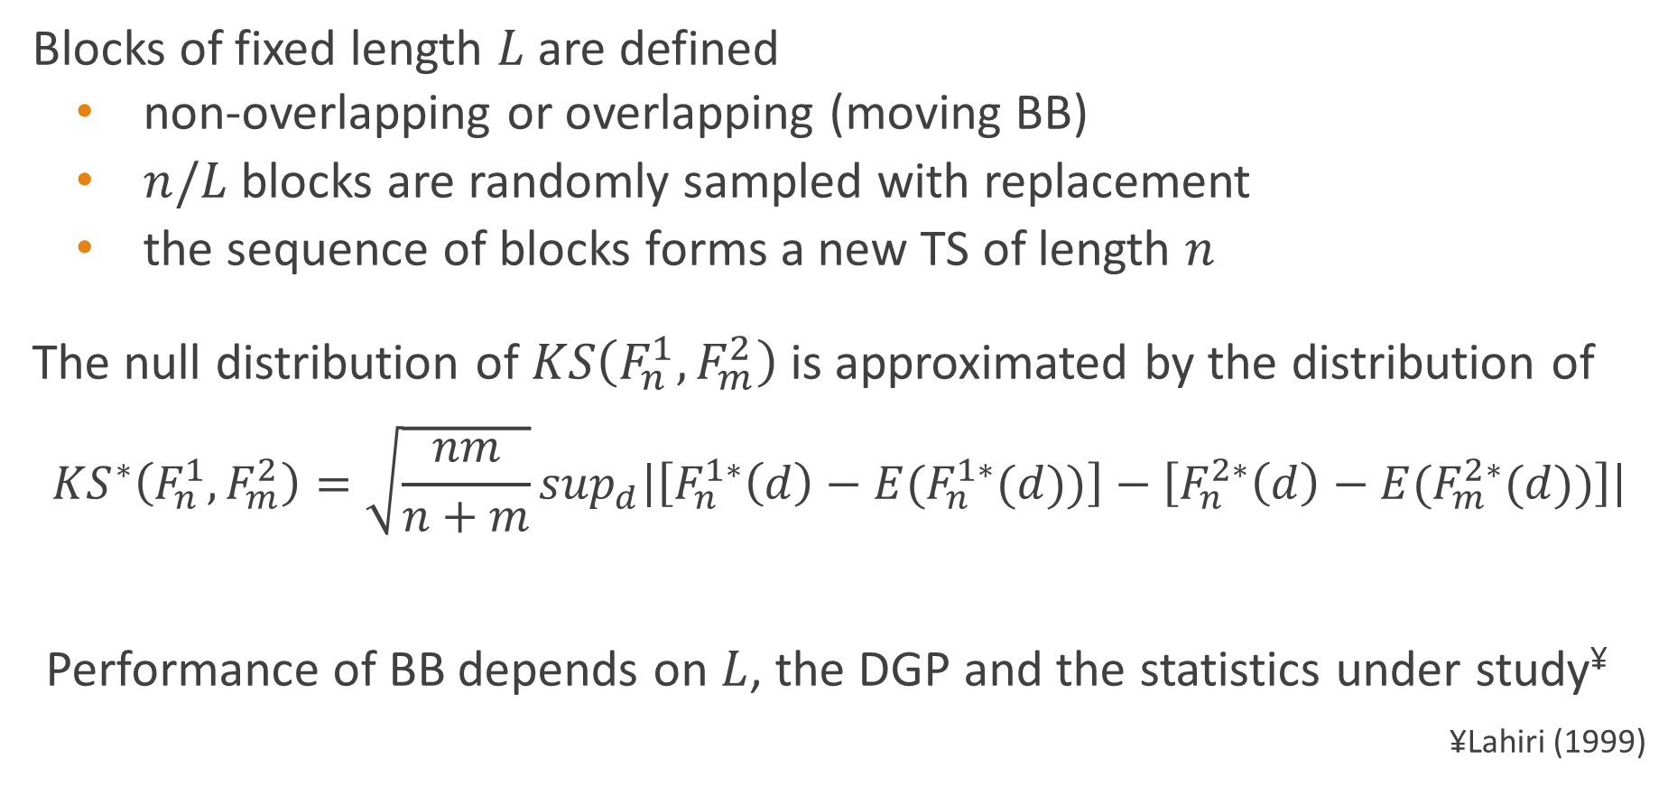
Block Bootstrap
Blocks of fixed length $L$ are defined
non-overlapping or overlapping (moving BB)
$n/L$ blocks are randomly sampled with replacement
the sequence of blocks forms a new TS of length $n$
The null distribution of $KS\left(F_{n}^{1},F_{m}^{2}\right)$ is approximated by the distribution of
$${KS}^{∗}\left(F_{n}^{1},F_{m}^{2}\right)=\sqrt{\frac{nm}{n+m}}\sup_{d}\left|\left[F_{n}^{1∗}\left(d\right)−{E(F}_{n}^{1∗}(d))\right]−\left[F_{n}^{2∗}\left(d\right)−{E(F}_{m}^{2∗}(d))\right]\right|$$
Performance of BB depends on $L$, the DGP and the statistics under study¥
^{¥Lahiri (1999)}

Slide 14
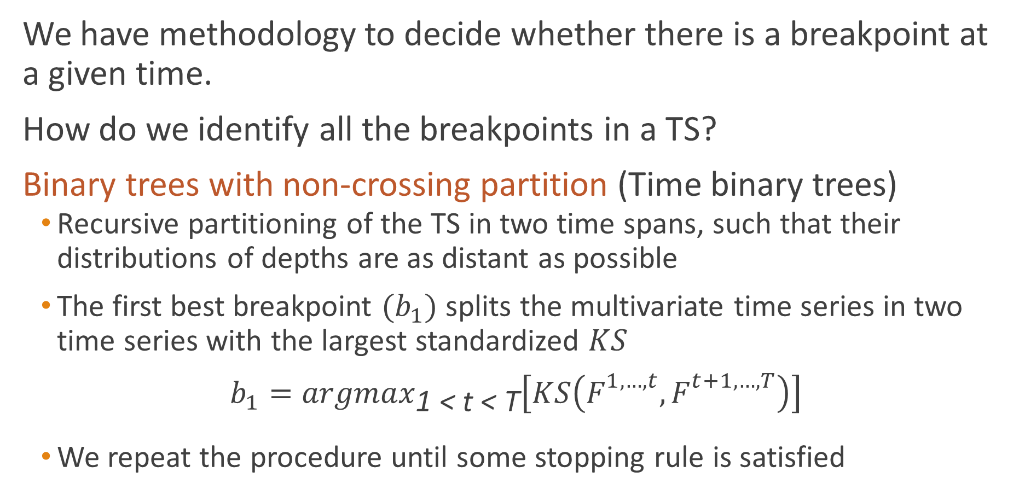
Multiple breakpoints – Binary trees
We have methodology to decide whether there is a breakpoint at a given time.
How do we identify all the breakpoints in a TS?
Binary trees with non-crossing partition (Time binary trees)
Recursive partitioning of the TS in two time spans, such that their distributions of depths are as distant as possible
The first best breakpoint $(b_{1})$splits the multivariate time series in two time series with the largest standardized $KS$
$$b_{1}={argmax}_{\text{1 }\text{<} \text{t}\text{ < }\text{T}}\left[KS\left(F_{}^{1,…,t},F_{}^{t+1,…,T}\right)\right]$$
We repeat the procedure until some stopping rule is satisfied

Slide 15
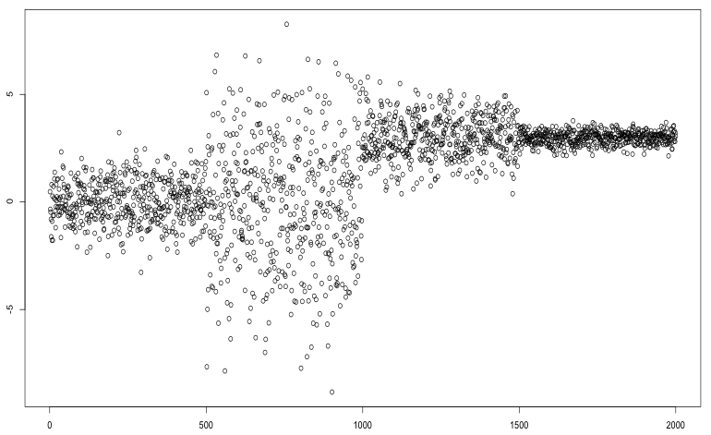
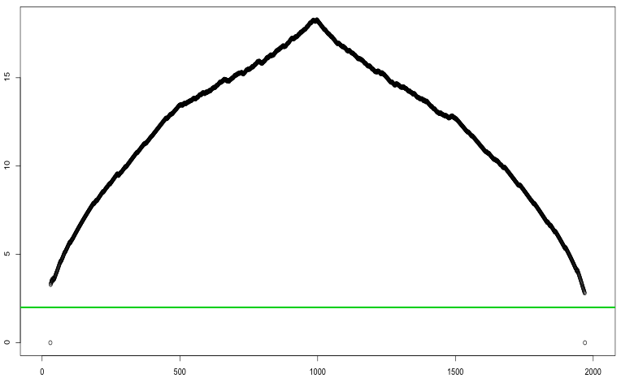
Growing the tree. First step

Slide 16
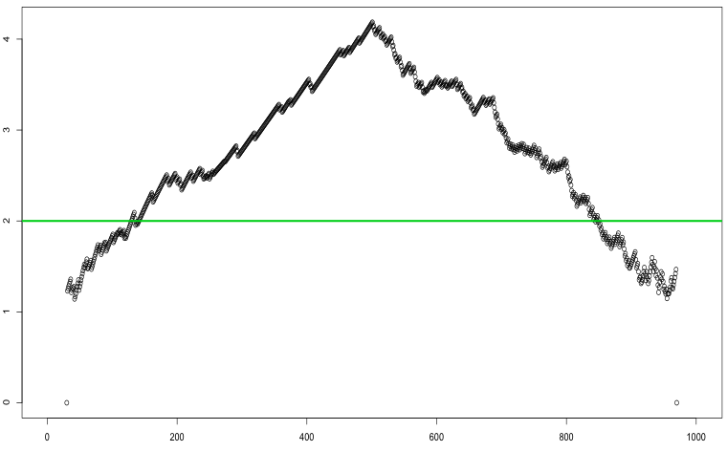
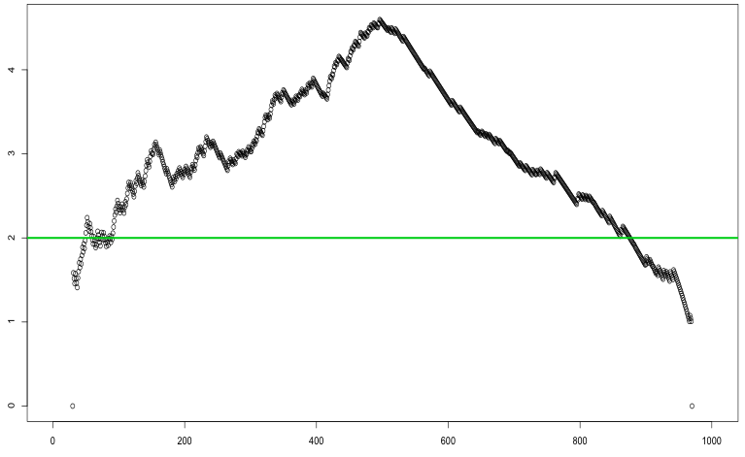
Growing the tree. Second step

Slide 17
The finest partition (saturated tree)
7 breakpoints
8 segments

Slide 18
Pruning of the tree
3 breakpoints
4 segments

Slide 19
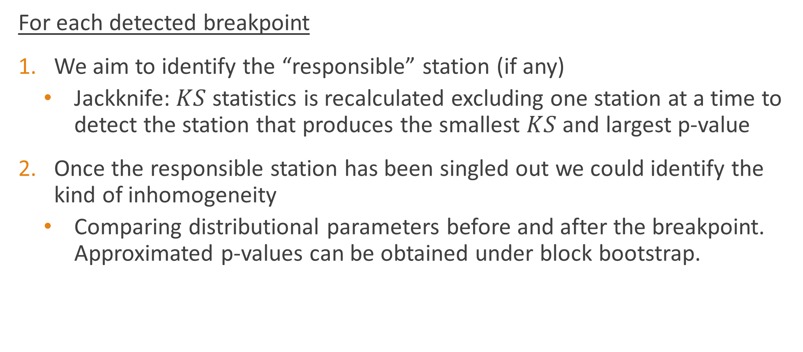
Final step
For each detected breakpoint
We aim to identify the “responsible” station (if any)
Jackknife: $KS$ statistics is recalculated excluding one station at a time to detect the station that produces the smallest $KS$and largest p-value
Once the responsible station has been singled out we could identify the kind of inhomogeneity
Comparing distributional parameters before and after the breakpoint. Approximated p-values can be obtained under block bootstrap.

Slide 20
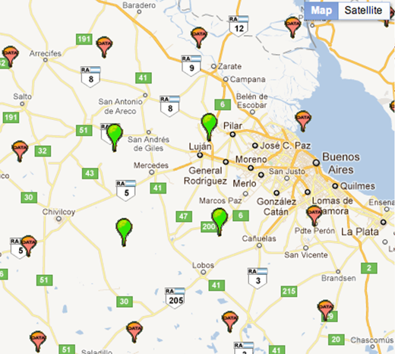
Regional Model Simulated Data*
Four time series of daily minimum temperature, Argentina were generated
Time span: 1981 to 2100 (120 years = 43929 days)
We introduced 4 inhomogeneities
Grid point 1, day 8,000, mean shift = + 0.5 °C
Grid point 2, day 16,000, mean shift = - 0.5 °C
Grid point 3, day 24,000, mean shift = + 0.5 °C
Grid point 4, day 30,000, mean shift = - 0.5 °C
*Rossby Center Regional Climate model (Swedish Meteorological and Hydrological Institute) simulates the main atmospheric variables for the South American region on a daily basis

Slide 21
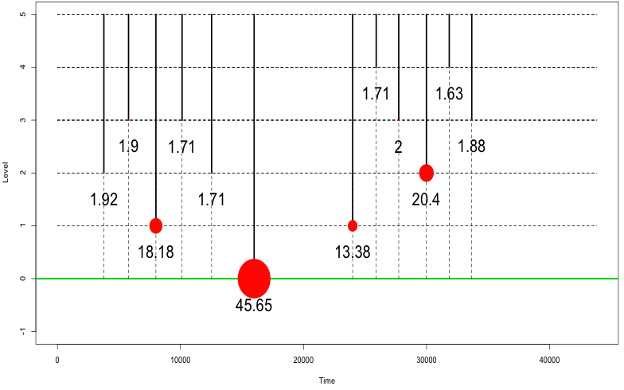
Growing the tree

Slide 22
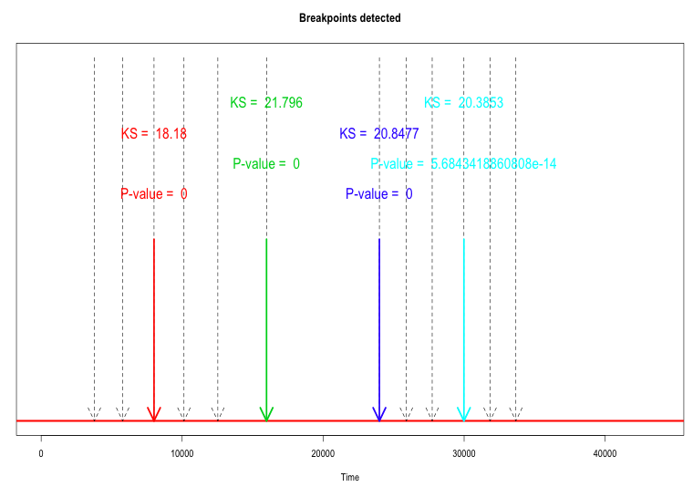
Detected breakpoints

Slide 23
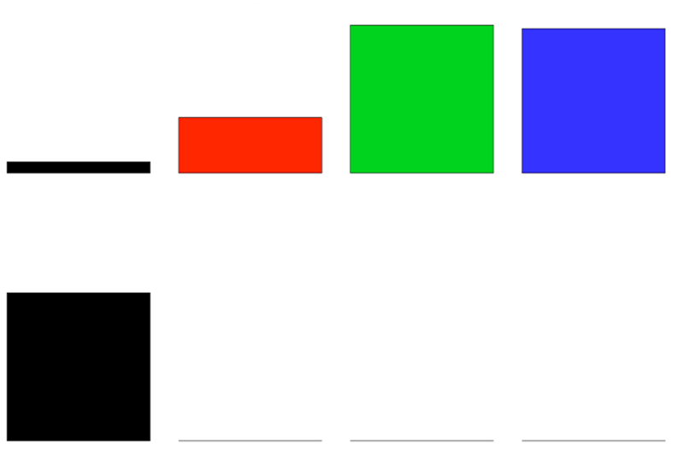
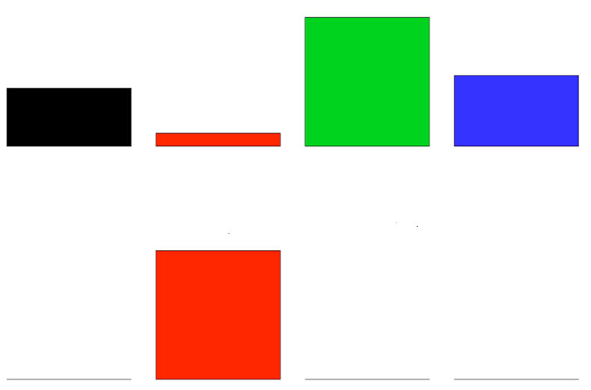



Identifying the responsible station
$t=$8005 $t=\text{15985}$ $t=\text{23990}$ $t=$ 29985
$KS$
P-value
1 2 3 4 1 2 3 4 1 2 3 4 1 2 3 4

Slide 24
Performance of the methods
Multivariate time series were generated from regional climate models under different scenarios
Number of stations in the influence set and distances between them
Kind and magnitude of changes in distributions
5 breakpoints at random locations (separated at least 5 years), i.e., 6 different regimes were artificially created, mean expected duration 20 years.
Procedure is repeated 20 times to allow for 100 breakpoints to be detected in the same conditions
Performance of the method was evaluated using AUC (ROC curves)
Performance increases with information (# stations, closeness of stations) and size/length of the change.

Slide 25
Conclusions
We have developed a methodology that
Is automated, does not require expert knowledge input
Uses information from multiple stations simultaneously
Detects several breakpoints per station
Evaluates the significance of the breakpoint
Identifies the kind of change/inhomogeneity (mean, variance, etc.)
Makes no distributional assumptions
Accounts for dependence in the climatic data
Is based on robust estimators
Codes developed in R

Slide 26
Remarks
The methodology can be used with for any continuous variable like atmospheric pressure, humidity or heliophany.
Detecting breakpoints in precipitation TS requires an adaptation
precipitation is less spatially -and temporally- smooth than temperature
precipitation data encloses two pieces of information, whether the event rain had occurred (rain yes/no) and given that it occurred, its intensity

Slide 27
Thank you!

