Slide 1
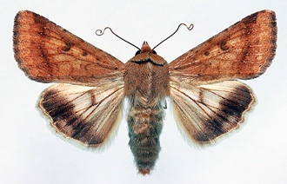
Estimating relative species abundance from partially-observed data
Melissa Dobbie| Statistician
November 2015

Slide 2
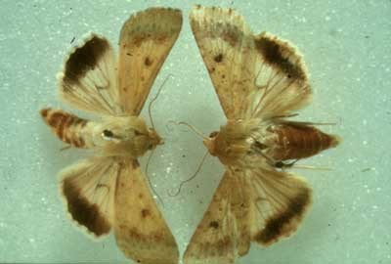
Context
Helicoverpa – a serious pest of grain legumes, summer grains and cotton
2 species:
Helicoverpa punctigera (Hp; Australian bollworm)
H. armigera (Ha; cotton bollworm)
Historically controlled by insecticides => resistance + reductions in beneficial populations => allow other pests with fast life cycles to develop to damaging levels.
Bacillus thuringiensis (Bt) expressing cotton introduced in 1996 to help control these pests => big uptake by growers
Most research limited to field level
Objective: determine how the configuration and composition of landscape influences Helicoverpa population dynamics
Source: Cotton CRC website
Notes:
The context motivated the solution but more general context evident.
Secondary Objective – does landscape composition and configuration contribute to reduced pest pressure and more effective resistance management

Slide 3
Study design
Notes:
This slide gives details of the design but also helps to convey that it was an extensive study with a relatively huge amount of data generated
Helicoverpa spp. Eggs
only developmental stage that survive in Bt cotton
less likely to be affected by insecticides used for other cotton pest
remain as eggs for approx 3 days throughout summer => provide a discrete developmental stage to quantify
Collected = counted?
Speciation can not be done in situ
Requires time, patience, equipment, lab space, etc. = MONEY

Slide 4
Data generation: 2 stages
Total unclassified counts of eggs for both target species are recorded
Observed species proportions for a subset of the counted eggs are recorded (e.g. collected eggs are hatched and specimens classified)
Assumption:
all eggs observed are exclusively classified into species of interest

Slide 5
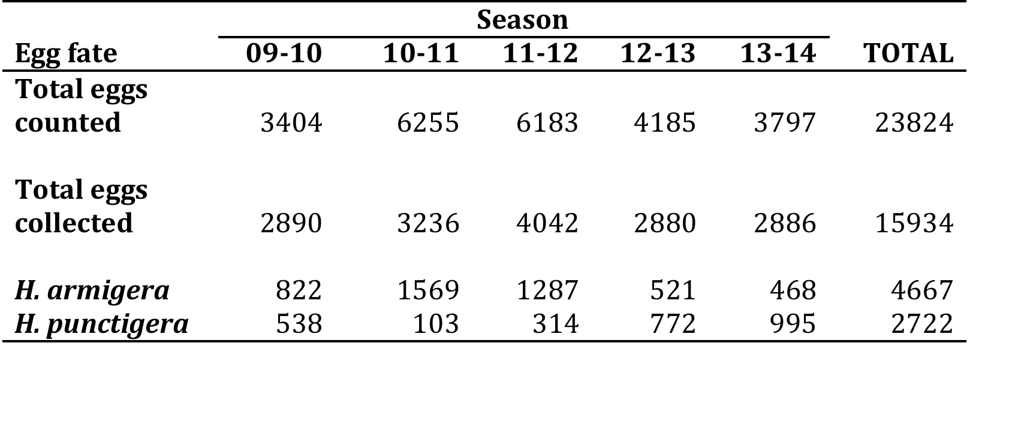
Data summary
Notes:
Point out Stage 1 data collection (first row) and Stage 2 data collection (subsequent rows)

Slide 6
Exploratory data analysis (2)

Slide 7
Exploratory data analysis (3)

Slide 8
Methods – Naïve approach
Using the observed species proportions, partition the total unclassified count into relative species abundances.
Develop appropriate models for the relative abundance of each species
BUT ………….
Fails to take into account small sample discreteness
Occurrence of zero observations a problem
Errors associated with observed proportions ignored

Slide 9
Methods – Proposed approach
Model the observed species proportions
a) Using the resulting predicted proportions, partition the total unclassified count into relative species abundances. b) Develop appropriate models for the relative abundance of each species
PROS ………….
Covariates can be incorporated into each part of the model
Better preserves the handling of small sample discreteness and small abundances
Standard software and model fitting tools are readily available

Slide 10
Methods –Step 1
Model observed species proportions
Aim: Empirical model – to smooth and interpolate the observed proportions by using the covariate space. Interpretation not of interest.
Use logistic mixed effects model framework with
Fixed effects: Land use, Crop development, Moon phase, etc.
Stepwise model selection on logistic regression model to reduce number of potential candidate predictors
Random effects: mixture of spatial, temporal and spatial-temporal effects, guided by the hierarchical study design

Slide 11
Methods –Step 2
Model relative species abundance
Aim:
Predictive model – quantify the effect of landscape composition and configuration and other drivers on species abundance
Use standard software and existing model fitting tools
Use linear mixed effects model framework with
Response (1 species): log(fitted proportion * total count + 0.5)
Fixed effects: Land use, Crop development, Moon phase, etc.
RandomForest modelling used to identify important variables
Random effects: mixture of spatial, temporal and spatial-temporal effects, guided by the hierarchical study design
Notes:
Why RF models? Distribution free (nonparametric), collinearity and dependence not a problem, handles many predictors of different types, etc.

Slide 12
Results: Ha relative abundance
Notes:
the interaction between the percentage of Bt cotton within 2 km of each field and landscapes is plotted along with the 95% bootstrapped confidence bands (calculated from the bootstrapped percentiles in Table 3). We see that all intercepts are fairly similar (that is when there is no Bt cotton planted within a 2 km radius, Ha egg abundance is fairly consistent across landscapes ranging from 3 [1,7] eggs in Cecil Plains to 5 [2,9] eggs in Nandi), but with increasing percentage of Bt cotton at the 2 km scale, abundance of Ha eggs increases with the greatest increase occurring in Pampas fields. On average, abundance increases by seven-fold in Pampas fields when Bt cotton increases from 0% to 60%, whereas at Nandi, abundance only increases by just over one-fold for the same increase in Bt cotton.

Slide 13
Results: Hp relative abundance
Notes:
we plot the effect that cotton development has on Hp egg abundance for three representative values of the percentage of fallow fields within a 1 km radius of each surveyed field, namely the minimum observed (0%), the median observed (7.5%) and the maximum observed value (78%). The main message from this model is that Hp egg abundance decreases with increase in cotton development. On the other hand Hp egg abundance increases with an increase in the percentage of fallow ground within a 1 km radius of a field, however this effect appears to be subtle so may have questionable practical importance.

Slide 14
Discussion
Our approach was modest improvement on naïve approach
Simpler modelling approach : model observed species abundance?
limited inference and generalization (collected eggs capped and dependent on eggs counted - both varied between sampling units and within and between seasons)
inferences about covariates meaningful?
More sophisticated and unified modelling approach : jointly model both stages of data generation?
Computationally challenging to fit
Bespoke programming would be required

Slide 15
Discussion
These types of data commonly occur in studies where immature life stages of a species are of interest, but taxonomic resolution is not clear or directly identifiable until after further processing. Two examples of such studies arise
In botany, where seeds are the observation unit but speciation necessarily occurs at a later stage, and
In entomology, where species abundance is the primary focus but unclassified egg samples form the observation unit.
Acknowledgements
Bill Venables (CSIRO Data61), Cate Paull (CSIRO Agriculture), Nancy Schellhorn (CSIRO Agriculture)

Slide 16
Thank you
Analytics group
Melissa Dobbie Statistician
t +61 7 3833 5530
e melissa.dobbie@csiro.au
w www.data61.csiro.au

