Slide 1
An experimental design for testing Bycatch Reduction and Turtle Exclusion Devices in the PNG Prawn Trawl Fishery
Emma Lawrence and Bill Venables
December 2015

Slide 2
Introduction
Experimental design literature:
highly balanced and efficient designs,
using combinatorial theory
Sometimes difficult to achieve symmetry in design due to logistical constraints
Standard methods for constructing designs may need to be radically adapted.

Slide 3
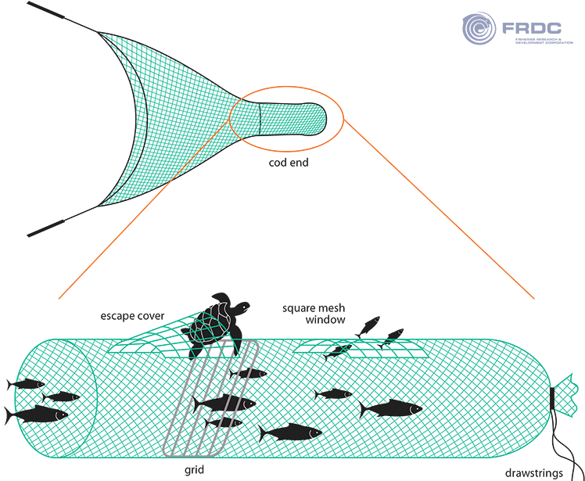

Slide 4
TED and BRD experimental design
Brief: Assess the relative effectiveness of 27 combinations of Turtle Excluder Devices (TEDs) and Bycatch Reduction Devices (BRDs) with a control net (neither device) in the PNG Prawn Trawl Fishery
Lead-in : Work in getting it down to 27 (all combinations of TED type (including none), with BRD type (including none))
Logistical constraints:
4 vessels with quad gear (4 nets – we think!!!)
18 consecutive sea days (at best – was 16)
Only one copy of each treatment net available
The vessels could be quite different
Vessels can only exchange nets ‘at sea’ 3-4 times
Net changes permitted once per day (6 shots a day)

Slide 5
Beginning the design phase
How do I get myself into these things……
Read some papers about TED and BRD trials from the past
Learnt a bit more about the PNG prawn trawl fishery
Added a new constraint – control net on all shots
Talk to Bill
Not convinced about the control net on every shot
We could try simulated annealing (or a variant)

Slide 6
Design stages
Design goals:
􏰀 Each treatment net should be used – at least once by each vessel
􏰀 Each treatment net should be used 8 times (4×3×18 = 27×8).
􏰀 As many pairs of treatment nets as possible should occur together on the same boat-day.
Stages:
􏰀Allocate nets to vessels for 4 shifts (days 1-5, 6-9, 10-14, 15-18).
Assign nets within shifts to trawling days, per vessel,
Assign the control net to a quad positions for each trawl day, for each vessel,
Assign the treatment nets to be used to their quad positions for each trawl day, for each vessel.

Slide 7
Assignment of treatment nets to vessels
 | Vessel 1 | Vessel 2 | Vessel 3 | Vessel 4
Shift 1 | 7 | 7 | 7 | 6
Shift 2 | 7 | 7 | 6 | 7
Shift 3 | 7 | 6 | 7 | 7
Shift 4 | 6 | 7 | 7 | 7
The nets were assigned to the vessels in the first shift in the natural order: N01,. . . ,N07 to Vessel 1, N08,. . . ,N14 to Vessel 2, N15,. . . ,N21 to Vessel 3 and finally N22,. . . ,N27 to Vessel 4. This assignment is kept constant.
􏰀For Shifts 2, 3 and 4, the nets are initially assigned at random to the four Vessels
􏰀Nets are swapped at random between vessels. After each swap an objective function is calculated that has a minimum of 0, only if there are:
– No nets in common between Shifts of the same Vessel, and – The number of nets in common between a Shift on one Vessel and another Shift on a different Vessel is either 2 or 3.

Slide 8
Assignment of treatment nets to vessels
If the swap has lowered the objective function the swap is kept.
􏰀If the swap has either increased the objective, or left it unchanged, the swap may be kept, with a stochastic choice made according to a simulated annealing protocol.
􏰀Stop when a large number of swaps in succession have not been accepted or the objective function is 0
􏰀Allocation of nets meeting the criteria in 3 runs

Slide 10
How well did we do?

Slide 11
Assignment of nets to Days
Four different types of session:
– 7 nets over 5 days, – 7 nets over 4 days, – 6 nets over 5 days,
– 6 nets over 4 days
􏰀 First we select optimal templates for assigning nets to boat-days
􏰀 Then we allocate the nets to the template positions to balance the design.

Slide 13
Assignment of nets to templates
Now have generic plan for assigning treatment nets to 3 available positions each day
In 3 of 4 templates we have unequal replication
Adjust the overall design to achieve balance
The experiment runs for 18 days, with 4 vessels and 3 quad positions available for treatment nets each days. Hence the total number of quad positions available for treatment nets is 18 × 4 × 3 = 216.
Since there are 27 treatment nets, equal replication over the experiment would require each to be replicated 216/27 = 8 times.

Slide 14
Assignment of nets to templates
In this step there are again two criteria we want to satisfy:
Over the entire experiment, each treatment net should be used 8 times (if possible) [Replication]
Over the entire experiment, as many pairwise combinations of treatment nets as possible should occur together within boat days [Concurrency]
Using a similar method to the allocation of nets to vessels
An objective function is calculated (combines the replication and concurrency criteria)
Swap random pair of treatment nets in a session and re-calculate objective function
Keep if objective function reduced and otherwise accept stochastically, according to a suitable simulated annealing rule.

Slide 15
Assignment of control nets to quad position

Slide 16
Treatment nets to quad position
Each treatment net appears 8 times
Desirable to be in each quad position twice
Instead opted for 4 x inside net and 4 x outside net
Similar allocation process used previously where objective function minimum was achieved when each net was ‘inside’ 4 times and ‘outside’ 4 times.
Process converged quickly and we were able to achieve perfect balance wrt quad position

Slide 18
Final design properties
The control nets occupy each quad position an equal number of times,
The treatment nets are equally replicated throughout the experiment, each being used 8 times,
Each treatment net is used 4 times in an outside position of the quad and 4 times in an inside position
As many pairs of distinct treatment nets as possible have been placed together within a boat-day quad configuration.

Slide 19
Field work
How did they go?:
Lost the first 5 days (but subsequently made up)
2 x codends tied on backwards for an entire day
1 x breakdown resulting in fewer than usual replications on 2 days
Huge variation in catches (depending on location)
Despite these (fairly minor) set-backs:
Initial data records look good!
All nets used on all boats (correctly) at least one (I think!)
Net changing between vessels worked well (even at night)
Largest experiment of its type ever and will hopefully be useful for Australian Northern Prawn Fishery

