Slide 1
Do left-handed people die young?
Martin Bland
Department of Health Sciences
University of York
With thanks to Douglas Altman and
John Aggleton

Slide 2
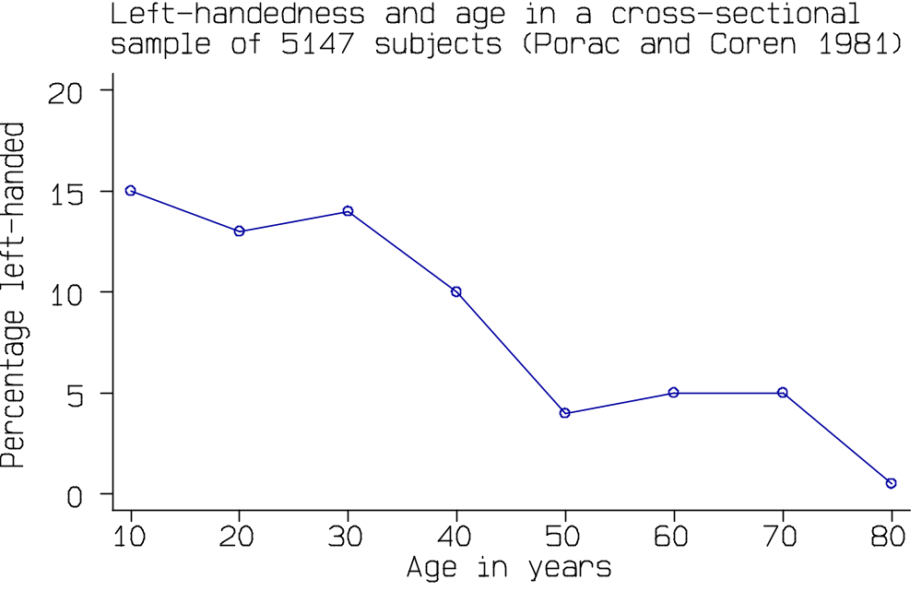
Left-handedness is related to age.

Slide 3
Left-handedness is related to age.
Theories:
• modification: left-handed people learn to be right-
handed as they age
• elimination: left-handed people die young
• cohort effect: older people were encouraged to be
right-handed

Slide 4
Baseball players
(Halpern and Coren 1988)
All baseball players listed in The Baseball Encyclopedia for whom dates of birth and death as well as throwing and batting hand were reported.

Slide 5
Baseball players
(Halpern and Coren 1988)
All baseball players listed in The Baseball Encyclopedia for whom dates of birth and death as well as throwing and batting hand were reported.
Lifetime (years)
n mean s.d.
Right-handed 1472 64.64 15.5
Left-handed 236 63.97 15.4

Slide 6
Lifetime (years)
n mean s.d.
Right-handed 1472 64.64 15.5
Left-handed 236 63.97 15.4
“This difference is difficult to interpret as the range is so large and the distribution is skewed. However, a non-parametric test of the group differences (Wald-Wolfowitz runs test) indicated that the greater longevity for right-handers is significant (z=6.63, P<0.001).”

Slide 7
Lifetime (years)
n mean s.d.
Right-handed 1472 64.64 15.5
Left-handed 236 63.97 15.4
“This difference is difficult to interpret as the range is so large and the distribution is skewed. However, a non-parametric test of the group differences (Wald-Wolfowitz runs test) indicated that the greater longevity for right-handers is significant (z=6.63, P<0.001).”
Large sample comparison of means test z=0.62, P=0.5.

Slide 8
In cohorts born many years ago, there will be deaths at old ages and the mean age at death will be high. In cohorts born more recently, only young deaths have occurred and so the mean age at death will be low. It may be that the earlier cohorts contained fewer left-handers than later ones. This would mean that dead left-handers would contain a greater proportion of deaths from later-born cohorts than would the dead right-handers, and so would have a lower mean lifespan.
An actuarial survival analysis within birth cohorts, which would include those still alive, would be more informative.
Bland (unpublished).

Slide 9
What Nature published:
June 1988: three letters, two pointing out that in the past left-handed people were forced to be right handed. No explanation as to why this might produce the observed effect was published.
September 1988: Wood analysed a larger set of baseball data, deaths only, using a Kolmogorov-Smirnov two sample test to get P=0.54.
September 1989: Anderson analysed a larger set of baseball data, deaths only. He used regression of difference between the proportions of right-handers and left-handers among the deaths, on birth year. He concluded that right-handers born before 1890 had an advantage, thereafter left-handers had an advantage.

Slide 10
Recently deceased subjects
(Halpern and Coren 1991)
2875 death certificates in two counties in California. Questionnaires on handedness to next of kin, giving 987 usable cases.
Mean lifetime (years)
Right-handed 75.00
Left-handed 66.03
Anova controlling for sex:
F_{1,945}=22.36, P<0.0001
Compare a difference of 6 years between women and men.
Also reported that significantly more left-handers die in accidents, relative risk = 5.7.

Slide 11
The observed difference of nine years is in marked contrast to the eight months difference observed for the baseball data. The recent deaths study has the same bias, but to a much greater extent.

Slide 12
The observed difference of nine years is in marked contrast to the eight months difference observed for the baseball data. The recent deaths study has the same bias, but to a much greater extent. In the baseball study, young deaths are recorded among those born recently and among those born long ago, whereas old deaths are only observed among those born long ago. Thus we would expect old deaths to contain fewer left-handers if the prevalence of left-handedness had increased over time.

Slide 13
The observed difference of nine years is in marked contrast to the eight months difference observed for the baseball data. The recent deaths study has the same bias, but to a much greater extent. In the baseball study, young deaths are recorded among those born recently and among those born long ago, whereas old deaths are only observed among those born long ago. Thus we would expect old deaths to contain fewer left-handers if the prevalence of left-handedness had increased over time. In the new study, deaths were very close in time, so young deaths are recorded only among those born recently.

Slide 14
The observed difference of nine years is in marked contrast to the eight months difference observed for the baseball data. The recent deaths study has the same bias, but to a much greater extent. In the baseball study, young deaths are recorded among those born recently and among those born long ago, whereas old deaths are only observed among those born long ago. Thus we would expect old deaths to contain fewer left-handers if the prevalence of left-handedness had increased over time. In the new study, deaths were very close in time, so young deaths are recorded only among those born recently. This might be expected to increase the observed difference in the proportion of left-handers between young and old deaths, which would increase the apparent difference in mean lifespan between left- and right-handers.

Slide 15
The observed difference of nine years is in marked contrast to the eight months difference observed for the baseball data. The recent deaths study has the same bias, but to a much greater extent. In the baseball study, young deaths are recorded among those born recently and among those born long ago, whereas old deaths are only observed among those born long ago. Thus we would expect old deaths to contain fewer left-handers if the prevalence of left-handedness had increased over time. In the new study, deaths were very close in time, so young deaths are recorded only among those born recently. This might be expected to increase the observed difference in the proportion of left-handers between young and old deaths, which would increase the apparent difference in mean lifespan between left- and right-handers.
(Altman and Bland, unpublished).

Slide 16
The New England Journal of Medicine published six letters, including:
Two letters which pointed out the birth cohort effect (Rothman, Strang)

Slide 17
The New England Journal of Medicine published six letters, including:
Two letters which pointed out the birth cohort effect (Rothman, Strang)
An analysis of a subset (n=2362) of the National Health Examination Follow-up Study using Cox regression. Marks and Williamson reported a 30% reduction in mortality for left-handers (RR=0.68, 95% c.i. 0.48 to 0.98).

Slide 18
The New England Journal of Medicine published six letters, including:
Two letters which pointed out the birth cohort effect (Rothman, Strang)
An analysis of a subset (n=2362) of the National Health Examination Follow-up Study using Cox regression. Marks and Williamson reported a 30% reduction in mortality for left-handers (RR=0.68, 95% c.i. 0.48 to 0.98).
An analysis of the Framingham cohort (n=1477) using Cox regression. Wolf, D'Agostino and Cobb reported no significant difference.

Slide 19
A British study could use cricketers!
The Complete Who's Who of Test Cricketers
The Association of Cricket Statisticians

Slide 20
The Independent newspaper, 13 February 1993:
Left-handed bowlers likely to die younger
A study of several thousand first class cricketers has found that left-handed bowlers are more likely to die younger than their right-handed colleagues.
. . . Psychologists at Durham University analysed the lifespans of about 3000 bowlers listed in the Who's Who of Cricketers, which describes first-class players from 1864 to 1983. They found that left-handed bowlers had an average lifespan of 63.5 years, compared with 65.5 years for their right-handed colleagues.

Slide 21
. . . John Aggleton, a senior lecturer in psychology at Durham, said the results were “highly significant” and could not have been due to chance alone. “Left-handers are more likely to die prematurely or accidentally,” he said. “There is definitely something going on.”

Slide 22
Analysis of the cricket data
The data set consists of 6172 observations and the following variables:
• whether left-handed
• year of birth (up to 1960)
• life-span or life-time up to 1992
• whether dead
• cause of death: natural causes, in an accident, or killed
in action
Exclusions: year of birth before 1840 (very few)
This gave 5960 subjects of whom 2573 were still alive and 3387 were dead.

Slide 23
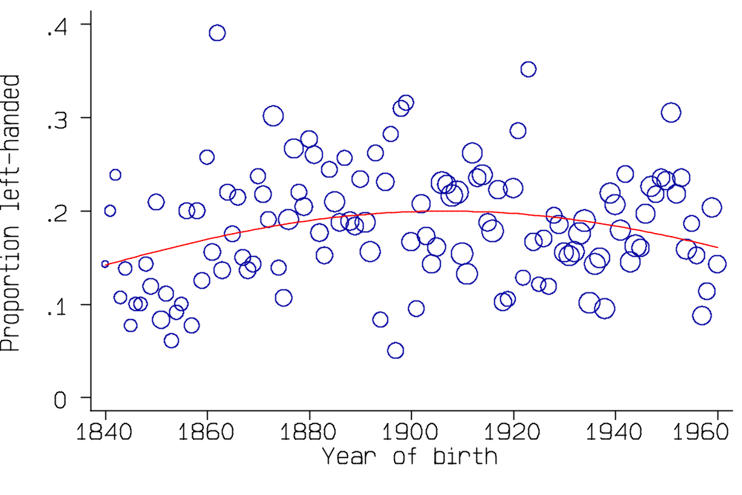
The figure shows the proportion left-handed for each birth year from 1840 to 1960. The circle is proportional to the number of players born in that year.

Slide 24
There appears to be a non-linear relationship (quadratic logistic regression P=0.02).
Note the high proportion of left-handers. General population estimate 6% to 8%.

Slide 25
Total mortality and left-handedness
Cox regression of lifetime on left-handedness, controlling for year of birth:
Hazard 95% Confidence
ratio interval
left-handed 1.05 P=0.3 0.96 to 1.14
year of birth 0.978 P<0.001 0.976 to 0.980
(year-1900)² 0.9998 P<0.001 0.9997 to 0.9998
Cox regression of lifetime on left-handedness, controlling for year of birth, shows no significant relationship (P=0.3).

Slide 26
Accidental deaths
If we restrict our attention to deaths in accidents, regarding all other deaths as censored observations, Cox regression of lifetime on left-handedness, controlling for year of birth, shows a significant relationship (P=0.03).
The risk of death increases for left-handed subjects, the hazard ratio being 1.45 (95% c.i. 1.04 to 2.01).

Slide 27
Killed in action
If we restrict our attention to those killed in action, regarding all other deaths as censored observations, Cox regression of lifetime on left-handedness, controlling for year of birth, shows a significant relationship (P=0.009).
The risk of death increases for left-handed subjects, the hazard ratio being 1.70 (95% c.i. 1.14 to 2.51).

Slide 28
As most of the deaths in action occurred in a few years, these cricketers came from a narrow range of birth years.
Most of those killed in action were born between 1880 and 1895 or between 1910 and 1920.
As the surviving subjects are at least 70 years old, no further deaths in action are likely and a cohort analysis can be done.
Killed in action
Yes No Total
n % n %
Right-handed 57 4.9 1096 95.1 1153
Left-handed 26 9.2 257 90.8 283

Slide 29
Killed in action
Yes No Total
n % n %
Right-handed 57 4.9 1096 95.1 1153
Left-handed 26 9.2 257 90.8 283
The lifetime relative risk of being killed in action for left-handed cricketers born in these years was 1.86 (95% c.i. 1.19 to 2.90), compared to the Cox regression estimate 1.70 (95% c.i. 1.14 to 2.51).

Slide 30
Natural causes
If we restrict our attention to deaths in bed, i.e. to non-accidental, non-action deaths, regarding all other deaths as censored observations, Cox regression of lifetime on left-handedness, controlling for year of birth, shows no significant relationship (P=0.6).
The risk of death increases for left-handed subjects, the hazard ratio being 1.02 (95% c.i. 0.94 to 1.12).

Slide 31
Dead cases only
If we look only at the dead cricketers and compare mean life-span, we get a shorter mean life for left-handers, mean difference 1.70 years, P=0.02, 95% c.i. 0.28 to 3.12 years.
Lifetime (years)
n mean s.d.
Right-handed 2755 66.69 16.17
Left-handed 632 64.99 17.35
Large sample comparison of means test z=2.35, P=0.02.

Slide 32
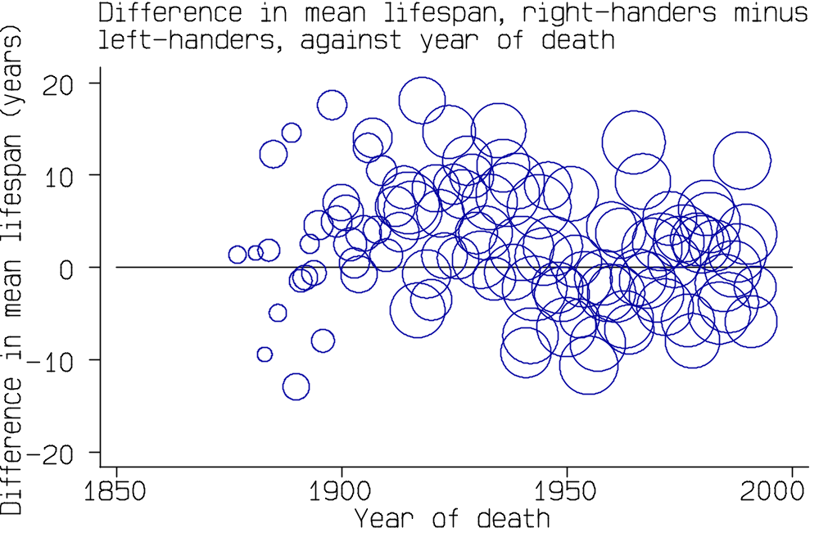
Analysis by year of death
If we look at all deaths in one year, we should have the same analysis as the recent deaths study of Halpern and Coren.
The circle is proportional to the number of deaths in that year.

Slide 33
The difference depends on the year of death.
This could be the result of the changing proportion of left-handed players.

Slide 34
This could be the result of the changing proportion of left-handed players.

Slide 35
Similar to the findings of Anderson (1989) in Nature.
The ‘conclusion’ would depend on the year of analysis. The nine year difference of Halpern and Coren can be replicated among cricketers in some years, in others we get the opposite!

Slide 36
Cricketers who died from natural causes only
If we look only at the dead cricketers and compare mean life-span, we get a shorter mean life for left-handers, mean difference 0.51 years, P = 0.5, 95% c.i. -0.84 to 1.86 years.
Lifetime (years)
n mean s.d.
Right-handed 2615 68.20 14.90
Left-handed 584 67.69 15.03
Large sample comparison of means test z = -0.76, P=0.5.

Slide 37
Suppose we had done this analysis earlier, say 1945:
Lifetime (years)
n mean s.d.
Right-handed 1121 61.07 15.78
Left-handed 231 58.62 16.09
Mean difference 2.45 years, P = 0.03, 95% c.i. 0.17 to 4.72 years.

Slide 38
Suppose we had done this analysis earlier, say 1945:
Lifetime (years)
n mean s.d.
Right-handed 1121 61.07 15.78
Left-handed 231 58.62 16.09
Mean difference 2.45 years, P = 0.03, 95% c.i. 0.17 to 4.72 years.
Now let us use only cricketers born since 1920:
Lifetime (years)
n mean s.d.
Right-handed 100 53.81 10.95
Left-handed 26 55.58 9.66
Mean difference -1.77 years, P = 0.5, 95% c.i. -6.06 to 2.52 years.

Slide 39
Suppose we had done this analysis earlier, say 1945:
Lifetime (years)
n mean s.d.
Right-handed 1121 61.07 15.78
Left-handed 231 58.62 16.09
Mean difference 2.45 years, P = 0.03, 95% c.i. 0.17 to 4.72 years.
Now let us use only cricketers born since 1920:
Lifetime (years)
n mean s.d.
Right-handed 100 53.81 10.95
Left-handed 26 55.58 9.66
Mean difference -1.77 years, P = 0.5, 95% c.i. -6.06 to 2.52 years.
Result depends on the data selection.

Slide 40
Conclusions
There is little evidence for an effect of left-handedness on total mortality. Any effect must be very small. Among cricketers, there is evidence for an effect on accidental and violent death. Once these deaths are removed, there is very little evidence for an effect on other deaths.
Sports stars are not representative of the general population for handedness.
Analysis of deaths only may be very misleading.

Slide 41
Conclusions
There is little evidence for an effect of left-handedness on total mortality. Any effect must be very small. Among cricketers, there is evidence for an effect on accidental and violent death. Once these deaths are removed, there is very little evidence for an effect on other deaths.
Sports stars are not representative of the general population for handedness.
Analysis of deaths only may be very misleading.
A left-hander looking for a long life should avoid the armed services in time of war!

Slide 42
The cricketers study was published:
Aggleton, Bland, Kentridge, Neave. (1994) Handedness and longevity: an archival study of cricketers. British Medical Journal 309, 1681-4.
Despite this, the findings of Halpern and Coren are often quoted in the media.
Similar studies are being reported:
Ellis and Engh (2001) Handedness and age of death: New evidence on a puzzling relationship. Journal of Health Psychology, 5, 555-559.

Slide 43
The cricketers study was published:
Aggleton, Bland, Kentridge, Neave. (1994) Handedness and longevity: an archival study of cricketers. British Medical Journal 309, 1681-4.
Despite this, the findings of Halpern and Coren are often quoted in the media.
Similar studies are being reported:
Ellis and Engh (2001) Handedness and age of death: New evidence on a puzzling relationship. Journal of Health Psychology, 5, 555-559.
I saw a news report of Ellis’s and Engh’s study and wrote to Prof. Ellis, offering to reanalyse his data.

Slide 44
The cricketers study was published:
Aggleton, Bland, Kentridge, Neave. (1994) Handedness and longevity: an archival study of cricketers. British Medical Journal 309, 1681-4.
Despite this, the findings of Halpern and Coren are often quoted in the media.
Similar studies are being reported:
Ellis and Engh (2001) Handedness and age of death: New evidence on a puzzling relationship. Journal of Health Psychology, 5, 555-559.
I saw a news report of Ellis’s and Engh’s study and wrote to Prof. Ellis, offering to reanalyse his data.
I got no reply.

Slide 45
And finally:
It is not only left-handed people who have trouble.
It has also been reported that left-footed lizards and tuataras experience more injuries than their right-footed brethren (Seligmann et al., 2003).
Seligmann H, Beiles A, Werner, YL. (2003) More injuries in left-footed individual lizards and Sphenodon. Journal of Zoology 260, 129-144.

