Slide 1
Personalised medicine: Endovascular aneurysm repair risk assessment model using 8 preoperative variables
Mary Barnes¹ Robert Fitridge², Maggi Boult²
1 CSIRO Mathematical & Information Sciences
2 University of Adelaide Department of Surgery
November 2009
Notes:
Cardiovascular disease (CVD) is the term used for heart, stroke and blood vessel diseases. It is the leading cause of death in Australia, accounting for 34% of all deaths in Australia in 2006. Cardiovascular disease kills one Australian nearly every 10 minutes.

Slide 2


Imagine you visit surgeon
Age
Gender
Blood results – Creatinine
Pre-existing conditions – how sick-ASA
Preliminary scans - Aneurysm diameter

Slide 3
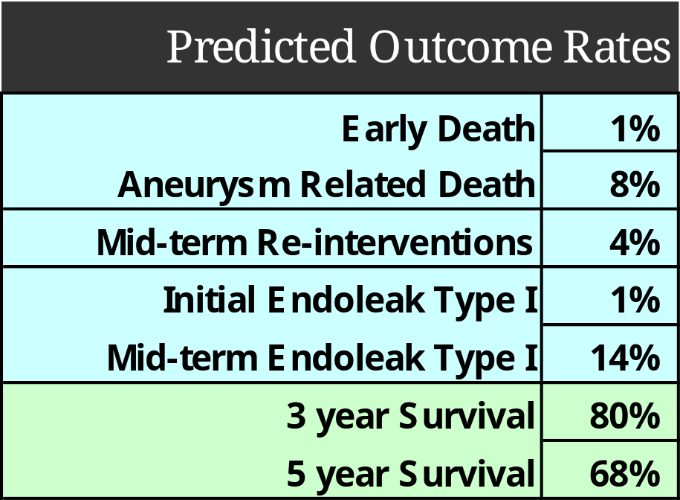
Ideally you’d get
Personalised predictions

Slide 4
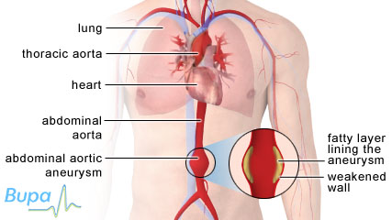
Abdominal aortic aneurysm
Aneurysm = localised dilation of a blood vessel.
Aortic aneurysm
large artery from the heart
Bulges like an old worn tire.
http://hcd2.bupa.co.uk/images/factsheets/Abdominal_aortic_Aneurysm_427x240.jpg

Slide 5
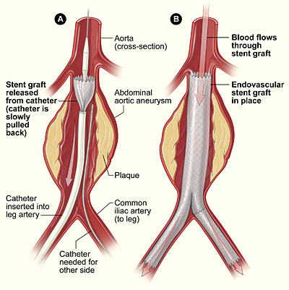
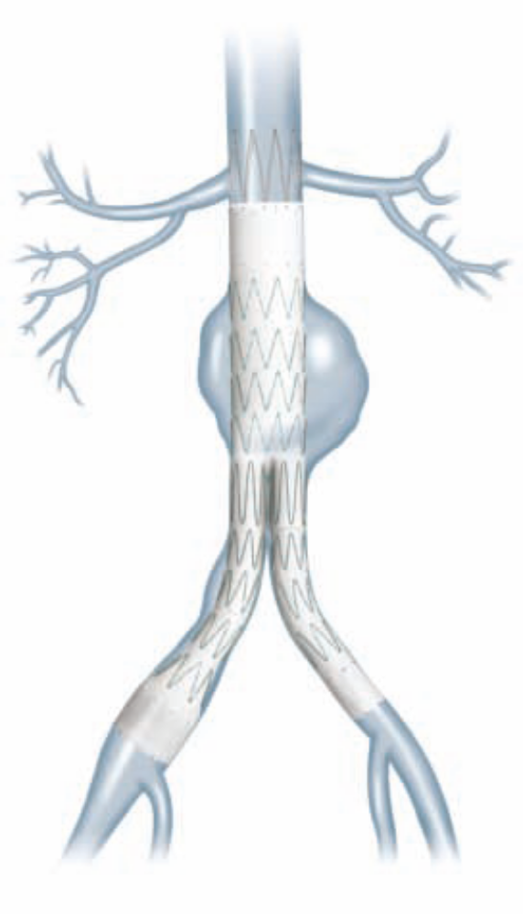
Endovascular stent graft – over 1800/year in Aust.

Slide 6
Australian Audit of Endovascular aneurysm repair Royal Australasian College of Surgeons
Mid to long term safety and effectiveness of the new procedure
961 cases Nov 1999 - May 2001 Australia
98% follow-up (to mid 2006)
Mortality data obtained from AIHW National Death Index
My role – Statistical analysis of audit
EVAR- Endovascular aneurysm repair

Slide 7
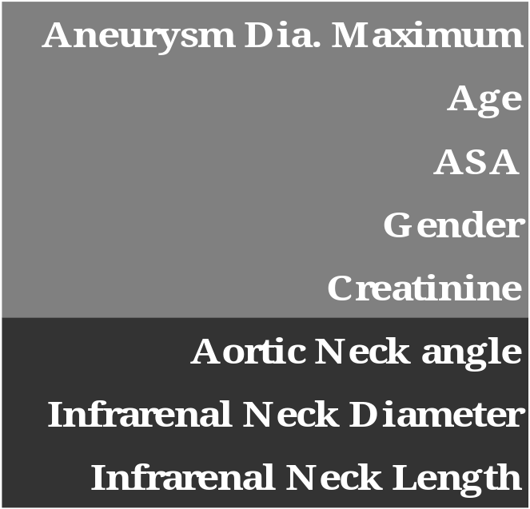
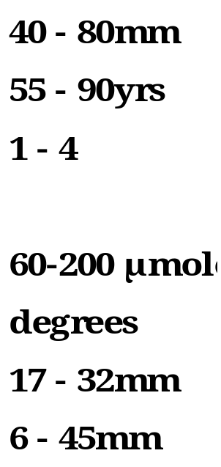
Eight preoperative variables in model
Size
Next slide- Fitness
Kidneys -Renal function
Mild <40˚ Severe>60˚
Short necks difficult
Definitions in subsequent slides
www.health.adelaide.edu.au/surgery/evar/predictive.html

Slide 8
ASA & Creatinine
Assess fitness of patients before surgery
American Society of Anesthesiologists
A normal healthy patient.
A patient with mild systemic disease.
A patient with severe systemic disease.
A patient with severe systemic disease that is a constant threat to life.
A moribund patient who is not expected to survive without the operation.
Creatinine measures renal/kidney function
60 poor 200 good

Slide 9

Definition of variables
bifurcation
Infrarenal Neck Length
Infrarenal Neck Diameter
Size -Maximum Aneurysm Diameter
Aortic neck angle α
α

Slide 10
Key Outcome Measures
Perioperative mortality
(Early death within 30-days)
Aneurysm related death
Re-intervention during follow-up
Type I Endoleak - initial (within 30 days)
- mid-term (6 months - 5 yrs)
Survival - 3 year
- 5 year

Slide 11
Two-stage predictive ERA model
Endovascular aneurysm repair Risk Assessment
Stage I (based on pre-CT data)
  Age
  Gender
  ASA
  Creatinine
  Aneurysm diameter
Prediction of Survival at 3 + 5 years and early deaths (perioperative mortality)

Slide 12
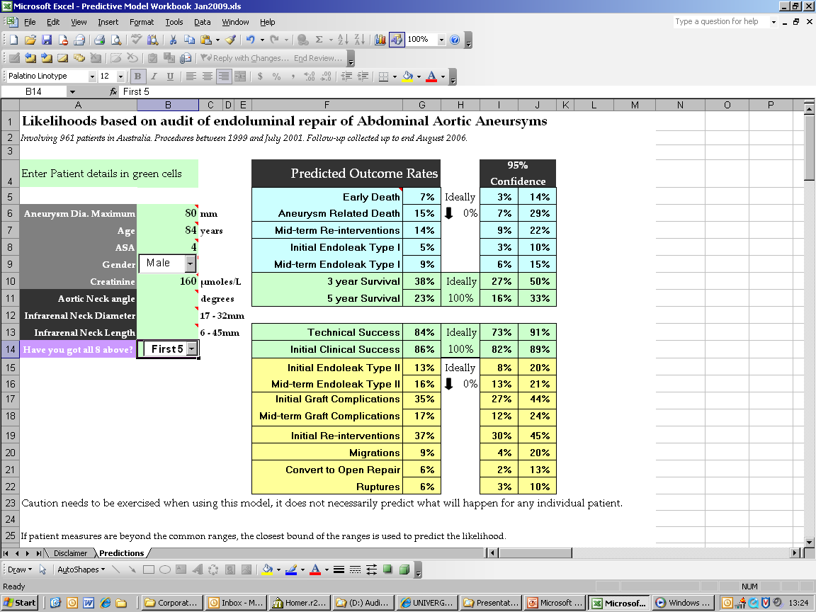
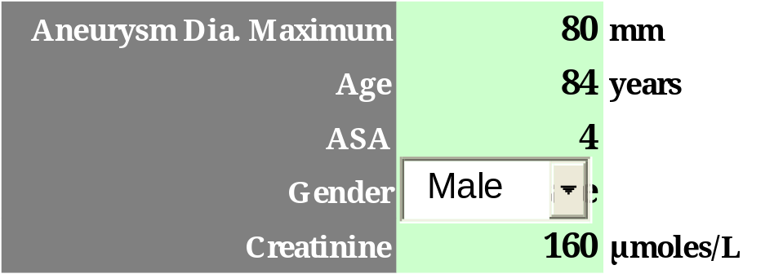
Outcome: before angiography (CT scan)
At first surgeon visit have
first 5 pre-operative variables

Slide 13
Two-stage predictive ERA model
Visit 2 (after CT scan data)
  aortic neck angle
  aortic neck length
  aortic neck diameter
Provides more detailed personalised predictions
Changes endoleak, re-intervention,
graft complication and migration likelihoods

Slide 14
Why develop a predictive model?
Some initial reluctance
Assist preoperative decision making
  Predicted survival & outcome rates
Assess risk for particular patient
Explain variation in outocmes
Perioperative mortaility
Early Deaths-within 30 days
  2% Australian audit
  6.3% ASA IV in Aust. audit - Sicker patients
  1.7% in EVAR-1 - UK trial patients fit for open repair
  9% in EVAR-2 - UK trial patients UNFIT for open repair
EVAR- Endovascular aneurysm repair

Slide 15
Statistical detail of model
Model developed in S-Plus Insightful
Stepwise binomial regressions with logit link
Both backwards and forwards stepwise used to be sure
AIC criteria used as include terms
Confidence intervals were calculated using covariance matrix
Results were back transformed onto natural scale for ease of interpretation
Credible limits used based on Australian audit

Slide 16
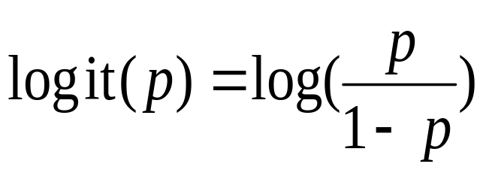
Statistical detail of model cont.
The binary logit of a number p between 0 and 1 is given by the formula:
eg
logit(Survival5yr) = -8.5575 + 0.0219size + 0.0553Age + 0.5810ASA + 0.0065Creat
Back transform to the original measurement scale
exp(logit)/(1+exp(logit))

Slide 17
Confidence Intervals
Var(logit) = d^{T}Cd
Where
d – data in column format
C – covariance matrix regression
Standard Error
se(logit) = sqrt( Var(logit) )
Confidence intervals (CI) on logit scale
CI_logit = logit + 2 se(logit)
Back transform
CI = exp(CI_logit)/(1+exp(CI_logit))

Slide 18
Regression p-values for primary outcomes
Preoperative variable | Aneurysm Diam. | Age | ASA | Gender | Creat-inine | Aortic neck angle | Infrarenal neck diam. | Infrarenal neck length
Outcome
3 year survival | <0.001 | <0.001 | <0.001 |  | 0.002
Aneurysm related death | <0.001 |  | 0.030
Early death | 0.001 | 0.070
Initial re-interventions |  |  | 0.057
Mid-term re-interventions |  |  |  | 0.045 | 0.029 | 0.014
Initial endoleak type I |  |  |  |  |  |  |  | 0.007
Mid-term endoleak type I | 0.005 |  |  |  |  |  | 0.130
Variables included in each model list likelihood ratio p-values
p-values displayed but AIC determined term inclusion
Notes:
M:\consult\Surgeons\2006\finaldata\code\Model_lrm_fullmodel_WALD p_values_2007_08_03.xls
‘Pred’ Sheet gets the full model (all terms included) lrm – WALD p-values as fit.p

Slide 19
Credible ranges- preoperative variables
If patient measures are beyond the common ranges, the closest bound of the ranges is used to predict the likelihood.
For example the common age range is 55-90 years. Predictions for a 40 year old are made for a 55 year old in the audit.

Slide 20
External validation
St Georges UK data compared to Australian
 | UK data | Australian data
Male ratio | 90% | 86%
Mean age | 77.4 | 75
ASA III | 48% | 59%
ASA IV | 27% | 6%
Mean aneurysm size | 64mm | 58mm
Aneurysms <55mm | 19% | 44%
Mean creatinine (µmoles/L) | 118 | 115
Infrarenal neck length <15mm | 28% | 10%
Infrarenal neck diameter (mm) | 23.7 | 23.6
Aortic neck angle >45 degrees | 30% | 16%
St George’s patients generally are sicker (higher ASA),
have larger aneurysms,
have more difficult anatomy and are more likely to die
than the original cohort of Australian patients

Slide 21
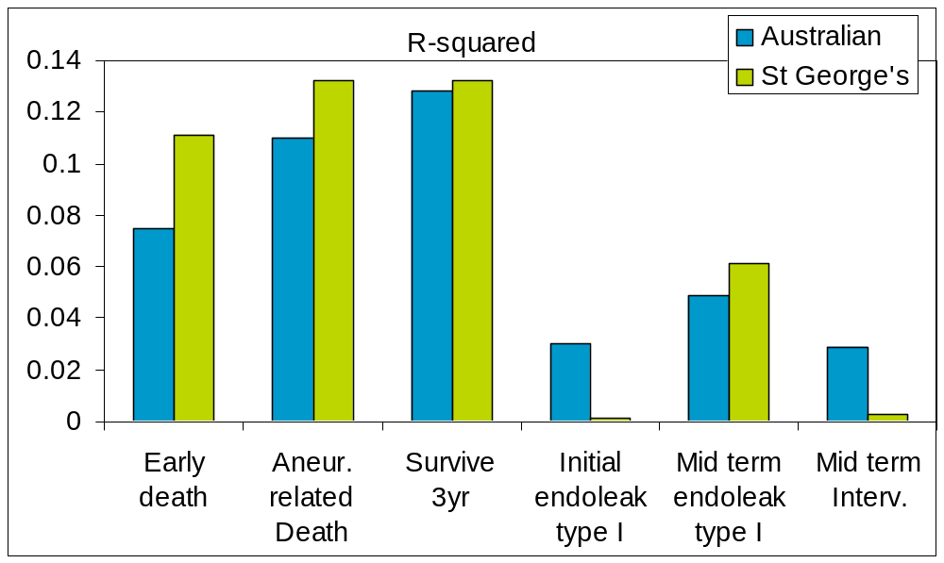
External validation
St George’s Vascular Unit London 312 patients
Despite data differences, models for deaths, survival & mid-term type I endoleaks performed better than Australian patients (R²)

Slide 22
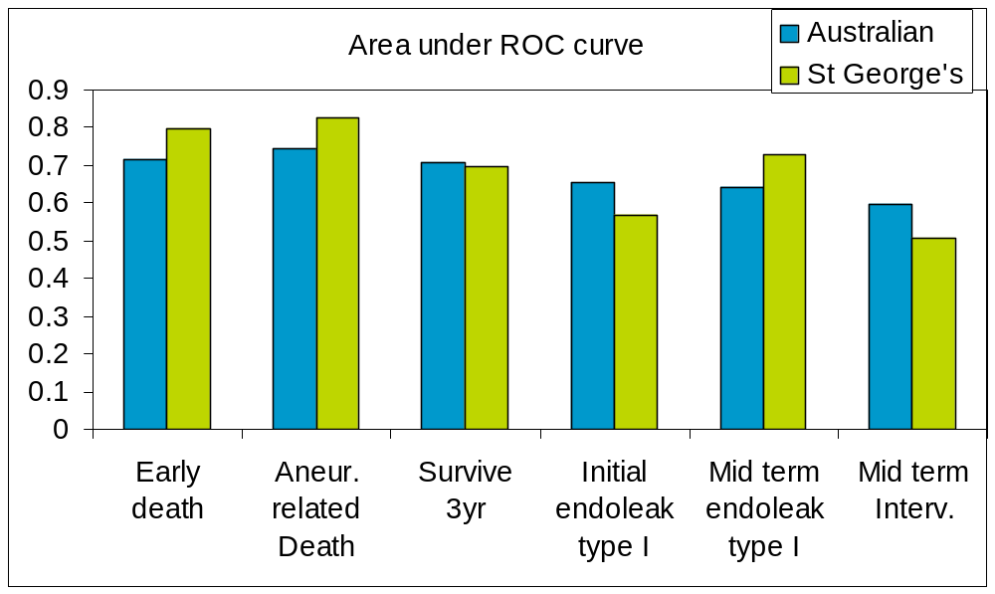
External validation
St George’s Vascular Unit London 312 patients
Area under ROC close to 1 suggests a good model.
Goodness of fit summary table using val.prob Frank Harrell’s Design library

Slide 23

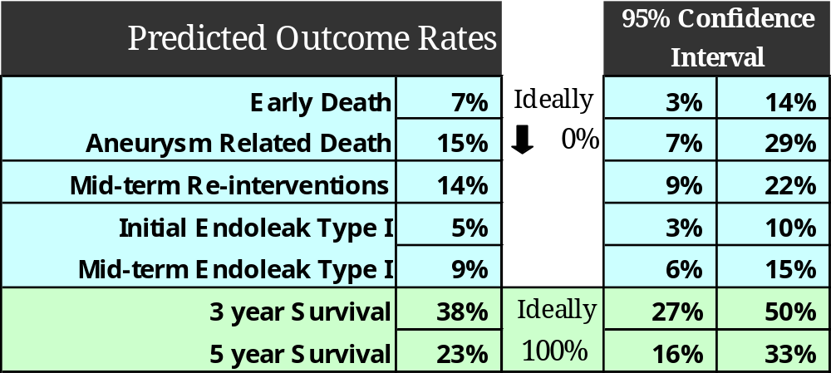
Outcome: before angiography (CT scan)

Slide 24
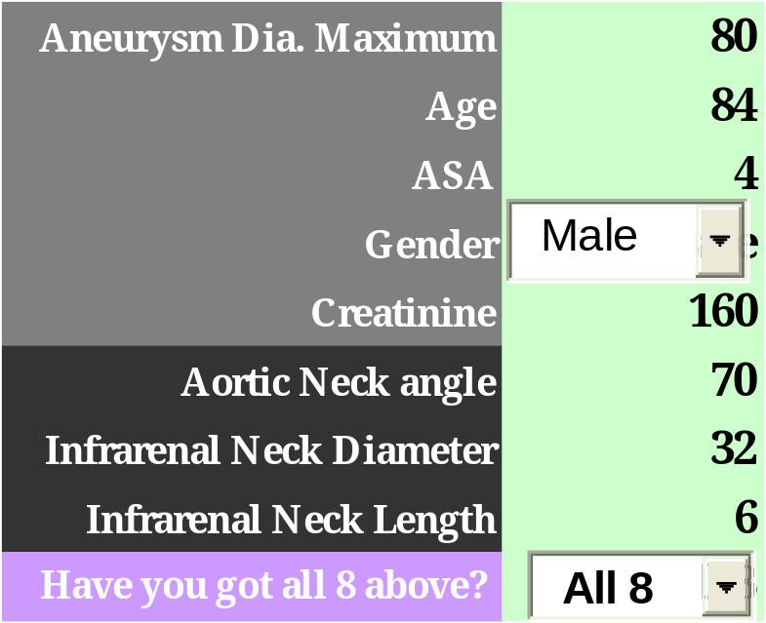

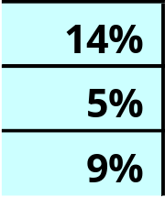
Outcome: after CT angiography
Pre
Predictions changed
after scans

Slide 25
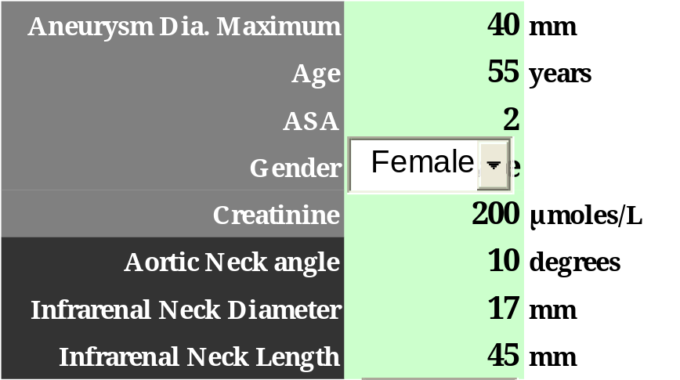
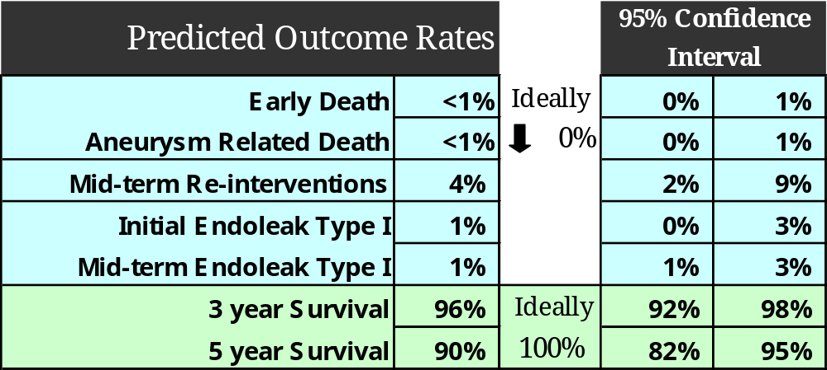
Outcome for healthier female

Slide 26
Summary
Original 7-year study resulted in development of ERA model
  Generates personalised predictions to informed decision-making and counselling (before and after CT scan)
  Surgeons liked using Excel rather than learning another software
  Increasing use
  250 downloads of the spreadsheet in about two years
  Basic model - room for improvement
Potential to develop other models using this approach
NHMRC funding provided to evaluate & improve model

Slide 27
Current & future directions
NHMRC 5-year grant to assess & improve ERA model
  2009-2013
  Comprehensive data set, including biomarkers, to evaluate additional potential success predictors
  1000 elective and non-urgent EVAR patients over 2 years, with follow-up for 3-5 years
http://www.health.adelaide.edu.au/surgery/evar
  NZ ethics approval most streamlined
External validation of model
  Imperial College London
  EVAR trial
  Medtronic trial (application recently submitted)

Slide 28


Thank you
CSIRO Mathematics, informatics and Statistics
Mary Barnes
Phone: +61 8 8303 8765
Email: Mary.Barnes@csiro.au
Audit reports: www.surgeons.org/asernip-s/audit.htm
Model & NHMRC grant: health.adelaide.edu.au/surgery/evar
M B Barnes, M Boult, G Maddern, R Fitridge. A Model to Predict Outcomes for Endovascular Aneurysm Repair Using Preoperative Variables. European Journal of Vascular and Endovascular Surgery. Volume 35, Issue 5, May 2008, Pages 571-579
Contact Us
Phone: 1300 363 400 or +61 3 9545 2176
Email: enquiries@csiro.au Web: www.csiro.au

Slide 29
Biomarkers – potential markers of AAA progression
Osteoprotegerin (OPG)
Osteopontin (OPN)
Macrophage derived chemokine (MDC)
Interleukin-6 (IL-6)
Interleukin-10 (L-10 )
Resistin
Also DNA for genotype analysis

Slide 30

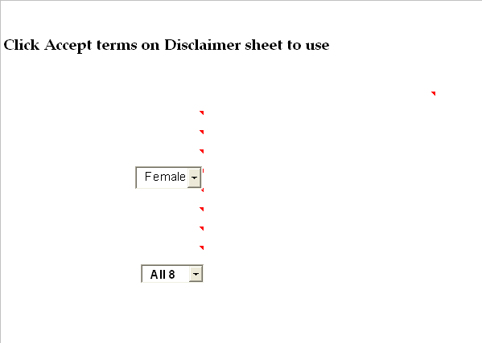
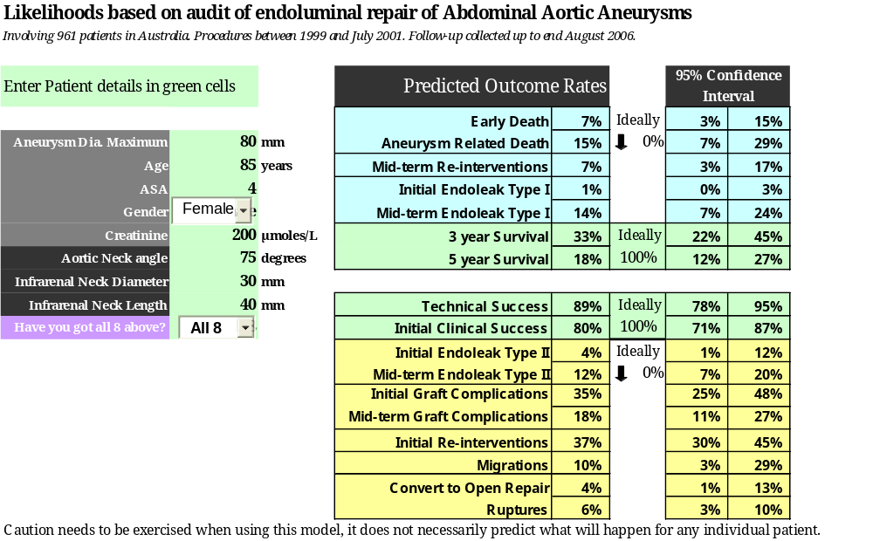
Disclaimer hidden text

Slide 31
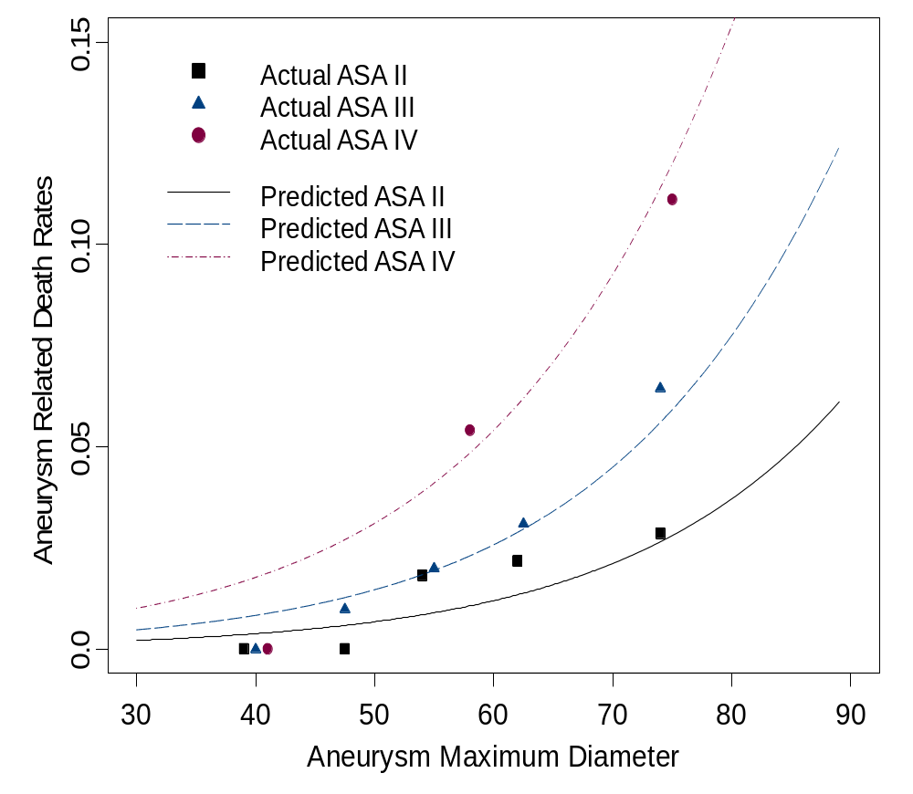
Graphical presentations difficult to interpret
Aneursym Related Deaths Model
Aust. R² = 0.11
Break into categories
Plot 2 variable models

Slide 32
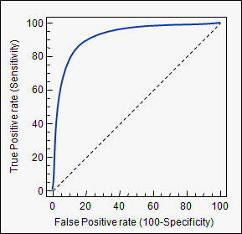
Receiver Operating Characteristic curves
Sensitivity versus 1- specificity
http://www.medcalc.be/manual/roc.php

Slide 33
Final thoughts
Tips in Excel -Disclaimer hidden text
-Matrix multiplications functions
Frank Harrell’s library handy for assessing fit of UK data
Acknowledge
Contributing Vascular Surgeons in Australia
NHMRC
Royal Australasian College of Surgery

Slide 34
NHMRC Study procedure*
 | Visit 1 Pre-op | Visit 2 Peri-op | Visit 3 6 week | Visit 4 6 M | Visit 5 12 M | Visit 6 24M | Visit 7 36M
Informed consent | X
Patient demographics | X
Inclusion/exclusion criteria | X
Medical/surgical history | X
Physical examination | X
Vital signs | X |  | X | X | X | X | X
CT scan or ultrasound | X |  | X | X | X | X | X
Adverse event recording |  |  | X | X | X | X | X
Concomitant medications | X |  | X | X | X | X | X
Blood biochemistry including creatinine, complete blood count (+/- biomarkers) | X |  | X | X | X | X | X
Peri-operative data collection |  | X
*Flow-charts available

Slide 35
Key Outcome rates (Australian data)
Outcome | %
Perioperative deaths | 1.8%
Aneurysm related deaths | 2.5%
Mid-term interventions | 13%
3 year Survival | 81%
5 year Survival | 68%
Endoleak – Type I
Initial | 2.5%
Mid-term | 4.5%
Endoleak – Type II
Initial | 7%
Mid-term | 14%

Slide 36
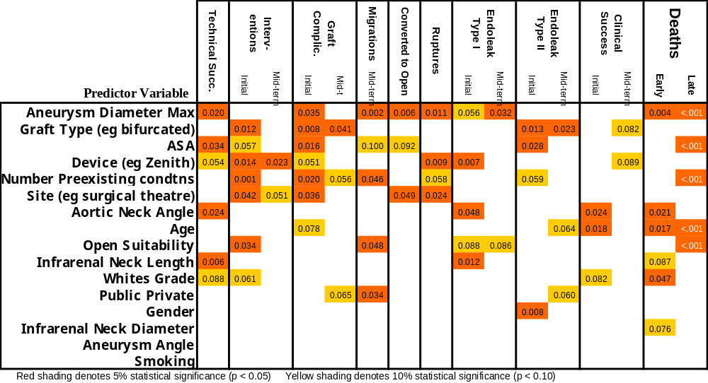
Significance of Predictors
Table shows Chi-squared p-value for terms included ONE AT A TIME with intercept in binomial (logit link) regression model.

Slide 37
Eight Predictor Variables
Age
ASA
Gender
Creatinine
Choice somewhat arbitrary
Show large table with many pre-op variables from report
Aneurysm diameter
Aortic neck angle
Infrarenal neck diameter
Infrarenal neck length

Slide 38
External validation
St George’s Vascular Unit London 312 patients
Primary outcomes | Goodness of fit (p) | Validation Results
 |  | Corrected D_{xy} | Corrected R² | Corrected Emax
Early death | 0.92 | 0.384 | 0.058 | 0.007
Aneurysm related death | 0.53 | 0.497 | 0.099 | 0.022
Mid-term re-interventions | 0.13 | 0.170 | 0.016 | 0.075
Initial endoleak type 1 | 0.59 | 0.310 | 0.026 | 0.142
Mid-term endoleak type 1 | 0.32 | 0.255 | 0.038 | 0.001
3 year survival | 0.57 | 0.405 | 0.115 | 0.017
Bold shaded indicates relatively ‘good’ models
St George’s patients generally sicker, having larger aneurysms, having more difficult anatomy and are more likely to die than the original cohort of Australian patients

