Slide 1
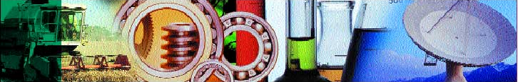

Introduction to Quantile Regression
David Baird
VSN NZ, 40 McMahon Drive,
Christchurch, New Zealand
email: David@vsn.co.nz

Slide 2
Reasons to use quantiles rather than means
Analysis of distribution rather than average
Robustness
Skewed data
Interested in representative value
Interested in tails of distribution
Unequal variation of samples
E.g. Income distribution is highly skewed so median relates more to typical person that mean.

Slide 3
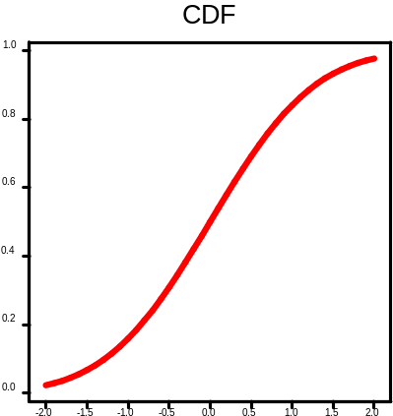
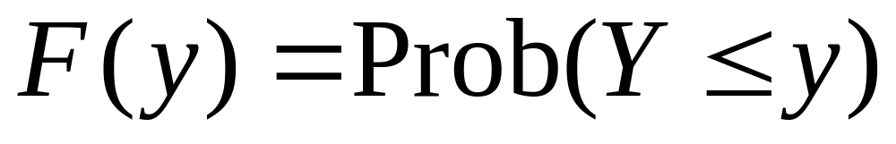
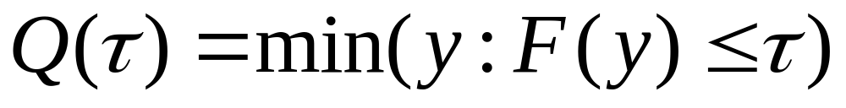
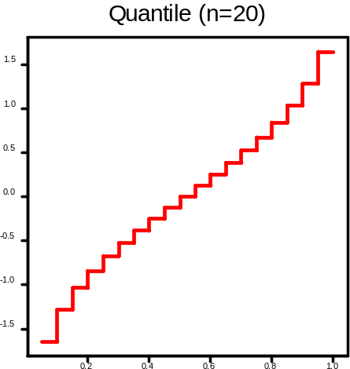
Quantiles
Cumulative Distribution Function
Quantile Function
Discrete step function

Slide 4
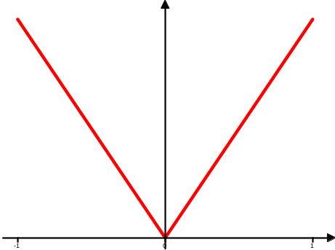
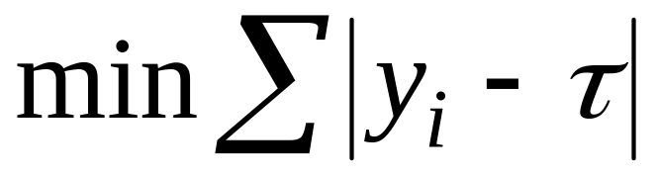
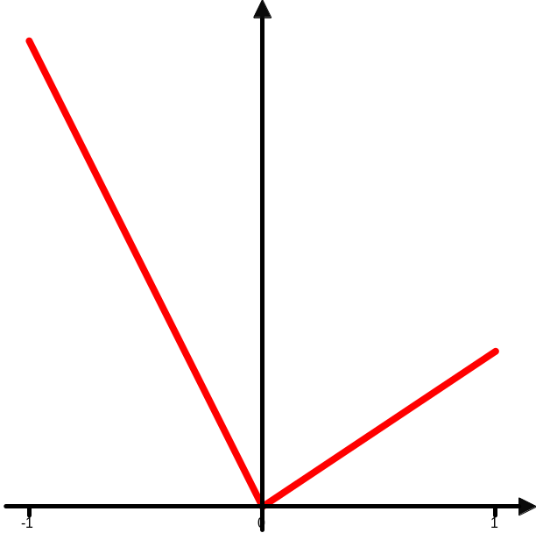
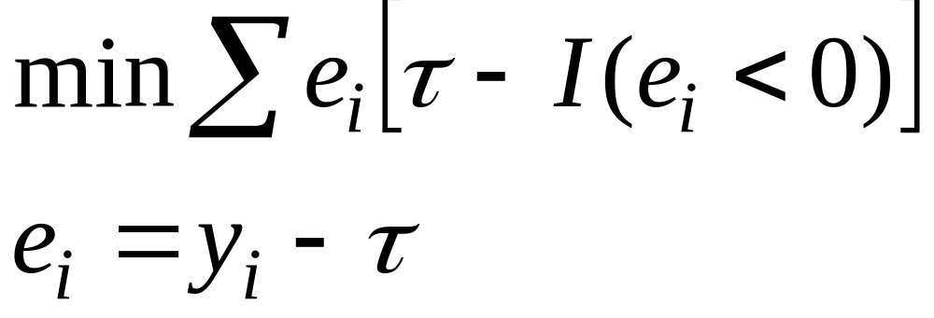
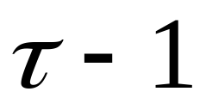

Optimality Criteria
Linear absolute loss
Mean optimizes
Quantile τ optimizes
I = 0,1 indicator function

Slide 5
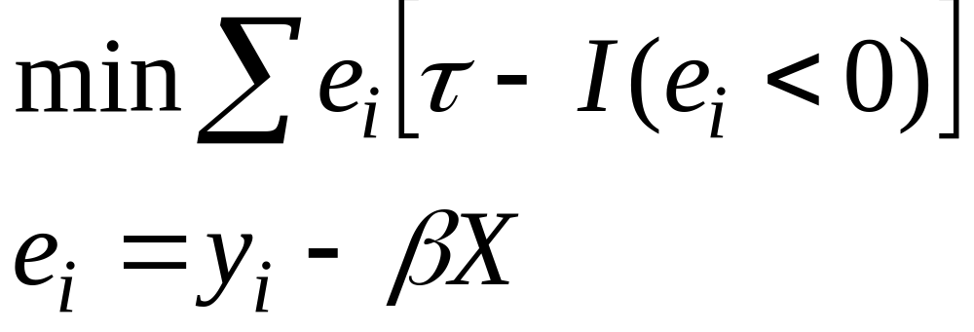
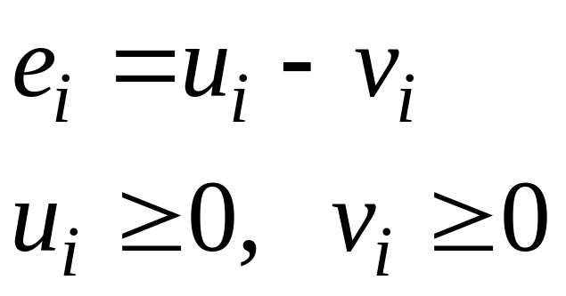
Regression Quantile
Optimize
Solution found by Simplex algorithm
Add slack variables
  split e_{i} into positive and
  negative residuals
Solution at vertex of feasible region
May be non-unique solution (along edge)
- so solution passes through n data points

Slide 6
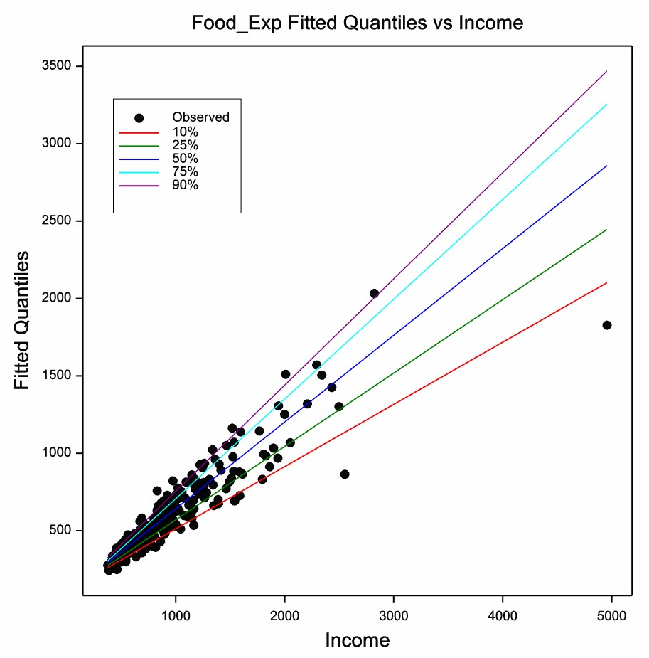
Simple Linear Regression
Food Expenditure vs Income
Engel 1857
survey of 235 Belgian households
Range of Quantiles
Change of slope at different quantiles?

Slide 7
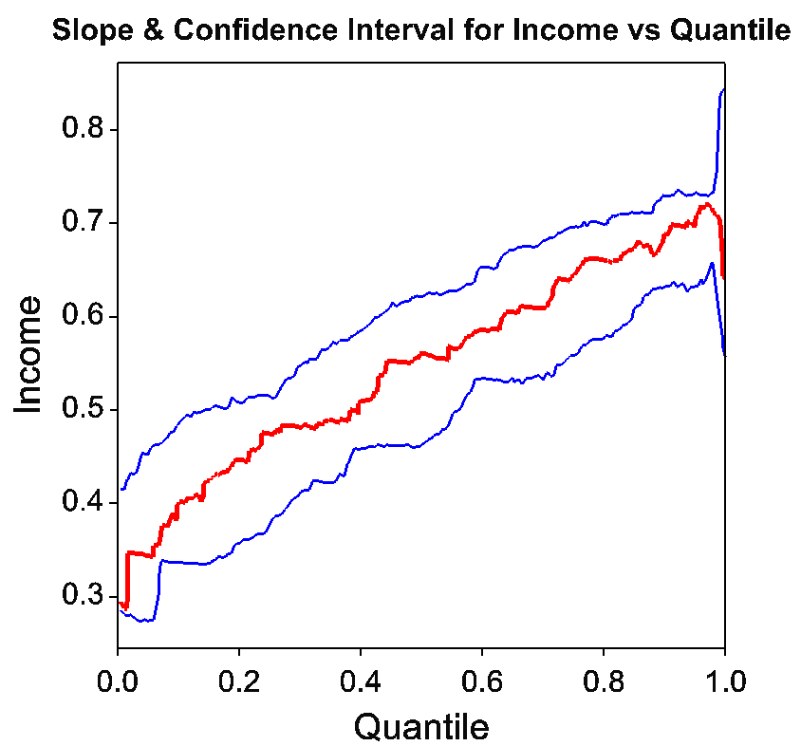
Variation of Parameter with Quantile

Slide 8
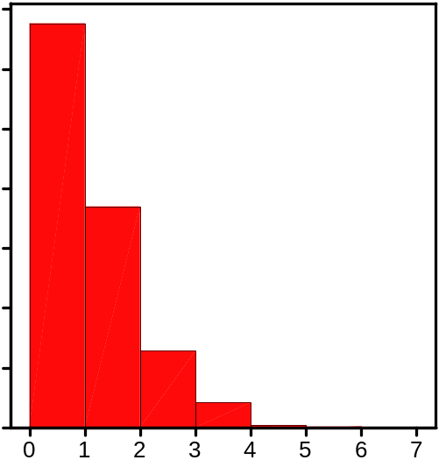
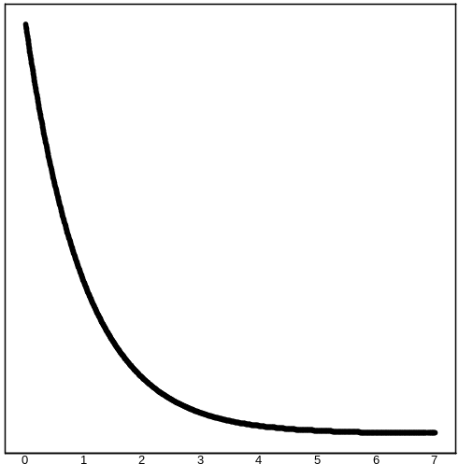
Estimation of Confidence Intervals
Asymptotic approximation of variation
Bootstrapping
Novel approach to bootstrapping by reweighting rather than resampling
W_{i} ~ Exponential(1)
Resampling is a discrete approximation of
exponential weighting
Avoids changing
design points so
faster and identical
quantiles produced

Slide 9
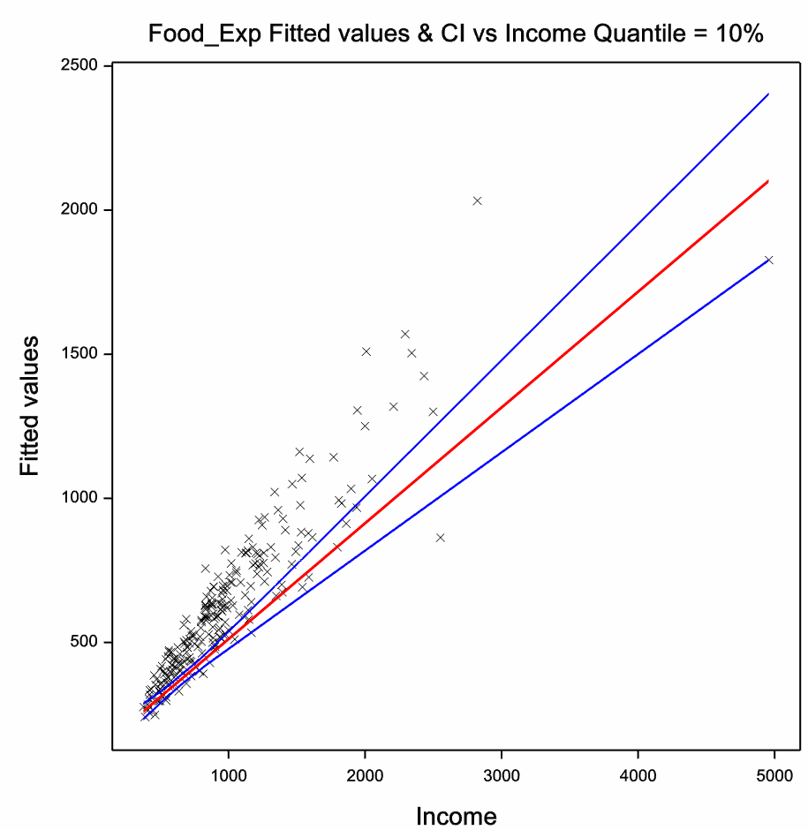
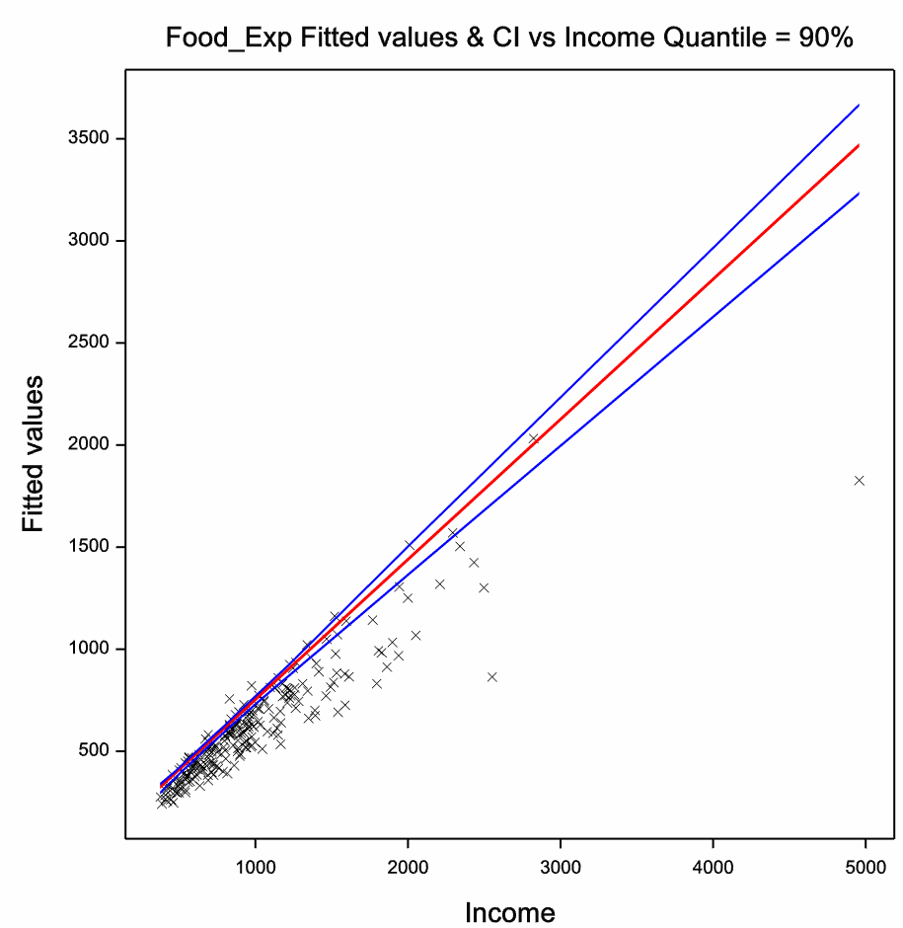
Bootstrap Confidence Limits

Slide 10
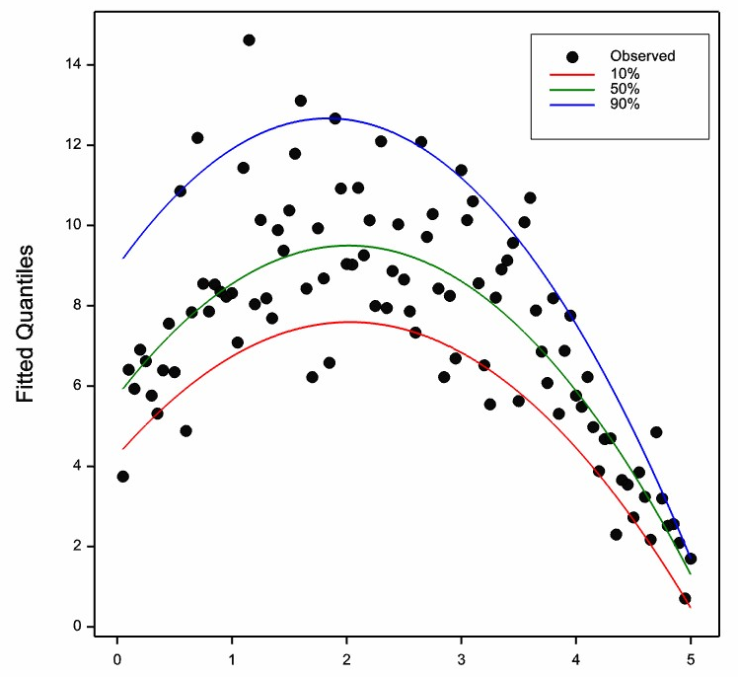
Polynomials
Support
points

Slide 11
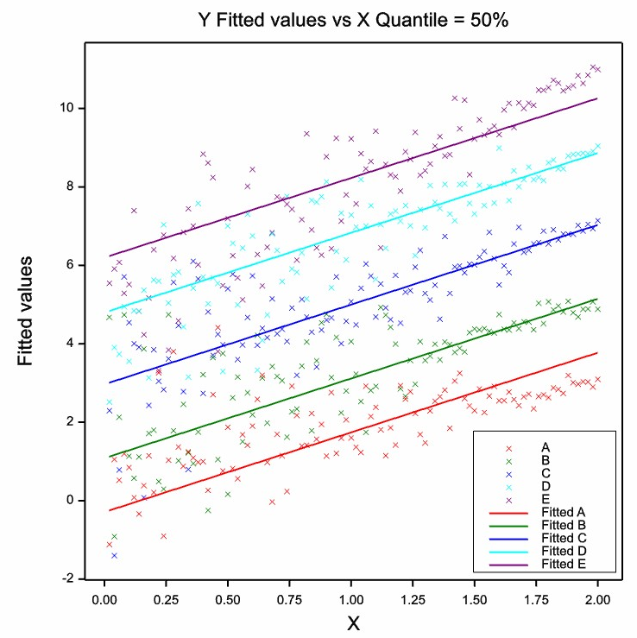
Groups and interactions

Slide 12
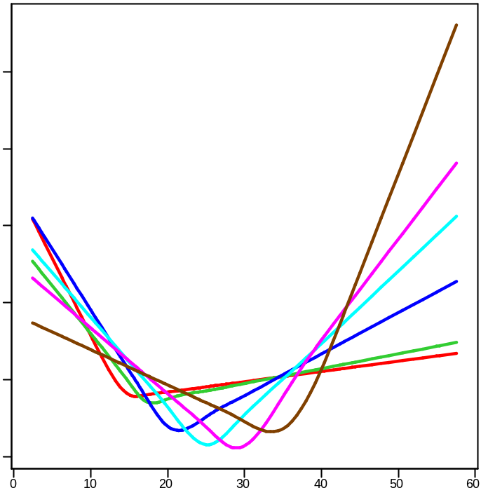
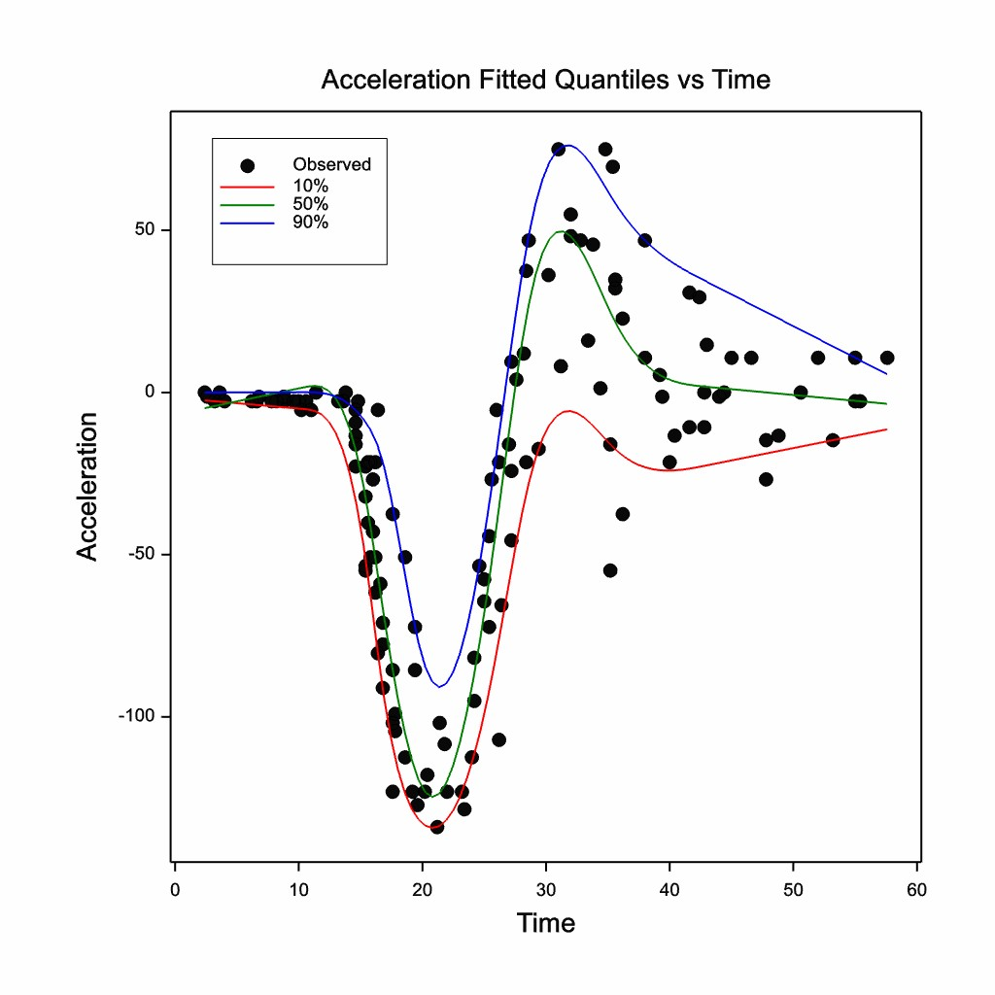
Splines
Generate basis functions
Motorcycle Helmet data
Acceleration vs Time from impact

Slide 13
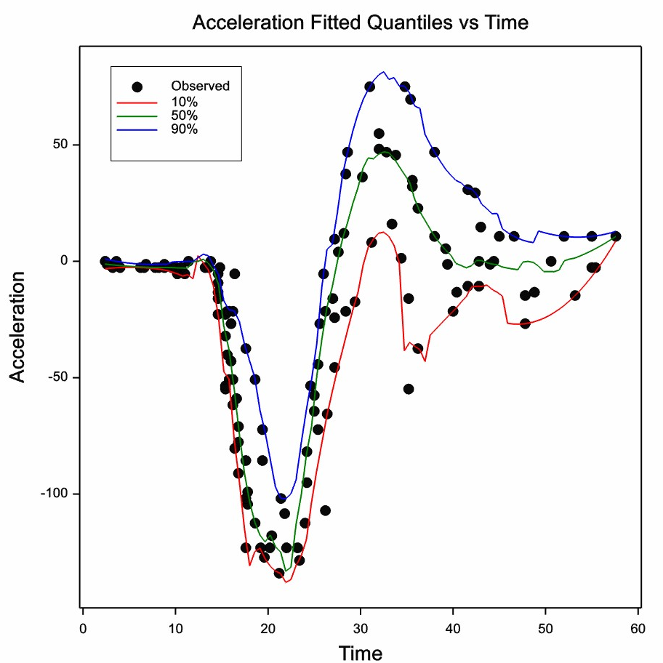
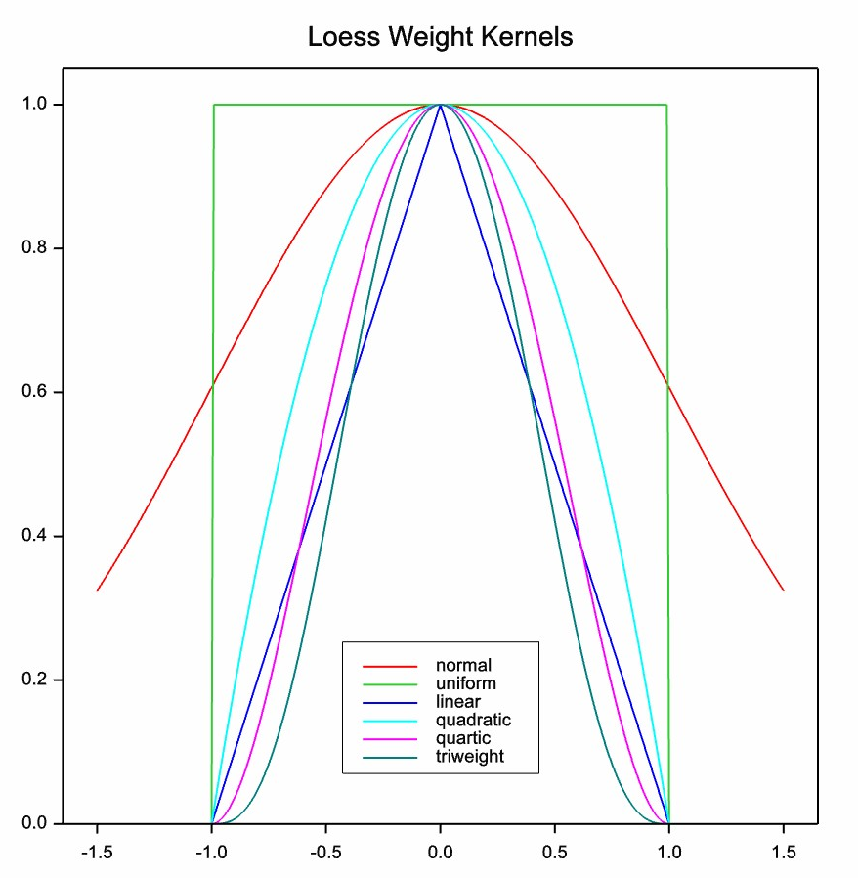
Loess
Generate moving weights using kernel and
specified
window width

Slide 14
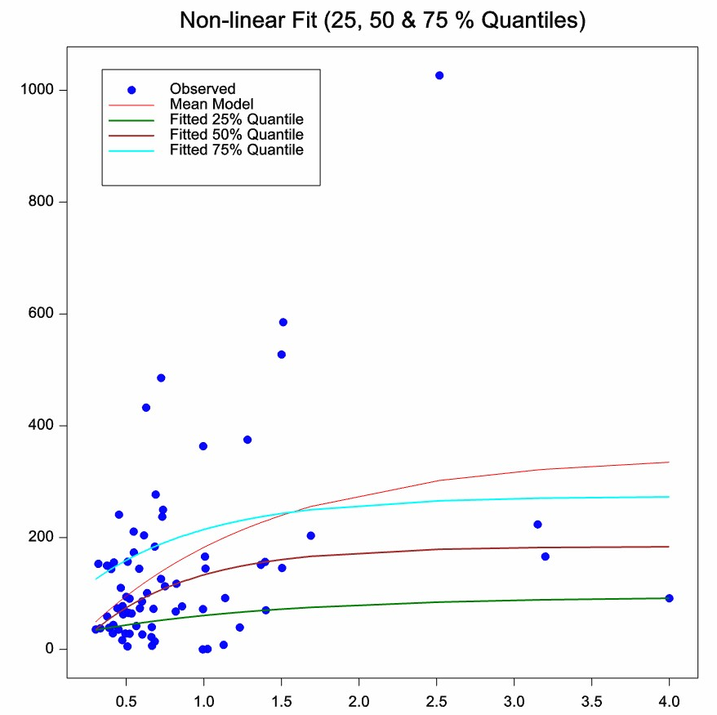
Non-Linear Quantile Regression
Run Linear quantile regression
in non-linear optimizer
Quantiles for exponential model

Slide 15
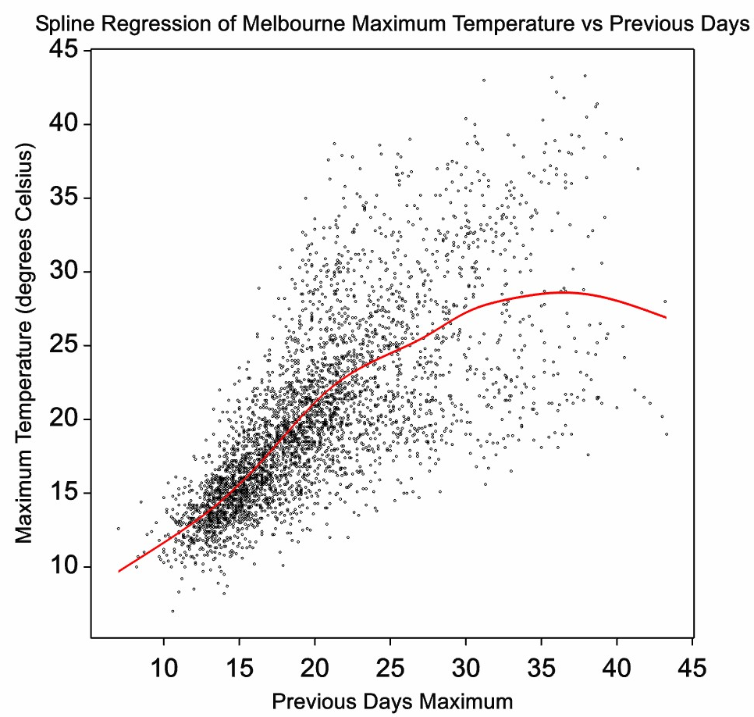
Example Melbourne Temperatures

Slide 16
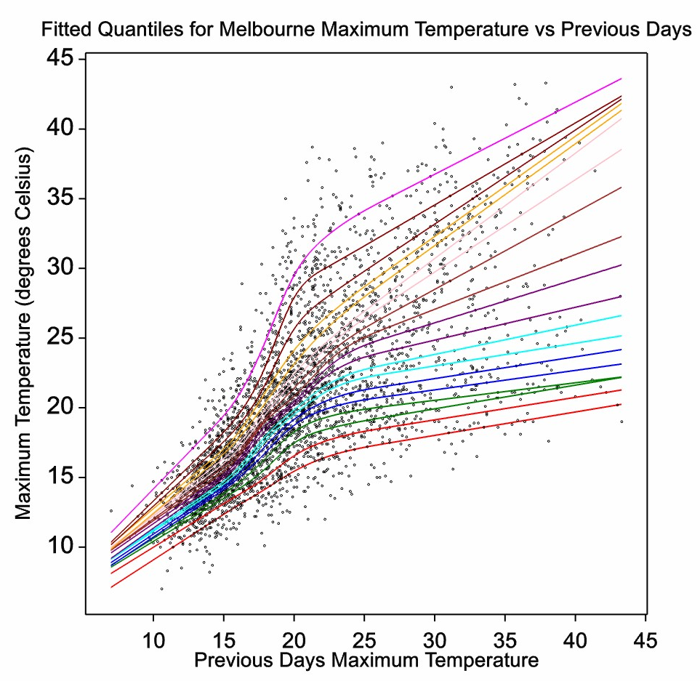
Example Melbourne Temperatures

Slide 17
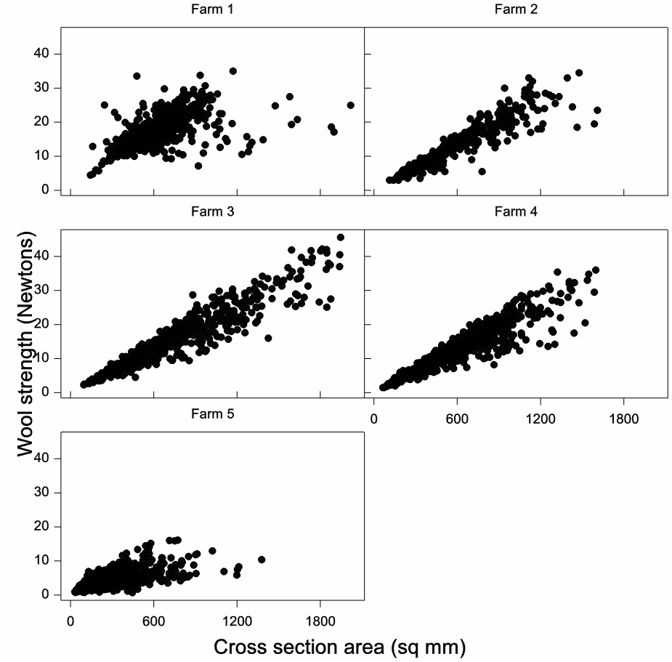
Wool Strength Data
5 Farms
Breaking strength and cross-sectional area of individual wool fibres measured

Slide 18
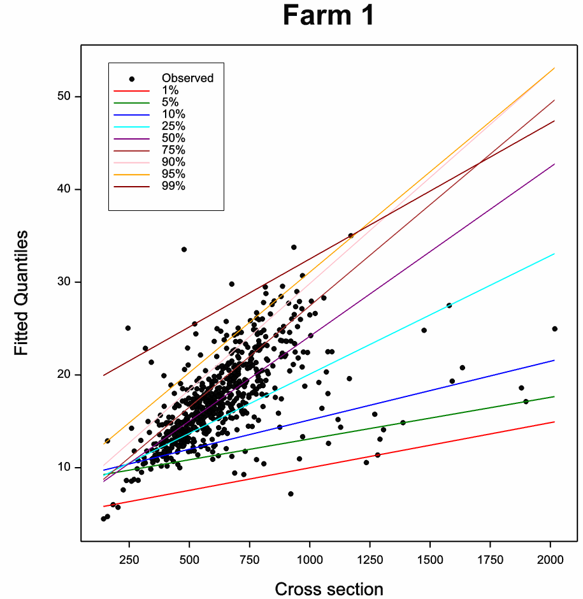
Fitted Quantiles

Slide 19
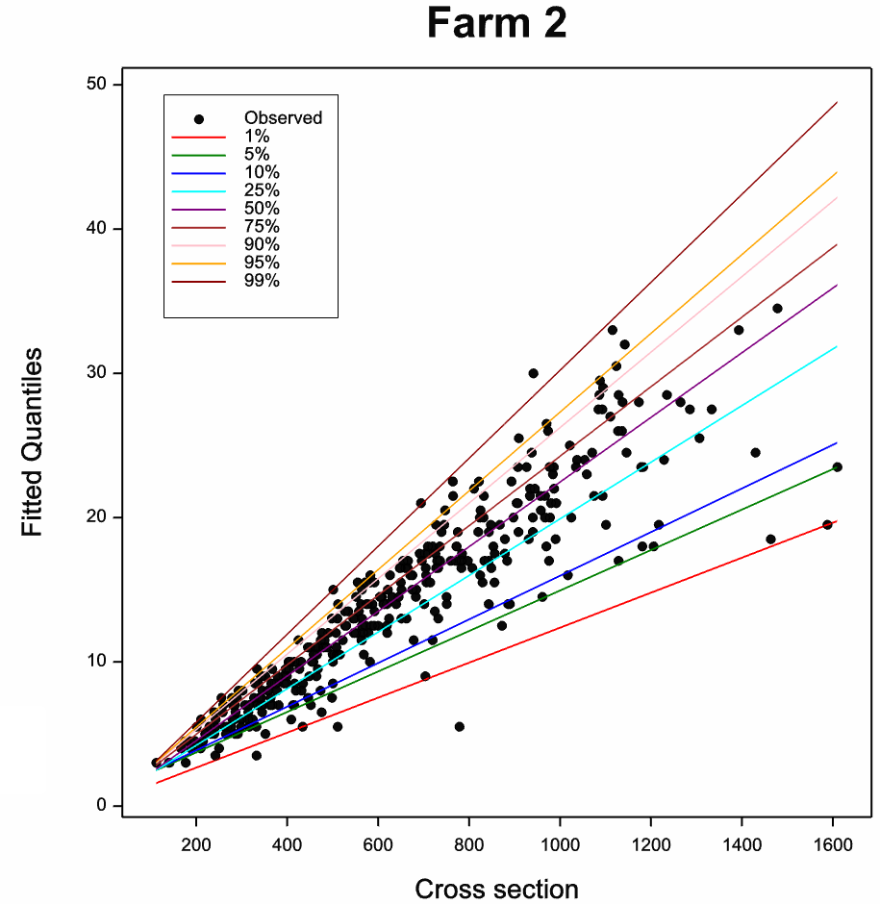
Fitted Quantiles

Slide 20
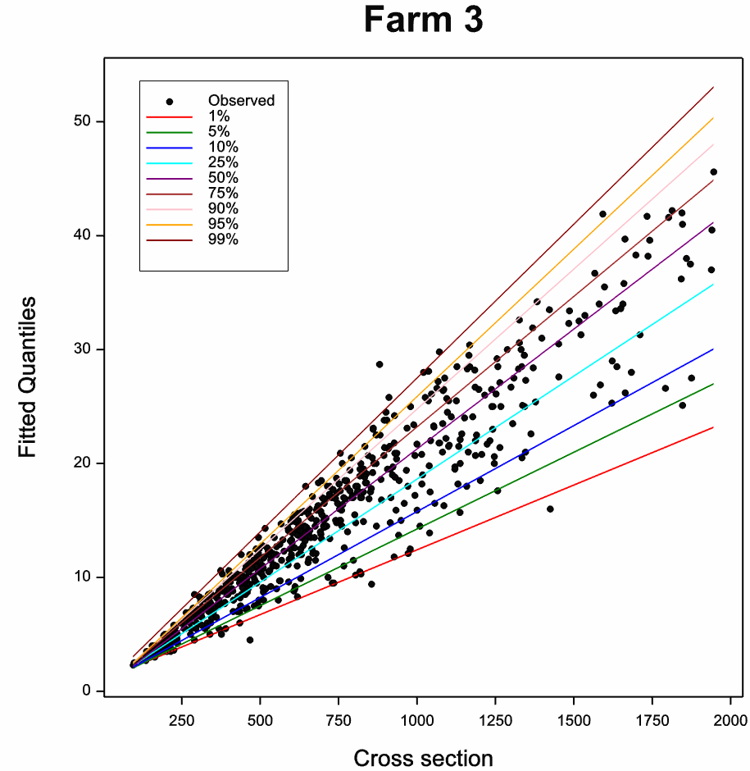
Fitted Quantiles

Slide 21
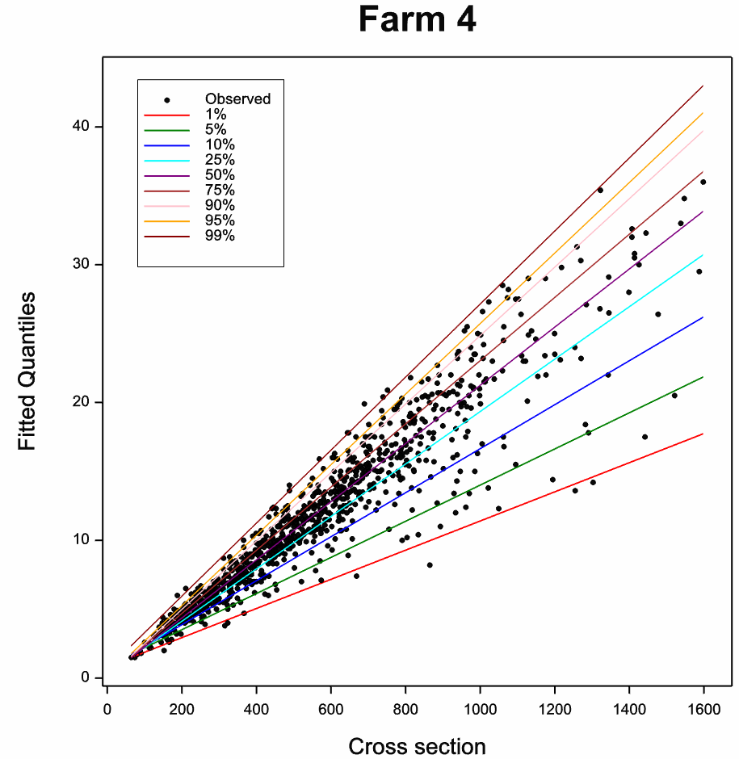
Fitted Quantiles

Slide 22
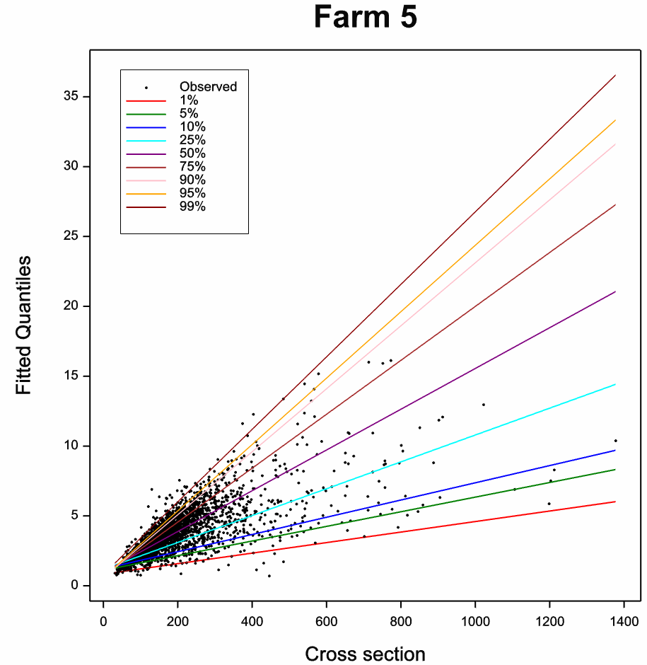
Fitted Quantiles

Slide 23
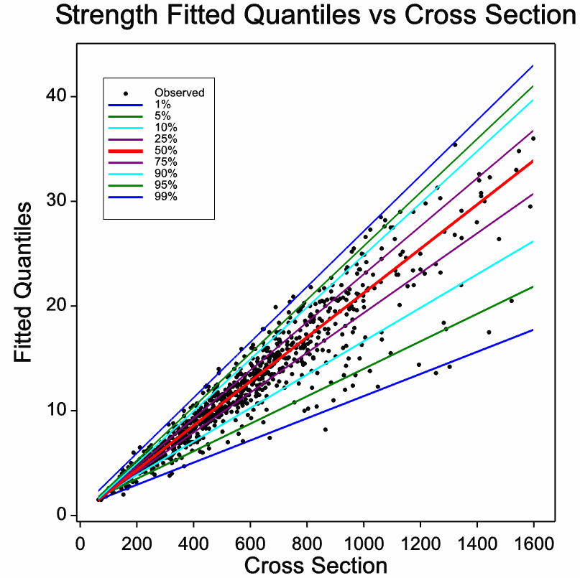
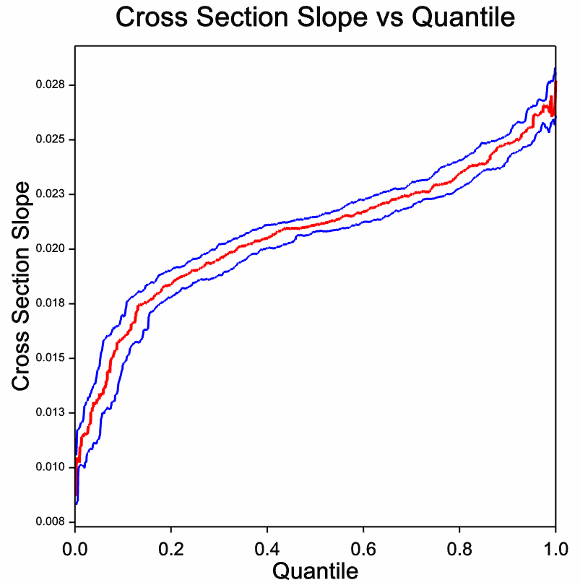
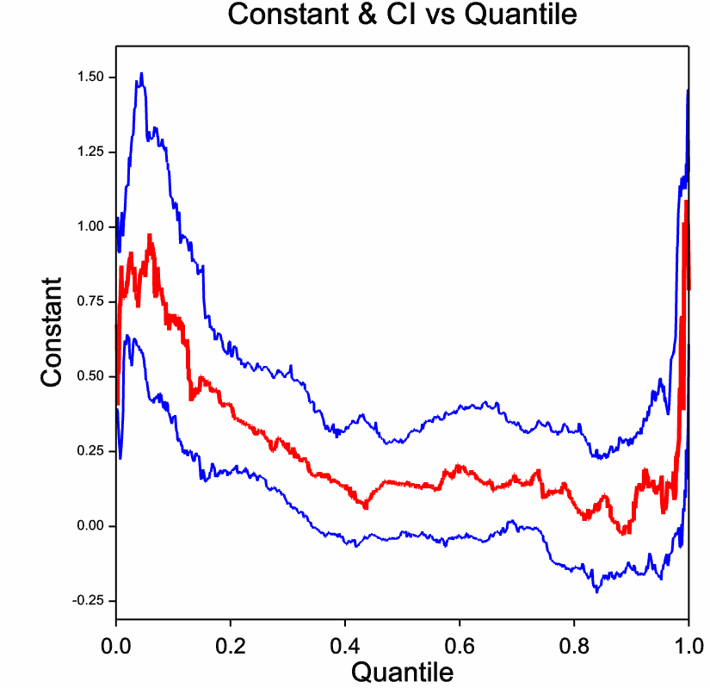
Wool Strength Data

Slide 24
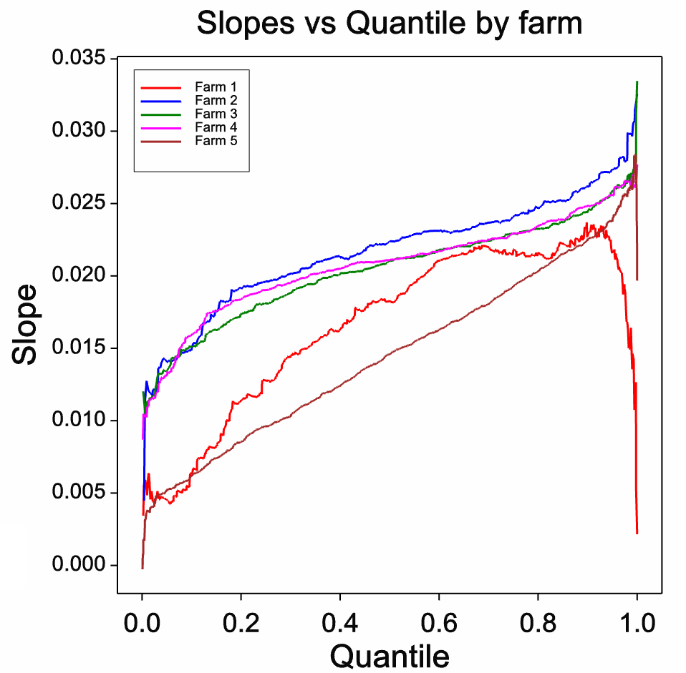
Between Farm Comparisons

Slide 25
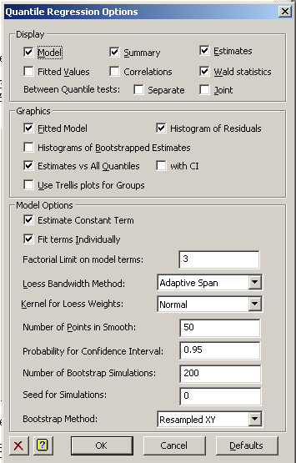
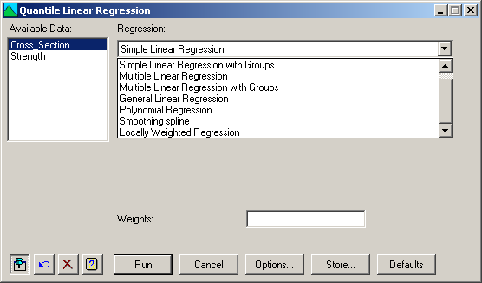
Software for Quantile Regression
SAS Proc QUANTREG
(experimental v 9.1)
R Package quantreg
GenStat 12 edition procedures:
RQLINEAR & RQSMOOTH
Menu: Stats | Regression | Quantile Regression

Slide 26
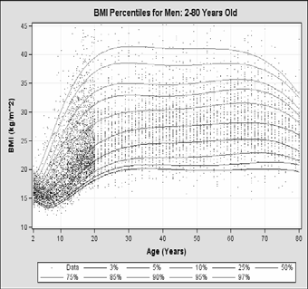
Reference
Roger Koenker, 2005.
Quantile Regression,
Cambridge University Press.

